Slide 1
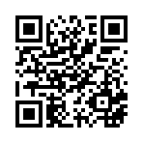
2026 Virtual PTC End of Conference Survey
Please scan the QR Code or click on the link below to take an anonymous survey about your experience during the Training Conference.
https://www.research.net/r/596TDK7

