Slide 1
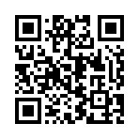
What’s New with VA
Please scan the QR Code or click on the link below to take an anonymous survey about your experience during the training Conference.
https://www.research.net/r/5JLS8V3

