Slide 1
CLEAR AND PERSUASIVE WRITING
Shereen Heath
May 2019

Slide 2
OBJECTIVE
To improve written communication technique

Slide 3

REFERENCES
https://www.plainlanguage.gov/about/definitions/clear-writing-and-plain-language/
The Reader-Focused Writing Manual (a VA training resource, not available on-line)
https://webaim.org/techniques/writing/#jargon
http://www.learnersdictionary.com/definition/persuasive
www.gunning-fog-index.com/index.html

Slide 4
REFERENCES CONT.
https://www.copyblogger.com/persuasive-writing/
https://writtent.com/blog/17-powerful-persuasive-writing-techniques/
https://extension2.missouri.edu/cm201
https://www.webfx.com/tools/read-able/gunning-fog.html
https://www.dailywritingtips.com/10-tips-for-clean-clear-writing/

Slide 5
TOPICS
Part I
Clear writing
Part II
Persuasive writing
Tools
Exercises
Review

Slide 6
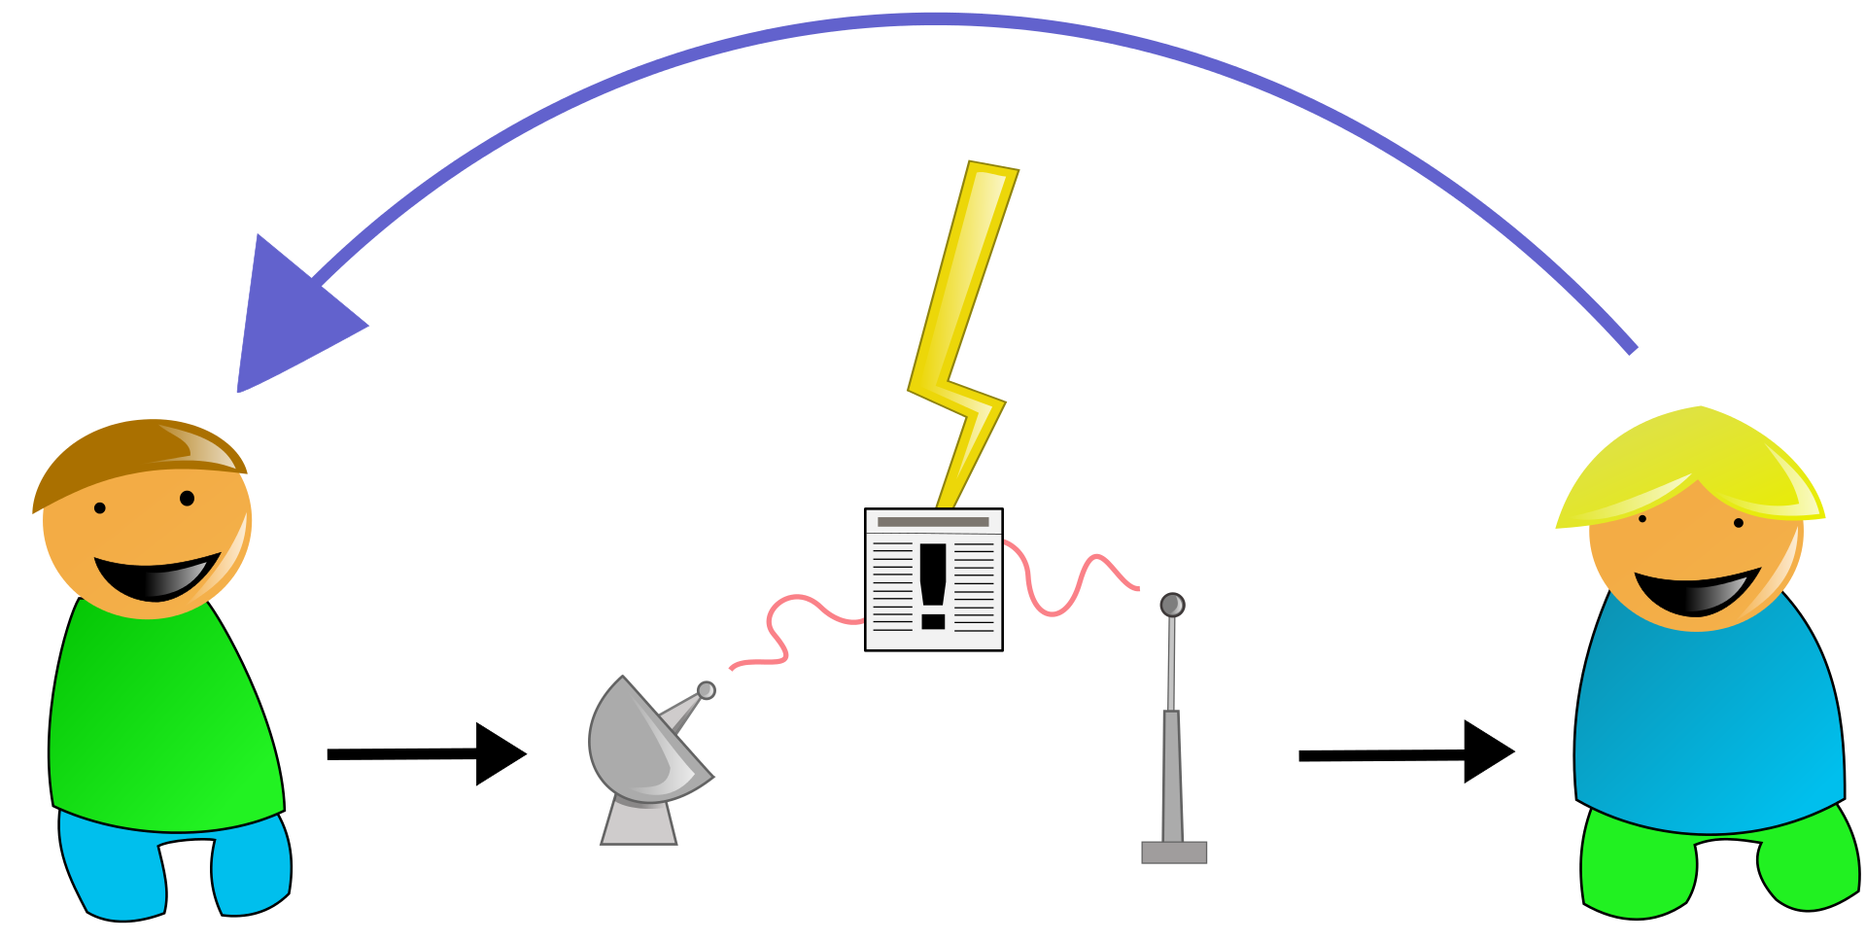
Part I
Clear Writing
This Photo by Unknown Author is licensed under CC BY-SA

Slide 7
What is clear writing?
Communication that your audience or readers can understand the first time they read it.
Notes:
Clear writing is NOT creative writing. It is not a meant for entertainment.

Slide 8
Why is clear writing important?
We’re all busy people.
We don’t want to waste a lot of time trying to translate difficult, wordy documents.
Notes:
Somewhere between a love letter and toaster oven manual

Slide 9
The Basics
Who?
Claimants
VA
Supervisor
Co-workers

Slide 10
The Basics
What?
Letters
Memos
Emails
Claims
Appeals

Slide 11
Identify your audience
Think of why the user needs to read your document
Keep in mind the average user's level of technical expertise
Write to everyone who is interested, not just to experts
Even an expert will prefer a clearly written document

Slide 12
What happens when readers don’t understand?
You may have to:
Answer phone calls
Write interpretative letters
Write explanatory documents
Notes:
Wastes time

Slide 13
Goals of clear writing
Help the reader find the information
Help the reader understand the information
If your document doesn’t do both, it’s not clear.

Slide 14
What are the main elements of clear writing?
1. Logical organization
2. Short sentences
3. Short paragraphs
4. Common, everyday words
5. Active voice
6. Use of pronouns
7. Use of headings
8. Lists and tables
9. Reading ease

Slide 15
1. Logical Organization
Once you know your main point you can write more clearly
Write from the reader’s point of view
Anticipate questions an informed reader is likely to ask
Organize writing to answer questions in the order the reader will ask them

Slide 16
2. Short sentences
The goal is to avoid complexity and confusion
Treat only one subject in each sentence
Aim for 20 words per sentence or fewer
Notes:
Do not strive to impress your reader

Slide 17
3. Short paragraphs
Limit a paragraph to one subject or step
Smaller “bites” of info are easier to digest
Aim for no more than 7 lines

Slide 18
4. Common, everyday words
anticipate
attempt
commence
demonstrate
implement
in the event that
submit
terminate
expect
try
begin, start
show, prove
start
if
send, give
end, cancel

Slide 19
5. Active voice
Active voice is more clear, concise and direct
Passive is a characteristic of bureaucratese

Slide 20
Passive Voice
Is awkward:
Consultation from respondents was obtained to determine the estimated burden
Active Voice
Is natural:
We consulted with respondents to determine the estimated burden.

Slide 21
Hidden Verbs
Why say this when…………..you can say this?
Conduct an analysis Analyze
Present a report Report
Do an assessment Assess
Provide assistance Help
Came to the conclusion of Concluded

Slide 22
6. Use of pronouns
Benefit of using pronouns:
Speaks directly to readers
Makes your writing relevant to readers
Requires less translation from your readers
Eliminates words

Slide 23
Use “we” to refer to your agency
Use “you” for the reader
If you are using Q&A format, use “I” in the questions and “you” in the text

Slide 24
Paragraph Without Pronouns
Once the candidate’s goals are established, one or more potential employers are identified. A preliminary proposal for presentation to the employer is developed. The proposal is presented to an employer who agrees to negotiate an individualized job that meets the employment needs of the applicant and real business needs of the employer.

Slide 25
Paragraph With Pronouns
Once we establish your goals, we identify one or more potential employers. We prepare a preliminary proposal to present to an employer who agrees to negotiate a job that meets both his and your employment needs

Slide 26
7. Use headings
Allows the reader to quickly find relevant information
Breaks up the information
Increases blank space on the page
Informative headings help the reader navigate the document
3 types of headings
Question
Topic
Statement

Slide 27
8. Use of lists and tables
Lists--
Make it easy for the reader to identify all items or steps in a process,
Add blank space for easy reading, and
Help the reader see the structure of your document.
Tables--
Make it easy to show comparisons

Slide 28
9. Reading Ease
Don’t sound bureaucratic
Limit jargon and acronyms*
Use everyday words (refer to slide #18)
Use a conversational tone
Use an empathetic tone
Limit three syllable words
Notes:
Contractions may help with a misunderstanding. Sometimes the not is missed….wouldn’t is see quickly where would not might miss the not

Slide 29
Proper use of an acronym
First spell out the full name then put the acronym in parenthesis next to it. From that point on you may use the acronym.
Example: The Veterans of Foreign Wars (VFW) loves you. All VFW members will go to the Valentine’s Day event.

Slide 30
Contractions
Contractions aren’t bad
Speeds up reading
Softens the tone
Examples:
You cannot come in now. Do not enter this building without permission.
You can’t come in now. Don’t enter this building without permission.

Slide 31
Use consistent terms
Avoid “Shall.” It is ambiguous and is not used in everyday speech
Use “must” for an obligation
Use “must not” for a prohibition
Use “may” for a discretionary action
Use “should” for a recommendation
Notes:
Shall = will

Slide 32
Tools
Word processing programs have tools
Spell check
Grammar check
There are many tools to check readability, some are free. Try www.gunning-fog-index.com/index.html, it is free and easy to use. Texts for a wide audience generally need a fog index less than 12. Texts that need a near-universal understanding need an index less than 8.

Slide 33
A Mess
CO Detector Update:
The Coast Guard has conducted an investigation to determine what carbon monoxide (CO) detection devices are available to recreational boaters, such that, when installed and activated could reduce the risk of being exposed to high levels of CO -THAT SILENT KILLER. A variety of technologies is available for detecting the presence of CO on boats and should be considered by recreational boaters to reduce their risk of injury or death while boating.
(72 words, 13 3-syllable words)(Gunning Fog Index 21.62)

Slide 34
A Fix
Carbon monoxide is a silent killer. The Coast Guard recommends that you use a carbon monoxide detection device on your boat to reduce the risk of being exposed to high levels of CO. You may choose from a variety of devices.
(46 words, 5 3-syllable words)(Gunning Fog Index 10.48)

Slide 35

Exercise
This Photo by Unknown Author is licensed under CC BY-NC

Slide 36
Re-write this paragraph using clear writing techniques
The VA has promulgated your rating and assigned an evaluation of twenty percent effective June 1, 2018. A payment for retroactive benefits will be forthcoming. If questions arise you should visit www.va.gov.

Slide 37
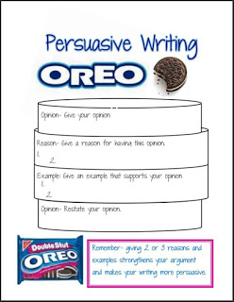
Part II
Persuasive Writing
This Photo by Unknown Author is licensed under CC BY-NC-ND

Slide 38
What is persuasive writing
PERSUASIVE WRITING is defined as presenting reasons and examples to influence action or thought. Effective persuasive writing requires a writer to state clearly an opinion and to supply reasons and specific examples that support the opinion.
http://web.alsde.edu/general/AnnotatedPackets/20082009/Grade10AnnotatedExemplars-4.pdf

Slide 39
What do you want?
A raise
A new computer
A better decision
A medical opinion
A new claim
Notes:
Persuasion means you want something, what is it?

Slide 40
Who needs persuading?
Your boss
The claimant
The Decision Review Officer
The care provider
Notes:
Who do you need to convince?

Slide 41
How will you do it?
Appeal to your reader’s logic
Give your point of view in an informed and fair
manner
Create feelings that lead to your point of view
Build your case
Notes:
You might want to solicit by-in from co-workers but it could backfire. What if you want to change something but no one else agrees?

Slide 42
Techniques
Use principles of clear writing
Explain the problem
Give a solution or a choice of solutions
Give data
Give the value of resolution
Give examples
Keep tone pleasant and professional
Do not threaten or whine

Slide 43

Exercises
Choose exercise 1 or 2 and write 1 or 2 paragraphs. If you finish one start on the other.
This Photo by Unknown Author is licensed under CC BY-NC-ND

Slide 44

REVIEW
This Photo by Unknown Author is licensed under CC BY-SA

Slide 45
What we covered……
Techniques for clear writing
Who
What
Main elements of clear writing
Tools
Techniques for persuasive writing

Slide 46

QUESTIONS?

