Slide 1


National Veterans Service
Medicare Training

Slide 2
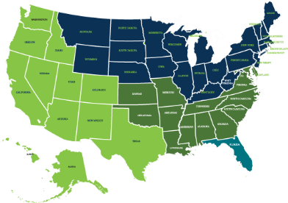
Veteran Channel Team Layout
MarketPoint Regional Sales Map
Director:
Requisition posted 1/1
Regional Executives:
Dee Hughes [R1]
Scott Mathis [R2]
Aaron McCoy [R3]
Darin Davis [R4]
Region 1 – Jennifer Steele
Region 2 – Frank Altier
Region 3 – Frank Pistone
Region 4 – Heather Kaufmann
CarePlus/PR – Lou Sessa

Slide 3





National Partnerships
Notes:
Humana is a National Partner of the VFW since 2012
We believe in improving the lives of the Veterans and
Partnership with Ryan and the NVS staff and how we can improve the lives of Veterans and be better resources to educate them on navigating Medicare
EBV
Humana became a corporate sponsor in 2011 by contributing $1 million. (Other sponsors are Wal-Mart, PepsiCo, Starbucks, CVS and others)
Founded at Syracuse University in 2007 to provide an alternative education program for Veterans returning from the Iraq and Afghanistan wars at a time when the unemployment rate for Veterans who were18-24 years old was 12-14% which was twice the National Average.
Since that time the program has graduated over 3,000 veterans of which 68% own their own business which generate over 280 million dollars in revenue a year
Rolling Thunder
Humana is a sponsor since 2017
Vietnam war motorcycle memorial ride and rally in Washington D.C on the National Mall
Memorializes the MIA and POWs from Vietnam and ensure that they are not forgotten
Attendance is 300,000 or more (participants) each year and takes place on Memorial Day Weekend
VWC
Established by Presidential Proclamation in 2012
To thank and honor veterans of the Vietnam War, including personnel who were held as prisoners of war, or listed as missing in action, for their service and sacrifice on behalf of the United States and to thank and honor the families of these veterans
The Commemorative Partner Program is designed for federal, state and local communities, veterans' organizations and other nongovernmental organizations to assist a grateful nation in thanking and honoring our Vietnam Veterans and their families

Slide 4

What is Medicare?
Medicare is the U.S. government’s largest health insurance program, serving more than 57 million people¹
It’s run by the Centers for Medicare & Medicaid Services (CMS), part of the U.S. Department of Health and Human Services
Medicare is divided into parts
Parts A and B are Original Medicare Part C is Medicare Advantage
Part D is prescription drug coverage
¹Centers for Medicare & Medicaid Services
Retrieved from www.cms.gov/Research-Statistics-Data-and-Systems/ Statistics-Trends-and-Reports/Dashboard/Medicare-Enrollment/Enrollment
%20Dashboard.html. Accessed March 27, 2017.
Medicare 2019
Notes:
Need to understand how Medicare works to understand how it impacts VA Healthcare, Tricare for Life & CHAMPVA

Slide 5

Medicare eligibility
At age 65, you may be eligible for Medicare Parts A and B, even if you still work
You may be eligible for premium- free Medicare Part A through your spouse, although you still must qualify by age or disability
You may also be eligible for Medicare Parts A and B if you’re under 65 and have a disability
Medicare 2019

Slide 6
Original Medicare
Offered by the federal government, Original Medicare covers much, but not all, of your care and generally has a deductible and coinsurance.
Part A
helps cover
Part B
helps cover
Hospitalization
Skilled nursing facilities
Hospice care Home health
Doctor appointments Outpatient care Preventive services
Occupational/physical therapies Home health
Medicare 2019
Notes:
Part A is generally no cost and Part B has a monthly premium associated with it.

Slide 7
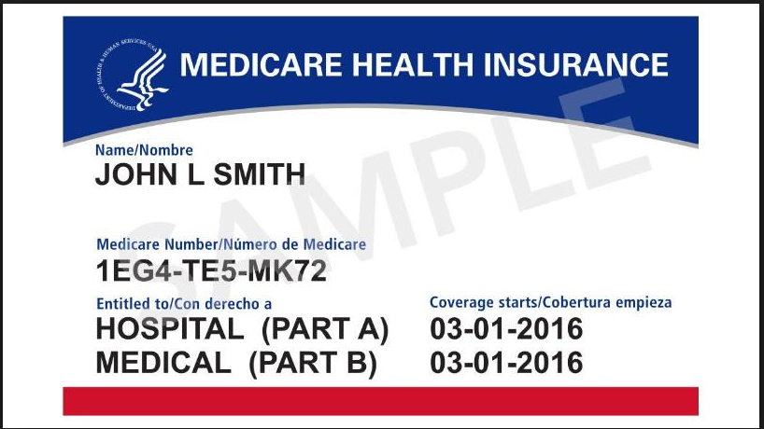
Why Take Part B?
If at all possible, Veterans should take Medicare Part B
“VA does not recommend Veterans cancel or decline coverage in Medicare (or other health care or insurance programs) solely because they are enrolled in VA health care.” www.va.gov
Notes:
Some Veterans consider opting out of Part B, to avoid paying the Part B premium. If they need to apply for Part B after their Initial Enrollment Period (IEP), they may pay a penalty. VA Health Care is NOT creditable medical coverage for Part B of Medicare.
In order for a Veteran to get a Medicare Advantage plan, the person has to have Medicare Part B.
Veterans and dependents on Tricare for Life and CHAMPVA must take Medicare Part B to continue their coverage once they are Medicare eligible
Medicare Part B provides Veterans with more health care options.
VA and Medicare Advantage do NOT interfere with each other nor do they coordinate benefits. The VA does not file claims with Medicare (Parts A, B or C). The VA is a provider, but is not health insurance.

Slide 8
Medicare Part C and Part D
These are offered by private companies.
Medicare Advantage—Part C—may include extra benefits, including prescription coverage. Part D, a Medicare prescription drug plan, is available as a stand-alone option.*
Part C
helps cover
Part D
helps cover
Everything that Medicare Parts A and B cover
Some plans include additional services, like dental, vision and wellness programs
Prescription drugs
*If you decide not to join a Medicare prescription drug plan when you’re first eligible and you don’t have other creditable coverage or get extra help, you’ll likely pay a late enrollment penalty if you join later.
Medicare 2019
Notes:
VA Prescription Coverage is creditable coverage. Pull language from VA Website regarding creditable drug coverage

Slide 9
Healthcare for Veterans
VA Healthcare | Healthcare for Veterans, Reservists and National Guard Meet eligibility and qualification requirements Receive treatment at VA health care facilities
Tricare for Life | Tricare comes first → once you’re Medicare-eligible, it becomes Tricare for Life Healthcare coverage for retired military and spouses who are on Medicare Plan can be used anywhere Medicare is accepted Works like a Medigap plan, but includes drug coverage
CHAMPVA | Healthcare for the family of a Veteran who is deemed 100% disabled by the VA, or who died in or as a result of service Rich coverage for those who are Medicare eligible
Notes:
These are the topics we are going to discuss today regarding Healthcare for Veterans
VA Health Care – There are two ways to qualify, either financially or by service connection. We will discuss this in more detail later and it’s important to know that not all Veterans qualify for VA Healthcare
Tricare for Life – Tricare is available to active duty, retired military and family. Once a retired Veteran becomes Medicare eligible they will transition to Tricare for Life. Tricare for Life was previously called CHAMPUS in case you ever hear a customer or member refer to CHAMPUS.
CHAMPVA – Not for the Veteran. This is strictly for the dependents of the Veteran who was/is 100% disabled or was killed as a result of their service.
To keep things simple we are going to cover each type of coverage above separately.

Slide 10

Why Take Medicare Advantage?
Emergency room
Choices and access to more providers, second opinions and specialists, RX formulary options
The combination of VA Health Care and a Medicare Advantage Plan provides the most options.
Potential savings opportunities
Plan extras
Notes:
ER coverage will be determined by the VA and the Veteran may be responsible for charges/the bill (unless they have an MA/MAPD plan in place)
Not every Veteran lives near a VA facility or wants to travel to the nearest one. Some Veterans may travel (out of state or service area) and need access to providers outside of the VA. Veterans may need second opinions or want to see a specific provider outside of the VA. Veterans may need to take prescriptions that are not covered by the VA or want to use a pharmacy that is closer to them. Copays could be less for some Veterans when using their MA/MAPD plan (this could be for doctors visits and prescriptions)
Veterans may want access to programs like Silver Sneakers, OTC benefits as well as Dental and Vision coverage available in some MA/MAPD plans.

Slide 11
Tricare for Life and CHAMPVA with Medicare Part C (Medicare Advantage)
Plans create network (CHAMPVA will not pay for Out of Network Costs)
Medicare Advantage replaces original Medicare
Premiums
Medical and Rx claims processing (not a seamless process anymore)
CHAMPVA beneficiary will lose Meds by Mail benefit
Referrals may be required
Notes:
Cautions to share with TFL beneficiaries interested in evaluating Medicare Advantage plans:
Original Medicare coordinates benefits with TFL to minimize out-of-pocket expenses; not the case with Medicare Advantage plans. Beneficiaries must file a DD Form 2642 when seeking reimbursement for out of pocket expenses.
Medicare Advantage plans have networks and many plans require referrals.
TFL coverage includes a very rich premium-free Rx benefit (Express Scripts) that is not subject to Medicare’s “donut-hole” considerations.
DEERS system enrollment makes it a seamless claims process for Veterans and their dependents

Slide 12
Special Enrollment Period (Other Creditable Coverage – OCC)
A Veteran/Spouse qualifies for a Special Enrollment Period if they:
Have creditable drug coverage (VA, CHAMPVA, or Tricare for Life)
And are enrolled in a Medicare Advantage Plan with prescription drugs (MA-PD) or a stand alone Prescription Drug Plan (PDP)
Notes:
Could help someone in CHAMPVA drop MAPD Coverage and regain access to Meds by Mail
Would allow someone to save money by dropping a Med Supp and a PDP plan if they have creditable coverage through the VA

Slide 13
“Should a Veteran take Medicare Part B if they have VA Healthcare?”
Yes No
Notes:
Facilitator Note: Call on someone and ask “why should they take Part B?”

Slide 14
“Is it recommended that a Veteran has a Medicare Advantage Plan with TRICARE?”
Yes No
Notes:
Facilitator Note: Call on someone and ask “But should they have MA/MAPD with Tricare?” “Why or why not?”

Slide 15
“Is VA prescription coverage considered creditable prescription coverage according to CMS (Medicare)?”
Yes No
Notes:
Facilitator Note: Call on someone and ask “But should they have MA/MAPD with Tricare?” “Why or why not?”

Slide 16
“If a VA Healthcare recipient doesn’t sign up for Medicare Part B when they’re first eligible they may have a late enrollment penalty.”
Agree Disagree
Notes:
Facilitator Note: Call on someone and ask “But should they have MA/MAPD with Tricare?” “Why or why not?”

