Slide 1

National Legislative Service
Carlos Fuentes, Director

Slide 2
The Importance of
Legislative Advocacy
Veterans Benefits don’t just happen
  Stronger and better advocates together
100 Years of Legislative Advocacy
  Veterans preference
  WWI War Bonuses
  GI Bill
  Toxic Exposures
Protect What We Have Secured
  Elimination of IU and other CBO proposals
  COLA round down
  TRICARE Increases

Slide 3
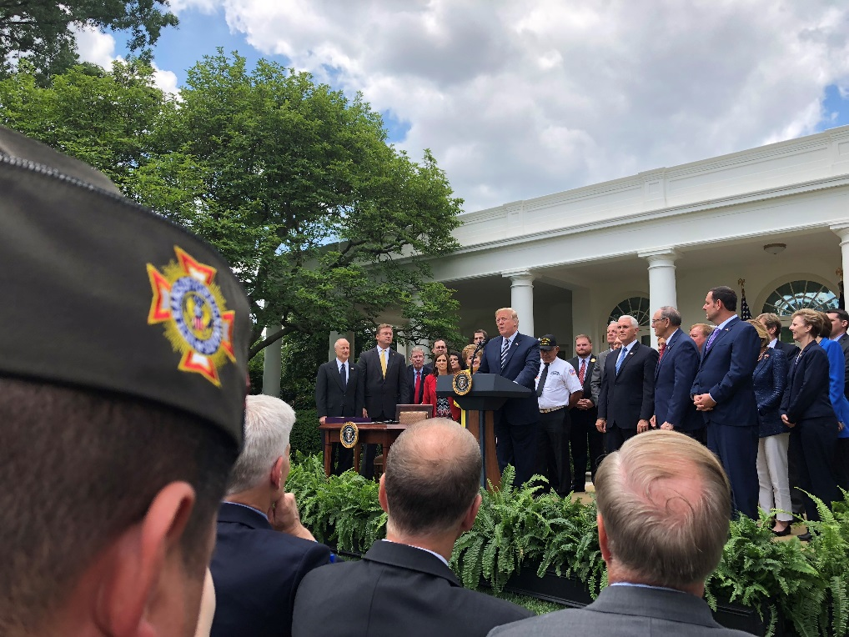
Recent Victories:
VA MISSION Act of 2018
Forever GI Bill
Streamlined appeals process
VA Accountability and
Whistleblower Protection
Act of 2017

Slide 4

2019 Priority Goals:
Blue Water Navy
Concurrent Receipt
Budget Request and CBO
Burn Pits
Suicide Prevention
Medical Cannabis
Transition Assistance
Implementation
Many more…

Slide 5

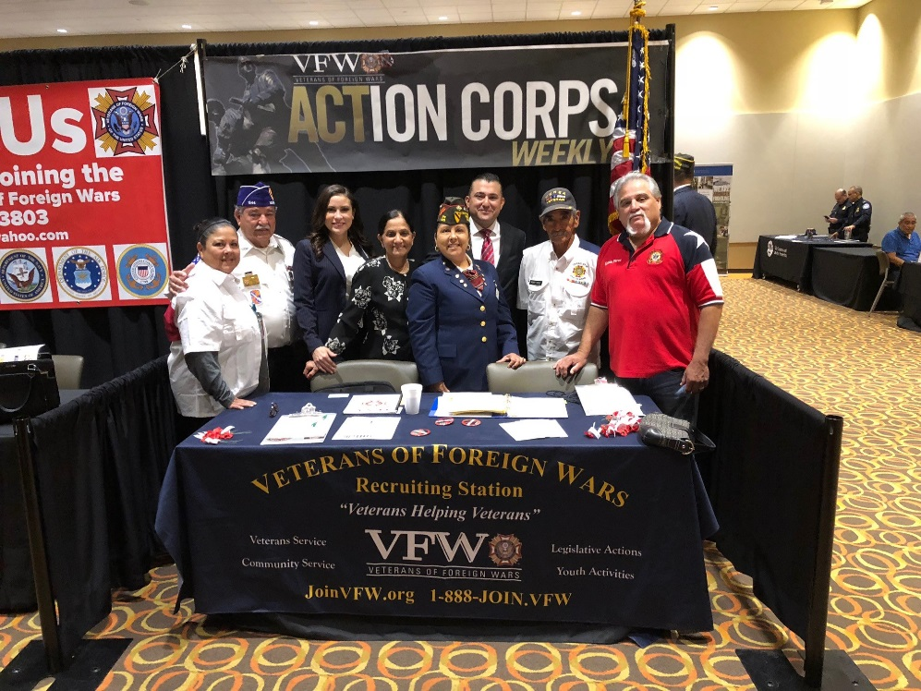
Legislative Advocacy:
Stay informed
  www.vfw.org/ActionCorps
Get involved
  All politics is local!
  Presidential Campaigns
  GOTV
Work with your National Legislative Committee Member(s)
Notes:
Know your congressional delegation. Use your position and access to make a difference for service members, veterans, and their families.

Slide 6
Political Activities:
DO’s
Do attend candidate town hall meetings and other events and ask candidates where they stand on our issues.
Do set up voter registration drives /Get Out the Vote Campaigns on the local level.
Do provide carpool service on Election Day to help the elderly and disabled get to the voting booth.
Do support and work for your favorite candidates as an individual voting constituent.
Do wear your VFW cap at public events such as town halls, rallies, forums, or debates.

Slide 7
Political Activities:
DON’Ts
Don’t endorse candidates on behalf of the VFW National Organization, Department, District or Post.
Don’t wear your VFW cap when actively campaigning for a candidate, such as soliciting donations or knocking on doors asking people to pledge their vote for a candidate.

Slide 8

We’re Here to Help:
www.vfw.org/advocacy
  Talking Points & Priority Goals
  Congressional Testimony
  Action Corps
  Voting Brochure

Slide 9
QUESTIONS?
Contact the VFW National Legislative Service
  Email: Cfuentes@vfw.org
  Call: (202) 608-8368

