Slide 1
Centralized Mail Portal

Slide 2
Getting started
First time login
Link: https://dmhs.digitalcontentservices.com/
Create account
If you encounter errors submit IT ticket, but ensure that you follow up
Notes:
For supervisor only
****************Point of contact Irina Rossikhina for trouble creating account irina.rossikhina@va.gov*************

Slide 3
Centralized Mail Portal
Formally known as Dimensions 360 is now called Centralized Mail Portal
Several names including the following: CMP, Direct Upload, and DUMP
You can “DUMP” anything into VA file
Replaces faxes to Janesville

Slide 4
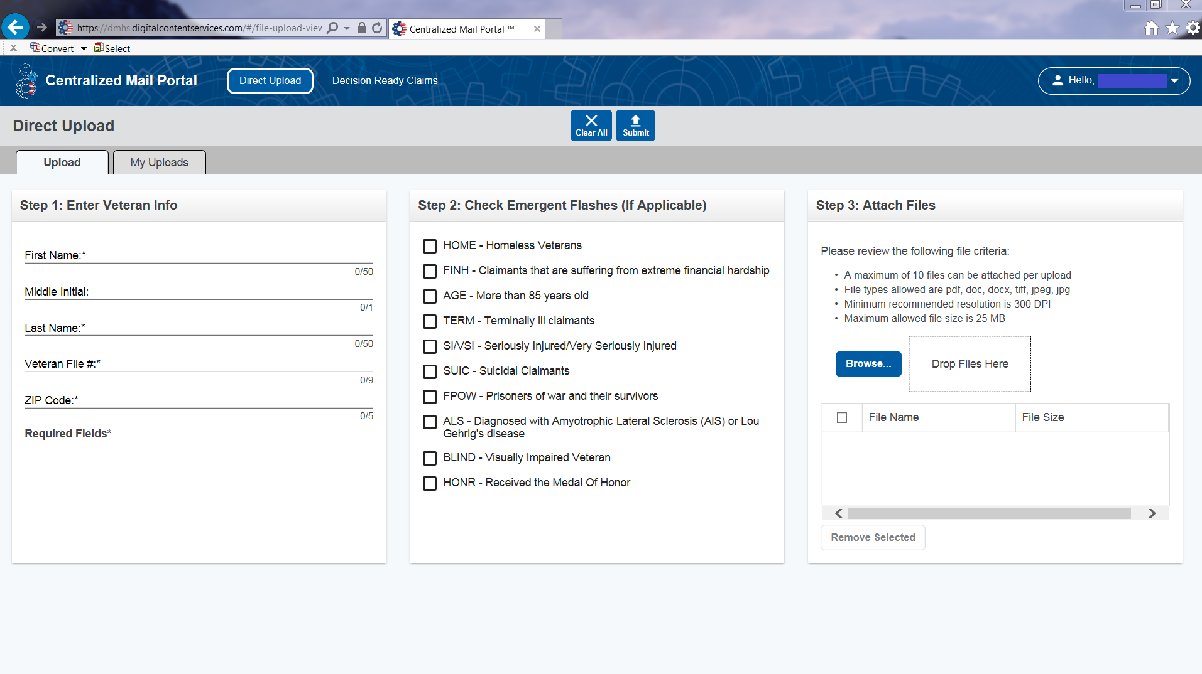
Centralized Mail Portal
Select Direct Upload
Complete Step 1 veteran’s information
Complete Step 2 check emergent flashes (if applicable)
Complete Step 3 attach files
Click SUBMIT

Slide 5
Centralized Mail Portal
After submissions of documents in direct upload, ensure to copy and paste confirmation number into communications of VetraSpec file for veteran
The confirmation number will display on the screen after submission, and will also be e-mailed to you
You will need the confirmation number to track documents after submission

Slide 6
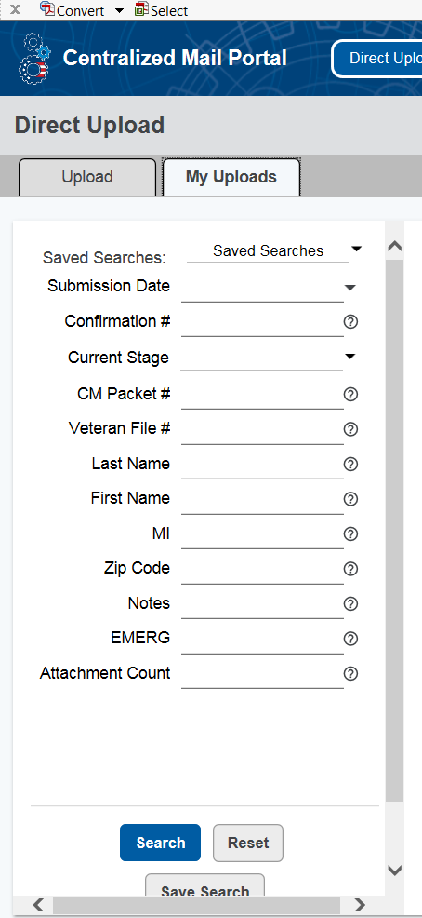
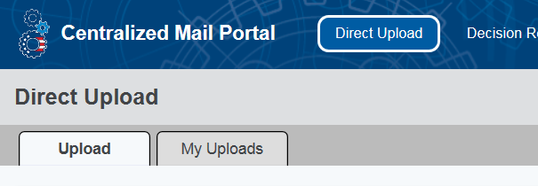
Centralized Mail Portal
Notes:
DEMONSTRATE HOW TO TRACK STATUS OF UPLOADED FILES

Slide 7
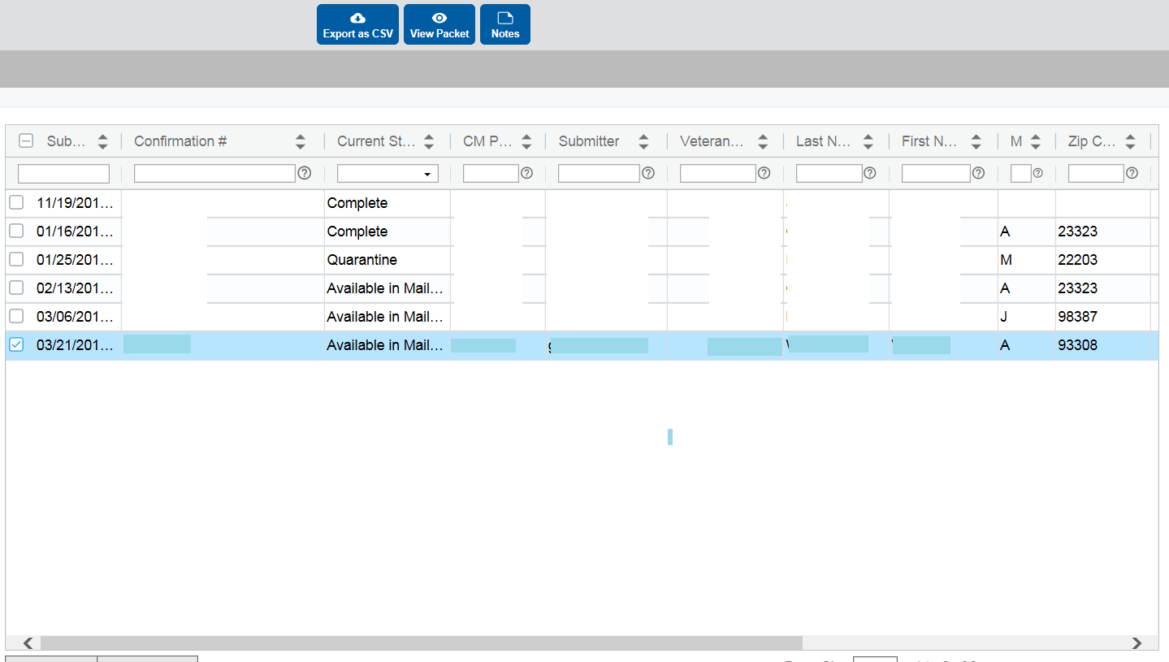
Centralized Mail Portal
Notes:
DEMONSTRATE WHERE TO CLICK TO EXPAND OPTIONS OF SELECTED FILE
THE STATUS IMAGE, IS A VISUAL THAT CAN HELP TRACK STATUS OF FILE UPLOAD, EXPLAIN TO CLASS THAT IF THE FILES HAS BEEN SITTING UNDER “AVAILABLE IN MAIL PORTAL” STATUS FOR MORE THAN 5 BUSINESS DAYS, THEN HAVE THEM CONTACT THE IPC COACH AND USE THE CONFIRMATION NUMBER AS REFERENCE. OR THEY CAN CONTACT THE IPC INBOX

Slide 8
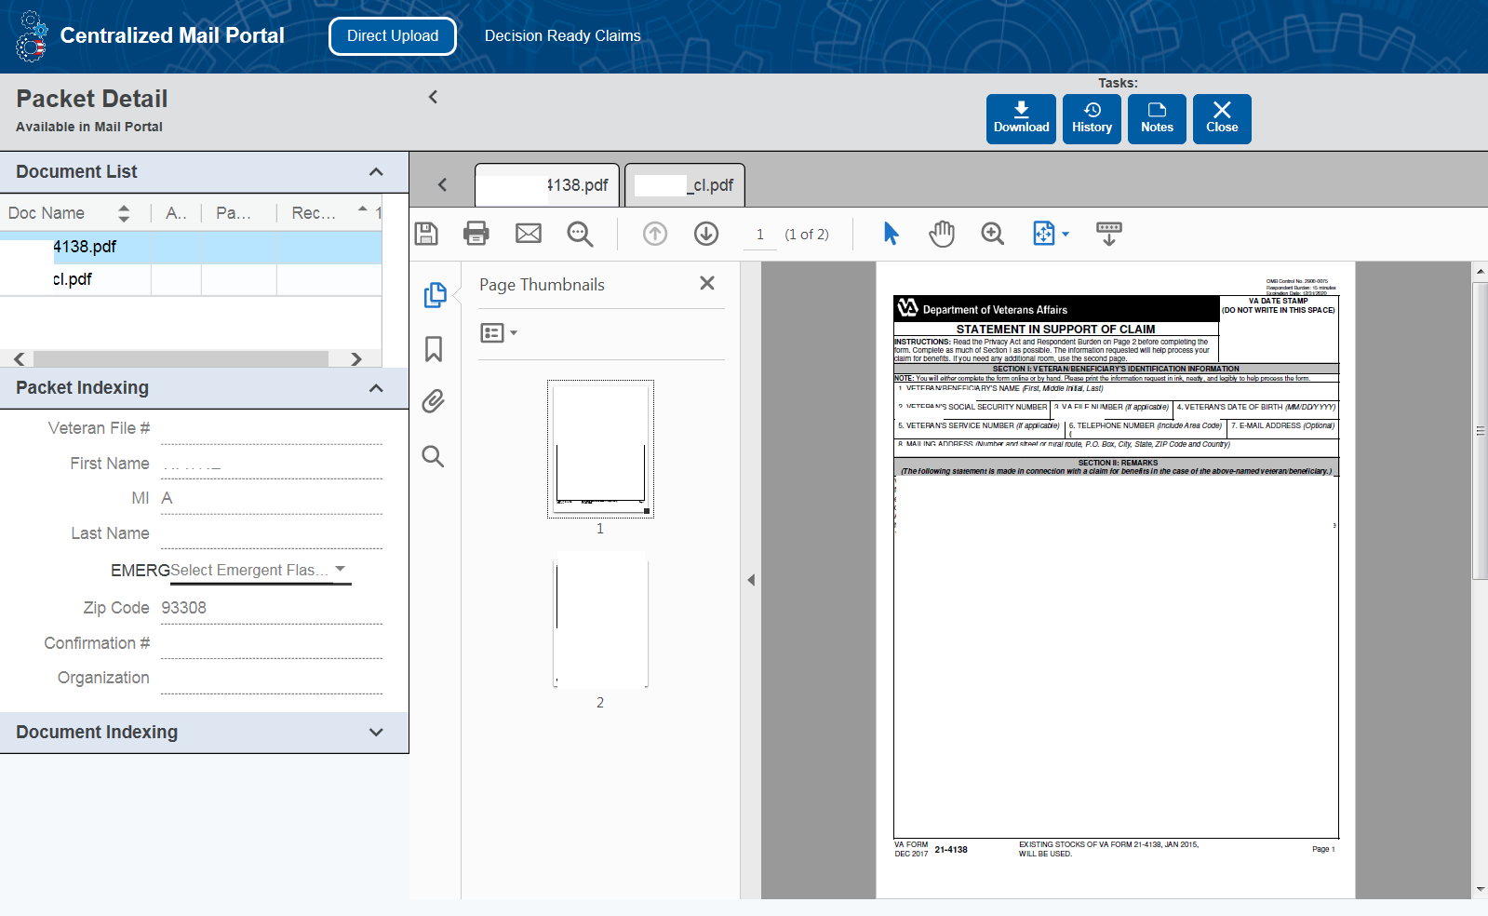
Centralized Mail Portal
Notes:
Explain how to view packets submitted and view upload history

Slide 9
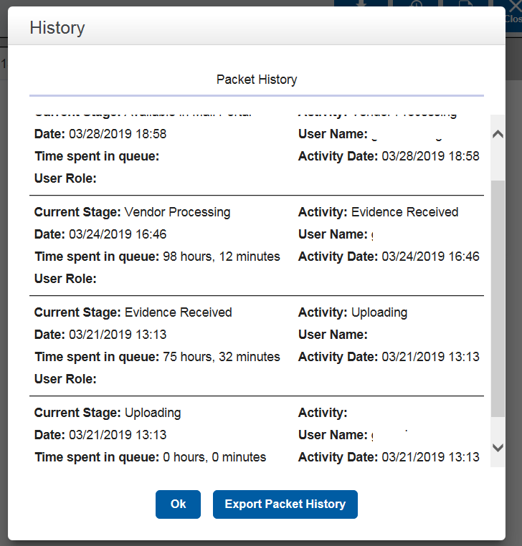
Centralized Mail Portal
Notes:
Explain upload history steps

Slide 10
Comparison
Uploading size limits in the different systems:
D2D size limit= 5 mb per file
SEP size limit= 25 mb per file
Centralized Mail Portal size limit= 25 mb per file, 10 files per upload

Slide 11
Comparison
When and for what to use the following:
D2D- submitting POA’s, quick and easy claim
SEP- Accepting POA request, VAF 686c & VAF 674
Direct Upload/CMP- Useful on submitting anything (replaces fax machines)
Tip: In the event that D2D or SEP encounter errors, use Direct Upload instead.
Notes:
Explain in further details which system to use for specific forms or actions

Slide 12
Link
Save link under your browser’s favorites
Access Centralized Mail Portal and familiarize yourself with the homepage
Website: https://dmhs.digitalcontentservices.com/
Notes:
Instructor: walk around and ensure that everyone has logged into correct website. If time permits have them access the document upload status check section.

Slide 13
QUESTIONS?

