Slide 1
The Electronic CFR and VACOLS

Slide 2
Electronic Code of Federal Regulations (eCFR)
The eCFR is located at http://www.ecfr.gov
This site is updated frequently sometimes several times per week with the most current regulations
Though maintained by the Government Printing Office (GPO) it is not an official edition of the CFR*
*If it is not yet printed in the official copy of the CFR, you can cite the Federal Register citation
Notes:
If it is not printed in the paper copy yet, can cite the Federal Register citation at the end of the eCFR section

Slide 3
Electronic Code of Federal Regulations (eCFR)
Let’s Practice:
Access the eCFR and look up the regulation for presumptive service connection due to herbicide exposure using the following steps:
Go to www.ecfr.gov
Click “Boolean” which is located in the left side column under “Advanced Search”
Enter “38” in the Title Number field
Type “herbicide” in the top retrieve box then click “Submit Search”
Select the correct result to read the regulation

Slide 4
Electronic Code of Federal Regulations (eCFR)
Let’s Practice:
Using the eCFR, find the diagnostic codes for the following disabilities:
Cushing’s syndrome
Chronic Fatigue Syndrome
Notes:
Cushing's syndrome 7907
Chronic Fatigue Syndrome 6354

Slide 5
Electronic Code of Federal Regulations (eCFR)
Let’s Practice:
Navy veteran Lorraine Grant wants to purchase her first home using her VA Home Loan Guaranty benefits and has asked you what percentage of the purchase price is used to determine the funding fee. She is not and cannot be service connected for any condition.
Using the eCFR, determine the answer and correct regulation for Ms. Grant.
Notes:
§36.4313 Charges and fees.
2%

Slide 6
Electronic Code of Federal Regulations (eCFR)
Using a search engine may be quick and easy but it does not always provide accurate answers.
The eCFR is one of the most accurate tools on the internet for researching regulations.
Though there is nothing wrong with using a search engine to find an answer quickly, always verify the validity of the information with the eCFR or another government source.
Notes:
§36.4313 Charges and fees.
2%

Slide 7
Electronic Code of Federal Regulations (eCFR)
Tips for Searching the eCFR
Use the “Browse” feature if you're not sure what you're looking for – select “Title 38”
“Browse” works just like paging through the book
For Windows based machines “Ctrl F” to search the current page
Use the “Search” feature if you know a keyword you are looking for – remember to enter “38” for the Title and the keyword
Try to use more uncommon keywords: “unemployability” versus “compensation”

Slide 8
Veterans Appeals Control and Locator System (VACOLS)
VACOLS is an automated VA database for tracking legacy appeals
This system only tracks legacy appeals; Caseflow is used to track AMA appeals
Can be accessed when you are logged into the VA network

Slide 9
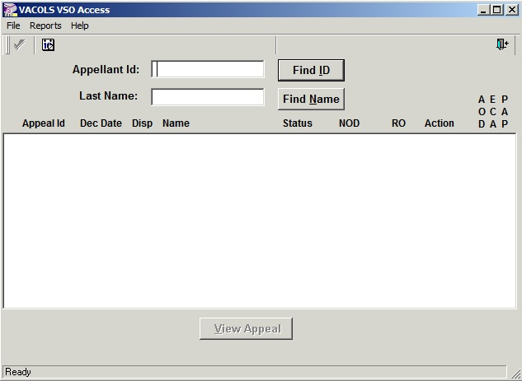
Veterans Appeals Control and Locator System (VACOLS)
Once you log into VACOLS you will be brought to this screen:
Appeals can be located by either entering the SSN or Claim number in the Appellant Id field or by entering a Last Name

Slide 10
Veterans Appeals Control and Locator System (VACOLS)
Docket- Docket number (once received at the BVA), dates of all pertinent documents, DRO election, hearing request and type, date certified to the Board.
Dispatch- Judge/counsel names (once received at the BVA), special contentions, other adjudicative information
Issues- What issues the veteran is appealing. Sometimes this information is WRONG. Be sure to compare this list with what the veteran has on the NOD, Form 9, SOCs and contact VA personnel if it is wrong.
Broker- If the appeal is being worked at the AMO or elsewhere it will say it here.
Address- The veteran’s address and contact information.

Slide 11
Veterans Appeals Control and Locator System (VACOLS)
Prior locations- Shows all prior locations. Once it is docketed at BVA, it will show which BVA personnel have had it and the current location (most of the time).
Attachments- Evidence is sometimes embedded in this tab once it is certified to the Board. You will also find the BVA decision once it’s promulgated here.
Diary- Reflects the process of the appeal at its current point.
Hearings- Reflects any hearings scheduled or completed, and what types have taken place.
Remand Reasons- If the BVA remands the case it will state the reasons briefly here.
Mail- If the veteran mails anything to the BVA, it will be listed here.

Slide 12
Veterans Appeals Control and Locator System (VACOLS)
Attorney Fee- If the veteran retains an attorney to represent them before VA, you will see it here (or you won’t be able to access the vet due to loss of POA).
Other Documents- Usually documents from third parties or other evidence.
CAVC Record- If the case went to the CAVC and was remanded or vacated and returned to the BVA, it will be reflected here.
Motion- Any motion (such as advance on docket) submitted by the veteran or their representative is reflected here.
CC- Lists any party contesting the claim, to include attorneys.

Slide 13
Veterans Appeals Control and Locator System (VACOLS)
Let’s Practice:
Using the SSN provided by your instructor, log into VACOLS, access the veteran’s appeals record, and then wait for further instruction.
Notes:
We will be using a live SSN, once each student accesses the file, the instructor will ask specific questions about the claim that can be found in VACOLS. (i.e. status, vets address, is there a BVA decision etc.)

Slide 14
What about Caseflow?
Caseflow is a new VA program that is used to track AMA appeals
This program is still in development, therefore we cannot provide accurate training at this time
We have provided each of you with a USB drive that includes all of the VA materials and instructions NVS has received on Caseflow
If you have a question regarding the status of an AMA appeal you can contact the VFW BVA staff at 202-632-4605

