Slide 1
VBMS

Slide 2
Objectives
In this class we will review how to utilize VBMS to include:
Accessing Claims
Locating Rating Decisions to review
Determining claims status and tracking claims
Bookmarking a veteran’s file for quick reference

Slide 3
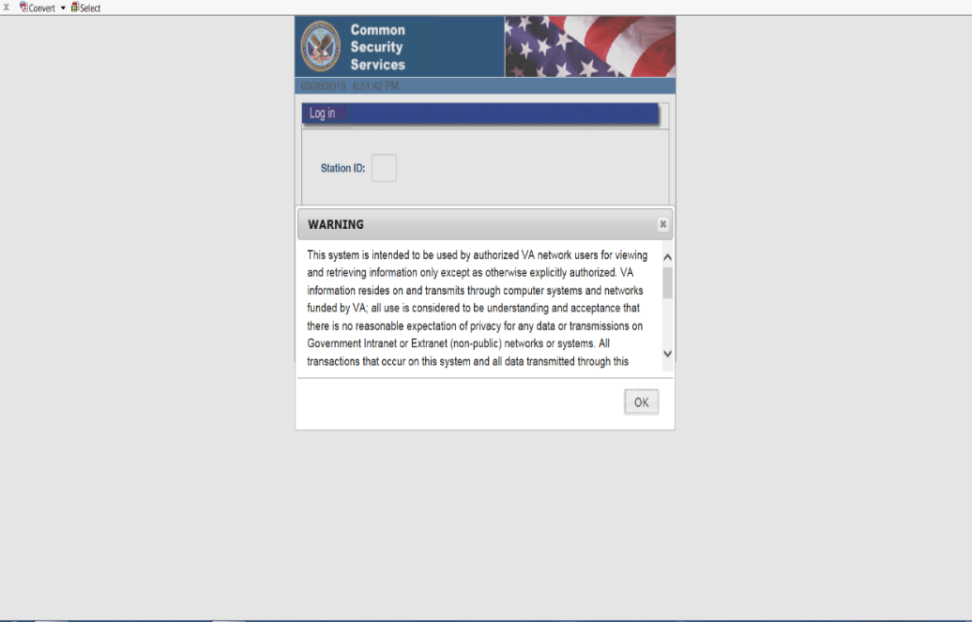
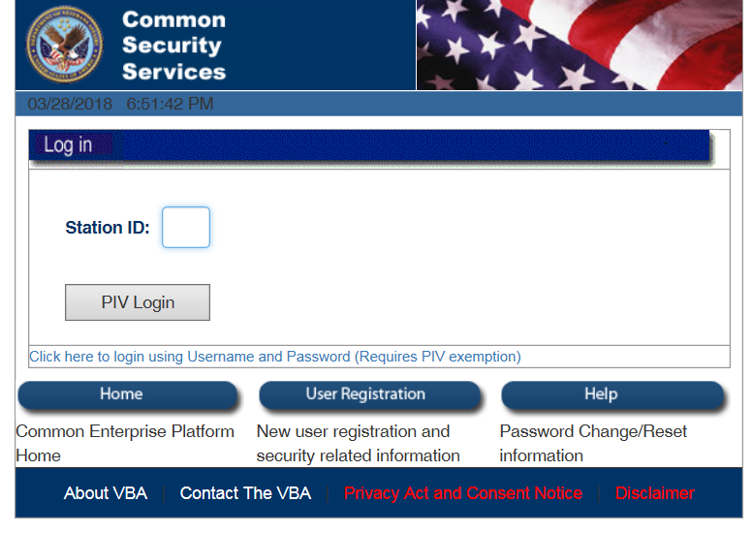
Logging into VBMS
Logging into VBMS
Type in your RO number
Select your certificate that contains valid certificate dates
Notes:
Instructor- demonstrate to class, how to identify correct certificate when logging in.

Slide 4
Access All Claims QUEUE
Familiarize yourself with the Home page
***Practice Time****
Take a minute to look up a veteran under “My History”
Notes:
Instructor- Spend SOME TIME LOGGING INTO VBMS AND EXPLAINING THE HOME PAGE AND TABS also have class search for a veteran that is under their history. For those that have never used VBMS, have them partner up.

Slide 5
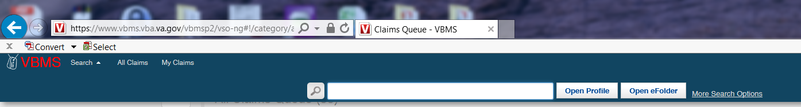
Searching for a Veteran
Demonstrate how to search for a veteran
Notes:
USE THE FILE NUMBER PROVIDED BY TRAINING MANAGER FOR SEARCHING FUNCTIONS. CAN SEARCH BY COMPLETE NAME IF NAME IS UNCOMMON

Slide 6
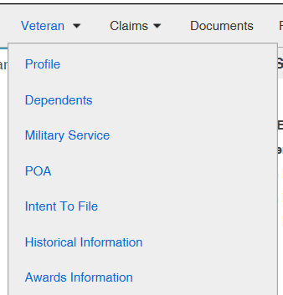
Accessing Veterans File Functions
Profile
Dependent
Military service
POA
Intent to File
Notes:
DEMONSTRATE WHAT EACH TAB CONTAINS. ENSURE TO EXPLAIN THE IMPORTANCE OF ENSURING THAT POA ACCESS IS ALLOWED AND HOW TO VIEW IF THERE ARE ANY PENDING ITF’S. ENSURE THAT THEY ARE AWARE OF HOW IMPORTANT TO TRACK THE DATE OF ITF.

Slide 7
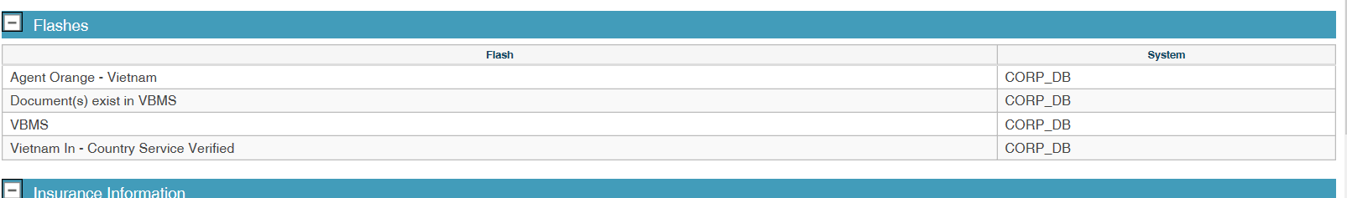
Flashes
Flashes will inform you of any specific flash related to file
Examples are following:
Homeless
Agent orange
Gulf war

Slide 8
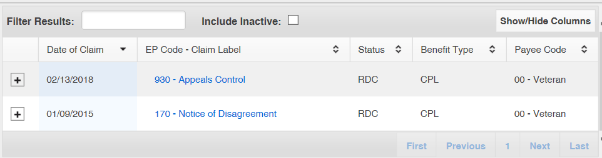
Claims
Selecting claims
Show you pending claims
Tells you quick status of claims
You can look at past claims
Notes:
EXPLAIN TO CLASS HOW TO VIEW ACTIVE CLAIMS AND INACTIVE CLAIMS.
EMS
TAKE THIS OPPORTUNITY TO ALSO EXPLAIN THAT APPEALS CAN BE VIEWED IN VBMS, HOWEVER, INFORMATION IS MORE DETAILED IN VACOLS.

Slide 9
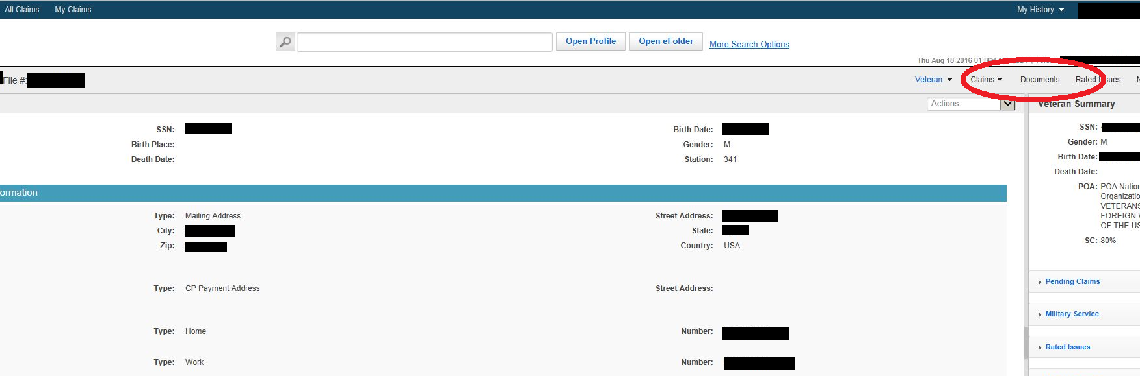
Documents
Notes:
DEMONSTRATE TO CLASS HOW TO ACCESS DOCUMENTS IN VBMS AND ALSO EXPLAIN BOTH DOCUMENT SECTIONS EFOLDER & LEGACY CONTENT MANAGER DOCUMENTS.

Slide 10
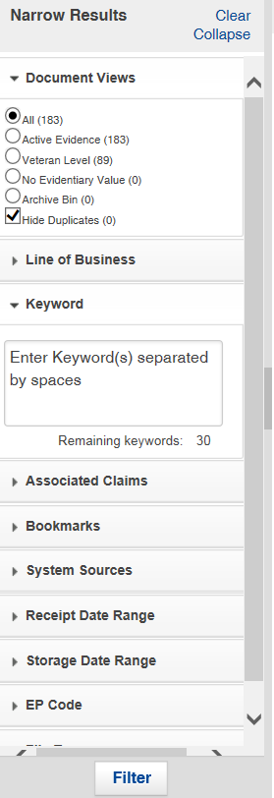
Document Filters
Find specific documents
Enter file name or word under “KEYWORD”
Then “click” on Filter
Notes:
ENSURE THAT THEY UNDERSTAND HOW TO FURTHER FILTER DOCUMENTS.

Slide 11
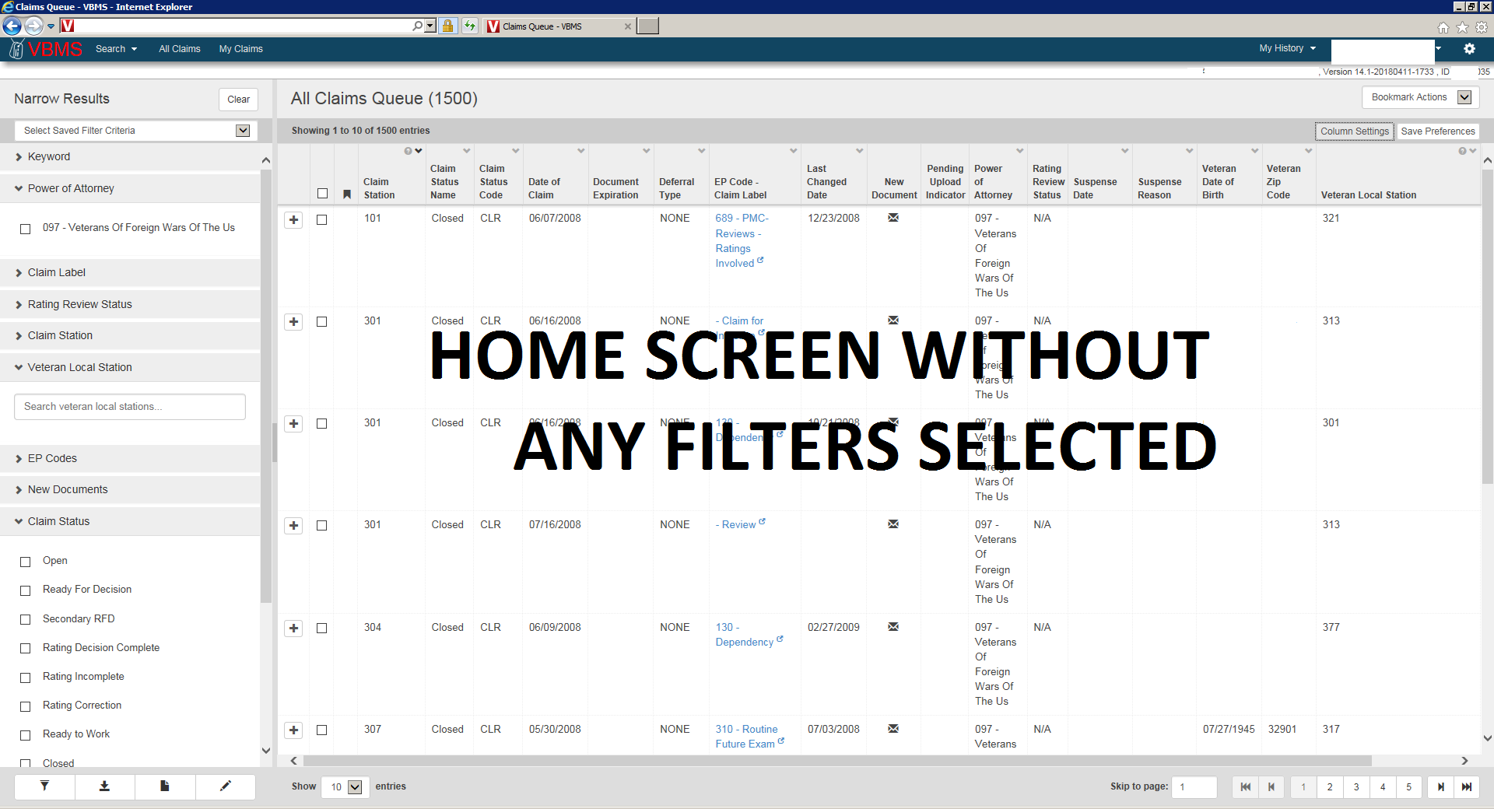
Rating Review Filter
Notes:
NEXT COUPLE OF SLIDES DEMONSTRATE HOW TO CHANGE YOUR FILTER TO REVIEW RATING DECISION

Slide 12
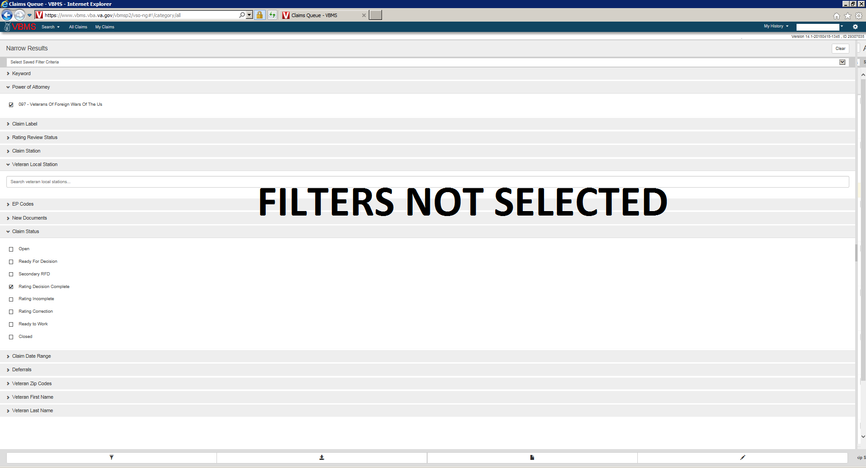
Before Starting ensure that filter settings resemble the filters shown on picture
Note: Some filters will automatically default to certain settings
If you have any other filters checked, uncheck them to ensure that you can successfully set up filters to review rating decisions

Slide 13
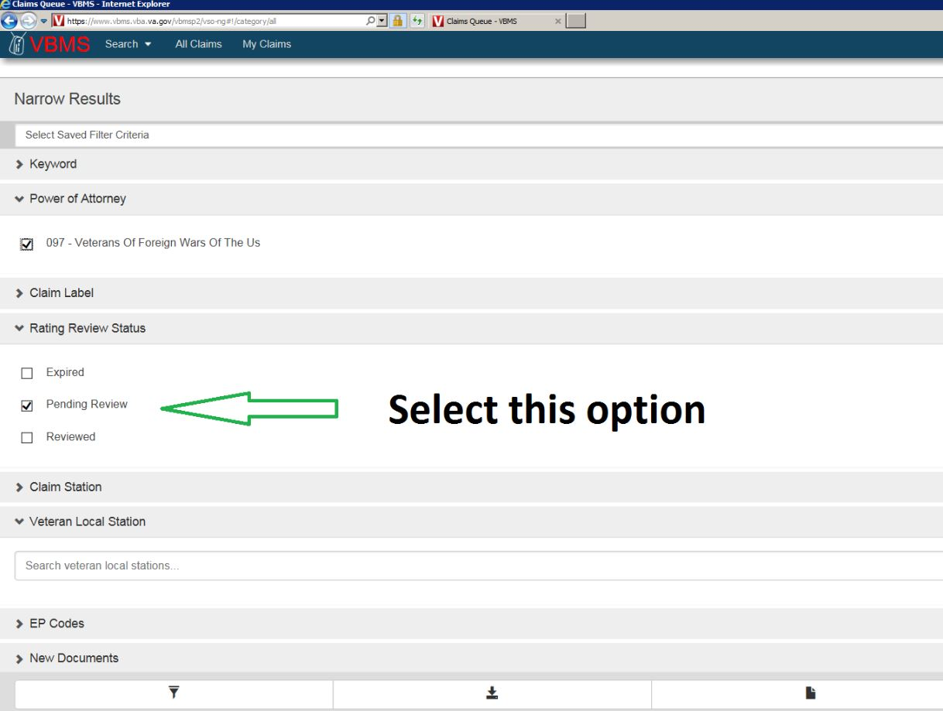
Under the Rating Review Status Filter, check pending review and ensure all other options are unchecked
You can check Expired option if you would like, in order to ensure that no ratings were missed

Slide 14
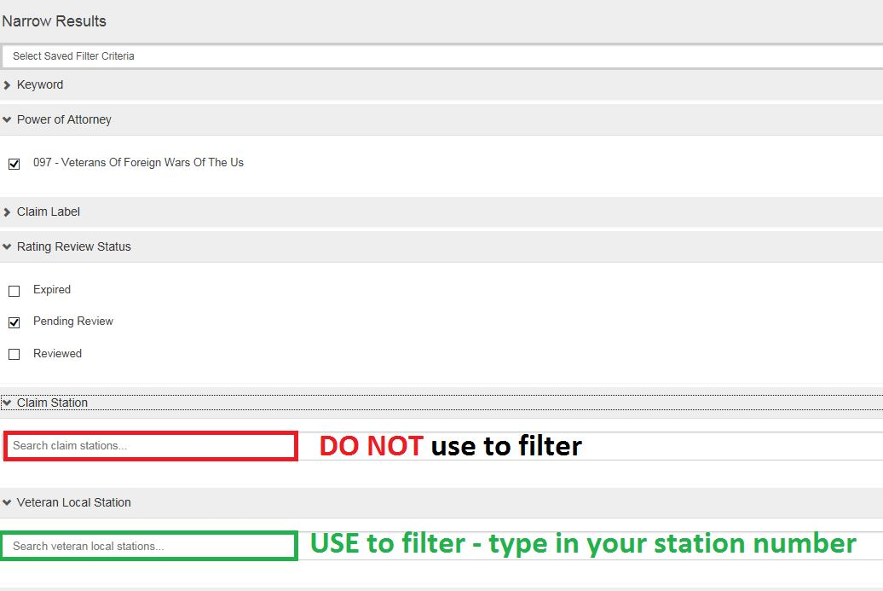
Do not use the claim station
Use the Local station filter
Note: NWQ can transfer claims to other stations outside your jurisdiction. When you select the Local Station filter, you are able to consolidate and view any claim that’s been transferred, back into your queue for you to review

Slide 15
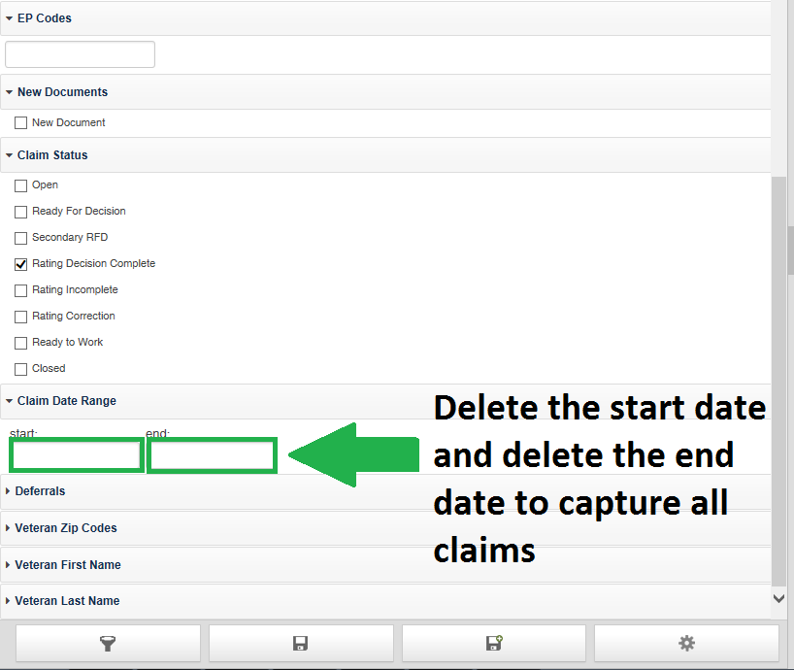
Delete any dates from the Claim Date Range filter
This will expand your search and ensure that you view all claims pending review

Slide 16
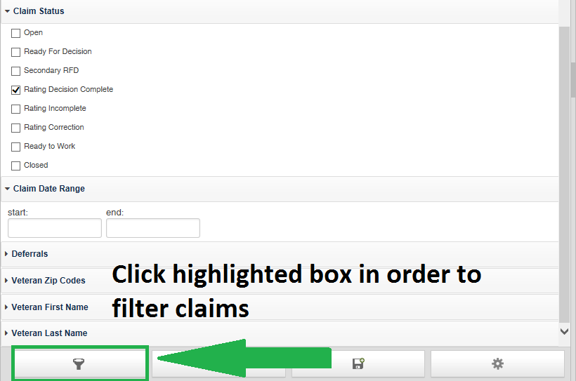
When you are done selecting all filtered options discussed click on the search light icon to view your filtered options

Slide 17
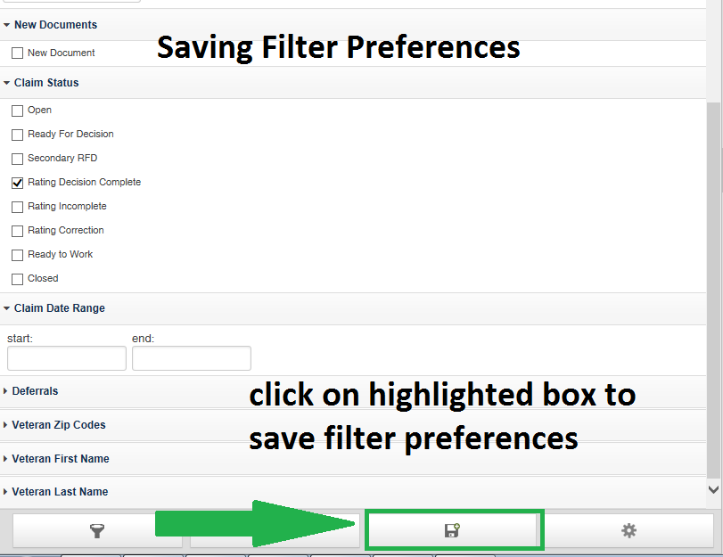
Optional
Tip: To save your filters, click on the option shown on the picture and follow the steps on the next slides

Slide 18
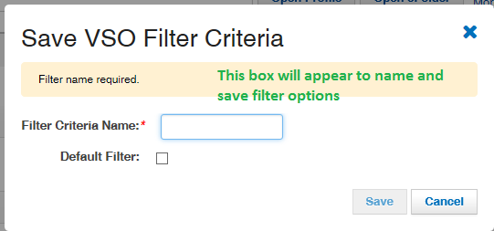
Saving Filter Preferences

Slide 19
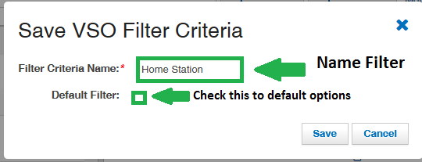
Saving Filter Preferences

Slide 20
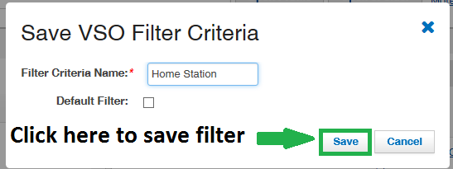
Saving Filter Preferences

Slide 21
Practice Time
Set up your filters to locate your ratings that need to be reviewed
Notes:
IF TIME PERMITS, HAVE CLASS SET UP A PREFERRED FILTER.

Slide 22
Practice Time
Important filters for ratings review
POA- 097
Claim label- blank
Rating review status- “select” pending review only
Claim station- Blank
Veteran local station- Your RO station number
Claim status- “select” Rating decision complete only
Claim date range- clear dates

Slide 23
Bookmarking
VBMS allows VSOs to save or “bookmark” files in order to allow you quick access to claims that you need to access regularly or follow up with.
You can only bookmark claims through the All Claims Queue
Bookmarking the claim does not affect VA’s processes nor will it bookmark it for any other users

Slide 24
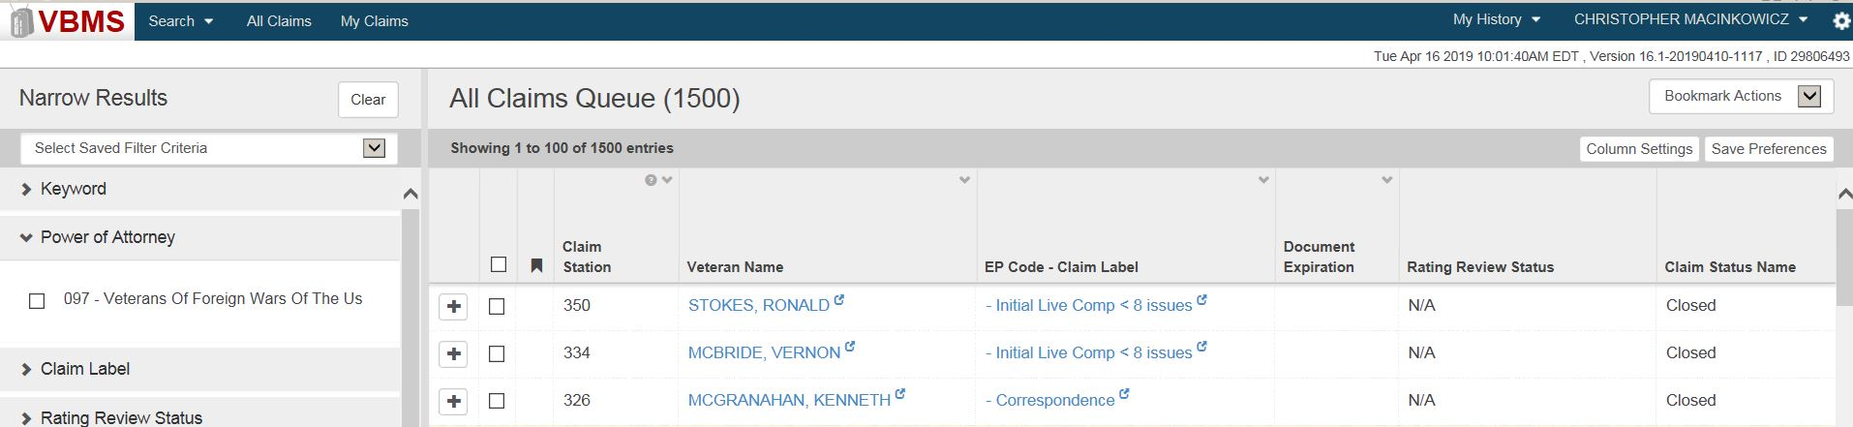
Bookmarking
To bookmark a claim in VBMS follow these steps:
Access the All claims queue:

Slide 25
Bookmarking
To bookmark a claim in VBMS follow these steps:
2. Scroll to the claim file you want to bookmark and check the box to the left
Notes:
RECOMMEND USING NAME FILETERS TO IDENTIFY CLAIM

Slide 26
Bookmarking
To bookmark a claim in VBMS follow these steps:
3. Select Bookmark Actions then choose “Add Bookmarks

Slide 27
Bookmarking
To bookmark a claim in VBMS follow these steps:
4. To access your bookmarked files, select “My Claims” and you will see a list of your bookmarked claims

Slide 28
Bookmarking
To remove a bookmark from a claim:
Access “My Claims”
Select the checkbox next to the claim(s) you no longer want bookmarked
Select “Remove Bookmarks” in the Bookmark Actions field

Slide 29
Practice Time
Access your All Claims Queue and bookmark 2 claim files.
Once you have done so, access My Claims to ensure that they have been bookmarked.
After you have reviewed the My Claims field, remove the bookmarks.

Slide 30
VBMS Notes
VBMS allows VSOs to view any notes or comments made about a particular claim or veteran
These notes are important! Oftentimes, notes are the only way to see who has been working on the claim or what actions have or have not been taken by VA
Notes:
DEMONSTRATE HOW TO TRACK FILE AND CLAIMS, BY REVIEWING NOTES.
TAKE OPPORTUNITY TO EXPLAIN HOW TO FIND OUT WHO HAS FILES BY SEARCHING GLOBAL ADRESS BOOK IN OUTLOOK AND SEARCHING UNDER ALIAS. USE THE EXAMPLE OF REVIEWING DECISIONS AND FINDING OUT NAME OF RVSR USING ALIAS.

Slide 31
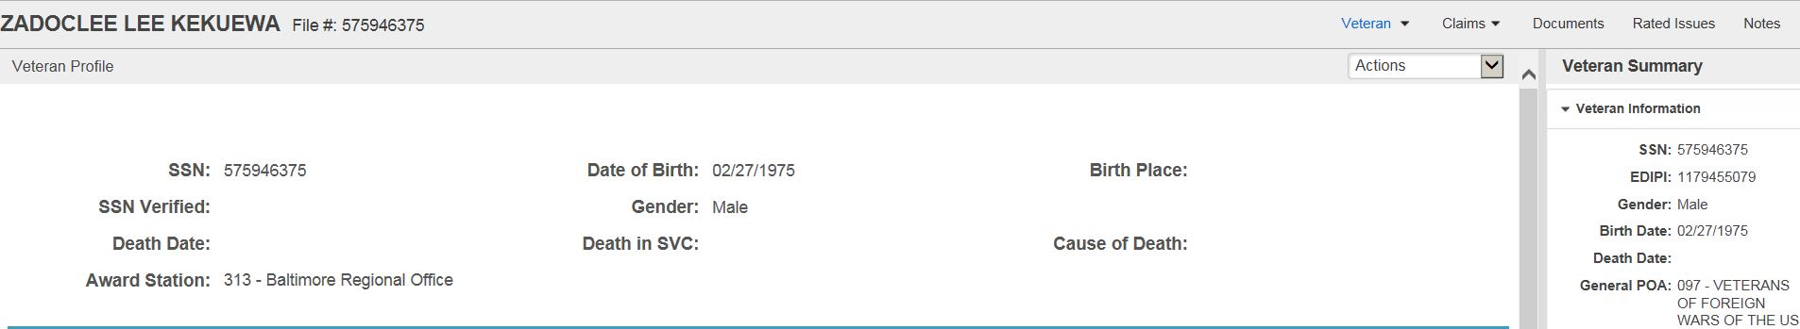
VBMS Notes
To view VA’s notes in VBMS you must first access a claim file
Once you are in the file click the Notes tab (located in the right upper corner)

Slide 32
VBMS Notes
Once you have entered the Notes section you can view any notes associated with the claim as well as who has taken action on the claim

Slide 33
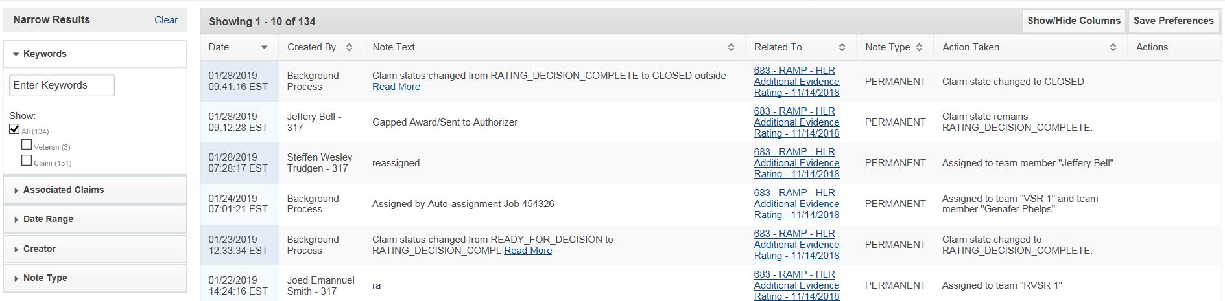
VBMS Notes
Date and Time the Note was made
Who created the note
Note text – If you see a “Read More” link you can click it to read the entire note
Which claim is the note affiliated with?
What action was taken
1 2 3 4 5

Slide 34
VBMS Notes
VBMS also allows users to search the notes screen using the menu on the left
Be careful not to rely solely on this tool. Instead only use it as a guide as it is not always accurate

Slide 35
Practice Time
Access a veteran’s file and view the notes associated with the claim
Be sure to pay close attention to who created the note and when it was created

Slide 36
QUESTIONS?

