Slide 1
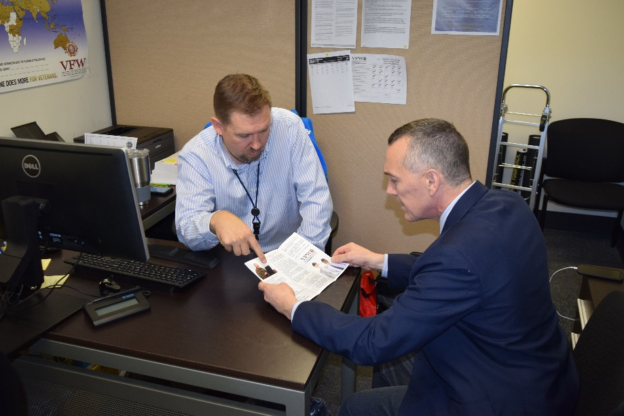
Professional Development within the VFW Service Office

Slide 2
Purpose
The purpose of this class is to have an interactive discussion about different ways that we can make the VFW a more productive and attractive workplace

Slide 3
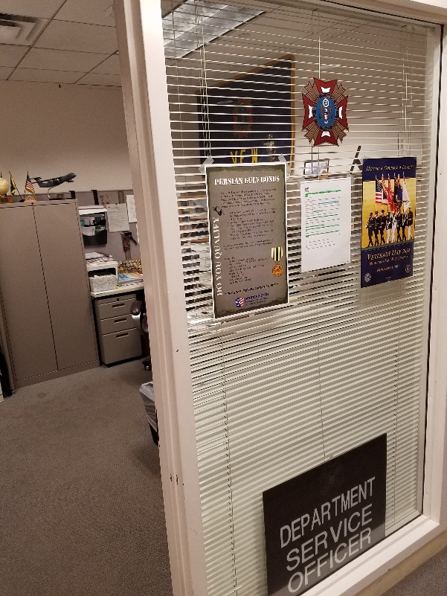
Objectives
Onboarding
Accreditation Process
Career Progression
Mentorship
Team Building
State and County Relationships
Questions?

Slide 4
Onboarding
Onboarding is a series of events that new employees complete in order to understand how to be successful in their day-to-day job and how their work contributes to the overall business.

Slide 5
Onboarding
Within the first few days of employment, new employees in the VFW service office should:
Begin the accreditation process (More on this later)
Complete T.R.I.P. training
Complete VA prescribed training
Meet key VA staff
Once they have completed these tasks, you can start having them learn the core tasks of a VSO. One tried and true method is right seat/left seat training.
Notes:
When introducing key staff, do not use this opportunity to discuss cases or other topics, this can and will confuse the new employee. Instead stick to names and job descriptions

Slide 6
Onboarding
When you have a new staff member, ensure that they are set up for success by tailoring their workload to their skills and increasing it as their experience increases.
Be sure to talk to the new employee and ask pertinent questions to determine their skill level.
Do not assume that people with “experience” in service officer work don’t need assistance.
Notes:
Ask what kind of questions should be asked of new employees to determine their skills
Should a knowledge test be given?

Slide 7
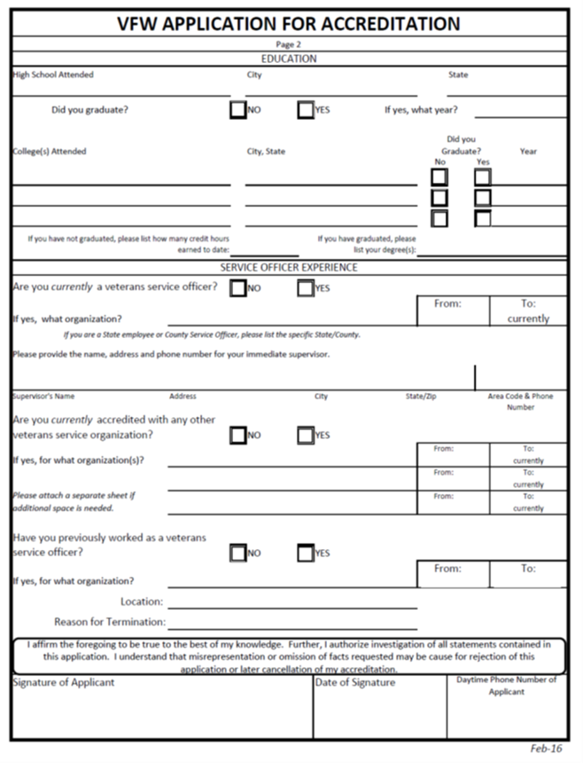
Accreditation
Accreditations must be routed the proper approval authority for your Department
  Usually Department Commander or Adjutant. May be DSO
  Make sure you follow your Department’s protocol
NVS plays NO ROLE in recommending any personnel in your state for accreditation, hiring, or appointment.
  This includes VFW employees and any cross-accredited State/County VSOs

Slide 8
Accreditation
Accreditation Process:
Department completes pre-employment* background check on candidates
Department submits complete VFW Accreditation Packet to NVS
NVS reviews for signature by National Certifying Representative (Ryan Gallucci, Director, NVS)
NVS submits to VA Office of the General Counsel (OGC) for processing
VA OGC notifies candidates and VFW of accreditation
VFW Accreditation Packet:
Letter of Appointment (need name of appointee, position of appointment, verification from authorized source)
VA Form 21 (Most recent – JAN 2016)
VFW Application for Accreditation
Background Investigation Certification

Slide 9
Accreditation
Accreditation Process:
Accreditations may take up to 8 weeks for OGC to process
This time STARTS when NVS submits the signed VA Form 21
The date an accreditation is submitted to NVS is not the date it will be submitted to OGC
NVS reviews all accreditation packets to ensure they are complete.
NVS will clarify any discrepancies with the Department prior to submission to OGC

Slide 10
Career Progression
When employees are offered career progression opportunities, it makes them feel like they're growing with the company and provides a sense of purpose, which in turn fosters loyalty.
Career progression does not necessarily mean a promotion; it means that as people gain experience, they should be offered more challenging projects and responsibilities in order to help set them up for future success
Although there may not be immediate promotion potential within your office, there may be opportunities for advancement within other VFW offices or with NVS

Slide 11
Career Progression
Does this make you uncomfortable?
Let’s talk about it…
  “There’s nowhere for them to go in my office”
  “They’re trying to take MY job”
  “They’re going to demand a raise”
  “They’re going to leave”
  Others?
Notes:
It makes your job easier if they know how to do their job.
Regardless of how long an employee stays or how much you pay them, if they feel like a productive member of the team, you will get the most out of them.

Slide 12
Career Progression
If you are a supervisor, there are many things you can do quite easily to help your employees gain experience and progress in their career with the VFW
Some examples include:
      Intra-office training
      Shadowing
      Performance reviews
What other ways can you help your employees?
Notes:
Shadowing- have the employee shadow you for a day and encourage them to take note of how you do things as well as of any mistakes you may have made

Slide 13
Career Progression
Performance reviews can be formal or informal
When offering a formal performance review, be sure to include the following:
What was accomplished during the review period
Ways to improve the employees performance
Future Goals
When the next review will take place
**Remember to keep personal opinions and feelings about the employee separate from the review. This should be a discussion not a lecture
Notes:
Ask how often they feel reviews should take place

Slide 14
Mentorship
Mentorship is the process of providing guidance to employees
Some ways to do this are:
Build an authentic connection – Be approachable, let your staff know they can come to you if they need to
Acknowledge their strengths – Pay attention to your staff’s interests inside and outside of the workplace to learn their talents
Identify goals and help your staff achieve them – Ask your employee where they see themselves in the future and ask how you can help them achieve those goals
Notes:
Ask what other ways they can help mentor

Slide 15
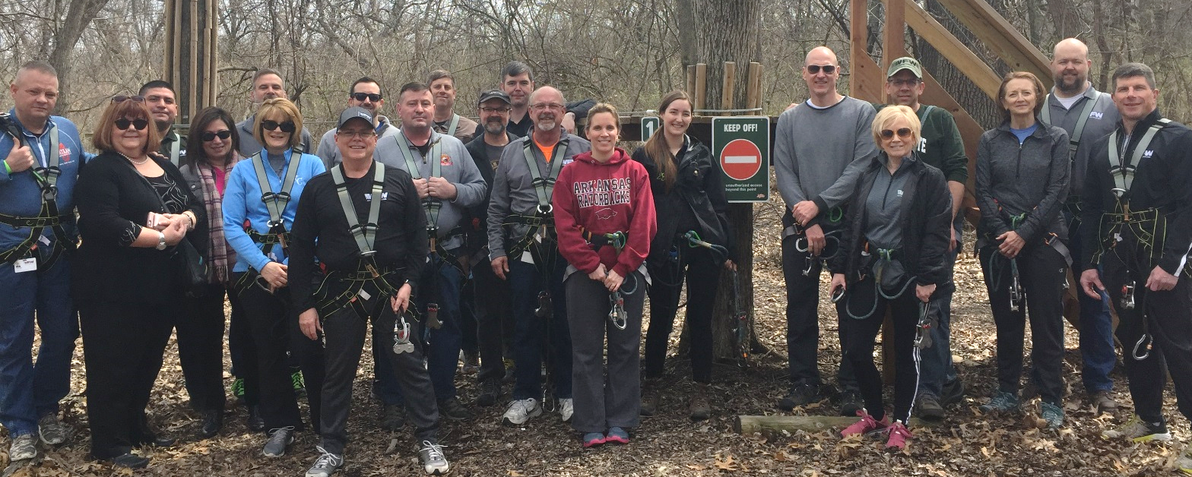
Team Building
In order to be successful, each VFW Service office must work as a team to provide the best service to our veterans and their families.
What are some ways to help your office work as a team?
Notes:
Give examples like Pot Lucks, Sporting Events, Volunteer projects, etc.

Slide 16
State and County Relationships
As an accredited VFW representative you may be expected to work with other agencies such as state or county VSOs.
Although they may not be VFW employees, many other agencies have obtained VFW accreditation and may call on you to help them assist their clients.
It is important to foster a good relationship with these agencies as it could help the VFW represent and assist more veterans.

Slide 17
State and County Relationships
When working with other agencies, remember that you are representing the VFW and its interests
A good relationship with county or state VFW accredited representatives can help reduce certain aspects of your workload*, and may offer a way for VFW represented veterans to obtain assistance in their local community without having to visit the VARO
NVS Policy now allows for direct submission to VA by CVSOs at the discretion of each DSO.
*It will likely increase other aspects…
Notes:
Discussion on how this affects workflow
Discussion on Direct Submission

Slide 18
State and County Relationships
Some ways to help develop these relationships are:
Share important information such as training materials and NVS updates
Attend local events hosted by the state or county VSOs
Coordinate joint training or outreach activities
If you already have a relationship with an agency, periodically visit them as a “goodwill” mission
Offer to have them visit your office

Slide 19
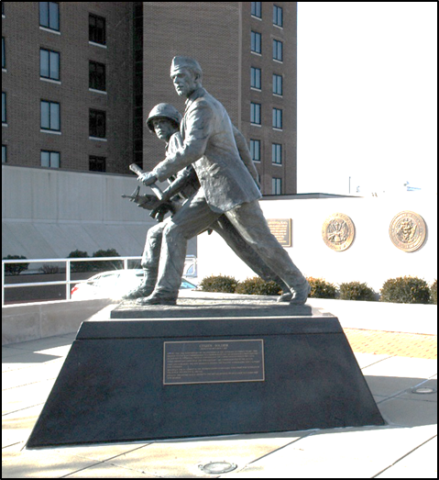
QUESTIONS?

