Slide 1
VA Intranet Resources
Lauren Barefoot
Manager, Training & QA
lbarefoot@vfw.org

Slide 2
Objectives
In this course we will navigate research tools and applications on the VA Intranet that can help you prepare claims and appeals.
We will also review communications using Outlook and Skype that are available both within and outside the VA network, and share best practices.

Slide 3
VA Intranet
To access the VA Intranet, you must be connected to the VA Network, either directly or through remote access methods (Citrix or RESCUE)
Some of these resources are also available on other websites
If it is on the VA Intranet, the webpage will begin with https://vbaw
Notes:
Please log onto the VA network through Citrix at this time or look on with a neighbor who has access.

Slide 4
Key VA Intranet Websites
Many of the following websites are already bookmarked in your “favorites” menu in Internet Explorer when you log in
Why? Many are used by VA employees
Some of the resources are only for VA employees or are on a “need to know” basis while others are public information
Notes:
None of these resources are meant to create extra work nor do they need to be checked every time you have a claim. They are supplemental resources.

Slide 5
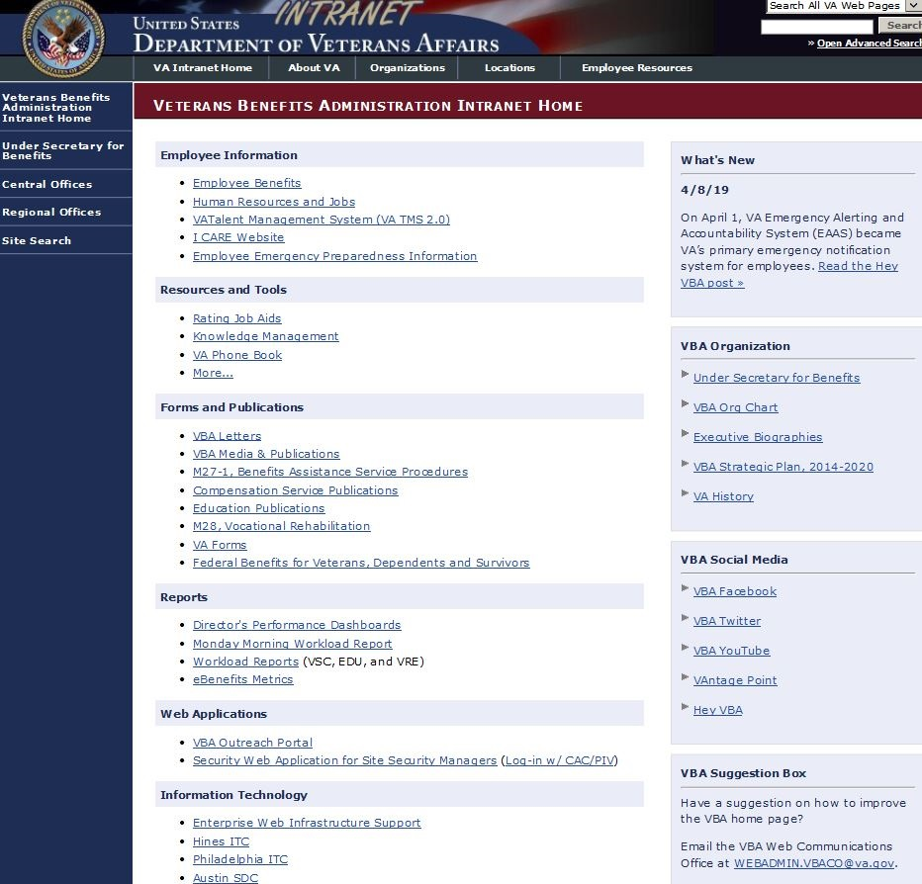
Key VA Intranet Websites
VBA Intranet Home
Notes:
None of these resources are meant to create extra work nor do they need to be checked every time you have a claim. They are supplemental resources.

Slide 6
Key VA Intranet Websites
VBA Intranet Home
“Rating Job Aids” has several key resources
Regulation Citator: find present and past versions of VA regulations
Combinator: Application that does “VA math”
Hearing Loss and SMC calculators: Application that helps raters with generating the decision for these types of claims
Notes:
None of these resources are meant to create extra work nor do they need to be checked every time you have a claim. They are supplemental resources.

Slide 7
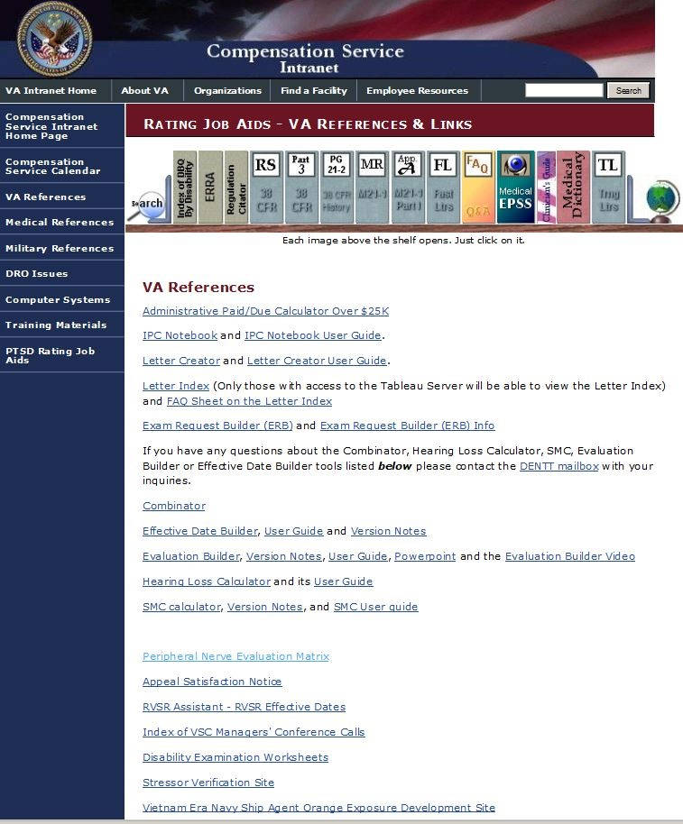
Key VA Intranet Websites
Rating Job Aids Home
Notes:
None of these resources are meant to create extra work nor do they need to be checked every time you have a claim. They are supplemental resources.

Slide 8
Key VA Intranet Websites
Let’s Practice: Regulation Citator
Navigate to https://vbaw.vba.va.gov/benefits/index.asp
Click on “Rating Job Aids”
Find “regulation citator” on “bookshelf”
Type in “skin” and see what you find
Let’s view the entry for evaluating skin conditions, 38 CFR 4.118
Notes:
None of these resources are meant to create extra work nor do they need to be checked every time you have a claim. They are supplemental resources.

Slide 9
Key VA Intranet Websites
Information also available on the internet:
Stressor verification websites (although information may be better arranged here)
Vietnam era Navy Ship Agent Orange Exposure Development Site
POW Status list
Veterans Health Initiative
Notes:
If your client can do some research on their own you may want to direct them to these websites when applicable

Slide 10
Key VA Intranet Websites
Let’s Practice: Stressor Verification Sites
On the rating job aids site, click on “stressor verification sites”
Click to expand “general information”
Select a service branch on the left hand column for unit awards, lessons learned, command histories, etc. by era
Notes:
If your client can do some research on their own you may want to direct them to these websites when applicable

Slide 11
Key VA Intranet Websites
VBA Social Media Sites (also available on internet)
VAntage Point: official VA blog
VBA YouTube: informational videos you can share with clients
Notes:
If your client can do some research on their own you may want to direct them to these websites when applicable

Slide 12
Key VA Intranet Websites
Board of Veterans Appeals Intranet site
Navigate to the BVA Intranet site https://vbaw.bva.va.gov/
BVA contact information
Training resources

Slide 13
Key VA Intranet Websites
Other Intranet sites: Pension, Appeals Management Office, etc.
Navigate to the VBA Intranet site https://vbaw.vba.va.gov/
Click on “Central Offices” on the left hand side of the screen

Slide 14
Key VA Intranet Websites
Knowledgebase
Good source of material on changes to regulations, M21-1 etc.
Let’s Practice:
Navigate to VBA Intranet site https://vbaw.vba.va.gov/benefits/index.asp
Select “knowledge management”
View “Blue Water Navy Court Decision – Procopio v. Wilkie”
Notes:
Most of this information is also available on internet at www.knowva.ebenefits.va.gov

Slide 15
Key VA Intranet Websites
Knowledgebase
You can bookmark and email topics in knowledgebase for future reference
At the bottom of the article, select “email” or “add to favorites”
Let’s practice: try adding the Blue Water Navy script to your favorites
Now at the top red banner under My Favorites, you should see all your favorite articles
Notes:
Most of this information is also available on internet at www.knowva.ebenefits.va.gov

Slide 16
VA Applications
VBMS-R
Can be used to find out what VA’s rating decision would look like based on different facts and examination criteria
Uses evaluation builder and effective date builder
This is a rating tool, it does not show veteran’s claim file documents, you want to continue to use regular VBMS for most functions
Notes:
Any other applications you use? MAP-D? VACOLS?

Slide 17
Communications
Outlook
Encryption reminder
Corporate mailboxes
“Reply to” addresses
Signature blocks
Out of Office messages
Notes:
Where do you direct people to contact you? Pay attention to out of office messages/voicemails etc.

Slide 18
Communications
Outlook
Sticky Notes (ctrl + shift + n)
Option for future delivery time for e-mails
Create email templates
Save frequently used message as template
Then create new item using “choose form”
Organize emails:
View as conversations
Rules: set alerts, direct to specific boxes
Notes:
Tips and tricks for efficiency. Create the sticky note, super easy, but only for items that won’t go in VetraSpec/other case management system

Slide 19
Communications
Let’s Practice
Write an e-mail to yourself with a link to a website we discussed, but select it to be delivered after the training conference
If you have a corporate email box, type in that as the “reply to” address
Notes:
Tips and tricks for efficiency.

Slide 20
Communications
Skype for Business
Instant messaging tool
Good for quick communications
Verify if someone is at their computer
Away messages – professionalism
Contact lists
Practice adding one of your colleagues to your contact list
“New” list will show others who have added you as a contact
Notes:
Where do you direct people to contact you? Pay attention to out of office messages/voicemails etc.

Slide 21
Best Practices
Discussion
What are some resources that you use frequently on the Intranet?
Are there tools or processes your office has adopted that make your day-to-day tasks easier?
Notes:
What are some sites that you rely on? Are there resources that make your job easier? Share with your fellow colleagues and NVS so we can all distribute best practices!

Slide 22
Thank you! Please complete your feedback forms
Lauren Barefoot
Manager, Training & QA
lbarefoot@vfw.org

