Slide 1


Keynote Remarks to Veterans of Foreign Wars Proficiency Training Conference
Willie C. Clark, Sr.
Deputy Under Secretary for Field Operations
May 7, 2019
Notes:
All data as of Sept. 30, 2017, unless otherwise noted.

Slide 2

Agenda
VFW and the VA
VBA Update
Our Common Goals
Requests
2
Notes:
And…..250 attendees here tonight who are currently serving, retired and former officers from the seven uniformed services, NOAA Commissioned Corps, and surviving military spouses.

Slide 3
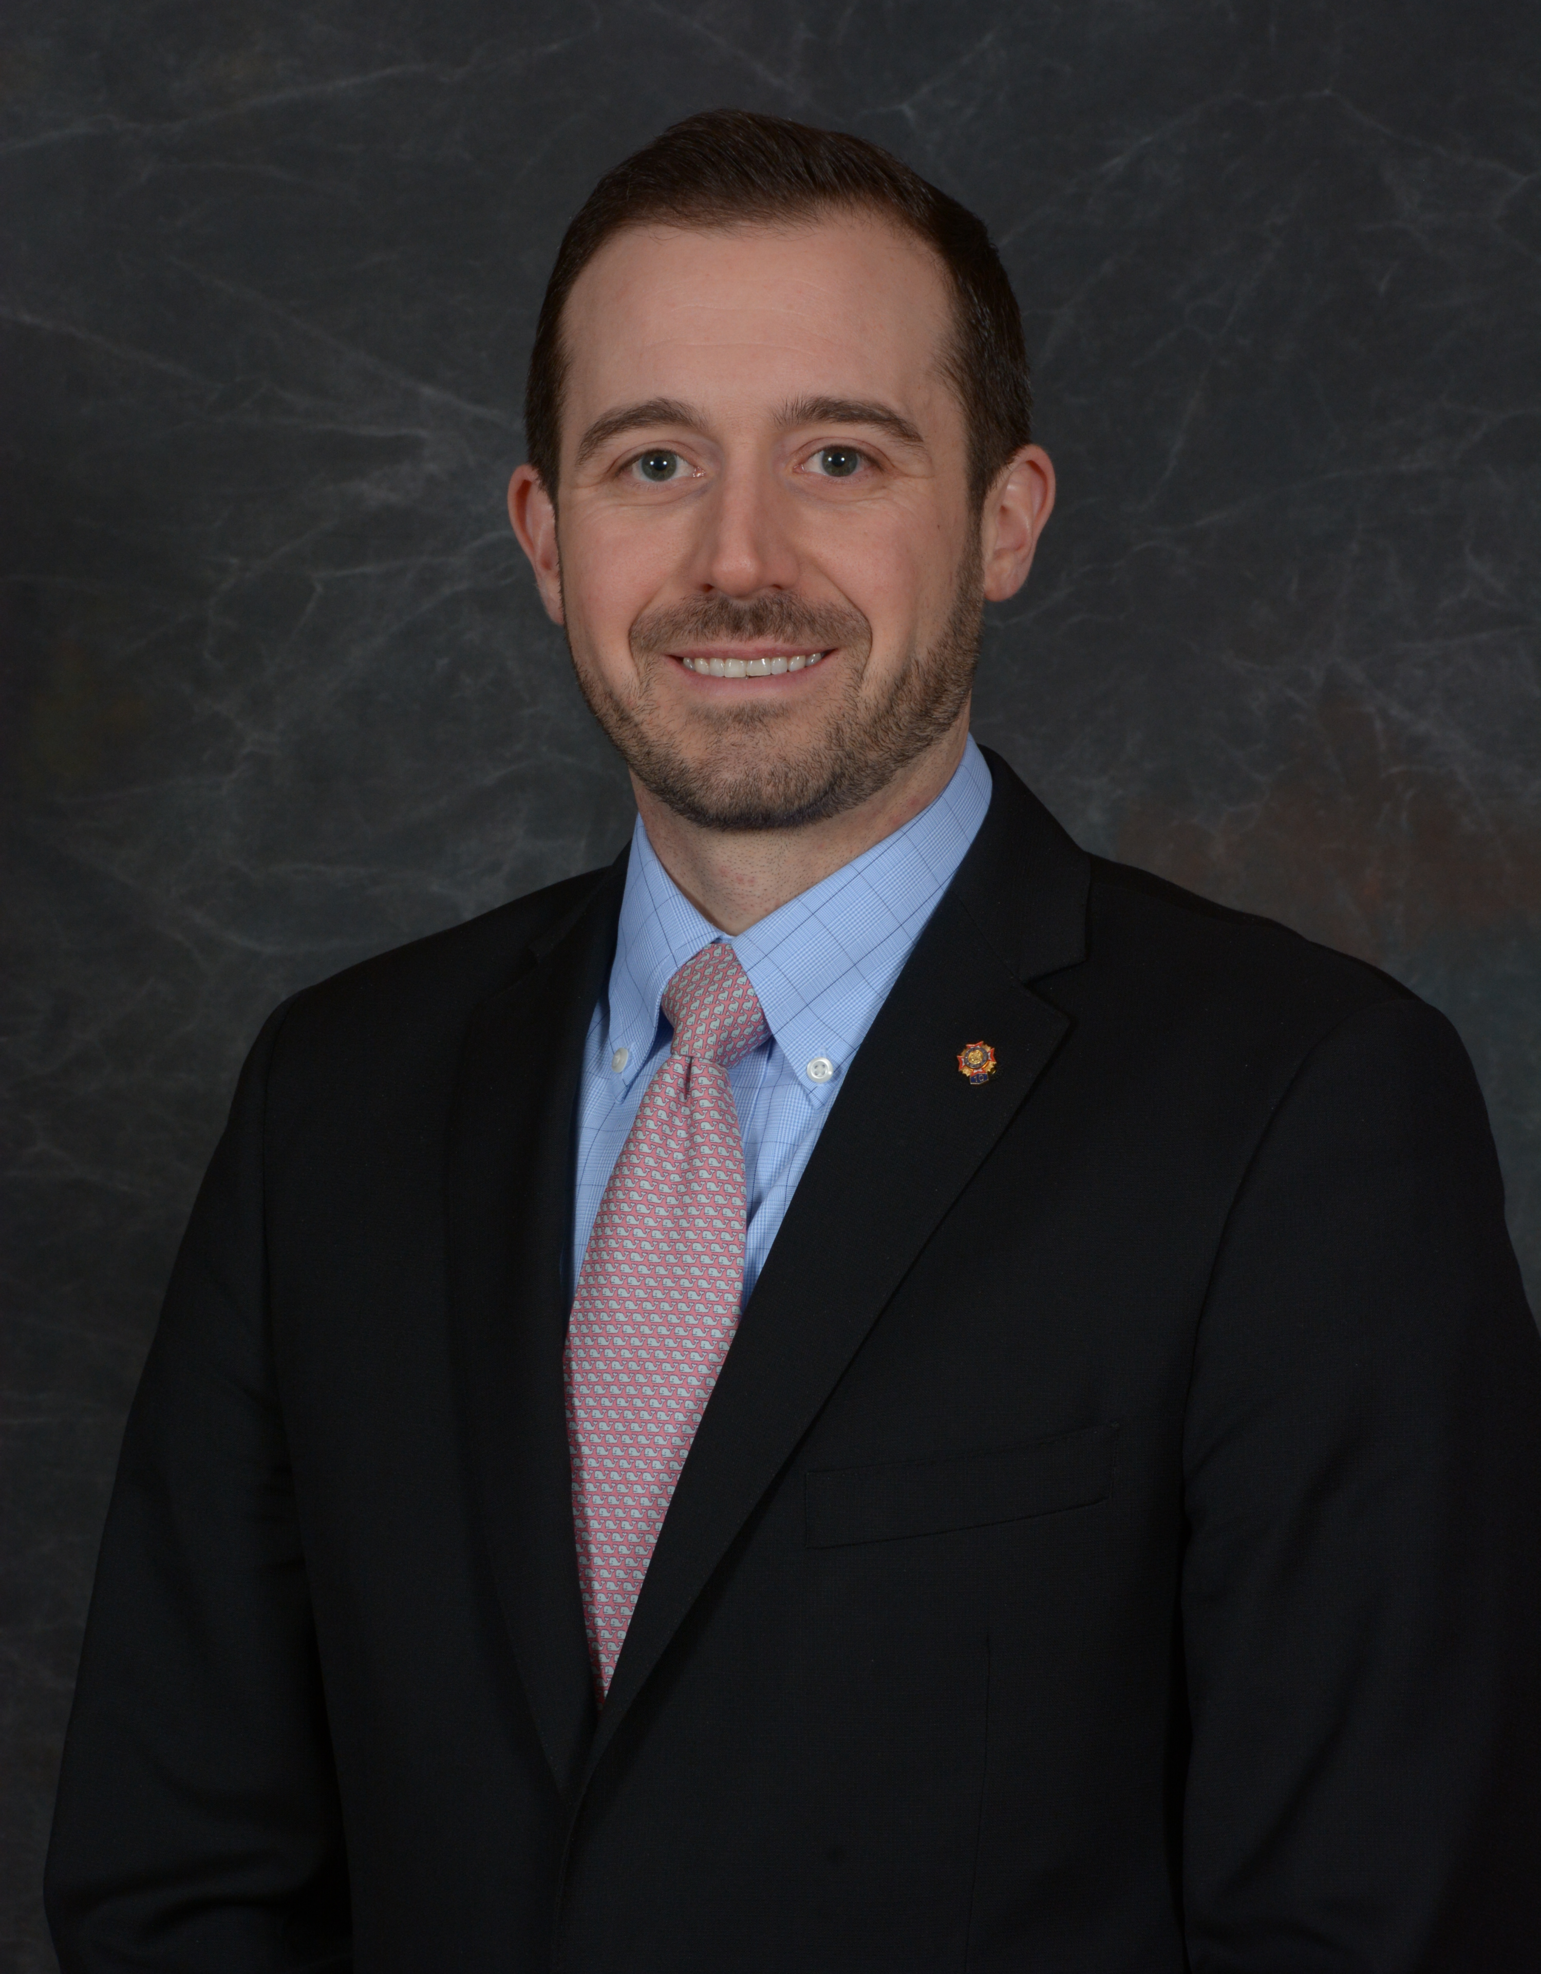
Thank you!
William J. “Doc” Schmitz Senior Vice Commander
in Chief
Robert E. Wallace
Assistant Adjutant General and Executive Director
Ryan Galluci
Deputy Director
And……to the 200 VA-accredited Veteran Service Officers here today, the 2,100 VSOs from around the country, and all the VFW local chapters
3

Slide 4

Veterans of Foreign Wars
The foremost organization representing the military and Veteran community for the past 100 years
Long history of service and caring for our Nations Veterans
Educating and informing Members of Congress and their staffs on the unique needs of the military and Veteran community
4

Slide 5
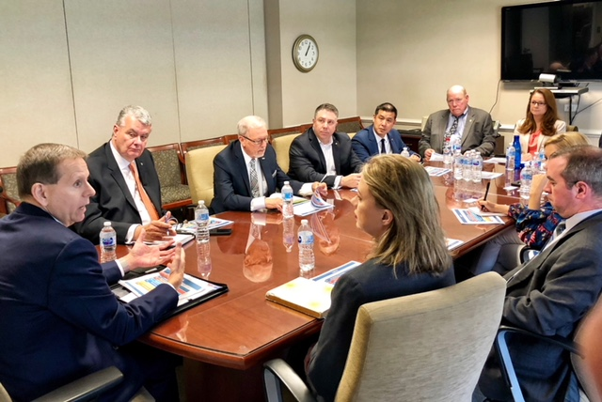
Importance of Collaboration
5

Slide 6
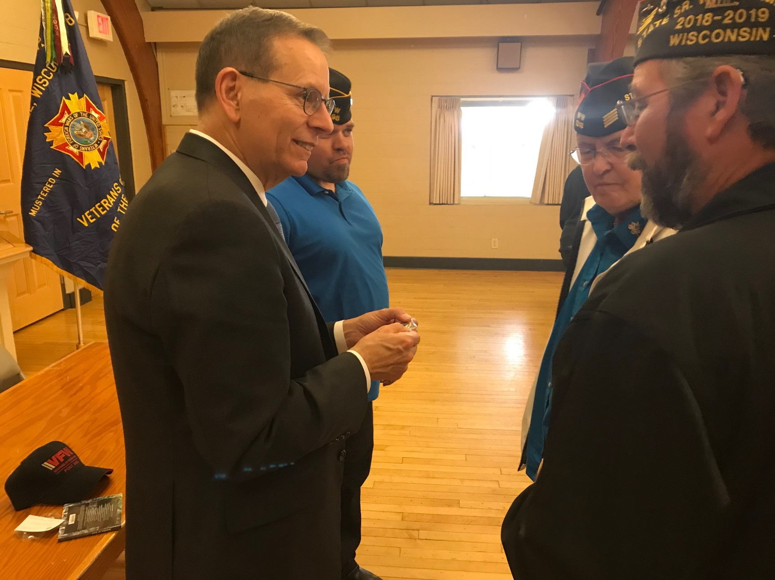
Regular Visits to Posts Around the Country
6

Slide 7

Claims Clinics

Slide 8
VBA Priorities
VFW’s partnership is critical to meeting our shared goal of serving Veterans
One of the largest membership bases of all VSOs
VFW service officers are intricately involved in our claims process

Slide 9


VBA Priorities
Provide Veterans with the benefits they have earned in a manner that honors their service
Ensure we are strong fiscal stewards of the money entrusted to us
Foster a culture of collaboration

Slide 10


VBA Overview
The mission of the Veterans Benefits Administration is to serve as a leading advocate for Service members, Veterans, their families and survivors, delivering benefits and services that honor their service, assist in their readjustment, enhance their lives, and engender their full trust.
56
REGIONAL OFFICES
39
OTHER SPECIAL PROCESSING AND
CALL CENTERS
$29B
IN BENEFITS DISTRIBUTED IN FY19 Q2
24,143 EMPLOYEES
57% VETERANS
540
INTAKE SITES, OUT-BASED FACILITIES, VETSUCCESS ON CAMPUS SITES, AND VR&E OFFICES

Slide 11










VBA Business Lines
Education
Compensation
Insurance
“ To care for
him who shall have
borne the battle and for his widow, and
his orphan.”
Appeals
Pension & Fiduciary
Home Loan Guaranty
Vocational Rehabilitation & Employment
Transition & Economic Development

Slide 12
Compensation
FY19 Q2 Results:
Disability Compensation is a monthly, tax-free benefits to eligible Veterans in recognition of the effects of disabilities, diseases, or injuries incurred or aggravated during active military service.
COMPENSATION RESULTS
FY19 Q2
Target
Program Highlight
Effective April 1, 2019, VBA began providing priority disability claims processing for initial claims from discharged combat Veterans awarded the Purple Heart Medal.
Veterans Served
4.8M
-
Dollars Paid
$21.7B
-
Claims Completed
263.7K
326.5K
Average Days to Complete
127.8
125
Unexpected technology issues and Appeals Modernization impacted claims.
Issues Per Claim
5.5
-
Issues Completed
1.4M
-
Focused on completing oldest claims in the inventory.
Issue Quality
95.4%
96.0%

Slide 13
Independence Day Veterans Claims Challenge
When: May 6 thru June 30th
Who: Rating Claims Processing Team
What: Complete significantly more claims in this period than every before (9 in 8)
Reward: One day time off grant for Friday,
July 5th

Slide 14
Appeals
FY19 Q2 Results:
The modernized decision review process is in place for Veterans and other claimants who disagree with VA’s decision on their claim. This applies to decisions made on or after February 19, 2019. Claimants have a choice of three review lanes (Supplemental Claim, Higher-Level Review, or Appeal to the Board of Veterans’ Appeals).
Program Highlight
In February 2019, VBA stopped accepting RAMP election forms; however, Veterans in the legacy process may still opt into the modernized process at certain decision points.
APPEALS RESULTS
FY19 Q2 Actual
FY19 Q2
Projected Inventory
VBA Legacy Appeals Inventory
267K
264K
VBA remains committed to eliminating all non-remand legacy appeals in FY 2020.
Actual appeals inventory was higher than projected due to a technical glitch in mail processing.

Slide 15
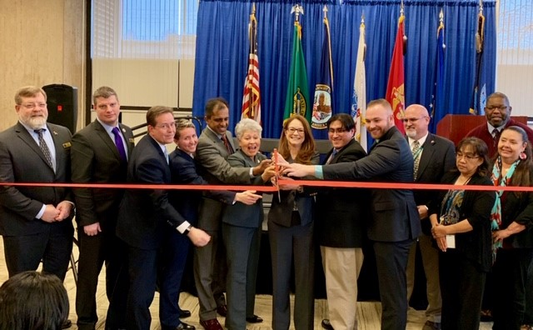
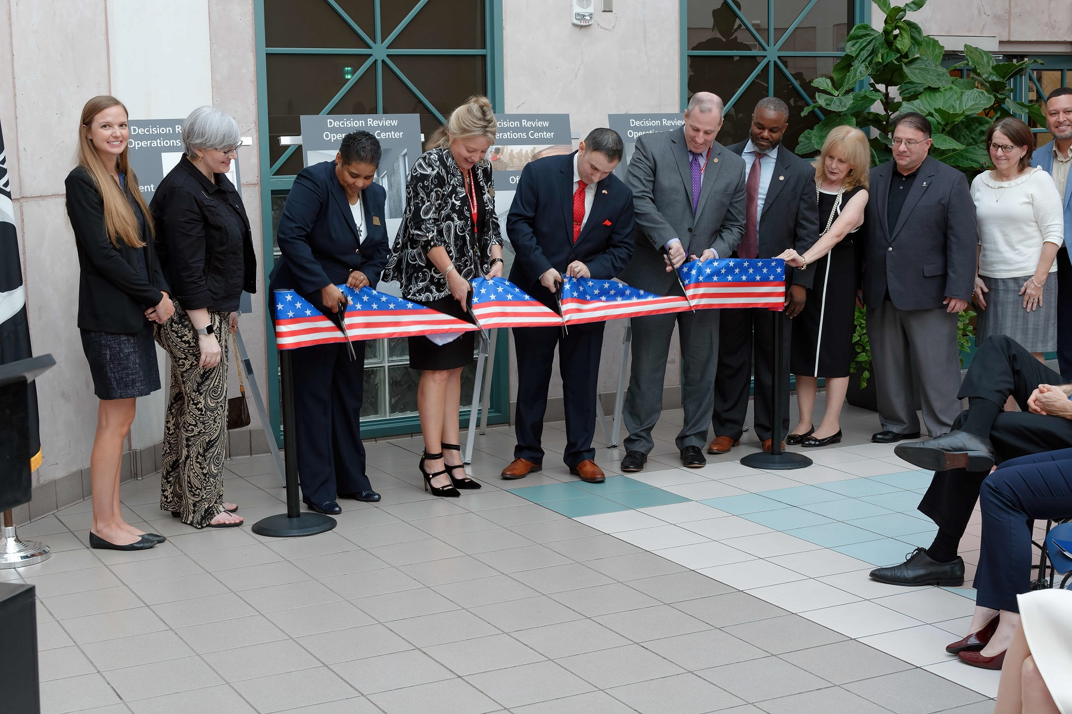
Appeals Modernization
First 50 Days of Appeals Modernization Act
Progress
Challenges
AMA work distributed as intended through National Work Queue.
DROCs are working Higher-Level Reviews (HLRs) as claims are established.
Total established AMA claims: 5,632.
Average Days to Complete HLRs: 27.8.
Average Days to Complete Supplemental Claims by Veterans Service Centers: 24.7.
Data as of April 9, 2019.
Change management challenges around new process changes.
Higher-level review filings lower than expected (21% of established claims).
All remaining RAMP workload being assigned to DROCs.
New Decision Review
Operations Centers Celebrate the Launch

Slide 16
Vocational Rehabilitation & Employment
FY19 Q2 Results:
The VR&E Program assists Service members and Veterans with service-connected disabilities and an employment handicap prepare for, find, and maintain suitable careers, or maintain a life of independence.
VR&E employs over 1,000 professional vocational rehabilitation counselors and delivers services through a network of over 350 office locations, including 104 VetSuccess on Campus (VSOC) schools/sites.
VR&E PROGRAM RESULTS
FY19 Q2
Target
Program Highlights
Tele-counseling:
An option for Veterans to virtually connect with a VR&E counselor.
Appointments with beneficiaries average over 1,000 per month.
Positive Outcomes
(Employment, Independent Living, Persisting in School)
4,046
3,886
Total Counselors Hired
160
169
Still on track!

Slide 17
VR&E Modernization
Comprehensive multi-year modernization effort:
Modernize antiquated legacy systems (Case Management System/e-Folders/e-Invoicing).
Increases access to Veteran case files and moves VR&E toward a paperless work environment.
Streamline processes (Centralized Mail/Active Folder Scan).
Streamlines the receipt, processing, and filing of mail.
Increase the responsiveness of the Veteran experience (Virtual Assistant).
Enables communication with Veterans through text message or e-mail.
Tele-counseling provides an option for Veterans to connect with their VR&E counselors from virtually anywhere:
Veterans can use from any mobile or web-based device (desktop, smartphone or tablet).
Uses encryption to ensure a secure and private session.
Appointments are more convenient, reduces the travel time for Veterans, especially in rural areas.

Slide 18
Forever GI Bill
Forever: Makes the Post 9/11 GI Bill a lifetime benefit – does away with 15-year limit (for Veterans discharged after Jan. 1, 2013)
Restoration: Since passage, VA has notified over 9,500 Veterans affected by school closures and restored over 15,000 months of entitlement so they can get back to school
New & expanded benefits:
Veteran Employment Through Technology Education Courses (VET TEC) is deigned to give Veterans an edge in the high tech job market
Additional benefits for STEM Education – up to nine extra months of benefits (not exceeding $30,000) if you meet the criteria

Slide 19
Our Common Goals
VFW
Modernize VA
VA Secretary Wilkie
“Biggest transformation of VA since General Bradley’s time”
19

Slide 20

Mission Act
Significance
Puts Veterans at the center of health care
Gives flexible access
Features
Strengthens VA’s ability to recruit and retain clinicians
Expands eligibility for caregiver services to all eras of Veterans
Creates ability for VA to match infrastructure to Veteran needs
Establishes a VA Center for Innovation for Care and Payment
Establishes access to urgent care in the community
WHAT IT IS NOT: “PRIVATIZATION”

Slide 21
Electronic Health Records
VA Secretary Wilkie – “not my father’s record”
Significance
VA will have one electronic health record shared across VA/DOD
This is a big deal
Features
Consolidated record with DoD, streamlining our exchange of information
Will drive consistent business practices across VA – a feature of high-reliability organizations
Resource-based scheduling will improve wait times, Veteran satisfaction and reduce scheduling errors
Expected to take up to 10 years to fully implement

Slide 22
Blue Water Navy
Procopio v. Wilkie – The intent of Congress was that the definition of the Republic of Vietnam extends 12 nautical miles from shore.
We are currently:
Analyzing policies and developing procedures.
Identifying affected populations and their eligibility to benefits and healthcare.
Developing a robust outreach and communications plan.
Much is still in progress.
We will keep you informed of updates.

Slide 23
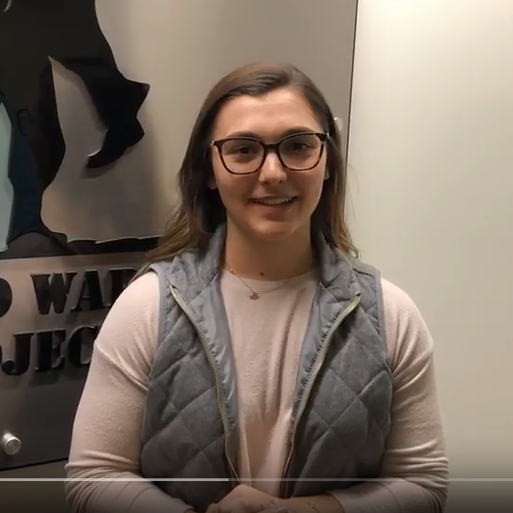
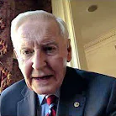

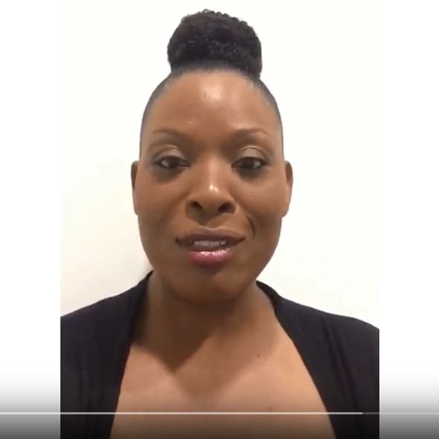
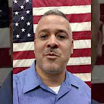
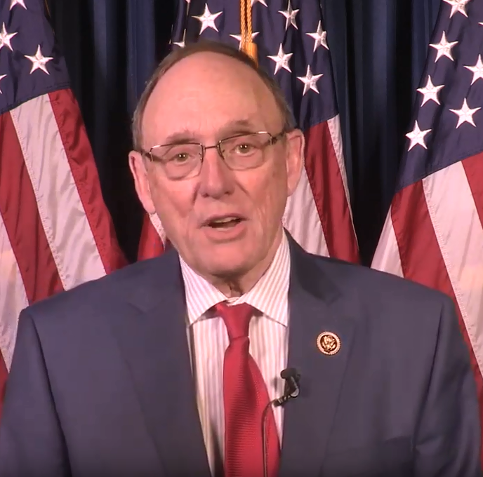
Celebrating the 75th Anniversary of the GI Bill: Share Your GI Bill Story!
Request: Share Your GI Bill Story
Tell us how the GI Bill helped you get an education, buy a home, or impacted your life.
Record a video and send it to us!
We’ll be featuring stories through June 22, 2019 as VA celebrates this important milestone.
Post your video at benefits.va.gov/gibill75

Slide 24
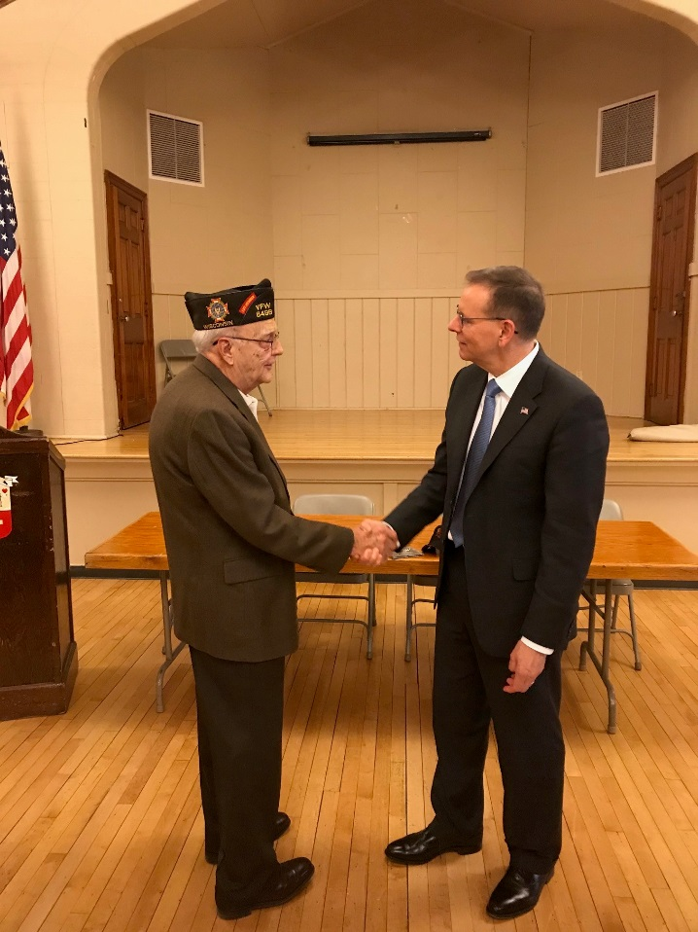
What Others Are Saying
Partnership for Public Service – VA is one of the best places to work
Dartmouth Report - VA healthcare is as good, or better, than any care
The Journal of the American Medical Association - wait times at VA hospitals are now shorter than private sector.
Service to Citizens Awards – 11 VA leaders and staff recognized
24

Slide 25
Some Important Facts
VA is the largest integrated medical system in the U.S.
Health Care enrollees – 9 million
Appointments per day – 163 K
Doctors in Residence (training) – 123 K
Benefits – more than $100 billion, efficiently administered
25

Slide 26
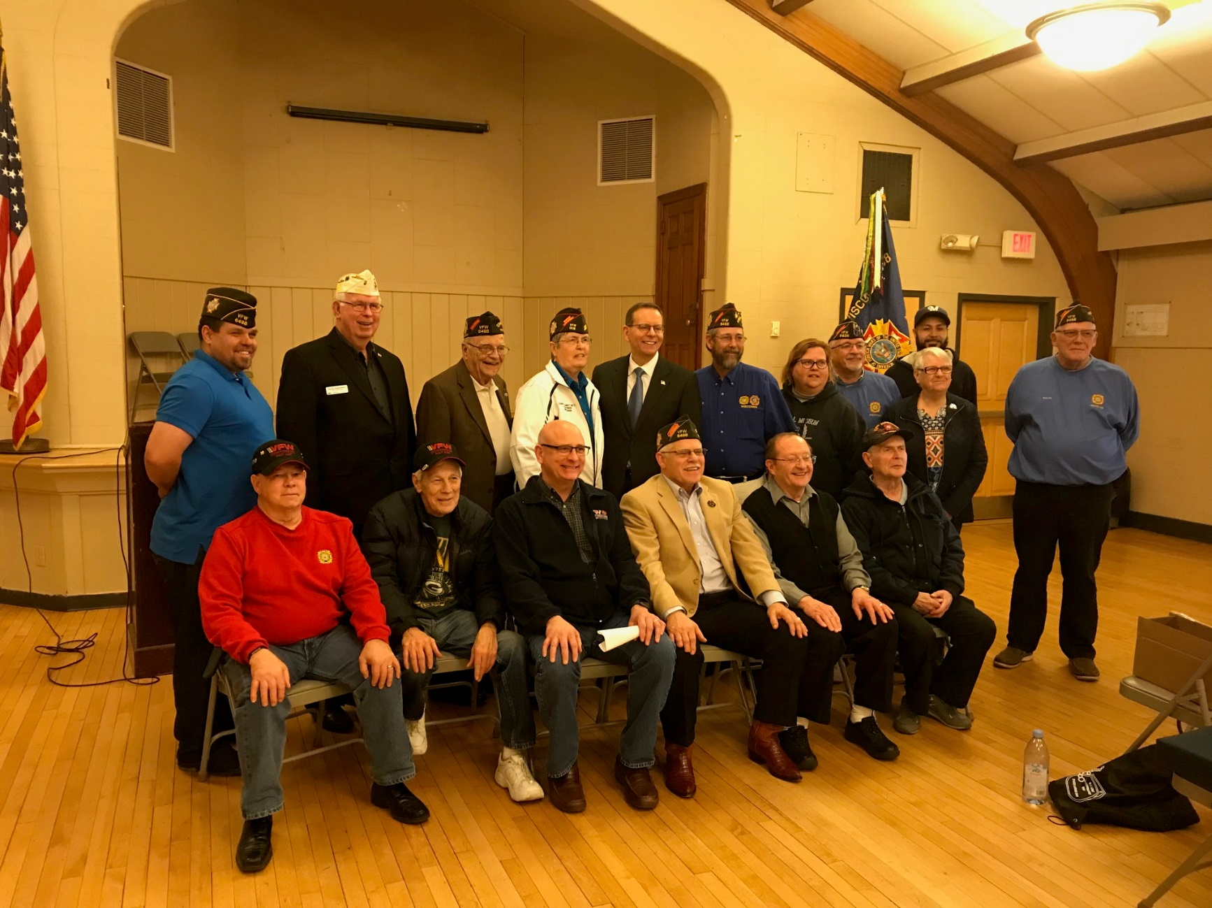
Questions?

Slide 27


