Slide 1
38 CFR Part 4
Schedule for Rating Disabilities
Notes:
These slides cover almost all of Part 4.
wanted you to have slides as reference, but not going to speak to every one of them.

Slide 2
OVERVIEW
This Class is designed to be a general overview and summary of 38 CFR Part 4
You do not need to memorize the regulations
By the end of this session you will understand VA math
After the session we will use the breakout rooms to practice VA Math
Notes:
Means 4.28, Prestabilization ratings from date of dc from service
4.29 Ratings for s/c disabilities requiring hospital treatment or observation
4.30 Convalescent ratings
Will discuss with the 100% rating regulations

Slide 3
SUBPART A
GENERAL POLICY IN RATING
38 CFR 4.1-38 CFR 4.31

Slide 4
§ 4.1 ESSENTIALS OF EVALUATIVE
RATING
  Explains the purpose of the rating schedule including that rating percentages represent the Average Impairment of Earnings Capacity resulting from disabilities or diseases
  Also explains that accurate Medical Exams are Required to determine the limitation of activity imposed by the disabling condition and that all evaluations must be viewed in relation to its history
Notes:
-Guide
-to apply this accurate and descriptive exams are needed-DBQ
look at limitation of activity
-Conditions wax and wane (Totality)

Slide 5
§ 4.3 RESOLUTION OF REASONABLE DOUBT
  “When after careful consideration to all procurable and assembled data, a reasonable doubt arises regarding the degree of disability such doubt will be resolved in favor of the claimant”
  One small paragraph, one giant effect!
  Does NOT mean that the VA is required to prove the disability is not related to service
  Require a relatively equal balance of positive and negative evidence (equipoise)
  Refer to 38 C.F.R. 3.102
Notes:
Have students open CFR and read it
3.102 Broad interpretation - consistent with the facts
evidence in equipoise
resolve in favor of veteran

Slide 6
§ 4.6 EVALUATION OF EVIDENCE
  This regulation explains that all evidence that is part of the claim must be thoroughly evaluated and considered prior to rendering a decision
Notes:
Discussed in VA exams class – skip over quickly

Slide 7
§ 4.7 HIGHER OF TWO EVALUATIONS
  “Where there is a question as to which of two evaluations shall be applied, the higher evaluation will be assigned if the disability picture more nearly approximates the criteria required for that rating. Otherwise the lower rating will be assigned.”
    Arguably the most arguable regulation!
    Arbitrary - allows for assigning either a higher, or lower evaluation???
    Example:
    A veteran has a disability with symptoms that warrant both a 30% and 40% rating. The rater should look at which rating most closely resembles the current severity of the disability and assign that rating percentage
Notes:
If there is question
Most nearly approximates

Slide 8
§ 4.9 CONGENITAL DEFECTS
  Congenital or developmental defects are NOT normally compensable or service-connected!
  But… Is there a way???
Notes:
Absent, displace or super-numerary parts, refractive error, personality disorder, mental deficiency
Brad discussed yesterday – aggravation

Slide 9
§ 4.10 FUNCTIONAL IMPAIRMENT
  The basis of an evaluation is the ability of the body, as a whole, to function under ordinary conditions of daily life.
  Regardless of the body system affected, evaluations are based on the usefulness of the affected body part or system
  The examiner must provide a full description of the effects of the disability on the veteran’s ordinary activity to include employment
  Must be remembered that although the veteran may be up and about or can function at home, they still may be too disabled to maintain employment
Notes:
ROM-LOM
Based on lack of usefulness
Examiner’s responsibility-etiological, anatomical, pathological, laboratory, and prognostic data. Full description of the effects of the disability on ADL/employment

Slide 10
§ 4.13 EFFECT OF CHANGE OF DIAGNOSIS
  This regulation explains that if the medical evidence shows that a change in diagnosis could be assigned it must be an actual medical change based on the symptoms not on the interpretation or thoroughness of the examiner
  Repercussions of change
  This regulation is often used when rating mental health disorders (38 CFR 4.125)
  Ensure any changes in diagnosis align with 38 CFR 4.7
Notes:
Cannot be changed simply for provider preference,
not based on the difference in thoroughness of an exam or use of descriptive term.
Must be justified or explained
4.125 B Have students open CFR and read it
4.7 Higher of two evaluations

Slide 11
§ 4.14 AVOIDANCE OF PYRAMIDING
  VA will not rate the same disability or symptom more than once
  Pay close attention to which symptoms relate to each disability as many body systems overlap and symptoms can often relate to more than one disability
  Special rules (exemptions) are in the Rating Schedule
  NSC versus SC etiologies
  VA is very aware of this rule!
Notes:
Avoid same disability under various diagnosis
Look at note in 4.71a The Elbow and Forearm after DC 5213 (pg 410)
Dyspnea, tachycardia, nervousness, fatigability have many causes
Don’t use symptoms/diagnosis from NSC and SC to determine rating.

Slide 12
§ 4.15 TOTAL DISABILITY RATINGS
  Disabilities can affect people differently
  Ratings are based on the average impairment of earning capacity – not the individuals success in overcoming it
  Individual success should still be measured as the VA can use it to determine a rating if the veteran does not have the average amount of success overcoming or adapting to the disability
    Total Disability (P&T) Ratings – Disability is severe enough to prevent an average person from securing or maintaining employment
    A total disability rating does not mean that the veteran is not allowed to work
Notes:
Impairment of mind or body sufficient to render it impossible for the average person to obtain and sustain substantially gainful employment.
LOU both hands or feet or one of each or both eyes or permanently helpless or bedridden or as found in rating schedule.
Looking at LOU you have to keep in mind SMC, which can be given concurrently with the 100% for additional benefit. …you will go more in-depth on SMC in the May class

Slide 13
§ 4.16 TOTAL RATINGS BASED ON
INDIVIDUAL UNEMPLOYABILITY
Compensation will be paid as if the veteran was rated 100% disabled if it is shown that service connected disabilities prevent the veteran from securing or maintaining substantially gainful employment.
The VA must find that the veteran is unable to work due to service-connected disabilities.
It is not sufficient to state that the veteran is unemployable due to nonservice-connected disabilities.
To qualify for TDIU a veteran must have:
A single disability evaluated at 60% or more (can be multiple disabilities based on the same etiology)
or
Two or more disabilities that equal a combined 70% and at least one 40% rating
An extra-schedular evaluation can be granted if a veteran has an exceptional or unusual disability picture due to marked interference with employment or frequent periods of hospitalization which are not reflected by regular schedular standards.
Notes:
60
70 w/40
Same etiology
In action or as a POW
Marginal employment does count.
If not met by scheduler rating consider requesting extra-scheduler can be granted in fact. Will look at s/c disability, employment history, educational and vocational attainment.

Slide 14
§4.18 UNEMPLOYABILITY
A veteran may be considered unemployable upon termination of employment provided the termination was due to a disability
For amputations, sequelae of fractures, and other residuals of traumatism that are static, a veteran can show continuous unemployability from date of incurrence or stabilization
May be attributed to a static disability
Increase in severity of combined service connected and non-service connected disabilities, §4.16 should be considered
Notes:
Of FACT

Slide 15
§ 4.17A MISCONDUCT ETIOLOGY
  The regulation explains that a veteran can still obtain a permanent and total disability even if they acquired a disability due to willful misconduct as long as:
  (a) The veteran has innocently acquired 100 percent disability
  (b) The veteran has other disabilities innocently acquired that render them unemployable

Slide 16
§4.19 AGE IN SERVICE-CONNECTED CLAIMS
May not be used
  deciding service-connected disability or unemployability
  as a basis to grant a total disability rating
Age can be a factor in evaluations of disability not resulting from service (Non-Service Connected Pension)

Slide 17
§4.27 USE OF DIAGNOSTIC CODE NUMBERS
Arbitrarily assigned for showing the basis of the evaluation and statistical analysis by the VA
No other numbers may be assigned with the exception of analogous diagnostic codes (§4.20)
Injuries will be represented by the number assigned to residuals conditions
Diseases assigned with preference given to the disease itself
Notes:
Rheumatoid Arthritis rated as ankylosis of the lumbar spine is coded “5002-5240”
The exact source of each rating can be easily identified
In citing disabilities on rating sheets, the diagnostic terminology will be that of the medical examiner with no attempt made to translate the terms into schedule nomenclature

Slide 18
§4.20 ANALOGOUS RATINGS
An Analogous Rating will be assigned if the veteran has a disability that is not listed in the rating schedule
The unlisted disability will be rated under diagnostic codes for a closely related disease or injury
Instead of a 4 number code, the code will have 2 sets of 4 digits
The first code identifies the body system, the second code is the closest related disability
Analogous ratings are not used for organic diseases/functional disorders
Notes:
An organic disease is one which involves or affects physiology or bodily organs. A disease in which there is a physiological change to some tissue or organ of the body.
Organic disease may also be used to mean a condition that is not caused by an infection.
Kidney disease
Ischemic heart disease
COPD
A functional disorder is a medical condition that impairs the normal function of a bodily process, but where every part of the body looks completely normal under examination. Examples are:
irritable bowel syndrome
headache, migraine, stress headache, benign headache
chronic pain syndrome
chronic low back pain/fibromyalgia
chronic fatigue syndrome
post-traumatic stress disorder
Part 4 body systems, 65 identifies diseases of the Nose and Throat, 99 identifies it as analogous. 6516 is the most closely related criteria (chronic laryngitis)

Slide 19
COMMON ANALOGOUS CODES
Arthralgia 5099-5003 (arthritis)
Chondromalacia patellae 5099-5014 (osteomalacia)
Pneumonia 6899-6845(restrictive lung disease)
Mitral valve prolapse 7099-7000 (valvular heart disease)
Gastroenteritis 7399-7307 (gastritis)
Crohn’s Disease 7399-7323 (ulcerative colitis)
Colostomy 7399-7333 (rectum and anus stricture)
Shingles/folliculitis 7899-7806 (dermatitis or eczema)
Carpal tunnel syndrome 8599-8515 (median nerve paralysis/incomplete paralysis)

Slide 20
§4.21 APPLICATION OF RATING SCHEDULE
Used to sufficiently identify disease/disability
Establishes criteria to ascertain level of disability or functional impairment
Does not include all disabilities (analogous)
Organized by body system in ranges from 0 to 100%

Slide 21
§4.28 PRE-STABILIZATION RATING FROM DATE OF DISCHARGE FROM SERVICE
VA can assign a 50% or 100% rating to veterans for 12 months who were recently discharged and have a disability that is still healing or not yet stable
Unstabilized condition with severe disability— Substantially gainful employment is not feasible or advisable = 100%
Unhealed or incompletely healed wounds or injuries— Material impairment of employability likely = 50%
Not to be assigned in lieu of a total rating or TDIU
Pre-stabilization 50% rating is not to be used in any case in which a rating of 50% or more can be assigned under regular provisions
Notes:
Note (1): Department of Veterans Affairs examination is not required prior to assignment of prestabilization ratings; however, the fact that examination was accomplished will not preclude assignment of these benefits. Prestabilization ratings are for assignment in the immediate postdischarge period. They will continue for a 12-month period following discharge from service. However, prestabilization ratings may be changed to a regular schedular total rating or one authorizing a greater benefit at any time. In each prestabilization rating an examination will be requested to be accomplished not earlier than 6 months nor more than 12 months following discharge. In those prestabilization ratings in which following examination reduction in evaluation is found to be warranted, the higher evaluation will be continued to the end of the 12th month following discharge or to the end of the period provided under §3.105(e) of this chapter, whichever is later. Special monthly compensation should be assigned concurrently in these cases whenever records are adequate to establish entitlement.
Note (2): Diagnosis of disease, injury, or residuals will be cited, with diagnostic code number assigned from this rating schedule for conditions listed therein.

Slide 22
§4.29 HOSPITALIZATION
100% rating will be assigned for hospitalization for SC disability for a period in excess of 21 days
Temporary release approved by a VA doctor as part of treatment will not be considered an absence
If convalescence is required may be continued for an additional 1-3 months
Additional periods may be approved by the Veterans Service Center Manager (VSCM)
Notes:
Hospitalization is deemed to be a VA hospital or a VA approved hospital
Rate is effective the first day of continuous hospitalization and terminated effective the last day of the month of discharge (regular discharge or non bed care) or effective the last day of the month of termination of treatment or observation
Additional periods of 1-3 Months beyond the initial 3 months may be authorized

Slide 23
§4.30 CONVALESCENT RATINGS
Total ratings will be assigned if convalescence is required or surgery with severe postoperative residuals
Immobilization by cast without surgery of one or more major joints
Extensions of 1-3 months beyond the initial 3 months may be made
Extensions of 1 or more months up to 6 months beyond the initial 6 months may be made by the VSCM
Notes:
Total ratings will be assigned if claimant had surgery requiring at least one month convalescence or surgery with severe post operative results

Slide 24
§4.31 ZERO PERCENT EVALUATIONS
Every service connected condition can be granted a 0% rating if the criteria for the minimum compensable rating is not met
This means that if the veteran has a diagnosed disability that is related to service but does not have severe enough symptoms to warrant the minimum rating in the schedule, VA can assign a 0% rating

Slide 25
38 CFR Part 4
Subpart- B
Disability Rating
§4.40 - §4.150

Slide 26
§4.40 FUNCTIONAL LOSS
Functional loss is the inability to perform the normal working movements of the body and is determined by:
  Strength
  Speed
  Coordination
  Endurance
  Weakness and Limitation of Motion are both important

Slide 27
§4.40 FUNCTIONAL LOSS
  DeLuca v. Brown, 8 Vet.App. 202 (1995)
  States that if a veteran has a disability of a joint that is painful upon motion or repetitive use, VA should assign the minimum compensable rating or increase the rating by one level if the veteran is already entitled to a compensable rating.

Slide 28
§4.41 HISTORY OF INJURY
  Residuals of an injury
  Mechanism of Injury
  Treatment
    Effectiveness
    Duration
    The absence of clear cut evidence of injury, may reflect congenital or developmental etiology, or the effects of a healed disease

Slide 29
§4.42 COMPLETE MEDICAL EXAMINATION
OF INJURY CASES
Must include all systems of the body affected
  General examination
  Complete Neurological & Psychiatric
  Special Exams as indicated
    Orthopedic
    Surgical

Slide 30
§4.43 OSTEOMYELITIS
DC 5000
  Chronic or recurring
  Considered continuously disabling
  Unless removed by amputation
  A permanent rating can be combined with other ratings for residual conditions
Notes:
Minimum rating of 10%

Slide 31
§4.44 THE BONES
  Malunion
  Disarticulation
  Shortening
    Consider strain on neighboring joints
Notes:
Especially weight bearing

Slide 32
§4.45 THE JOINTS
  Less movement
  More movement
  Weakened movement
  Fatigability
  Incoordination
  Pain
  Major Joints – Shoulder, elbow, wrist, hip, knee, ankle
  Minor Joints – Vertebrae, all smaller joints

Slide 33
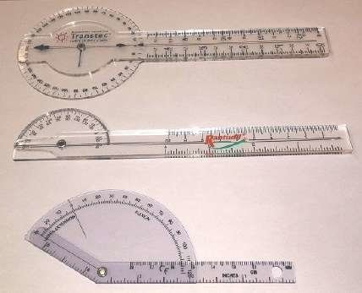
§4.46 – Accurate Measurement
Insist on accurate measurement of lengths of stumps, movement of joints and dimensions and locations of scars
If an examination does not have accurate measurements, it’s inadequate!
Joint movement is measured by a Goniometer

Slide 34
§4.55 PRINCIPLES OF COMBINED RATINGS
FOR MUSCLE INJURIES
  38 CFR §4.73 – Schedule of Ratings
    DC 5301-5323
  32 groups
  8 regions

Slide 35
§4.55 PRINCIPLES OF COMBINED RATINGS
FOR MUSCLE INJURIES
  Muscle Injuries ratings and Peripheral Nerve Paralysis ratings cannot be combined if they are part of the same body part unless they affect different functions
  If a joint is Ankylosed, the muscles that act on that joint will not be rated
  Exceptions: Knees, Shoulders

Slide 36
§4.55 PRINCIPLES OF COMBINED RATINGS
FOR MUSCLE INJURIES
  Multiple muscles
    Same Region but Different joint: The evaluation for the most severely injured muscle group will be raised one level and used as the evaluation for all muscle groups in the region.
    Different Region: Rate separately

Slide 37
§4.56 EVALUATION OF MUSCLE DISABILITIES
  There are 4 levels of severity for muscle disabilities:
  Severe
  Moderately Severe
  Moderate
  Slight

Slide 38
§4.56 EVALUATION OF MUSCLE DISABILITIES
When VA evaluates muscle disabilities they consider:
Cardinal signs and symptoms (S/S)
  Loss of power
  Weakness
  Lowered threshold of fatigue
  Fatigue-pain
  Impairment of coordination
  Uncertainty of movement
Type of injury
        Blunt trauma
        Gun shot
        Shrapnel
History and complaint
    Type of treatment required
    Length of treatment
Objective findings
Residuals

Slide 39
§4.56 | SLIGHT | MODERATE | MODERATELY SEVERE | SEVERE
TYPE OF INJURY | Simple Wound No Debridement | Through & through Single Bullet | Through & through Small high velocity or large low-velocity Debridement Prolonged infection Intramuscular scarring | Through & Through High-velocity Open comminuted fracture Extensive debridement Prolonged infection Sloughing of parts Intermuscular binding & scarring
HISTORY & COMPLAINT | Brief Treatment Return to Duty Good Function No Cardinal Signs | One or more cardinal S/S Lowered threshold of fatigue that affects function | Hospitalization Cardinal S/S Inability to keep up with work requirements | Hospitalization/prolonged treatment Consistent complaint of cardinal S/S
OBJECTIVE FINDINGS | Minimal scar No functional impairment No retained foreign bodies | Small linear scars Some loss of fascia or muscle Decreased power when compared to other side | Scars Loss of deep fascia/muscle Impaired strength and endurance | Scaring/Adhesions Loss of fascia or muscle Muscle(soft & flabby or hard & swollen) Impaired function X-ray evidence of Foreign Body

Slide 40
§4.57 STATIC FOOT DEFORMITIES
  Bilateral Flatfoot – Must be determined if congenital or acquired
    Congenital – Not service connected
    Acquired – Rating based on:
      Arch depression
      Calluses
      Tenderness
      Rotation
      Pain
      With regard to exercise

Slide 41
§4.58 ARTHRITIS DUE TO STRAIN
  Lower extremity amputation or shortening
  Service connection for Arthritis
    in joints under strain
    Both lower extremities
    Lumbar spine

Slide 42
§4.59 PAINFUL MOTION
Recognize painful, unstable, or malaligned joints
…at least the minimal compensable rating for that joint.
  Arthritis
  Objective pain
  Muscle spasm
    Active/Passive motion
    Weight-bearing/Non weight-bearing

Slide 43
§4.61 EXAMINATION
  Examinations for arthritis must cover all major joints
  Exception – Traumatic arthritis

Slide 44
§4.62 CIRCULATORY DISTURBANCES
  Circulatory disturbances are generally rated as phlebitis
  Pay close attention to the lower extremity in the popliteal space

Slide 45
§4.63 LOSS OF USE OF HAND OR FOOT
  No function remains
  Equally served by an amputation
  Hand - Foot
    Grasping - Balance
    Manipulation - Propulsion
  Unfavorable ankylosis
  Complete paralysis
  Special Monthly Compensation** (38 CFR 3.350)
Notes:
Explain special monthly compensation purpose: outside the rating schedule for loss of quality of life. 38 CFR 3.350.

Slide 46
§4.64 LOSS OF USE OF BOTH BUTTOCKS
  Cannot rise from sitting/stooped position without assistance
  The assistance can be from their arms, another person, or an assistive device

Slide 47
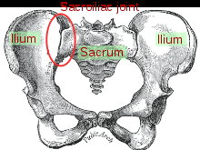
§4.66 SACROILIAC JOINT
  Lumbosacral and sacroiliac joints are considered one segment
  X-ray
  Tenderness
  Limitation of flexion and extension of hip
  Trauma is rare cause

Slide 48
§4.67 PELVIC BONES
Rate the Residuals
  Posture
  Limitation of motion
  Painful motion
  Muscle spasm
  Neuritis

Slide 49
§4.68 AMPUTATION RULE
  Combined rating of an extremity will not exceed the rating if there was an amputation at that level
  Example:
    Veteran has 5 disabilities of the left knee and ankle which when combined equal 70%
    Knee level amputation (DC 5164) is rated at 60%
    Veteran will be rated at 60%
Notes:
Below knee-40%
Above knee (middle/lower thirds) 60%
Upper 1/3 thigh 80%
Disarticulated hip 90%
Upper extremity depends on dominance

Slide 50
§4.69 DOMINANT HAND
  Determined by evidence of record or testing at VA exam
  Ambidextrous
    Can only have one dominant hand
      Injured or most severely injured is dominant
Notes:
DC 5120 (pg 405)

Slide 51
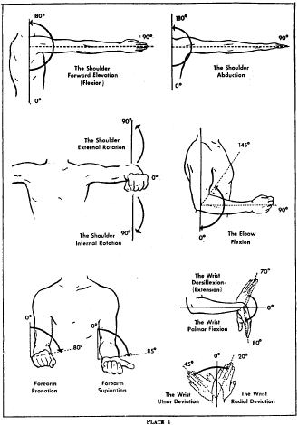
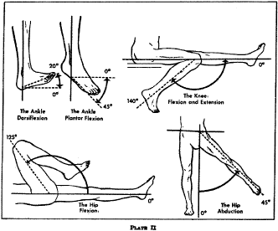
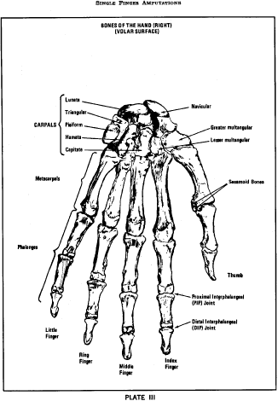
§4.71 MEASUREMENT OF ANKYLOSIS AND JOINT MOTION
Plates I and II
Plate III for fingers
Favorable or unfavorable ankylosis is determined by rating schedule
Plate II
Plate III
Plate I
Notes:
Pg 401, 402, 407

Slide 52
§4.71A- §4.150
RATING SCHEDULE

Slide 53
§4.71A & 4.73 SCHEDULE OF RATINGS-
MUSCULO-SKELETAL SYSTEM/MUSCLE INJURIES
DC 5000-5298 pertain to musculo-skeletal system
DC 5301-5329 pertain to muscle injuries
*Remember §4.56 (how to evaluate muscle injuries)

Slide 54
§4.75 GENERAL CONSIDERATIONS FOR EVALUATING VISUAL IMPAIRMENT
Visual impairment is based on impairment of visual acuity, visual field, and muscle function.
Developmental refractive errors cannot be service connected
Examination must be conducted by a optometrist or ophthalmologist and must identify the cause of any impairment
For rating purposes, if only 1 eye is service connected, the other eye will be considered 20/40
Maximum evaluation for 1 eye– cannot exceed 30% unless there is anatomical loss
Anatomical loss-no prosthesis add 10%
SMC (38 CFR 3.350)

Slide 55
§4.76 - §4.77 VISUAL ACUITY & VISUAL FIELDS
Vision examinations must include central uncorrected and corrected for distance (no glasses and with glasses)
Evaluation – if acuity falls between two ratings, give the higher one
4.76a contains graphs and charts used to determine visual fields
4.77 lists the types of authorized visual field tests, how to evaluate visual fields, and how to evaluate a combination of visual field and acuity disabilities

Slide 56
§4.78 & §4.78 MUSCLE FUNCTION and SCHEDULE OF RATINGS-EYE
4.78 Explains which tests are authorized for use and examination requirements
4.79 contains the listing of eye disabilities DC 6000-6091

Slide 57
§4.85 - §4.87 Hearing Impairment and Ears
Exams for hearing loss must be performed by an State-licensed audiologist and must include a Maryland CNC speech discrimination test
Tables VI, VIA, VII are used to determine evaluations
How to determine non-exceptional hearing loss: (DC 6100)
Step 1: Determine the puretone threshold average by averaging the loss at 1000, 2000, 3000, & 4000 Hertz for each ear
Step 2: Locate the Speech discrimination score for each ear
Step 3: Determine the roman numeral for each ear using table VI using the puretone threshold average & speech discrimination score
Step 4: use Table VII to combine the roman numerals and determine the evaluation
4.86 explains when to use table VIA for exceptional patterns of hearing loss (Severe cases)
4.87 contains the listing of ear disabilities DC 6200-6260

Slide 58
§4.87a SCHEDULE OF RATINGS-
OTHER SENSE ORGANS
Loss of Smell
  DC 6275
Loss of Taste
  DC 6276
Both are rated at 10% but can only be assigned if there is an anatomical or pathological basis for the condition

Slide 59
§4.88a CHRONIC FATIGUE SYNDROME
A diagnosis of chronic fatigue syndrome requires:
  New onset of decreased daily activity to 50% or less
  Symptoms not due to another diagnosis
  Six or more:
    Acute onset
    Low grade fever
    Headaches
    Non-exudative pharyngitis
    Tender clavicle lymph nodes
    Fatigue > 24hrs after exercise
    Muscle aches/weakness
    Migratory joint pain
    Neuropsychologic (brain function) symptoms
    Sleep disturbance

Slide 60
§4.88b – §4.89 INFECTIOUS DISEASES, IMMUNE DISORDERS, NUTRITIONAL DEFICIENCIES, & TB
4.88b contains the listing of infectious diseases, immune disorders and nutritional deficiencies DC 6300-6354
4.88c explains how to rate inactive nonpulmonary tuberculosis for veterans who become entitled after August 19, 1968 (100% for 1 year after date of inactivity then rate residuals)
4.89 explains how VA rated inactive nonpulmonary tuberculosis for veterans who become entitled before August 19, 1968 (Graduated rating scale)

Slide 61
§4.96 – 4.97 SPECIAL PROVISIONS REGARDING EVALUATION OF RESPIRATORY CONDITIONS
Explains which disabilities cannot be combined with each other
When these disabilities coexist, a single rating will be assigned using the predominant disability then that rating will be raised to the next higher level
Special Monthly Compensation may apply (3.350)
Evaluation criteria
  Pulmonary function tests
  Bronchodilators
  FVC, FEV-1
4.97 contains the listing of disabilities of the respiratory system DC 6502-6847

Slide 62
§4.100 - §4.104 CARDIOVASCULAR SYSTEM
4.100 explains how to apply diagnostic codes 7000-7007,7011, & 7015-7020
Cardiac Hypertrophy or Dilatation (determined using EKG, Echo, X-ray) and medication must be determined in all cases
  METS – Must be determined in most cases (exceptions are listed)
  LVEF testing - If not of record, alternate criteria can be used to determine severity unless the examiner states otherwise
  4.104 contains the listing of disabilities of the cardiovascular system DC 7000-7123

Slide 63
§4.110 - §4.114 DIGESTIVE SYSTEM
4.110 explains that the location of ulcers must be identified (stomach, Duodenum), and that the term “peptic ulcer” cannot be used to rate
4.111 discusses postgastrectomy syndromes specifically “Dumping Syndrome” and manifestations of hypoglycemia
4.112 Substantial weight loss: > 20% of baseline weight, for 3 months
Minor weight loss: >10-20% of baseline weight, for 3 months
Inability to gain weight: Substantial weight loss that cannot be regained
Baseline weight: Average weight for past 2 years, before problem
4.113 Watch out for pyramiding in abdominal claims
4.114 contains the listing of disabilities of the digestive system DC 7200-7354

Slide 64
§4.115 - §4.115b GENITOURINARY SYSTEM
4.115 discusses nephritis and its symptoms
Diseases of the heart & nephritis not rated separately unless there is only 1 kidney or dialysis is required
4.115a contains the ratings for dysfunctions of the genitourinary system and explains that only the predominant area of dysfunction shall be considered for rating purposes
4.115b contains the ratings for diagnoses of the genitourinary system

Slide 65
§4.116 – §4.119 GYNECOLOGICAL CONDITIONS, DISORDERS OF THE BREAST, HEMIC & LYMPHATIC SYSTEMS, SKIN, ENDOCRINE SYSTEM
4.116 contains the ratings for diagnoses of the gynecological conditions & disorders of the breast DC 7610-7632
4.117 contains the ratings for diagnoses of the hemic and lymphatic systems DC 7702-7725
4.118 contains the ratings for diagnoses for skin conditions DC 7800-7833
Review of rating for DC 7800,7801,7803,7804,& 7805 before October 23, 2008
4.118 contains the ratings for diagnoses for endocrine conditions DC 7900-7919 (Type 2 Diabetes)
Notes:
Note: SMC (k) may apply for FSAD, loss of ovaries/hysterectomy, loss of breast tissue

Slide 66
§4.120 – §4.124a Neurological Conditions
4.120 Explains the different symptoms that must be considered and used to rate neurological conditions in proportion to impairment
  Refer to the appropriate schedule
4.121 explains that seizures must be witnessed or verified by a physician; frequency and effect can be by lay testimony
4.122 gives a description of psychomotor epilepsy and notes that seizures and chronic psychiatric disturbances are not uncommon

Slide 67
§4.120 – §4.124a NEUROLOGICAL CONDITIONS
4.123 discusses cranial or peripheral neuritis which is characterized by loss of reflexes, muscle atrophy, sensory disturbances, and constant pain at times excruciating. If there are no organic changes the highest rating is moderate, for sciatic nerve w/o organic change moderately severe
4.124 Explains that neuralgia is to be rated according to the nerve affected and is characterized by dull intermittent pain. It is rated according to the nerve affected
4.124a contains the ratings for neurological conditions DC 8000-8914

Slide 68
§4.125 DIAGNOSIS OF MENTAL DISORDERS
Diagnosis must conform to DSM-5 criteria
If a diagnosis is changed the rater must determine if it is:
  Progression of prior diagnosis
  Correction of an error
  Development of a new/separate condition
Notes:
4.125-4.130

Slide 69
§4.126 EVALUATION OF DISABILITY
FROM MENTAL DISORDERS
Rater must consider full picture of disability
  Frequency, severity, duration of symptoms
  Length of remissions
  Consider social impairment
  Neurocognitive disorders (head injuries) will be rated separately and combined with evaluation
  If rated as both physical and mental disorder the more dominant condition DC is utilized

Slide 70
§4.127 INTELLECTUAL DISABILITY (INTELLECTUAL DEVELOPMENTAL DISORDER) & PERSONALITY DISORDER
Not diseases or injuries for service connection
Consider aggravation §3.310(a)
Mental disorder superimposed may be service connected

Slide 71
§4.128 CONVALESCENCE RATINGS FOLLOWING
EXTENDED HOSPITALIZATION
Mental disorder at 100% due to continuous hospitalization, lasts 6 months or more
Must continue the 100% indefinitely until improvement is shown
Evaluation 6 months after release and may be decreased in accordance with §3.105(e)

Slide 72
§4.129 MENTAL DISORDERS DUE TO TRAUMATIC STRESS
If discharged due to this
  Service connect at no less than 50%
  Re-examination within 6 months

Slide 73
§4.130 SCHEDULE OF RATINGS – MENTAL DISORDERS
The General Rating Formula for Mental Disorders is used to rate all mental health conditions except for eating disorders
Pay close attention to symptoms when determining ratings

Slide 74
§4.150 SCHEDULE OF RATINGS-
DENTAL & ORAL CONDITIONS
4.150 contains the listings for Dental and Oral conditions DC 9900-9918
Separately evaluate loss of vocal articulation, loss of smell, loss of taste, neurological impairment, respiratory dysfunction, and other impairments under the appropriate diagnostic code and combine under §4.25 for each separately rated condition

Slide 75
APPENDIX A-TABLE OF AMENDMENTS & EFFECTIVE DATES SINCE 1946
APPENDIX B- NUMERICAL INDEX OF DISABILITIES
APPENDIX C- ALPHABETICAL INDEX OF DISABILITIES
Part 4 Appendices
Notes:
Note: Lexis-Nexis book of Veterans Laws, Rules and Regulations has a different order to it and does not have all table of contents.

Slide 76

VA MATH

Slide 77
VA MATH CONCEPT
VA does not add disability ratings together, rather they combine the disabilities using the combined ratings table
To help understand the concept of VA Math think of a sale:
  A shirt costs $100 regular price
  The store advertises 50% off – The new price is $50
  The store takes off an additional 50% – New price is $25 you save 75% total
  Why? Because you take the additional percentage from what’s left of the original price
  The veteran is the original price, the disabilities are the sale, and the total saved is the combined rating
Notes:
Once the rating values are “used” to add the bilateral factor, they cannot be used again. Make a list and cross them off, then combine the remaining evaluations in order of severity.
ALWAYS compute bilaterals FIRST
If the upper is greater than lower in severity start there and vice versa.
If one is rated 0% then the bilateral factor does not apply. They must both be at least 10% disabling.

Slide 78
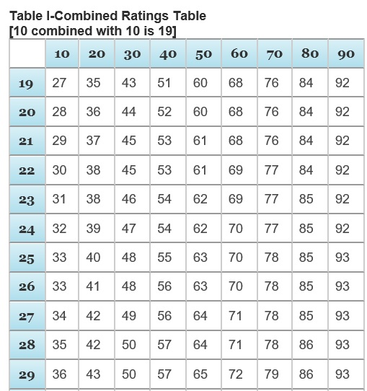
§4.25 COMBINED RATINGS TABLE
Calculated in order from highest percentage to lowest
Read down, then across - figure at intersection represents the actual (true) percentage
After all the disabilities are combined the final value is rounded to the nearest 10% to create the combined percentage (values ending in 5 are rounded up)
Table begins at 19 (combination of two 10 % disabilities)
What would be the combined rating if the veteran had disabilities rated at 20% and 30%?
Notes:
Answer is 40%

Slide 79
BASIC VA MATH EXAMPLE
Example:
20% Left shoulder limitation of motion
10% Tinnitus
Step 1 Start with 100% Whole Veteran
-20% Left Shoulder
    80% Whole / 20% Disabled
    Step 2 Continue to combine disabilities 80% Remaining
- 10% Tinnitus (10% of 80 is 8)
72% Whole / 28% Disabled
Actual rating is 28% VA will round and assign the veteran a 30%
Notes:
Once the rating values are “used” to add the bilateral factor, they cannot be used again. Make a list and cross them off, then combine the remaining evaluations in order of severity.
ALWAYS compute bilaterals FIRST
If the upper is greater than lower in severity start there and vice versa.
If one is rated 0% then the bilateral factor does not apply. They must both be at least 10% disabling.

Slide 80
§4.26 BILATERAL FACTOR
Requires more than one compensable disability
  (both arms, both legs, paired skeletal muscles)
Applied before any other combinations are carried out and treated as one disability when combining with non-bilateral disabilities
Combine in order of severity
Add additional 10 percent before combining other non- bilateral disabilities (not combined, added)
Notes:
Once the rating values are “used” to add the bilateral factor, they cannot be used again. Make a list and cross them off, then combine the remaining evaluations in order of severity.
ALWAYS compute bilaterals FIRST
If the upper is greater than lower in severity start there and vice versa.
If one is rated 0% then the bilateral factor does not apply. They must both be at least 10% disabling.

Slide 81
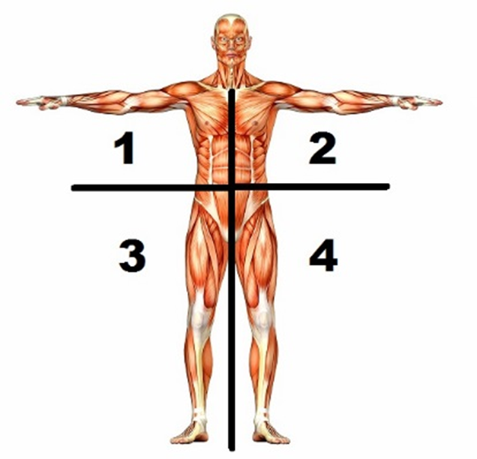
§4.26 BILATERAL FACTOR
In order for a bilateral factor to be applied, the veteran must have disabilities of the extremities in sections across from each other. (1 & 2) or (3 & 4)

Slide 82
§4.26 BILATERAL FACTOR EXAMPLE
10% Left Shoulder Limitation of Motion
10% Right Elbow Sprain
50% PTSD
Step 1 Combine Bilateral Disabilities: 100% Whole Veteran 90% Whole Veteran
-10% Left Shoulder -10% Right Elbow
90% Whole / 10% Disabled 81% Whole / 19% Disabled
Step 2 Determine Bilateral Factor: 19% Disabled + 1.9 (10% of 19 = Bilateral Factor) = 20.9 (round to 21)
Step 3 Determine Bilateral Rating 100% Whole Veteran
-21% Bilateral Disabilities
    79% Whole / 21% Disabled
    Step 4 Continue to combine disabilities 79% Remaining
-50% PTSD
39.5% Whole / 60.5% Disabled
Actual rating is 61% VA will round and assign the veteran a 60%
Notes:
Once the rating values are “used” to add the bilateral factor, they cannot be used again. Make a list and cross them off, then combine the remaining evaluations in order of severity.
ALWAYS compute bilaterals FIRST
If the upper is greater than lower in severity start there and vice versa.
If one is rated 0% then the bilateral factor does not apply. They must both be at least 10% disabling.

Slide 83
§4.26 BILATERAL FACTOR EXAMPLE WITH WORKSHEET
We have provided you a Bilateral Factor Worksheet in the OLP and chat box which can be used to help combine ratings with bilateral factors
Use the worksheet determine the combined rating for the following disabilities:
    60% Left hand loss of use
    30% Cervical disc disease with right upper arm radiculopathy
    10% Amputation of the left ring finger
    10% Tinnitus

Slide 84
QUESTIONS?

