Slide 1
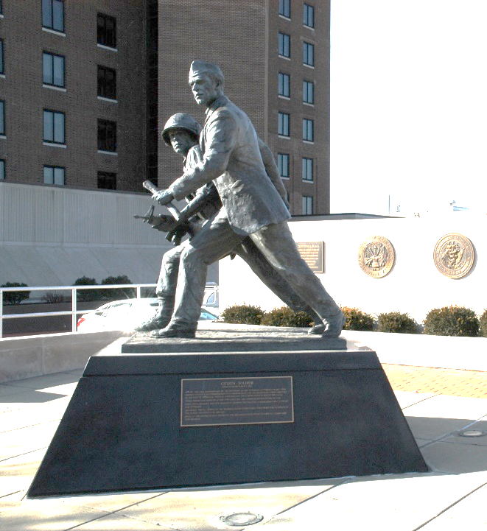
The Role of the VFW Representative
Mike Figlioli
Director, NVS

Slide 2
What is a VFW Representative?
An accredited VFW representative is a person who legally assists veterans and their families obtain their earned VA benefits for free.
That is the short definition…

Slide 3
NATIONAL VETERANS SERVICE
Primary Responsibilities:
Help veterans access earned benefits:
Accredit and train VFW’s network of service officers
Provide direct assistance to separating service members and VFW client appeals
Provide referral and casework services
Work with federal agencies to ensure proper administration of veterans’ benefit programs
Manage VFW’s national network of volunteers at VA hospitals (VAVS)

Slide 4
STRUCTURE
National Veterans Service:
National Certifying Authority:
Director, National Veterans Service
National Veterans Service Advisory Committee amends and approves NVS Policy & Procedure
National Veterans Service conducts required training for all accredited VFW representatives:
In-person/virtual training conferences
Quality Assurance site visits
Online training
National VFW Provides Restricted Grants to assist in funding service offices

Slide 5
STRUCTURE
VFW Department:
Department Commander appoints the Department Service Officer.
Departments employ support staff:
Usually managed by Adjutant/Quartermaster
Rules are established by Department Service Committee
Departments prepare and submit all accreditation paperwork to NVS
Departments decide whether to cross-accredit State or County employees with VFW
DSO provides “general oversight” and training for District/Post Service Officers
*This is different for state-run agencies, where the VFW service program is administered in partnership with the state government.

Slide 6
BENEFITS DELIVERY AT DISCHARGE
VFW has Accredited Pre-Discharge representatives at the following locations:
CONUS
Camp Lejeune, NC
Ft. Liberty, NC
Ft. Cavasos, TX
Nellis AFB, NV
San Diego Naval Base
Camp Pendleton, CA
Ft. Campbell, KY
Ft. Stewart, GA
Ft. Lewis, WA
Ft. Drum, NY
Winston-Salem, NC
Salt Lake City, UT
Ft. Carson, CO
U.S. Air Force Academy
Ft. Riley, KS
Naval Base Norfolk
Ft. Bliss, TX
Military District of Washington:
Walter Reed at Bethesda
Joint Base Anacostia-Bolling
Joint Base Andrews
Navy Yard
Marine Corps Base Quantico, VA
U.S. Naval Academy
Joint Base Myer-Henderson Hall
Fort Belvoir, VA
Fort Meade, MD
OCONUS
Osan Air Base, South Korea
United States Army Garrison-Humphreys, South Korea
Joint Base Pearl Harbor-Hickam, Hawaii

Slide 7
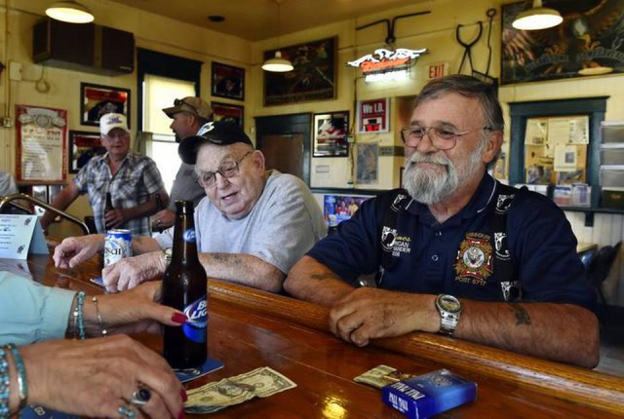
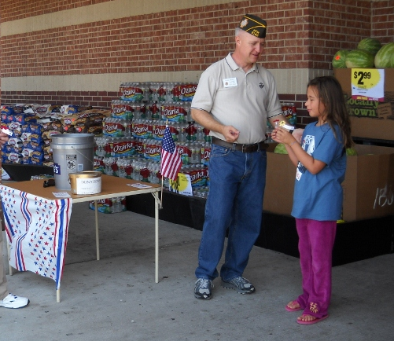
STEREOTYPES ABOUT THE VFW
Looking to recruit members
Looking for donations
Club-centric
Others?

Slide 8
BENEFITS ASSISTANCE
Common Misconceptions about our Services:
Volunteers
Untrained
Pay-to-Play
Members Only
“Are you VA?”
We Only Do Claims
I’m taking benefits away from other vets
I’m not disabled
I can do it on my own
If I pay for it, I’ll get better help

Slide 9
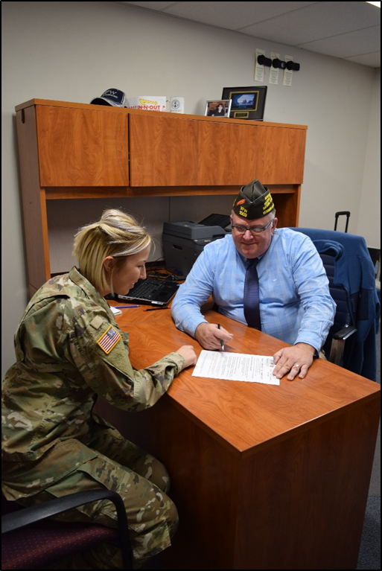
WHO ARE VFW SERVICE OFFICERS?
Veterans who have been through this transition, or
Advocates who care about veterans and their families
Highly-trained professionals who can help
Services are no obligation and free of charge

Slide 10

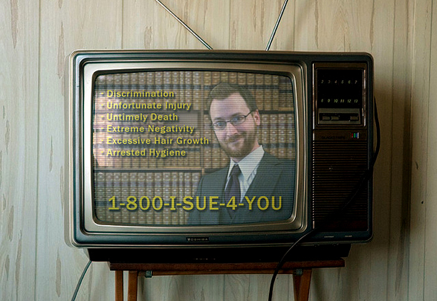
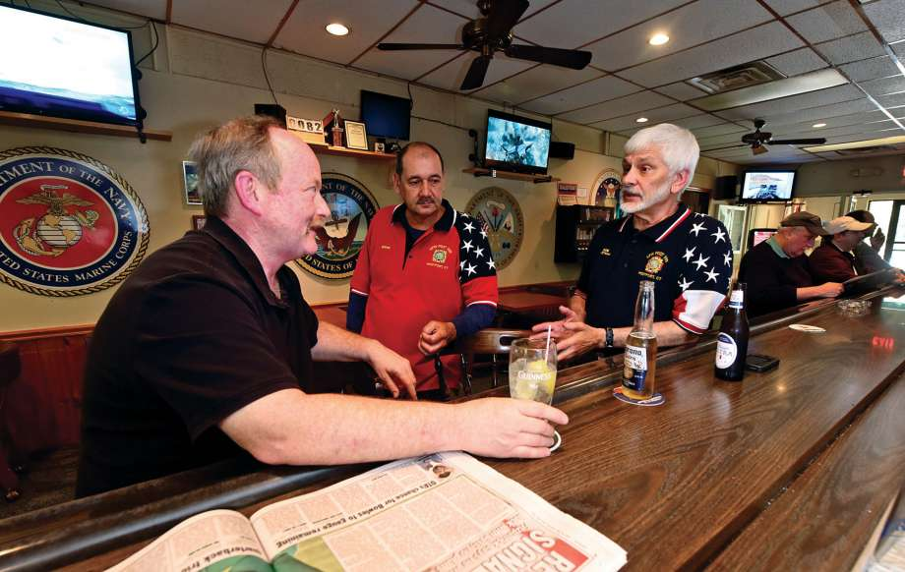
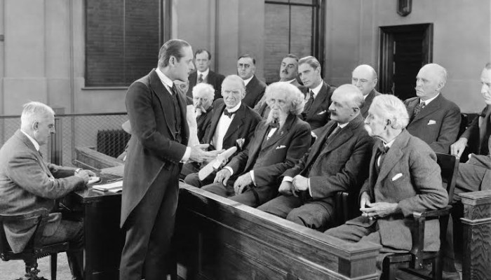
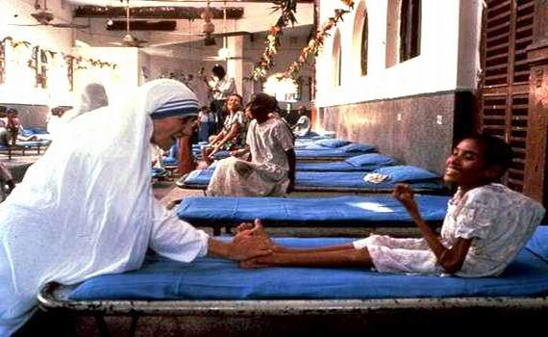
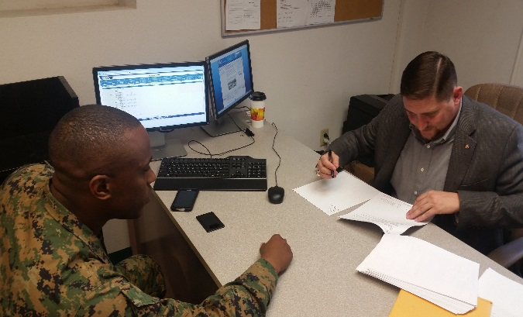
SERVICE OFFICER:
What VA thinks I do
What veterans think I do
What civilians think I do
What I think I do
What clients think I do
What I actually do

Slide 11
OTHER TITLES
Although we often use the term Service Officer, there are many other titles out there such as Claims Consultant, Benefits Representative, or Veteran Representative
If you have received accreditation you are authorized to represent veterans and can perform any benefits related tasks
Notes:
Many people believe that only DSOs can represent at hearings, review decision or write arguments for appeals

Slide 12
BENEFITS ASSISTANCE
VFW Service Officers are…
…the best trained, accredited and certified PROFESSIONAL advocates in the nation.
IG reports indicate veterans represented by VSOs received more VA compensation. They know and understand the law.
Board of Veterans Appeals more likely to grant for VFW-represented veterans.
Located in VA offices and allowed access to VA systems to provide best possible advocacy
Lifelong advocacy from initial claims, dependency, increases, pension, burial, and survivor’s benefits

Slide 13
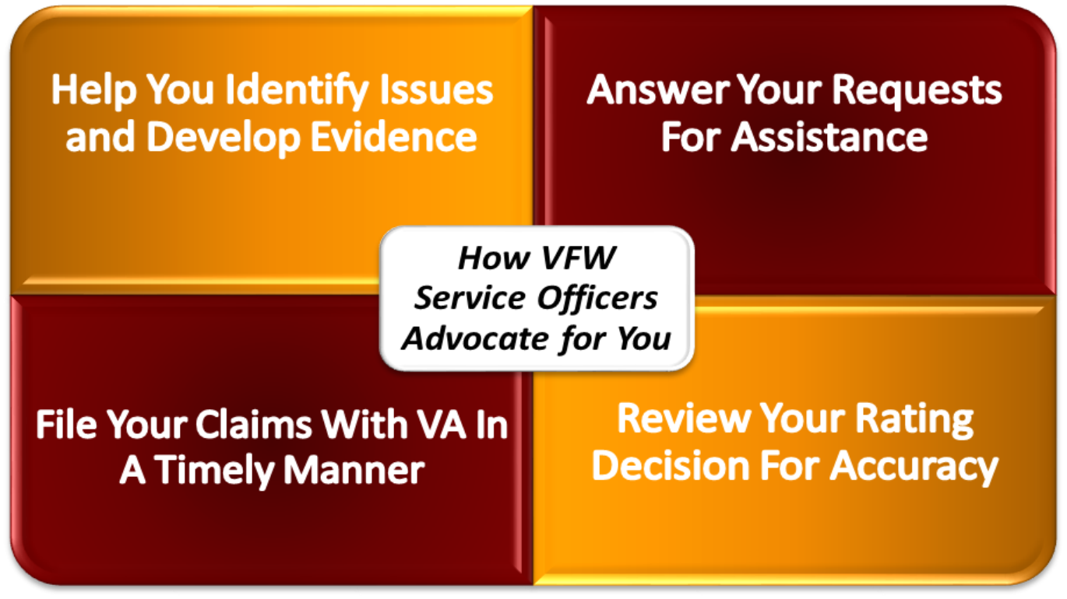
WE TRAIN IN FOUR CORE TASKS:

Slide 14
BENEFITS ASSISTANCE
VA Benefits are…
…EARNED through honorable service to our nation.
Think about your family’s well being when seeking to access benefit programs
If it was broken on active duty, VA is there to help fix it.
Let VA determine your eligibility

Slide 15
BENEFITS ASSISTANCE
Success Stories:
More than $13 billion in benefits in FY2023
2,000+ advocates accredited worldwide
Over 100,000 veterans assisted in FY2023
80+ hours of training for service officers every year
More likely to WIN appeals at BVA
FREE services for all clients*
FREE services for all clients*
FREE services for all clients*
*Once again- the VFW never has and never will charge for any services

Slide 16
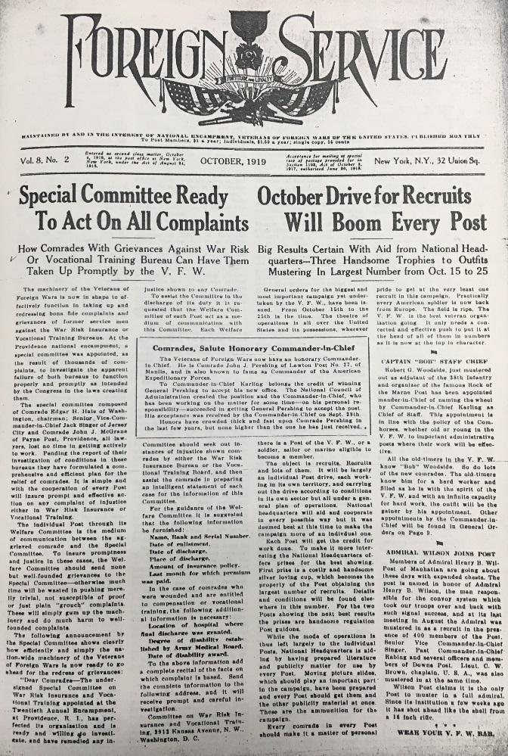

BENEFITS ASSISTANCE
“We’ve been doing this longer than V.A.”
VFW National Encampment in 1919 authorized an investigation of the War Risk Insurance Bureau and the Federal Vocational Rehabilitation Board.
VFW concluded its investigation in October 1919 and solicited the VFW to find veterans’ claims to expedite.
Claims were stored in the basement of the U.S. Department of Treasury, bound with a Red Tape.
VFW would pull each file, cut the tape, and bring it upstairs to be expedited, coining the phrase “Cutting through Red Tape.”
VFW led the charge to first consolidate all programs under a single Veterans Bureau in 1921; then to formally establish a Veterans Administration in 1930; and finally elevate VA to the President’s Cabinet as the Department of Veterans Affairs in 1988 and 1989.
During WWII, the VFW recognized it needed to meet veterans closer to home, commissioning Department Service Officers to work with veterans in their communities.

Slide 17
VFW SERVICE OFFICERS LEAD THE WAY!
VFW Service Officers are the “go-to” people for all veterans’ benefits to include VA claims and VA health care issues.
Tell Veterans and their families to:
Never file a VA claim without representation from an accredited representative
Refer Folks to VFW Service Officers for assistance
Service Officers can be VFW’s best recruiters – If you provide good service, they will come…

Slide 18
OUTREACH
Where do your clients come from?
VFW Posts/Events
Military Installations
Reserve/Guard Units
VA Health Care Facilities
College Campuses
County Service Officers
VFW Post Service Officers
Veterans’ community events
Virtual Benefits Briefings
Virtual “Events”
Social Media
Other?

Slide 19
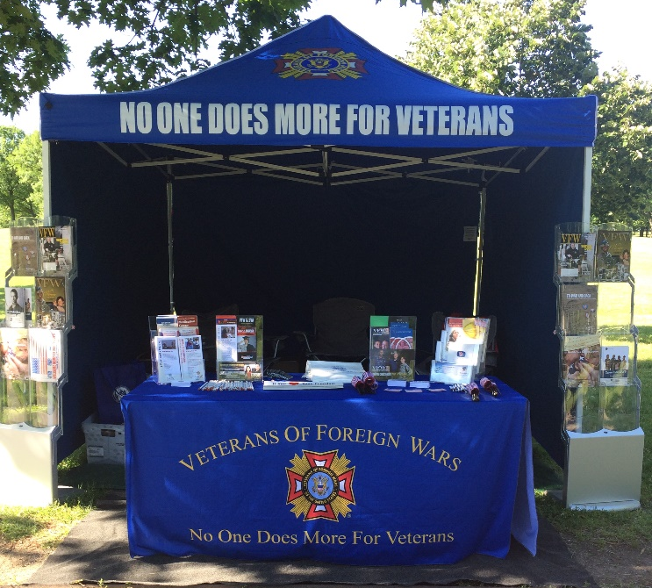
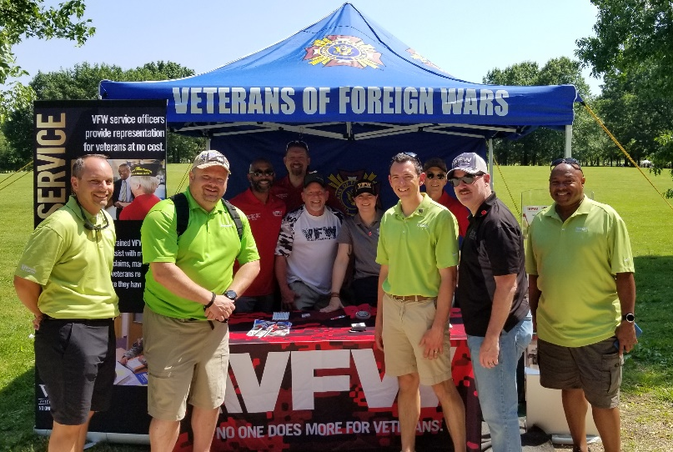
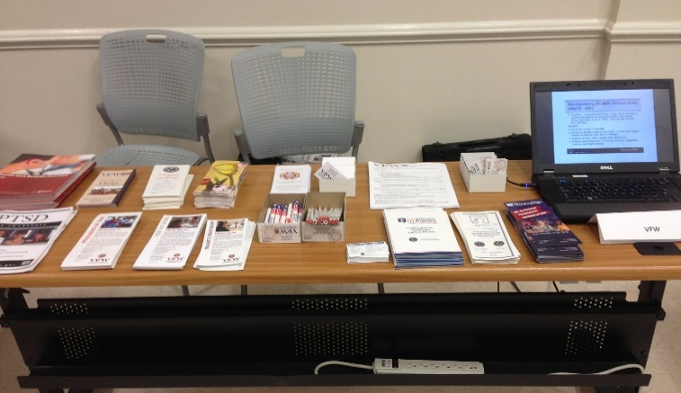
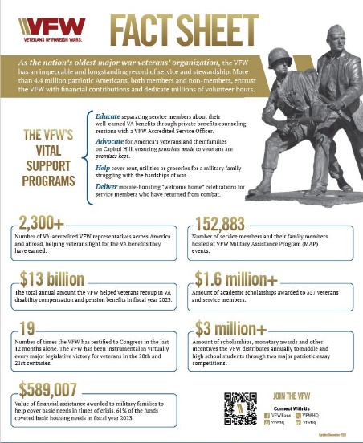
OUTREACH MATERIALS
Outreach events are generally more successful if you have something to hand out
Pencils/Pens
Flags
Beverage Holders
Pins
Pamphlets
Virtual Pamphlets
What Else?
**Information Pamphlets can be ordered through VFW General Services
**Other items can be ordered through the VFW Store

Slide 20


QR Codes
A QR (quick response) code allows users to quickly access web pages, applications, forms and so much more.
The most important thing to remember is that a QR code should provide added value to a user experience and can be used whenever it is more convenient than using another means of accessing information.
Talk with your Department to obtain QR codes that can direct veterans to your office and help with membership

Slide 21
POST/DISTRICT SERVICE OFFICERS
Posts & Districts are authorized to appoint Service Officers.
These officers are charged with assisting veterans in understanding and navigating benefits available to them.
These officers are NOT accredited and must not represent themselves as such.
These officers fall under the “general supervision” of the VFW Department Service Officer.

Slide 22
POST/DISTRICT SERVICE OFFICERS
MOP Sec. 218 (12) Service Officer. The Post Service Officer shall assist members of the Post, their surviving spouses and orphans and other worthy cases brought to their attention in obtaining rightful entitlements from federal and state governments. The work of a Service Officer shall be performed in accordance with the instructions contained in the VFW Guide for Service Officers under the general supervision of the Department Service Officer. The Service Officer shall perform such other duties as may be incident to the office and as may from time to time be required by the laws and usages of this organization or lawful orders from proper authority.
*Similar rules apply to District Service Officers.

Slide 23
POST/DISTRICT SERVICE OFFICERS
MOP Sec. 518 (11) Service Officer. The Department Service Officer shall assist the members of the Department, their surviving spouses and orphans and other worthy cases in obtaining rightful benefits from the federal or state governments. Their work shall be performed in accordance with policies established by the National Veterans Service Advisory Committee. The Service Officer shall perform such other duties as are incident to their office or may be from time to time required by the laws and usages of this organization or as may be directed by proper authority.

Slide 24
POST/DISTRICT SERVICE OFFICERS
What does this mean???
The NVS Policy and Procedure guides the terms of service offered by Post/District Service Officers
Post/District Service Officers refer claims to the DSO immediately
Post/District Service Officers cannot represent veterans because they are not accredited
Post/District Service Officers must not retain ANY records for the veterans they assist, as this is a violation of VFW policy and a violation of the veteran’s privacy

Slide 25
POST/DISTRICT SERVICE OFFICERS
Your Responsibilities
As DSO/ADSO:
Know your District/Post Service Officers
Provide training to your District/Post Service Officers
Refuse requests for status updates from your District/Post Service Officers
Provide requested status updates DIRECTLY to the veteran client
Work with your Department leadership to clarify roles/responsibilities of District/Post Service Officers
Notes:
Question: As a VFW Service Officer, who do you work for?

Slide 26
OTHER NVS PROGRAMS
Success Stories:
VA Voluntary Service: www.vfw.org/VolunteerService
1,500 regularly-scheduled volunteers at more than 150 facilities
Contributes nearly 175,000 volunteer hours per year
VA Health Care Casework: www.vfw.org/VAWatch
Intervened on behalf of thousands of veterans
Conducted multiple surveys to publish numerous reports on the current state and future of VA care

Slide 27

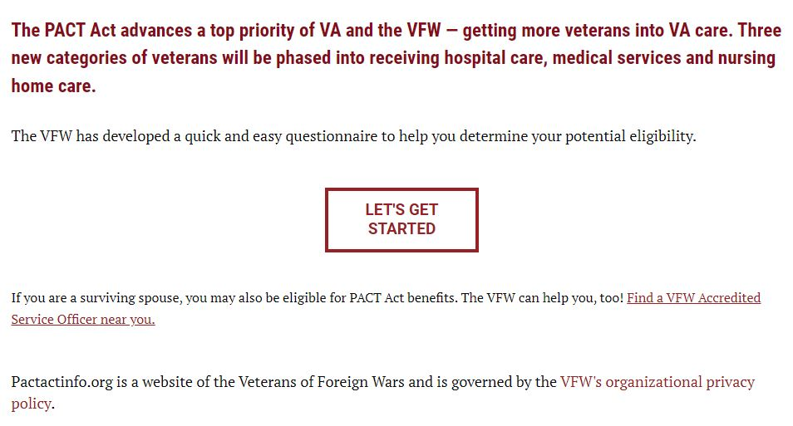
OTHER NVS PROGRAMS
In November 2022, VFW launched www.pactactinfo.org, a website designed to streamline referrals to accredited service officers.
When a veteran visits the site, they can answer a short series of questions to determine if they are potentially eligible for benefits and can also request that an accredited representative contact them to discuss their claim.
To date, we have received more than 15,000 referrals from this site

Slide 28
Claim Sharks
What is a “Claim Shark”?
A Claim Shark is an individual or company that charges hefty fees to “assist” or “consult” veterans with ﬁling their VA beneﬁt claims – this practice is illegal!
Claim Sharks are not VA accredited, meaning they aren’t required to adhere to the well-established professional and ethical standards of VA accreditation, so their advice can often be misleading or even fraudulent.
Like a “Loan Shark,” once you’re in, you can’t get out, and may be subject to new and
hidden fees whenever you get a new rating, no matter who does the work.
Some of their predatory practices are:
Promising or guaranteeing an increased disability rating or percentage increase.
Advertising expedited VA claims decisions.
Requesting login credentials to access a veteran’s personal information through secure VA websites like eBeneﬁts or VA.gov.
Using confusing tactics or ambiguous language to mislead claimants or coerce them into signing a contract.
Telling veterans to forego VA exams and offering health consultations within their own network of doctors.

Slide 29
Claim Sharks
Some Notable Claim Sharks:
Trajector Medical
Vet Benefits Guide
Veterans Guardian
VA Claims Insider
Telemedica
Patriot Angels
Veteran Care Services
VetComm
VA Claims Academy
Vet Assist
Veterans can protect themselves by:
• Always working with VA accredited representatives.
• Attending all exams ordered by VA.
• Not signing contracts.
• Not agreeing to fees or payments from future benefits.
• Not agreeing to pay for medical consultations or opinions.
• Not providing access to Protected Health Information or Personal Identifiable Information.

Slide 30
Claim Sharks
Who is NOT a Claim Shark?
• VA accredited veterans service organization representatives, like the VFW
• VA accredited claims agents
• VA accredited attorneys
• Attorneys assisting with Camp LeJeune lawsuits who do not charge excessive fees
How can you help?
Spread the word! Ensure that veterans know to visit an accredited representative
Have your accreditation number listed in your email signature block
Keep up to date on pending legislation that will help fight the sharks (GUARD ACT)
Notify NVS of any additional potential claim sharks (Do not engage on your own)

Slide 31
Key VFW Web Pages:
Online Learning Portal: https://vfw.psycharmor.org/
Claims Assistance: www.vfw.org/NVS
PACT Act Info: www.pactactinfo.org
Health Care Advocacy: www.vfw.org/VAwatch
VA Voluntary Service: www.vfw.org/volunteerservice
Post Service Officer Training: https://www.vfw.org/assistance/va-claims-separation-benefits
Key NVS Email Addresses:
Tactical Assessment Center: vfw@vfw.org
DSO Help Desk: DSOHelpDesk@vfw.org
Additional VFW Services:
Unmet Needs (Emergency Grants): www.vfw.org/UnmetNeeds
Action Corps (Legislative Advocacy): www.vfw.org/ActionCorps
Student Veterans (Scholarships, Grants, Fellowships): www.vfw.org/assistance/student-veterans-support
Mental Wellness Campaign: www.vfw.org/mental-wellness

Slide 32
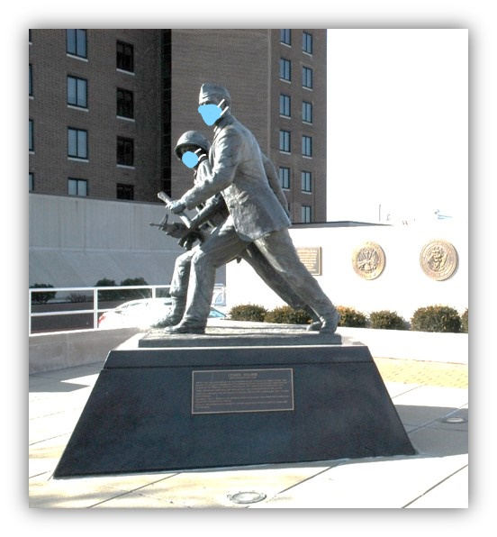
QUESTIONS?

