Slide 1
APPEALS MODERNIZATION Advanced Training September 2019
Lauren Barefoot
Manager, Training & Quality Assurance
Lbarefoot@vfw.org

Slide 2
LEARNING OBJECTIVES
Understand Changes created by AMA
Identify Decision Review Options and their Features
Supplemental Claims
Higher Level Review
Board of Veterans Appeals
Rapid Appeals Modernization Program (RAMP)
What other changes does AMA create?
Pros and cons of choices at AOJ and BVA
Challenges and opportunities with AMA

Slide 3
“Legacy” Appeals over time
Legacy appeal system was cobbled together over time – a few examples:
1933: Board of Veterans Appeals established
1957: VA regulations codified in statute (law)
1962: SOC and Form 9 added to process
1988: Veterans Court (CAVC) established
2000: Veterans Claims Assistance Act amends notice and duty to assist
2001: DRO process created
2015: Standard NOD form required
2019: Appeals Modernization Act
Notes:
There have been many changes to appeal process over time. More examples: centralization of BVA, elimination of TB hearings, failed ECA initiative, “fast track” AMA will not be the last.

Slide 4
Veterans Appeals Improvement and Modernization Act of 2017 (AMA)
GOAL: Ensure veterans receive fair appeals decisions in a timely, transparent, consistent and simple manner.
Improves rating decision notice letters to better inform veterans of reasons for decision, evidence considered, and appeal rights
Formalizes two options at the AOJ to offer veterans resolution to claim disputes at the lowest possible level
Allows appeal directly to Board of Veterans Appeals, replacing duplicative and confusing processes like NOD elections, Form 9, and 646
Protects veterans’ effective dates so long as claimants pursue adjudication in the timeframes prescribed by VA
Protects “Duty to Assist” in initial and supplemental claims
Notes:
AMA meant to simplify process and create more choice. Started work in 2015 – signed into law in 2017 with effective date of 2019

Slide 5
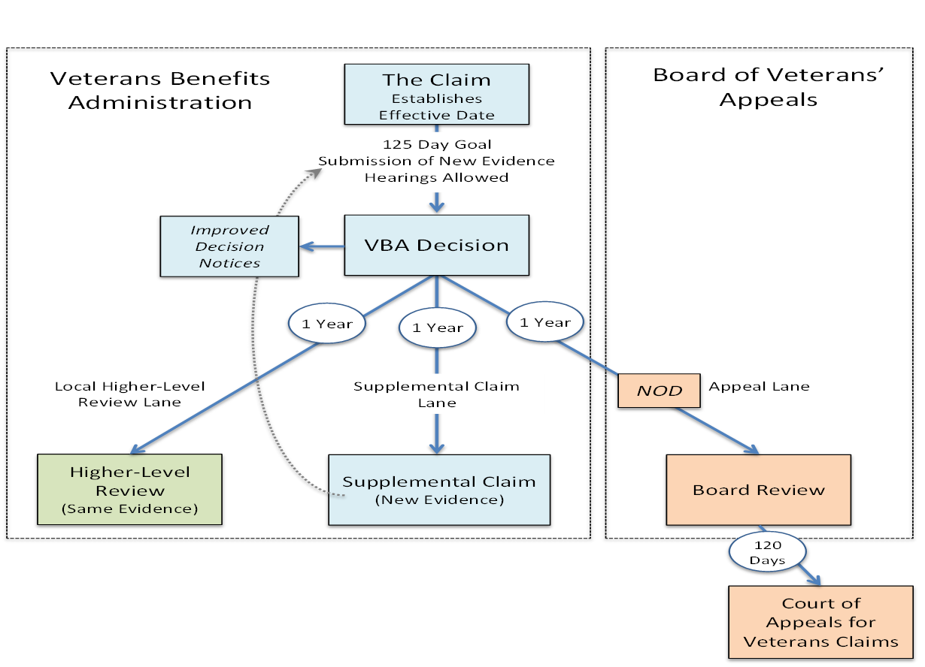
New Framework

Slide 6
Adjudication Lanes
Claimants can pursue only one lane at a time for the same claimed issue
There are no limits to the number of times a veteran may pursue a claimed issue in any of the given lanes
The effective date is protected as long as the veteran pursues the same claimed issue in any of the lanes within the established timeframes

Slide 7
Effective Date of Continuously Pursued Claim
38 CFR 3.400 (Effective Dates, General):
Preserves the effective date based on date of receipt of the initial claim IF a claimant continuously pursues an issue by timely filing in succession any of the review options in 3.2500 within one year of the date VA, BVA, or CAVC issues notice of decision.

Slide 8
Closing the record
Under AMA, the evidentiary record that VA is obligated to consider “closes” at the time of the rating decision
Evidence submitted after the rating decision or with a request for Higher Level Review or BVA direct docket will not be considered: must select supplemental claim or BVA docket with evidence or hearing
Evidence submitted before the rating decision but not considered by VA: can request HLR to have it considered
Creates quality feedback mechanism: if HLR/BVA granted based on same evidence, there was an error

Slide 9
Closing the record and VA’s Duty to Assist
VA’s duty to assist is only triggered by evidence submitted before the initial or supplemental claim
If VA did not take adequate steps to assist veteran, can raise through higher level review or BVA
VA will return to supplemental claim lane or BVA will remand for additional development if VA did not comply with duty to assist 38 CFR 3.159(c)
If additional evidence is submitted at BVA (through evidence only or hearing dockets), it will not trigger the duty to assist, but VA can still grant or deny based on the additional evidence.

Slide 10
Options after selecting a lane
Supplemental claim can always be selected after receiving any rating decision by the AOJ, BVA decision, or CAVC decision
Why? It changes the evidence
Higher Level review can only be selected after receiving a rating decision on an initial or supplemental claim
Why? It must be higher level (DROC employee is not higher level than BVA or CAVC judge)
Also, can’t select a HLR right after a HLR, must go to a higher level (BVA) or change evidence
Appeal to the BVA can be selected after receiving rating decision on supplemental or higher level review

Slide 11
Hearing Options
Note that hearings are not available in the higher level review or supplemental claim lanes
Informal conference may be requested for those lanes
Pre-determination hearings will still take place in the case of waivers and reductions
Hearings will still be available for veterans who choose the Hearing Docket at the BVA
Notes:
Mention telehearing pilot
Discuss options other than hearings to talk with a human: VSO interview, C&P exam, VSO review of rating, teleconference

Slide 12
Decision Timeline Goals
VA’s goal for deciding lanes at AOJ (supplemental or higher level review) is an average of 125 days
Actual time will be lower for specialized claims such as education, loan guaranty
Time will increase if more development is needed
BVA’s goal for deciding direct review docket is 1 year
Evidence and Hearing dockets will take longer
BVA will still pull cases from the evidence and hearing dockets, not every direct case will go quicker
AOD cases will still go faster
Notes:
Decision timeline may influence which option to select (such as when reconsideration was an option rather than filing NOD)

Slide 13
Changing Lanes
If you or the client have chosen a particular lane and decide that another lane is more favorable, AMA does allow limited circumstances to withdraw an option and change lanes
AOJ: 38 CFR 3.2500(d)
BVA: 38 CFR 20.205
You only have the original appeal window because you are withdrawing a review option and choosing a new one
Example: Rating decision 3/2/19, select higher level review on 6/14/19. Still only have until 3/1/2020 to change lanes.
Otherwise, you can wait until decision is rendered and then select another option if not granted
Notes:
Just like driving a car, best to change lanes for a purpose and not zigzagging back and forth quickly
Why Citrix/VBMS access is key

Slide 14
Improved Decision Letter Notice 38 CFR 3.103(f)
Decisions must contain 8 elements:
Identification of issues adjudicated
Summary of the evidence considered
Summary of the applicable laws and regulations
Listing of findings favorable to the claimant
In the case of a denial, identification of elements not satisfied leading to the denial
If applicable, identification of the criteria that must be satisfied to grant service connection or the next higher level of compensation
Explanation of how to obtain or access evidence used in making the decision
Summary of applicable review options under §3.2500 available for the claimant to seek further review of the decision
Notes:
Red = new or revised elements
More choices in AMA = need to understand reason for denial and evidence considered by VA to choose best path

Slide 15
Favorable Findings
Favorable findings include any element of a claim that is met, but the claim cannot be granted at this time
Example: Veteran claimed compensation for a condition, has a current diagnosis, but no proof of in-service event. Current diagnosis would be favorable finding
If veteran re-files later and shows in-service event, VA must accept that he has a current diagnosis, unless that finding was result of clear and unmistakable error (CUE)

Slide 16
Favorable findings not required
Favorable findings are not required if:
Applicant does not qualify as a claimant
There are no favorable findings
Decision is a full grant

Slide 17
Decision Review Options
Supplemental Claims
Higher Level Review
Board of Veterans Appeals
38 CFR 3.2500

Slide 18
Supplemental Claims 38 CFR 3.2501
Requesting a new rating decision from VA based on the submission of “New and Relevant” evidence
If filed within one year of VA issuing a rating decision, Board of Veterans Appeals Decision, or CAVC Decision, protects effective date of claim
Claimants can perpetually file supplemental claims on the same issue, provided they satisfy the “New and Relevant” criteria
Submission of new and relevant evidence triggers duty to assist

Slide 19
Supplemental Claims
What is “New and Relevant?” - 38 CFR 3.160(c)
“New” means it is not already in the veteran’s claim file
“Relevant” means it is pertinent to the benefit sought and reason benefit was previously denied (even if not favorable to claimant: lower threshold than “material”)
Example:
Red Foreman is claiming his diagnosed ischemic heart disease is the result of exposure to herbicides while serving in Korea in 1970. His claim for service connection was denied because his military service records did not indicate that he served in a unit in or near the Korean demilitarized zone.

Slide 20
New and Relevant Evidence
Which of these are “New and Relevant?” (assume not in file)
Buddy statements from those who supervised Mr. Foreman while serving in Korea and witnessed him on the DMZ.
Doctor’s notes confirming that Mr. Foreman has a diagnosis for ischemic heart disease
Spouse statement documenting the affects of ischemic heart disease on Mr. Foreman’s daily life
Photos of Mr. Foreman in Korea alongside defoliated areas or signs/landmarks indicating he was physically present at the DMZ
Submission of Mr. Foreman’s letters home, indicating that he served in Korea during the presumptive period for herbicide exposure
Notes:
Buddy Statements - yes
Doctor’s notes: not relevant, favorable finding
Spouse: not relevant, rating not at issue
Photos - yes
Letters home - yes

Slide 21
Supplemental Claim Form VA Form 20-0995
Block 13A: List specific issues – be sure to list whether service connection, increased rating, etc.
Block 13B: What if you don’t have date of prior decision notice?
Notice Opt-In from SOC/SSOC
Block 14: Submit or Identify new and relevant evidence
Non-federal records will require VAF 21-4142
Federal records: Block 15
Block 16: Signature
Have claimant sign if possible – especially if opting in to AMA
We can sign if POA already of record
Notes:
13B: ask someone at RO/ask veteran for copy of letter, if not previously decided, file VAF 21-526EZ

Slide 22
Supplemental Claim Form VA Form 20-0995
Currently VA is requiring a supplemental claim form almost any time you re-apply for a benefit that was previously denied
Including ancillary benefits such as specially adapted housing
Should also include specific claim form if the evidence is substantially different (example: pension income changes)
E-Benefits still allows veterans to file reopened issues on 21-526EZ, this will generate a request for application letter. There is now a warning about this on eBenefits
Notes:
13B: ask someone at RO/ask veteran for copy of letter, if not previously decided, file VAF 21-526EZ

Slide 23
Claims for Increase VA Form 21-526EZ
If claiming an increased rating and you are not concerned about the effective date or it has been more than a year since the last claim was filed on the issue, complete the 21-526EZ
ITF applies to the 21-526EZ
Be sure to add military service information to VetraSpec so future 21-526EZs are easier to complete
Remember 38 CFR 3.400(o)(2) also applies for effective dates
However if you are contesting a rating that was evaluated within the last year, be sure VA characterizes as a supplemental claim, not a claim for increase
Notes:
13B: ask someone at RO/ask veteran for copy of letter, if not previously decided, file VAF 21-526EZ

Slide 24
Supplemental Claim Decision
Rating decision will be in new AMA format with 8 decision points
Supplemental claim decision can be challenged in any of three lanes: new supplemental claim with additional new and relevant evidence, higher level review, or appeal to BVA
Request for higher level review can identify duty to assist errors in first or subsequent supplemental claim decision:
VA must review entire record
If claim denied due to no new and relevant evidence being submitted, can challenge (higher level review or NOD) determination on whether evidence was new and relevant
Must have submitted or identified some evidence
Notes:
Don’t try to game the system: if you don’t have new evidence, select HLR or direct review at BVA

Slide 25
Higher Level Review 38 CFR 3.2601
Veteran requests “de novo” review of rating decision by a higher authority
Review is solely on evidence of record – cannot submit additional evidence
Decisions can be overturned based on difference of opinion or CUE
Can only be requested within one year of rating decision

Slide 26
Higher Level Review Jurisdiction
VA has established three “Decision Review Operation Centers” (DROCs) to address decision review requests for higher level review and BVA remands
Located in Seattle, St. Petersburg, and Washington, D.C. (Appeals Management Office)

Slide 27
Higher Level Review Example
Example:
Johnny Utah claimed service connection for fibromyalgia related to service in Southwest Asia in 2005. He was diagnosed with fibromyalgia in 2011, three years after he separated from the military. Johnny completed an exam for fibromyalgia that sufficiently demonstrates his current level of impairment and the DBQ is in his record, along with his service records and his 2011 diagnosis.
However, VA denied service connection based on the lack of a diagnosis of fibromyalgia while in service.
What are some reasons Johnny might consider Higher Level Review?

Slide 28
Higher Level Review
Why could Johnny request HLR?
Fibromyalgia is a presumptive condition for Southwest Asia service
Johnny’s military record indicates that he has qualifying Southwest Asia service in Iraq in 2011
Johnny has a current diagnosis of fibromyalgia present for more than six months
Johnny’s exam indicates that the condition is compensable at a rate greater than 10%
VA misinterpreted the presumption, which dictates that the condition must have emerged while serving in Southwest Asia OR by December 21, 2021.

Slide 29
Higher Level Review Form VA Form 20-0996
Block 13: Doesn’t really matter – all higher level reviews being sent to three Decision Review Operation Centers (DROCs) in Seattle, St. Petersburg, and Washington, D.C.
Block 14: Informal conference – check with your DSO on who will be representing at conference – It will be a teleconference
Block 15: Must list specific issues – be sure to list whether service connection, increased rating, etc.
Notice Opt-IN from SOC/SSOC
Block 16: Signature
Have claimant sign if possible – especially if opting in to AMA
We can sign if POA already of record

Slide 30
Higher Level Review can turn into Supplemental Claim
38 CFR 3.2601(g), 3.2502
When higher level review or BVA review is requested and the claim cannot be granted on the evidence of record BUT the evidence triggers duty to assist, development is completed
Because development was triggered, claimant can now submit new evidence
New rating decision made, veteran has all three options for decision review

Slide 31
Appeal to Board of Veterans Appeals
The NOD is filed directly with the BVA
There are three separate BVA dockets:
Direct Review docket with no introduction of new evidence
Evidence Only docket with limited window for introduction of new evidence (90 days after NOD)
Hearing docket with limited window for introduction of new evidence (at hearing or 90 days after hearing)
Remands only issued for pre-existing duty to assist errors or to obtain an advisory medical opinion
Notes:
if a veteran wants to submit evidence directly to the BVA and the evidence submitted would not result in an outright grant but would instead raise additional development, it should instead first be submitted as a supplemental claim to force VA to comply with DTA

Slide 32
Appeal to Board of Veterans Appeals
When should appeal to BVA be selected?
When supplemental claim or higher level review results in another denial
When you need a change in the law and want to get to CAVC quicker
When you don’t want VA to engage in more development
Examples:
Reductions
Earlier Effective Dates
Well-reasoned positive medical opinion

Slide 33
Board Appeal VA Form 10182
Under AMA, VA no longer requires VSOs to complete the VA Form 646 or Form 9.
Instead, all arguments and contentions will be made on the new Notice of Disagreement (VA Form 10182) for claims going directly to the BVA.
Block 11: Select Docket
Block 12: List specific issues
Check box if providing argument
Notice Opt-In from SOC/SSOC
Notes:
Always provide argument. If no argument, restate what veteran is saying
Try to list where evidence is in file (date in VBMS)

Slide 34
Tips on VA Form 10182
Appeals submitted directly to BVA (especially on the direct docket) must be researched fully
NOD should have at least a 21-4138 attached with a well thought out argument
Only use the “no merit argument” as a last resort
If an appeal has several issues you may need to write up a separate argument for each issue.
Notes:
Refer to example argument

Slide 35
Clarification of VA Form 10182
If BVA asks for clarification of the issues or the docket select on a NOD, claimant has 60 days or remainder of one year appeal period to respond
This is crucial, because if the claimant does not respond, VA will not establish or will close out the appeal
38 CFR 20.202
Notes:
Refer to example argument

Slide 36
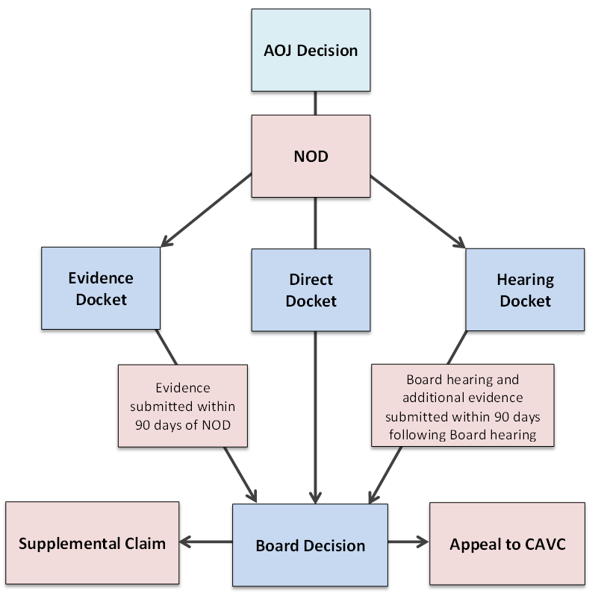
BVA Dockets
Notes:
The only docket that has a timeliness goal is the direct docket. (1 year)

Slide 37
Docket Dates
BVA publishing “appeals metrics” on their public website: https://www.bva.va.gov/Appeals_Metrics.asp
AMA allows flexibility in how cases are managed between dockets – not a set ratio of legacy/direct/evidence/hearing
VA is prioritizing legacy and direct docket

Slide 38
Docket Dates
VA’s goal is to decide direct docket claims within one year from VA 10182
This is not a deadline
Evidence and Hearing dockets will take longer, unless advanced on the docket
Notes:
Especially when VA is trying to work down legacy backlog

Slide 39
Advancement on the Docket
Advancement on the Docket (AOD) motions have the same criteria as in the past: age 75, seriously ill, severe financial hardship, administrative error resulting in significant delay in docketing, and at the discretion of the Chairman (such as areas affected by severe natural disasters).
Legacy docket: 38 CFR 20.902
AMA dockets: 38 CFR 20.800
Contact VFW’s office at BVA, or hearing branch, if veteran is scheduled for hearing, for AOD
Notes:
Refer to example argument

Slide 40
Switching Dockets
You can switch dockets at the BVA by filing a new NOD
Time limit: within original one year from the rating decision, or 60 days after first NOD filed, whichever is later (38 CFR 20.202)
If switching to evidence only docket, 90 days to submit evidence starts from the date the request to switch dockets is granted.
Once evidence is submitted or a hearing is held, you cannot switch to the direct review docket
Why? You have changed the evidentiary record and VA can’t “un-see” the evidence or testimony
38 CFR 20.301, 20.302, 20.303
Notes:
Refer to example argument

Slide 41
Medical Opinions
Under AMA, BVA no longer requests independent medical opinions before making a decision
Why? Because record is closed
If representative requests or BVA determines that an advisory medical opinion is needed from an outside source (not C&P or contract C&P), BVA will remand for an advisory medical opinion
38 CFR 20.802
Example: 1151 claims for medical negligence
All development occurs at AOJ
Notes:
Refer to example argument

Slide 42
What about CUE?
Challenging a final decision on the basis of clear and unmistakable error is still an option
No specific form required, recommend 21-4138 to avoid confusion with other types of claims
Should only be exercised if claimant is not in appeal timeframe
Can still argue VA made an error, but higher level review or direct docket to BVA may be better
Why? Higher bar of evidence to meet with CUE: standard of review
Notes:
Benefit of doubt 50% v. CUE about 94%

Slide 43
RAPID APPEALS MODERNIZATION PROGRAM (RAMP)
RAMP was in effect from November 2017 through February 2019
Offered legacy appellants opportunity to opt into Supplemental Claim and Higher Level Review lanes after filing a NOD, filing a Form 9, having their claim certified to the BVA, or remanded from BVA
Note: this did not include the SOC stage, however if VA accepted the election they should honor it
VA is completing decisions for veterans who already opted into RAMP. If an election was made after February 2019, veteran will receive letter stating still processing legacy appeal
Notes:
NOT TO BE CONFUSED WITH THE NEW REMOTE ACCESS MANAGEMENT PORTAL (ALSO RAMP)

Slide 44
RAPID APPEALS MODERNIZATION PROGRAM (RAMP) ISSUES
If your veteran opted into RAMP in the appropriate time limits but was told their appeal was cancelled, let us know.
During RAMP, it was presumed that the veteran had submitted new and relevant evidence. If opting in today, you must submit or identify new and relevant evidence.
During RAMP, veterans received a decision letter with appeal rights that allowed them to file a supplemental claim, higher level review or Board appeal on a special 21-4138. After February 19, 2019, that form is no longer valid
If VA did not recognize and establish the decision review request, please assist the claimant in completing a 20-0995, 20-0996 or VAF 10182, as appropriate.
Notes:
NOT TO BE CONFUSED WITH THE NEW REMOTE ACCESS MANAGEMENT PORTAL (ALSO RAMP)

Slide 45
Opting into AMA today
Appellant in legacy appeal process can “opt-in” to AMA after receiving a Statement of the Case or Supplemental Statement of the Case
Can select any lane, but only has time limit noted in SOC/SSOC (30 or 60 days)
Once a veteran opts-in to AMA, that decision is final and the veteran cannot revert back to the legacy appeals program
Can opt to file Form 9 instead and remain in legacy (or if Form 9 already filed, wait)
Notes:
Refer to opt in form. If you don’t know what’s in file, may want to file Legacy Form 9 as it allows submission of evidence at any point. Important to obtain file access.

Slide 46
Downside to remaining in Legacy
If you remain in the legacy system, you do not have the option of retaining the effective date by filing a supplemental claim within a year of BVA or CAVC decision
Must obtain remand and be issued a new SOC/SSOC in order to opt in
Notes:
Refer to opt in form

Slide 47
What other changes does AMA create?
While 94% of appeals are related to compensation or DIC, AMA will apply to all claims including pension, fiduciary, education, vocational rehabilitation, loan guaranty, insurance, burial benefits, and VHA appeals that are not solely clinical decisions
See VA forms 20-0995 and 20-0996
VHA is reviewing their processes, manual and IT capabilities to be able to offer supplemental and higher level reviews
Notes:
Refer to opt in form

Slide 48
New information technology
Caseflow: new IT program used to establish and track decision review requests
AMA appeals will not be added to VACOLS: need to receive access to Caseflow
Functionality still being updated
Quality review program
Additions to VHA telehealth application to provide BVA hearings
Notes:
Refer to opt in form

Slide 49
Pros and cons of choices at AOJ and BVA
AMA creates more choice and more decisions to make about which option is best for your client
AMA options are not one size fits all, they have pluses and minuses dependent on the evidence and how quickly a decision is needed
Following are general guidelines on which option may be best in certain circumstances
Notes:
Refer to opt in form

Slide 50
Supplemental Claims When to use
Denial from CAVC: supplemental claim is only option to preserve effective date
Denial from BVA: you don’t think an error was made, and you have new evidence
Rating decision denial, and you now know what evidence you need to submit
Rating decision denial, missed C&P exam
Notes:
Refer to opt in form

Slide 51
Higher Level Review When to use
VA made a clear mistake of law and you can easily find it in the CFR
Decision will be quicker than appeal to BVA
VA made a duty to assist error (did not request an exam or records) that wasn’t fixed in the 48 hour rating decision review period
BVA can’t order development, so this will get additional development done quicker
Notes:
Refer to opt in form

Slide 52
Appeal to Board of Veterans Appeals When to use
VA did not weigh the evidence as you feel they should have
BVA must discuss lay testimony in decisions
AOJ has mischaracterized the issue
Reductions treated as claims for increase
Earlier effective date of rating treated as earlier effective date of service connection
You don’t want VA to engage in additional development
You have a well-reasoned nexus opinion and don’t want VA to counter it
Notes:
Refer to opt in form

Slide 53
Challenges and Opportunities with Appeals Modernization
Review the provided scenarios and discuss with your group
Write notes on your ideas to resolve the issue, including which decision option/form is best
When directed, rotate to the next scenario
We will discuss these scenarios and the questions and remaining issues you wrote down at the beginning of class as a group
Notes:
Refer to opt in form

Slide 54
What’s Next?
Class actions are now available at the Court of Appeals for Veterans Claims.
Godsey v. Wilkie: class of appeals waiting to be certified to BVA
May be able to consolidate cases and get quicker movement
CAVC recently found veterans entitled to more than one hearing at BVA in Quinn v. Wilkie
May impact timeliness of scheduling hearings
Opportunity for veterans to discuss new evidence developed during a remand
Notes:
There have been many changes to appeal process over time. AMA meant to simplify process and create more choice.

Slide 55
What’s Next?
BVA Tele-hearing Pilot
Should reduce no-shows and allow more veterans to access hearing with Veterans Law judge (but not in person)
If you have a scheduled videoconference and your client wants to participate, contact the BVA hearing coordinators

Slide 56
What’s Next?
Precedential Court Cases
There were many precedential court cases after the passage of the VCAA due to the changes to VA’s duty to notify and duty to assist
Some issues that may be taken up regarding AMA include:
Definition of new and relevant evidence
Scope of VA’s duty to notify in decision letters
When favorable findings are required and overturning favorable findings
And others…
Notes:
There have been many changes to appeal process over time. AMA meant to simplify process and create more choice.

Slide 57
We need your feedback
If appeals are not being processed as they should under AMA, please contact your DSO
Have your DSO contact NVS if still not resolved
We will assist in getting a resolution or if needed, advocate for a change to the process
VSOs were involved in creation of AMA and made many changes to the initial concept – we intend to continue this advocacy

Slide 58
KEY APPEALS MODERNIZATION RESOURCES:
Veterans Appeals Improvement and Modernization Act:
https://www.congress.gov/bill/115th-congress/house-bill/2288/text
Appeals Modernization Website:
https://benefits.va.gov/benefits/appeals.asp
BVA Appeals Statistics:
https://www.bva.va.gov/Appeals_Metrics.asp
Electronic Code of Federal Regulations:
https://www.ecfr.gov
VA Adjudication Procedures Manual M21-1:
knowva.ebenefits.va.gov/

