Slide 1
Choosing the right Medicare plan for you
Is now the time?
What you need
to know to make
an informed choice as a veteran

Slide 2
Today we will cover
Enjoy the great things ahead of you
Choose your Medicare coverage with knowledge and confidence.
What Medicare is
Eligibility
Your Medicare options Costs
Important dates and more
Medicare 2019

Slide 3

What is Medicare?
Medicare is the U.S. government’s largest health insurance program, serving more than 57 million people¹
It’s run by the Centers for Medicare & Medicaid Services (CMS), part of the U.S. Department of Health and Human Services
Medicare is divided into parts
Parts A and B are Original Medicare
Part C is Medicare Advantage
Part D is prescription drug coverage
¹Centers for Medicare & Medicaid Services
Retrieved from www.cms.gov/Research-Statistics-Data-and-Systems/ Statistics-Trends-and-Reports/Dashboard/Medicare-Enrollment/Enrollment
%20Dashboard.html. Accessed March 27, 2017.
Medicare 2019

Slide 4

Medicare Eligibility
At age 65, you may be eligible for Medicare Parts A and B, even if you still work
You may be eligible for premium- free Medicare Part A through your spouse, although you still must qualify by age or disability
You may also be eligible for Medicare Parts A and B if you’re under 65 and have a disability
Medicare 2019

Slide 5
Original Medicare
Offered by the federal government, Original Medicare covers much, but not all, of your care and generally has a deductible and coinsurance.
Part A
helps cover
Part B
helps cover
Hospitalization
Skilled nursing facilities
Hospice care Home health
Doctor appointments Outpatient care Preventive services
Occupational/physical therapies Home health
Medicare 2019

Slide 6
Medicare Part C and Part D
These are offered by private companies.
Medicare Advantage—Part C—may include extra benefits, including prescription coverage. Part D, a Medicare prescription drug plan, is available as a stand-alone option.*
Part C
helps cover
Part D
helps cover
Everything that Medicare Parts A and B cover
Some plans include additional services, like dental, vision and wellness programs
Prescription drugs
*If you decide not to join a Medicare prescription drug plan when you’re first eligible and you don’t have other creditable coverage or get extra help, you’ll likely pay a late enrollment penalty if you join later.
Medicare 2019

Slide 7

Your Medicare options
Most people get their Medicare coverage in one of three broad ways:
Option 1: Original Medicare
Medicare Part A helps cover hospital and other inpatient costs. Medicare Part B helps cover doctor and other healthcare provider costs. Together, they are Original Medicare, available through the federal government.
Option 2: Original Medicare, plus a Medicare Supplement plan, plus a prescription drug plan
Option 3: Medicare Advantage (MA) plan
Includes Medicare Parts A and B (often requires paying Part B premium in addition to the MA premium)
Frequently includes extra benefits and services May include prescription drug coverage
MA plans are available through private companies, such as Humana.
Medicare 2019

Slide 8
Enrolling in Medicare
Initial Enrollment Period (IEP):
In the three months prior to the month you turn 65 The month in which you turn 65
In the three months after the month you turn 65
Medicare 2019

Slide 9
When choosing Medicare Advantage instead of staying with Original Medicare
You must have both Medicare Parts A and B coverage
You usually have to pay an additional monthly plan premium
You remain a Medicare member as long as you keep paying your Part B premium, if applicable
Along with a Medicare Advantage plan, you may have an opportunity to purchase optional supplemental benefits, like dental and vision coverage, for an additional premium
Medicare 2019

Slide 10
Special Needs Plans
Medicare Advantage Special Needs Plans (SNPs) generally offer benefits, more focused and specialized healthcare and Drug Lists designed to meet specific needs.
To join a Medicare-approved SNP, you must have Medicare Parts A and B and at least one of the following:
A chronic illness, like diabetes or a heart condition Medicaid assistance from the state
Residence in certain types of institutions—such as a nursing home— or a need for home nursing care
SNPs include all Medicare Part A, Part B and Part D benefits.
Eligibility is for people who live in certain institutions (like nursing homes) or who require nursing care at home.
Medicare 2019

Slide 11

Medicare Supplement plans
These plans, often called “Medigap plans,” are plans that work
with Original Medicare.
They are designed to pay some of the costs Original Medicare doesn’t pay, such as copayments, coinsurance and deductibles.
Each Medicare Supplement plan has a unique blend of benefits. Medicare beneficiaries may want this type of plan because costs
can be more predictable and they are not limited to a specific network of providers.
Medicare 2019

Slide 12
Medicare Part D
Prescription drug coverage
Part D coverage is available only from private companies contracted by the federal government
Part D plans are required by federal law to offer the basic benefits offered by Medicare
Each Part D plan has its own list of covered drugs; choose the one that includes medicines you take regularly
You usually choose Part D in one of two ways:
A stand-alone insurance plan you buy to help cover medicines (PDP) As part of a Medicare Advantage plan that includes Part D (MAPD)
If you enroll in a Medicare Advantage plan with prescription drug coverage, you don’t need to sign up for a stand-alone prescription drug plan
Medicare 2019

Slide 13

Veterans options
Is now the time?
Medicare 2019

Slide 14
First step: Determine your eligibility for VA benefits
Where do I go?
  Veterans Service Organizations (VSO) in all 50 states and Washington D.C., including:
    • The VFW
    • AMVETS
    • The American Legion
    • DAV
  The National Association of County Veterans Service Officers (not in all 50 states)
  Your state’s Department of Veterans Affairs (VA)—most have a representative in each county
Not all veterans are eligible for VA coverage.
Consult a nationally accredited service officer.
Medicare 2019
Notes:
Read slide: Be sure to make the Last Point: Not all veterans are eligible for VA coverage.
Consult a nationally accredited service officer.

Slide 15
Option 1: Enroll in both the VA healthcare and Medicare
Reasons to do this:
If you have veterans' benefits, enrolling in Medicare may provide you with additional service and location options.
If you don’t keep Part B, you may have to wait to sign up later, and you may pay a late enrollment penalty.
Medicare Parts A and B will give you the freedom to choose non-VA providers.
Still have VA coverage, if eligible.
Very important:
VA healthcare normally works only with VA providers and facilities
Medicare works only with Medicare-approved providers and facilities
The VA and Medicare do not coordinate coverage
Medicare does not interfere with your VA benefits
With both, you must decide
If you have both Medicare and VA, you must choose which benefits to use every time you see a doctor or
get healthcare. Medicare can't pay for the same service VA covered, and VA can't pay for the same service
Medicare covered.
Medicare 2019
Notes:
What are your options? Read Option1: Enroll in both the VA cont…
Reasons to do this: Read points. Make the point that if you only have VA you have limited healthcare choices. Make point: by not enrolling in Part B when 1st eligible without other credible health coverage, you may have a late enrollment penalty. VA coverage is NOT credible coverage for Part B of Medicare.
Very Important: Read slide: Important Point: The VA does not file claims. VA is not health insurance. VA healthcare is an earned benefit for veterans who are eligible and qualify for VA benefits. You CAN have Medicare and other health coverage such as a Medicare Advantage Plan and still use your VA healthcare benefit.
With both you have more choices: then read With both, you must decide cont…reading
Do not leave out the last line: The VA does not recommend that you cancel or decline coverage in Medicare because you enroll in VA Healthcare.”

Slide 16
Option 2: Enroll in the VA healthcare only
VA Medical Benefits Package (MBP)
The VA is the determining factor for health benefits. Eligible veterans who sign up for VA MBP have creditable drug coverage as a part of their MBP.
Healthcare services available in the MBP are determined through a priority grouping.
Very important:
The MBP is not considered “Creditable Coverage” for Part B
of Medicare.
Failure to sign up for Part B of Medicare when first eligible
will result in a penalty should you do so at a later date.
The MBP limits you to VA facilities and providers.*
*The Veterans Choice Program allows access to non-VA facilities for specific reasons.
Consult a nationally accredited service officer for more details.
Source: US Department of Veterans Affairs
Medicare 2019
Notes:
Option 2: Read slide Important note: The VA determines if a veteran is eligible and qualifies for VA healthcare. VA is credible coverage for Part D of Medicare VA is NOT credible coverage for Part B of Medicare
Make this Point: The Veterans Choice Program allows access to non-VA facilities for specific reasons.
Consult a nationally accredited service officer for more details.

Slide 17
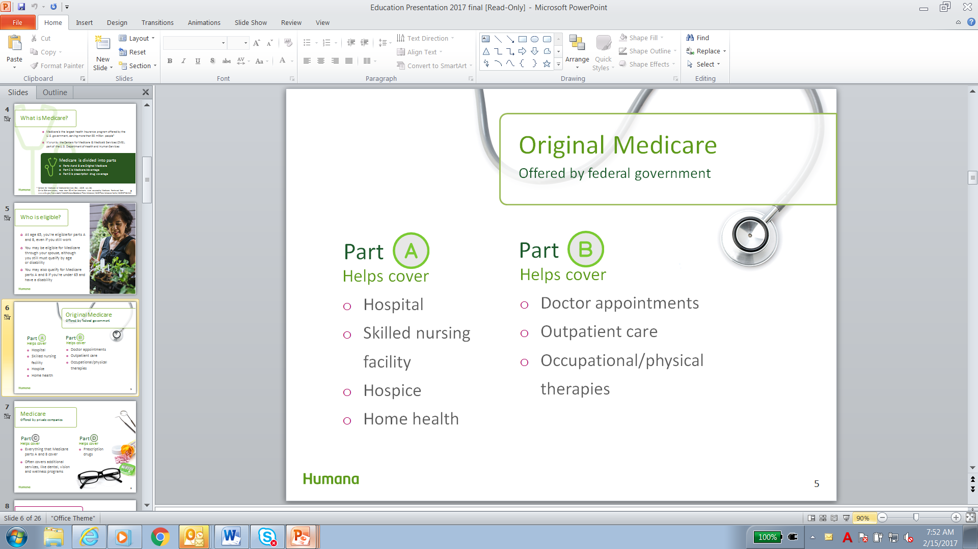
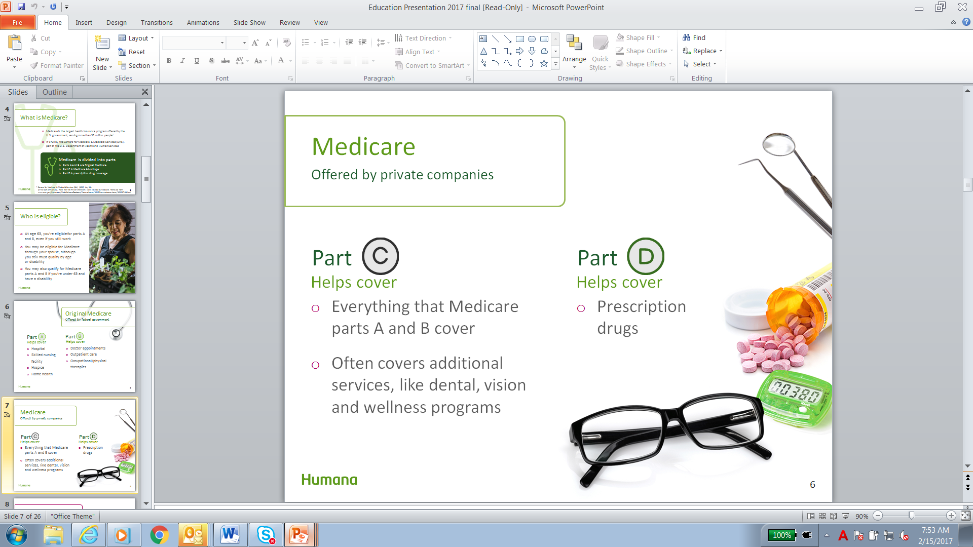
Option 3: Enroll in Medicare only
Limited to Medicare-approved providers and facilities only
This option doesn’t offer coverage by any VA facility or provider.
The VA drug benefit will work with Medicare.
Medicare does not affect VA drug benefits. You’ll continue to get your drugs from a VA pharmacy.
Medicare 2019
Notes:
Option 2: Read slide NOTE: Medicare Only covers only Medicare providers and facilities and Medicare only coverages about 80% of your medical cost leaving you with an undetermined amount of out-of-pocket expense.

Slide 18
Summary of options: pros and cons
The VA Medical Benefit Package (MBP) provides coverage by
VA providers and facilities.
Medicare is not accepted by VA providers and facilities.
With few exceptions, the MBP is generally not accepted by Medicare-approved providers and facilities.
Medicare and VA healthcare do not coordinate coverage.
Conclusion: The combination of Medicare Coverage and the MBP would provide the most options for coverage.
Talk to your nearest VSO and a licensed insurance agent for more information.
Medicare 2019
Notes:
Read slide Note at the end, Talk to your nearest VSO and a licensed insurance agent for more information. A Medicare Advantage plan or other medical healthcare and VA healthcare may be a good option, providing you with the most choice and the least out-of-pocket expense.

Slide 19
Other coverage: CHAMPVA
and Medicare
Who is eligible? Spouses and dependent children of a veteran who:
is rated permanently and totally disabled due to a service-connected disability; or
was rated permanently and totally disabled due to a service-connected condition at the time of death; or
died of a service-connected disability; or
died on active duty, and the dependents are not eligible for DoD TRICARE benefits.
Source: US Department of Veterans Affairs
Medicare 2019
Notes:
Champ VA is a rich benefit once you have both Part A and B of Medicare

Slide 20
CHAMPVA and Medicare, continued
Effective October 1, 2001, CHAMPVA benefits were extended to beneficiaries age 65 and older. To be eligible, you must also meet the following conditions:
If you were 65 or older prior to June 5, 2001, and were otherwise eligible for CHAMPVA, and were entitled to Medicare Part A coverage, then you will be eligible for CHAMPVA without having to have Medicare Part B coverage.
If you turned 65 before June 5, 2001, and only have Medicare Part A, you’ll be eligible for CHAMPVA without having to have Medicare Part B coverage.
If you turned 65 before June 5, 2001, and had Medicare Parts A and B on June 5, 2001, you must keep both to be eligible.
If you turn age 65 on or after June 5, 2001, you must be enrolled in Medicare Parts A and B to be eligible.
CHAMPVA pays after Medicare pays.
CHAMPVA is creditable drug coverage.
Source: US Department of Veterans Affairs
Medicare 2019
Notes:
Read slide: Sum it up…you must have Part A and B of Medicare once you become eligible for Medicare to have Champ VA unless you turned 65 before June 5, 2001

Slide 21
Other coverage: TRICARE for Life
Who is covered? Military retirees and their dependents.
What is needed? Eligibility for Original Medicare (Parts A and B).
When do I do it? To retain TFL and be eligible for Medicare, one must enroll in Medicare Part B at the age of 65 or when eligible.
Why do I do it? Complete coverage! Including Part D. Medicare
is the primary insurer and TFL is the secondary.
How much? No enrollment fee for TFL but must pay monthly
Part B premium.
If you‘re eligible for TRICARE and you have both Medicare Parts A and B, TRICARE for Life is the plan for you.
Source: www.tricare.mil
Medicare 2019
Notes:
Read Slide Important point: Tricare for Life is for Veterans and their dependents who have 20 or more years of military service and who have both A and B of Medicare.

Slide 22
For information regarding veteran benefits | Phone | Website
• VA Health Care Benefits • National Association of County Veterans Service Officers | 1-877-222-8387 | www.va.gov
Civilian Health and Medical Program of the Department of Veterans Affairs (CHAMPVA) | 1-800-733-8387
For information regarding Medicare and other benefits
Medicare | 1-800-MEDICARE (1-800-633-4227) | www.medicare.gov
Your state Medicaid office | TTY: 1-877-486-2048 (24 hours day/7 days a week) | www.medicaid.gov
State Health Insurance Assistance Program |  | www.shiptacenter.org
Social Security Administration | 1-800-772-1213 | www.ssa.gov
Medicare 2019
Notes:
Read slide

Slide 23

Helpful resources
The “Medicare & You” handbook, published by the Centers for Medicare & Medicaid Services (CMS), released each fall
“Choosing a Medigap Policy: A guide to health insurance for people with Medicare,” a publication developed jointly by CMS and National Association of Insurance Commissioners
Visit http://www.shiptacenter.org to view your local State Health Insurance Program (SHIP)
You may be able to get extra help to pay for your prescription drug premiums and costs.
To see if you qualify, contact:
Your state Medicaid office
The Social Security Administration
Medicare 2019
Notes:
Read slide

Slide 24
Scenario One
You are meeting with a Veteran or spouse of Veteran with no type of Veteran Healthcare. What questions will you ask them to identify their healthcare needs?
Medicare 2019

Slide 25
Scenario Two
You are meeting with a Veteran or spouse of a Veteran with Tricare for Life. What questions will you ask them to identify their healthcare needs?
Medicare 2019

Slide 26
Scenario Three
You are meeting with a Spouse of a Veteran with CHAMPVA. What questions will you ask them to identify their healthcare needs?
Medicare 2019

Slide 27
Scenario Four
You are meeting with a Veteran with VA Healthcare. What questions will you ask them to identify their healthcare needs?
Medicare 2019

Slide 28

Thank you for your time and attention today.
We hope this provides guidance as you consider your Medicare coverage choices.
Medicare 2019
Notes:
Read slide, if possible have a veteran service officer at your public service seminar and direct those with eligibility and qualifying question to the veteran service officer.

Slide 29
Medicare 2019

Slide 30
Medicare 2019

