Slide 1
Using Lay Testimony to Augment the Claim
By Crystal M. Trulove
November 18-21, 2019

Slide 2


Introduction
Crystal M. Trulove
  crystal.trulove@gmail.com
Air Force veteran
  Familiar with military culture
Veterans Affairs veteran
  RVSR for 8 years
  DRO for 3 ½ years
    Hearings
    Appeals Team evidence

Slide 3
Lay Testimony, in three parts
Part one
  Lay Evidence & Testimony Definitions
  Criteria & Uses for Testimony
  Examples
Part two
  Pain/Functional Loss/Flare Ups Definitions
  Laws/Court Cases Addressing Pain
  Examples
Part three
  VA as partner
  Exercises
Notes:
Take note of what I will cover each part, and save your deep dives for the right part.

Slide 4
Course Objectives
Define Lay Evidence/Testimony/Statement
Define Pain/Functional loss/Flare Up
Identify when lay evidence is/is not needed
Understand criteria for effective lay testimony
Understand laws governing lay testimony
Know how VA laws & court cases got us where we are today
Be able to coach someone and/or write an effective lay statement

Slide 5

References
38 CFR 3.303
38 CFR 3.304(d)
38 CFR 3.159(a)(2)
38 CFR 3.159(c)(4)(A), (B), (C)
38 CFR 4.40, 4.45, 4.59
M21-1 I.1.C.3.d.
M21-1 III.iii.2.E.2.b.
M21-1 III.iv.3.D.4.h.
M21-1 III.iv.5.A.2.b. & c.
M21-1 III.iv.6.C.4.a.
Court cases – please see handout
https://www.knowva.ebenefits.va.gov/
Notes:
There are more court cases referenced but these are the most important

Slide 6

Lay Evidence Basics
Why is it called lay evidence?
  Lay persons
Why is lay evidence used?
  Fills in blanks
  Can raise body of evidence to equipoise
Why does VA accept lay evidence?
  Required by law
  Lay evidence is helpful
Notes:
Brief explanation of “benefit of the doubt”. Help students access public M21-1

Slide 7
Legal definition
38 CFR 3.159(a)(2) Competent lay evidence
means any evidence not requiring that the proponent have specialized education, training, or experience. Lay evidence is competent if it is provided by a person who has knowledge of facts or circumstances and conveys matters that can be observed and described by a lay person.
Notes:
M21-1 I.1.C.3.d. explains that unless there is contradictory evidence, VA must accept lay statement as true. USC & CFR & M21-1 – different levels of same law

Slide 8
Service Connection
Requires three components:
  a current disability
  an event, injury, or disease in service, and
  a link or nexus
Lay evidence must address one of these.
Lay evidence is accepted at every claim level, for the life of the claim.

Slide 9
Examples of lay evidence
Veteran’s statement (spoken or written)
Lay statement (spouse, friend, family)
  Buddy statement
Photographs
Newspaper clippings
Performance evaluations
Copies of bills paid on time
Q: What if veteran’s uncle is a nurse who wants to provide testimony?
Notes:
spoken lay testimony at a hearing and at an exam. Also, deck logs, letters sent home, diaries, maps. Bills show competence

Slide 10
Lay Testimony requires both:
Credibility
  Person making statement is believable
  e.g. malingering, exaggeration
Competency
  Person’s words have value
  e.g. description of symptoms vs diagnosis
  M21-1 III.iv.5.A.2.b.
  “accept evidence at face value”
  M21-1 I.1.C.3.d.
  “without contradictory evidence, VA must accept lay statements as true”
Notes:
Parkinson’s Disease, for example. NOTE: this is different than incompetency determination

Slide 11
Valuable lay testimony
Veteran’s description of their own experience
Witness to same in-service event (another veteran)
Witness of current symptoms (spouse, co-worker, neighbor)
Opinion of how disability is related to event in service
Comparison before service event and now
Spouse also heard what doctor said
Description of how bad pain can get
Example of how symptoms impact daily life
Notes:
Have people in class give an example for each. Mclendon v Nicholson “may be associated” with service

Slide 12
All true – but helpful?
Neighbor says she watches veteran walk to mailbox with a limp
Veteran reports unit, rank, and theater
Letter from sister saying veteran has always loved his country
Facebook friend knew veteran in high school
Buddy was there the day of the fire
Spouse says bills are piling up
Notes:
Petitti v McDonald says pain can be corroborated in a lay statement

Slide 13
Combat veteran lay statement
38 CFR 3.304(d) Combat.
Satisfactory lay or other evidence that an injury or disease was incurred or aggravated in combat will be accepted as sufficient proof of service connection if the evidence is consistent with the circumstances, conditions or hardships of such service even though there is no official record of such incurrence or aggravation.

Slide 14
Changing culture
Court decisions have reinforced the need for VA to value lay testimony.
  Buchanan v Nicholson, June 2006
  Mclendon v Nicholson, June 2006
  Barr v Nicholson, June 2007
  Jandreau v Nicholson, July 2007
The law consistently values a veteran’s lay testimony.
Notes:
You don’t need to remember these cases, just that lay testimony is consistently found valuable

Slide 15
KnowVA Knowledge Base
https://www.knowva.ebenefits.va.gov/
Decision Assessment Document
VA summary of case
Impact on law
Impact on procedure
Link to full case
Notes:
This is the reference tool VBA uses when the Intranet crashes, and during testing

Slide 16
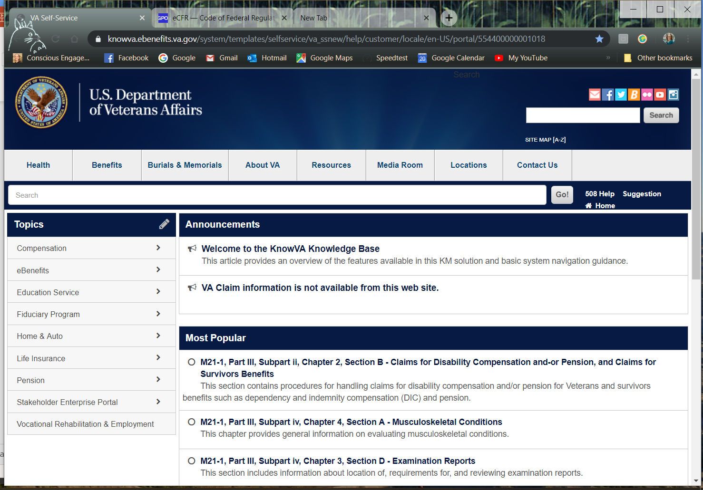
KnowVA Knowledge Base

Slide 17
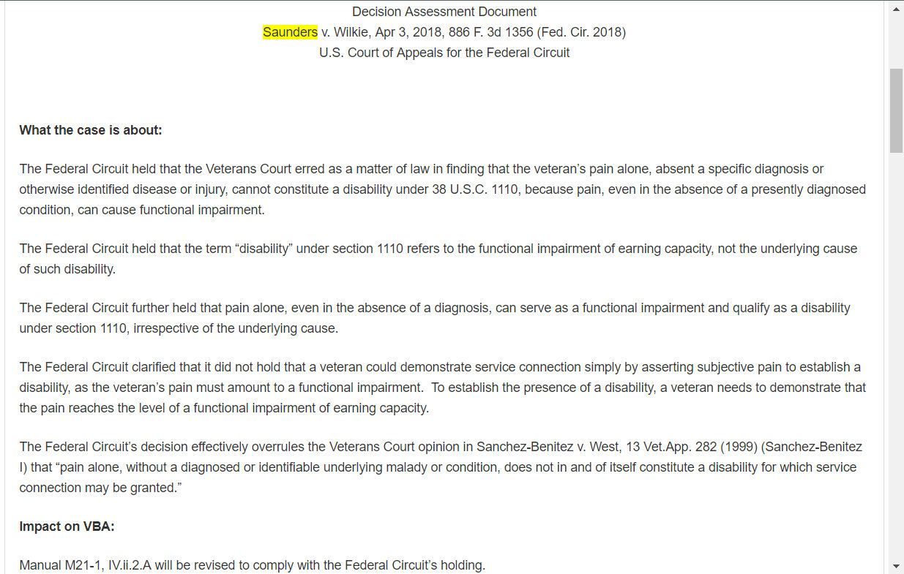
Decision Assessment Document

Slide 18
During/after C&P exam
Before exam
  Research Rating Schedule requirements
    Mild, moderate, severe
    Find symptoms that match
  Submit lay testimony
During exam
  Bring notes
After exam
  Take notes
  Submit lay testimony
Notes:
Exams are fast, overwhelming, even if vet is prepared. Examiners don’t know VBA system, so don’t ask questions in the best way. Examiners don’t realize veterans need terms defined.

Slide 19

Pain Basics
What are terms related to pain?
  Painful motion
  Functional loss
  Flare up
Why report pain?
  Minimum compensation for joints
  Employment impact
  May be the only accurate report
  Establishes a more complete picture
  Can be considered a disability
Notes:
Address testimony in statement vs. in exam

Slide 20
Definitions
Painful motion
  Pain while a joint is in motion
Functional Loss
  Inability to perform normal working movements of the body.
  Employment impact.
Flare-Up
  Temporary functional limitation

Slide 21
Functional Loss
38 CFR 4.40
…The functional loss may be due to absence of part, or all, of the necessary bones, joints and muscles, or associated structures, or to deformity, adhesions, defective innervation, or other pathology, or it may be due to pain, supported by adequate pathology and evidenced by the visible behavior of the claimant undertaking the motion…
Notes:
Ellipses indicate missing text. 4.40 is the reg that legalizes evaluations based on worst day.

Slide 22
The Joints
38 CFR 4.45
As regards the joints the factors of disability reside in reductions of their normal excursion of movements in different planes.
Inquiry will be directed to these considerations:
…(f) Pain on movement, swelling, deformity or atrophy of disuse. …
Notes:
a) Less movement, b) more movement, c) weakened movement, etc.

Slide 23
Painful Motion
38 CFR 4.59
With any form of arthritis, painful motion is an important factor of disability…
...The intent of the schedule is to recognize painful motion with joint or periarticular pathology as productive of disability. It is the intention to recognize actually painful, unstable, or malaligned joints, due to healed injury, as entitled to at least the minimum compensable rating for the joint…
Notes:
Burton v Shinseki 2011 – ruled that 4.59 applies to pathology other than arthritis.

Slide 24
Lay Testimony of pain
Medical terms that may need Lay Testimony
  Guarding
  Prostrating
  Incapacitating
  Instability
  Panic attack
  Headache
  Tinnitus
  Plantar
  Periarticular
  Voiding
How to report pain?
  Without exaggeration
  Describe worst day (38 CFR 4.40)
  Frequency, severity & duration of flare ups
  Employment impact
  Daily impact
Notes:
Talk about 4.40

Slide 25
Changing Culture
DeLuca v. Brown 1995
  Functional loss due to pain includes flare ups and repetitive use
  Examiners must opine additional loss of function
Sanchez-Benitez v. West 1999
  Incorrectly determined that pain alone does not constitute disability
Jones v. Shinseki 2010
  Allows examiners to state “speculation”
Mitchell v. Shinseki 2011
  Painful motion is not the same as limited motion
  Added question to DBQs
Notes:
DeLuca, i.e. not during exam/ Sanchez-Benitez disability vs. functional loss/ Jones can’t determine functional impact without resorting to speculation

Slide 26
Changing Culture
Joyner v. McDonald 2014
  Said Veterans Court erred in concluding that pain cannot constitute a qualifying chronic disability
Sharp v. Shulkin 2017
  Examiners must demonstrate attempt to discern functional loss due to flare-ups not during exam
  Ask the veteran
Saunders v. Wilkie 2018
  Pain, even in the absence of a presently diagnosed condition, can cause functional impairment
  Officially overruled Sanchez-Benitez v West

Slide 27
Evidence of pain in testimony
Saunders v. Wilkie
  Vet must demonstrate that pain reaches the level of a functional impairment
Petitti v. McDonald
  “objective evidence of pain” is not required, but pain must be “objectively confirmed”
  Lay statements must be considered
38 CFR 4.59 provides guidance for painful motion:
  facial expression
  wincing, etc., on pressure of manipulation
  muscle spasms, or
  crepitation in tendons, ligaments, or joint structures
Notes:
What are some ways the vet could provide evidence of pain through testimony?

Slide 28
Pain as a disability
Saunders v. Wilkie 2018
  Pain, even in the absence of a presently diagnosed condition, can cause functional loss/impairment
Rare cases
  PCP and VA examiner unable to provide diagnosis
    Patellofemoral pain syndrome
    Costochondritis
  Pain is related to military service
Notes:
Still must meet 3 components for service connection

Slide 29
Be A Detective:
Why is this valuable testimony?
Veteran goes to work every day, despite suffering with migraines
Veteran almost fell twice in past month when knee “seized up”
Veteran bus driver has to stand to fully turn lever to close door after passengers are seated
Veteran has learned to use computer mouse with left hand to protect right wrist
Veteran wears sunglasses, even on cloudy days, to prevent “episodes”
Notes:
Incapacitating episodes, flare ups or instability, shoulder ROM, guarding, headaches/TBI

Slide 30
Consider VBA a partner
Since 2015, VBA has managed an inventory of 350,000 claims
In the past three years, VBA has processed over three million claims
  2,778 per day
Mandatory overtime has been enforced most years since 2011

Slide 31
Consider VHA/VBA as partners
In FY2017 veterans made up 32.4% of VA employees
Disabled veterans made up 16.6%, or just over half of all veteran employees are disabled vets
Other employees include spouses, family, friends of veterans
Notes:
https://www.fedshirevets.gov/veterans-council/veteran-employment-data/employment-of-veterans-in-the-federal-executive-branch-fy2017.pdf

Slide 32
Consider VHA/VBA as partners
Keep in mind that VHA/VBA employees:
  Work hard
    Keep it short!
  Are vets
    Understand the military
  Want to help
    Make it easy for them
Learn when it is best NOT to send in more evidence

Slide 33
Practice Research
7122 Cold injury residuals:
With the following in affected parts:
Arthralgia or other pain, numbness, or cold sensitivity plus two or more of the following: tissue loss, nail abnormalities, color changes, locally impaired sensation, hyperhidrosis, X-ray abnormalities (osteoporosis, subarticular punched out lesions, or osteoarthritis) | 30
Arthralgia or other pain, numbness, or cold sensitivity plus tissue loss, nail abnormalities, color changes, locally impaired sensation, hyperhidrosis, or X-ray abnormalities (osteoporosis, subarticular punched out lesions, or osteoarthritis) | 20
Arthralgia or other pain, numbness, or cold sensitivity | 10
Notes:
Discuss as a class

Slide 34
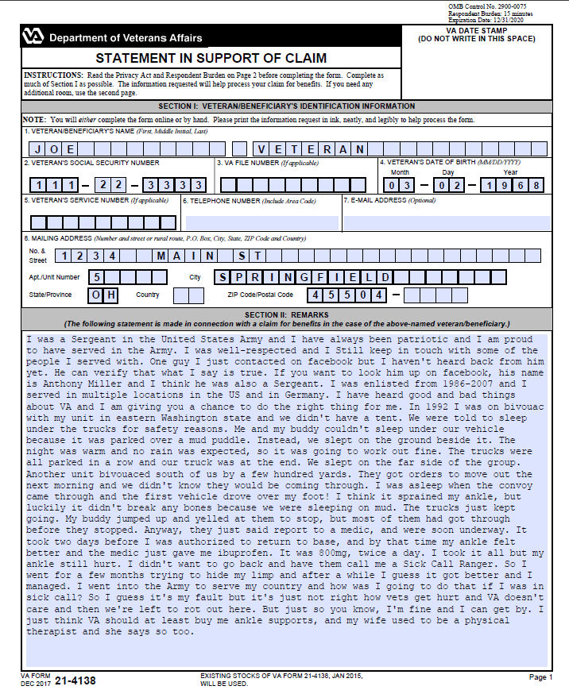
Exercise
#1
Notes:
Imagine you’re a VBA employee seeing this. Should take 10 minutes.

Slide 35
Exercises #2 & #3
Write a rough draft lay statement
Groups of two
One person is veteran, one VSO
Veteran has information, but is shy
  Don’t volunteer information
VSO must ask questions and write a lay statement for the veteran
5 minutes to read, 10 minutes for interview
Switch roles for exercise 3

Slide 36
QUESTIONS?
Crystal M. Trulove
crystal.trulove@gmail.com
Notes:
If we have time, recap. Also mention Gulf War Illness. Incompetence rating.

