Slide 1
Rating Changes
38 CFR 4.118 Skin
By Diane Williams
November 2019

Slide 2
Objectives
Review updates and changes to the rating schedule for skin.
Determine correct evaluations and effective dates, considering historical and new criteria.
Evaluate skin conditions with accuracy in scenarios provided.
Review skin conditions and treatments

Slide 3
References
38 CFR 3.309 (e) – Diseases associated with herbicide agents.
38 CFR 3.344 – Stabilization of disability evaluations
38 CFR 3.400 – Effective Dates, General
38 CFR 3.951(a) –Preservation of disability ratings
38 CFR 4.9 – Congenital or developmental defects
38 CFR 4.118 – Schedule of ratings – skin

Slide 4
References (cont.)
M21-1 Part III, Subpart iv, 4.L – Skin conditions
M21-1 Part III, Subpart iv, 5.C – Effective Dates
Johnson v. McDonald
McClain v. Nicholson

Slide 5
Reason for change-court cases
Johnson v. McDonald…
clarified the definition of “systemic therapy such as corticosteroids or other immunosuppressive drugs,” contained in certain DCs under 38 CFR 4.118:
Notes:
Court case defined this.

Slide 6
Review of court cases
Johnson stated:
“Systemic therapy”…”refers to any oral or parenteral medication(s) prescribed by a medical professional to treat the underlying skin disorder. Medications that are applied topically (directly to the skin), including topical corticosteroids or immunosuppressives, are not considered systemic for VA purposes.”
Impact?

Slide 7
Review of court cases
Johnson created a dramatic disconnect between the severity of the veteran’s disability and the corresponding rating.
Therefore, VA amended §4.118 to clearly provide that VA does not intend for treatment administered through the skin (topical therapy) to constitute systemic therapy. VA notes that it is possible for topical treatments to have systemic effects if administered on a large enough scale. However, in these situations, a veteran can obtain a higher rating due to the percentage of the body affected, not the mode of administration for his or her treatment.
Notes:
This is straight from the proposed CFR regulation change. You may wish to use this information to explain why the law was changed to your Veteran.

Slide 8
Old criteria – for illustration
7806 Dermatitis or eczema.
More than 40 % of the entire body or of exposed areas affected, or: constant or near-constant systemic therapy such as corticosteroids or other immunosuppressive drugs required during the past 12-months | 60
20 to 40 % of the entire body or of exposed areas affected, or; systemic therapy such as corticosteroids or other immunosuppressive drugs required for a total duration of 6 weeks or more, but not constantly during the past 12 months | 30
At least 5 %, but <20 %, of the entire body, or exposed areas affected, or; intermittent systemic therapy such as corticosteroids or other immunosuppressive drugs required for a total duration of less than six weeks during the past 12-months. | 10
Less than 5 % of the entire body, or of exposed areas affected, and; no more than topical therapy required during the past 12-months. | 0
Notes:
So, we can see what the problem was. A Veteran may have dermatitis that requires hydrocortisone for control. The condition could effect a small area, but hydrocortisone was considered a corticosteroid, entitled to a 60 percent. There was a disconnect.

Slide 9
Review of Court Cases
McClain v. Nicholson, found that:
the requirement a “current disability” is satisfied when the claimant has the disability
at the time the claim for VA disability compensation is filed or
during the pendency of the claim and
that a claimant may be granted service connection even though the disability resolves prior to VA’s adjudication of the claim.

Slide 10
Review of Court Case
Impact?
Conditions should be examined or evaluated when the condition is active.
Notes:
Why is this important? The entirety of the evidence must be used to determine service connection.

Slide 11
Reasons for change
Other considerations:
Several of the skin disorders have similar superficial components of the skin, and the severity of impairment for each condition increases as more skin is involved. All of the conditions have treatments which are applied directly to the skin, as well as taken systemically (e.g., by mouth). There are still more similarities with regard to which treatments are used, treatment dosages given, treatment routes of administration, and treatment duration.
As a result, VA concluded it would be more efficient to rate under the same formula, rather than to prescribe individual rating criteria.
Notes:
These comments are also found in the proposed CFR change, and help us to explain the reasons for the change in the law to our Veterans.

Slide 12
CFR 4.118 changes (New in red)
Introductory text revision – two notes
a) For the purposes of this section, systemic therapy is treatment that is administered through any route (orally, injection, suppository, intranasally) other than skin. For the purposes of this section, topical therapy is treatment administered through the skin.
Notes:
This is further defined within the New General Rating Formula, which we will look at in a minute.

Slide 13
4.118 continued
b) Two or more skin conditions may be combined in accordance with 38 CFR 4.25 only if separate areas of skin are involved. If two or more skin conditions involve the same area of skin, then only the highest evaluation shall be used.
Notes:
Let’s consider an example…..

Slide 14
New! General Rating Formula
The new rating formula accounts for percentages of areas affected, both of the entire body and exposed areas, as well as the level of treatment required.
Notes:
Let’s discuss the New General Rating Formula for these changes.

Slide 15
New! General Rating Formula
General Rating Formula For The Skin For DCs 7806, 7809, 7813-7816, 7820-7822, and 7824:
At least one of the following | 60
Characteristic lesions involving more than 40 percent of the entire body or more than 40 percent of exposed areas affected; or
Constant or near-constant systemic therapy including, but not limited to, corticosteroids, phototherapy, retinoids, biologics, photochemotherapy, psoralen with long-wave ultraviolet-A light (PUVA), or other immunosuppressive drugs required over the past 12-month period | 60
Notes:
And here within the body of the General Rating Formula, we see the definition of systemic therapy.

Slide 16
New! General Rating Formula
General Rating Formula For The Skin For DCs 7806, 7809, 7813-7816, 7820-7822, and 7824:
At least one of the following | 30
Characteristic lesions involving 20 to 40 percent of the entire body or 20 to 40 percent of exposed areas affected; or Systemic therapy including, but not limited to, corticosteroids, phototherapy, retinoids, biologics, photochemotherapy, PUVA, or other immunosuppressive drugs required for a total duration of 6 weeks or more, but not constantly, over the past 12-month period

Slide 17
New! General Rating Formula
General Rating Formula For The Skin For DCs 7806, 7809, 7813-7816, 7820-7822, and 7824:
At least one of the following | 10
Characteristic lesions involving at least 5 percent, but less than 20 percent, of the entire body affected; or
At least 5 percent, but less than 20 percent, of exposed areas affected; or
Intermittent systemic therapy including, but not limited to, corticosteroids, phototherapy, retinoids, biologics, photochemotherapy, PUVA, or other immunosuppressive drugs required for a total duration of less than 6 weeks over the past 12-month period

Slide 18
New! General Rating Formula
General Rating Formula For The Skin For DCs 7806, 7809, 7813-7816, 7820-7822, and 7824:
No more than topical therapy required over the past 12-month period and at least one of the following | 0
Characteristic lesions involving less than 5 percent of the entire body affected; or
Characteristic lesions involving less than 5 percent of exposed areas affected
Or rate as disfigurement of the head, face, or neck (DC 7800) or scars (DCs 7801, 7802, 7804, or 7805), depending upon the predominant disability. This rating instruction does not apply to DC 7824
Notes:
The zero percent level is unchanged.

Slide 19
New! General Rating Formula
The following DC are evaluated under the new General Rating Formula:
7806 Dermatitis or Eczema
7809 Discoid lupus erythematosus
7813 Dermatophytosis
7815 Bullous disorders
7816 Psoriasis

Slide 20
New! General Rating Formula
7820 Infections of the skin not listed elsewhere
7821 Cutaneous manifestations of collagen-vascular diseases not listed elsewhere
7822 Papulosquamous disorders not listed elsewhere
7824 Diseases of keratinization

Slide 21
SCARS - DC 7801 & 7802
DC 7801 & 7802 Burn Scars, Scars due to Other Causes,
DC 7801 – …of the Head, face or neck
DC 7802 – …other than the Head, face or neck
Removed “deep and linear” and “superficial and non-linear”
Replaced with “that are associated with underlying soft tissue damage.”
Notes:
This helps with the subjective terms, deep and superficial…. Redefines in medical terma.

Slide 22
DC 7801 & 7802 notes
Note 1 and 2 changed
- Note 1 – defines the six zones of the body – each extremity, anterior trunk, and posterior trunk. Use midaxillary line to divide the anterior trunk from posterior trunk.
Notes:
Example of this? Scar from lung surgery. Possible scar from chest/arm surgery, etc.

Slide 23
DC 7801 & 7802 notes
-Note 2:
A separate evaluation may be assigned for each affected zone of the body under this DC if there are multiple scars, or a single scar, affecting multiple zones of the body. Combine separate evaluations under CFR 4.25.
Alternatively, if a higher evaluation results from adding areas from multiple zones of the body, a single evaluation may be assigned under the diagnostic code.
Notes:
What is CFR 4.25? What does “combined” mean? We will have an example of this…

Slide 24
DC 7802- 7805 (Scar DCs)
DC 7802 - Scars …superficial and nonlinear, other than the head face or neck.
DC 7804 - Scars, unstable or painful.
DC 7805, Scars, other; and other effects of scars evaluated under DC 7800, 7801, 7802 or 7804
The phrase “including linear scars” was removed from the DC 7805 description
Notes:
7804 is listed for reference and a refresher. It is not changed, but still rates a separate evaluation, if found.

Slide 25
DC descriptions (changes in red)
7809 Discoid lupus erythematosus (DLE)
(subacute cutaneous lupus erythematosus is removed)
7813 Dermatophytosis (ringworm, tinea corporis, tinea pedis, tinea barbae, tinea unguium, tinea cruris, and tinea versicolor (added)

Slide 26
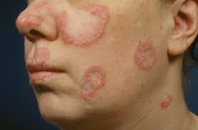
Discoid lupus erythematosus
Notes:
Discoid produces a coin-shaped red, scaly rash on the cheeks, nose, and ears. The rash doesn’t itch or hurt, but once it fades, it may leave the skin discolored. If the rash is on the scalp, hair loss may occur. Sometimes hair loss may be permanent.

Slide 27
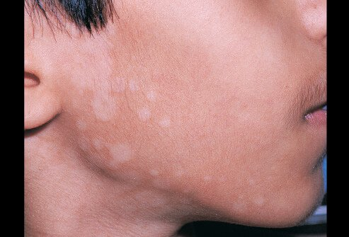
Tinea versicolor
Notes:
fungal infection of the topmost layer of the skin causing scaly, discolored patches.

Slide 28
DC descriptions (changes in red)
7821 Cutaneous manifestations of collagen-vascular disease not listed elsewhere (including scleroderma, calcinosis cutis, subacute cutaneous lupus erythematosus, and dermatomyositis)
7822 Papulosquamous disorders not listed elsewhere (including lichen planus, large or small plaque parapsoriasis, pityriasis lichenoides et varioliformis acuta (PLEVA), lymphomatoid papulosus, mycosis fungoides and pityriasis rubra pilaris (PRP)

Slide 29
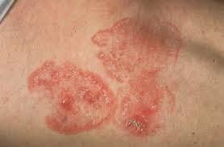
Mycosis fungoid
Notes:
a disease in which T-cell lymphocytes (a type of white blood cell) become malignant (cancerous) and affect the skin

Slide 30
DC notes (changes in red)
7815 Bullous disorders
Added Note: Rate complications and residuals of mucosal involvement (ocular oral, gastrointestinal, respiratory, or genitourinary) separately under the appropriate DC.
7816 Psoriasis:
Added Note: Rate complications such as psoriatic arthritis and other clinical manifestations (oral mucosa, nails) separately under the appropriate DC

Slide 31
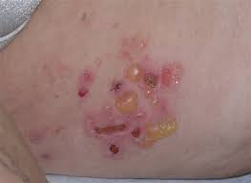
Bullous Disorders
Notes:
Bullous pemphigoid usually appears on the belly, chest, arms, legs, groin, or armpits. It may occur in the mouth as sores. The risk of developing this condition increases with age.
Symptoms include fluid-filled blisters that are often located along creases in the skin. It cannot be cured.

Slide 32
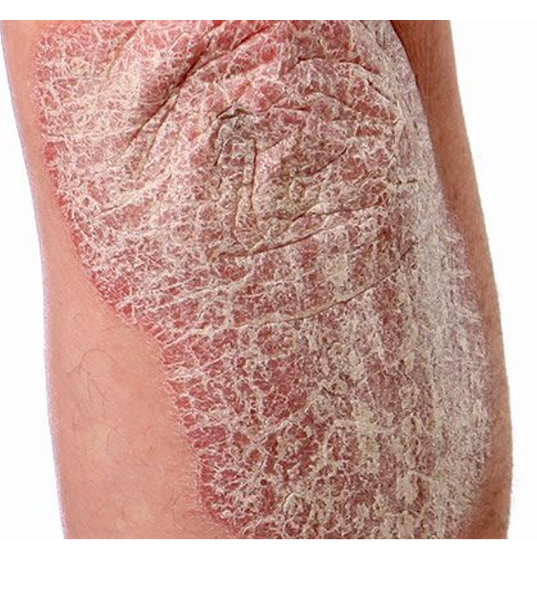
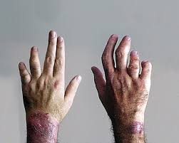
Psoriasis
Psoriasis
Psoriatic Arthritis
Notes:
Psoriatic arthritis (PsA), an inflammatory form of arthritis, affects about 30 percent of people with psoriasis

Slide 33
DC 7825 Chronic urticaria (hives)
Evaluations based on chronicity and “line of treatment”
7825 Chronic urticaria:
For the purposes of this diagnostic code, chronic urticaria is defined as continuous urticaria at least twice per week, off treatment, for a period of six weeks or more
Chronic refractory urticaria that requires third line treatment for control (e.g., plasmapheresis, immunotherapy, immunosuppressives) due to ineffectiveness with first and second line treatments | 60
Chronic urticaria that requires second line treatment (e.g., corticosteroids, sympathomimetics, leukotriene inhibitors, neutrophil inhibitors, thyroid hormone) for control | 30
Chronic urticaria that requires first line treatment (antihistamines) for control | 10

Slide 34
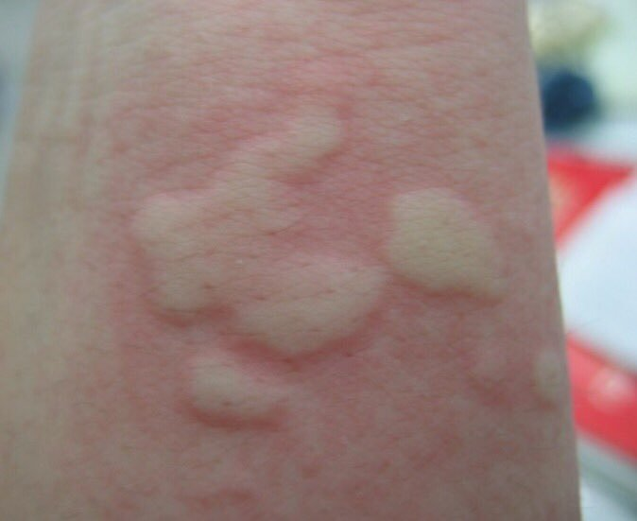
Urticaria (Hives)

Slide 35
DC 7826 Vasculitis
DC 7826 Vasculitis
Changed “debilitating episodes” to “documented vasculitic episode.”

Slide 36
DC 7827 changes
DC 7827 Erythema multiforme; Toxic epidermal necrolysis.
Changes “debilitating episodes” to “recurrent mucosal, palmar, or plantar involvement”
Defines systemic therapy (for this DC only) as immunosuppressives, antihistamines, or sympathomimetics

Slide 37
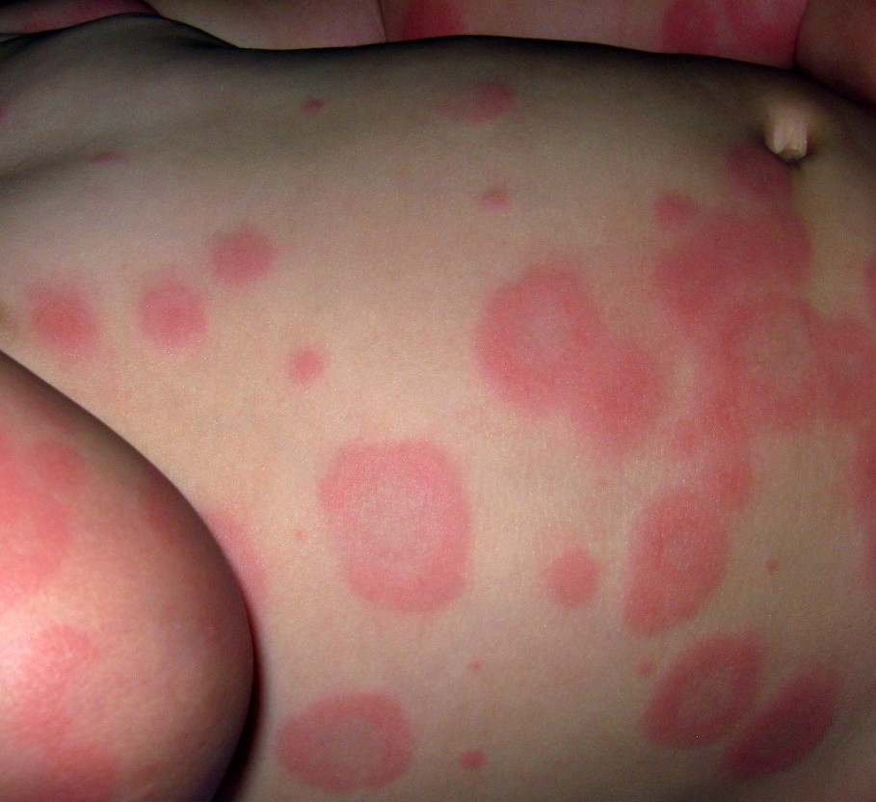
Erythema multiforme

Slide 38
DC 7828 & 7829 changes
DC 7828 Acne.
Removed “superficial cysts”
DC 7829 Chloracne
Removed “superficial cysts”
Adds 20 percent evaluation level:
7829 Chloracne
Deep acne (deep inflamed nodules and pus-filled cysts) affecting the intertriginous areas (the axilla of the arm, the anogenital region, skin folds of the breasts, or between digits) | 20

Slide 39
Other changes
DC 7817 Erythroderma (changed from Exfoliative dermatitis (erythroderma)
Added biologics to systemic therapy examples
Allows for evaluation in cases of documented history of treatment failure
Defines treatment failure: “Either disease progression, or less than a 25 percent reduction in the extent and severity of disease after four weeks of prescribed therapy, as documented by medical records.”

Slide 40
General Considerations-Scars:
Exposed areas as referenced in evaluation criteria refer to the face, neck, and hands. (M21-1.III.iv.4.L.1.g.)
An unstable scar is a scar in which, for any reason, there is frequent loss of covering of skin over the scar. (DC 7804)
Painful scar is found when there is objective indication supporting subjective reports of pain or tenderness. (M21-1.III.iv.4.L.3.b)

Slide 41
General Considerations-Scars:
Scar measurements:
The DBQ requires measurements of
Linear,
Superficial non-linear, and
Deep non-linear scars.
The length and width of each scar is measured in centimeters. Approximate total area by extremity, or trunk area, is provided on the DBQ.

Slide 42
Common skin conditions
Most common skin conditions include:
Scars
Acne
Pseudofolliculitis Barbae
Eczema
Dermatitis
Tinea infections
Psoriasis

Slide 43
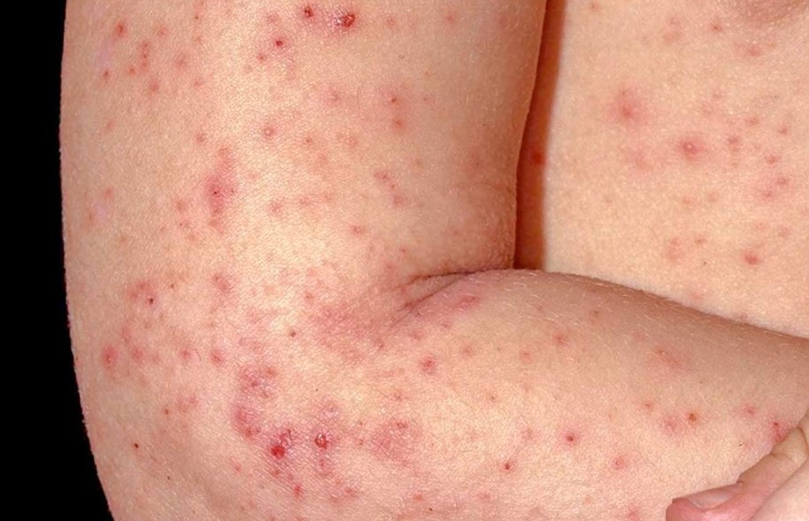
Eczema

Slide 44
Non-Disabilities
The following are not disabilities for VA purposes:
Androgenetic alopecia
Birthmarks, moles
Scars from elective procedures

Slide 45
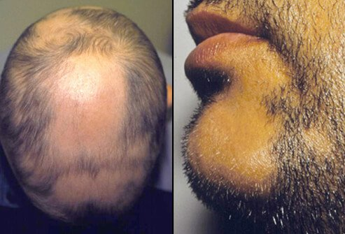
Alopecia Areata

Slide 46
Important considerations

Slide 47
Which criteria apply?
Does the veteran warrant a higher evaluation under the old criteria?
Do they qualify for an increase under the new criteria?
Is there an intent to file (ITF) to consider?
What date did the claim come in?
Is the date entitlement arose based on an increase shown in medical records the applicable effective date?
When was the Veteran released from active duty? Should the effective date be RAD+1?

Slide 48
Scars and Skin Conditions DBQs
Does the DBQ or exam of record give information needed for current criteria?
Did you check for issues considered within the scope of the claim of inferred issues that were brought to issue on the DBQ?
Were all relevant sections pertaining to the condition completed?

Slide 49
Remember the skin law change,
effective
August 13, 2018
Not Liberalizing Legislation under
38 CFR 3.114

Slide 50
QUESTIONS?
Diane Williams

