Slide 1
Communications 101
Terrence Hayes
Director of Communications
& Public Affairs thayes@vfw.org
202-608-8357
September 2020

Slide 2





























































The World’s View of Us
Notes:
Every organization on this slide either wants your money, your membership, or both.

Slide 3



Our Challenge: Being Heard!

Slide 4

Recognizing Our Weaknesses
Brand/Perception
Smokey bars
Geriatric gin joint
Unwelcoming
Old Boy’s Club
Not family friendly
No diversity
No visibility
No communication
No online presence
Dying organization
Funny hats
Too much ritual
Membership dues
No Auxiliary
No relevance

Slide 5
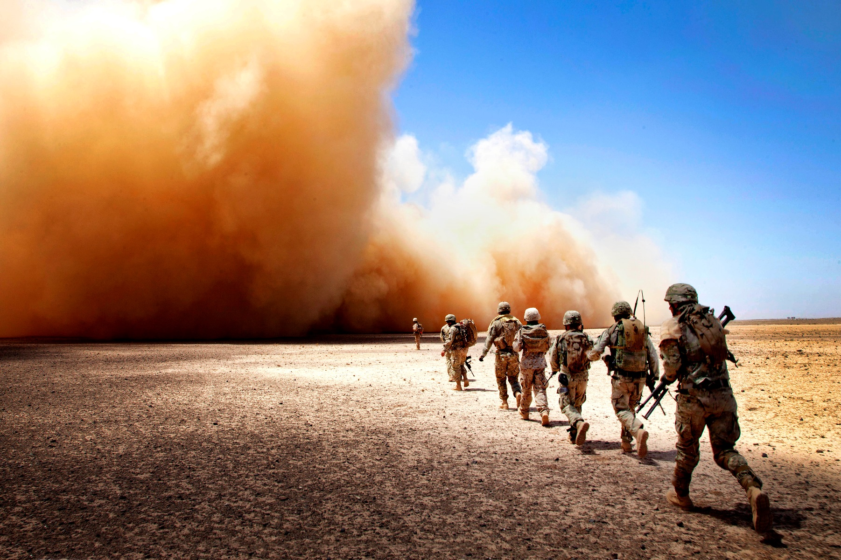
No Relevance?
120-year pedigree of walking the talk from Syria, Iraq and Afghanistan to the Balkins, Rwanda, Somalia, Desert Storm, Panama, Libya, Grenada, El Salvador, Mayaguez, Vietnam, Laos, Cambodia, Congo, Lebanon, Korea, Berlin, World War II, China, Nicaragua, World War I, Dominican Republic, Haiti, Mexico, China, the Philippines, Puerto Rico, Cuba …
And some still say
No Relevance?

Slide 6
Overcoming Our Weaknesses
Listen!
Communicate!
Repeat!
VFW National can’t do it all, but here’s what we are doing …

Slide 7
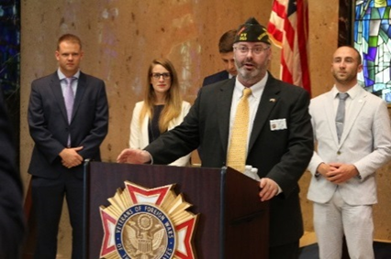
Defining Our Product: Service
Veterans Service
2,100-plus VA-accredited VFW service officers
$9 billion-plus recouped in 2019
Legislative Service
Operating among 30,000 registered lobbyists
Fingerprints on every Quality of Life program
20-plus times VFW has testified before Congress in last year
National Security & Foreign Affairs
Full POW/MIA Accounting Mission
Community Service
$44.1 million annually to local community service projects
$11.6 million in Unmet Needs grants to 10,000-plus families since 2004 (including $5 million-plus from participating Burger Kings since 2007)
9.4 million volunteer hours annually
$7.2 million in Sport Clips Help-A-Hero scholarships to 1,606 veterans since 2014
$3 million annually in student scholarships (VOD, Patriot’s Pen)
2.3 million troops and family members hosted at MAP events since 2005

Slide 8






VFW Communications Initiatives
VFW Magazine 1.1 million subscribers
VFW Facebook 597,061 friends
VFW Action Corps 300,000 members
@VFWHQ Twitter 74,264 followers
VFW Google+ 49,400
VFW LinkedIn 25,402 followers
#VFWPostPride 5,000 submissions
VFW Instagram 7,768 followers
VFW Pinterest VFW YouTube
VFW Check Point
VFW.org Training & Support
Website Solutions
Total Social Audience = 709,144

Slide 9
Surveying Our Readers
GfK MRI, a New York-based leader in magazine research conducted a study from March to May 2018, polling 1,047 VFW members. The results provided demographic and product usage data.
Average age 66
57% are Vietnam War veterans
33% are Desert Storm, Iraq or Afghanistan war veterans
48% are college graduates
Median net worth higher than average U.S. adult males ($333,500 vs. $259,100)
Much more likely to volunteer (40% vs. 16%)
75% are “influentials” vs. 7% U.S. average
Currently looking at expanding subscribers

Slide 10
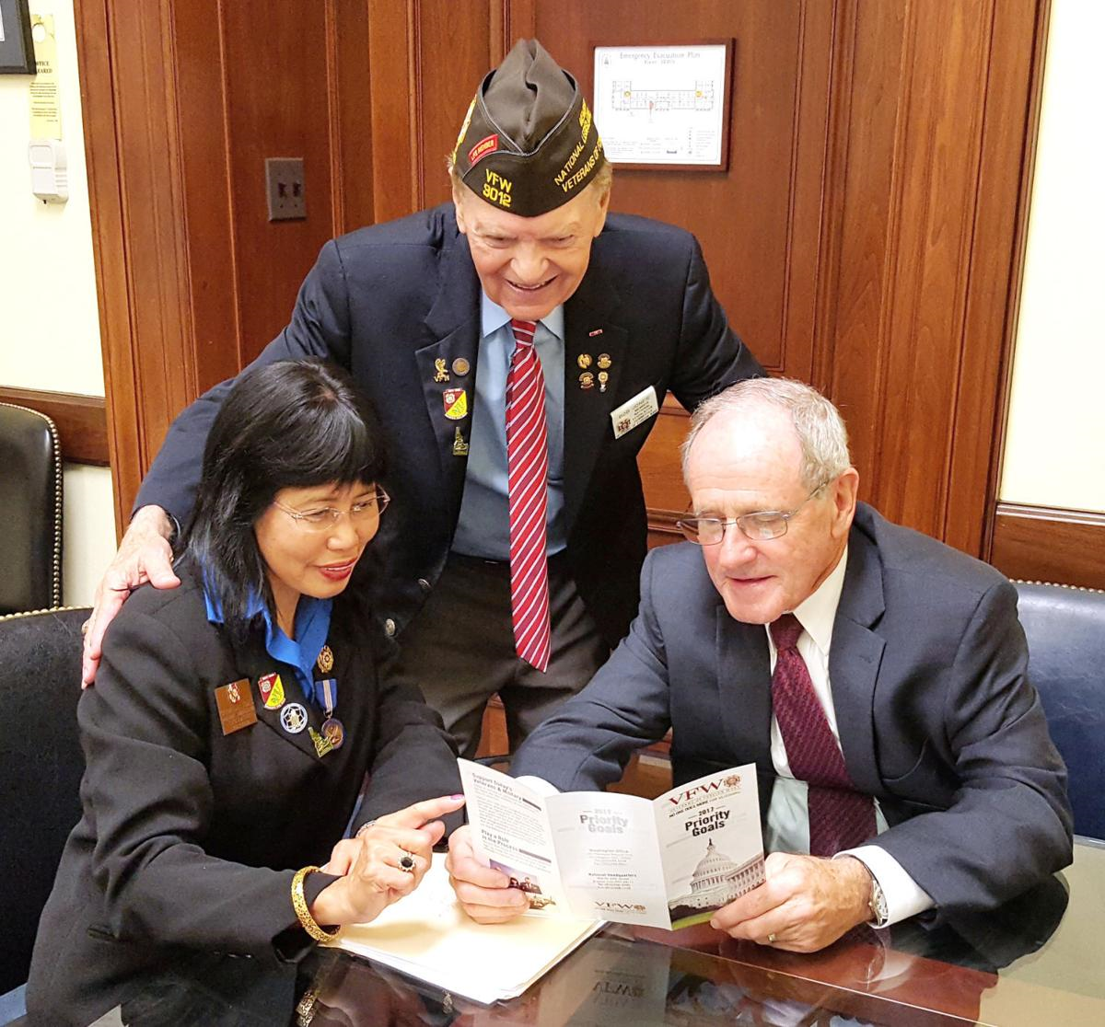
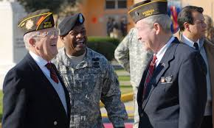
And Opportunities
On Military Units/Installations
Every unit/installation has service member of the year awards, but do local VFWs help recognize their best of the best?
A VFW plaque and dinner for two keeps doors and military minds open to other VFW initiatives.
Don’t forget ROTC, JROTC, EMS, Scouting and others.
For Members & Families
Does communication end after dues are paid?
Does your Post have a social media and web presence?
Did you know only 80,000 VFW members share mailing addresses with Auxiliary members?
Huge potential for both organizations.

Slide 11
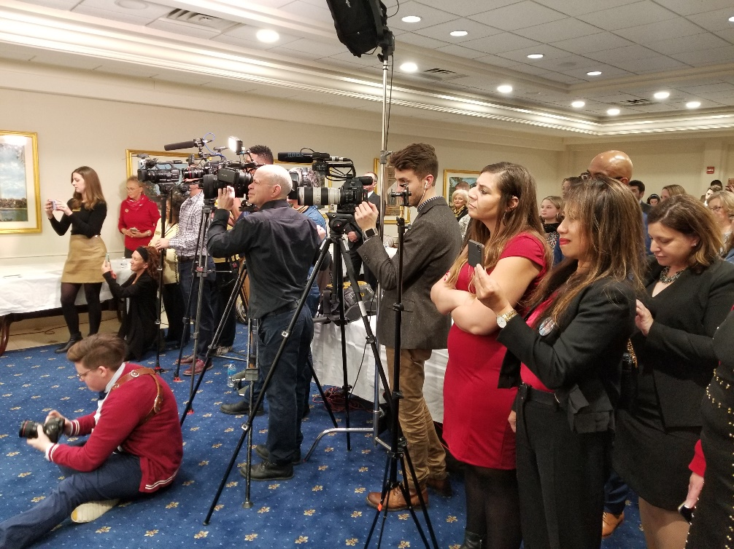
Creating More Opportunities
With News Media
The press serves as a force multiplier to communicate National and local themes and messages
Most media are uneducated in military and/or veteran matters.
Positive media coverage begins with developing professional relationships.
Most media are neutral or positive.

Slide 12
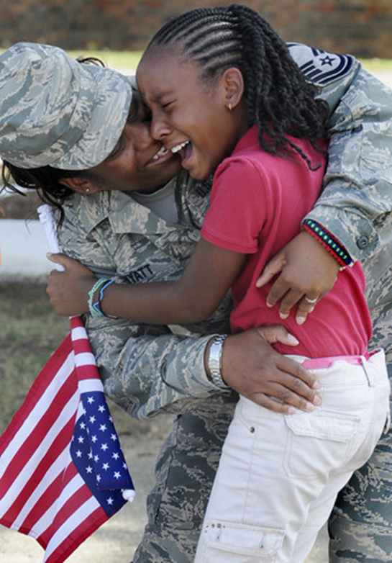
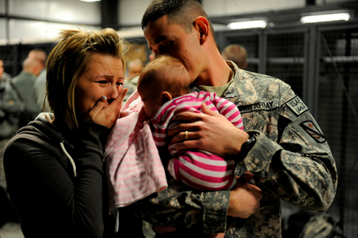
Refining Opportunities
Success depends on message
Positive communication begins with a sound strategic communication campaign
Talk in clear, concise soundbites (15-20 seconds)
Message development
Answer + Message = Response

Slide 13

Media Rules of Engagement
You are always on the RECORD.
Never use “No comment.”
Admit if you do not know the answer to a question.
Remain apolitical at all times.
Prepare talking points.
Be clear and concise in your responses.
Always tell the truth.
Practice before conducting any interview.
You can decline an interview.
And if ever in doubt, call National for assistance.

Slide 14
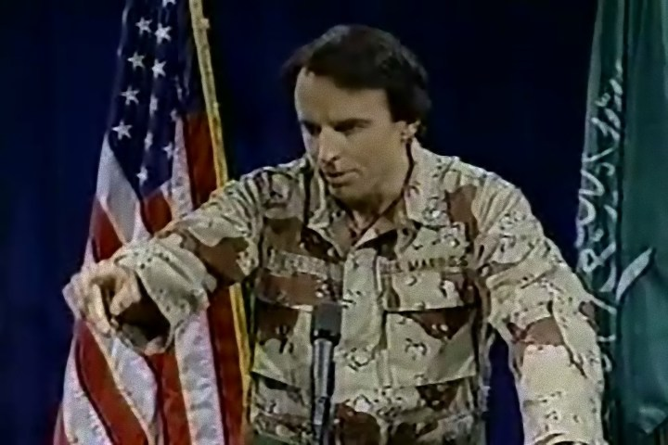
In Closing
Desert Storm Press Conference

Slide 15
You share the story, we tell the world!
QUESTIONS?

