Slide 1
Legislative Department
Patrick Murray, Director
National Legislative Service

Slide 2
The Importance of Legislative Advocacy
Veterans Benefits Do Not Just Happen
100 Years of Legislative Advocacy
Veterans Preference
WWI War Bonuses
GI Bill
Toxic Exposures
Protect What We Have Secured
Elimination of IU and other CBO proposals
COLA round down
TRICARE copay increases

Slide 3
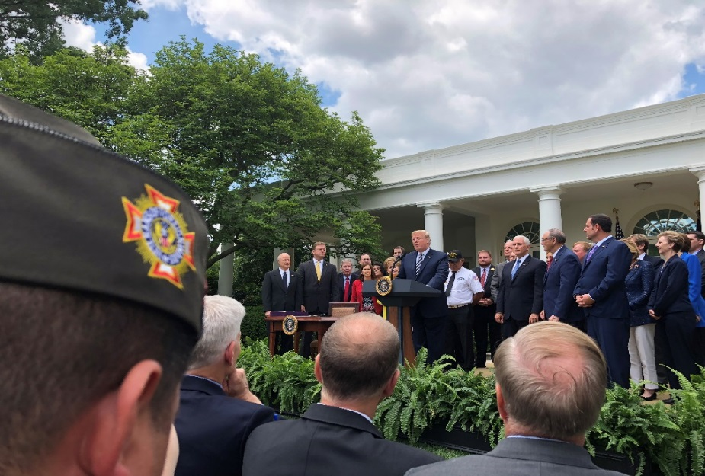
Recent Victories:
VA MISSION Act of 2018
Forever GI Bill
Blue Water Navy Vietnam Veterans Act
Elimination of the Widow’s Tax

Slide 4

2020 Priority Goals:
Toxic Exposures
Bladder cancer, hypothyroidism, and parkinsonism added to NDAA
Veterans Health Care
S. 785, Commander John Scott Hannon Veterans Mental Health Care Improvement Act of 2019
S. 514/H.R. 3224, Deborah Sampson Act
48-Hour Rule

Slide 5
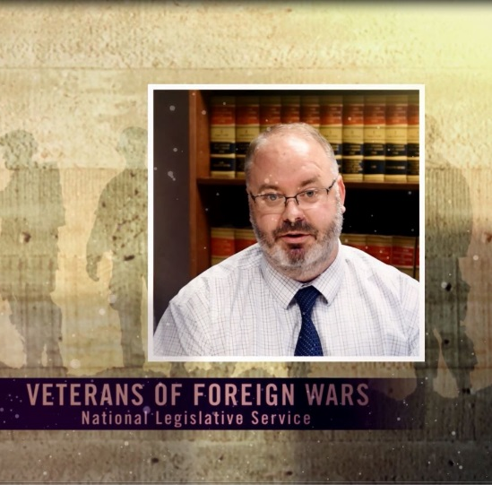
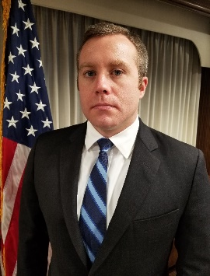
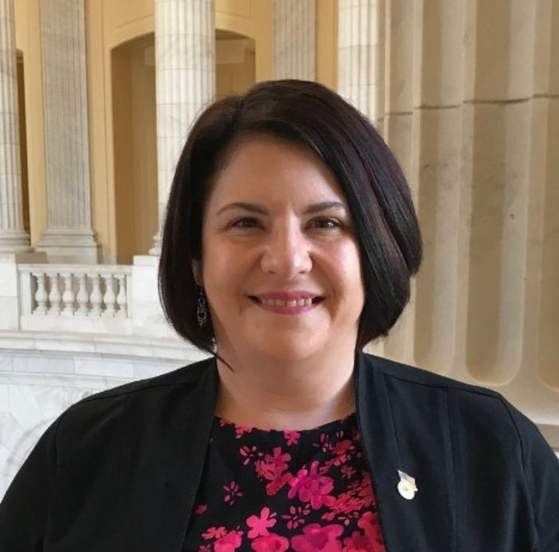
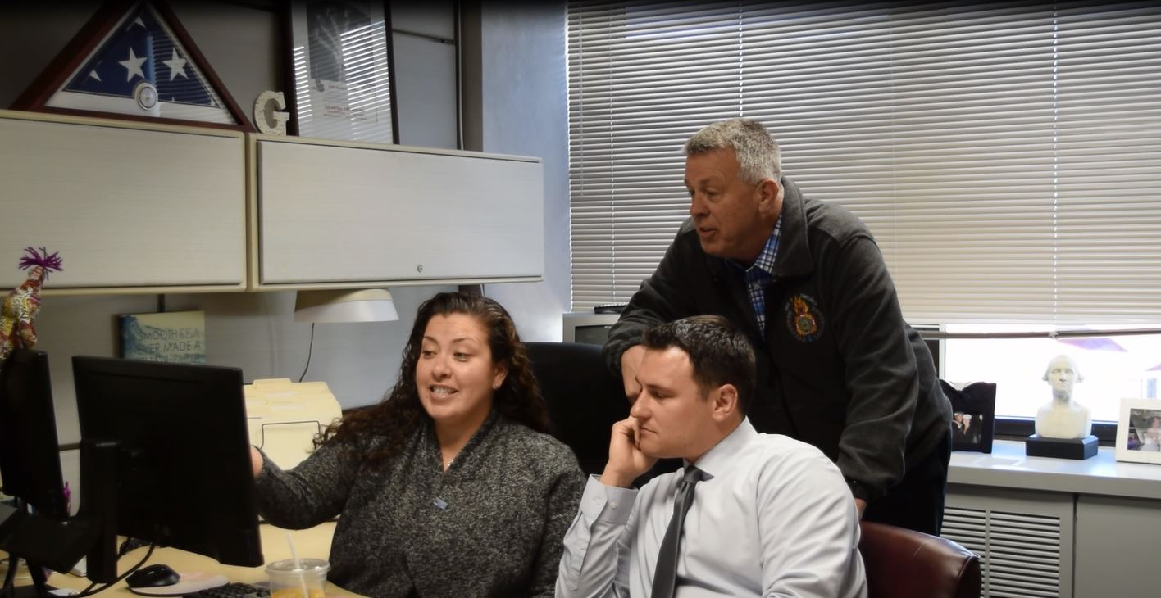
We Are Here to Help:
www.vfw.org/advocacy
Talking Points & Priority Goals
Congressional Testimony
Action Corps
Read the weekly
Take action
Sign up advocates

Slide 6
QUESTIONS?
Contact the VFW National Legislative Service
Email: PMurray@vfw.org
Call: (202)608-8365

