Slide 1
VA
Customer Experience (CX)
Veterans Experience Office (VEO)
September 2021
By deeply understanding our Veterans, VEO designs with and for our community to enable VA to deliver exceptional products and services.

Slide 2





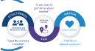



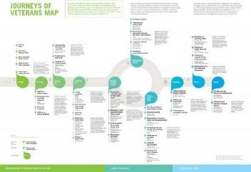

VA’s Customer Experience Journey Line
Through transformational leadership and dedicated employees, VA committed itself to core values, characteristics and principles that define the organization and how it serves Veterans, their families, caregivers, and survivors
 | Customer Experience Prime Directive
 | VA/VEO Leads PMA CAP Goal for Improving Customer Experience
 | VA Welcome Kit published VA.gov redesign (11/2018)
VA Trust 55%
FY2016 Q2
 | Employee Experience Journey Map published (9/30/2020)
 | CX Cookbook Released (11/2020)
 | VA Directive 0010: VA Customer Experience (12/7/2020)
38 C.F.R. amended to include ICARE Core Values and Characteristics §§ 0.600-0.602 (7/13/2012) | Phoenix OIG Report released (8/2014)
2012 | 2014 | 2016 | 2018 | 2020
2011 | 2013 | 2015 | 2017 | 2019 | 2021
ICARE formally introduced (6/20/2011) |  |  | Patient Experience Program launched | 38 C.F.R. § 0.603 added to include CX Principles (5/20/2019)
 | I CARE Refresh “The VA Way”
 | VA Trust Report released
 | MyVA Transformation to rebuild trust, VEO was established.
 | Veterans Journey Map published (11/2015)
VETERANS
EXPERIENCE OFFICE
VA Trust 78% FY2021 Q3

Slide 3


VEO Vision & Mission
To leverage customer experience (CX) data, tools, technology, and engagement to enable the Department of Veterans Affairs (VA) to be the leading CX organization in government, so Service members, Veterans, their families, caregivers and survivors choose VA.
VEO supports VA as the Secretary of Veterans Affairs’ CX insight engine and a shared service to partner with, support and enable VA Administrations and Staff Offices to provide the highest quality CX in the delivery of care, benefits and memorial services to Service members, Veterans, their families, caregivers and survivors.
VISION
MISSION

Slide 4
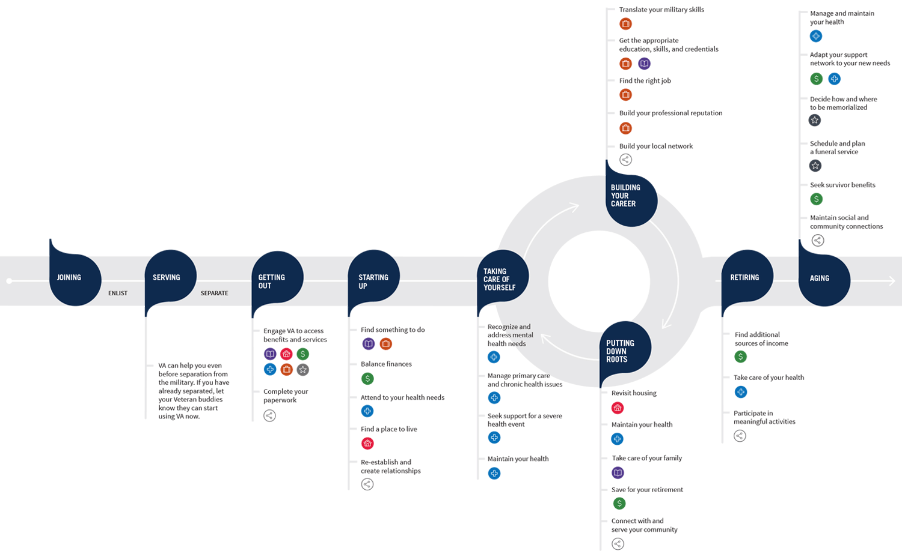
Driving the Delivery of VA Services from the Veteran’s Perspective
VA from a VA Perspective | VA from a Veterans Perspective
This Veterans Journey Map* identifies key moments that matter to Veterans and aligns VA care, benefits and memorial services available according to the Veteran’s life journey.
Secretary
- - - - - - - - - - - - - -
Deputy Secretary
Staff Offices
Veterans Health Administration
Veterans Benefits Administration
National Cemetery Administration
* The Veteran Journey Map is foundational to VA’s Strategic Plan, available at: www.va.gov/oei/docs/VA2018-2024strategicPlan.pdf.

Slide 5
VEO Structure
VEO was established in 2015 with VA’s Chief Veterans Experience Officer reporting directly to the Secretary and is structured around its four core capabilities of DATA, TOOLS, TECHNOLOGY and ENGAGEMENT.
Secretary of Veterans Affairs
Chief Veterans Experience Officer John Boerstler (Appointed) Deputy Chief Veterans Experience Officer Barbara C. Morton (SES)
Chief of Staff
Employee Experience and Operations
Enterprise Measurement & Design Directorate
Capture and analyze the voices of the Veteran, their family, caregivers, and survivors Qualitative & quantitative data Veteran interviews & listening (human-centered design) Real-time, web-based customer experience survey data capture (Veterans Signals) Veteran experience data analysis Insight & design Project management
Patient Experience Directorate
Build and deliver Veteran experience tools and products for VHA and Staff Offices Customer-driven and industry informed experience frameworks Veteran Patient Experience Tools Veteran Customer Service training Journey Maps
Benefits Experience Directorate
Build and deliver Veteran experience tools and products for VBA/NCA/BVA and Staff Offices Customer-driven and industry informed experience frameworks Veterans Benefits Experience tools Appeals modernization support Veteran Customer Service training Journey Maps
Multi-Channel Technology Directorate
Deliver easy and effective Veteran experiences through all communication channels VA.gov Hotline & Contact Center Modernization Unified Customer Relationship Management (CRM) Veteran PROFILE common customer data
Veteran, Family, & Community Engagement Directorate
Support Veterans through coordination and integration of local VA and non-VA services Navigation Veterans Experience Action Centers (VEACs) Community Veterans Engagement Boards (CVEBs) Federal Advisory Committees Veteran-Friendly Communities
Notes:
Directorate Overview:
The Portfolio Management Directorate (PMD) supports VEO as a key business integrator, including coordination across VEO Directorates and VA. PMD applies portfolio management best practices through a robust project intake and tracking capability to monitor project execution and measure impact. PMD further facilitates integrated project teams for Enterprise-wide initiatives as well as specific projects for VA Administrations and Staff Offices and creates actionable plans / recommendations for project execution.
The Enterprise Measurement and Design (EMD) Directorate employs human-centered design (HCD) techniques and Veterans Signals (VSignals) Surveys to gather and analyze qualitative and quantitative data to create a shared understanding of Veterans concerns and bright spots in their interactions with VA. EMD enables data-driven strategy and decision making in VA and VEO by hardwiring quantitative and qualitative insights and predictive analytics in the Department to improve service recovery and VA performance. This capability allows the Department to view VA’s performance from the Veteran’s perspective and holds VA accountable to Veterans. Modeling after industry, EMD gathers multiple tiers of CX input.
The Patient Experience (PX) Directorate partners with the Veterans Health Administration to create and implement a patient experience improvement program across VHA facilities. In partnership with VHA, PX develops tangible CX tools and best practices to empower employees to provide and enable a consistent, world-class patient experience for Veterans, their families, caregivers and survivors who seek health care at VA facilities.
The Benefits Experience (BX) Directorate supports the Veterans Benefits Administration, National Cemetery Administration, and the Board of Veterans’ Appeals by developing tangible tools, including training and other programs, to provide world-class customer experiences for Veterans, their families, caregivers and survivors.
The Multi-Channel Technology (MCT) Directorate, in partnership with other VA offices, ensures services offered via web self-service and contact centers are designed and implemented based on customer insights, and are supported by authoritative customer information. The Office partners with VA’s Office of Information and Technology to deliver high touch, technology-enabled customer service capabilities throughout the enterprise thus enabling Veterans and others to access information, benefits and services anywhere, anytime.
The Veterans, Family and Community Engagement (VFCE) Directorate partners with local communities and serves as a conduit for on-the-ground listening and information distribution through the community network. VFCE thus enables two-way communication between Veterans and the local community, and the Department to improve outcomes for transitioning Service members, Veterans, families, caregivers and survivors

Slide 6

VEO Capabilities

Slide 7




VA CX Principles
CX Principles are codified in 38 C.F.R. § 0.603 as part of VA’s Core Values & Characteristics
EASE
VA measures CX along the core principles of CX:
Ease. VA will make access to VA care, benefits, and memorial services smooth and easy.
Effectiveness. VA will deliver care, benefits, and memorial services to the customer's satisfaction.
Emotion. VA will deliver care, benefits, and memorial services in a manner that makes customers feel honored and valued in their interactions with VA.
The combination of these factors impact the overall trust the customer has in VA.
TRUST
EMOTION
EFFECTIVE

Slide 8
Drivers of CX at VA
VA through VEO is hardwiring CX as a core capability to provide the best experiences in delivery of care, benefits and memorial services to Veterans, Service members, their families, caregivers and survivors
Veterans, Families, Caregivers & Survivors | Needs and experience of Veterans, their families, caregivers and survivors to drive VA strategy and decision making.
 | 38 C.F.R § 0.603 | Adds CX Principles to VA’s Core Values and Characteristics. Codifying these principles and measuring CX through Ease, Effectiveness and Emotion, will ensure that Veterans, their families, caregivers, and survivors receive the proper emphasis at all levels within VA and become an enduring part of the VA culture (May 20, 2019).
 | VA Directive 0010 | Establishes policy, requirements and accountability for VA CX in accordance with 38 C.F.R. §§ 0.600-0.603 to ensure all Veterans, Service members, their families, caregivers and survivors receive consistent world-class experiences across VA (December 7, 2020).
 | White House Initiatives | Initiatives such as those listed below play a key role in scaling and sustaining CX across government. Executive Order 13985: Advancing Racial Equity and Support for Underserved Communities Through the Federal Government (January 20, 2021). President’s Management Agenda (PMA) Cross Agency Priority (CAP) Goals
 | VA CX APG | VA Agency Priority Goal (APG) requires reporting on Veteran experience (trust, ease, effectiveness and emotion) with customer satisfaction through VA.gov.
 | VA Strategic Plan | Designed around the Veteran experience and Veterans Journey Map to drive VA-wide strategic focus on CX.
 | VEO CX Framework | Defines Core CX capabilities as data, tools, technology and engagement.
Additional driver in the pipeline:
Trust in Public Service (TIPS) Act, if passed, would require Federal agencies to collect CX data and use it for service recovery and performance improvement.
 | VA Governance | Hardwires CX data into VA strategy and decision-making, to include for the Navigator Initiative.

Slide 9
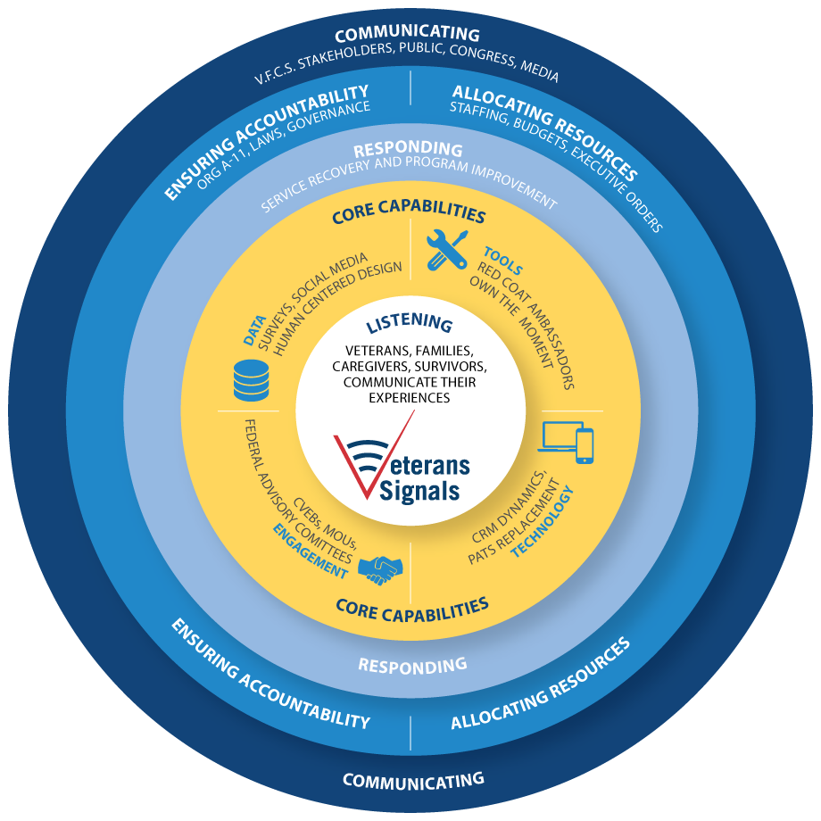
VA CX Strategy
Pursuant to VA Directive 0010: VA Customer Experience (December 7, 2020) VA is strategically institutionalizing CX goals in policy and operational decision-making to deliver exceptional customer experiences along 3 key pillars:
Pillar I: CX Core Capabilities & Framework Drives improvements to individual service recovery and systems performance improvement using industry best practices and CX insights (i.e., human-centered design (HCD), CX data)
Pillar II: CX Governance Hardwires CX data and insights into VA strategy, decision-making and management
Pillar III: CX Accountability Infuses CX into performance metrics, budget strategy, policy and operations

Slide 10
Pillar I: CX Core Capabilities & Framework

Slide 11
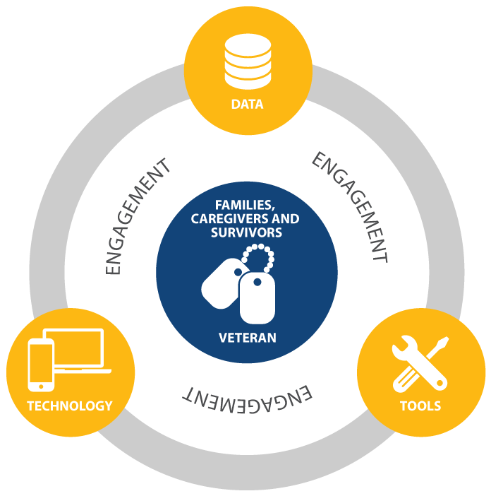
VA CX Core Capabilities
Modeling after the private sector, VA is implementing CX with four core capabilities: data, tools, technology and engagement.
Data | Capture and analyze the voices of Veterans, their families, caregivers and survivors
HCD Research | Veterans Signals (VSignals) Surveys | VA Trust Score | CX Data Analytics
Tools | Build and deliver tangible CX tools and products across VA
VA Welcome Kit | Quick Start Guides | Own the Moment Training | WECARE Rounding | VA Customer Experience Institute (VACXi) – HCD Training and PX University | Red Coat Ambassador Program | Inpatient Solutions | ICARE Refresh | CX Consultations | EX Solutions | Letters Rewrite
Technology | Deliver easy and effective Veteran experiences through all communication channels
White House/VA Hotline | VA Profile | Unified Customer Relationship Management | Patient Advocate Tracking System-Replacement (PATS-R) | Contact Center Modernization | Digital Modernization (VA.gov)
Engagement | Connect VA and local public / private services in a coordinated support network for Veterans, their families, caregivers, and survivors
Veterans Experience Action Centers (VEACs) | Community Veteran Engagement Boards (CVEBs) | Strategic Partnerships | #VetResources Newsletter | Choose Home Initiative | Federal Advisory Committees – Greater Los Angeles and Veterans’ Family, Caregiver, and Survivor

Slide 12
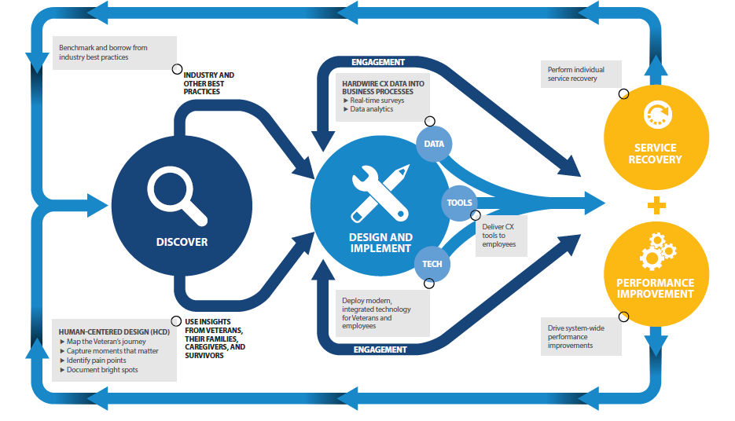
VA CX Framework
The CX Framework showcases how VEO implements CX initiatives across VA and can be applied across Federal Agencies
Discover
Qualitative interviews
Synthesis
Identify moments that matter, pain points, bright spots
Design & Implement
Rapid prototyping, testing, and product refinement
Design and implement CX surveys, tangible tools, modern technology, targeted engagement
Respond & Improve
Making it right for individuals through service recovery
Monitoring system-wide performance and instituting performance improvements globally
Benchmark and borrow from industry best practices
ENGAGEMENT
Perform individual service recovery
INDUSTRY AND OTHER BEST PRACTICES
HARDWIRE CX DATA INTO BUSINESS PROCESSES
Real-time surveys
Data analytics
DATA
SERVICE RECOVERY
TOOLS
DISCOVER
Deliver CX tools to employees
DESIGN AND IMPLEMENT
TECH
PERFORMANCE IMPROVEMENT
Deploy modern, integrated technology for Veterans and employees
HUMAN-CENTERED DESIGN (HCD)
Map the Veteran’s Journey
Capture moments that matter
Identify pain points
Document bright spots
USE INSIGHTS FROM VETERANS, THEIR FAMILIES, CAREGIVERS, AND SURVIVORS
Drive system-wide performance improvements
ENGAGEMENT
Notes:
PX EXAMPLE
DISCOVER:
HCD RESEARCH – Map the Veteran’s Journey; Capture Moments That Matter Most; Identify Pain Points; Document Bright Spots
BENCHMARK AND BORROW FROM INDUSTRY BEST PRACTICES – Cleveland Clinic, Mayo Clinic, Beryl Institute, UCLA Medical Center
DESIGN AND IMPLEMENT
DATA: HARDWIRE CX DATA INTO BUSINESS PROCESSES – Real-time Surveys for VHA; Outpatient Services; Data Analytics
TOOLS: DELIVER FOUNDATIONAL PX FRAMEWORK AND TOOLS TO EMPLOYEES – Red Coat Ambassadors; Own the Moment CX Training; WECARE Rounding; Standard Phone Greetings; Employee Badges
TECHNOLOGY: DEPLOY MODERN, INTEGRATED TECHNOLOGY/ CASE MANAGEMENT – CRM Dynamics; PATS Replacement
RESPOND & IMPROVE
PERFORM INDIVIDUAL SERVICE RECOVERY – VHA Patient Advocates; Service Line Leadership
DRIVE SYSTEM-WIDE PERFORMANCE IMPROVEMENTS – VHA Senior Leaders; VHA Office of Patient Advocacy

Slide 13
VEO Application of CX Core Capabilities

Slide 14
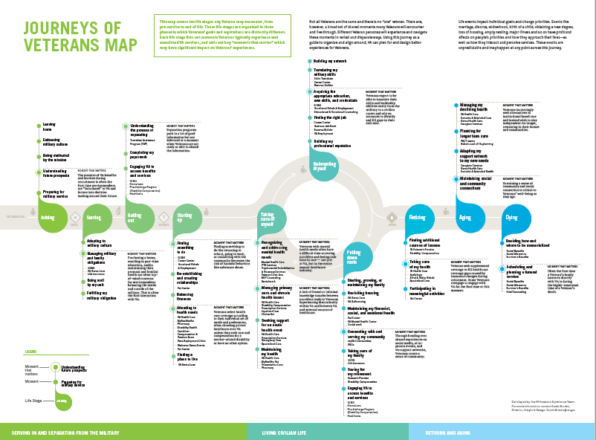
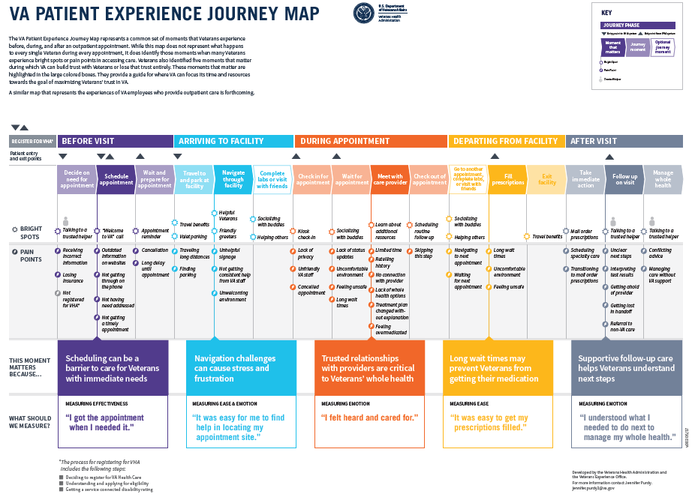
CX Data: Human-Centered Design (HCD)
HCD enables VEO to gather key insights directly from Veterans, Service members, their families, caregivers and survivors to identify the moments that matter most, pain points and bright spots
Journey maps uncover moments that matter most to Veterans that might not naturally appear on traditional operational dashboard
VEO has created 45 unique journey maps and accompanying insight reports that are used to prototype and ultimately deploy tangible CX tools and products

Slide 15





CX Data: Digital Listening
The Veterans Signals (VSignals) Platform collects and analyzes CX data and insights in real-time to inform service recovery and performance improvement efforts across VHA, VBA, NCA and the Board
Administration and Program Priorities
Monitor Veteran insights identified as priorities of Administrations and program offices with immediate access to descriptive, predictive and prescriptive analytics
Trust Scores
Measure CX metrics—Ease, Effectiveness, Emotion and Trust—at the service level and compare across business lines
Live Feed
Review Veteran insights within seconds of a survey or any digital insight submission
Intelligent Search
Search intelligently through insights data to monitor priorities, compliments, concerns, and recommendations; data cuts by location, age, gender, time frame, predictive analytics to identify emerging topics
Social Media Scraping
See what conversations are taking place in social media on VA digital accounts like VA Facebook and Twitter accounts
Emerging Topics
Monitor conversations to detect or predict what is emerging, especially before topics Veterans discuss intensify
 | 94 UNIQUE SURVEYS
 | 43.0 MILLION SURVEYS SENT
 | 7.3 MILLION RESPONSES / 17.2% RESPONSE RATE
 | 2.5 MILLION FREE-TEXT COMMENTS

Slide 16

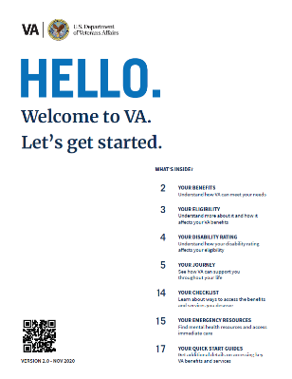



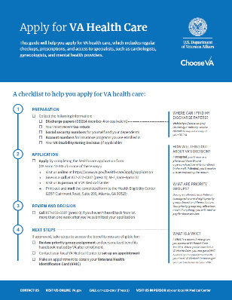


CX Tools
VEO has developed and deployed dozens of tangible CX tools across VA to empower employees to deliver excellent experiences and allow Veterans, their families, caregivers and survivors better access and navigate benefits and services
Training
VA Welcome Kit & Quick Start Guides
 | Own the Moment CX Training sets CX behavioral standards for employees 115,000+ employees trained Is the core of VA’s Annual ICARE Training refresh for all VA employees
 | WECARE Leadership Rounding trains leaders in industry best practice of regular rounding
 | Red Coat Ambassadors Program outfits volunteers across VA health care facilities with red coats to greet and assist Veterans with wayfinding services, and information about services and programs Deployed at 147 VHA sites Ease of navigation increased 4% between FY2018 and FY2019
 | Standard Phone Greeting sets consistent phone experience with a simple, 4-part greeting that ensures that Veterans know where they have called and understand how the employee can assist
 | Green Gloves Initiative helps employees and Veterans feel more comfortable at VA facilities by encouraging a clean and safe environment; as a result, the SHEP cleanliness score increased 3% between FY2018 and FY2020
The VA Welcome Kit gives customers clear and accurate guided journeys to navigate VA’s comprehensive offerings 1.3M+ downloads 260,000 printed and distributed across VA and to non-VA stakeholders, including Veterans Service Organizations, Congress and others
Quick Start Guides describe in simple steps and plain language how to access specific VA benefits and services; currently 14 guides are available on VA.gov such as: Applying for a Disability Rating, Education Benefits, Survivor Benefits and VA Health Care Getting Started with Health Services for Women Veterans, Caregiver Benefits, and Mental Health Services
Toolkits

Slide 17


CX Technology
Enterprise Data Management
Building a Veteran-centric information infrastructure, VEO’s Enterprise Data Management enables VA to deliver seamless contact center and digital experiences for Veterans and their supporters Business owner for VA Profile, the authoritative source for 14.5M+ Veterans’ customer data profiles, which automatically updates across VA systems
Contact Center Modernization
Enhancing personalized customer experiences Provides common Customer Relationship Management software platform across VA contact centers to provide a single view of the Veteran For the first time, Veterans can now update an address by phone and online, and updates will be captured across VHA and VBA systems – 650,000+ Veteran updates to their contact information
Digital Modernization
Making it easier for Veterans to access and navigate VA services online Relaunch of VA.gov as redesigned based on Veteran feedback and preferences providing a single digital front-door to access all VA services As a result, average monthly total users increased by 221% and user satisfaction increased by 25%
Enterprise Data Management
Enterprise Data
Management
Contact Center Modernization
Contact Center Modernization
Digital Modernization
Digital Modernization

Slide 18
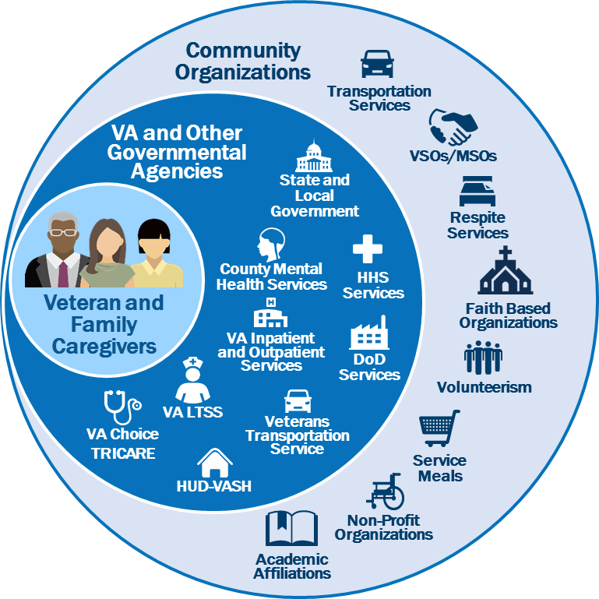
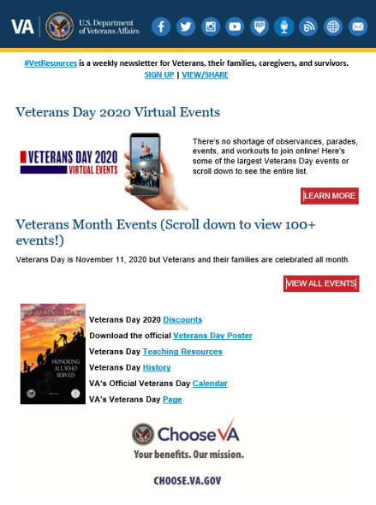
CX Engagement
Veterans’ Families, Caregivers and Survivors Federal Advisory Committee (FAC)
Veterans’ Families, Caregivers and Survivors Federal Advisory Committee (FAC)
First FAC of its kind to establish listening channel for Veteran families, caregivers and survivors Chaired by Senator Elizabeth Dole is comprised of Veteran representatives and national leaders
Community Veteran Engagement Boards (CVEBs)
Local community listening and information distribution channels CVEBs are nation-wide (map) Catchment area of 12.5M Veterans and 50M Veteran family members, caregivers and survivors
#VetResources Newsletter
VEO’s weekly newsletter sent to 11.6M subscribers highlighting VA and non-VA resources for Veterans, their families, caregivers and survivors Sent more than 1 billion emails, resulting in 290M opens, 55M clicks to resources and 150,000 clicks to the Veterans Crisis Line since 2019
Veterans Experience Action Centers (VEACs)
Events that allow Veterans, their families, caregivers and survivors to directly engage with VA to resolve questions and gain assistance with VA benefits and services VEACs are collaborative events, both in-person and virtual, between community partners and VA which contributed to over 1,600 claims filed (resulting in more than $3,000,000 in retroactive grants received) and 300 new enrollments in VA health care 94% satisfaction rate from Veterans and their supporters during inaugural Virtual VEAC
Community Veteran Engagement Boards (CVEBs)
#VetResources Newsletter
Veterans Experience Action Centers (VEACs)

Slide 19
VA-Wide Trust Survey Results Since FY 2016 Q2
Since the inception of the VA-Wide Trust Survey, Veteran Trust, Ease, Effectiveness and Emotion have all risen.
Trust | Ease | Effectiveness | Emotion
23% ↑ | 11% ↑ | 5% ↑ | 12% ↑
“I trust VA to fulfill our country’s commitment to Veterans.” | “It was easy to get the care or service I needed.” | “I got the care or service I needed.” | “I felt like a valued customer.”

Slide 20
VEO Application of CX Capabilities to the Employee Experience (EX)

Slide 21
Improving the Employee Experience (EX)
Goal: To provide easy, effective and emotionally resonant experiences for employees across their workforce life-cycle as members of the VA team by leveraging proven CX data, tools, technology and engagement capabilities to maximize recruitment and retention.
VEO in collaboration with HRA/OSP created VA’s first-ever EX Journey Map: For the first time ever, this journey map identifies the moments that matter to employees (i.e., applying, hiring, onboarding), bright spots and pain points encountered throughout an employee’s journey with VA.
11,000 data points captured from employee interviews
5 phases in which an employees’ goals and expectations are distinctly different:
Considering & Getting in
Starting Up
Performing, Growing, and Adapting
Changing Roles
Moving On
Within the 5 phases, there are 23 employment stages a VA employee may encounter
Within the 23 stages, 30 identifiable moments that matter are highlighted
Employee Experience
Customer Experience

Slide 22
Pillar II: CX Governance & Pillar III: CX Accountability

Slide 23
Pillar II: CX Governance and Pillar III: CX Accountability
Hardwires and institutionalizes customer experience data and insights into VA strategy and decision-making
VA CX Governance Model |  | VA CX Accountability
Organizational
Individual
Senior Leadership
VA senior leadership considers and ultimately approves recommendations
President’s Management Agenda (OMB A-11 Circular)
VA Agency Priority Goal
VA Directive 0010
VA Trust score
Amendment to 38 C.F.R. to include CX Principles
SES performance plans
Transactional surveys
Matrixed Integrated Project Teams (IPTs)
Matrixed IPTs with subject-matter experts from across VA develop recommendations and strategies
Veteran Experience Data & Insights
Gather CX data & insights through qualitative interviews (HCD), real-time surveys and other feedback channels, and business challenges in need of resolution drive priorities

Slide 24
Resources and References
REFERENCES
38 C.F.R. §§ 0.600-0.603, Core Values, Characteristics, and Customer Experience Principles of the Department: www.govinfo.gov/content/pkg/CFR-2019-title38-vol1/pdf/CFR-2019-title38-vol1-part0-subpartA.pdf Employee Experience Journey Map: https://www.blogs.va.gov/VAntage/82394/va-creates-governments-first-ever-employee-experience-journeymap/ OMB A-11 Circular Section 280 – Managing Customer Experience and Improving Service Delivery: https://www.performance.gov/cx/assets/files/a11-280.pdf SECVA CX Policy (August 22, 2018): vaww.Insider.VA.gov/wp-content/uploads/2018/08/Customer-Service-Policy-Statement-SECVA-Signed.pdf VA APG: https://trumpadministration.archives.performance.gov/veterans-affairs/ VA Directive 0010: VA Customer Experience: https://vaww.va.gov/vapubs/viewPublication.asp?Pub_ID=1217&FType=2 VA FY 2021 Budget Submission (VEO on p. 399): www.va.gov/budget/docs/summary/fy2021VAbudgetvolumeIIIbenefitsBurialProgramsAndDeptmentalAdministration.pdf VA Strategic Plan: www.VA.gov/OEI/docs/VA2018-2024strategicPlan.pdf VA Trust Report: www.va.gov/trust Veterans Journey Map: www.blogs.va.gov/VAntage/wp-content/uploads/2020/02/Veteran-Journey-Map.pdf
RESOURCES
Community Resources, Information and Toolkits: www.VA.gov/VE/Engagement/Resources.asp Discover Virtual Events for Veterans, their Families, Caregivers and Survivors: www.va.gov/outreach-and-events/events/ Sign up to Receive #VetResources Newsletter: www.va.gov/VetResources VA CX Accomplishments Report: www.va.gov/ve/docs/cx/customer-experience-accomplishments.pdf VA CX Cookbook: www.va.gov/ve/docs/cx/customer-experience-cookbook.pdf VA Welcome Kit and Quick Start Guides: www.va.gov/welcome-kit/ VEO: www.VA.gov/VE/ VEO Catalog of Services: https://www.va.gov/ve/docs/cx/customer-experience-capabilities.pdf VEO SharePoint Site: https://dvagov.sharepoint.com/sites/VACOVEO/

Slide 25
Whether just getting out of the military or have been a civilian for many years, DOWNLOAD THE VA WELCOME KIT, at https://www.va.gov/welcome-kit/, to help guide you to the benefits and services you have earned.
SIGN UP TO RECEIVE #VETRESOURCES for weekly information on resources for Veterans, their families, caregivers and survivors at www.va.gov/VetResources.
DISCOVER VIRTUAL EVENTS for Veterans, their families, caregivers and survivors at https://www.va.gov/outreach-and-events/events/.

