Slide 1
VA
Board of Veterans’ Appeals Update
Updates-November 2021

Slide 2
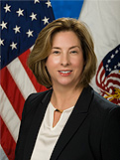
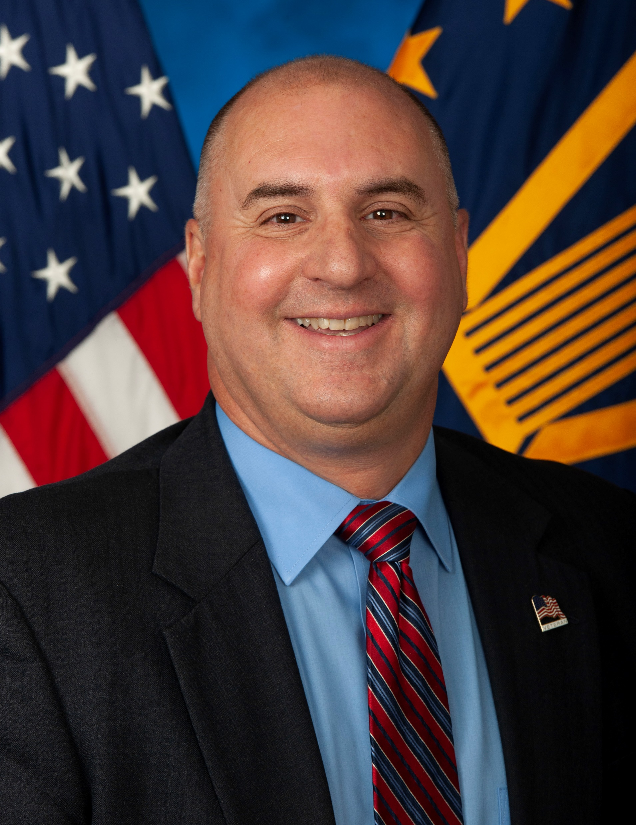
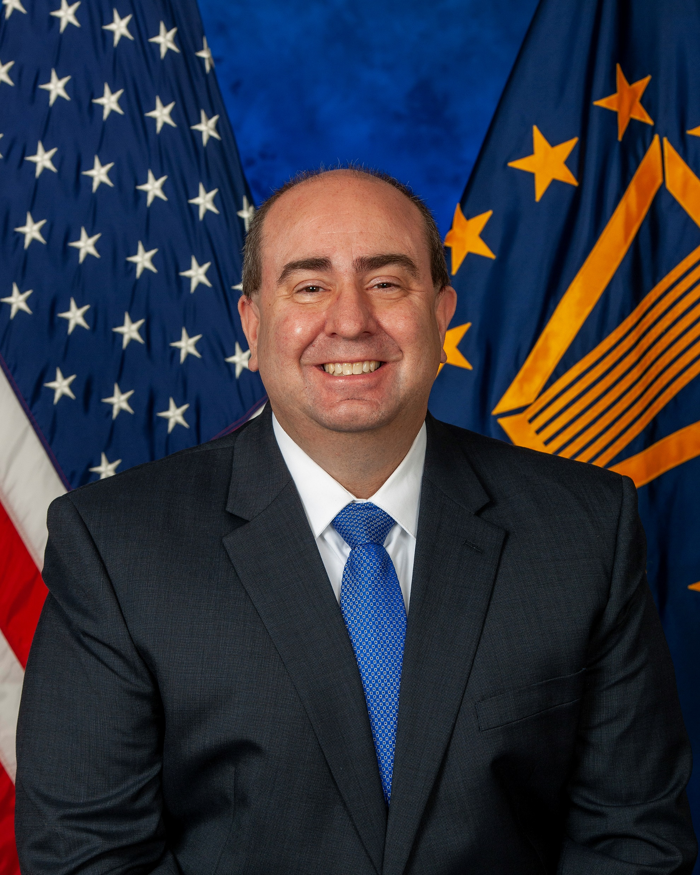
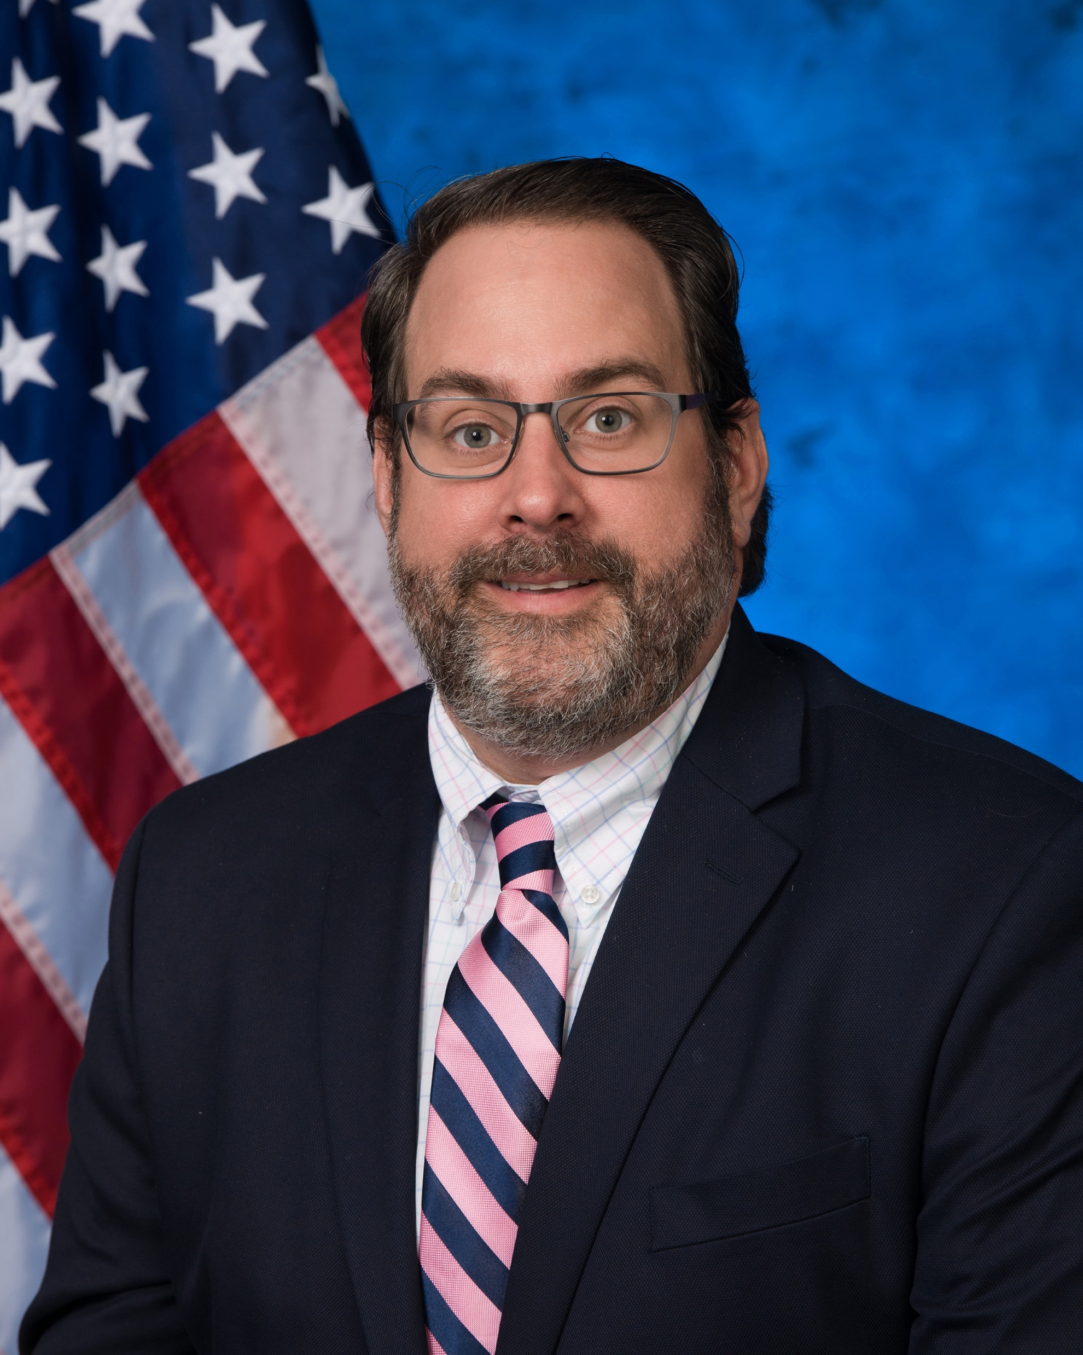
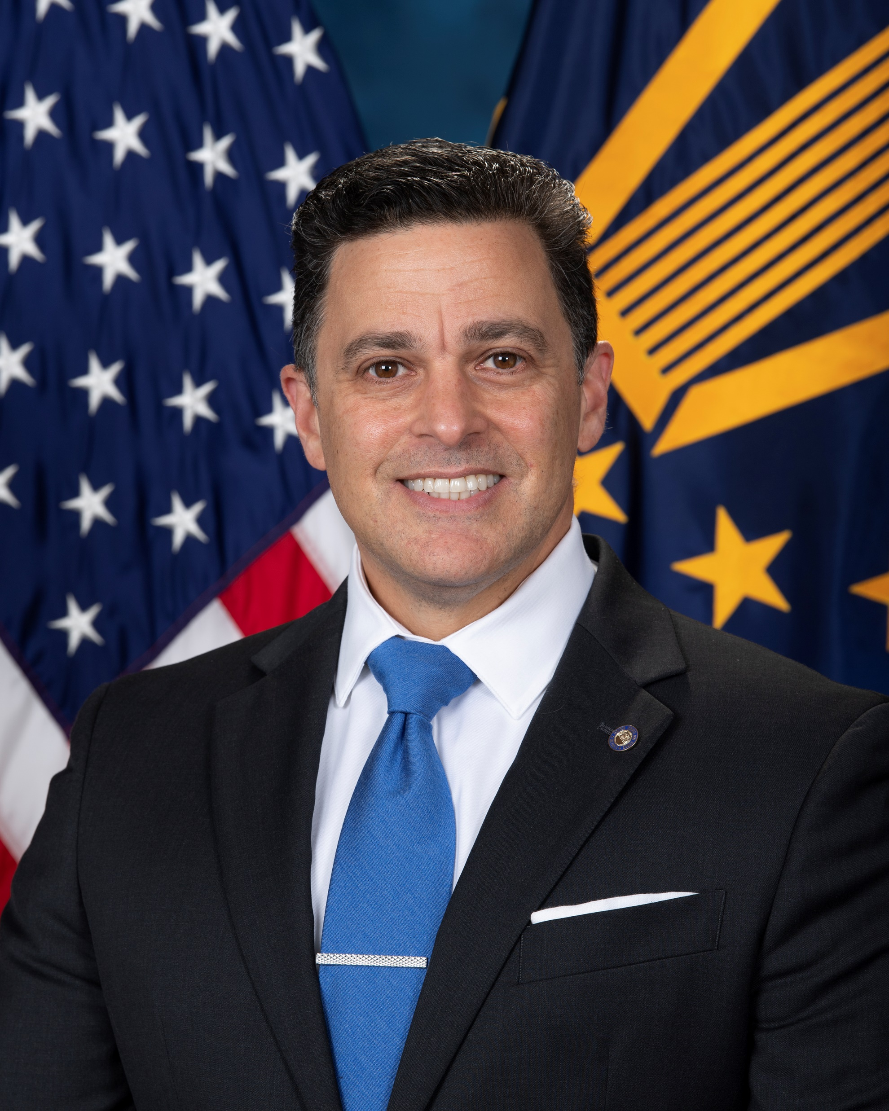
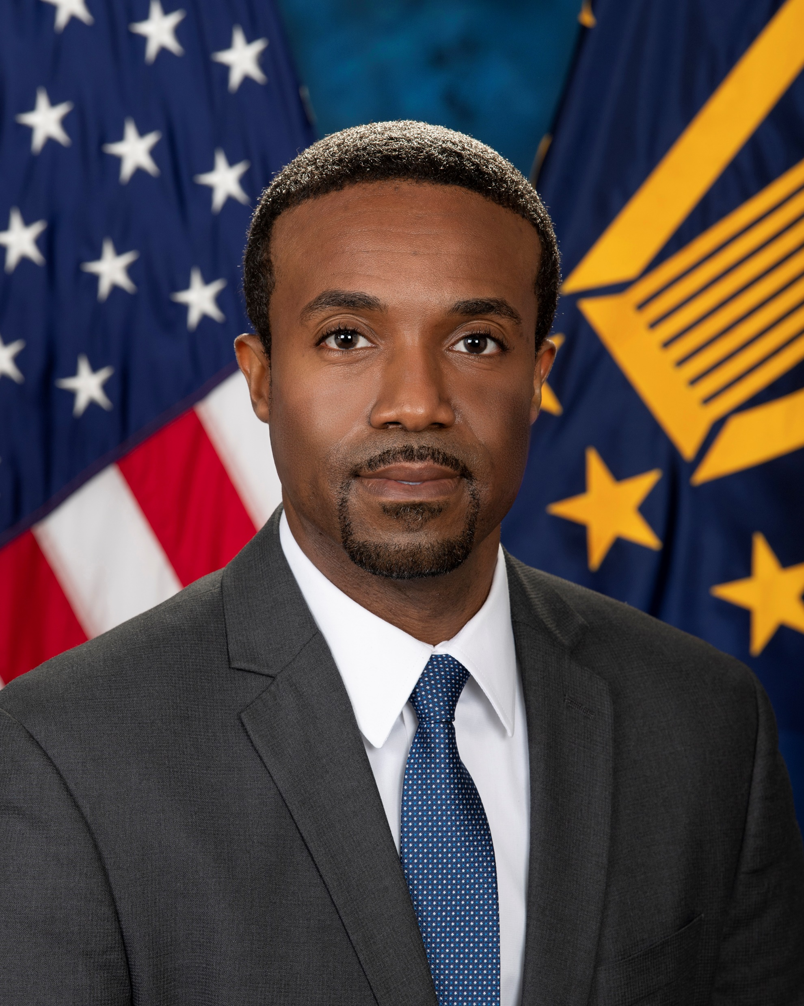
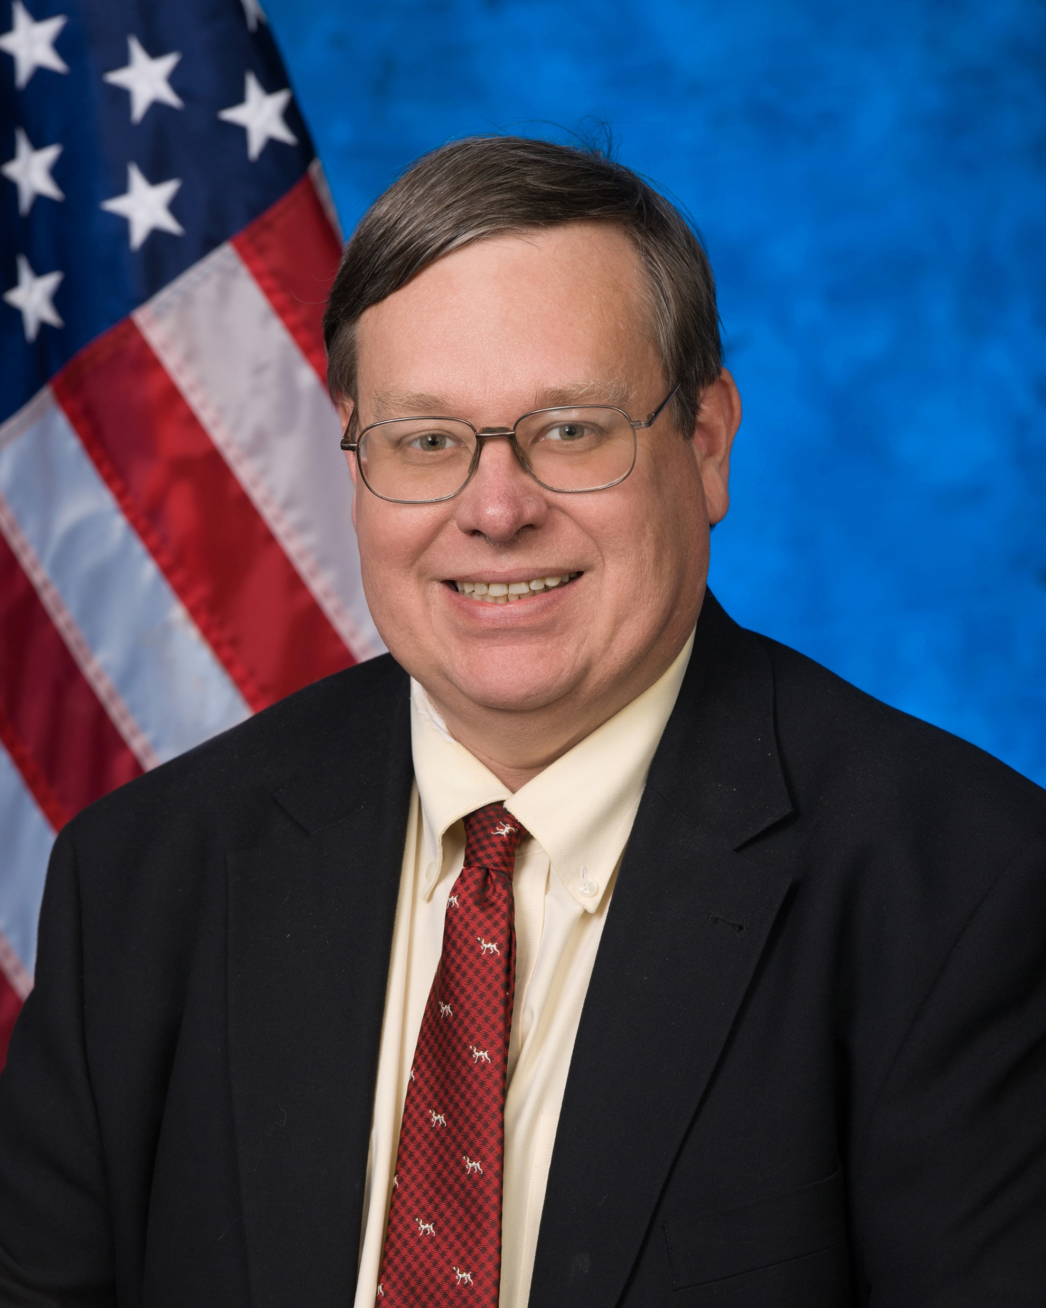
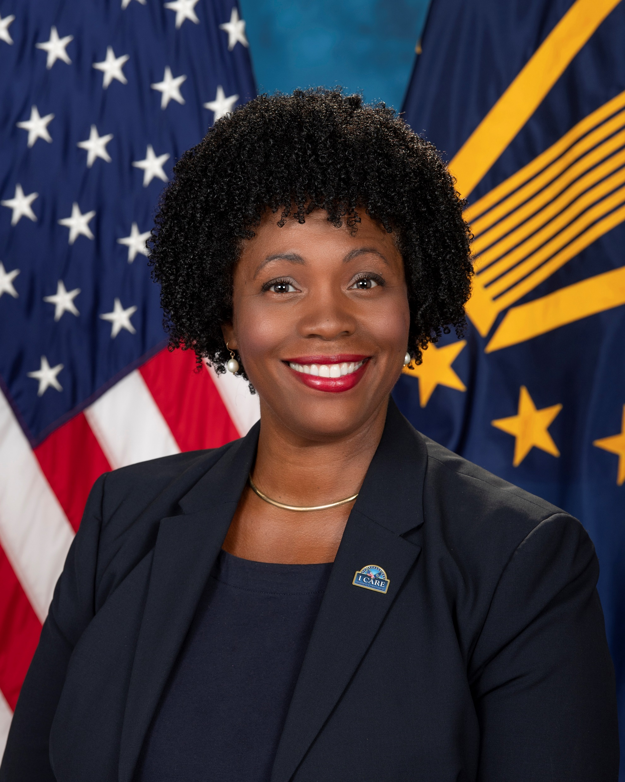
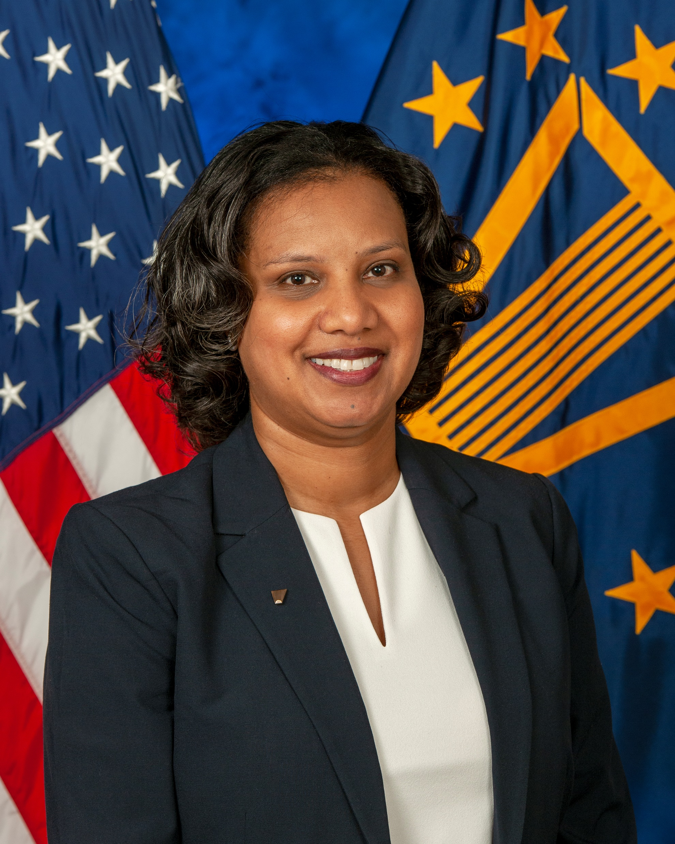
Board’s Organizational Structure
Chairman Cheryl Mason
The Board is comprised of ~1,200 FTE which includes ~108 judges, ~850 attorneys and ~220 admin and operations personnel.
Strategic Advisor on VSO and Representative Affairs Marty Caraway Strategic Engagement and Comm’s Director Jill Snyder
Chairman’s Assistant Ruby Clendenning
Vice Chairman Ken Arnold
Chief of Staff Nick Uchalik
Chief of Budget & Internal Controls Katy Mozingo
Senior Deputy Vice Chairman Chris Santoro
Chief Counsel Tony Sciré
Deputy Vice Chairman Tom Rodrigues
Deputy Vice Chairman Silas Darden
Deputy Vice Chairman Robert Scharnberger
Deputy Vice Chairman Tamia Gordon
Executive Director Nina Tann
2

Slide 3

Board of Veterans’ Appeals Summary
Integrity, Commitment, Advocacy, Respect, and Excellence
The Board’s mission is conducting hearings and deciding appeals in a timely manner, supporting VA’s mission of commitment and advocacy for Veterans by providing benefits and services to Veterans and their families through appellate decisions.
Responsible for resolving appeals on behalf of the Secretary for Veterans benefits and services.
Invested in employee and customer experience with strong partnerships with labor relations representatives, Veterans Service Organizations, private advocates and the Hill.
Collaborate across the Department, working closely with the 3 administrations and OGC as well as OSVA, COS, OIT, VEO, OCLA, OPIA, and OALC.
Strong working partnership with VSOs and the private bar.
Current FY 2022 Metrics Through October:
6,373 Decisions FYTD
199,633 Appeals Pending
85,212 Hearings Pending

Slide 4
FY 2022 Preview
50,000 Hearings scheduled and held
111,500 Decisions Dispatched
10182 Filing on VA.Gov
Intake/mail improvements using AI and machine learning
More Judge attendance at trainings
Improved hearing scheduling
Vsignal survey feedback improvements

Slide 5
Total Appeals and Hearing Requests Pending
Appeals Pending: 199,633
AMA: 109,089
Legacy: 90,544
Data as of: October 31, 2021
43% of Appeals Pending Require a Hearing

Slide 6
Board Hearings
FY 2022 Goal: Hold 50,000 hearings
Use ALL hearing platforms
Prioritize legacy hearings
Focus on virtual tele-hearings
Judge Depth: ~30 VLJs conducting hearings daily
Virtual Capacity: ~1,300 hearings per week
Only holding ~500 per week
Travel Board hearings resumed for limited locations in Q4. Now scheduling for FY2022
Encouraging Veterans to choose a virtual tele-hearing when possible!

Slide 7
Decisions and Hearing Goals
FY 2022 Goal: 111,500
FY 2021: 99,721 decisions. 4th consecutive year exceeding goal
Hiring more Judges and Attorneys in FY 2022
6,373 decisions in October
80/20 Legacy to AMA decision split
50,000 Stretch Goal for FY 2022
October 2022: A monthly record of 3,038 hearings held
* 99% Virtual (includes Video Conference)
Held a Record 23,777 Hearings in FY 2021
* Previous record was 22,743 in FY 2019
* Averaging ~680 hearings held per week last 4 weeks

Slide 8
Intake and Notification
GPO mail/printing delays impacting Veteran mail, decisions, and hearing notices continues to be addressed.
Average days to docket appeals reduced ~60 days since peak in Nov 2020.
Board/VBA IAA detailed staffing with ARP funds with focus on intake
Current Average to Docket: 43 days
Staffing: Fully staffed @ 46 FTE | Recent vacancies filled
FY 2021 Appeals Docketed: 74,000 AMA | 61,000 Legacy
~2,500 new appeals /week
~3,500 additional evidence/week
~4,000 pieces of evidence mail and ~4,000 AMA actionable appeals awaiting

Slide 9
Legacy Hearing Requests Pending

Slide 10
Case Distribution Algorithm
In holding true to the promise made by all parties involved in crafting and passing AMA, we are continuing to prioritize legacy appeals.
Cases are assigned by priority:
Current Distribution of Cases: 80% Legacy | 20% AMA
~125,000 Legacy appeals remaining in Dept
Legacy Appeals pending reduced 346,000+ since Nov 2017
Reduction of 28% in FY 2021
New VLJs primarily focused on AMA appeals
AODs
(Legacy and AMA)
CAVC Remands
Legacy (by oldest docket)
AMA | Direct Docket
AMA | Evidence & Hearing (by volume)

Slide 11
AMA Decisions and Inventory FYTD
Appeals Pending by Lane
(through Oct)
AMA Appeal Election Rates | Post Implementation (Feb 2019) | FYTD 2022
Direct Docket | 38% | 39%
Evidence Docket | 19% | 22%
Hearing Docket | 43% | 39%
Notes:
41% of incoming AMA appeals are electing hearings

Slide 12
Remand Rates for Legacy and AMA

Slide 13
VA Legacy Appeals Resolution Plan
LEGACY APPEALS INVENTORY SHIFT | Appeals Pending | Start of FY20 | End of FY21
 | VBA & Other | 238,772 | 32,810
 | Board | 98,410 | 92,530

Slide 14
Resources & Materials
The Board of Veterans’ Appeals:
https://www.bva.va.gov/
Appeals Status Tracker:
https://www.va.gov/claim-or-appeal-status/
Claimants can find information on filing requirements and the forms to apply at https://www.va.gov/decision-reviews.
Direct Upload Tool
https://dmhs.digitalcontentservices.com/
Board has a twitter page – follow us!
@BoardVetAppeals

