Slide 1
VA CAREGIVER SUPPORT PROGRAM
CSP High-Level Overview & Program Update
Presented by: Dr. Colleen Richardson, Executive Director, CSP
Notes:
Good morning and thank you for having me. I’m presenting on behalf of the Caregiver Support Program.

Slide 2
Overview
Introduction to VA Caregiver Support Program
Program of Comprehensive Assistance for Family Caregivers (PCAFC)
Program of General Caregiver Support Services (PGCSS)
Informational Purposes Only
Notes:
There are 2 programs under Caregiver Support, which are PCAFC and PGCSS.

Slide 3
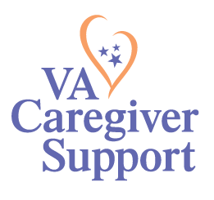
Caregiver Support Program Mission Statement:
To promote the health and well-being of family caregivers who care for our nation’s Veterans, through education, resources, support, and services
Informational Purposes Only
Notes:
The mission of The Caregiver Support Program is to promote the health and well-being of family caregivers who care for our nations’ Veterans through education, resources, support and services.
So why is caregiver support important to VA?
The way we see it, just as Veterans served, so now do their families, through the care and support that they provide.
And it is our role at VA to care for them.
Caregivers are often the ones providing care day after day, and our support of them as a country, is critical.
Many of the Veterans enrolled in VHA reported in our VHA Survey of Enrollees, that they are in need a variety of different types of care and support at home from a family member or friend – this ranges from assistance with coping with difficult situations or coping with memory loss to hands on assistance with activities of daily living, like bathing or dressing. We also know that caregivers are often the ones keeping these Veterans living safely in their home, where many of our Veterans tell us they want to be.
And caregiving can take a toll on a caregiver. Caregivers have reported increased stress and strain as well as a general decline in their overall health.
The Caregiver Support Program can help promote caregiver health and well-being in a variety of ways.

Slide 4
Where we Started, Where we are Headed…..
2008 – Caregiver Support Program established
2010 – Program of Comprehensive Assistance for Family Caregivers (PCAFC) and Program of General Caregiver Support Services (PGCSS) established under P.L. 111-163
2011 – Program officially accepts applications for PCAFC
2018 – MISSION Act of 2018 expands Veteran eligibility for PCAFC
2020 – Implement expansion of PCAFC eligibility (On or before May 7, 1975, on or after September 11, 2001)
2022 – Second Expansion – PCAFC – All Eras
Informational Purposes Only
Notes:
In late 2007, as military operations in Afghanistan and Iraq progressed, the provision of services and supports to family caregivers of veterans seriously injured in these conflicts moved to the forefront. Family caregiver issues became a focus of the President’s Commission on Care for America’s Returning Wounded Warriors, established by President G.W. Bush on March 8, 2007. In 2008, the VA Caregiver Advisory Board was established to develop the caregiver assistance program.
With the conflicts in Iraq and Afghanistan, new challenges presented themselves to our service members returning from combat with serious injuries that may have been fatal in previous conflicts. These service members require personal care services, which are often provided by family members and loved ones. In recognition of this significant challenge, in 2010, Congress enacted the Caregivers and Veterans Omnibus Health Services Acts of 2010 or PL 111-163. which required VA to establish specific supports for caregivers of veterans. Two programs were established, the Program of General Caregiver Support Services and the Program of Comprehensive Assistance for Family Caregivers. Collectively we refer to these two programs as the Caregiver Support Program. PCAFC was established/created for Family Caregivers of eligible Veterans who had a serious injury incurred or aggravated in the line of duty.
10 Years ago, the program began officially accepting applications for PCAFC.
2018 – In 2018, the VA MISSION Act required VA to expanded eligibility for the family caregivers' program to caregivers of Veterans of all eras in a phased approach, establish new benefits for designated Primary Family Caregivers and other changes that affected program eligibility and VA’s evaluation of PCAFC applications. These expansion efforts are being implemented in two phases. Veterans who were seriously injured in the line of duty before May 7, 1975 became eligible as of October 1, 2020 and two years later, October 1, 2022 Veterans who served and were injured in the line of duty between May 7, 1975 and September 11, 2001 are to become eligible. In other words, by 10/1/2022 all Veterans of all eras will be eligible to apply.

Slide 5
Caregiver Support Program: PCAFC & PGCSS
Other VHA Veteran services that support Caregivers
Program of General Caregiver Support Services (PGCSS)
Home Tele-health
Home-maker and Home Health Aides
Four Core Elements:
Education & Support
Collaboration & Partnerships
Outreach
Resources & Referrals
Respite Care
Veteran Directed Care
Training and Education
Coaching, Skills Training,
Group & Individual Interventions
Building Better Caregivers
Caregiver Support Line
Diagnosis Specific Programs for Caregivers
Caregiver Support Program Website
Peer Support Mentoring
Email Listserv
Resources for Enhancing
All Caregivers Health (REACH)
Self-Care Courses
Home Hospice Care
Adult Day Health Care Centers
Home-Based Primary Care
Skilled Home Care
Program of Comprehensive Assistance for Family Caregivers (PCAFC)
Monthly stipend
Access to CHAMPVA (if eligible)
Mental health counseling
Caregiver training
Enhanced respite services
Certain beneficiary travel
Ongoing monitoring
Choose Home
Other Services: MHICM / PACT / Mental Health
Informational Purposes Only
5
Notes:
As mentioned, CSP consists of 2 programs and these programs are administered under the Veterans Health Administration. I’m going to speak to both of these programs today.
PGCSS or the Program of General Caregiver Support Services (larger dark blue circle) and the Program of Comprehensive Assistance for Family Caregivers or PCAFC (the smaller light blue circle). There are a variety of different benefits, services and supports within both programs.
You will also see that there are other supports available through VHA that support caregivers, such as – respite care, hospice, skilled home care and more….and these programs are administered under other offices within VA.

Slide 6
MISSION Act and Caregivers
The VA MISSION Act of 2018 was designed to improve Veteran access to healthcare.
The MISSION Act gives Veterans greater access to healthcare in VA facilities and the community, expands benefit for caregivers, and improves VA’s ability to recruit and retain the best medical providers.
The MISSION Act enhances VA support for Family Caregivers through the Program of Comprehensive Assistance for Family Caregivers (PCAFC).
Informational Purposes Only
Notes:
The VA Mission Act of 2018 was really designed to improve Veteran access to healthcare.
As it relates to the PCAFC, it allowed VA to expand eligibility to all eras using a phased approach.

Slide 7
VA MISSION Act Timelines
The MISSION Act of 2018 authorized VA to:
Expand PCAFC to eligible Veterans of all eras of service, which will occur in two phases:
Phase I: Eligible Veterans injured on or before May 7, 1975
Went live 10/01/2020
Phase II: Eligible Veterans injured between May 7, 1975-Sept. 11, 2001
Anticipated to launch in 2022
Informational Purposes Only
Notes:
As you know. The Program of Comprehensive Assistance for Family Caregivers was established based on PL111-163 in 2010. This law allowed VA to provide comprehensive support to caregivers of seriously injured Veterans who served on/after Sept 11, 2001.
As mentioned, with the passing of MISSION Act of 2018, expansion of this program to all eras was authorized, in two phases.

Slide 8
PCAFC Eligibility Criteria
Eligibility Criteria
The Veteran must need in-person personal care services for a minimum of six (6) continuous months based on either:
An inability to perform an activity of daily living, or
Need for supervision, protection, or instruction.
Previously: VA required a connection between the need for personal care services and the qualifying serious injury.
Expansion Changes: Eliminates the need for a connection between personal care services and the qualifying serious injury. Also redefines serious injury to now include any service-connected disability – regardless of whether it resulted from an injury, illness or disease.
Why This is Important: In most cases, the eligible Veteran has multiple conditions that may warrant a need for personal care services. Veterans’ needs may be so complex that it can be diﬃcult to determine what speciﬁc condition causes the need for personal care services.
Informational Purposes Only
Notes:
PCAFC has specific eligibility requirements for Veterans and caregivers.
There are 7 Veteran eligibility requirements for PCAFC. I am just going to highlight a few of those here.
First of all, the Veteran or servicemember undergoing medical discharge, must have a serious injury incurred or aggravated in the line of duty. We define serious injury as a 70% service connected rating. This can be a single or combined rating. It can include a presumptive rating.
Secondly the Veteran must be in need of in-person, personal care services for a min. of 6 continuous months.
This need is based on either: An inability to perform an activity of daily living (such as eating, dressing, bathing, toileting) or be in need of supervision protection or instruction. The need for SPI is due to a functional impairment that directly impacts the Veteran’s ability to maintain their personal safety on a daily basis.
I want to highlight that VA previously required a connection between the Veteran’s need for PCS and the qualifying serious injury. With expansion, this connection is no longer needed. A Veteran can be found eligible for PCAFC regardless of whether the care needs are due to an injury, illness, or disease. This is incredibly important as most Veterans have multiple conditions and it may be difficult to determine which one exactly would cause the need for personal care services.
For more information about the eligibility requirements, please see the eligibility fact sheet on the caregiver support program’s website. www.caregiver.va.gov

Slide 9
PCAFC Services
Education and Training
Enhanced Respite Care
Counseling
Beneficiary Travel
Monthly Stipend – based on OPM General Schedule Grade 4, Step 1.
Access to healthcare through Civilian Health and Medical Program of the Department of Veterans Affairs (CHAMPVA), if eligible
Financial planning and legal resources for Primary Family Caregivers. VA is actively working to establish a viable contract vehicle for these services
Informational Purposes Only
Notes:
Once a Veteran and family caregiver are approved and deemed eligible, there are benefits and services available to the caregiver as you can see here, listed on this slide.
This includes education and training, respite care (no less than 30 days per year), counseling (very important when you consider the toll that caregiving can take), beneficiary travel, the monthly stipend (which is a financial benefit paid directly to the caregiver), access to health care via CHAMPVA health insurance (if otherwise uninsured).
Under Mission Act, Primary Family Caregivers are also eligible for financial planning and legal services. VA is actively working to establish a viable contract vehicle for these services.
Another thing I want to point out is that this program is a clinical program. So, participation in ongoing wellness contacts and annual reassessments are part of the program. Wellness contacts are conducted by clinical staff to help ensure the health and well-being of the Veteran and caregiver, monitor the caregiver’s continued ability to provide personal care services and identify any gaps as well as connect the caregiver and Veteran to any needed services and support.

Slide 10
High-level Steps of the Application Process
Once the Veteran’s application is received by the Caregiver Support Program (CSP), a preliminary review will be performed.
A Veteran assessment, a functional assessment, and a caregiver assessment will be scheduled and completed by the CSP team.
The CSP team will collaborate with the Veteran’s Primary Care Provider to obtain input regarding the Veteran’s needs.
The completed assessments are then reviewed by a VISN Centralized Eligibility Appeals Team (CEAT) to determine initial eligibility.
Once initial eligibility is established, the caregiver is referred to training, and when complete, a home-care assessment will take place.
The CEAT receives verification of caregiver training and results of home-care assessment and makes the final eligibility determination and stipend level (Level 1 or Level 2).
Notes:
As we prepared to expand under MISSION Act, we heard from our stakeholders, the importance of having a standard process for determining eligibility across VA and for consistency in these decisions. So with expansion in Oct 2020, we implemented a standard application process across all VA. I am going to briefly review that here.
Once the Veteran and caregiver’s application is received by the Caregiver Support Program (CSP), a preliminary review is performed.
A Veteran assessment, a functional assessment, and a caregiver assessment is completed by the CSP team.
The CSP team works to collaborate with the Veteran’s Primary Care Provider to obtain input regarding the Veteran’s needs.
The completed assessments are then reviewed by a VISN Centralized Eligibility and Appeals Team (trained multi-disciplinary teams at the integrated networks) to determine initial eligibility.
Once initial eligibility is established, the caregiver is referred to training and a home-care assessment will take place.
The CEAT receives verification of caregiver training and results of home-care assessment and makes the final eligibility determination and stipend level (Level 1 or Level 2).
These process steps are outlined with a visual in our application process fact sheet, available online www.caregiver.va.gov

Slide 11
How To Apply
Veterans and Caregivers may apply for PCAFC in three ways:
Complete the application online at: http://www.caregiver.va.gov
For most, this is the fastest and easiest route!
Access and download the application (VA Form 10-10CG) and mail to your local Caregiver Support Program.
You may also contact your local Caregiver Support Program for assistance.
Connect with your local Veteran Service Office/Officer for assistance in completing and submission of the application.
Informational Purposes Only
Notes:
So how does one apply to the Program? (read through slide): online, download and mail, via VSO

Slide 12

Program of General Caregiver Support Services
The Program of General Caregiver Support Services (PGCSS) provides resources, education and support to caregivers of all era Veterans.
The Veteran must be enrolled in VA healthcare but does not need to have a service-connected condition.
No formal application is required.
Informational Purposes Only
Notes:
Let’s switch gears to talk about the Program of General Caregiver Support Services (PGCSS) – this program provides resources, training, and support to caregivers of all era Veterans.
To participate in the program, the Veteran must be enrolled in VA healthcare, but does not need to have a Service Connected rating/condition, rather they must just be in need of help with ADLs or need supervision or protection. A caregiver also does not need to live with the Veteran to enroll in the program, but rather, just be providing personal care services to the Veteran.
It is important to know that there is no formal application required – many caregivers reach out on their own, sometimes because they’ve found us online or heard about the program from another caregiver or from a VSO, or because they are referred by a Veteran’s primary care team.
The enrollment process is very simple. It includes a brief intake to gather information on the reported needs of the Veteran and to ensure that the Veteran agrees to receive care from the caregiver who is requesting to participate in the PGCSS. The caregiver is then enrolled. We open up a health record for them at VA and they begin to receive the benefits and services of the program. The clinical staff work with the caregiver to obtain information on their current situation, understand any challenges the caregiver is facing and develop a plan of care, based on the needs and interest of the caregiver.
I also want to highlight 2 things:
1. Caregivers in PCAFC application process can enroll in PGCSS and begin receiving support
2. Family Caregivers, those participating in PCAFC, can receive PGCSS services and support in addition to the benefits and services available under PCAFC
Benefits: per our regulations.
Instruction and training which we will talk about here shortly
Information on supportive services available –at VA, but also in the public, private and nonprofit agencies – and I will tell you more about this too in coming slides.
Counseling and other services, and for PGCSS, this is counseling is as it relates to the care of the Veteran
Respite care available through VHA

Slide 13
PGCSS Four Core Elements
Education and Support
Collaboration and Partnerships
Outreach
Resources and Referrals
Informational Purposes Only
Notes:
We recognized that it was important that across VA, all caregivers have access to the same resources and services no matter where their Veteran received care and thus we established 4 core elements as you can see here. Education and Support, Collaboration and Partnerships, Outreach, and Resources and Referrals.
Education and Support Our one-on-one clinical support to help the caregiver care for the Veteran and themselves. This is based on the needs of the caregiver- some caregivers may wish to have weekly check-ins over 6 weeks whereas others may want a monthly support call ongoing. We also provide support groups – Many sites offer topic specific support groups, targeted at bringing together caregivers facing similar circumstances or caring for someone with a specific diagnosis. These can be offered in a number of modalities, via video telehealth or phone as well as in person, when feasible.
Collaboration and Partnerships – caregivers are present throughout VA and in our communities, and it is critical that we are collaborating and partnering to be sure caregiver needs are met. These collaborations and partnerships happen at the national and local level. We often say ‘VA can do a lot, but we can’t do it alone’. This is why our trusted partnerships are so key.
Outreach – we want to be sure that caregivers know we are here for them! So we work to make sure we are putting out communications to alert caregivers as to what is available to them. We don’t want to wait for them to find us – we want to reach out and bring them in for support.
Resources and Referrals- PGCSS helps caregivers get connected to the right services and support for them, whether that be at VA or in the community. We want to be sure that caregivers and families have awareness and connection to the resources available that best meet their specific needs.

Slide 14


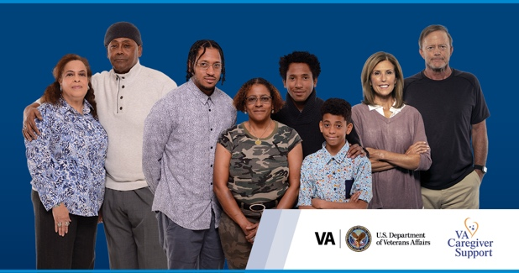
Coaching & Skills Training
Resources for Enhancing All Caregivers Health (REACH VA) Caregiver Program
Individual Coaching
Telephone Support Groups
S.A.V.E. Suicide Prevention Skills Training
Signs
Ask
Validate
Encourage & Expedite
Suicide Prevention Toolkit for Caregivers
Informational Purposes Only
Notes:
I’m pleased to note that over the past year and a half we have hired more staff to specifically support the enhancement of PGCSS across VA. Now PGCSS Staff are available at every medical center.
With that, we’ve been able to implement PGCSS programming standardly across the enterprise. I want to tell you about a few of those programmatic offerings.
REACH VA Caregiver Program -At every medical center, we offer: Resources for Enhancing all Caregivers Health or REACH VA Caregiver coaching. PGCSS Clinical Staff at every site have been trained to provide this coaching tool. There’s coaching for specialty populations (such as PTSD, dementia, MS, ALS) as well as general coaching for all eras. The REACH coach works with the caregiver directly to target problem behaviors or challenges that the caregiver is facing in the care of the veteran. In addition, the coach works with them to develop specific strategies through this intervention that assists the caregiver in their role while also providing support to the caregiver.
This same coaching strategy is also available through telephone support groups. Often, caregivers express a feeling of isolation, they feel alone in their caregiving journey. Participating in a group such as the REACH telephone support group can not only help enhance caregiver skills, but it can reduce a sense of isolation, and provide a community to caregivers, where they can learn from one another.
REACH VA has been shown to significantly improve caregiver quality of life – related to caregiver burden, depression/emotional well-being, self-care and healthy behaviors, social support, and management of care recipient problem behaviors.
VA SAVE
In addition, every facility PGCSS is offering the VA S.A.V.E Suicide Prevention training to caregivers and family members. VA SAVE – is a training that provides information and steps anyone can take when a Veteran may be at risk for suicide. We’ve have partnered with the Office of Suicide Prevention on how to best support caregivers around suicide prevention and intervention. Caregivers play an important role in suicide prevention. They may be the first to notice changes in the Veteran or may be the one that a Veteran turns to when having suicidal thoughts. It is important that caregivers have the tools they need to intervene. As you likely know, SAVE stands for signs, ask, validate, encourage and expedite. It provides simple steps that ANYONE can take when talking with Veterans at risk for suicide.
Last year, we released the Suicide Prevention Toolkit for Caregivers. This toolkit includes important information for caregivers about risk factors, protective factors, warning signs, safety planning to include safe firearm storage. It also includes information on supports available to both caregivers and Veterans to assist them in their health and well-being. Please share this toolkit with Veterans and caregivers.

Slide 15
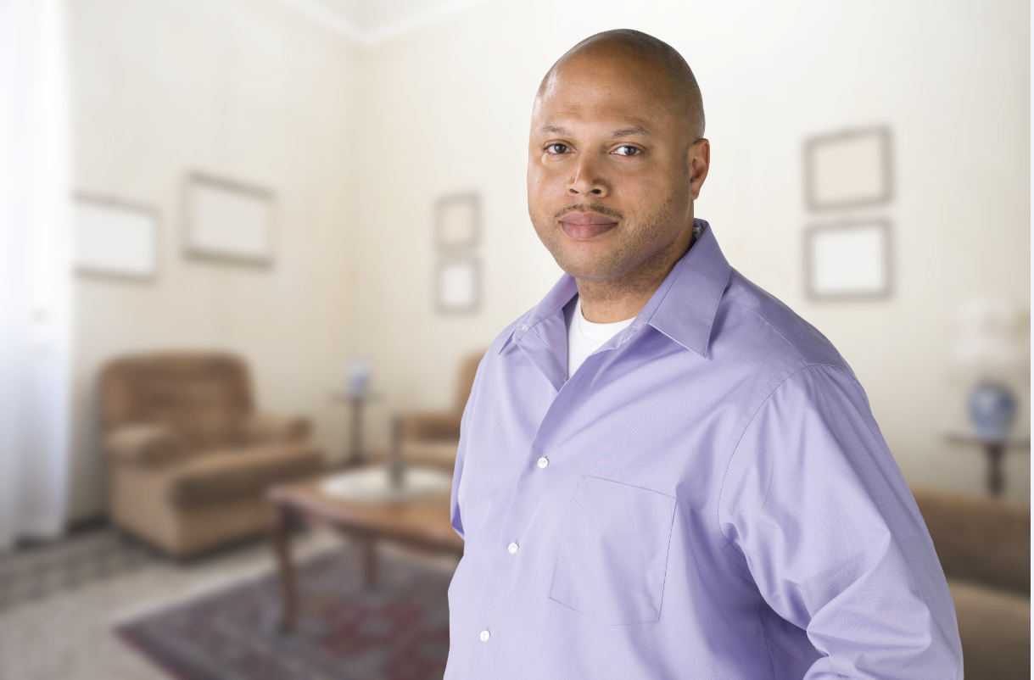
National CSP Resources
Building Better Caregivers
Self-Care Courses for Caregivers
Caregiver Support Line (CSL) Education Calls
Peer Support Mentoring
REACH VA Caregiver Program
Annie Caregiver Text Program
Notes:
In addition to the services and support available at every medical center, there are some national programs available as well.
BBC – online training and self-care, helps caregivers build community with other caregivers
Self-care courses – currently offered virtually, allowing caregivers to learn skills to care for themselves and manage stress
CSL education calls - monthly topic, callers can join to hear information presented and questions answered
PSM – the program matches caregivers with each other who may be further along in their journey, offering fellowship and decreasing the sense of isolation
Annie Caregiver Text Program – texts for caregivers on self-care, provides inspiration, and even tips about caring for yourself during covid. “Don’t second guess yourself. Trust the health care team and trust yourself. You are doing the right thing by helping your loved one” - Annie

Slide 16
Summit & Resource Fair
Caregiver & Family
Resource Fair
Offered at every VA facility annually with a focus on resources for caregivers and families to include:
VHA resources
VBA resources
Local non-profits
County agencies
Caregiver Summit
The CSP hosts an annual summit to include caregiver-specific topics.
Includes VA and external organizations/agencies that regularly support caregivers and families.
Goal: to increase awareness of the needs of caregivers in the local community and the available resources.
Notes:
Caregivers and families really do need wrap-around supports from both the VA and the community as they care for those who served.
Caregiver Summit (annual)
The summit provides an opportunity to bring together VA and community stakeholders who support caregivers and families. The goal is to really help increase awareness of the needs of caregivers in the community and come together to help make sure those needs are met. This year’s theme is Inclusive Care: Empowering and Engaging caregivers as partners in care, which I will talk about here shortly but really want to flag this for you all as we are inviting community agencies, and organizations to participate in the local facility’s resource fair.
A summit may have a keynote speaker/presenter, an expert panel, resource tables, etc. This helps increase the awareness of the needs of caregivers in the community and strengthens the supports and programs we offer caregivers and families.
Resource Fair
VA CARES partnered evaluation center noted the importance that CSP makes caregivers aware of the diversity of services and supports available to them. One way we do this is to provide an annual Caregiver and Family Resource Fair at every facility. This resource fair brings together VA, local non-profits and county representatives to offer information to caregivers and families on the services and support available to them in their local community. It is so important to us that caregivers have an increased awareness of the resources available to them at VA and in the community. We have seen some amazing fairs that allow staff to be creative ways to host these in the midst of a pandemic, being held, to include virtual, outdoor, drive thru. Example of El Paso, Texas.

Slide 17
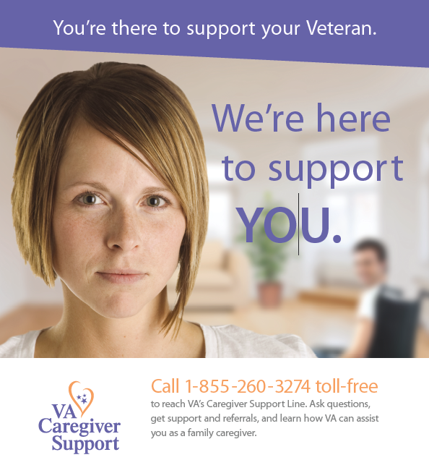
Caregiver Support Line (CSL)
The VA Caregiver Support Line responds to calls from caregivers, Veterans and community agencies seeking information about VA caregiver services.
Hours:
Monday - Friday 8:00 a.m. – 10:00 p.m. ET
Saturday 8:00 a.m. – 5:00 p.m. ET
Links callers to their local Caregiver Support Program Team
Provides information about assistance through the VA
Offers supportive counseling when needed
Notes:
The VA’s National Caregiver Support Line responds to calls from caregivers, Veterans, family members, and community agencies that seek information about VA caregiver services. The Caregiver Support Line accepts calls Monday through Friday from 8:00 AM to 8:00 PM and Saturday 8am to 5pm Eastern Time and is staffed by a team of professionals.
The Caregiver Support Line offers supportive counseling and provides information about assistance that may be available through the VA. The Caregiver Support Line also links callers to their local VA Caregiver Support Coordinators for assistance with support services and resources in their local area and through their VA medical center.

Slide 18
Caregiving During the Pandemic
A tip sheet was created to provide additional information and guidance to Veterans and caregivers regarding COVID-19.
This document provides information on:
How to protect against COVID-19
Ways to connect and receive support
CSP, VA, and other Resources
Caregiving During COVID-19: Tip sheet located on the https://www.caregiver.va.gov
Notes:
Caregiving in normal times can be challenging. Caregiving during a pandemic –that’s a whole other story! Every day and now during this pandemic, caregivers are unsung heroes, keeping Veterans safe at home, keeping themselves as healthy as they can so they can be there for the Veteran. Many went w/o in home help in the height of the pandemic….when healthcare agencies could not send clinical staff into homes.
VA developed a Caregiving During the Pandemic tip sheet with info on protecting themselves, obtaining support during this time and resources available.
I will say, it was incredible to see many caregivers within their caregiving networks rise up to support each other during this challenging time.

Slide 19
How Do You Contact the Caregiver Support Program?
VA Caregiver Support Line
1-855-260-3274
To find your local Caregiver Support Program, or
for more information: http://www.caregiver.va.gov
Informational Purposes Only
Notes:
So how do you reach CSP?
CSL 1-855-260-3274
Or via the is a locator tool on our website www.caregiver.va.gov
CSP team at every VA
Thank you and please let me know if you have any questions.

