Slide 1
Cardiovascular Review & Changes
By Jan Avant
November 2021

Slide 2

My Introduction
Jan Avant
Quality Rating Specialist, Retired
Worked at VA Regional Office
Little Rock, AR

Slide 3
Definitions
Arrhythmia—irregular/abnormal heart beat
Asymptomatic—showing no symptoms
Bradycardia—slow heart rate (usually below 60 bpm)
Claudication—blocked arteries causing pain, burning and limping
Cor Pulmonale—condition causing right side of heart to fail
ECG/EKG—electrocardiogram detects electrical activity
Tachycardia—fast heart rate (usually 100+ bpm)

Slide 4

Effective Date
Rules effective November 14, 2021
Per Federal Register of September 30, 2021
Changes affect 38 CFR 4.100 and 4.104

Slide 5
38 CFR 4.100
Application of the evaluation criteria for diagnostic codes
7000-7007, 7011, and 7015-7020.
(b) Even if the requirement for a 10% (based on the need for continuous medication) or 30% (based on the presence of cardiac hypertrophy or dilatation) evaluation is met, METs testing is required in all cases except:
(1) When there is a medical contraindication.
(2) When a 100% evaluation can be assigned on another basis.
    Authority: 38 U.S.C. 1155
Removed use of Left Ventricular Ejection Fraction (LVEF) for evaluation
Removed consideration of chronic congestive heart failure and frequencies

Slide 6
38 CFR 4.100 (continued)
The Authority of the Rating Schedule is 38 USC 1155
    In summary….VA’s rating schedule is intended to reflect reductions
    in earning capacity from specific injuries or disabilities incurred
    in or due to military service, so any proposed classification system
    must fill this requirement.

Slide 7

38 CFR 4.104
Diseases of the Heart
Unless otherwise directed,
use this General Rating formula
to evaluate diseases of the heart.

Slide 8
38 CFR 4.104 (continued)
Note (1): Evaluate cor pulmonale, which is a form of secondary heart disease, as part of the pulmonary condition that causes it.
Note (2): One MET (metabolic equivalent) is the energy cost of standing quietly at rest and represents an oxygen uptake of 3.5 milliliters per kilogram of body weight per minute. When the level of METs at which breathlessness, fatigue, angina, dizziness, or syncope develops is required for evaluation, and a laboratory determination of METs by exercise testing cannot be done for medical reasons, a medical examiner may estimate the level of activity (expressed in METs and supported by specific examples, such as slow stair climbing or shoveling snow) that results in those symptoms.
Note (3): For this general formula, heart failure symptoms include, but are not limited to, breathlessness, fatigue, angina, dizziness, arrhythmia, palpitations, or syncope.
Breathlessness replaced dyspnea throughout.
Note 3 is new

Slide 9
38 CFR 4.104 (continued)
GENERAL RATING FORMULA FOR
DISEASES OF THE HEART
Workload of 3.0 METs or less results in heart failure symptoms 100
Workload of 3.1-5.0 METs results in heart failure symptoms 60
Workload of 5.1-7.0 METs results in heart failure symptoms; or evidence of cardiac hypertrophy or dilatation confirmed by echocardiogram or equivalent ( e.g., multigated acquisition scan or magnetic resonance imaging) 30
Workload of 7.1-10.0 METs results in heart failure symptoms; or continuous medication required for control 10

Slide 10
DC 7000, 7001, 7002
7000 Valvular heart disease (including rheumatic heart disease),
7001 Endocarditis, or
7002 Pericarditis:
During active infection with “cardiac involvement” and for three months following cessation of therapy for the active infection 100
Thereafter, with diagnosis confirmed by findings on physical examination and either echocardiogram, Doppler echocardiogram, or cardiac catheterization, use the General Rating Formula.

Slide 11
DC 7003 & 7004
7003 Pericardial adhesions.
Use General Rating Formula
7004 Syphilitic heart disease:
Note: Evaluate syphilitic aortic aneurysms under DC 7110 (Aortic aneurysm: Ascending, thoracic, abdominal).

Slide 12
DC 7005
7005 Arteriosclerotic heart disease (coronary artery disease CAD).
    Use General Rating formula
Note: If non-service-connected arteriosclerotic heart disease is superimposed on service-connected valvular or other non-arteriosclerotic heart disease, request a medical opinion as to which condition is causing the current signs and symptoms.
*ASHD/CAD is also know as Ischemic heart disease (IHD) which is a recognized disease associated with exposure to Agent Orange in Vietnam. VA regulations effective
August 31, 2010. M21-1, Part VIII, Subpart I, 1.B.1.h

Slide 13
DC 7005
M21-1MR, Part III, Subpart iv, Chapter 4, Section E, Topic 20
b. Definition: Arteriosclerotic Heart Disease-- also diagnosed as ischemic heart disease and coronary heart disease, is a disease of the heart caused by the diminution of blood supply to the heart muscle due to narrowing of the cavity of one or both coronary arteries due to the accumulation of fatty material on the inner lining of the arterial wall.

Slide 14

DC 7006 & 7007
7006 Myocardial infarction (known as heart attack)
  During and for three months following myocardial infarction,
  confirmed by laboratory tests 100
  Thereafter, use the General Rating Formula.
7007 Hypertensive heart disease.
  Use the General Rating Formula.

Slide 15
DC 7008
7008 Hyperthyroid heart disease:
  Rate under the appropriate cardiovascular diagnostic code, depending on particular findings.
  Use General Rating Formula

Slide 16
DC 7009-7011 and 7015
For DCs 7009, 7010, 7011, and 7015, a single evaluation will be assigned under the diagnostic code that reflects the predominant disability picture.
Disability determined by interpretation of exams (38 CFR 4.2) and functional impairment (38 CFR 4.10)
7009 Bradycardia (Bradyarrhythmia), symptomatic, requiring permanent pacemaker implantation:
      For one month following hospital discharge for implantation or re-implantation 100%
Thereafter, use the General Rating Formula.

Slide 17
DC 7009-7011 and 7015 (continued)
Note (1): Bradycardia (bradyarrhythmia) refers to conduction abnormalities that produce a heart rate less than 60 beats/min. There are five general classes of bradyarrhythmia: Sinus bradycardia, including sinoatrial block; atrioventricular (AV) junctional (nodal) escape rhythm; AV heart block (second or third degree) or AV dissociation; atrial fibrillation or flutter with a slow ventricular response; and, idioventricular escape rhythm.
Note (2): Asymptomatic bradycardia (bradyarrhythmia) is a medical finding only. It is not a disability subject to compensation.

Slide 18
DC 7009-7011 and 7015 (continued)
7010 Supraventricular tachycardia:
Confirmed by ECG, with five or more treatment interventions per year 30
Confirmed by ECG, with one to four treatment interventions per year; or, confirmed by ECG with either continuous use of oral medications to control or use of vagal maneuvers to control 10
Note (1): Examples of supraventricular tachycardia include, but are not limited to: Atrial fibrillation, atrial flutter, sinus tachycardia, sinoatrial nodal reentrant tachycardia, atrioventricular nodal reentrant tachycardia, atrioventricular reentrant tachycardia, atrial tachycardia, junctional tachycardia, and multifocal atrial tachycardia.
Note (2): For the purposes of this diagnostic code, a treatment intervention occurs whenever a symptomatic patient requires intravenous pharmacologic adjustment, cardioversion, and/or ablation for symptom relief.

Slide 19
DC 7009-7011 and 7015 (continued)
7011 Ventricular arrhythmias (sustained):
For an indefinite period from the date of inpatient hospital admission for initial medical therapy for a sustained ventricular arrhythmia; or, for an indefinite period from the date of inpatient hospital admission for ventricular aneurysmectomy; or, with an automatic implantable cardioverter-defibrillator (AICD) in place 100
Note: When inpatient hospitalization for sustained ventricular arrhythmia or ventricular aneurysmectomy is required, a 100-percent evaluation begins on the date of hospital admission with a mandatory VA examination six months following hospital discharge. Evaluate post-surgical residuals under the General Rating Formula. Apply the provisions of § 3.105(e) of this chapter to any change in evaluation based upon that or any subsequent examination.

Slide 20
DC 7009-7011 and 7015 (continued)
38 CFR 3.105(e)-- the rating activity prepares a proposed rating decision to reduce or terminate benefits due to a reduction in the combined evaluation as the severity of a Veteran’s service-connected (SC) disability has improved.
Example:
As an inpatient on 1/3/20, Jack had a ventricular aneurysmectomy on 1/31/20. He was discharged 2/15/20 and had a mandatory VA exam on 8/21/20 reporting his METs as 4.2. Rater worked case on 11/3/20 and proposed reduction from 100% to 60% effective 2/1/21. Case was with VSR on 1/12/21 and reduced effective 2/1/21.

Slide 21
DC 7009-7011 and 7015 (continued)
7015 Atrioventricular block:
Benign (First-Degree and Second-Degree, Type I):
Evaluate under the General Rating Formula.
Non-Benign (Second-Degree, Type II and Third-Degree):
Evaluate under DC 7018 (implantable cardiac pacemakers).

Slide 22
DC 7016
7016 Heart valve replacement (prosthesis):
For an indefinite period following date of hospital admission
for valve replacement 100
Thereafter, use the General Rating Formula.
Note: Six months following discharge from inpatient hospitalization, disability evaluation shall be conducted by mandatory VA examination using the General Rating Formula. Apply the provisions of § 3.105(e) of this chapter to any change in evaluation based upon that or any subsequent examination.

Slide 23
DC 7017
7017 Coronary bypass surgery:
For three months following hospital admission
for surgery 100
Thereafter, use the General Rating Formula.

Slide 24
DC 7018
7018 Implantable cardiac pacemakers:
For one month following hospital discharge for implantation or re-implantation 100
Thereafter:
Evaluate as supraventricular tachycardia (DC 7010), ventricular arrhythmias (DC 7011), or atrioventricular block (DC 7015).
Minimum 10
Note: Evaluate automatic implantable cardioverter-defibrillators (AICDs) under DC 7011.

Slide 25
DC 7019
7019 Cardiac transplantation:
For a minimum of one year from the date of hospital
admission for cardiac transplantation 100
Thereafter:
Evaluate under the General Rating Formula.
Minimum 30
Note: One year following discharge from inpatient hospitalization, determine the appropriate disability rating by mandatory VA examination. Apply the provisions of § 3.105(e) of this chapter to any change in evaluation based upon that or any subsequent examination.

Slide 26
DC 7020
7020 Cardiomyopathy
Use General Rating Formula

Slide 27
Relations to Amputations
M21-1MR, Part III, Subpart iv, Chapter 4, Section E, Topic 20
j. Considering Conditions Subsequent to Amputation. Grant service connection on a secondary basis for the following conditions that develop subsequent to the SC amputation of one lower extremity at or above the knee, OR SC amputations of both lower extremities at or above the ankles: · ischemic heart disease, or other cardiovascular disease, including hypertension. M21-1, Part V, Subpart iii, Chapter 5
Secondary M21-1, Part V, Subpart ii,2.D, 38 CFR 3.310 (b) and (c)

Slide 28
VA OIG 19-08095-198 August 5, 2020
According to VBA, about 382,000 veterans had service-connected disabilities involving heart disease as of September 30, 2019. In addition, VA estimated that up to 560,000 additional veterans may be eligible to receive compensation for illnesses related to herbicide exposure, one of which is heart disease, beginning in January 2020.
The OIG estimated, based on a statistical sample, that VBA decision makers incorrectly evaluated about 2,000 of 16,300 veterans (12 percent) with service-connected heart disease between November 1, 2018, and April 30, 2019. Of those that were incorrectly processed, about 870 resulted in improper payments totaling at least $5.6 million. The OIG estimated that VBA could make $56.2 million in improper payments over the next five years.

Slide 29
VA OIG 19-08095-198 August 5, 2020
The review team identified incorrect evaluations in two major categories:
  · VBA decision makers inappropriately evaluated heart disease using insufficient disability benefits questionnaires (DBQ’s).
  · VBA decision makers inaccurately assigned disability evaluations for service-connected heart disease.
  VETERANS NEED YOUR HELP!!!

Slide 30
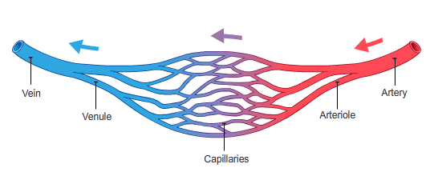
Diseases of the Arteries and Veins

Slide 31
DC 7110
7110 Aortic aneurysm: Ascending, thoracic, or abdominal:
Evaluate at 100 percent if the aneurysm is any one of the following:
Five centimeters or larger in diameter; symptomatic
( e.g., precludes exertion); or requires surgery 100
Otherwise 0

Slide 32
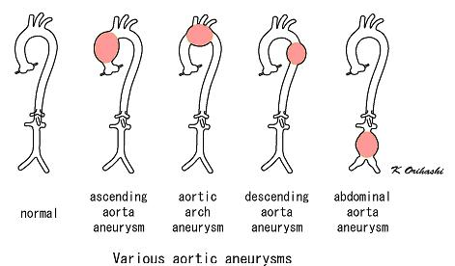
Aneurysms

Slide 33
DC 7110 (continued)
Evaluate non-cardiovascular residuals of surgical correction according to organ systems affected.
Note: When surgery is required, a 100-percent evaluation begins on the date a physician recommends surgical correction with a mandatory VA examination six months following hospital discharge. Evaluate post-surgical residuals under the General Rating Formula. Any change in evaluation based upon that or any subsequent examination shall be subject to the provisions of § 3.105(e) of this chapter.

Slide 34
DC 7111
7111 Aneurysm, any large artery:
If symptomatic; or, for the period beginning on the date a physician recommends surgical correction and continuing for six months
following discharge from inpatient hospital admission for
surgical correction 100
Following surgery: Evaluate under DC 7114 (peripheral arterial disease).
Note: Six months following discharge from inpatient hospitalization for surgery, determine the appropriate disability rating by mandatory VA examination. Any change in evaluation based upon that or any subsequent examination shall be subject to the provisions of § 3.105(e) of this chapter.

Slide 35
DC 7113
7113 Arteriovenous fistula, traumatic:
With high-output heart failure 100
Without heart failure but with enlarged heart, wide pulse
pressure, and tachycardia 60
Without cardiac involvement but with chronic edema,
stasis dermatitis, and either ulceration or cellulitis:
    Lower extremity 50
    Upper extremity 40
Without cardiac involvement but with chronic edema or stasis dermatitis:
    Lower extremity 30
    Upper extremity 20

Slide 36
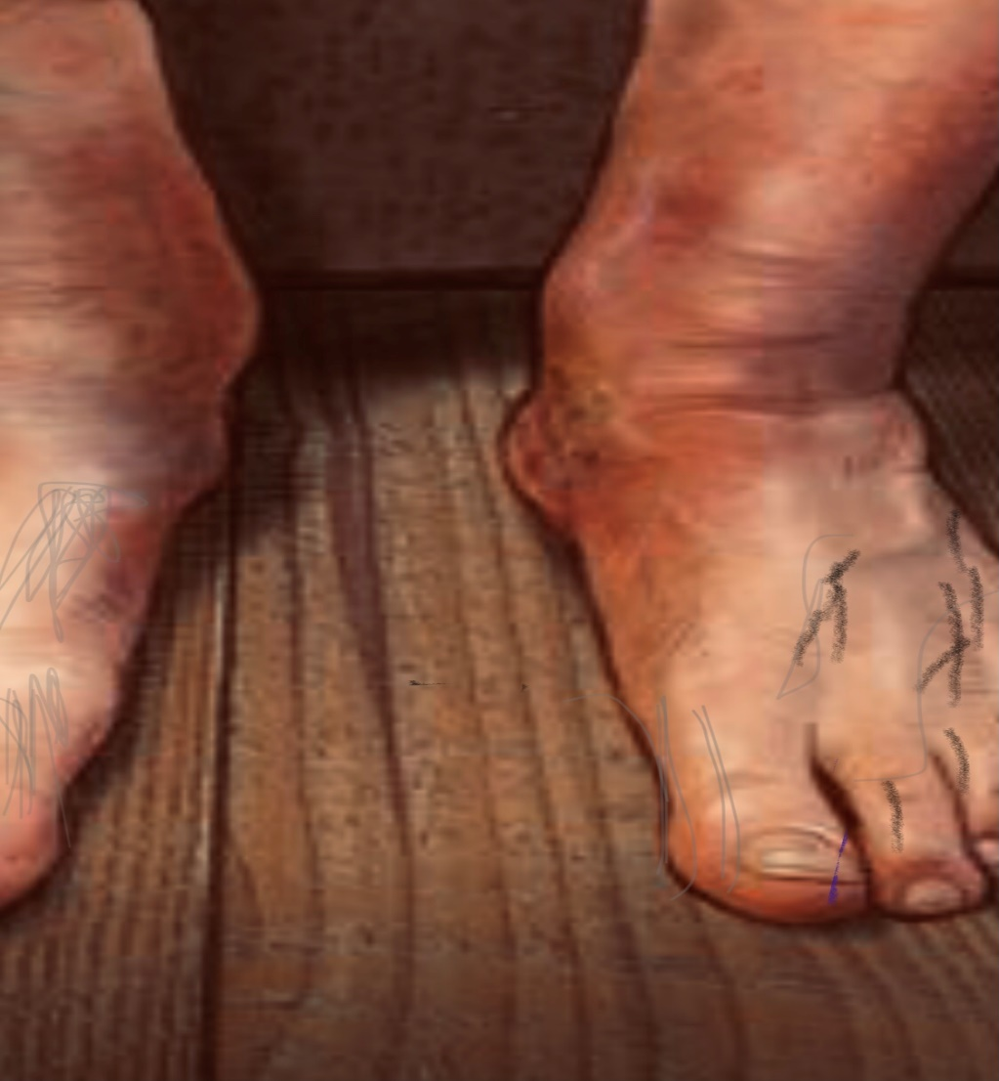
DC 7113 (continued)
Stasis dermatitis

Slide 37
DC 7114
7114 Peripheral arterial disease:
At least one of the following: Ankle/brachial index less than
or equal to 0.39; ankle pressure less than 50 mm Hg;
toe pressure less than 30 mm Hg; or transcutaneous oxygen
tension less than 30 mm Hg 100
At least one of the following: Ankle/brachial index of 0.40-0.53;
ankle pressure of 50-65 mm Hg; toe pressure of 30-39 mm Hg;
or transcutaneous oxygen tension of 30-39 mm Hg 60

Slide 38
DC 7114 (continued)
At least one of the following: Ankle/brachial index of
ankle pressure of 66-83 mm Hg; toe pressure of40-49 mm Hg;
or transcutaneous oxygen tension of 40-49 mm Hg 40
At least one of the following: Ankle/brachial index of 0.67-0.79;
ankle pressure of 84-99 mm Hg; toe pressure of 50-59 mm Hg;
or transcutaneous oxygen tension of 50-59 mm Hg 20

Slide 39
DC 7114 (continued)
Note (1): The ankle/brachial index (ABI) is the ratio of the systolic blood pressure at the ankle divided by the simultaneous brachial artery systolic blood pressure. For the purposes of this diagnostic code, normal ABI will be greater than or equal to 0.80.
The ankle pressure (AP) is the systolic blood pressure measured at the ankle. Normal AP is greater than or equal to 100 mm Hg.
The toe pressure (TP) is the systolic blood pressure measured at the great toe. Normal TP is greater than or equal to 60 mm Hg.
Transcutaneous oxygen tension (T c PO 2 ) is measured at the first intercostal space on the foot. Normal T c PO 2 is greater than or equal to 60 mm Hg. All measurements must be determined by objective testing.

Slide 40
DC 7114 (continued)
Note (2): Select the highest impairment value of ABI, AP, TP, or T c PO 2 for evaluation.
Note (3): Evaluate residuals of aortic and large arterial bypass surgery or arterial graft as peripheral arterial disease.
Note (4): These evaluations involve a single extremity. If more than one extremity is affected, evaluate each extremity separately and combine (under § 4.25), using the bilateral factor (§ 4.26), if applicable.

Slide 41
DC 7115
7115 Thrombo-angiitis obliterans (Buerger's Disease):
Lower extremity: Rate under DC 7114.
Upper extremity:
Deep ischemic ulcers and necrosis of the fingers with persistent coldness
of the extremity, trophic changes with pains in the hand during physical
activity, and diminished upper extremity pulses 100

Slide 42
DC 7115 (continued)
Persistent coldness of the extremity, trophic changes with pains in the hands during physical activity, and diminished upper extremity pulses 60
Trophic changes with numbness and paresthesia at the tips of the fingers, and diminished upper extremity pulses 40
Diminished upper extremity pulses 20
Note (1): These evaluations involve a single extremity. If more than one extremity is affected, evaluate each extremity separately and combine (under § 4.25), using the bilateral factor (§ 4.26), if applicable.
Note (2): Trophic changes include, but are not limited to, skin changes (thinning, atrophy, fissuring, ulceration, scarring, absence of hair) as well as nail changes (clubbing, deformities).

Slide 43
DC 7117
7117 Raynaud's syndrome (also known as secondary Raynaud's phenomenon or secondary Raynaud’s):
With two or more digital ulcers plus auto-amputation of one or
more digits and history of “characteristic attacks” 100
With two or more digital ulcers and history of characteristic attacks 60
Characteristic attacks occurring at least daily 40
Characteristic attacks occurring four to six times a week 20
Characteristic attacks occurring one to three times a week 10

Slide 44
DC 7117 (continued)
Note (1): For purposes of this section, characteristic attacks consist of sequential color changes of the digits of one or more extremities lasting minutes to hours, sometimes with pain and paresthesia’s, and precipitated by exposure to cold or by emotional upsets. These evaluations are for Raynaud's syndrome as a whole, regardless of the number of extremities involved or whether the nose and ears are involved.
Note (2): This section is for evaluating Raynaud's syndrome (secondary Raynaud's phenomenon or secondary Raynaud's). For evaluation of Raynaud's disease (primary Raynaud's), see DC 7124.

Slide 45
DC 7124
7124 Raynaud's disease (also known as primary Raynaud's):
Characteristic attacks associated with trophic change(s), such as tight, shiny skin 10
Characteristic attacks without trophic change(s) 0
Note (1): For purposes of this section, characteristic attacks consist of intermittent and episodic color changes of the digits of one or more extremities, lasting minutes or longer, with occasional pain and paresthesias, and precipitated by exposure to cold or by emotional upsets. These evaluations are for the disease as a whole, regardless of the number of extremities involved or whether the nose and ears are involved.

Slide 46
DC 7124 (continued)
Note (2): Trophic changes include, but are not limited to, skin changes (thinning, atrophy, fissuring, ulceration, scarring, absence of hair) as well as nail changes (clubbing, deformities).
Note (3): This section is for evaluating Raynaud's disease (primary Raynaud's). For evaluation of Raynaud's syndrome (also known as secondary Raynaud's phenomenon, or secondary Raynaud's), see DC 7117.

Slide 47

DC 7120
7120 Varicose veins:
Evaluate under
diagnostic code 7121.

Slide 48
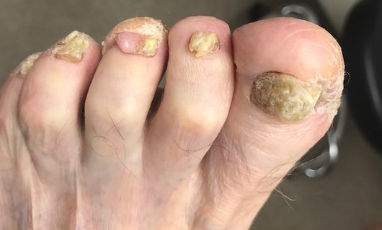
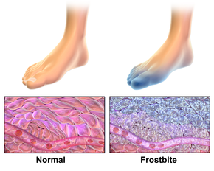
DC 7122 Cold Injury
A

Slide 49
DC 7122
7122 Cold injury residuals:
With the following in affected parts:
Arthralgia or other pain, numbness, or cold sensitivity plus two or more of the following: Tissue loss, nail abnormalities, color changes, locally impaired sensation, hyperhidrosis, anhydrosis, X-ray abnormalities (osteoporosis, subarticular punched-out lesions, or osteoarthritis), atrophy or fibrosis of the affected musculature, flexion or extension deformity of distal joints, volar fat pad loss in fingers or toes, avascular necrosis of bone, chronic ulceration, carpal or tarsal tunnel syndrome 30

Slide 50
DC 7122 (continued)
Arthralgia or other pain, numbness, or cold sensitivity plus one of the following: Tissue loss, nail abnormalities, color changes, locally impaired sensation, hyperhidrosis, anhydrosis, X-ray abnormalities (osteoporosis, subarticular punched-out lesions, or osteoarthritis), atrophy or fibrosis of the affected musculature, flexion or extension deformity of distal joints, volar fat pad loss in fingers or toes, avascular necrosis of bone, chronic ulceration, carpal or tarsal tunnel syndrome 20
Arthralgia or other pain, numbness, or cold sensitivity 10

Slide 51
DC 7122 (continued)
Note (1): Separately evaluate amputations of fingers or toes, and complications such as squamous cell carcinoma at the site of a cold injury scar or peripheral neuropathy, under other diagnostic codes. Separately evaluate other disabilities diagnosed as the residual effects of cold injury, such as Raynaud's syndrome (which is otherwise known as secondary Raynaud's phenomenon), muscle atrophy, etc., unless they are used to support an evaluation under diagnostic code 7122.
Note (2): Evaluate each affected part ( e.g., hand, foot, ear, nose) separately and combine the ratings in accordance with §§ 4.25 and 4.26.
See Coded page sample in Handouts.

Slide 52
DC 7122 (continued)
M21-1MR, Part III, Subpart iv, Ch 4, Sec E, Topic 21
(a) Injury due to exposure to extremely cold temperatures causes structural and functional disturbances of · small blood vessels · cells · nerves · skin, and · bone. The physical effects of exposure may be acute or chronic, with immediate or latent manifestations.
Examples: Exposure to · damp cold temperatures (around freezing) cause frostnip and immersion or trench foot. · dry cold, or temperatures well below freezing, cause frostbite with, in severe cases, loss of body parts, such as fingers, toes, earlobes, or the tip of the nose.
(b) Long-Term Effects of Exposure to Cold-- The fact that the immediate effects of cold injury may have been characterized as “acute” or “healed” does not preclude development of disability at the original site of injury many years later.

Slide 53
DC 7122 (continued)
M21-1MR, Part III, Subpart iv, Ch 4, Sec E, Topic 21
(d) Grant service connection for the residuals of cold injury if
(1) the cold injury was incurred during military service, and (2) an intercurrent nonservice-connected (NSC) cause cannot be determined. Notes: The fact that an NSC systemic disease that could produce similar findings is present, or that other areas of the body not affected by cold injury have similar findings, does not necessarily preclude service connection for residual conditions in the cold-injured areas. When considering the possibility of intercurrent cause, always resolve reasonable doubt in the veteran’s favor. Reference: For more information on reasonable doubt, see 38 CFR 3.102.

Slide 54
DC 7122 (continued)
M21-1MR, Part III, Subpart iv, Ch 4, Sec E, Topic 21
(e). The Chosin Reservoir Campaign was conducted during the Korean War, October 1950 through December 1950, in temperatures of –20ºF or lower. Many participants in this campaign suffered from frostbite for which they received no treatment and, as a result, there may be no service treatment records (STRs) to directly support their claims for frostbite. If the veteran’s participation in the Chosin Reservoir Campaign is confirmed, concede exposure to extreme cold under the provisions of 38 U.S.C. 1154(a).

Slide 55
DC 7122 (continued)
M21-1, Part V, Subpart iii, Ch 5, Topic 4 – Residual of Cold Injury
(a) and (b) nearly verbatim to M21-1MR, Pt III, Sub iv, Ch 4, Sec E, Topic 21
(b) The fact that the immediate effects of cold injury may have been characterized as “acute” or “healed” does not preclude development of disability at the original site of injury many years later.
*There does not need to be continuity of symptoms following a cold injury. Typically symptoms may last for days up to a week or two after the cold injury. Unless there was a loss (such as part of a hand or foot) this is followed by a long symptom free period, after which signs and symptoms may reoccur.

Slide 56
DC 7122 (continued)
M21-1, Part V, Subpart iii, Ch 5, Topic 4 – Residual of Cold Injury
(c) Veterans with a history of cold injury may experience the following signs and symptoms at the site of the original injury:
· chronic fungal infection of the feet · disturbances of nail growth · hyperhidrosis · chronic pain of the causalgia type · abnormal skin color or thickness · cold sensitization · joint pain or stiffness · Raynaud’s phenomenon · weakness of hands or feet · night pain · weak or fallen arches · edema · numbness · paresthesias · breakdown or ulceration of cold injury scars · vascular insufficiency, indicated by edema, shiny, atrophic skin, or hair loss, and · increased risk of developing conditions, such as - peripheral neuropathy - squamous cell carcinoma of the skin, at the site of the scar from a cold injury, or - arthritis or other bone abnormalities, such as osteoporosis, or subarticular punched-out lesions.
(j) Very important there be medical evidence addressing whether or not
X-ray abnormalities exist. The DBQ instructs abnormalities be confirmed by X-rays at least once. If never performed, the exam should be returned.

Slide 57

DC 7122 (continued)
DBQ INFO and COLD INJURY TIPS:
DBQ exams can only be completed by VA physicians, not accepted if
  completed by a private physician.
Weather-- Inquire as to location, duty, dates, weather. Google for
  Weather records for that period and area to submit with veteran’s claim!
  https://www.almanac.com/weather/history/
  https://www.wunderground.com/history/
  (See handout for example of full page)

Slide 58
Cold Injury—Weather History
http://weather.nysaes.cals.cornell.edu/history/
NYSAES Historical Weather Data - 1958 (cornell.edu) Vet in Worms, Germany Jan and December 1958
Column Headings:
AA Year (4-digits) GG Minimum relative humidity
BB Month (2-digits) HH Vapour pressure deficit (1/1000 in Hg)
CC Day (2-digits) II Solar radiation (cal/cm2)
DD Maximum air temperature (°F) JJ Precipitation (1/100 in)
EE Minimum air temperature KK Wind (miles at 1.5 ft)
FF Maximum relative humidity (%) LL Pan evaporation (1/1000 in)
AA BB CC DD EE FF GG HH II JJ KK LL
1958 1 1 41 29 NA NA NA NA 2 NA NA
1958 1 2 38 18 NA NA NA NA 0 NA NA
1958 1 3 28 9 NA NA NA NA 6 NA NA
1958 1 4 20 2 NA NA NA NA 2 NA NA
1958 1 5 22 2 NA NA NA NA 2 NA NA
1958 1 6 31 8 NA NA NA NA 0 NA NA
1958 1 7 39 26 NA NA NA NA 0 NA NA
1958 1 8 35 13 NA NA NA NA 9 NA NA
1958 1 9 15 10 NA NA NA NA 1 NA NA
1958 1 10 29 11 NA NA NA NA 0 NA NA
1958 1 11 45 19 NA NA NA NA 2 NA NA
1958 1 12 26 -1 NA NA NA NA 0 NA NA
1958 1 13 25 2 NA NA NA NA 0 NA NA
1958 1 14 41 12 NA NA NA NA 0 NA NA

Slide 59
Appendix Changes
Appendix A revisions reflected in Table of Amendments and
Effective Dates Since 1946
Appendix B revisions reflected in Numerical Index of Disabilities
Appendix C revisions reflected in Alphabetical Index of Disabilities

Slide 60

Don’t Agree?
Refer to handout VA Form 20-0998
  (See handout---Higher level review)
*Cold Injury denied as “Not Shown in Service”—
*Bilateral factors not considered for compensable
separate evaluations (e.g. DC 7114, DC 7115,
DC 7121, DC 7122)
*Incorrect reductions under 3.105 (e)

Slide 61
38 CFR 4.29 and 4.30
Handout will cover examples of:
4.29 Temporary 100% evaluation
4.30 Convalescent ratings

Slide 62
QUESTIONS?
Jan Avant
(501) 951-3074
jkavant1@Yahoo.com

Slide 63
REFERENCES
https://www.federalregister.gov/documents/2021/09/30/2021-19998/schedule-for-rating-disabilities-the-cardiovascular-system
38 CFR 4.2
38 CFR § 4.6
38 CFR 4.10
38 CFR 4.25
38 CFR 4.26
38 CFR 4.29
38 CFR 4.30
38 CFR 3.102.
38 CFR 3.303(a)
38 CFR 3.304(d)
38 CFR 3.310(b) and (c)

Slide 64
REFERENCES (continued)
38 USC 1154(a)
38 USC 1155
M21-1MR, Part III, Subpart iv, Chapter 4, Sec E, Topics 20 & 21
M21-1, Part V, Subpart ii,2.D
M21-1, Part V, Subpart iii. Chapter 5
M21-1, Part VIII, Subpart i, 1.B.1.h
https://www.ecfr.gov/recent-changes
https://www.vba.va.gov/pubs/forms/VBA-20-0998-ARE.pdf
https://www.almanac.com/weather/history/
https://www.wunderground.com/history/
VAOIG 19-08095-198, August 5, 2020, page iii

