Slide 1
Genitourinary Rating Schedule Changes
By Shereen Heath
November 2021

Slide 2
What you need
Copy of power point
Code of Federal Regulations
Handouts:
Federal Register
Definition of some conditions
Scenarios (will receive later)

Slide 3
GOAL
To understand most recent changes to the genitourinary system in VA Rating Schedule per Federal Register Final Rule effective November 14, 2021

Slide 4
REFERENCES
Federal Register / Vol. 86, No. 187 / Thursday, September 30, 2021 / Rules and Regulations
Code of Federal Regulations
4.14 3.10
4.115 3.350
4.115a 3.400
4.115b 3.105(e)
4.125 3.114
4.130 3.400
M21-1, Part V, Subpart iii, Chapter 7 (do be updated)

Slide 5
TOPICS
I. Study of Federal Register
II. General Changes
III. Changes to CFR 4.115a
a. Renal Function Dysfunction
b. Urinary Tract Infection Dysfunction
IV. Changes to CFR 4.1115b
a. Diagnostic codes
b. Diagnoses
V. Guidance
Class Exercise
Glossary
Questions
Evaluation

Slide 6

I. FEDERAL REGISTER
This Photo by Unknown Author is licensed under CC BY-SA

Slide 7
The Federal Register is the official daily publication for rules, proposed rules, and notices of Federal agencies and organizations, as well as executive orders and other presidential documents.
Federal Register / Vol. 86, No. 187 / Thursday, September 30, 2021 / Rules and Regulations
From herein it will be referred to as Federal Register or FR

Slide 8
How long does it take?
On October 15, 2019, VA published the proposed rule for Schedule of Rating Disabilities; The Genitourinary Diseases and Conditions in the Federal Register. VA received 12 comments during the 60-day comment period. VA appreciates the comments submitted in response to the proposed rule. Based on the rationale stated in the proposed rule and in this document, the proposed rule is adopted as a final rule with minor changes noted. The effective date November 14, 2021.

Slide 9
Why read the Federal Register?
It is helpful to read through the rationale and comments posted in the Federal Register because:
Explains the rationale behind a change
Includes input provided by interested parties
May answer your questions

Slide 10
Review the Federal Register changes to Genitourinary System

Slide 11

II. GENERAL CHANGES
This Photo by Unknown Author is licensed under CC BY-NC-ND

Slide 12
Updated medical terminology and more specific, objective laboratory findings such as glomerular filtration rate (GFR).
Replaced subjective terms such as “markedly,” “some,” and “slight” with specific, objective laboratory findings, such as GFR and albumin/creatinine ratio (ACR).
Specific date range such as “for three months during the past twelve months”

Slide 13

III. Changes to CFR 4.115a
This Photo by Unknown Author is licensed under CC BY-SA-NC

Slide 14
Renal Dysfunction *
Voiding Dysfunction
Urinary Frequency
Obstructive Voiding
Urinary Tract Infection*
*These two dysfunctions were changed
(38 CFR 4.115a, Federal Register)

Slide 15
a. RENAL FUNCTION
Glomerular Filtration Rate (GFR)
Duration of 3 consecutive month over past 12 months
Albumin level only used at zero percent level
Hypertension no longer built into evaluation criteria
(CFR 4.114a, Federal Register)

Slide 16
Glomerular Filtration Rate (GFR)
It is calculated on the basis of factors such as age, gender, race, and blood creatinine. Normal GFR values are between 90 to 120 ml/min. A GRF below 60 ml/min could mean that some kidney damage has occurred. The higher the level the better the kidney function.
VS.
Blood urea nitrogen (BUN) or, creatinine

Slide 17
EXAMPLE
100% Evaluation criteria prior to November 14, 2021
Requiring regular dialysis, or precluding more than sedentary activity from one of the following: persistent edema and albuminuria; or, BUN more than 80mg%; or, creatinine more than 8mg%; or, markedly decreased function of kidney or other organ systems, especially cardiovascular
100% Evaluation criteria effective November 14, 2021
Chronic kidney disease with glomerular filtration rate (GFR) less than 15 mL/min/1.73 for at least 3 consecutive months during the past 12 months; or requiring regular routine dialysis; or eligible kidney transplant recipient

Slide 18
URINARY TRACT INFECTION DYSFUNCTION
Drainage by stent or nephrostomy tube (this is a clarification of how the drainage occurs)
Suppressive drug therapy lasting six months or longer (replacing Long-term drug therapy)
Zero percent rating level added: recurrent symptomatic infection not requiring hospitalization, but requiring suppressive drug therapy for less than 6 months
(CFR 4.115a, Federal Register)

Slide 19
EXAMPLE
30% Evaluation criteria prior to November 14, 2021
Recurrent symptomatic infection requiring drainage/frequent hospitalization (greater than two times/year), and/or requiring continuous intensive management
30% Evaluation criteria effective November 14, 2021
Recurrent symptomatic infection requiring drainage by stent or nephrostomy tube; or requiring greater than 2 hospitalizations per year; or requiring continuous intensive management

Slide 20

IV. Changes to CFR 4.115b

Slide 21
a. Diagnostic Codes
Revised the entry for diagnostic code 7508
Removed the entry for diagnostic code 7510
Revised the entries for diagnostic codes 7520, 7521, 7522, 7524, 7525, 7527, 7533, 7534, 7537, 7539, 7541, and 7542
Revised the entries for diagnostic codes 7520, 7521, 7522, 7524, 7525, 7527, 7533, 7534, 7537, 7539, 7541, and 7542
(CFR 4.115b)

Slide 22
b. Diagnoses
Diagnostic Code 7522 wording has changed to put emphasis on erectile dysfunction and now includes the following note:
Note: For the purpose of VA disability evaluation, a disease or traumatic injury of the penis resulting in scarring or deformity shall be rated under diagnostic code 7522.
Also, a 20% evaluation as been removed. There is no compensable evaluation now. Special monthly compensation is allowed. See the FR for rationale. See CFR 3.350 for information on special monthly compensation.

Slide 23
b. Diagnoses (continued)
Diagnostic code 7525. Prostatitis, urethritis have been added to epididymitis, orchitis
Diagnostic code 7533. Moved some of the diagnosed conditions into the note and added the following: Alport's syndrome, cystinosis, primary oxalosis, and Fabry's disease.
Diagnostic code 7534. The following was added: or large vessel disease, unspecified

Slide 24
b. Diagnoses (continued)
Diagnostic code 7537: The following was added: including gouty nephropathy, disorders of calcium metabolism
Diagnostic code 7539: An extensive note was added (see the FR)
Diagnostic code 7531. The following has been removed: sickle cell anemia, systemic lupus erythematosus, vasculitis, or other systemic disease processes.

Slide 25
b. Diagnoses (continued)
Diagnostic code 7542. The following was added: or urinary tract infection, whichever is predominant.
Diagnostic code 7543. New code adding Varicocele/Hydrocele 0% with special monthly compensation consideration.

Slide 26
b. Diagnoses (continued)
Diagnostic code 7544. New code adding Renal disease caused by viral infection such as human immunodeficiency virus (HIV, Hep B, and Hep C. Rate as renal dysfunction.
Diagnostic code 7545. New code adding bladder, diverticulum of: rate as voiding dysfunction or urinary tract infection, whichever is predominant.

Slide 27
EXAMPLE
Evaluation criteria prior to November 14, 2021
7522 Penis, deformity, with loss of erectile power – 20¹
Evaluation criteria effective November 14, 2021
Erectile dysfunction, with or without penile deformity - 01
Note: For the purpose of VA disability evaluation, a disease or traumatic injury of the penis resulting in scarring or deformity shall be rated under diagnostic code 7522

Slide 28

V. Guidance
This Photo by Unknown Author is licensed under CC BY-SA-NC

Slide 29
VA will issue procedural guidance. This will hopefully address:
Changes in plain language
Management of effective dates
Staging of ratings
Reductions
Examples
CFR 3.105(e), 3.114, 3.400, M21-1, Part V, Subpart iii, Chapter 7

Slide 30
M21-1 is a very good resource for guidance:
Application of rating schedule
Application of effective date
Case examples
Check out M21-1, Part V, Subpart iii, Chapter 7.

Slide 31
Additionally
Secondary conditions, such as mental health
Ancillary benefits through VA. Dependent programs, Vocational Rehabilitation, Home Loan fee waivers, Federal Employment preference, etc…..
Local programs for service connected disabled veterans and dependents

Slide 32

VI. Class Exercise

Slide 33
VII. Glossary
ACR - albumin/creatinine ratio
BUN - Blood urea nitrogen
DX – diagnostic code
NIH - National Institute of Health
eGFR - estimated glomerular filtration rate
GFR - glomerular filtration rate
GU – Genitourinary

Slide 34

QUESTIONS?
This Photo by Unknown Author is licensed under CC BY-ND

Slide 35
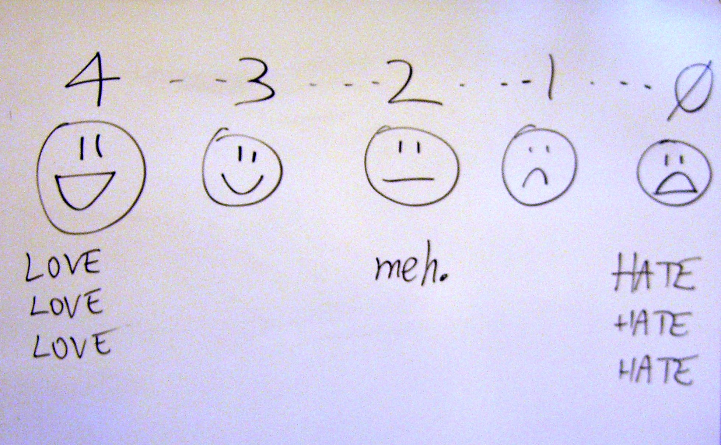
EVALUATION
This Photo by Unknown Author is licensed under CC BY-SA

Slide 36

This Photo by Unknown Author is licensed under CC BY-NC-ND

