Slide 1
2021 VETERAN
Your best health starts here
A guided tour and introduction to Medicare
Y0040_GHHK9YGEN_21_C

Slide 2

2021 VETERAN
Your best health starts here
A guided tour and introduction to Medicare
Y0040_GHHK9YGEN_21_C

Slide 3


Slide 4
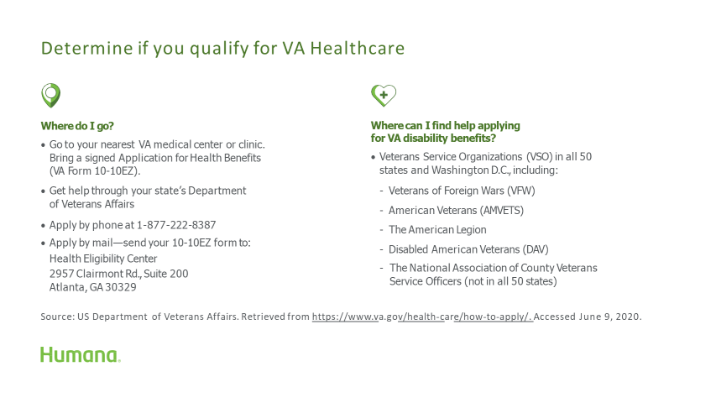

Slide 5

Are you eligible for Medicare?
If you are within three months of turning 65, you are eligible for the Medicare Initial Enrollment Period (IEP) and can enroll in a Medicare plan.
It’s time to explore Medicare.
Are you eligible for Medicare?
If you are within three months of turning 65, you are eligible for the Medicare Initial Enrollment Period (IEP) and can enroll in a Medicare plan.
It’s time to explore Medicare.

Slide 6
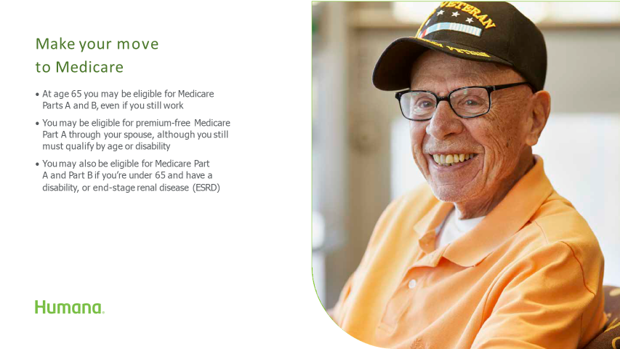

Slide 7


Slide 8


Slide 9


Slide 10


Slide 11
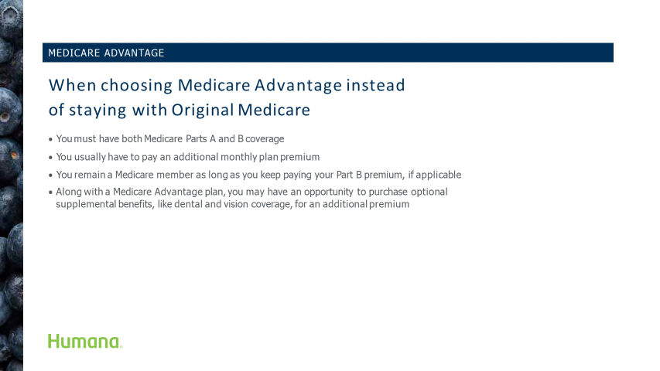

Slide 12
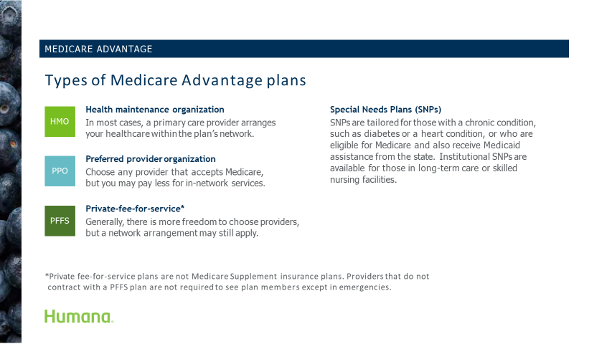

Slide 13
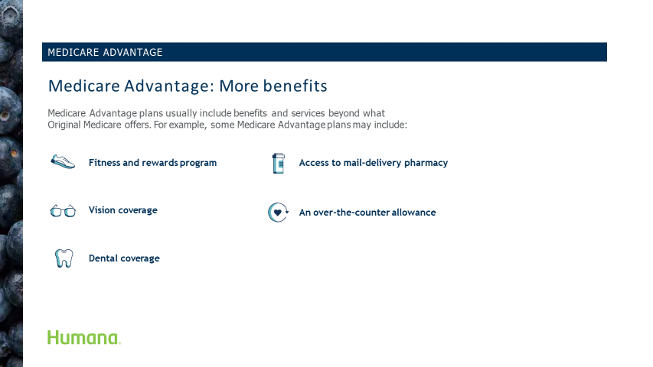

Slide 14


Slide 15
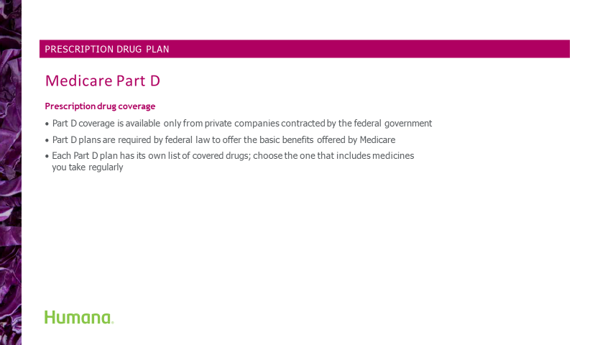

Slide 16
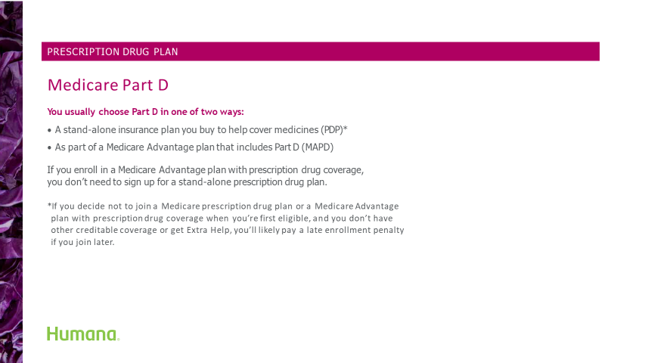

Slide 17
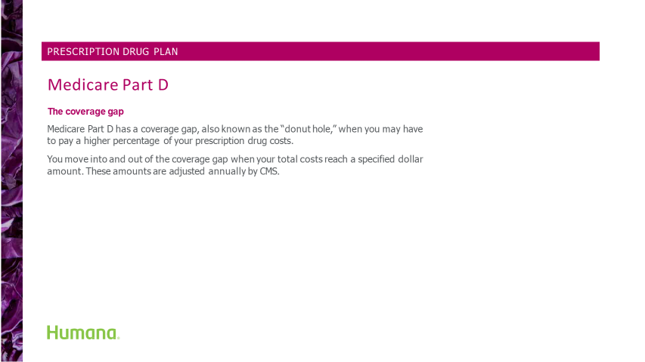

Slide 18
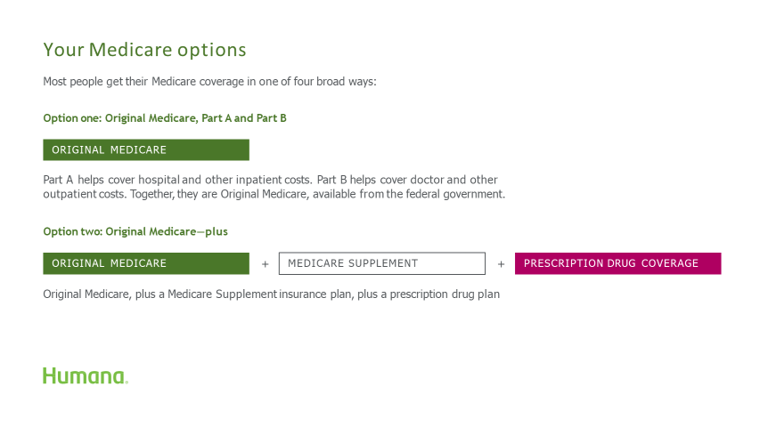

Slide 19
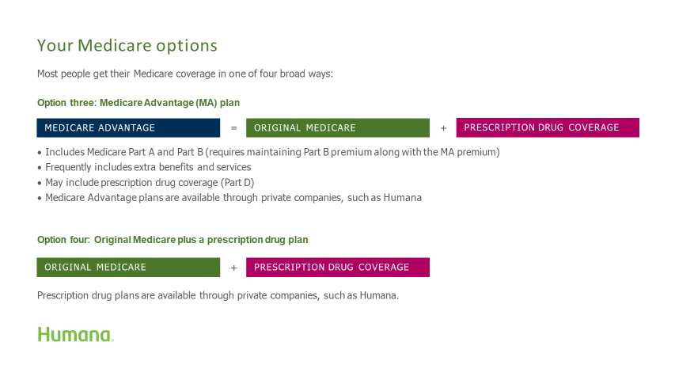

Slide 20


Slide 21


Slide 22


Slide 23
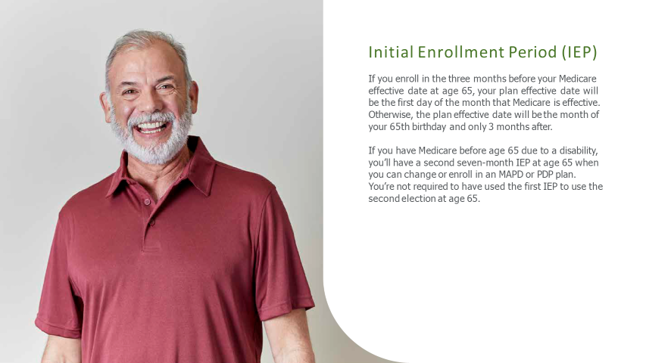

Slide 24


Slide 25


Slide 26
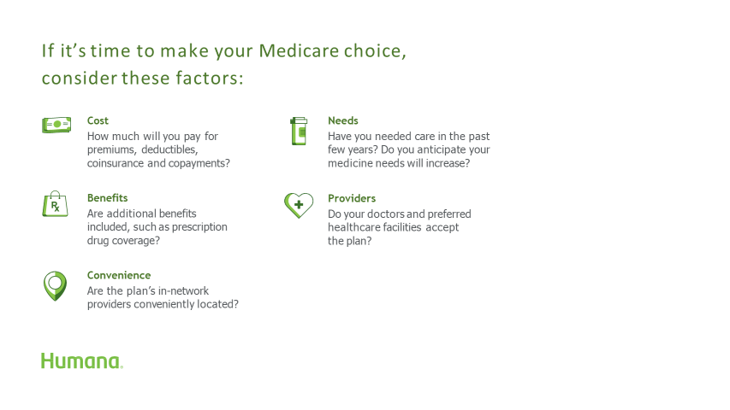

Slide 27


Slide 28
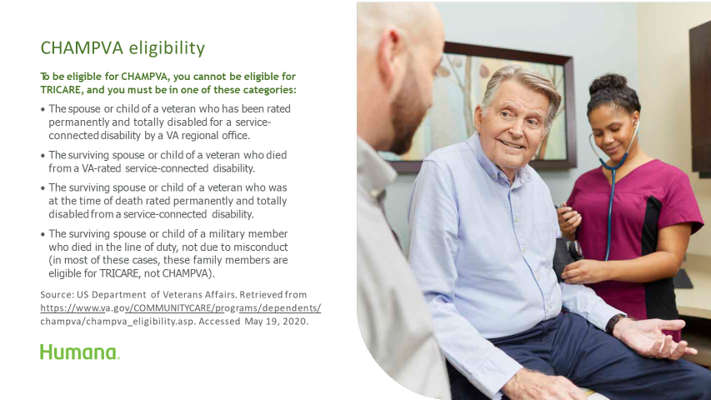

Slide 29
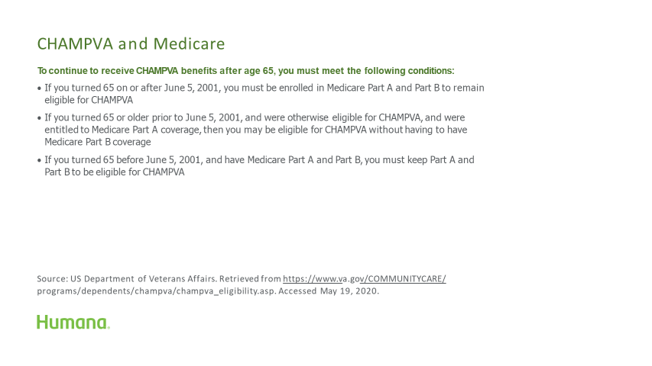

Slide 30
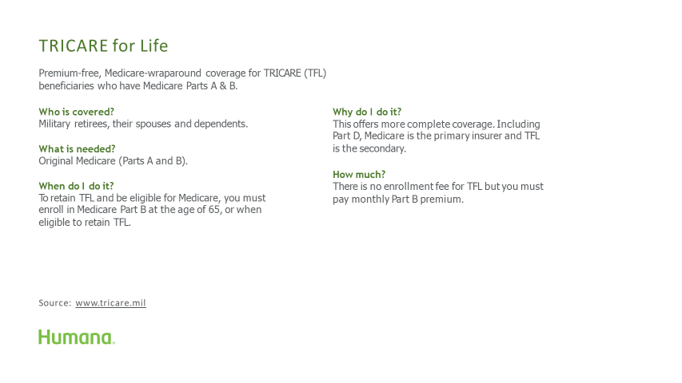

Slide 31
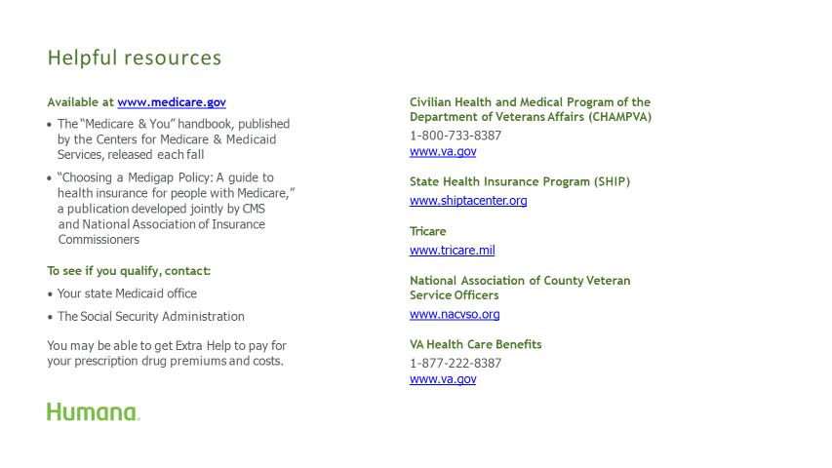

Slide 32


Slide 33
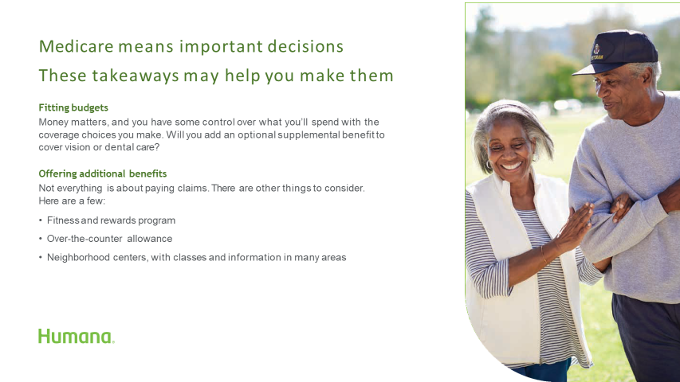

Slide 34
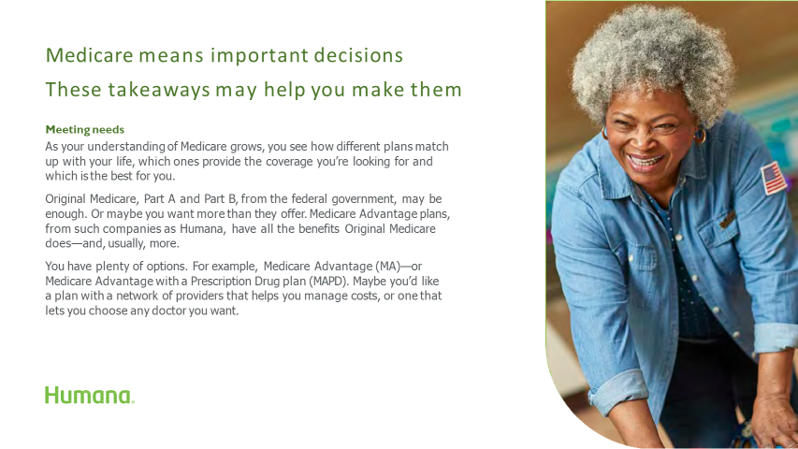

Slide 35


Slide 36
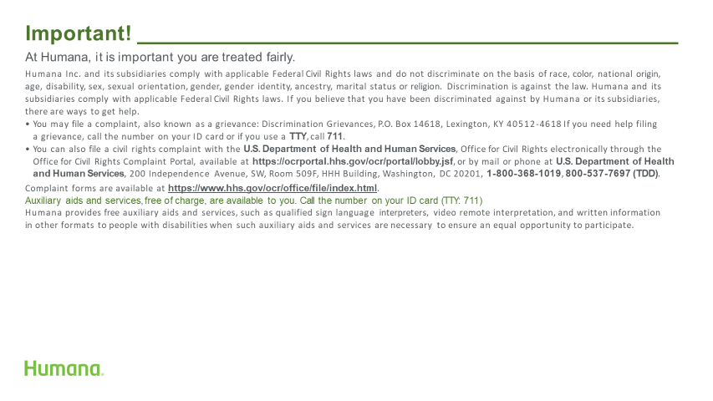

Slide 37
