Slide 1

Veteran Benefits Administration Medical Disability Examinations (VBA MDE 2)
NOVEMBER 14, 2021
Steve Paquette, Program Director – Medical Disability Examinations (MDE)

Slide 2
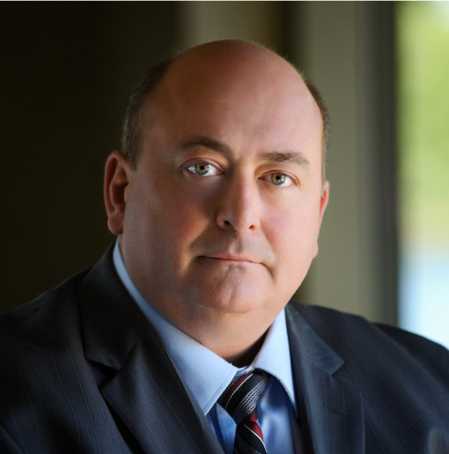

PRESENTER
Steve served eight years in the United States Marine Corps and deployed to Okinawa, South Korea, the Philippines and Saudi Arabia. After the Marine Corps, he worked for the Federal government before joining a government contracting company. Steve has been working in the Federal Contracting arena for 20 years and has managed nine nationwide contracts. He has been the Program Director for LHI/OSHS’s MDE contract for ten years.
STEVE PAQUETTE
Program Director Medical Disability Examinations (MDE)
Notes:
Good afternoon, everyone
Intro of each leader (I am Ed/Christine/Brian)
Thank you for joining us for our this All Hands meeting
1-2 minutes Town

Slide 3

Who We Are
LHI is part of OptumServe, the federal health services business of Optum and UnitedHealth Group.
OptumServe provides health policy research, analytics and consulting, military and Veteran health services, health IT solutions, health care data and analytics, health care operations and population health management.

Slide 4
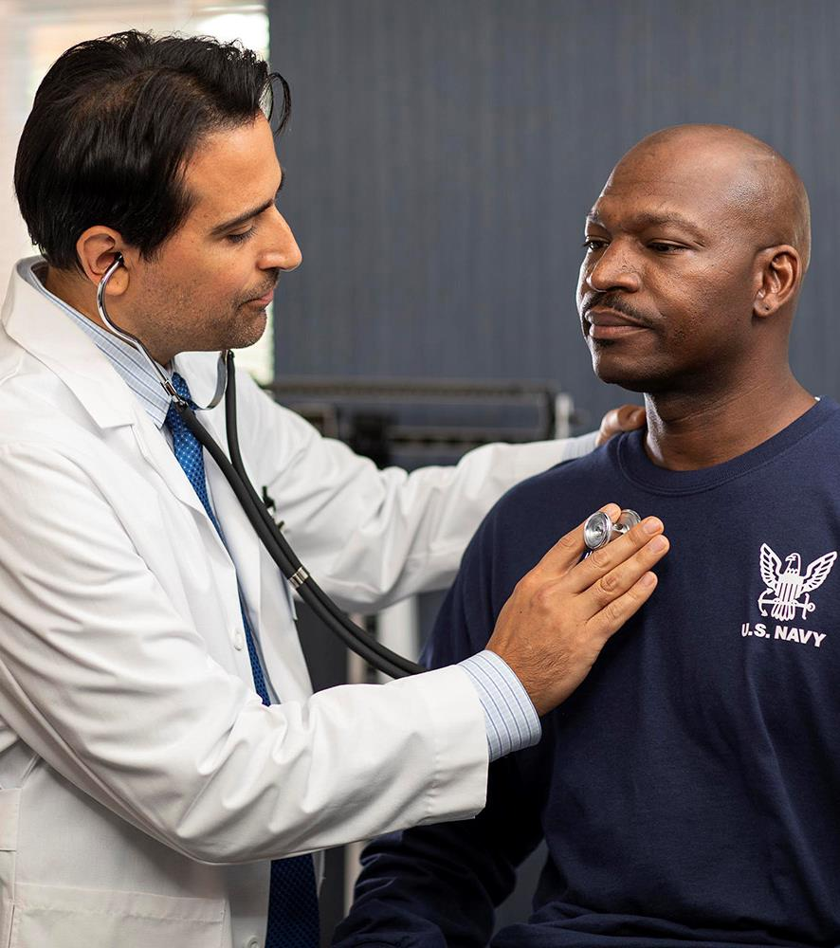
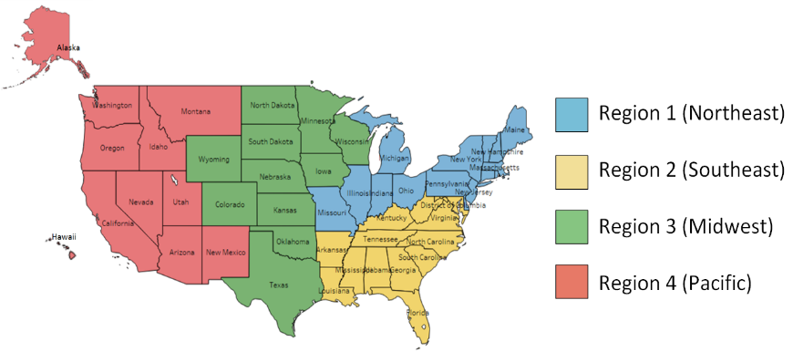
MDE 2 Program Overview
10-Year Contract 11/28/2018 – 9/30/2028
Three vendors awarded in each region
Four delivery models:
Subcontracted Network
Dedicated Facilities
Mobile Medical
Telehealth
The VHA (VAMCs) are still participating because of the pandemic but at a greatly diminished level
FULL NAME: | Veterans Benefits Administration Medical Disability Examinations
MISSION: | Provide quality compensation and pension examinations to Veterans and separating Service members
POPULATION: | Veterans and separating Service members of the U.S. military seeking disability benefits for service-connected health issues
SERVICES: | Review of Veterans’ medical history and current state of health; examinations in general medical, mental health, audiology, vision, dental and traumatic brain injury
CUSTOMER: | U.S. Department of Veterans Affairs
NUMBERS
In 2020, OSHS provided more than 935,456 services and/or disability benefit questionnaires (DBQs) to 267,808 Veterans.
© 2021 Optum, Inc. All rights reserved. Confidential property of Optum. Do not distribute or reproduce without express permission from Optum.

Slide 5
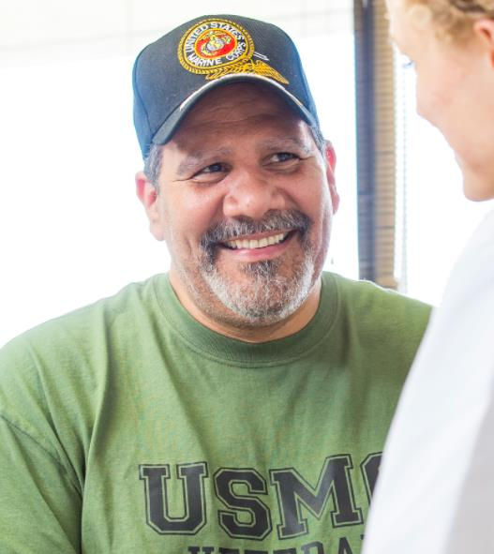
Compensation and Pension Exams
Six types of exams:
Medical (51% of appointments)
Audio (22% of appointments)
Behavioral Health (20.5% of appointments)
Vision (3% of appointments)
Traumatic Brain Injury (2.5% of appointments)
Dental (1% of appointments)
85 Disability Benefits Questionnaires (DBQs)
One Veteran (order) averages 1.4 appointments and 3.1 DBQs.
Orders are required to be completed within 20 days from receipt (weekends and holidays included)
DISABILITY BENEFITS QUESTIONNAIRES (DBQs)
DBQs were developed as a specific means to collect the necessary medical information required in the processing of Veterans disability claims. DBQs provide Veterans with a way to submit medical evidence from their health care provider to support their claims for disability benefits. Veterans can have their health care providers fill out and submit to VA any of the DBQs listed below that are appropriate for their claimed conditions.
© 2021 Optum, Inc. All rights reserved. Confidential property of Optum. Do not distribute or reproduce without express permission from Optum.
Notes:
DBQ REFERENCE: https://www.benefits.va.gov/compensation/dbq_publicdbqs.asp

Slide 6

How Exams are Distributed
The VBA has a system call ERRA which automatically splits up orders between the VA Medical Centers who perform C&P and MDE contractors
The system can divert and disperse orders down to the DBQ level.
For Example: If a VAMC cannot do Mental Health C&P any longer, any order with a mental health claim will be sent to a vendor
Vendors are not allowed to turn down an Order. They can only request cancellation if it is outside the parameters of the Contract or the Veteran refuses.
Each vendor receives one-third of orders unless their performance is consistently below standards.

Slide 7

Appointment Scheduling
LHI is adding a text and email notification in advance of the phone call to increase the response rate.
LHI contacts the Veteran via telephone within three business days of receipt of the order.
Notify the Veteran of the exam via telephone, electronically secure method, or a mailed postage-prepaid letter.
Confirmation by letter dispatched to the Veteran at least five calendar days prior to the scheduled appointment. (VBA proposes this to go to 3 days)

Slide 8
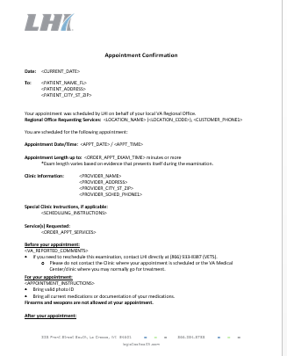
Appointment Scheduling (Continued)
Verbal confirmation of attendance to the appointment is acceptable in lieu of the five calendar days’ notice.
Written notice of the appointment by an electronic method (email or text) or a mailed postage-prepaid letter is always required. LHI uses FedEx unless Vet has a PO Box.
When no verbal confirmation is received, an appointment is scheduled and written notification sent.
Sample Appointment Confirmation Letter

Slide 9
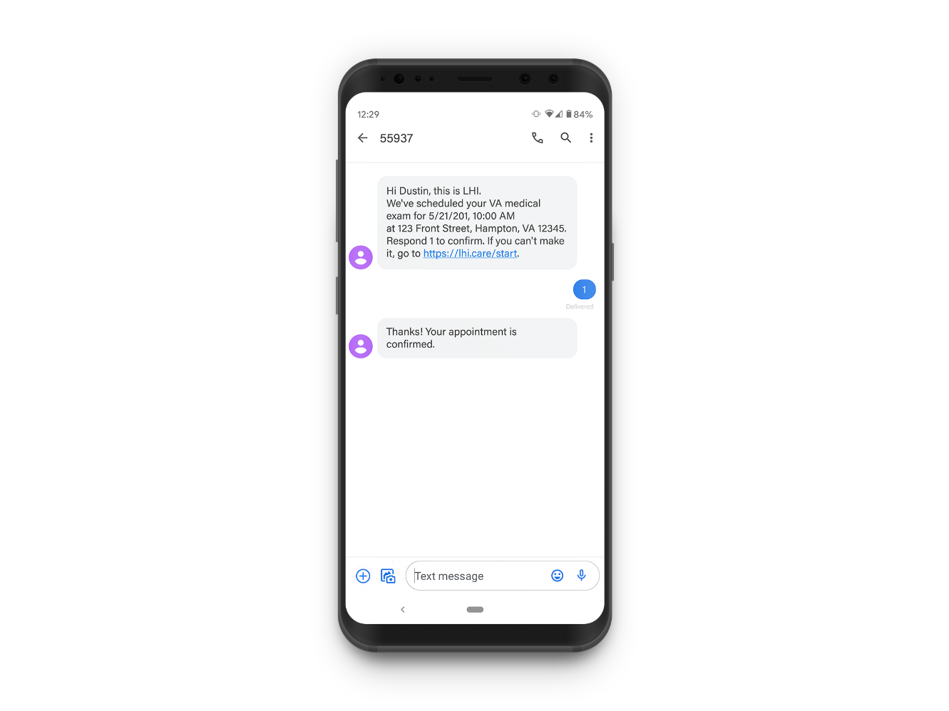
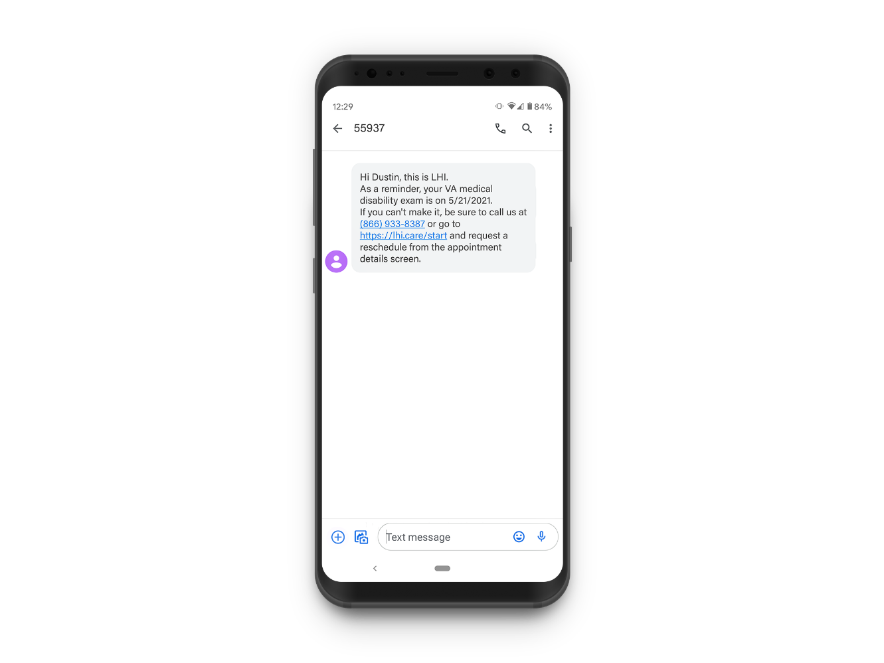
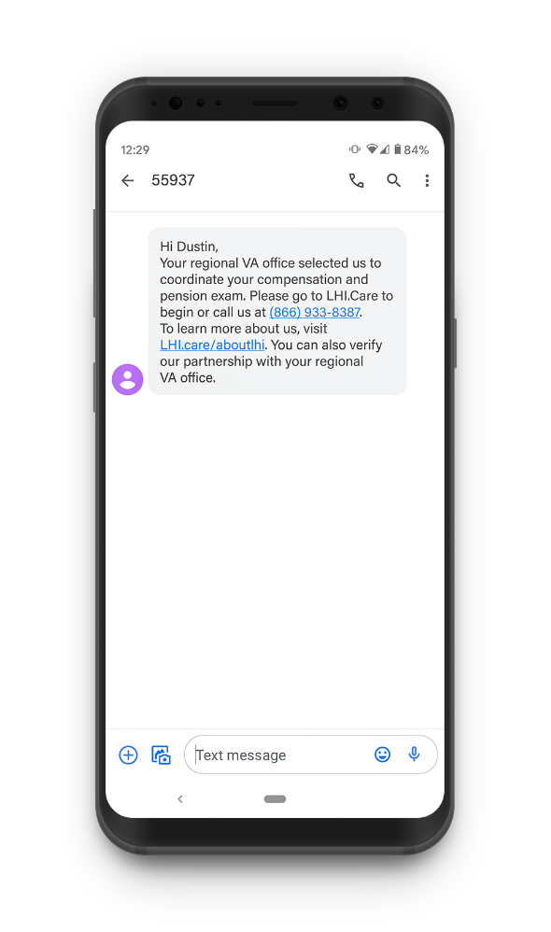
Appointment Scheduling (Continued)

Slide 10
Order Timeline (Normal Operations)
20 Days from time of receipt to transmittal back to the VA.
9
20
Without Phone Contact: 12 Days Open to the Veteran
7
20
With Phone Contact: 14 Days Open to the Veteran
0
20
Vendors Timeline
1
2
3-5
9
3
Process order
Contact Vet
Advanced Notification
Perform all appointments and complete DBQs.
Retrieve - Review
THE 20 DAY PERIOD INCLUDES WEEKENDS AND HOLIDAYS – THE CLOCK NEVER STOPS.

Slide 11
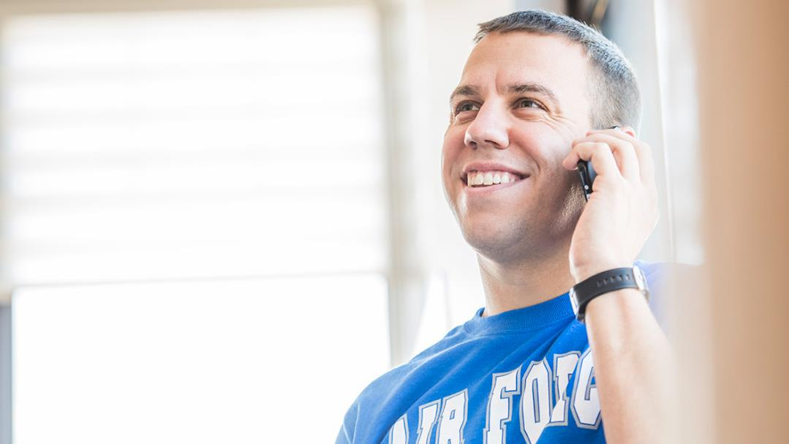
Reschedules
Veterans have only one opportunity to request any or all appointment(s) to be rescheduled.
They can only reschedule (1) one time and the rescheduled appoint must be within the 20-day window.
If the Veteran fails to show for the rescheduled appointment(s), the VARO is notified.
A new request will be generated by the VBA when the Veteran is available to attend the required examination.
The Veteran must file a new request through the VARO.

Slide 12
Failure to Report
(Normal Operations)
No Show / Failure to Report
If a Veteran does not show up for an appointment, all subsequent appointments are canceled unless there is an appointment less than 5 days out.
If the Veteran has a future appointment scheduled less than 5 days into the future; the appointment(s) will remain scheduled.
Partial No-Show (Short Notice Cancellation)
If a Veteran cancels an appointment 24 hours or less prior to the scheduled appointment it is designated as a partial no show and the Veteran will not be allowed to reschedule.
Veteran will be able to retain all other previously scheduled appointments if the appointments are with in the 20-day limit and the Veteran has made voice contact.
If the order has been canceled due to a no show or a partial no show, the Veteran must file a new request through the VARO.

Slide 13
Special Orders
Acceptable Clinical Evidence (ACE)
No face-to-face appointment is required. About 30% of these exam will require a telephonic interview. Veteran will still receive a notification letter
Sleep Study
May be done at home or overnight in a sleep clinic.
Incarcerated Veterans
Audio and Vision exams are usually not possible for incarcerated Veterans due to equipment issues.
Housebound
Veterans
Contracting Officers Representatives must approve a homebound exam. Veteran needs to be able to participate in the exam in some instances.

Slide 14
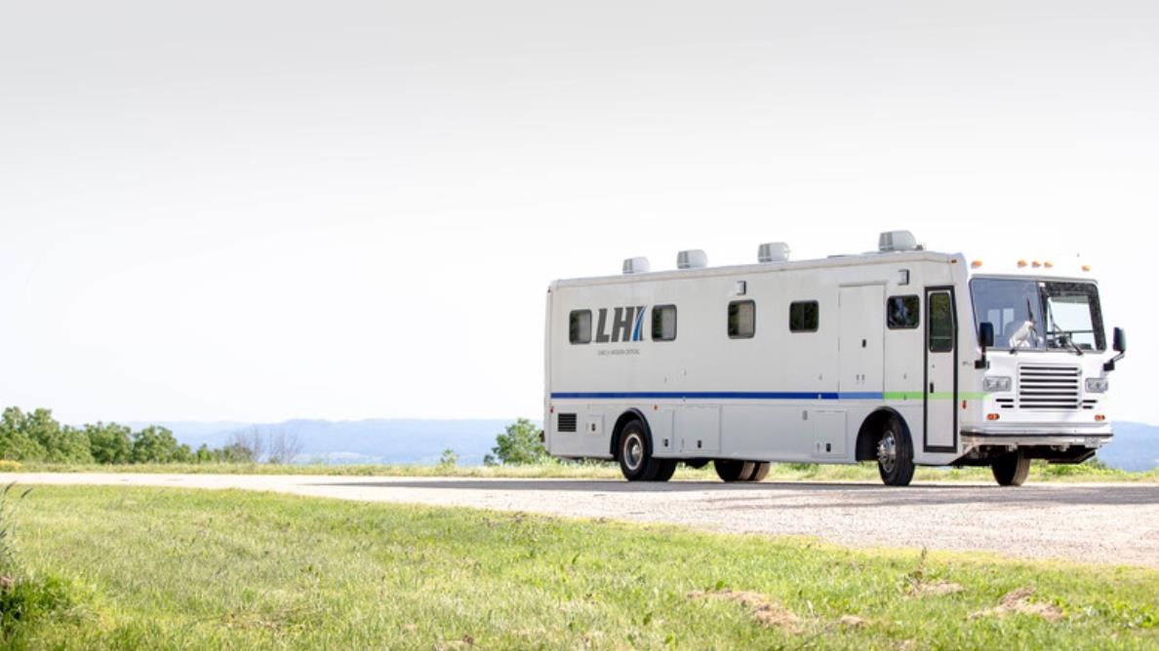
Pandemic Impacts
April 4, 2020 Vendors ordered to cease face-to-face exams
LHI continued with Acceptable Clinical Evidence (ACE) and Telehealth exams. (56,000 Telehealth exams to date)
June 8, 2020 Vendors allowed to resume conducting face to face exams in designated markets.
Large backlog due to the shut down. Orders are being processed by “oldest date of claim” first.
All markets able to resume in-person exams on Aug 23, 2020.

Slide 15
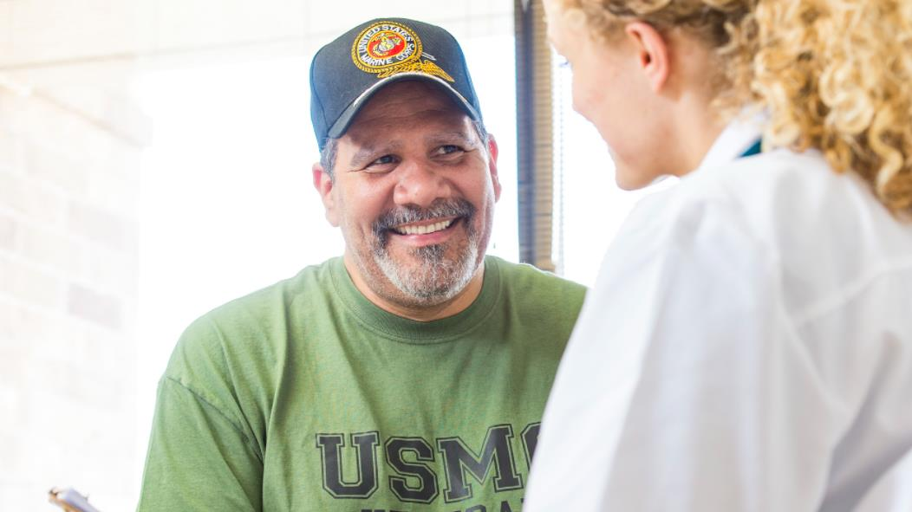
Veteran Travel
Travel payments are made in accordance with 38 U.S.C. § 111 - 41.5 cents per mile
Special Transportation requests are made through Regional Office or vendor
Medical Transport – Homeless – Special Needs
Vendor must seek permission from the VBA prior to special transport taking place
Mileage Exceptions: Veteran contacted by vendor prior to being asked to travel beyond 50/100-mile ranges

Slide 16

Service Delivery Methods
Subcontracted network serves smaller, low volume markets. This allows cost effective geographic coverage.
Subcontractors
Larger markets with a steady volume of Veterans. Dedicated facilities allow for a faster turn around and a better experience for the Veteran.
Dedicated Facilities
Serves highly rural markets, on site events and special needs such as post disaster support. LHI has 8 units.
Mobile
Conducting video and telephonic appointments when in person exams are not practical or an examiner is not in the vicinity.
Telehealth

Slide 17
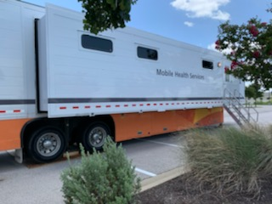
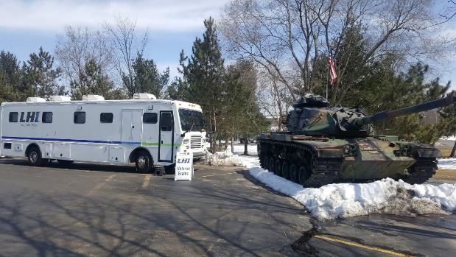
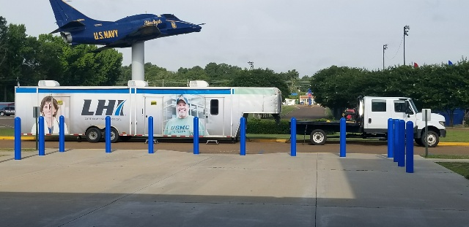
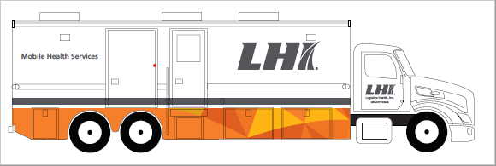
OSHS Mobile Units
OSHS leverages a fleet of various mobile units to perform on-site examinations in places where network availability or existence is minimal, or in cases where Veterans cannot leave their homes.
OSHS Owned Semi-Trailer (Four Exam Rooms)
Original OSHS-Owned Unit Operating in the Midwest
Three Towed Unit Operating by WWDL
New OSHS-Owned Unit (Completion Planned for September)

Slide 18
Completed Exams
The contract specifies Examiner Signature/Credentials required on the DBQs.
Once signed (speaking for LHI) the DBQ is locked and cannot be changed.
If changes are required and the document is “unsigned” the examiner who preformed the exam must agree to any corrections and resign.
When signed and reviewed for quality and completeness, the DBQs are sent electronically to the VA and automatically loaded into VBMS.
Vendors no longer have access to recall or change documents once transmitted to the VA.
Vendors are not allowed to release DQBs or any other records of the exams to anyone including the Veteran.
The VA rates the claim, LHI or its providers has no input into rating – only providing the clinical exam documentation.

Slide 19
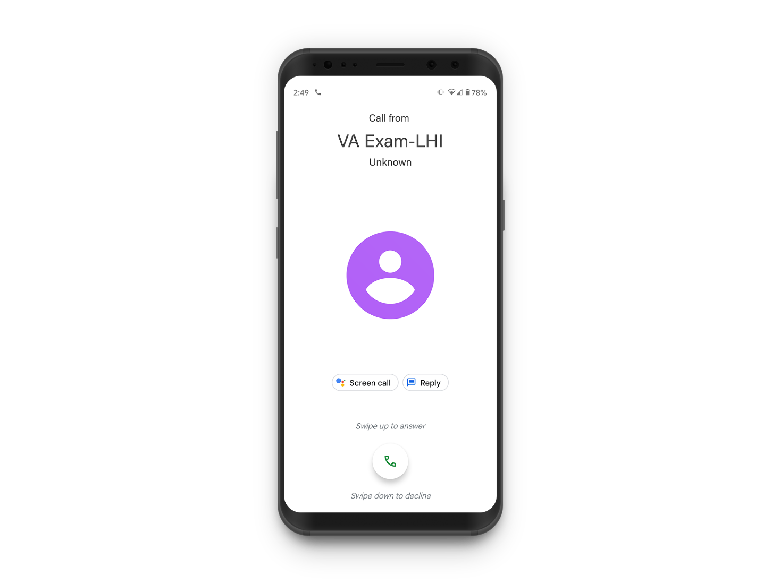
Driving Positive Outcomes for our Veterans
If a Veteran has questions or concerns about their appointment, encourage them to contact LHI at 866-933-8387
Depending on their carrier, Veterans may see LHI calling them with this caller ID – encouraging taking our calls helps ensure a timely experience
Encourage appointment attendance – missing an exam takes away bandwidth for other Veterans to get their exam completed
© 2021 Optum, Inc. All rights reserved. Confidential property of Optum. Do not distribute or reproduce without express permission from Optum.

Slide 20

© 2021 Optum, Inc. All rights reserved. Confidential property of Optum. Do not distribute or reproduce without express permission from Optum.

