Slide 1
Presumptive Conditions due to Toxic Exposure Part 1
By Vicki Von Loh
November 2021

Slide 2
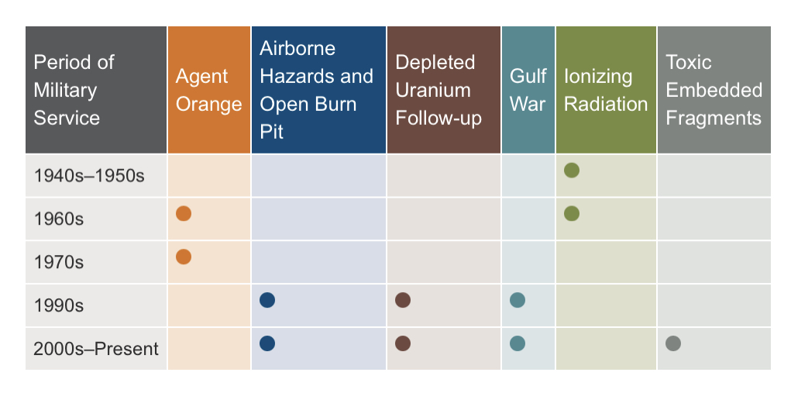
Chart of Periods and Presumptives (publichealth.va.gov)

Slide 3
VA Environmental Health Coordinators
VA Environmental Health Coordinators are found by state and U.S. territory.
Veterans may contact their local VA Environmental Health Coordinator about registry evaluations or health concerns related to military exposures. See the directory for the lead Environmental Health Coordinator in each Veterans Integrated Service Network (VISN).
This listing is Found at publichealth.va.gov.

Slide 4
VA Registries
EXPOSURE CATEGORIES
Chemicals (Agent Orange, contaminated water…)
Radiation (nuclear weapons, X-rays…)
Air Pollutants (burn pit smoke, dust…)
Occupational Hazards (asbestos, lead…)
Warfare Agents (chemical and biological weapons)

Slide 5
VA Registry
A registry is defined as a system for collecting and maintaining, in a structured record, data on specific persons from a defined population, which allows for preliminary research analyses and reviews. Two broad categories of health registries are disease-based registries and exposure based registries.
A disease-based registry organizes data based on the cases of a specific disease or condition, while an exposure registry organizes data based on people who have had a common exposure.

Slide 6
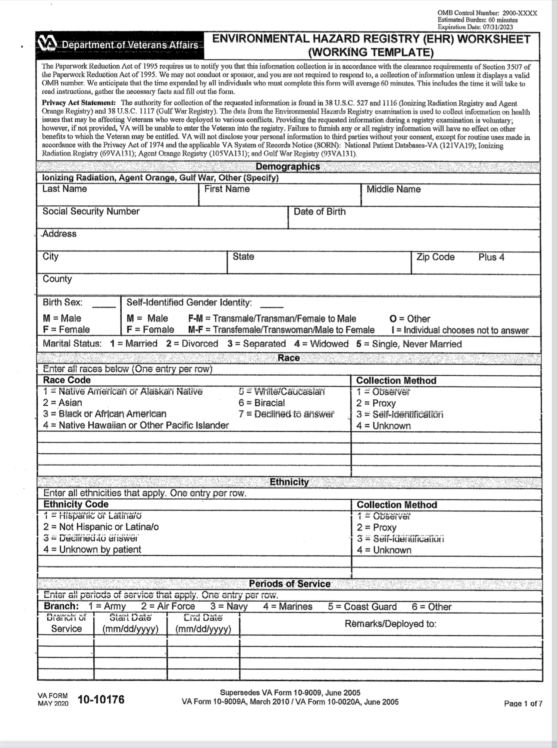
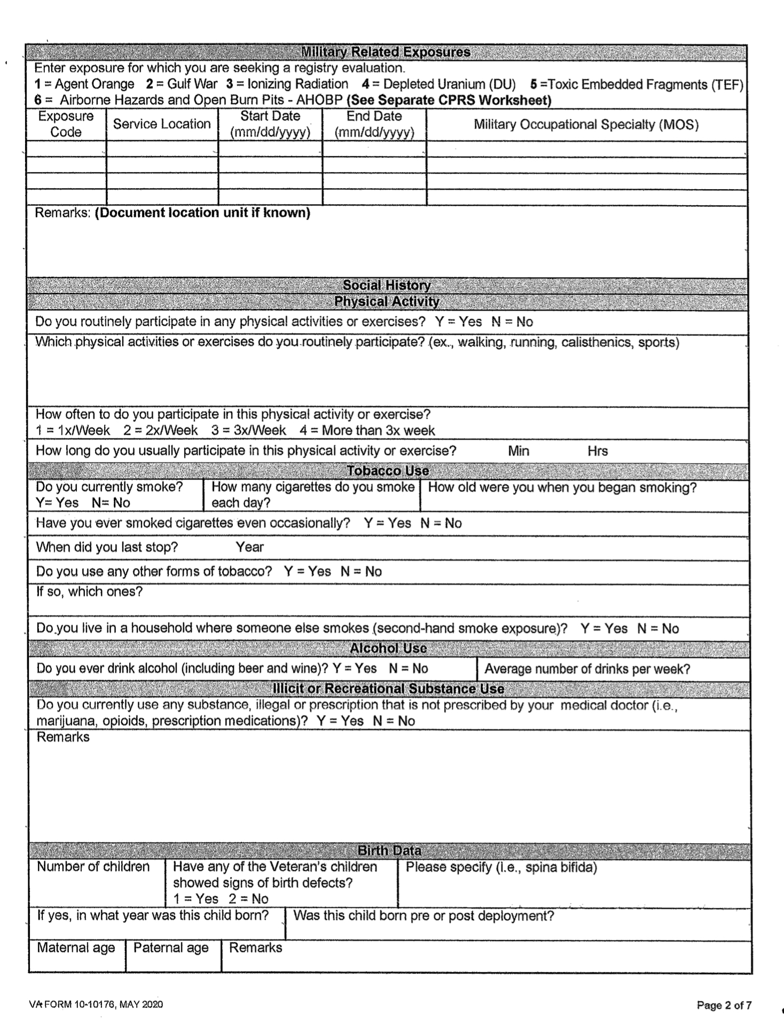
Registry Examination
VA Form 10-10176

Slide 7
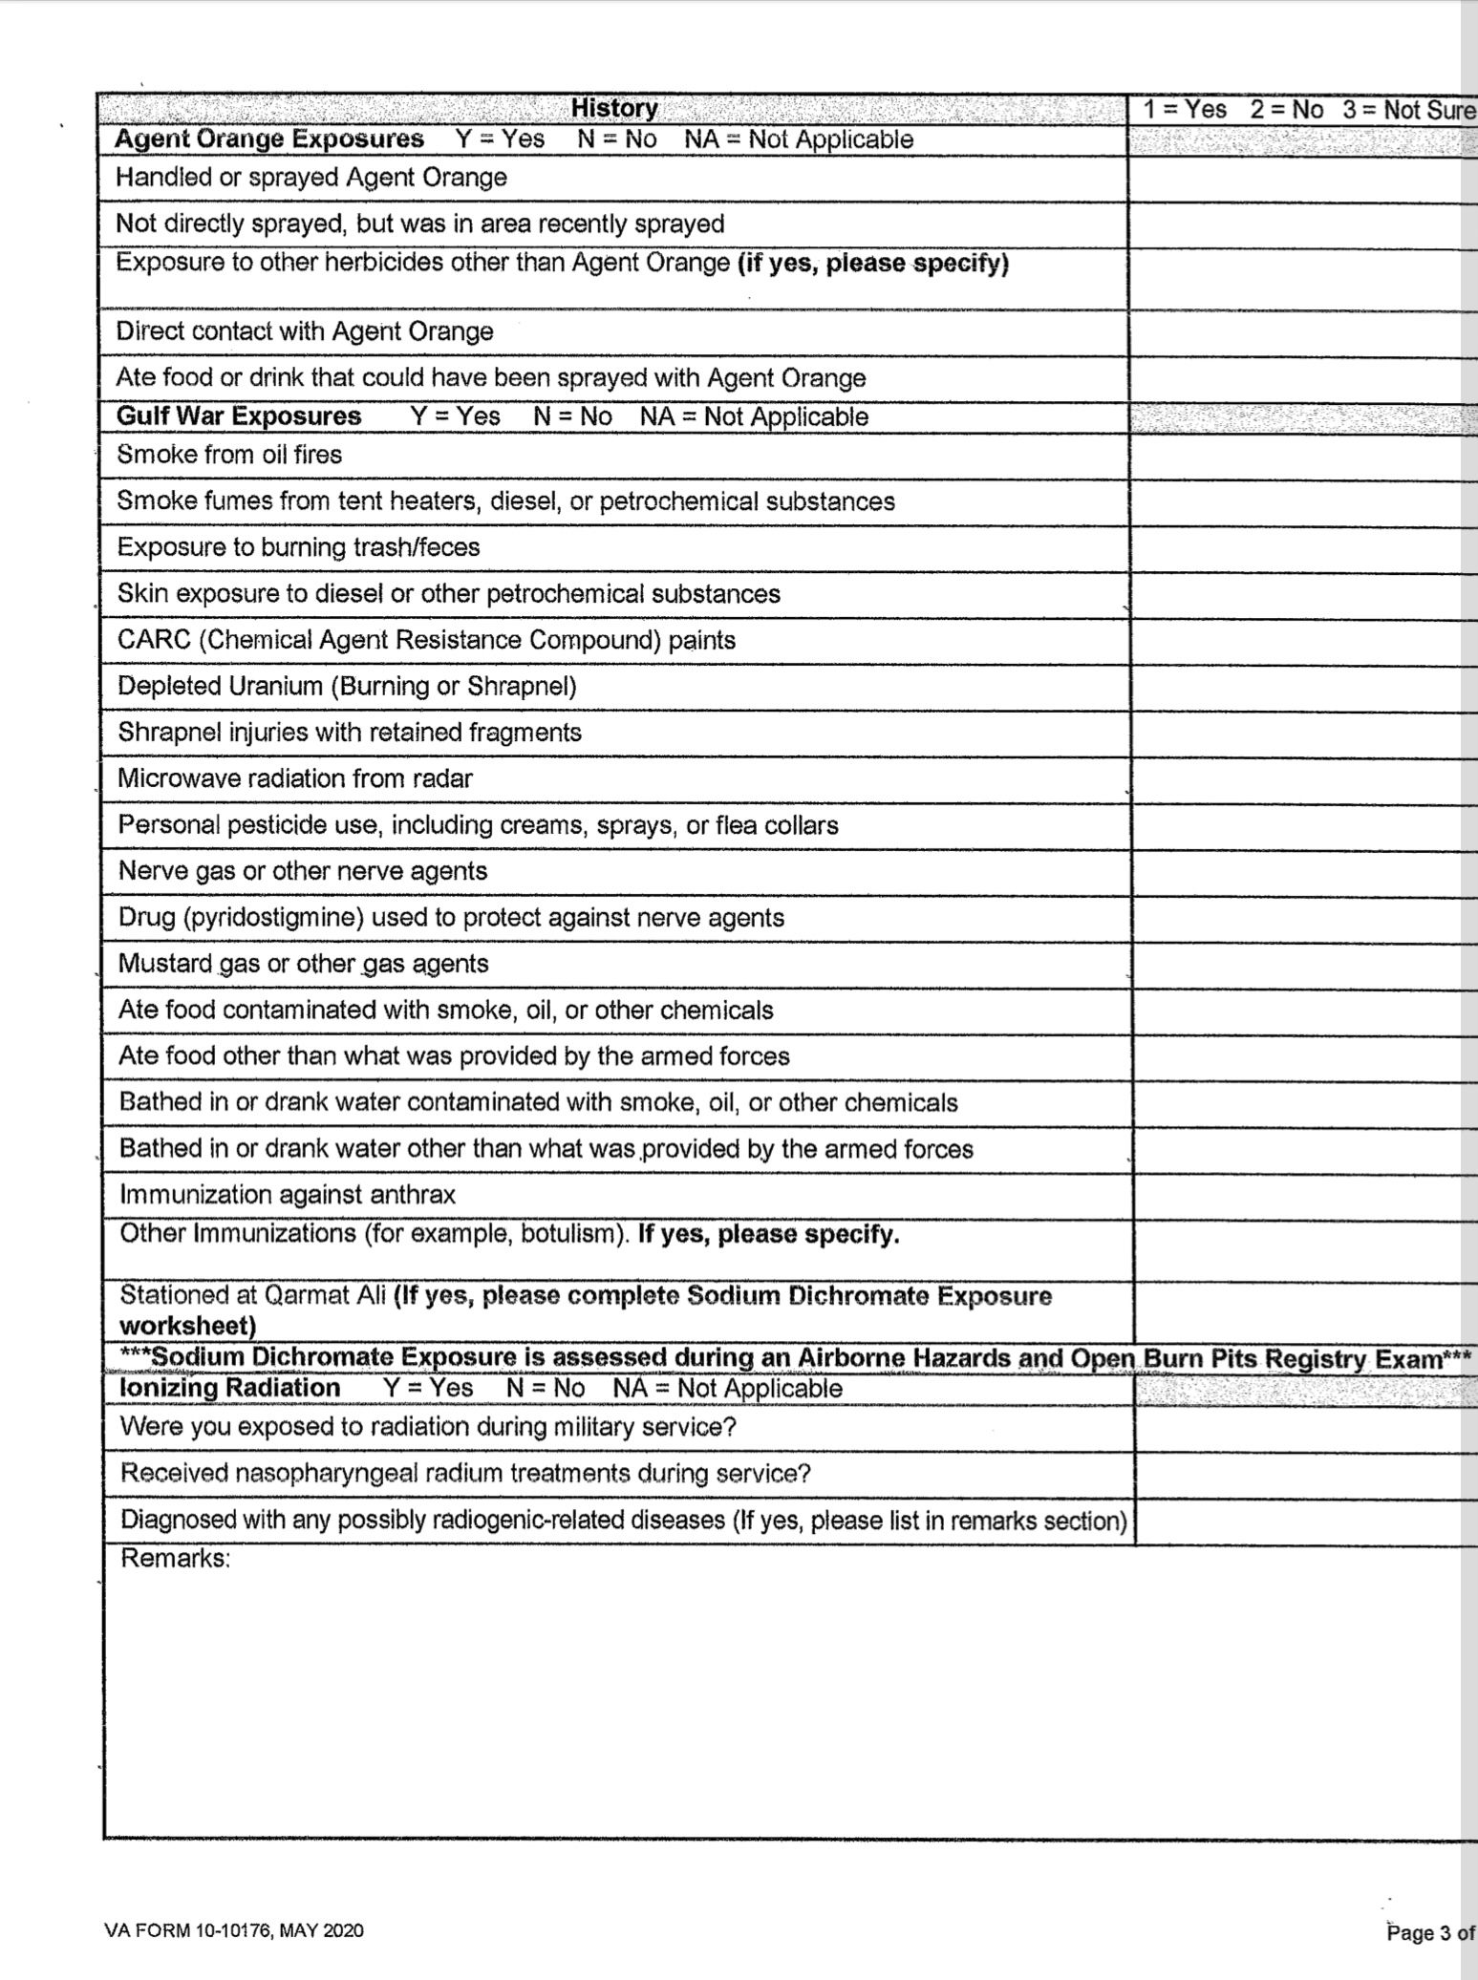
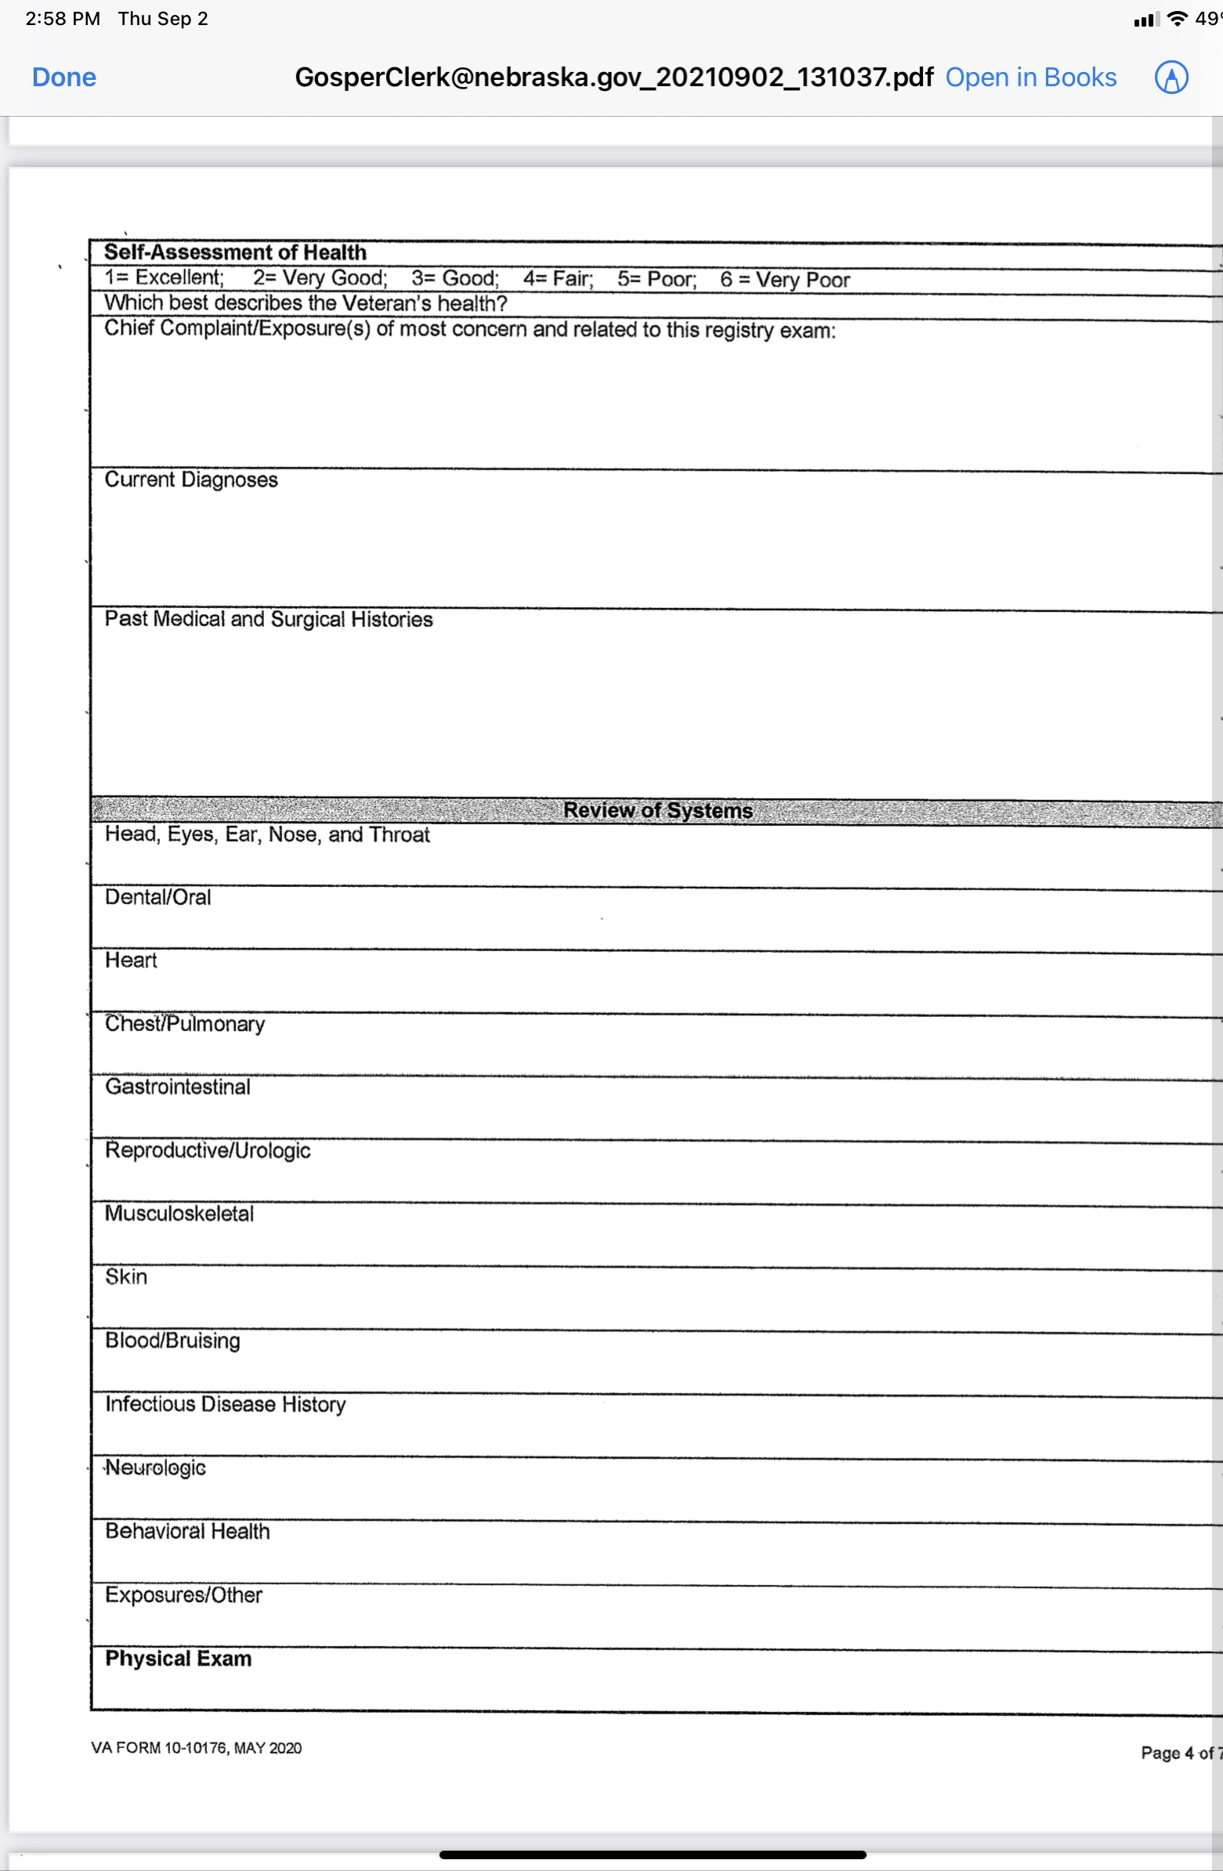
Registry Examination (continued)

Slide 8
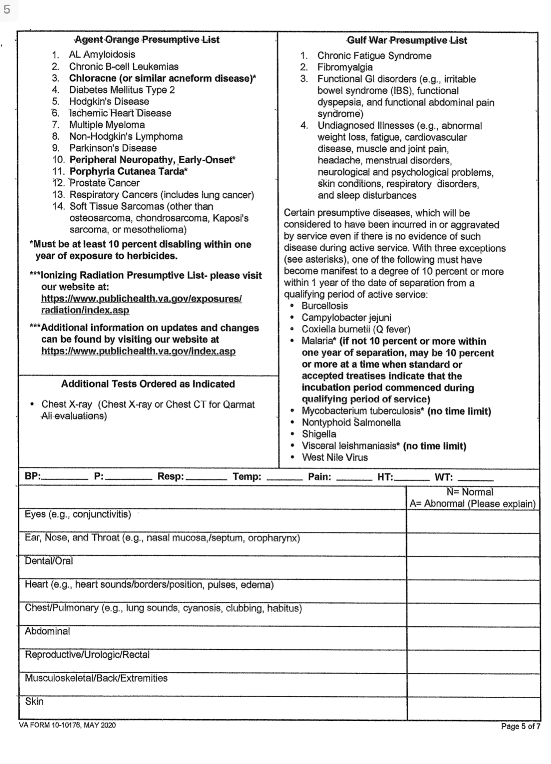
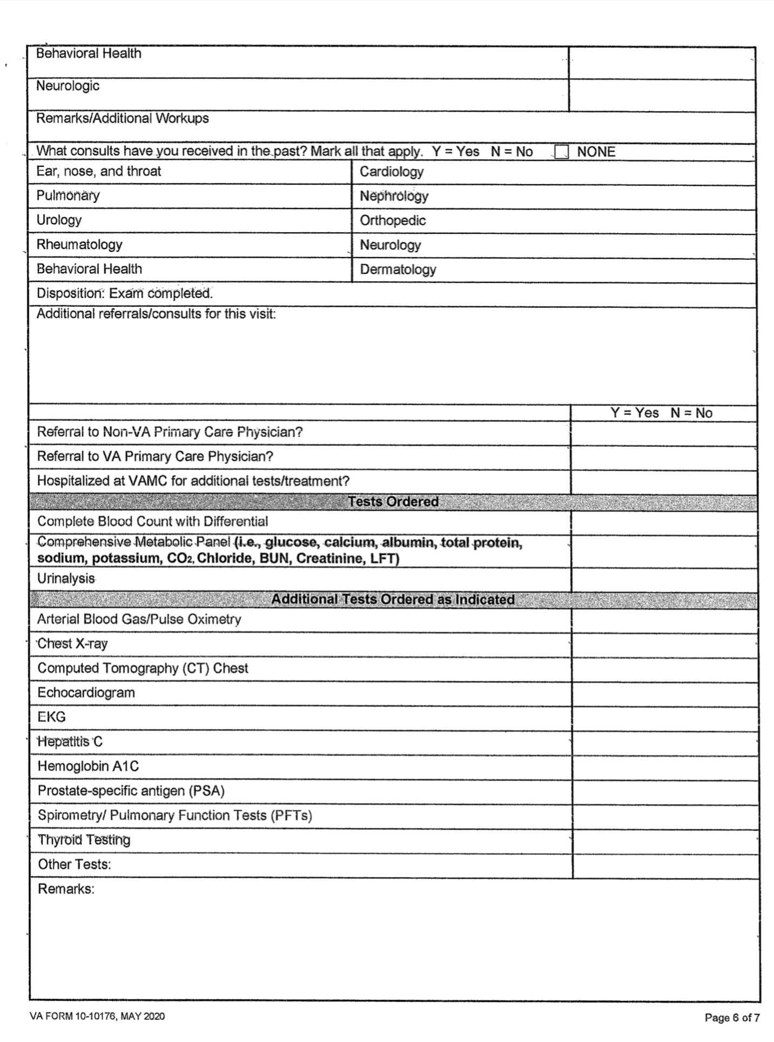
Registry Examination (continued)

Slide 9
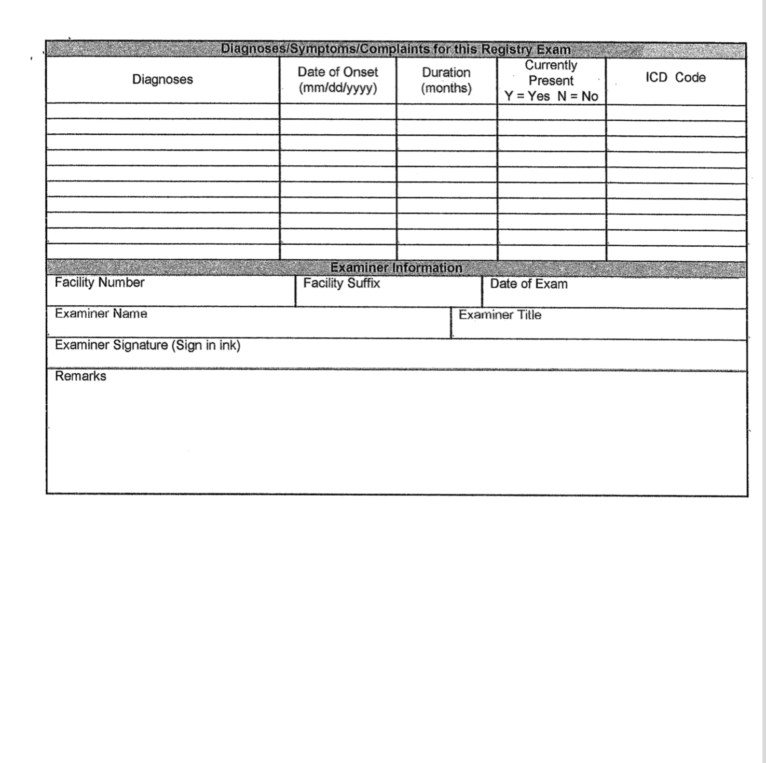
Registry Examination (continued)

Slide 10
VA Airborne Hazards and Open Burn Pit Registry Eligibility
VA established the Airborne Hazards and Open Burn Pit Registry (AHOBPR) in 2014 to help put data to work for Veterans through research about potential health effects of airborne hazard exposures.
By joining the registry, information can be provided to help VA better understand whether long-term health conditions may be related to these exposures. Even if service members have not experienced any symptoms or illnesses believed to be related to exposures during military service, their participation in the registry could help VA provide better care to all Veterans.

Slide 11
VA Airborne Hazards and Open Burn Pit Registry Eligibility
Veterans are eligible to participate in the registry if they were deployed to the Southwest Asia theater of operations any time after August 2, 1990 or Afghanistan or Djibouti on or after September 11, 2001.
Regions and countries include: Iraq, Afghanistan, Kuwait, Saudi Arabia, Bahrain, Djibouti, Gulf of Aden, Gulf of Oman, Oman, Qatar, United Arab Emirates, waters of the Persian Gulf, Arabian Sea, and Red Sea.
Operations and campaigns include: Desert Shield and Desert Storm (ODS/S), Iraqi Freedom (OIF), Enduring Freedom (OEF), and New Dawn (OND).

Slide 12
VA Airborne Hazards and
Open Burn Pits
“Airborne hazard” refers to any sort of contaminant or potentially toxic substance that we are exposed to through the air we breathe. While on active duty, military service members may have been exposed to a variety of airborne hazards including:
The smoke and fumes from open burn pits
Sand, dust, and particulate matter
General air pollution common in certain countries
Fuel, aircraft exhaust, and other mechanical fumes
Smoke from oil well fires

Slide 13
VA Airborne Hazards and
Open Burn Pits
Depending on a variety of factors, veterans may experience health effects related to this exposure. Factors that may indicate veterans have a greater or lesser risk of short or long-term health effects include:
Types of waste burned
Proximity, amount of time, and frequency of exposure
Wind direction and other weather-related factors
Presence of other airborne or environmental hazards in the area

Slide 14
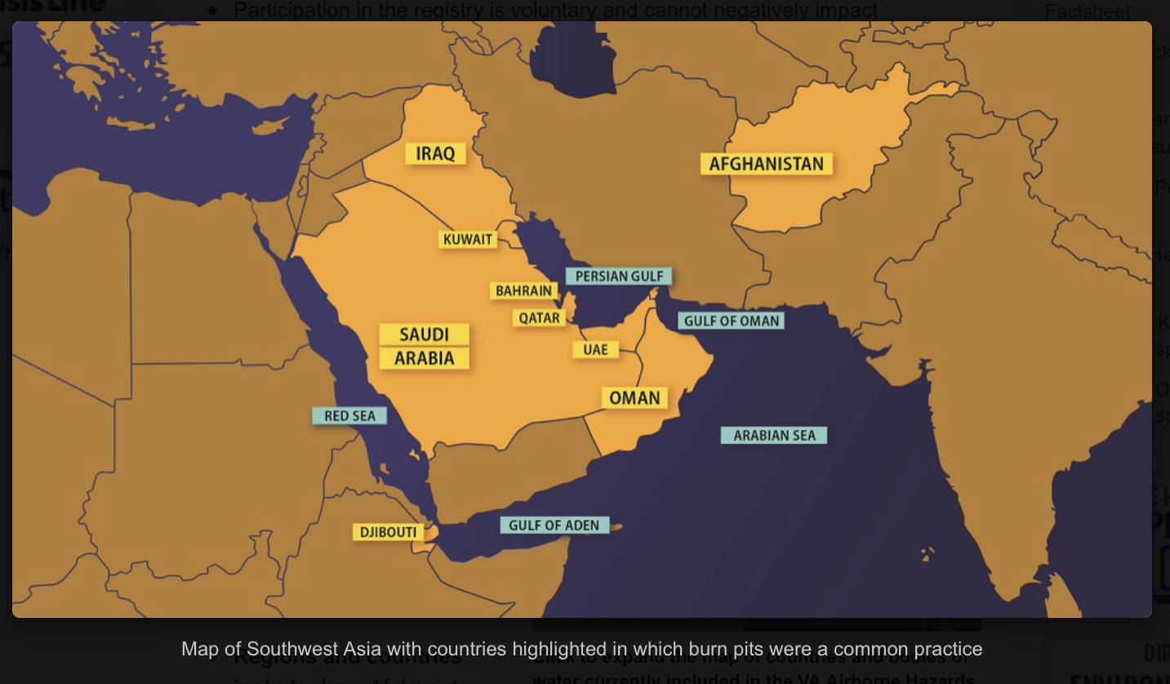
Locations of Burn Pits

Slide 15
Particulate Matter
Particulate matter is a complex mixture of extremely small particles and liquid droplets made up of a number of components including acids, organic chemicals, metals, and soil or dust particles.
Under 38 CFR 3.320, there is no length of deployment required in order to concede exposure. The service member shall be presumed to have been exposed, unless there is affirmative evidence that the veteran was not exposed to fine, particulate matter during that service.

Slide 16
Particulate Matter (continued)
The term qualifying period of service means any period of active military, naval, or air service in:
The Southwest Asia theater of operations, as defined in §3.317(e)(2), during the Persian Gulf War as defined in §3.2(i).
(ii) Afghanistan, Syria, Djibouti, or Uzbekistan on or after September 19, 2001 during the Persian Gulf War as defined in §3.2(i).

Slide 17
Particulate Matter (continued)
If the veteran’s exposure to particulate matter is conceded based on qualifying service, then the claim should be considered on a presumptive basis. VA should give a sympathetic reading of claims for respiratory symptoms.
However, a diagnosis of one of the presumptive respiratory conditions, within ten (10) years of separation from service, must be developed for and confirmed before service connection can be granted.
Claims will be developed by standard development procedures.

Slide 18
Particulate Matter (continued)
If it appears that entitlement can be established for the claimed respiratory disability on another basis, ie direct, then the claim should not be processed as GW particulate exposure claim.
If evidence show the condition existed prior to service, aggravation should be considered.
If entitlement exists under multiple theories, the grant should be based on the most advantageous effective date.

Slide 19
Particulate Matter (continued)
There is no requirement that the respiratory disabilities manifest to a compensable degree, ie. 10 percent or more, to establish presumptive service connection under 38 CFR 3.320.
Effective date considerations, under 38 CFR 3.114, are applicable. The regulation went into effect on August 5, 2021; in no case will an award be effective prior to that date.

Slide 20
Presumptive Conditions Based on
Particulate Matter Exposure
Chronic Asthma
Chronic Sinusitis
Chronic Rhinitis

Slide 21
Chronic Asthma
Asthma is a condition in which your airways narrow and swell and may produce extra mucus. This can make breathing difficult and trigger coughing, a whistling sound (wheezing) when you breathe out and shortness of breath.
For some people, asthma is a minor nuisance. For others, it can be a major problem that interferes with daily activities and may lead to a life-threatening asthma attack.
Asthma can't be cured, but its symptoms can be controlled. Because asthma often changes over time, it's important that you work with your doctor to track your signs and symptoms and adjust your treatment as needed.

Slide 22
Chronic Asthma (continued)
Asthma symptoms vary from person to person. You may have infrequent asthma attacks, have symptoms only at certain times — such as when exercising — or have symptoms all the time.
Asthma signs and symptoms include:
  Shortness of breath
  Chest tightness or pain
  Wheezing when exhaling, which is a common sign of asthma in children
  Trouble sleeping caused by shortness of breath, coughing or wheezing
  Coughing or wheezing attacks that are worsened by a respiratory virus, such as a cold or the flu

Slide 23
Chronic Rhinitis
Hay fever, also called allergic rhinitis, causes cold-like signs and symptoms, such as a runny nose, itchy eyes, congestion, sneezing and sinus pressure. But unlike a cold, hay fever isn't caused by a virus. Hay fever is caused by an allergic response to outdoor or indoor allergens, such as pollen, dust mites, or tiny flecks of skin and saliva shed by cats, dogs, and other animals with fur or feathers (pet dander).
Besides making you miserable, hay fever can affect your performance at work or school and generally interfere with your life. But you don't have to put up with annoying symptoms. You can learn to avoid triggers and find the right treatment.

Slide 24
Chronic Rhinitis (continued)
Hay fever signs and symptoms can include:
  Runny nose and nasal congestion
  Watery, itchy, red eyes (allergic conjunctivitis)
  Sneezing
  Cough
  Itchy nose, roof of mouth or throat
  Swollen, blue-colored skin under the eyes (allergic shiners)
  Postnasal drip
  Fatigue

Slide 25
Chronic Sinusitis (Rhinosinusitis)
Chronic sinusitis occurs when the spaces inside your nose and head (sinuses) are swollen and inflamed for three months or longer, despite treatment.
This common condition interferes with the way mucus normally drains, and makes your nose stuffy. Breathing through your nose may be difficult, and the area around your eyes might feel swollen or tender.
Chronic sinusitis can be brought on by an infection, by growths in the sinuses (nasal polyps) or by swelling of the lining of your sinuses. Also called chronic rhinosinusitis, the condition can affect both adults and children.

Slide 26
Chronic Sinusitis (Rhinosinusitis)
(continued)
Common signs and symptoms of chronic sinusitis include:
Nasal inflammation
Thick, discolored discharge from the nose (runny nose)
Drainage down the back of the throat (postnasal drainage)
Blocked or stuffy (congested) nose causing difficulty breathing through your nose
Pain, tenderness and swelling around your eyes, cheeks, nose or forehead
Reduced sense of smell and taste

Slide 27
Chronic Sinusitis (Rhinosinusitis)
(continued)
Other signs and symptoms can include:
  Ear pain
  Headache
  Aching in your upper jaw and teeth
  Cough or throat clearing
  Sore throat
  Bad breath
  Fatigue

Slide 28
Chronic vs Acute Sinusitis
Chronic sinusitis and acute sinusitis have similar signs and symptoms. But acute sinusitis is a temporary infection of the sinuses often associated with a cold.
The signs and symptoms of chronic sinusitis last at least 12 weeks, but you may have several episodes of acute sinusitis before developing chronic sinusitis.
Fever isn't a common sign of chronic sinusitis, but you might have one with acute sinusitis.

Slide 29
How is Service Connection (SC)
Established?
Presumptive SC can be established under 38 CFR 3.320 effective August 5, 2021.
Apply the liberalizing law provisions of 38 CFR 3.114(a) when determining the effective date of SC under 38 CFR 3.320.
In order to establish presumptive SC for asthma, rhinitis, and/or sinusitis (to include rhinosinusitis) under 38 CFR 3.320, the evidence must show qualifying service, and manifestation of the qualifying chronic disability(ies) within the presumptive period. With those conditions met, VA can concede exposure to fine, particulate matter in the correlating duty location and the nexus between said exposure and the chronic disability(ies).

Slide 30
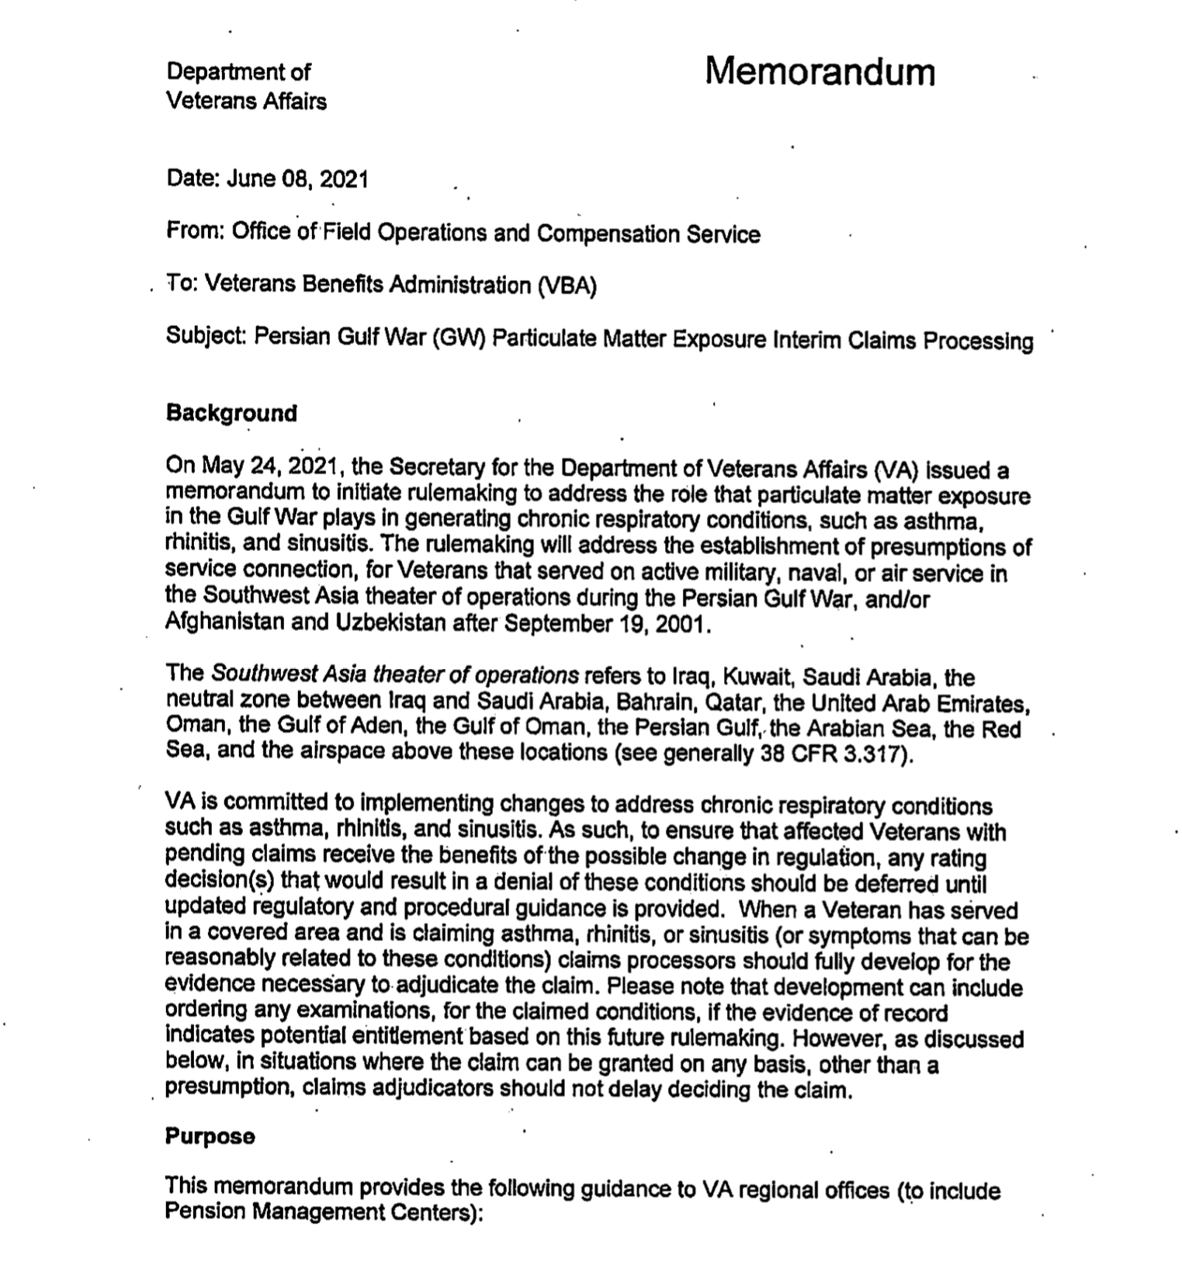
Interim Guidance VA Memo dated June 8, 2021

Slide 31
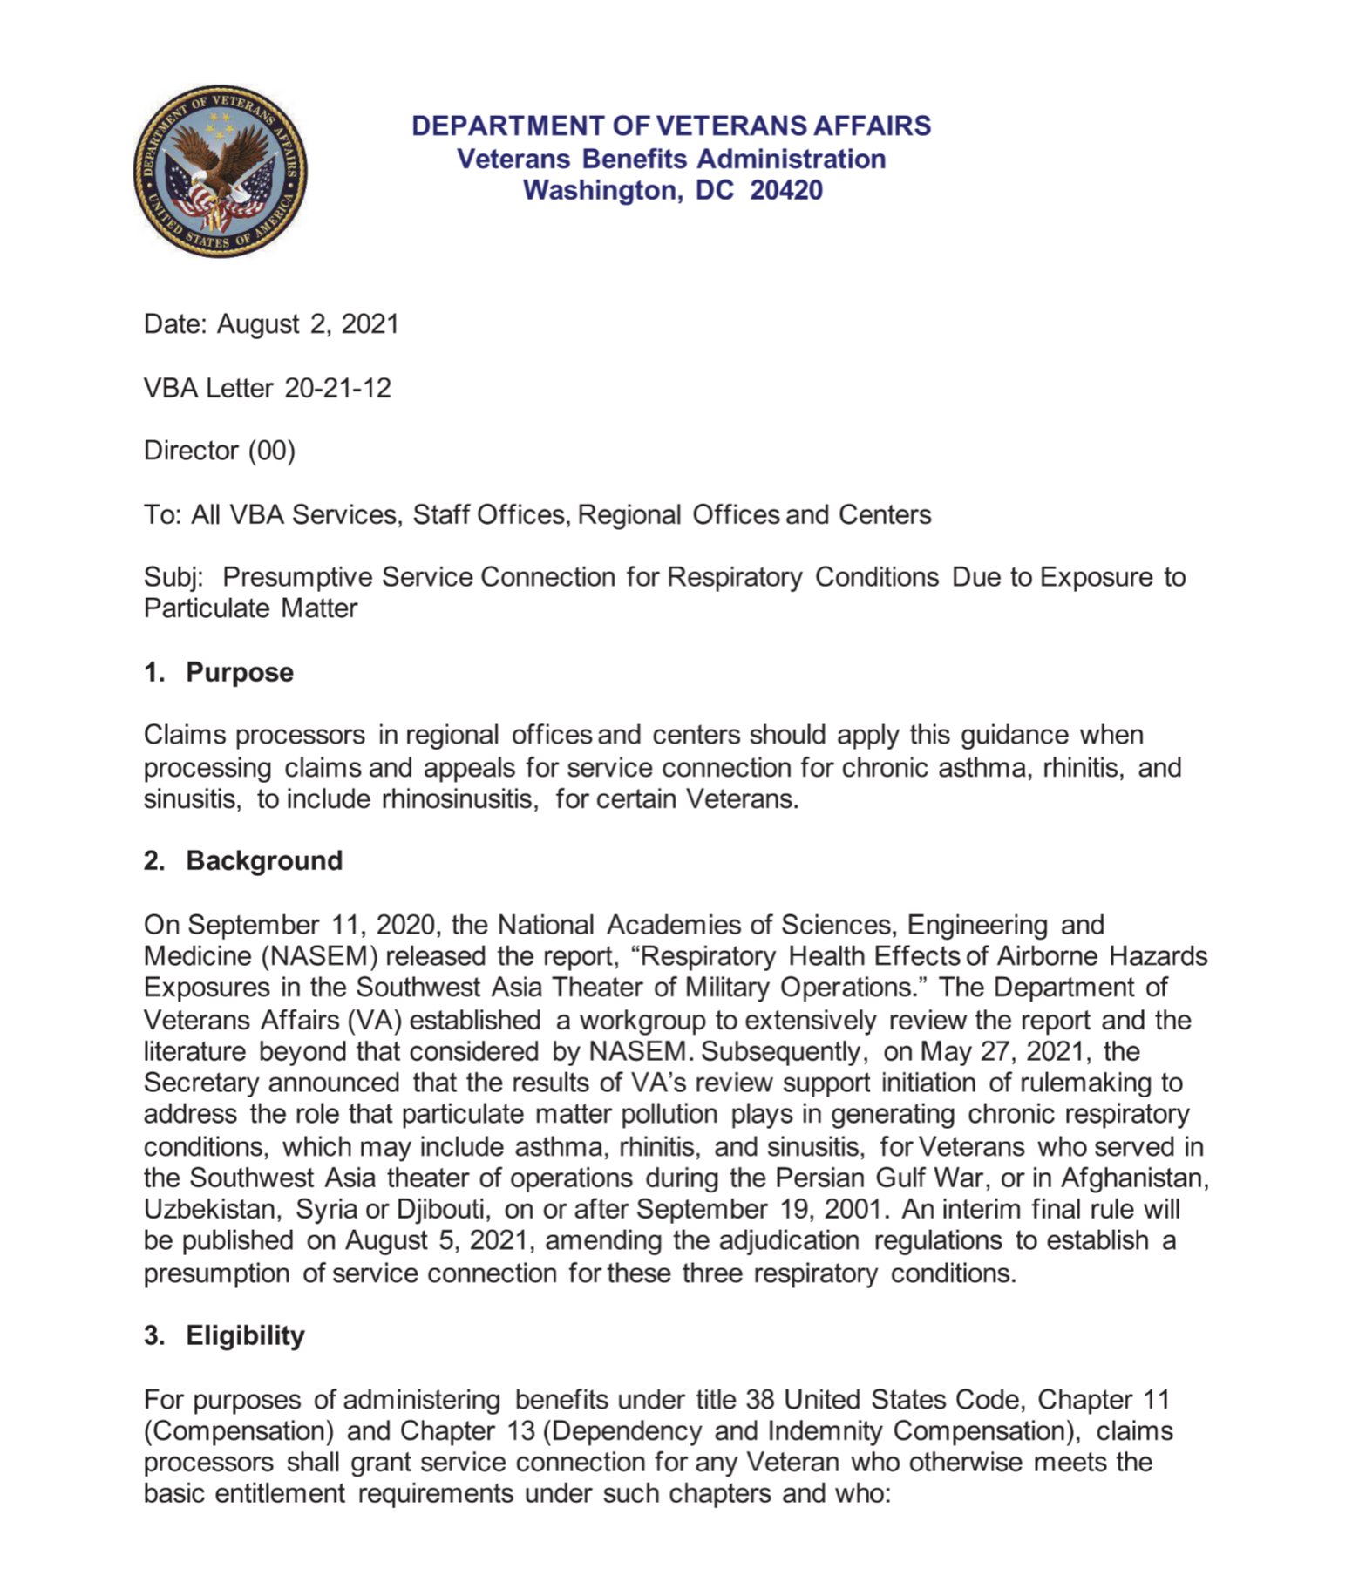
Interim Guidance VA Letter 20-21-12 dated August 2, 2021

Slide 32
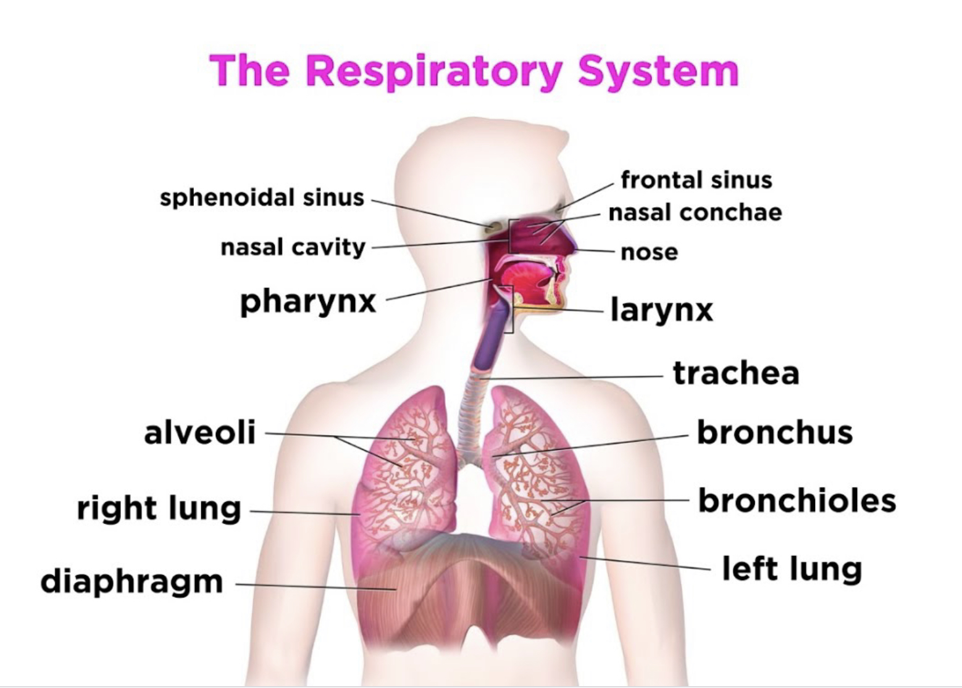
Respiratory System

Slide 33
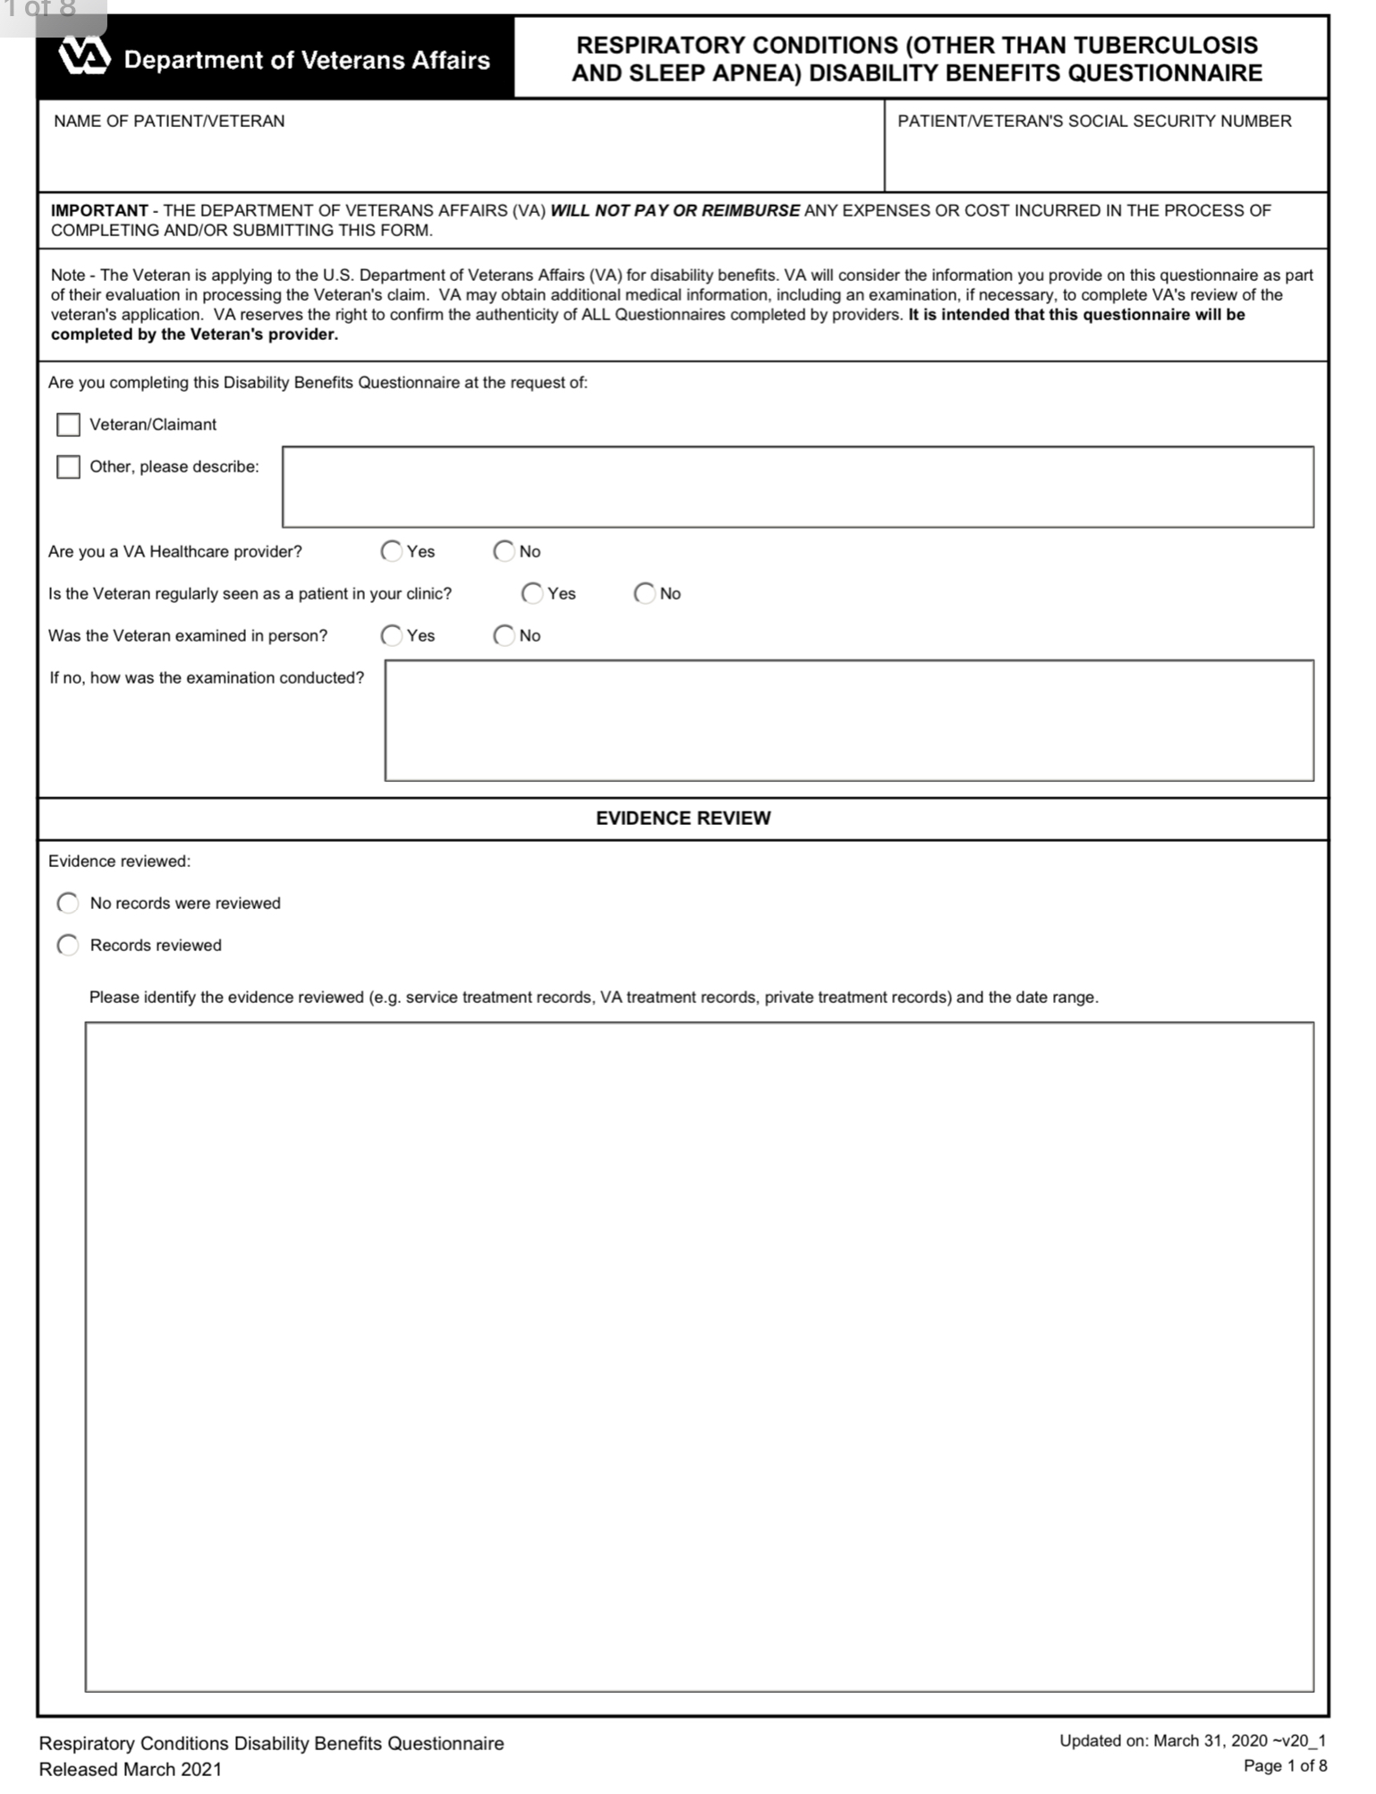
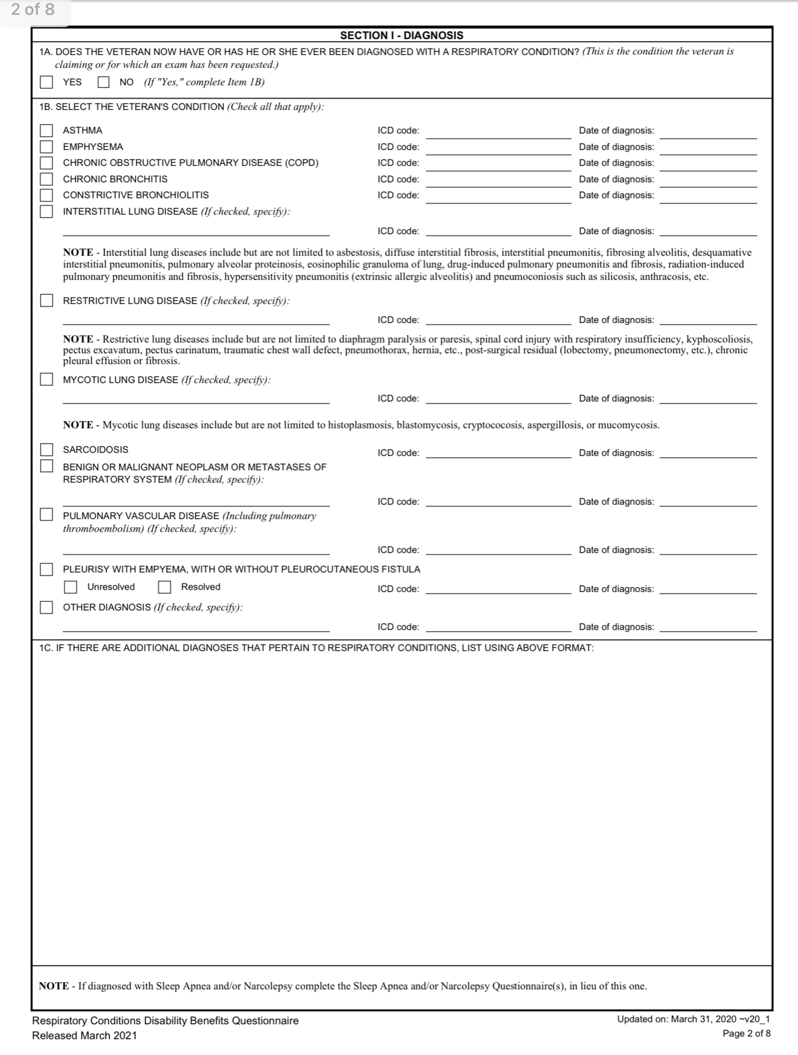
Respiratory Examination
(Extract)

Slide 34
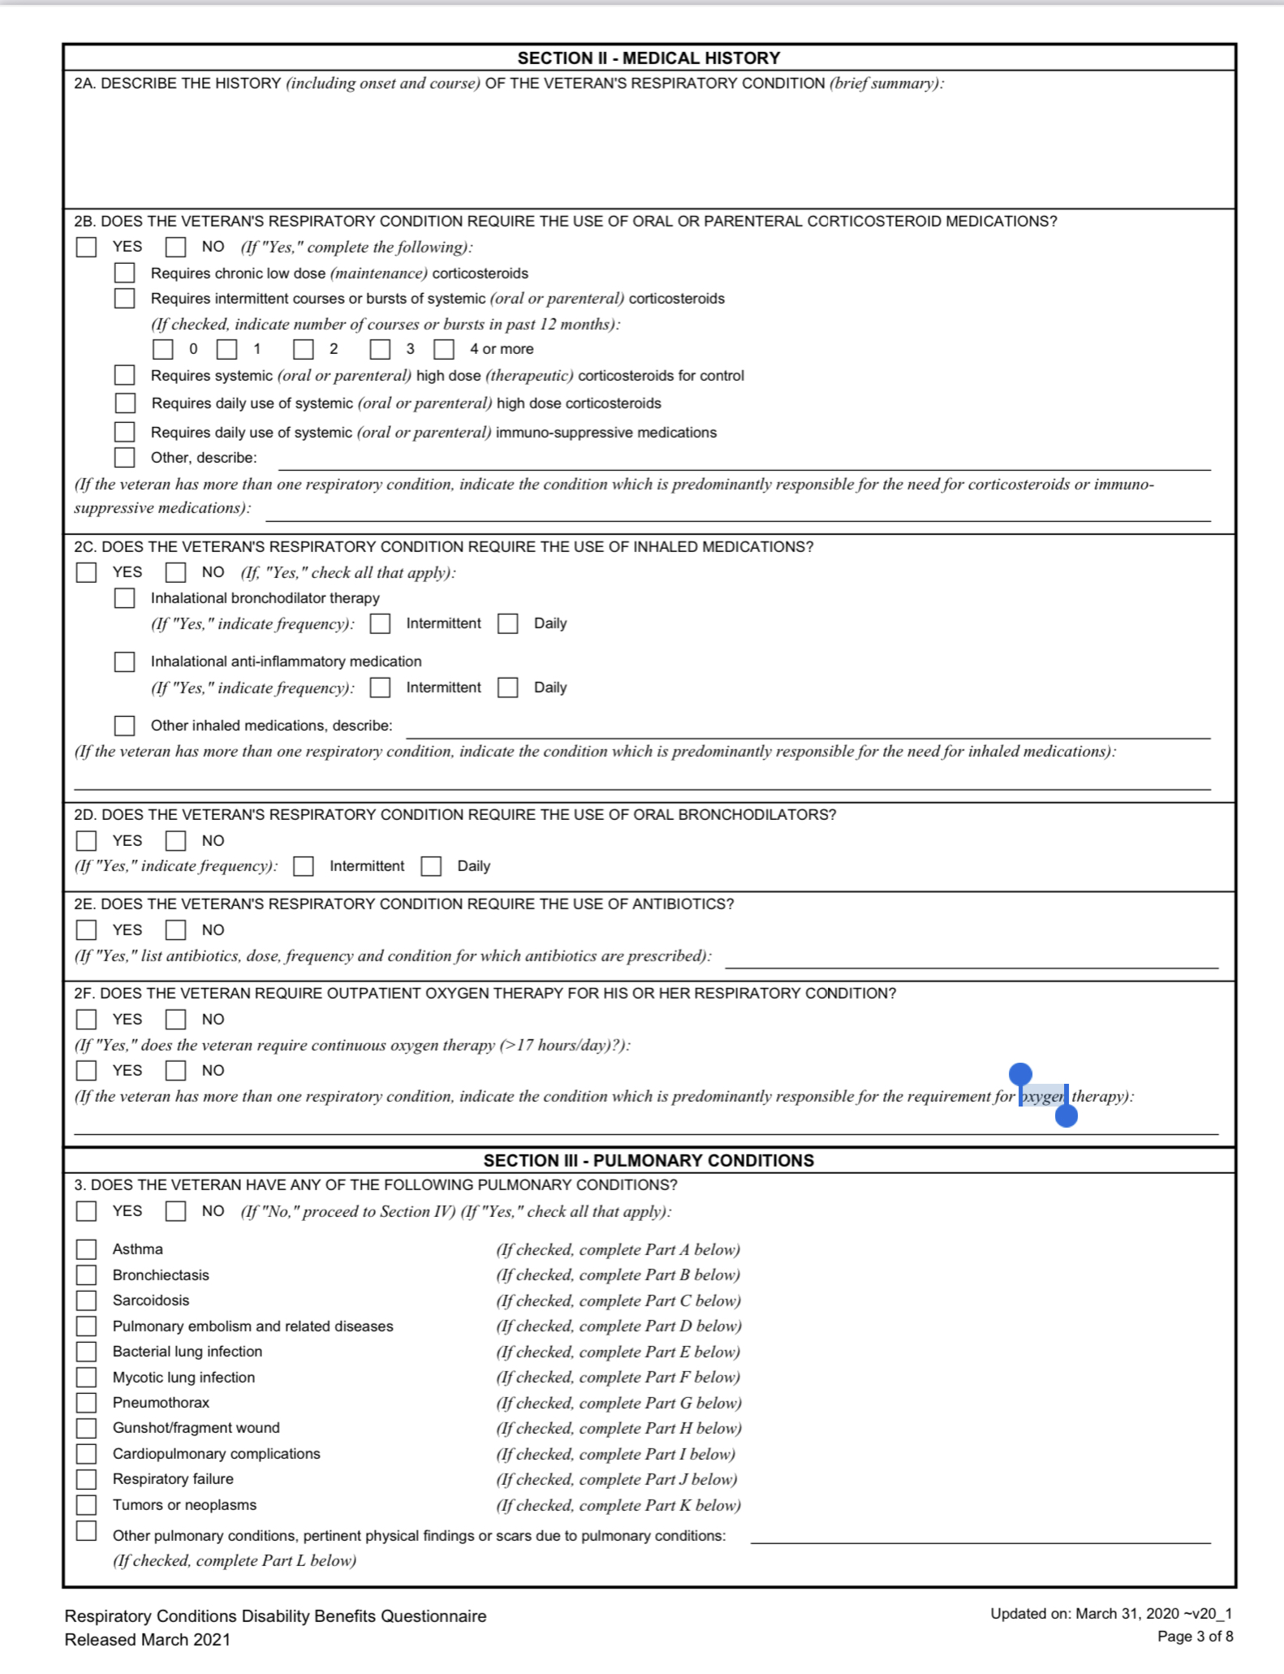
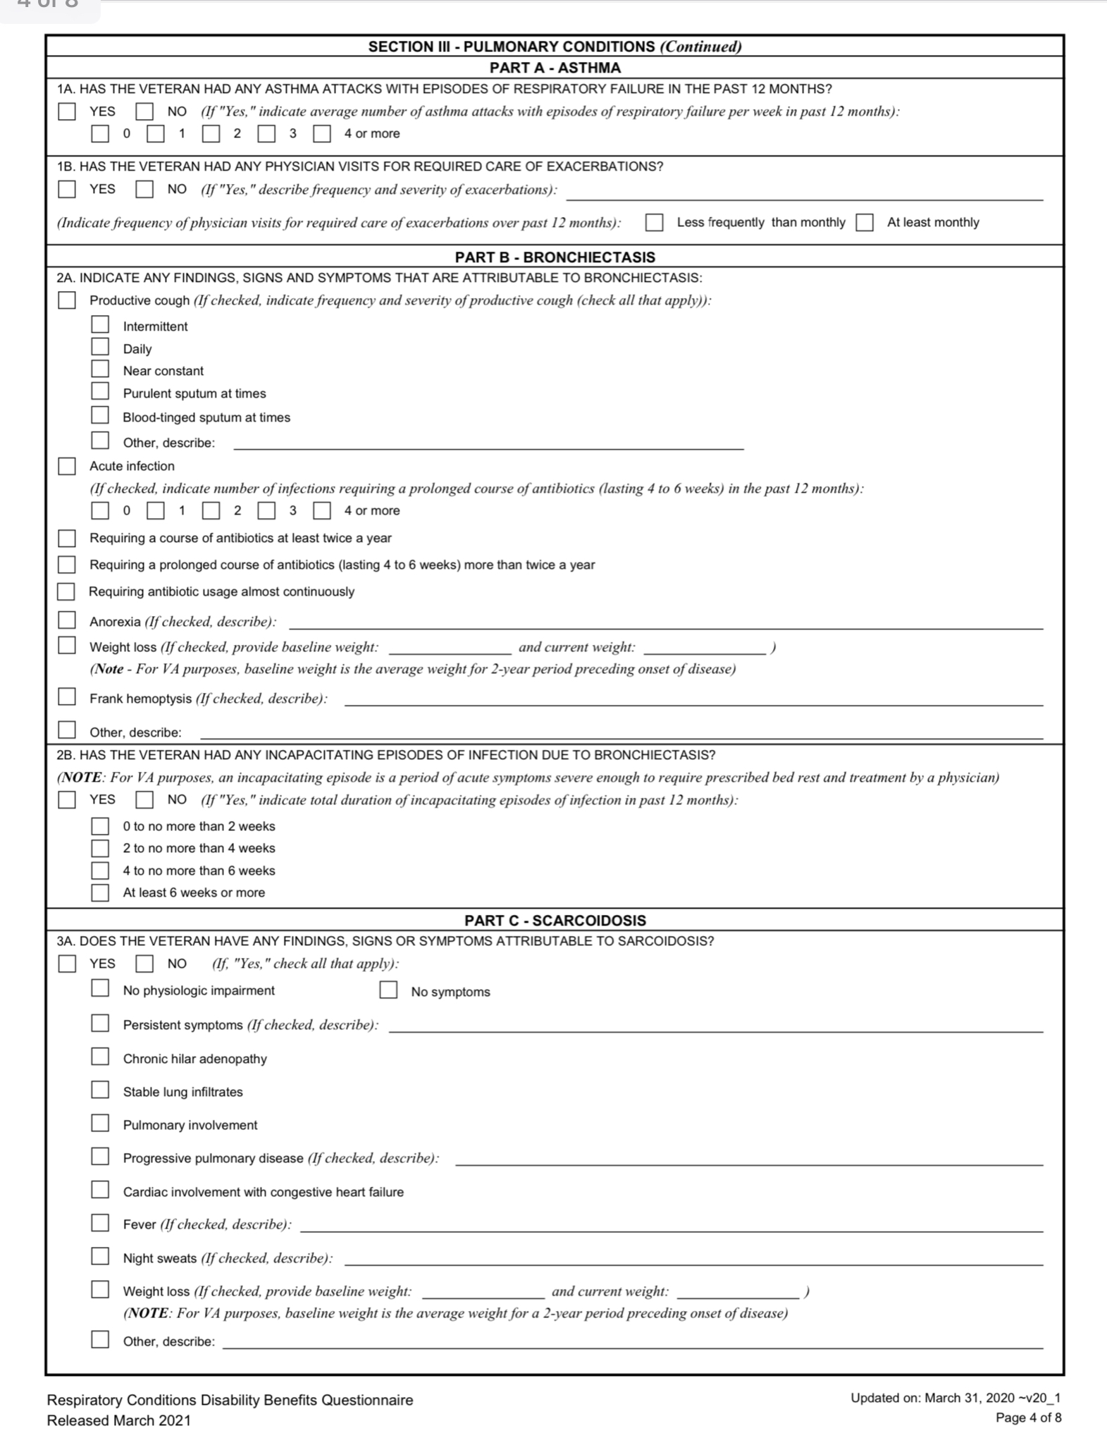
Respiratory Examination
(Extract)

Slide 35
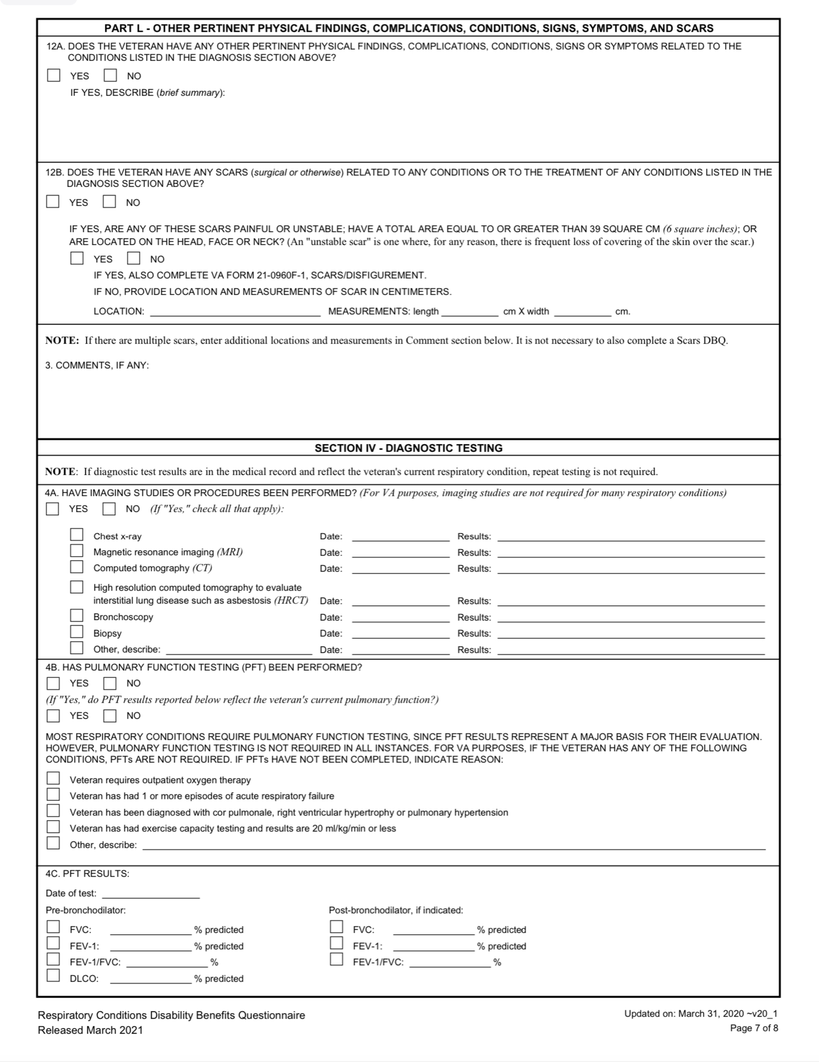
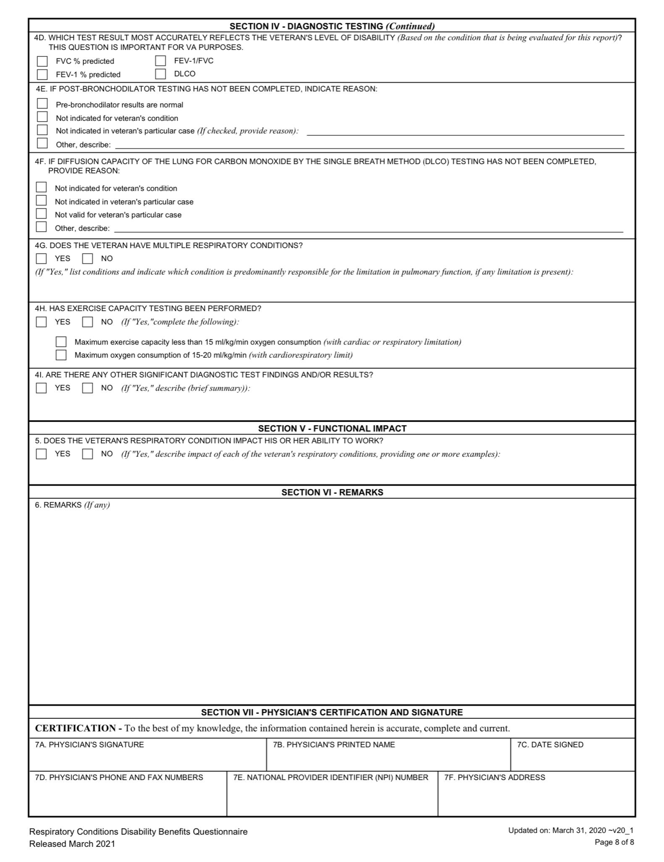
Respiratory Examination
(Extract)

Slide 36
Rating Criteria
38 CFR 4.96
38 CFR 4.97

Slide 37
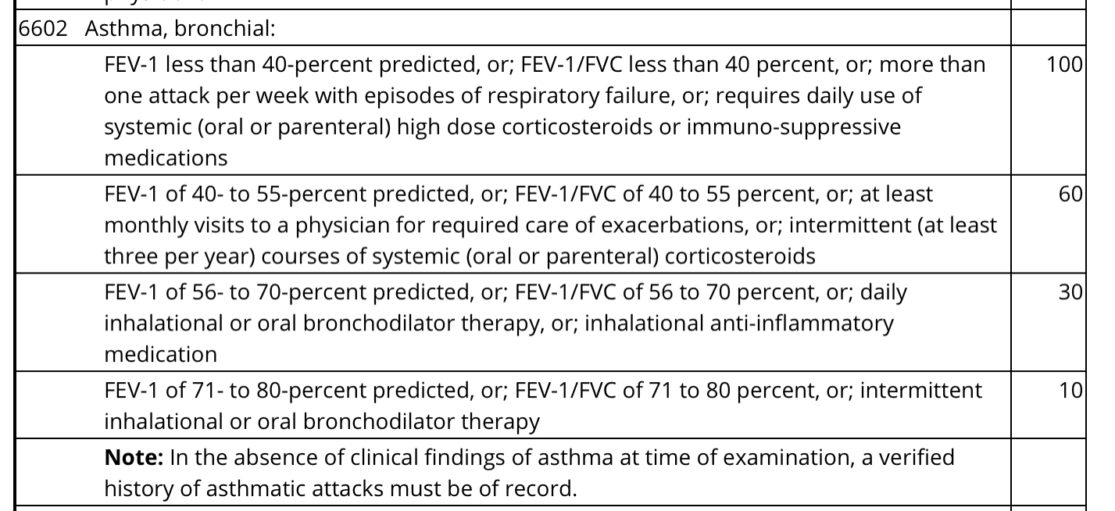
Rating Criteria for Asthma
Under 38 CFR 4.97

Slide 38
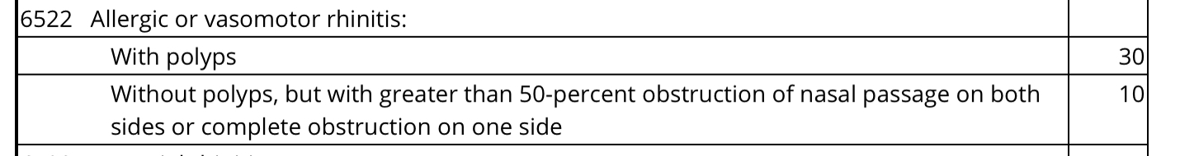
Rating Criteria for Rhinitis
Under 38 CFR 4.97

Slide 39
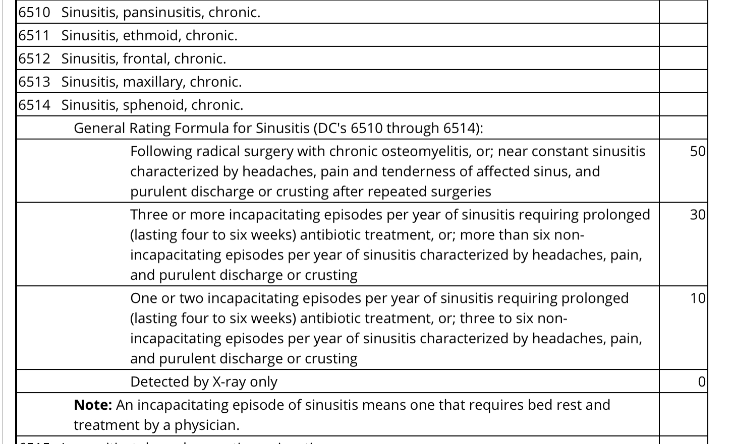
Rating Criteria for Sinusitis
Under 38 CFR 4.97

Slide 40
Rhinosinusitis
Rhinosinusitis should be rated as a type of sinusitis, using the general rating criteria for sinusitis, DC 6510, 6511, 6512, 6513, and 6514.
The DC used should be the one that most closely matches the location of the rhinosinusitis. The analogous code 6569 should precede the analogous sinusitis code, ie. 6569-6510, as rhinosinusitis is not listed in rating schedule.
The rating decision should consider the provisions of 38 CFR 4.96.

Slide 41
Herbicide/Agent Orange Exposure
VA's Agent Orange Registry health exam alerts Veterans to possible long-term health problems that may be related to Agent Orange exposure during their military service.
This Registry was established in mid 1978. The registry data helps VA understand and respond to these health problems more effectively.

Slide 42
Eligibility
These Veterans are eligible for the Agent Orange Registry health exam:
Vietnam
Veterans who served in Vietnam between 1962 and 1975, regardless of length of time.
Veterans who served aboard smaller river patrol and swift boats that operated on the inland waterways of Vietnam (also known as “Brown Water Veterans”)
“Blue Water Navy” Veterans who served on a vessel operating not more than 12 nautical miles seaward from the demarcation line of the waters of Vietnam and Cambodia as defined in Public Law 116-23.

Slide 43
Eligibility (continued)
Korea
Veterans who served in a unit in or near the Korean Demilitarized Zone (DMZ) anytime between September 1, 1967 and August 31, 1971.
Thailand
U.S. Air Force Veterans who served on Royal Thai Air Force (RTAF) bases near U-Tapao, Ubon, Nakhon Phanom, Udorn, Takhli, Korat, and Don Muang, near the air base perimeter anytime between February 28, 1961 and May 7, 1975.
U.S. Army Veterans who provided perimeter security on RTAF bases in Thailand anytime between February 28, 1961 and May 7, 1975.

Slide 44
Eligibility (continued)
U.S. Army Veterans who were stationed on some small Army installations in Thailand anytime between February 28, 1961 and May 7, 1975. However, the Army Veteran must have been a member of a military police (MP) unit or was assigned a military occupational specialty whose duty placed him or her at or near the base perimeter.
C-123 Airplanes
Veterans (including some Reservists) who state that they flew on or worked on a C-123 aircraft between 1969 and 1986.

Slide 45
Eligibility (continued)
Other potential Agent Orange exposures
Veterans who may have been exposed to herbicides during a military operation or as a result of testing, transporting, or spraying herbicides for military purposes.

Slide 46
Eligibility (continued)
Eligible Reserve locations, time periods, and units include:
Lockbourne/Rickenbacker Air Force Base in Ohio, 1969 to 1986 (906th and 907th Tactical Air Groups or 355th and 356th Tactical Airlift Squadrons)
Westover Air Force Base in Massachusetts, 1972 to 1982 (731st Tactical Air Squadron and 74th Aeromedical Evacuation Squadron, or 901st Organizational Maintenance Squadron)
Pittsburgh International Airport in Pennsylvania, 1972 to 1982 (758th Airlift Squadron)

Slide 47
National Defense
Authorization Act FY 2021
The National Defense Authorization Act for Fiscal Year 2021 (NDAA) (H.R.6395) added three (3) more conditions to the Agent Orange presumptive-conditions list wherein Veterans who were exposed to Agent Orange may qualify for benefits:
  bladder cancer,
  hypothyroidism, and
  Parkinsonism, or Parkinson-like symptoms.

Slide 48
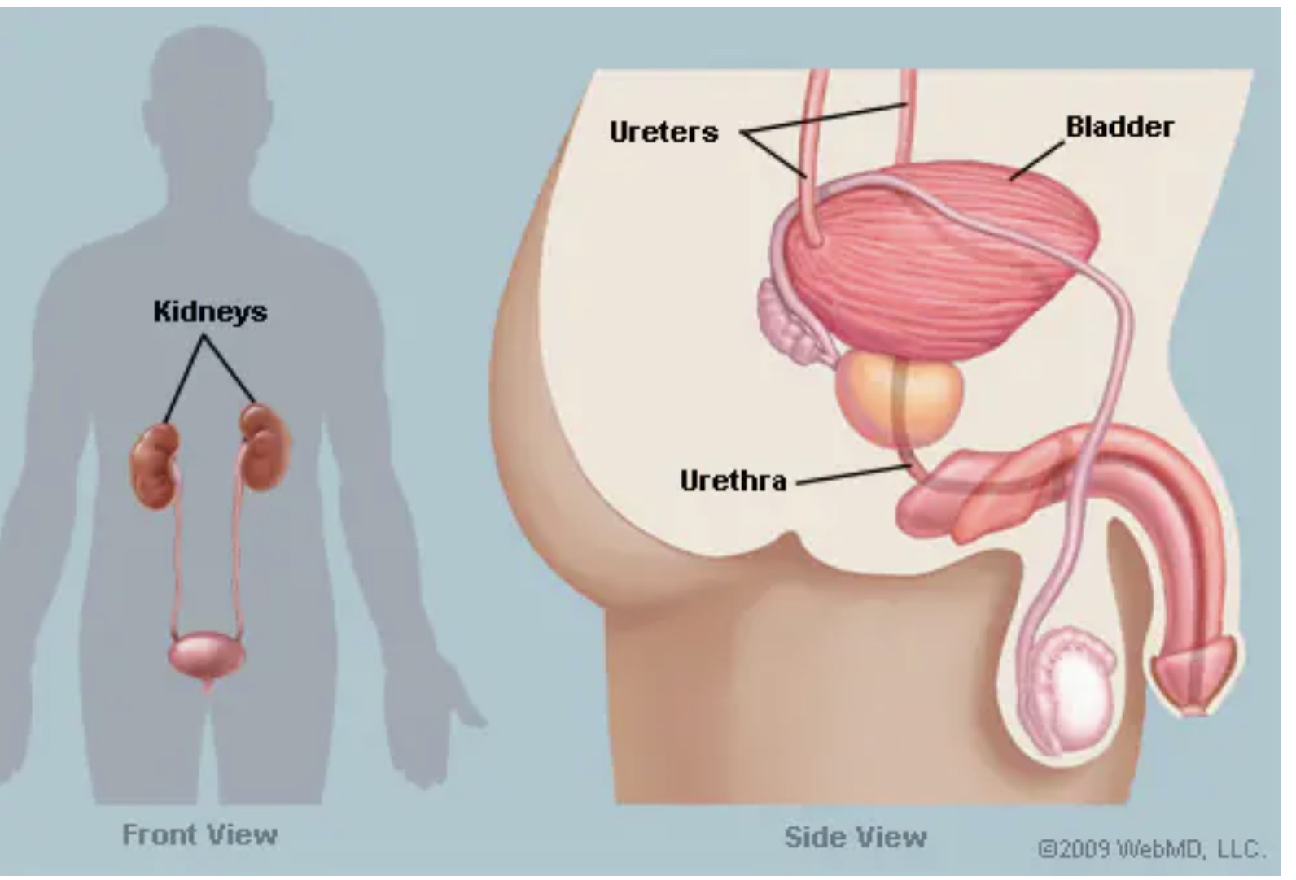
Bladder

Slide 49
Bladder Cancer
Bladder cancer is a common type of cancer that begins in the cells of the bladder. The bladder is a hollow muscular organ in your lower abdomen that stores urine.
Bladder cancer most often begins in the cells (urothelial cells) that line the inside of your bladder. Urothelial cells are also found in your kidneys and the tubes (ureters) that connect the kidneys to the bladder.
Most bladder cancers are diagnosed at an early stage, when the cancer is highly treatable. But even early-stage bladder cancers can come back after successful treatment.

Slide 50
Bladder Cancer (continued)
For this reason, people with bladder cancer typically need follow-up tests for years after treatment to look for bladder cancer that recurs.
Symptoms
Bladder cancer signs and symptoms may include:
Blood in urine (hematuria), which may cause urine to appear bright red or cola colored, though sometimes the urine appears normal and blood is detected on a lab test
Frequent urination
Painful urination
Back pain

Slide 51
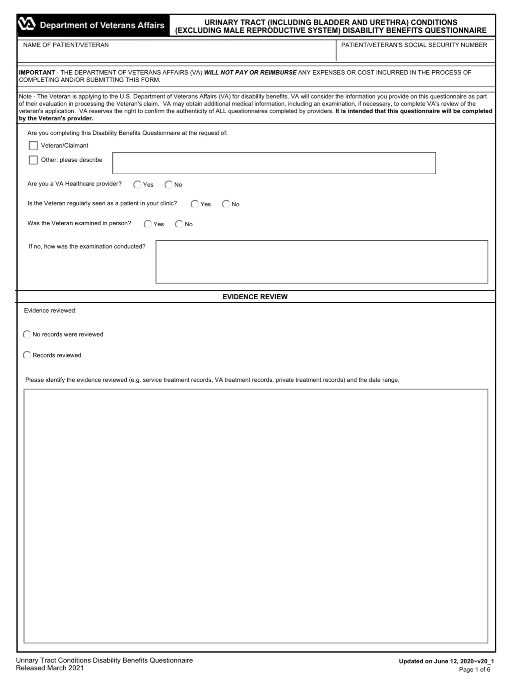
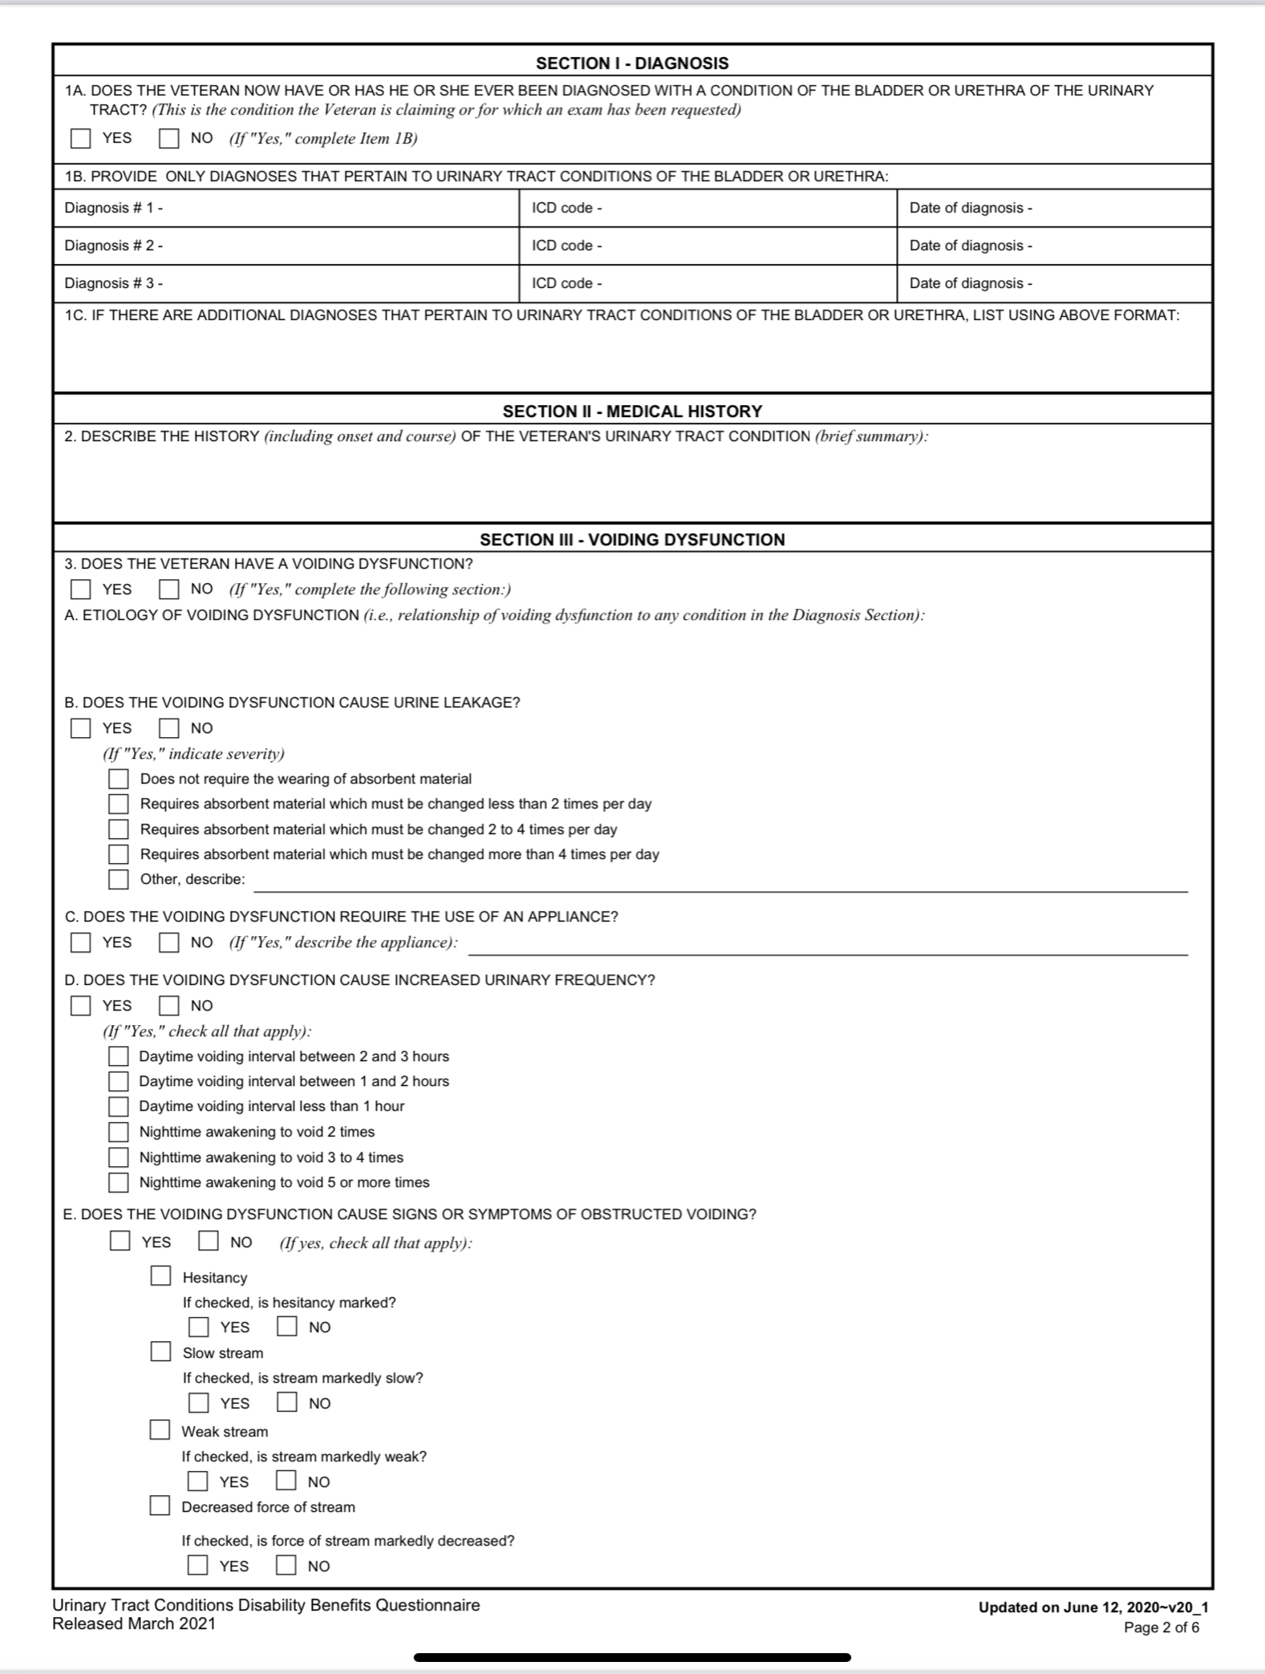
Urinary Tract Examination

Slide 52
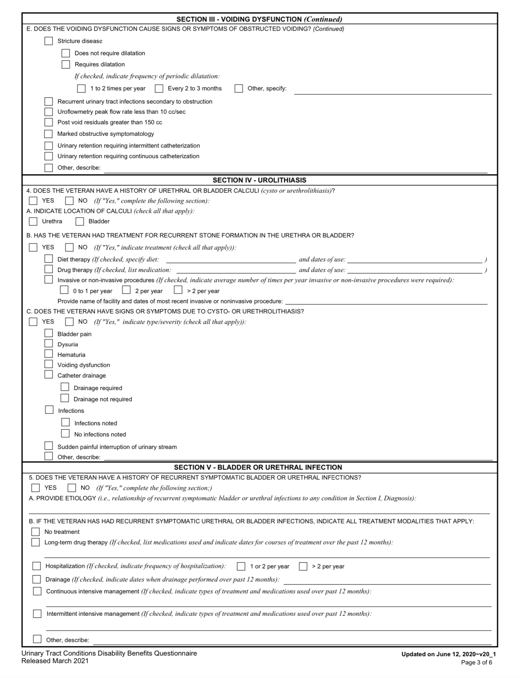
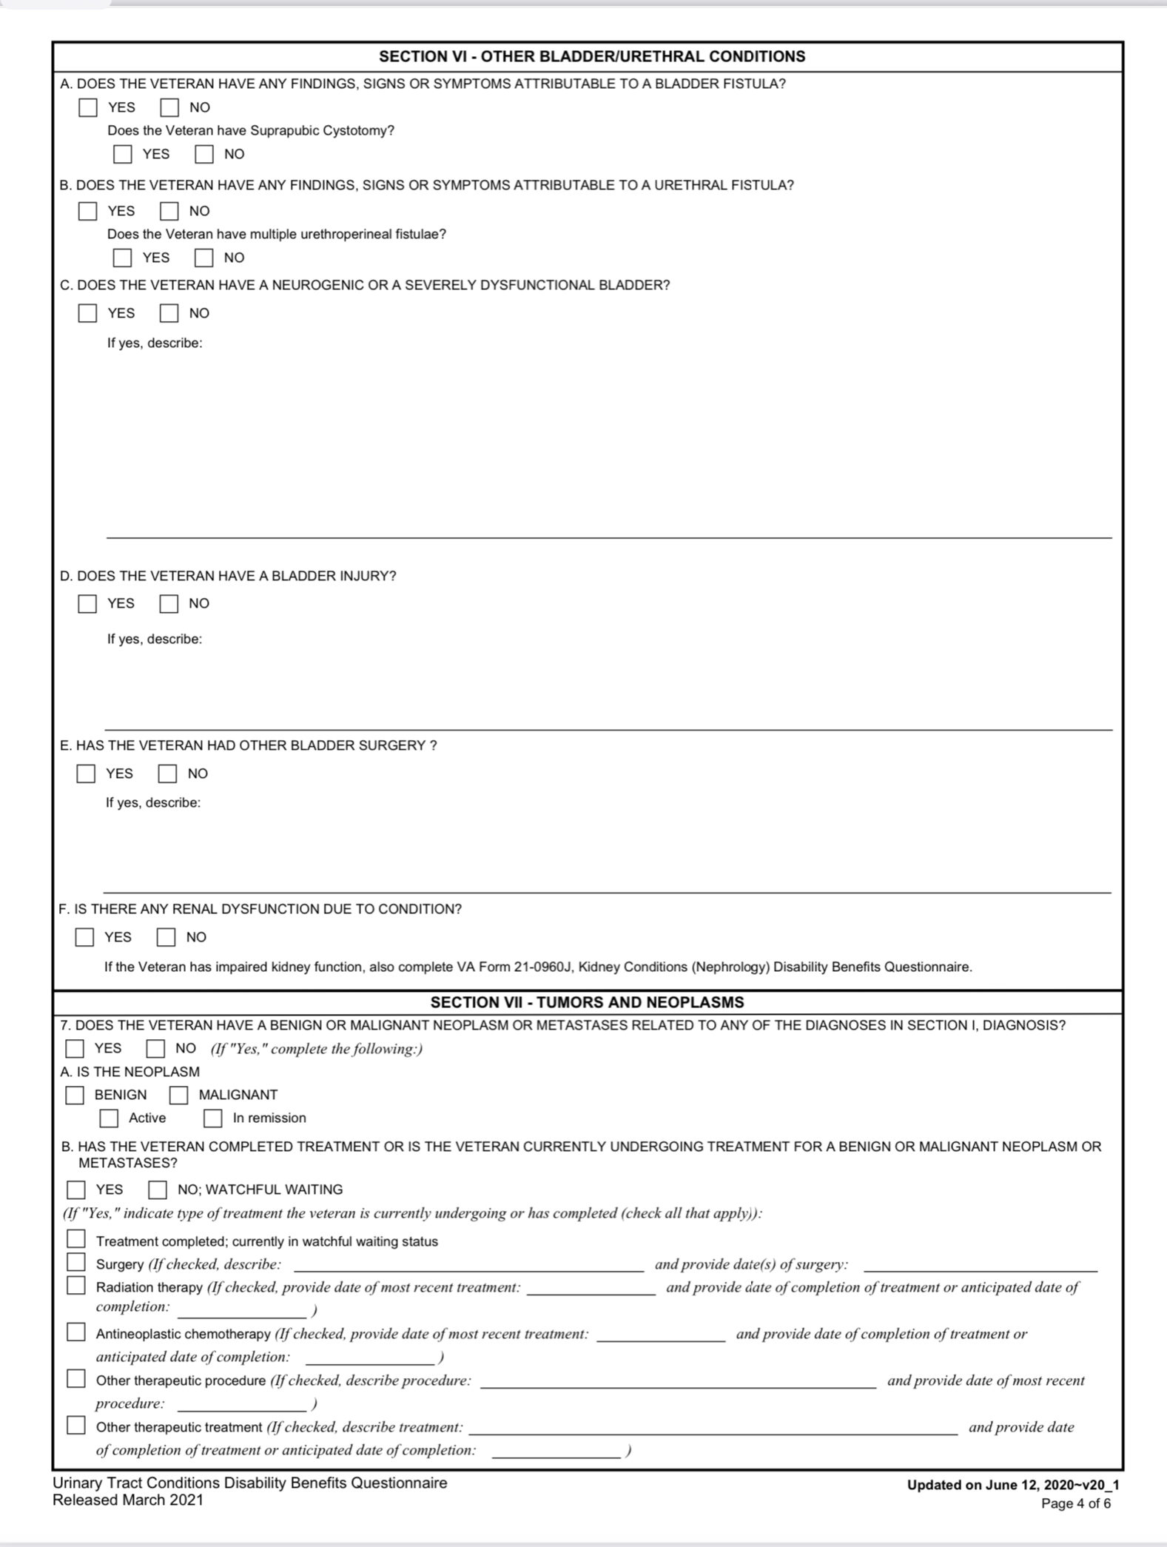
Urinary Tract Examination (continued)

Slide 53
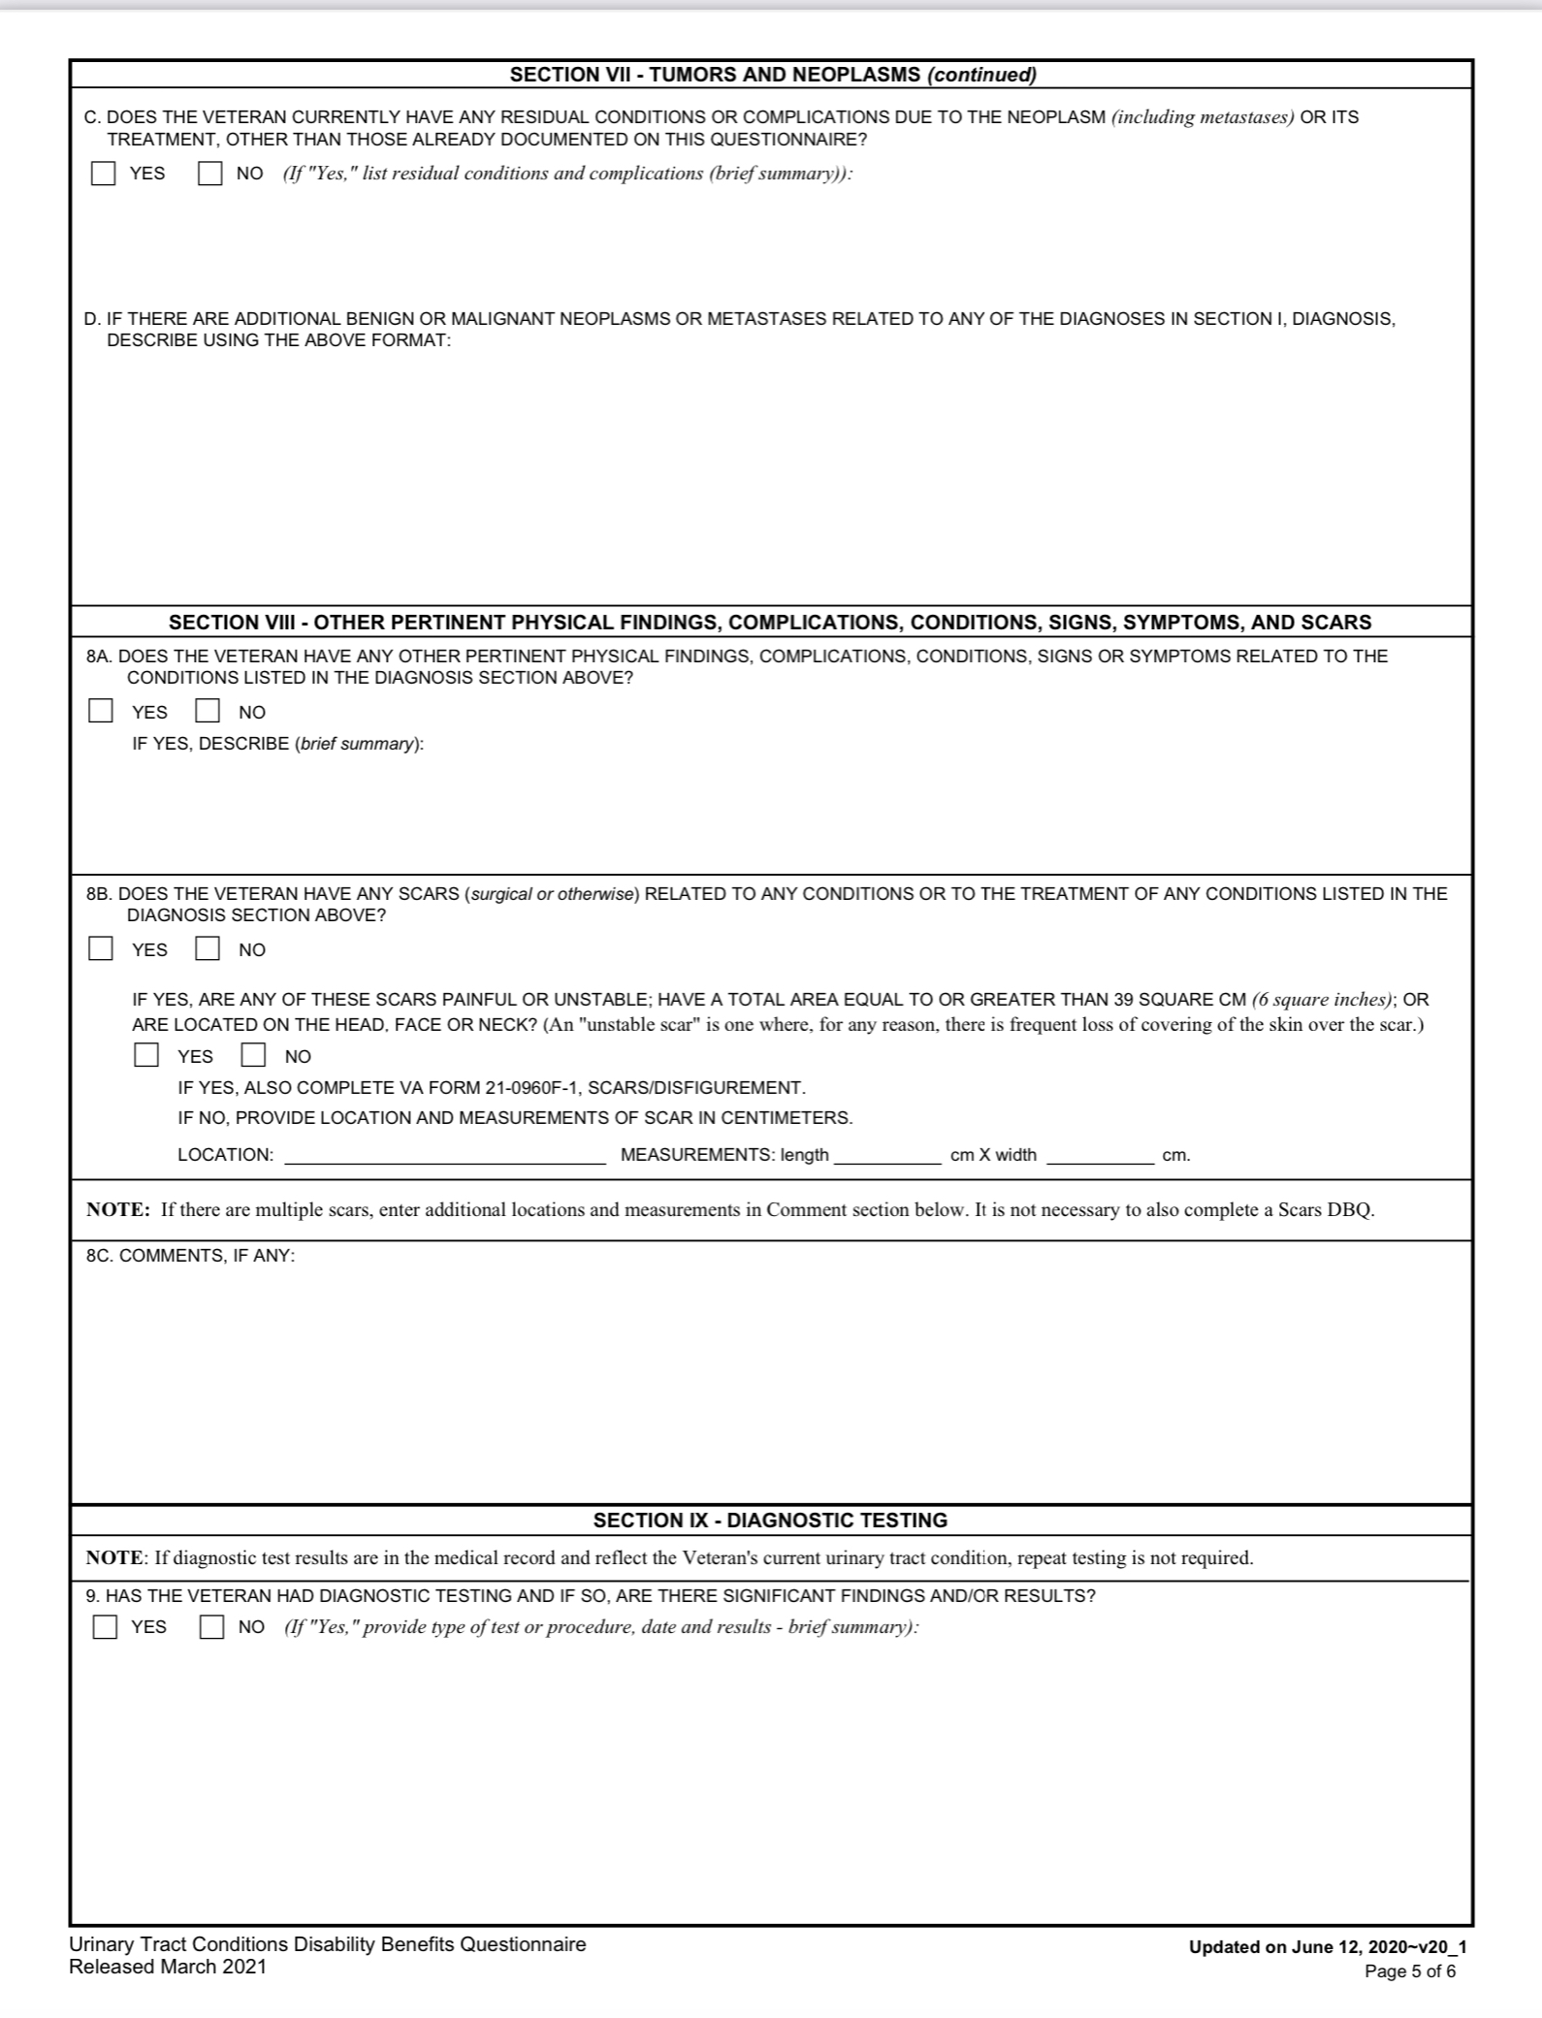
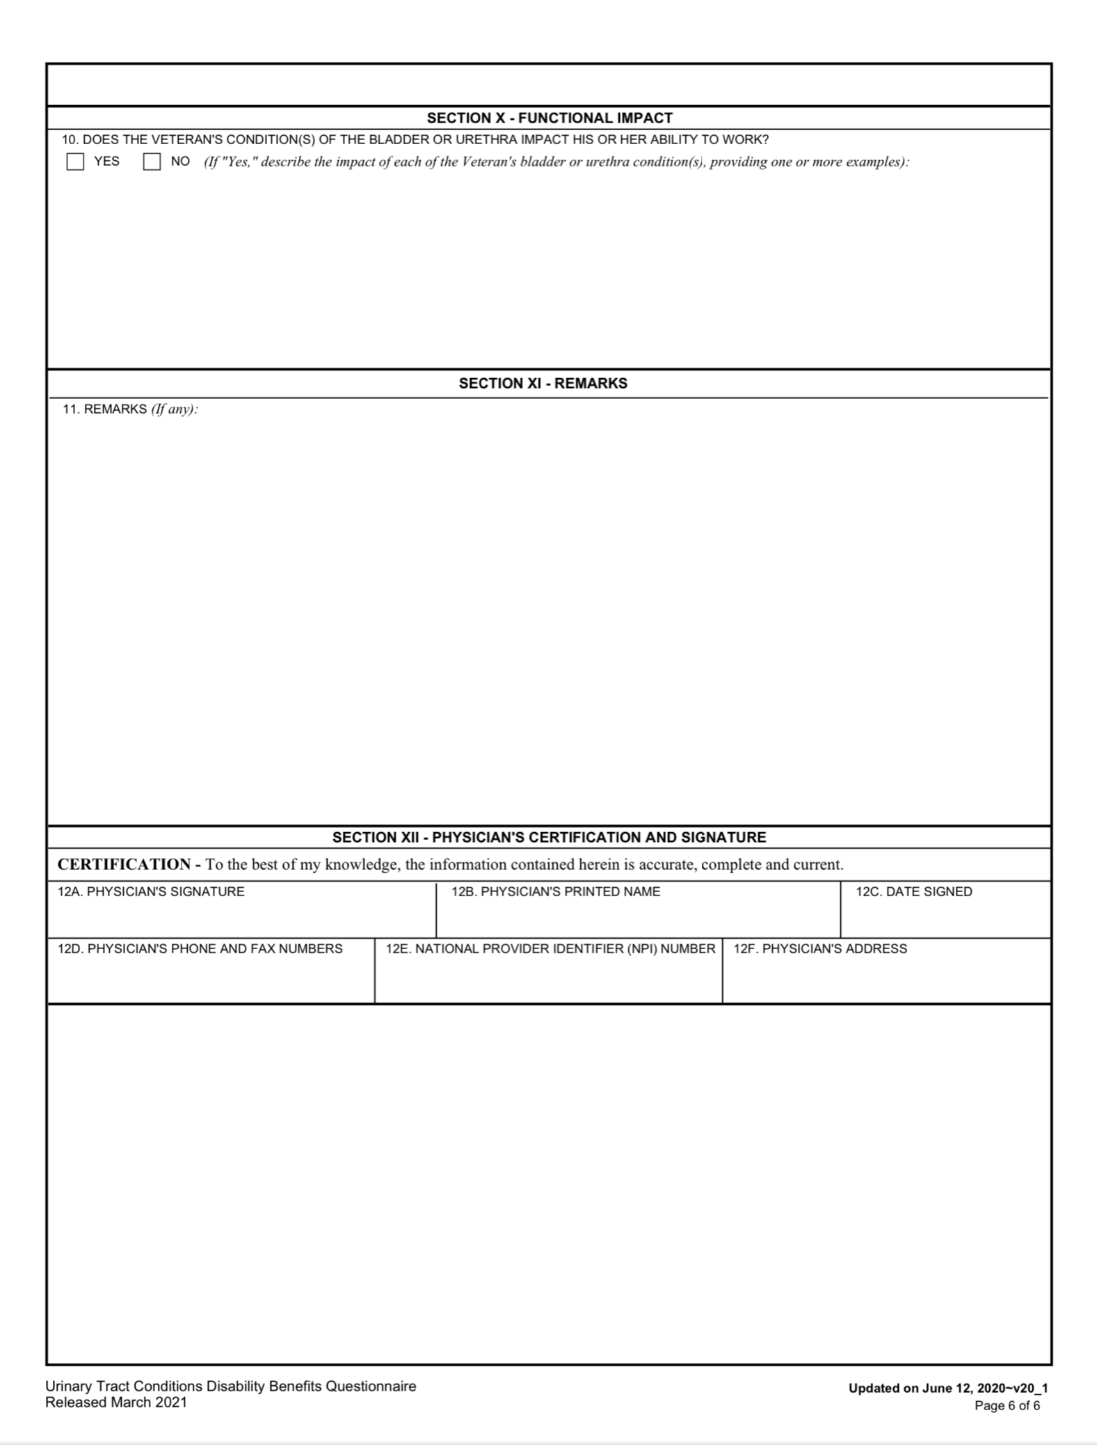
Urinary Tract Examination (continued)

Slide 54
Rating Criteria Under
38 CFR 4.115b
DC 7528 Malignant neoplasms of the genitourinary system. 100
Note—Following the cessation of surgical, X-ray, antineoplastic chemotherapy or other therapeutic procedure, the rating of 100 percent shall continue with a mandatory VA examination at the expiration of six months. Any change in evaluation based upon that or any subsequent examination shall be subject to the provisions of §3.105(e) of this chapter. If there has been no local reoccurrence or metastasis, rate on residuals as voiding dysfunction or renal dysfunction, whichever is predominant.

Slide 55
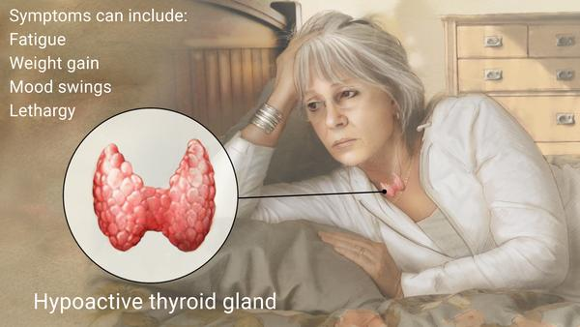
Hypothyroidism

Slide 56
Hypothyroidism
Hypothyroidism (underactive thyroid) is a condition in which your thyroid gland doesn't produce enough of certain crucial hormones.
Hypothyroidism may not cause noticeable symptoms in the early stages. Over time, untreated hypothyroidism can cause a number of health problems, such as obesity, joint pain, infertility and heart disease.
Accurate thyroid function tests are available to diagnose hypothyroidism. Treatment with synthetic thyroid hormone is usually simple, safe and effective once you and your doctor find the right dose for you.

Slide 57
Hypothyroidism
Hypothyroidism signs and symptoms may include:
  Fatigue
  Increased sensitivity to cold
  Constipation
  Dry skin
  Weight gain
  Puffy face
  Hoarseness
  Muscle weakness
  Elevated blood cholesterol level
Muscle aches, tenderness and stiffness
Pain, stiffness or swelling in your joints
Heavier than normal or irregular menstrual periods
Thinning hair
Slowed heart rate
Depression
Impaired memory
Enlarged thyroid gland (goiter)

Slide 58
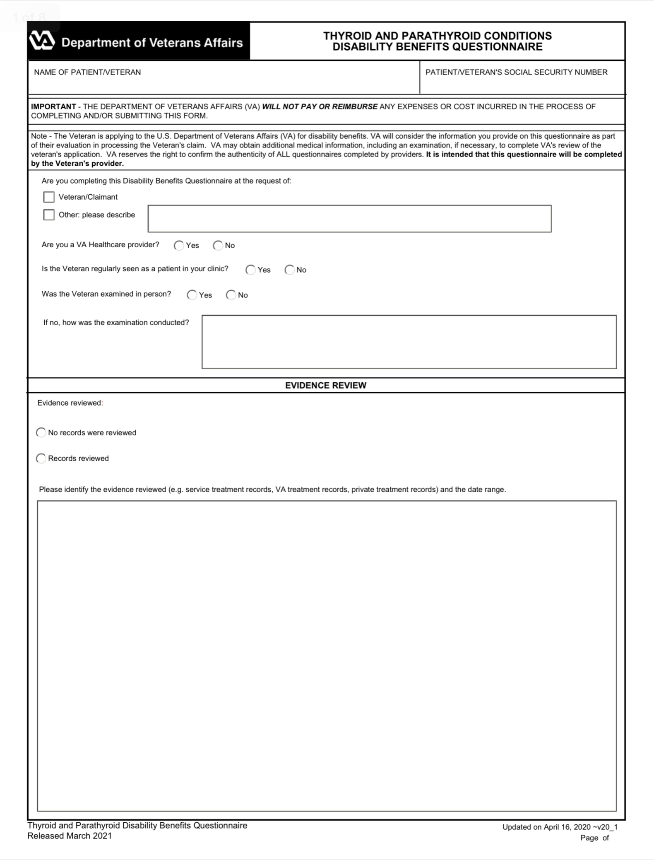
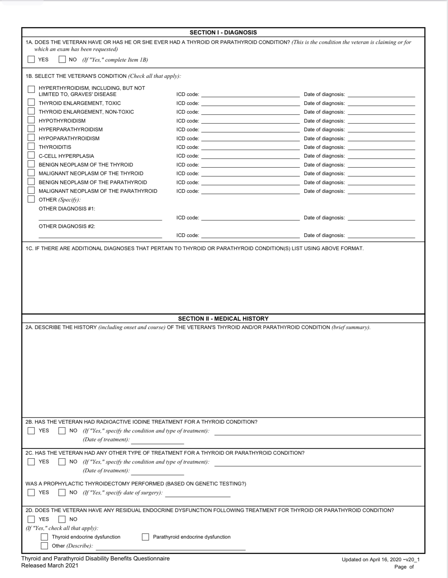
Hypothyroidism Examination

Slide 59
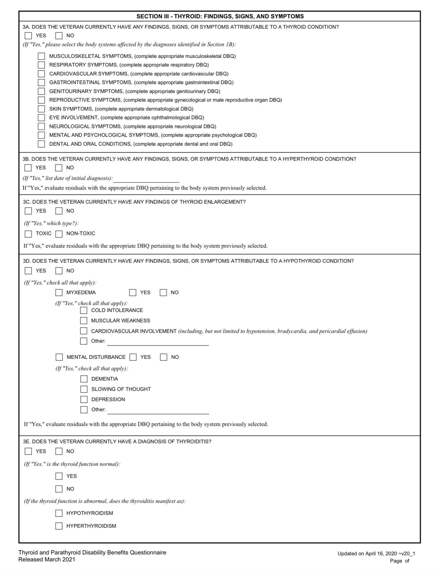
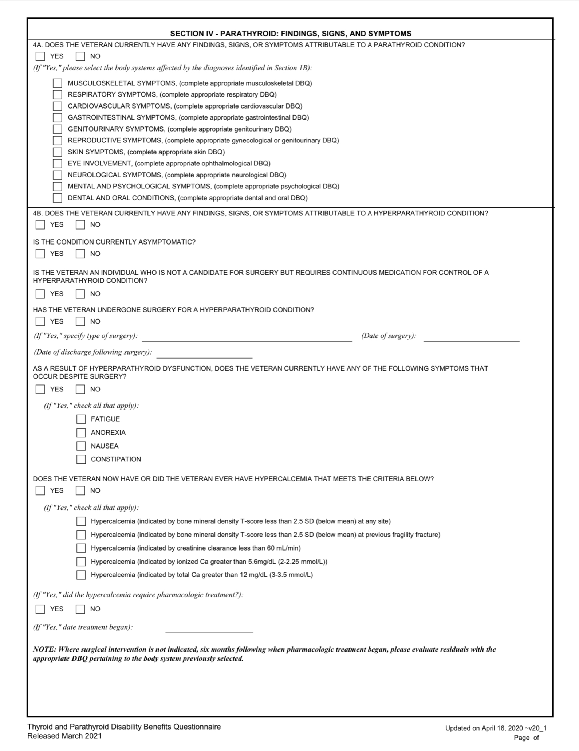
Hypothyroidism Examination

Slide 60
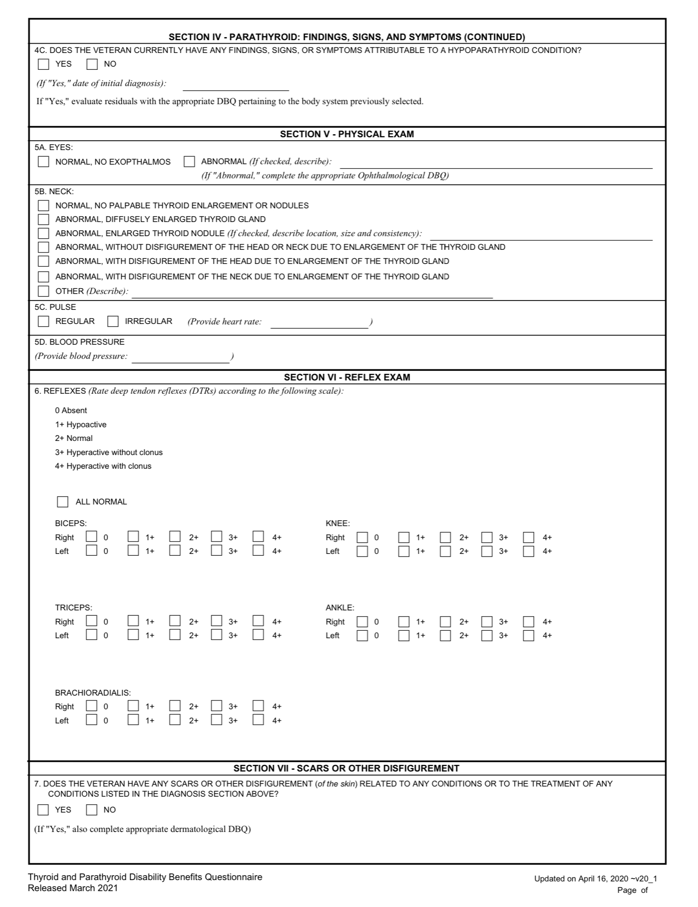
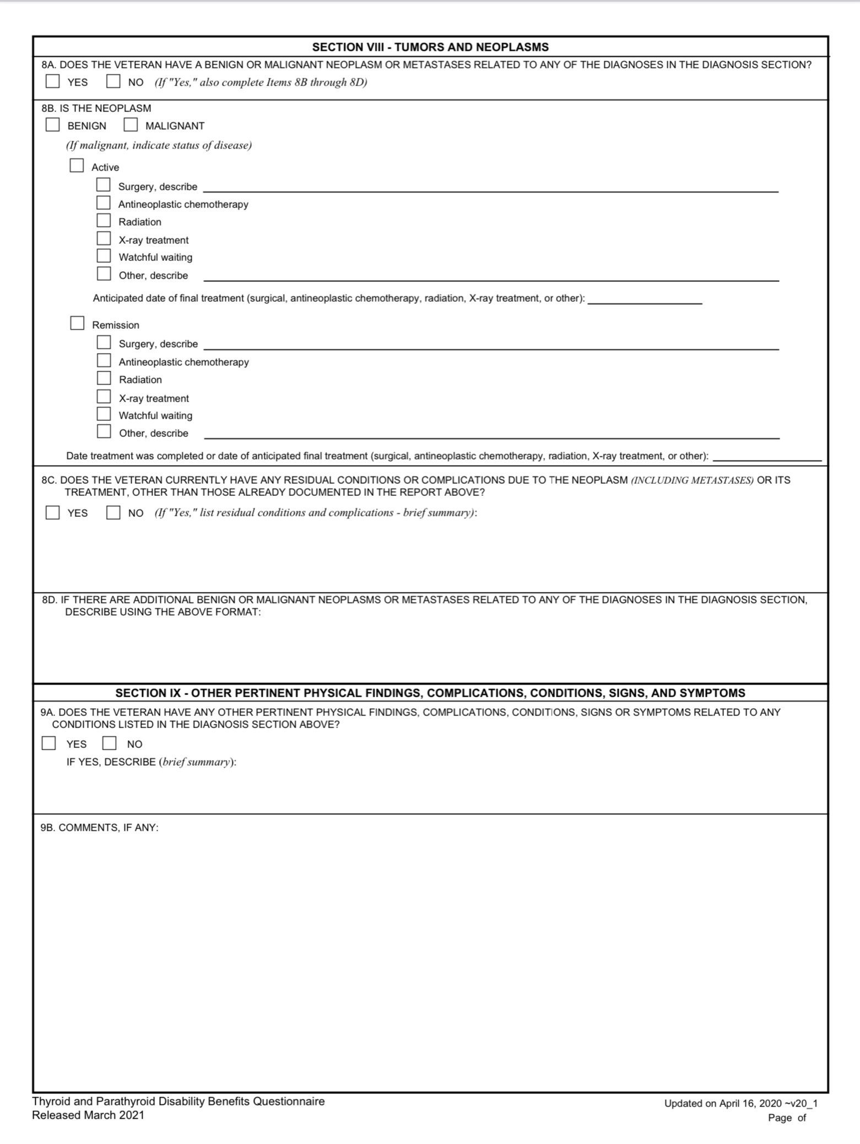
Hypothyroidism Examination

Slide 61
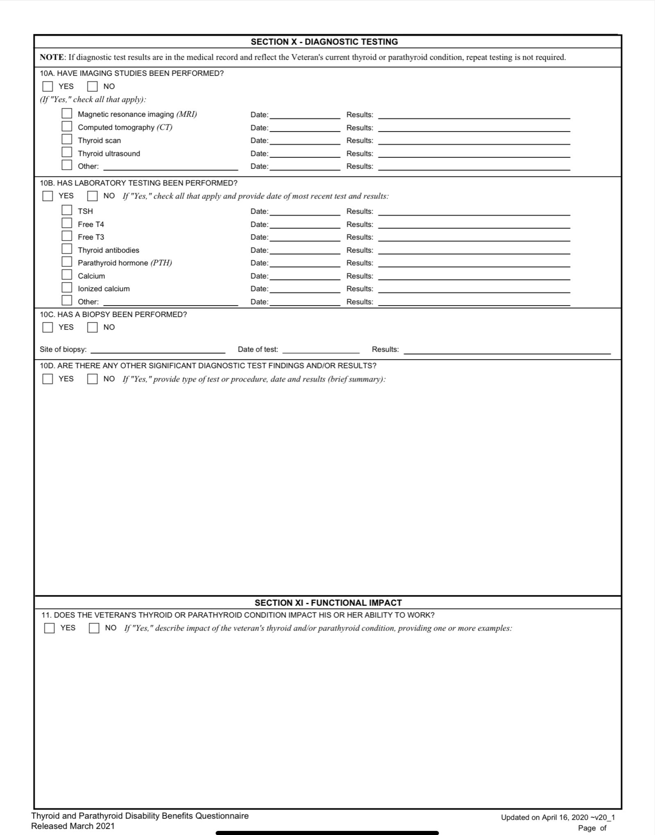
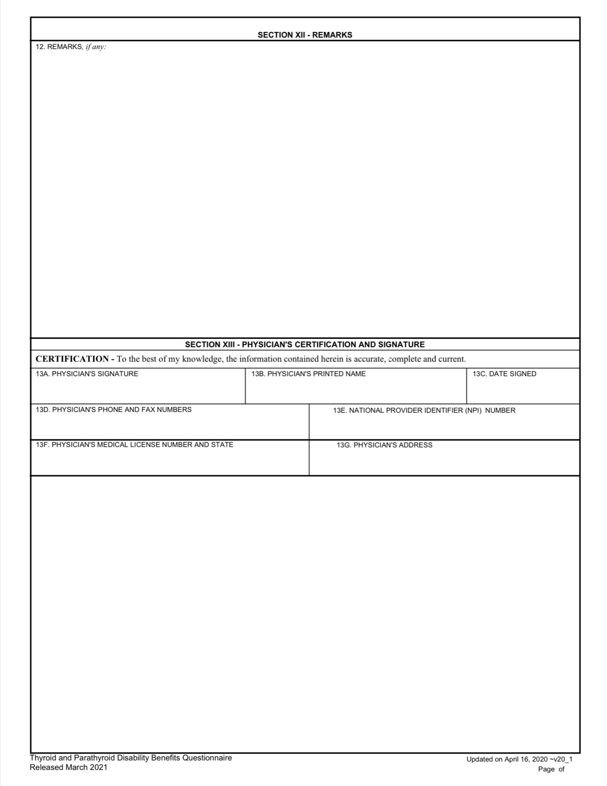
Hypothyroidism Examination

Slide 62
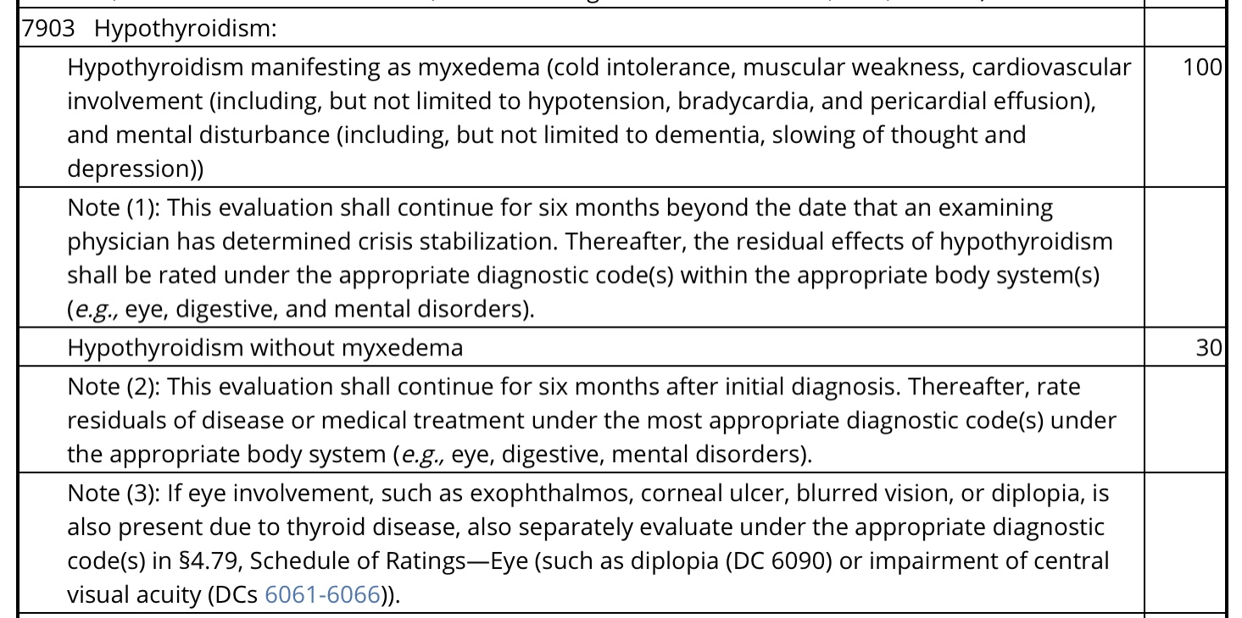
Rating Criteria Hypothyroidism
Under 38 CFR 4.119

Slide 63
Parkinsonism
Parkinsonism is any condition that causes a combination of the movement abnormalities seen in Parkinson's disease — such as tremor, slow movement, impaired speech or muscle stiffness — especially resulting from the loss of dopamine-containing nerve cells (neurons).
Possible causes
Not everyone who has parkinsonism has Parkinson's disease. There are many other causes of parkinsonism (secondary parkinsonism), including:
  Medications, such as those used to treat psychosis, major psychiatric disorders and nausea

Slide 64
Parkinsonism (continued)
Repeated head trauma, such as injuries sustained in boxing
Certain neurodegenerative disorders, such as multiple system atrophy, Lewy body dementia and progressive supranuclear palsy
Exposure to toxins, such as carbon monoxide, cyanide and organic solvents
Certain brain lesions, such as tumors, or fluid buildup
Metabolic and other disorders, such as chronic liver failure or Wilson's disease

Slide 65
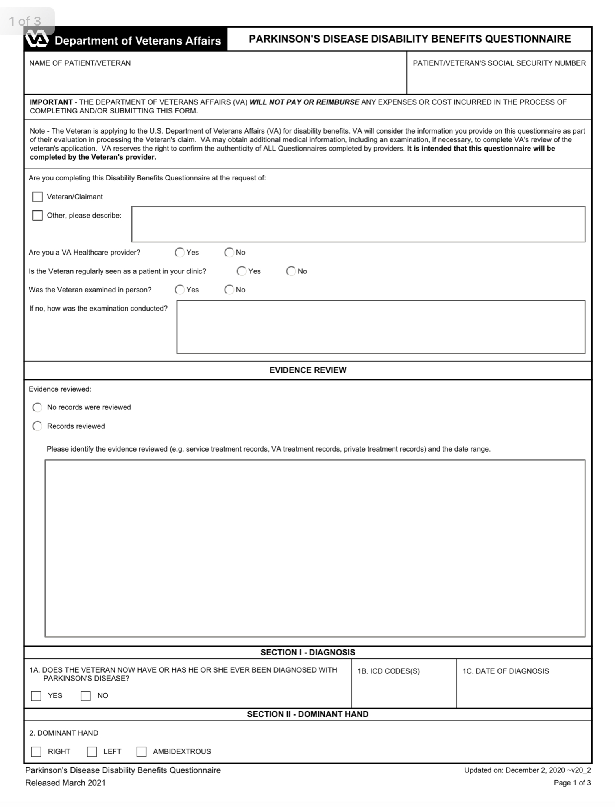
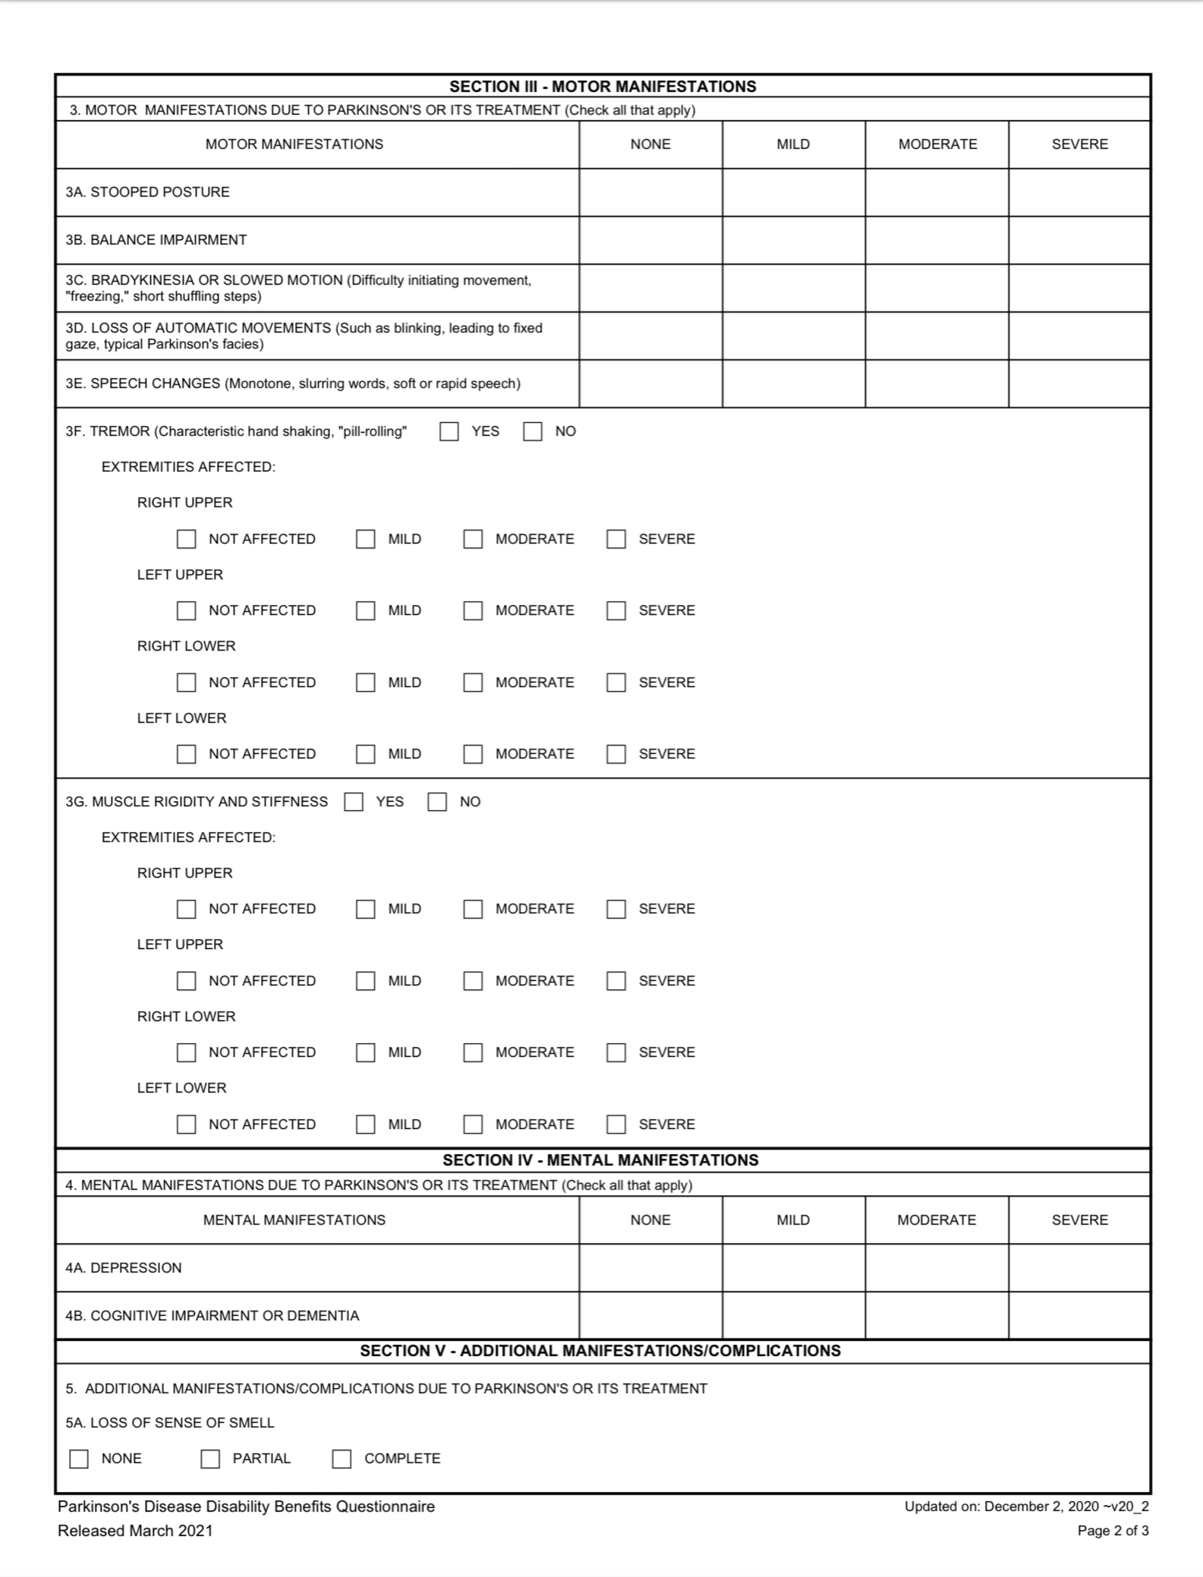
Parkinson’s Examination

Slide 66
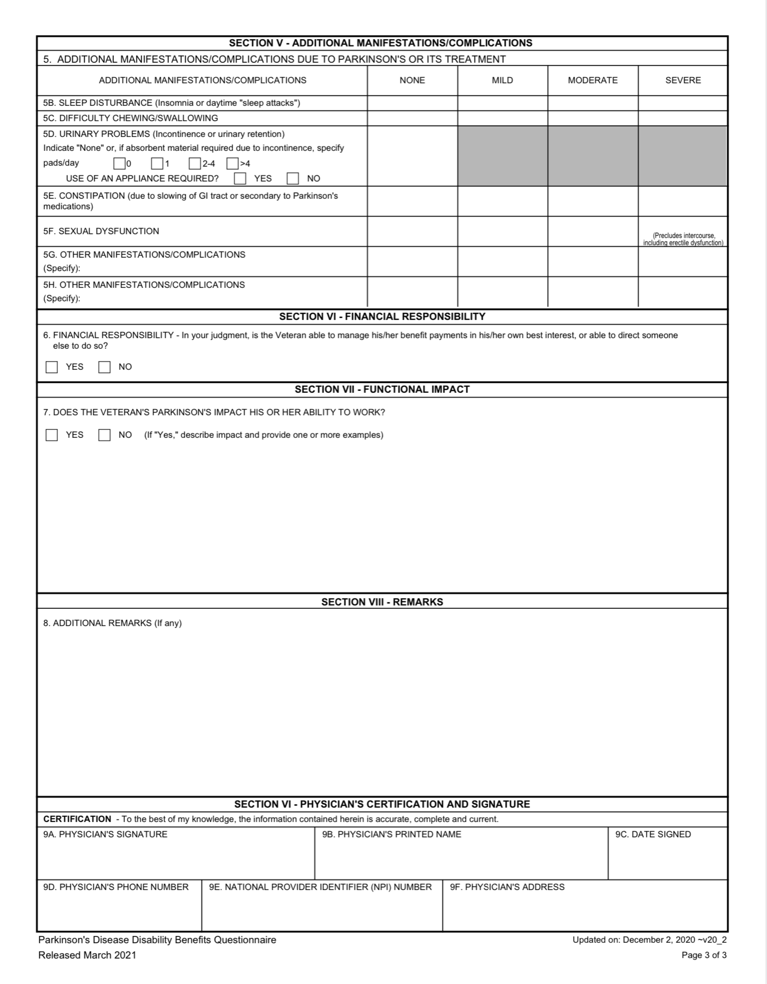
Parkinson’s Examination
Please note:
Parkinsonism is rated analogous to Parkinson’s under DC 8099-8004

Slide 67
Rating Criteria Parkinsonism
Under 38 CFR 4.124a
§4.124a Schedule of ratings—neurological conditions and convulsive disorders.
[With the exceptions noted, disability from the following diseases and their residuals may be rated from 10 percent to 100 percent in proportion to the impairment of motor, sensory, or mental function. Consider especially psychotic manifestations, complete or partial loss of use of one or more extremities, speech disturbances, impairment of vision, disturbances of gait, tremors, visceral manifestations, etc., referring to the appropriate bodily system of the schedule. With partial loss of use of one or more extremities from neurological lesions, rate by comparison with the mild, moderate, severe, or complete paralysis of peripheral nerves]

Slide 68
Nehmer Application- Extract from
38 CFR 3.816
(c) Effective date of disability compensation. If a Nehmer class member is entitled to disability compensation for a covered herbicide disease, the effective date of the award will be as follows:
(1) If VA denied compensation for the same covered herbicide disease in a decision issued between September 25, 1985 and May 3, 1989, the effective date of the award will be the later of the date VA received the claim on which the prior denial was based or the date the disability arose, except as otherwise provided in paragraph (c)(3) of this section. A prior decision will be construed as having denied compensation for the same disease if the prior decision denied compensation for a disease that reasonably may be construed as the same covered herbicide disease for which compensation has been awarded. Minor differences in the terminology used in the prior decision will not preclude a finding, based on the record at the time of the prior decision, that the prior decision denied compensation for the same covered herbicide disease.

Slide 69
Nehmer Application- Extract from
38 CFR 3.816
(2) If the class member's claim for disability compensation for the covered herbicide disease was either pending before VA on May 3, 1989, or was received by VA between that date and the effective date of the statute or regulation establishing a presumption of service connection for the covered disease, the effective date of the award will be the later of the date such claim was received by VA or the date the disability arose, except as otherwise provided in paragraph (c)(3) of this section. A claim will be considered a claim for compensation for a particular covered herbicide disease if:
(i) The claimant's application and other supporting statements and submissions may reasonably be viewed, under the standards ordinarily governing compensation claims, as indicating an intent to apply for compensation for the covered herbicide disability; or

Slide 70
Nehmer Application- Extract from
38 CFR 3.816
(ii) VA issued a decision on the claim, between May 3, 1989 and the effective date of the statute or regulation establishing a presumption of service connection for the covered disease, in which VA denied compensation for a disease that reasonably may be construed as the same covered herbicide disease for which compensation has been awarded.
(3) If the class member's claim referred to in paragraph (c)(1) or (c)(2) of this section was received within one year from the date of the class member's separation from service, the effective date of the award shall be the day following the date of the class member's separation from active service.
(4) If the requirements of paragraph (c)(1) or (c)(2) of this section are not met, the effective date of the award shall be determined in accordance with 38 CFR 3.114 and 3.400.

Slide 71
References
Public Law 103-446 dated November 2, 1994
Public Law 105–277 Persian Gulf War Veterans Act of 1998
Public Law 107-103 under the veterans expansion and benefits act of 2001
38 USC 1117
38 USC 1118
38 CFR 3.2
38 CFR 3.103
38 CFR 3.114
38 CFR 3.159
38 CFR 3.306
38 CFR 3.307
38 CFR 3.309
38 CFR 3.317
38 CFR 3.320
38 CFR 3.816

Slide 72
References (continued)
M 21-1.IV.2.D
M 21-1.V.ii.2
M 21-1.VIII.ii.2
https://www.publichealth.va.gov/exposures
https://www.va.gov/disability/eligibilty
https://www.va.gov
https://www.mayoclinic.org
VA Memorandum dated June 8, 2021 concerning Persian Gulf War particulate Matter Exposure Interim Claims Processing
VBA Letter dated August 2, 2021 concerning Presumptive Service Connection for Respiratory Conditions due to Particulate Matter
National Defense Authorization Act for Fiscal Year 2021

Slide 73
QUESTIONS?
Vicki Von Loh
402-499-6836
vvonloh@gmail.com

Slide 74
Presumptive Conditions due to Toxic Exposure Part 2
By Vicki Von Loh
November 2021

Slide 75
Other Possible
Toxic Exposures

Slide 76
Gulf War Registry
VA’s Gulf War Registry Health Exam alerts Veterans to possible long-term health problems that may be related to environmental exposures during their military service. The registry data helps VA understand and respond to these health problems more effectively.
This comprehensive health exam includes an exposure and medical history, laboratory tests, and a physical exam. A VA health professional will discuss the results face-to-face with the Veteran and in a follow-up letter.

Slide 77
Eligibility
Veterans who served in the Gulf during Operation Desert Shield, Operation Desert Storm, Operation Iraqi Freedom, or Operation New Dawn are eligible for the Gulf War Registry exam.

Slide 78
Ionizing Radiation Registry
VA’s Ionizing Radiation Registry health exam alerts Veterans to possible long-term health problems that may be related to ionizing radiation exposure during their military service. The registry data helps VA understand and respond to these health problems more effectively.
This comprehensive health exam includes an exposure and medical history, laboratory tests, and a physical exam. A VA health professional will discuss the results face-to-face with the Veteran and in a follow-up letter.

Slide 79
Ionizing Radiation Registry
(continued)
Veterans who meet any of the following criteria are eligible:
On-site participation in a test involving the atmospheric detonation of a nuclear device, whether or not the testing nation was the United States
Participation in the occupation of Hiroshima or Nagasaki from August 6, 1945 through July 1, 1946
Internment as a prisoner of war in Japan during World War II
Receipt of nasopharyngeal (NP)—nose and throat—radium irradiation treatments while in the active military, naval, or air service

Slide 80
Ionizing Radiation Registry
(continued)
Involved in the following "radiation-risk activities":
  Service at Department of Energy gaseous diffusion plants at Paducah, KY, Portsmouth, OH, or the K25 area at Oak Ridge, TN, for at least 250 days before February 1, 1992 under certain conditions
  Proximity to "Longshot," "Milrow," or "Cannikin" underground nuclear tests at Amchitka Island, AK, before January 1, 1974

Slide 81
Depleted Uranium Followup Program
VA and the Department of Defense established the Depleted Uranium Follow-up Program at the Baltimore VA Medical Center to screen and monitor Veterans for health problems associated with exposure to depleted uranium (DU).

Slide 82
Eligibility
VA requires active duty service in any of the conflicts listed below to qualify for the DU Follow-up Program:
    Gulf War
    Bosnia
    Operation Enduring Freedom
    Operation Iraqi Freedom
    Operation New Dawn
    Service at Karshi-Khanabad Air Base (K-2)
The DU Follow-Up Program has two aspects: 1) for Veterans who were on or in vehicles hit with DU "friendly fire"; and 2) for rescuers entering burning vehicles, and those near burning vehicles; salvaging damaged vehicles; or near fires involving DU munitions.

Slide 83
Screening and Followup
Most Veterans concerned about DU exposure during combat were not involved in friendly fire, but had a possible exposure inhaling DU. For these Veterans, VA offers a screening program that involves completing:
  An exposure questionnaire
  A spot urine collection test to measure DU
For Veterans exposed to DU from embedded fragments or with DU-contaminated wounds from friendly fire, the Depleted Uranium Follow-up Program involves:
  Detailed physical exams
  Clinical tests of organ systems function
  Recommendations for treatment, including surgical removal of embedded fragments in some cases

Slide 84
Toxic Embedded Fragment
Some Veterans of Operation Enduring Freedom (OEF), Operation Iraqi Freedom (OIF), and Operation New Dawn (OND) have retained toxic embedded fragments in their bodies after blast injuries sustained during military service.
These Veterans may be eligible for medical surveillance conducted by the Toxic Embedded Fragment Surveillance Center at the Baltimore VA Medical Center.
Shrapnel is a common term to describe the toxic fragments from improvised explosive devices (IEDs), bombs, mines and shells. Some of the fragments may contain depleted uranium.

Slide 85
Toxic Embedded Fragment
(continued)
Although health problems caused by toxic embedded fragments are not fully understood, generally fragments are potentially harmful in two ways:
Injury at the site of the fragment
Metal ions released from the fragment can travel through the bloodstream and affect other parts of the body

Slide 86
Camp Lejuene Water
From the 1950s through the 1980s, people living or working at the U.S. Marine Corps Base Camp Lejeune, North Carolina, were potentially exposed to drinking water contaminated with industrial solvents, benzene, and other chemicals.
As a part of the Caring for Camp Lejeune Families Act of 2012, qualifying Veterans can receive all their health care (except dental care) from VA if they served on active duty at Camp Lejeune for at least 30 days between August 1, 1953 and December 31, 1987, even if they don’t have a health condition that is presumed to be related to exposure.

Slide 87
Camp Lejuene Water
(continued)
VA has established a presumptive service connection for Veterans, Reservists, and National Guard members exposed to contaminants in the water supply at Camp Lejeune from August 1, 1953 through December 31, 1987 who later developed one of the following eight diseases:
Adult leukemia
Aplastic anemia and other myelodysplastic syndromes
Bladder cancer
Kidney cancer

Slide 88
Camp Lejuene Water
(continued)
Liver Cancer
Multiple myeloma
Non-Hodgkin's lymphoma
Parkinson's disease
Presently, these conditions are the only ones for which there is sufficient scientific and medical evidence to support the creation of presumptions; however, VA will continue to review relevant information as it becomes available.

Slide 89
Qurmat Ali Water Treatment Plant
During the spring and summer of 2003, about 830 Service members guarded a water treatment facility in the Basrah oil fields at Qarmat Ali, Iraq. Service members included National Guard, Reserve, and active duty soldiers. Many of the Guard/Reserve members were from Indiana, South Carolina, West Virginia, and Oregon.
This facility was contaminated with sodium dichromate dust, which is a source of hexavalent chromium, a chemical that is known to cause cancer.

Slide 90
Qurmat Ali Water Treatment Plant
The chemical was used as an anti-corrosion agent by previous workers at the plant and was found on the ground after bags of the chemical were opened at the site. Those Service members assigned to the Qarmat Ali Water Treatment Facility may have been exposed to toxic hexavalent chromium from breathing contaminated sodium dichromate dust.
The water at Qarmat Ali was not used for drinking, so drinking contaminated water is not considered a significant source of exposure.

Slide 91
Sulfur Fire at Mishraq
A fire that ignited in June 2003 at the Mishraq State Sulfur Mine Plant near Mosul, Iraq burned for almost a month. Field samples of air in the vicinity of the fire detected sulfur dioxide at levels immediately dangerous to health and life. Hydrogen sulfide also was released. Exposure varied by wind and fire conditions over time.
Firefighters were considered the most exposed. Firefighters were primarily from the 101st Airborne Division – 52nd Engineer Battalion, 326th Engineer Battalion, and the 887th Engineer Battalion.

Slide 92
Sulfur Fire at Mishraq
Servicemembers involved with fighting this fire experienced irritation, minor burns, and blood-tinged nasal mucous.
Both sulfur dioxide and hydrogen sulfide are gases that can produce irritation and reddening of the nose and throat, eye irritation, and coughing. At high levels, these gases can burn the skin and cause severe airway obstruction, hypoxia (inadequate supply of oxygen to the body) and pulmonary edema (fluid accumulation in the lungs).
Short-term high-level exposure has been associated with a rare condition of lung damage known as constrictive bronchiolitis and an asthma-like condition known as reactive airway dysfunction syndrome.

Slide 93
Industrial Solvents
Many service members used industrial solvents in regular military tasks such as cleaning, degreasing, paint stripping, and thinning oil-based paints. Too much exposure to some industrial solvents can cause short-term and long-term health effects.
Exposure to solvents may impact veterans health depending on the specific chemicals, level of concentration, length of exposure, and how it enters the body.

Slide 94
Industrial Solvents
Inhaled vapors: These may irritate the eyes, cause drowsiness, difficulty with breathing and if severe, neurological damage
Direct eye contact: This may cause burning and tearing and if severe, visual problems.
Skin contact: This may cause skin dryness, irritation, rashes or chemical burns.Ingested: Although rare, this can cause serious illness.

Slide 95
Industrial Solvents
For information on specific solvents, the Agency for Toxic Substances and Disease Registry (ATSDR) provides the following fact sheets:
  Benzene (92 KB, PDF)
  Acetone (140 KB, PDF)
  Tetrachloroethylene (PCE or PERC) (238 KB, PDF)
  Trichloroethylene (TCE) (238 KB, PDF)
  Xylenes (72 KB, PDF)

Slide 96
Polychlorinated Biphenyls (PCBs)
Polychlorinated biphenyls (PCBs) are manufactured organic chemicals that are no longer produced in the United States, but are still in the environment and can cause health problems. PCBs do not easily break down and may remain in the air, water and soil for long periods of time.
Products made before 1977 that may contain PCBs include old fluorescent lighting fixtures and electrical devices containing PCB capacitors, and old microscope and hydraulic oils. PCBs also are common contaminants in fish.

Slide 97
Polychlorinated Biphenyls (PCBs)
Veterans at risk for PCB exposure during military service are those who, before 1977, worked on repair and maintenance of PCB transformers, capacitors, and conduits.
Other ways of exposure to PCBs include eating contaminated food (a major source is fish caught in contaminated lakes or rivers), breathing air near hazardous waste sites, and drinking contaminated water.
The most common health problems for people exposed to large amounts of PCBs are skin conditions such as acne and rashes. Studies in exposed workers have shown changes in blood and urine that may indicate liver damage.

Slide 98
Perfluoroalkyl and polyfluoroalkyl substances (PFAS)
Perfluoroalkyl and polyfluoroalkyl substances (PFAS) are synthetic chemicals found in many products, such as clothing, carpets, fabrics for furniture, adhesives, paper packaging for food, and heat-resistant/non-stick cookware.
They are also present in fire-fighting foams (or aqueous film forming foam; AFFF) used by both civilian and military firefighters. They are persistent (i.e., they do not break down) in the environment, and since they are used in the manufacturing of so many products, they are widespread internationally.

Slide 99
Perfluoroalkyl and polyfluoroalkyl substances (PFAS)
Exposure to PFAS During Military Service
In the 1970s, the Department of Defense began using AFFF to fight fuel fires. The release of these chemicals into the environment during training and emergency responses is a major source of PFAS contamination of ground water on military bases.

Slide 100
Perfluoroalkyl and polyfluoroalkyl substances (PFAS)
According to the Agency for Toxic Substances and Disease Registry (ASTDR), some studies in humans suggest that certain PFAS may be associated with:
  Fertility issues and pregnancy-induced hypertension/preeclampsia
  Increased cholesterol
  Changes in the immune system
  Increased risk of certain cancers (e.g., testicular/kidney cancer)
  Changes in fetal and child development
  Liver damage
  Increased risk of thyroid disease
  Increased risk of asthma
Although some studies have reported these possible health outcomes, the overall scientific and medical evidence is currently inconclusive.

Slide 101
Lead Exposure
Lead is a naturally occurring metal that has been used in the production of batteries, metal products such as solder and pipes, devices to shield X-rays, explosives, artillery, ammunition, and more.
Because of health concerns, lead use has decreased dramatically in gasoline, ammunition, paints, ceramics, caulking, and pipe solder over the past decades.

Slide 102
Lead Exposure (continued)
Veterans may be at risk for elevated lead levels if they:
Spent many days at indoor firing ranges, such as in a special operations unit
Had contact with lead-based paints that were deteriorating
Drank water from old lead pipes
Had contact with lead in the air, dust, soil, water, and some commercial products

Slide 103
Lead Exposure (continued)
When lead is inhaled or swallowed, it can affect almost every organ and system in the body, including the nervous system.
Long-term exposure in adults can cause:
  Decreased memory and concentration
  Weakness in fingers, wrists, or ankles
  Small increases in blood pressure, particularly in middle-aged and older people
  Anemia

Slide 104
References
Public Law 103-446 dated November 2, 1994
Public Law 105–277 Persian Gulf War Veterans Act of 1998
Public Law 107-103 under the veterans expansion and benefits act of 2001
38 USC 1117
38 USC 1118
38 CFR 3.2
38 CFR 3.103
38 CFR 3.114
38 CFR 3.159
38 CFR 3.306
38 CFR 3.307
38 CFR 3.309
38 CFR 3.317
38 CFR 3.320
38 CFR 3.816

Slide 105
References (continued)
M 21-1.IV.2.D
M 21-1.V.ii.2
M 21-1.VIII.ii.2
https://www.publichealth.va.gov/exposures
https://www.va.gov/disability/eligibilty
https://www.va.gov
https://www.mayoclinic.org
VA Memorandum dated June 8, 2021 concerning Persian Gulf War particulate Matter Exposure Interim Claims Processing
VBA Letter dated August 2, 2021 concerning Presumptive Service Connection for Respiratory Conditions due to Particulate Matter
National Defense Authorization Act for Fiscal Year 2021

Slide 106
QUESTIONS?
Vicki Von Loh
402-499-6836
vvonloh@gmail.com

