Slide 1
VA Community Care in 2021
November 2021
Joseph Duran
Director, Policy and Planning Office of Community Care

Slide 2
Agenda
Introduction
Health Care through VA
1
OCC
Community Care Overview
2
MISSION Act
Improvements in Community Care
3
CCN
4
CCN as VA’s Primary Provider Network
Emergency Care
Access to care during medical emergencies
5

Slide 3

Health Care Through VA
Enrollment
Veterans generally must be enrolled to receive VA Health Care (38 U.S. Code § 1705)
Enrollment assures Veterans that comprehensive health care services will be available when they are needed
All enrolled Veterans receive VA’s comprehensive Medical Benefits Package which includes preventive, primary and specialty care, diagnostic, inpatient and outpatient care services
Health care benefits are completely portable throughout the entire VA system
For more information:
www.va.gov/healthbenefits/vhbh/
Role of Community Care in VA Health Care
Providing Veterans more choices to receive care in their local communities
Provided through community providers participating in VA’s community care network
Requires VA’s pre-approval, with certain exception (urgent care, flu vaccinations)
VA’s reimbursement for services exempt from pre-approval must still meet specific requirements

Slide 4
How To Apply for VA Health Care Benefits - Overview
There are specific requirements to enroll with VA:
Find out if you’re eligible for VA health care benefits: https://www.va.gov/health-care/eligibility/
Fill out an Application for Health Benefits (VA Form 10-10EZ) https://www.va.gov/vaforms/medical/pdf/10-10EZ-fillable.pdf
Apply by phone – Toll-free hotline at 877-222-8387, M-F 8am to 8pm ET
Apply by mail
Apply in person at the nearest VA medical center or clinic https://www.va.gov/find-locations/

Slide 5
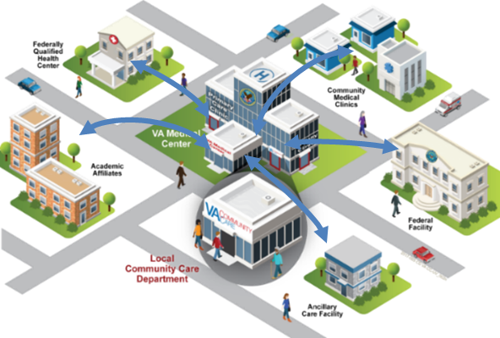
Office of Community Care: Mission and Vision
Mission
To play an integral role in VA’s High Performing Integrated Delivery Network by delivering innovative healthcare programs that provide access to timely, high-quality, cost-efficient, and well-coordinated community care for Veterans and VA beneficiaries.
Vision
To achieve outstanding healthcare outcomes and provide best in class customer experience to Veterans, beneficiaries, VA employees, and community providers.

Slide 6

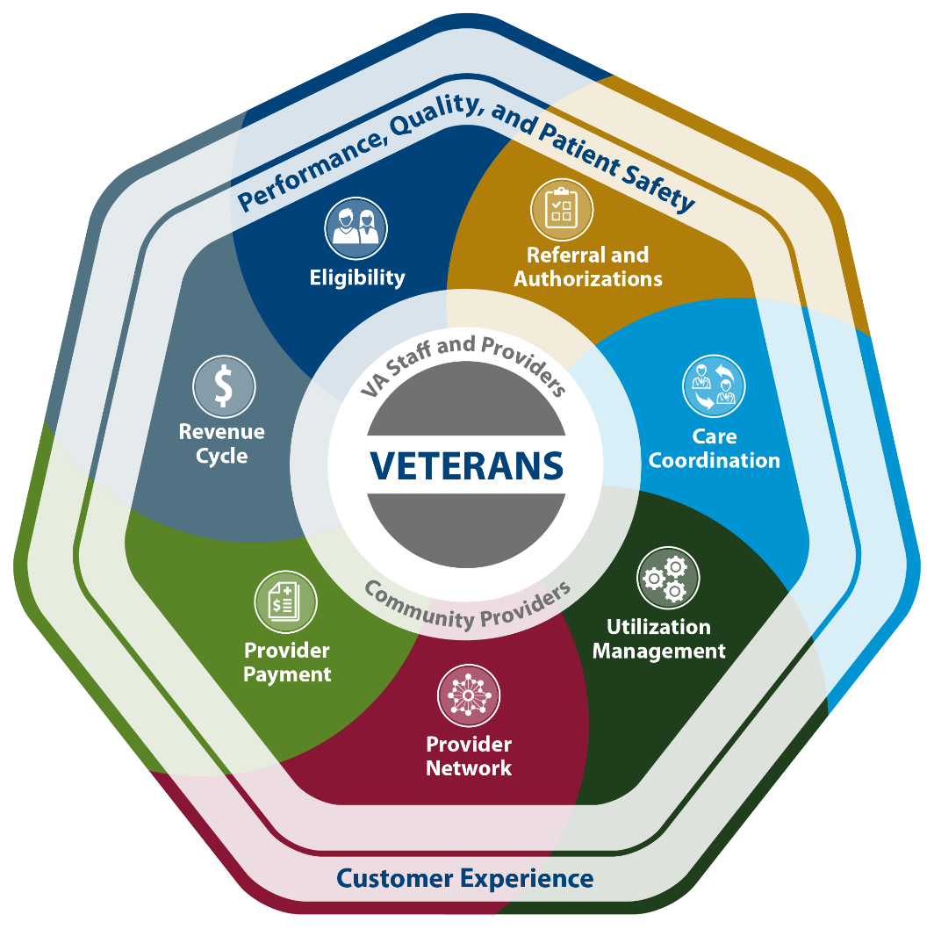






Veterans Community Care: Key Components
Eligibility
Simplified eligibility criteria for Veterans
Referral and Authorizations
Web-based system to manage Veterans’ care
Care Coordination
Coordinating care based on personalized needs of Veterans
Utilization Management
Established standardized episodes of care for better outcomes
Provider Network
Access to a high-performing and quality network
Provider Payment
Prompt payment of providers by leveraging new systems
Revenue Cycle
Payment recoupment through billing third party insurance plans

Slide 7
VA MISSION Act: Community Care Key Changes
MISSION Act fundamentally transformed VA’s health care system with significant improvements.
It fulfills VA’s commitment to provide Veterans with more choice in their health care providers.
New for Providers
Establishment of the Community Care Network and Veterans Care Agreements. Providers must:
Undergo an industry standard credentialing process
Submit claims within 180 days filing timeframe
Meet new training requirements
New for Veterans
Veterans receive new benefits under the Veterans Community Care Program. These benefits include:
Access to urgent care
Expanded eligibility for community care
Scheduling by the Veteran and VHA
Technology that streamlines communication
New for VA Staff
Introduction of new and modernized IT systems and business processes that will result in:
Broader options for care coordination
Fewer manual process / increased automation
Faster, easier information sharing

Slide 8
MISSION Act: Expanded Eligibility Overview
Best medical interest of the Veteran
Required care or services are not offered
Care or services are non-compliant with VA’s standards for quality
6 Community Care eligibility criteria established by MISSION Act
Lack of full-service medical facility
Care or services not provided within designated access standards
Grandfathered eligibility from Veterans Choice Program
ACCESS STANDARDS | Primary Care, Mental Health, Non-institutional Extended Care | Specialty Care
Drive Time | 30 minutes | 60 minutes
Wait Time | 20 days | 28 days

Slide 9
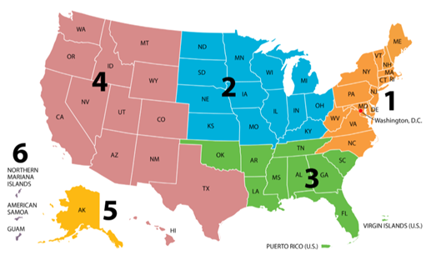


Community Care Network (CCN) Regions
The Community Care Network (CCN) is a set of region-based contracts to provide health care services in the community through a contractor who builds and credentials the associated network and processes claims.
Region 1 Deployment June 2019 – December 2019
Region 2 Deployment October 2019 – March 2020
Region 3 Deployment January 2020 - June 2020
Region 4 Deployment April 2020 - August 2020
Region 5 Deployment Spring 2021
VA selected Optum Public Sector Solutions, Inc. (Optum) part of UnitedHealth Group, Inc., to serve as the Third-Party Administrator (TPA) for CCN Regions 1, 2 and 3.
VA selected TriWest Healthcare Alliance (TriWest) to manage CCN Regions 4, 5 and 6.

Slide 10
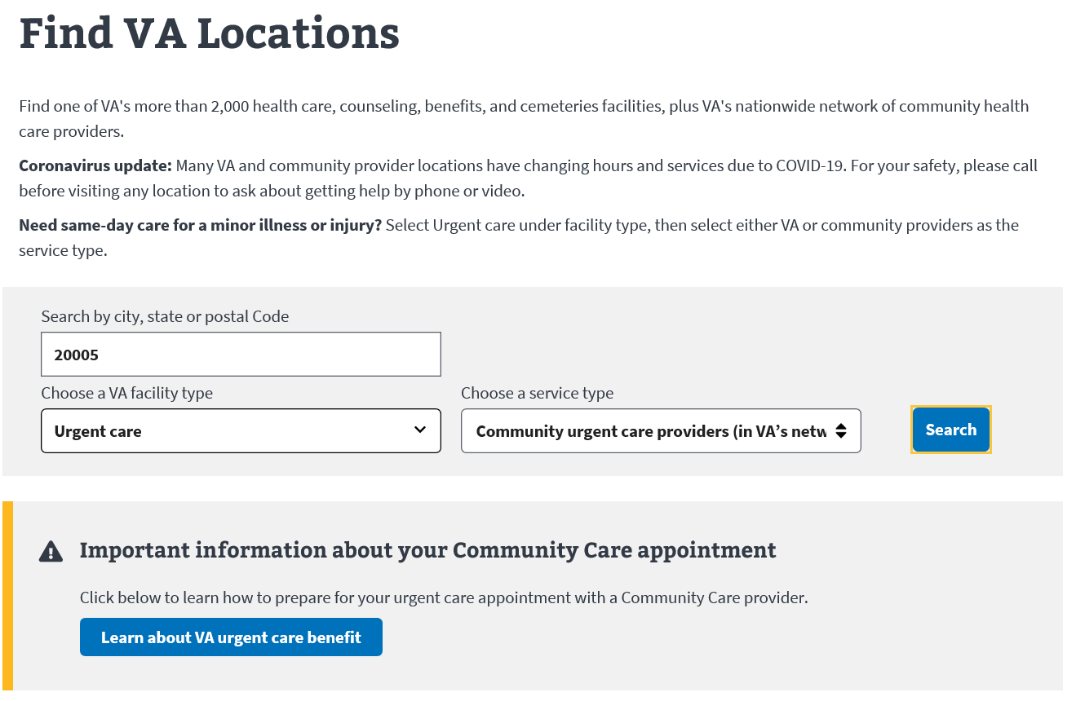
Locating Community Care Providers in VA’s Network
To find in-network providers for different types of services, including pharmacies:
Use the VA Facility Locator
Contact your local VA medical facility, or
Call 877-881-7618 to reach the National Contact Center
Figure 1. Screenshot example of using the locator to find urgent care providers.
10

Slide 11
Coordinating Veterans’ Care with Community Providers
Digital requests for community care to providers through HSRM
HealthShare Referral Manager (HSRM) – VA’s secure, web-based system
Includes bundled care/standardized episode of care (SEOC) details
SEOCs are identified by VA providers or the clinical delegated authority to ensure appropriate services are provided to Veterans
Modalities for exchanging electronic health records
HSRM - Allowing bi-directional exchange of health information
Veterans Health Information Exchange (VHIE): https://www.va.gov/VHIE/For_Providers.asp
VA Exchange: Bi-directional sharing of Health Information over a secure network
Data available for viewing through the provider’s own EHR system
VA Direct Messaging: Web tool that allows VA staff to securely send and receive Veteran health information with community care providers who are a part of the DirectTrust Network.
Other options: Azure RMS, eFax, traditional fax and US mail

Slide 12
Community Provider Training
Providing continuing medical education credits to providers
Broad curriculum of community provider trainings available 24 hours a day, 7 days a week
Includes 190+ courses (free, optional)
Highly recommended general competency training courses available on specific topics:
Suicide prevention, traumatic brain injury (TBI), post-traumatic stress syndrome (PTSD), military sexual trauma (MST), and others
For more information: https://www.train.org/vha/welcome

Slide 13

Urgent Care Benefit
Access to urgent, non-emergency care (e.g. non-life threatening conditions) through the VA contracted network. Services such as:
• Colds • Ear infections • Minor injuries • Pink eye • Skin infections • Strep throat
Coverage
URGENT CARE
To be eligible for urgent care, Veterans must:
Be enrolled in the VA health care system AND
Have received care through VA from either a VA or community provider within the past 24 months
Applicable VA copayments, separately billed
Eligibility& Copays
Veterans access providers in the network when it is convenient for them without needing
pre-authorization
Expanded access through telehealth
COVID-19 Testing at certain in-network locations
New Changes

Slide 14


Urgent Care Prescriptions
Prescriptions can be filled at an in-network pharmacy, at VA, or at a non-network pharmacy. Pharmacy limitations and requirements:
Up to 14-day supply (no refills) for urgent care
If a non-network pharmacy is used, Veterans must pay for the prescription and then file a claim for reimbursement with their local VA medical facility
Filled in the same state as the Veteran’s urgent care visit
Listed on the VA Urgent/Emergent Formulary https://www.pbm.va.gov/PBM/NationalFormulary.asp
Opiates limited to seven days or less, consistent with state laws
For a 14-day supply or greater, or for routine, non-urgent medications, the prescription can be filled at local VAMC pharmacy or via VA Mail Order Pharmacy
Some Veterans may be required to pay a VA copayment for prescription medication, which is billed separately by VA
14

Slide 15
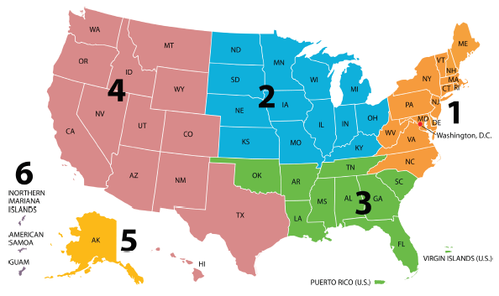
Key Urgent Care Information and Resources
For help with urgent care eligibility and general questions:
Call 844-MyVA411 (844-698-2411), select option 1 twice
Urgent Care Assistance Card: For Veterans to bring along for their visit and pharmacy
https://www.va.gov/COMMUNITYCARE/docs/programs/UC_Assistance_Cards.pdf#
For help when at the urgent care provider or pharmacy, call:
888-901-6609 if located in Regions 1 – 3
AL, AR, CT, DC, DE, FL, GA, IA, IL, IN, KS, KY, LA, MA, MD, ME, MI, MN, MO, MS, NC, ND, NE, NH, NJ, NY, OH, OK, PA, PR, RI, SC, SD, TN, VA, VI, VT, WI or WV
866-620-2071 if located in Regions 4 – 6
AK, AS, AZ, CA, CO, GU, HI, ID, MP, MT, NM, NV, OR, TX, UT, WA or WY
15

Slide 16


Emergency Care Benefit
What is it?
A medical emergency is an injury, illness or symptom so severe that without immediate treatment, a Veteran believes their life or health is in danger.
Veterans do not need to check with VA before calling for an ambulance or going to an emergency room, as VA encourages all Veterans seek immediate medical attention without delay.
Prudent Layperson Standard applies to a medical condition that a prudent layperson would have reasonably expected a delay in seeking immediate medical attention would have been hazardous to his or her health.
A claim for emergency care will never be denied based solely on VA not receiving notification prior to seeking care.
Key Step: After receiving emergency care at a community emergency department, it is essential to promptly notify VA. Notification must be made within 72 hours of admission to be considered under the new Community Care Program authority and the care must be in a contracted facility. If either criteria is not met, claims will be reviewed under existing emergency care authorities.

Slide 17
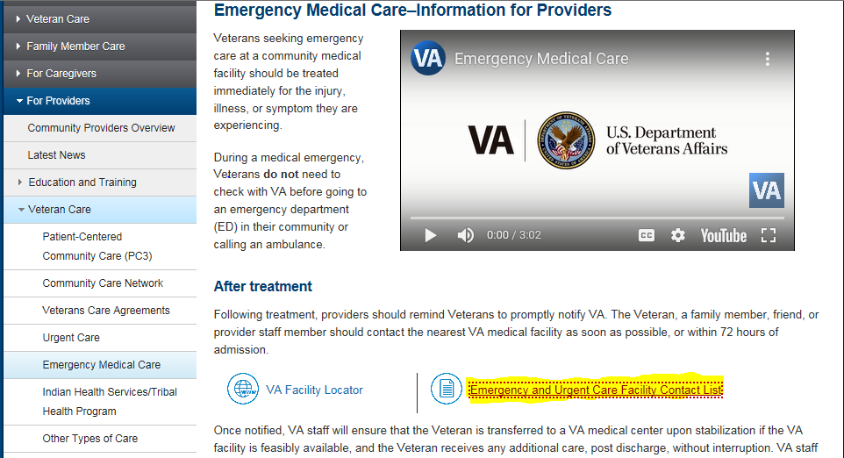
Notification Contact Information
Providers, Veterans and representatives can utilize any one of the following options to report notification:
https://emergencycarereporting.communitycare.va.gov/
844-72HRVHA (844-724-7842)
When calling or emailing notification, case specific information detailed in VA Form 10-10143g, Non-VA Hospital Emergency Notification, will be requested
VA Form 10-10143g
For more information: https://www.va.gov/COMMUNITYCARE/providers/info_EmergencyCare.asp

Slide 18











Service Connected (SC) Emergency Care
SC Emergency Care
A SC condition is one that has been adjudicated by the Veterans Benefits Administration (VBA) and disability rating has been granted. An adjunct condition is one that, while not directly SC, is medically considered to be aggravating a SC condition.
Administrative Eligibility Criteria (Only one has to be met)
A Veteran in a rehabilitation program is medically determined to be in need of a hospital care of medical services for any reasons listed to prevent or make a rehab program possible.
Treatment for VA adjudicated SC disability
Any condition of a Veteran rated permanent and total from a SC disability
There is an adjunct condition
Clinical Decision Criteria (All criteria has to be met)
VA or any other federal facility was not feasibly or geographically available to provide the emergency care
Prudent Layperson emergency standard

Slide 19










Non-Service Connected (NSC) Emergency Care
NSC Emergency Care
VA can also pay for emergency medical care at a community ED for a Veteran’s NSC condition. However, there are administrative and clinical requirements that need to be met for a Veteran to be eligible.
Administrative Eligibility Criteria (All criteria has to be met)
Emergency services were provided in a hospital or ER
Veteran is enrolled and received medical services from VA within the past 24 months
Veteran is financially liable to the provider. If no OHI, can pay as primary
If OHI, can consider claim as secondary payer, but prohibited from paying co-pay, cost share or deductibles
Claims must be filed within 90 days of the date of service or date of OHI exhaustion
Clinical Decision Criteria (All criteria has to be met)
Prudent Layperson criteria for emergent need and determining VA availability
The point of stability for inpatient care

Slide 20
Community Care & MISSION Act Public Resources
Community Care Website (External):
https://www.va.gov/communitycare/
Community Care YouTube Playlist
https://www.youtube.com/playlist?list=PL3AQ_JVoBEyys0cr7PzSVvnW1_YVYFs1p
General Information | Eligibility | Appointments and Getting Care
Webpage (Public) Fact Sheet: General Information Video: Veteran Community Care - Overview Information Sheet: Current vs. Future Article: Top Questions Answered Article: What is the latest on community care? | Webpage (Public) Article: New eligibility criteria a major improvement over existing rules Fact Sheet: Eligibility Video: Veteran Community Care – Eligibility | Webpage (Public) Article: Finding a community provider, making appointments, and getting care Fact Sheet: Appointments and Getting Care Video: Veteran Community Care: Making Appointments
Other
Veterans Care Agreements Webpage (Public – Providers) Fact Sheet: Veterans Care Agreements Veteran-focused Trainings: VHA TRAIN – No cost, Veteran-focused training for community providers Opioid Safety Fact Sheet: Opioid Safety Initiative Emergency Care Webpage (Public – Veterans) Webpage (Public – Providers) Fact Sheet/FAQs Video: Emergency Medical Care Sunset of Choice Program Webpage (Public – Veterans) Webpage (Public – Providers) Article: What to expect for community care on June 6 Fact Sheet: Sunset of Veterans Choice Program
Billing and Payments | Urgent Care
Webpage (Public) Fact Sheet: Billing and Payments Additional Information on Claims Payment Viewing Claims Status Checking Claims Status Customer Engagement Portal (CEP) Online viewing of EOBs and EOPs | Webpage (Public - Veterans) Webpage (Public – Providers) Article: VA's new urgent care benefit for Veterans Top Questions Answered Article/Blog Video: Veteran Community Care: Urgent Care Article: Answers to the top five questions

