Slide 1
Readjustment Counseling Service (RCS) Vet Center Briefing
Edward McEvoy
National Outreach Specialist

Slide 2
Vet Center Mission Statement
To welcome home and honor those who served, those still serving, and their families by reaching out to them, engaging their communities, and providing them with quality readjustment counseling and timely referral.

Slide 3
Vet Center Eligibility
Any Veteran or active-duty Servicemember, to include federally-activated members of the National Guard and Reserve components, is eligible Vet Center services who:
Has served on active military duty in any combat theater or area of hostility.
Experienced a sexual trauma while serving on active military duty or inactive training status.
Provided direct emergent medical care or mortuary services, while serving on active military duty, to the casualties of war.
Served as a member of an unmanned aerial vehicle crew that provided direct support to operations in a combat zone or area of hostility.
Vietnam era Veteran who received Vet Center services prior to Jan 2013

Slide 4
New Eligibility from Recent Legislation
Vet Center Eligibility Expansion Act
Opens eligibility to:
Reserve component members of the Armed Forces who served on active service in response to a national emergency/major disaster declared by the President or for the National Guard under State orders issued by the Chief Executive of that State in response to a disaster or civil disorder.
Any individual who participated in a drug interdiction operation as a member of the Coast Guard, regardless of the location of the operation.

Slide 5
Vet Center Eligibility Cont.
All readjustment counseling services available at Vet Centers are at no charge to the eligible individual or their family and are also available without time limitation.
Service members and Veterans are not required to enroll in the VA health care system or have received a service connection for conditions caused by military service.
These services are also provided regardless of the nature of the Veteran’s discharge. This includes service provision to those individuals with problematic discharges (dishonorable discharges).

Slide 6
Family Eligibility
Readjustment Counseling
Families of eligible Veterans and Service members are authorized to use Vet Centers when it is found to aid in the readjustment of that Veteran or Service member.
The Veteran or Service member defines who their family is.
Bereavement Counseling
Services for families who experience the death of a loved one while on active duty.
Coping with Deployment
Families of deployed Service members are eligible for Vet Center services to help cope with the deployment of their loved one.

Slide 7
Readjustment Counseling Service Vet Center Services
Readjustment counseling is a wide range of services offered to eligible Veterans and their families in the effort to make a successful transition from military to civilian life. Services offered at Vet Centers nationwide include:
Individual and group Counseling for eligible Veterans and Service members
Family counseling for military related issues
Bereavement counseling
Counseling and referral for those that experience a sexual trauma
Outreach
Substance abuse assessment and referral
Employment referral
Referral to other VA services
Community education

Slide 8
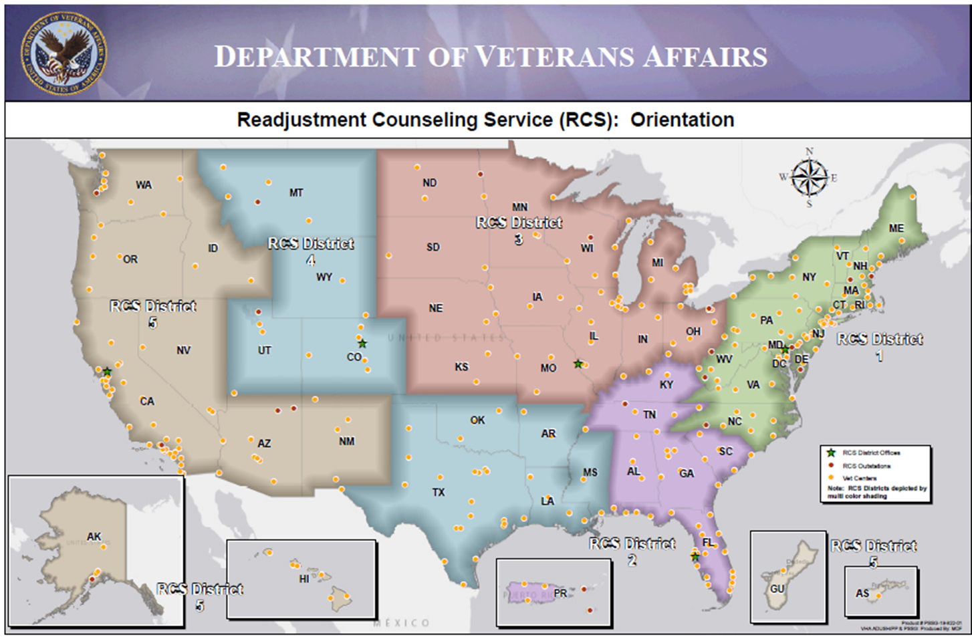

Slide 9

Vet Center Effectiveness
Veteran to Veteran/ Service member Services
Confidentiality
Veteran Focused Services
Eligibility to See Families
Listen to Veterans/Families and adjust
Services
Adaptive / Flexible
Culturally Competent Services

Slide 10
1-877- 927-8387 24/7 Vet Center Call Center
Vet Center Call Center is an around the clock confidential call center where those who served in war and their families can call to talk about their military experience or any other issue they are facing in their readjustment.
Product of VA leveraging technology to condense a national system of toll free numbers into a single modern center located in Denver, CO.
The staff is comprised of combat Veterans from several eras as well as families members of combat Veterans.
Warm handoff capacity has been established with all Vet Centers, VA Crisis Hotline, and National Caregiver Hotline.

Slide 11
1-877- 927-8387 24/7 Vet Center Call Center
Vet Center Call Center is an around the clock confidential call center where those who served in war and their families can call to talk about their military experience or any other issue they are facing in their readjustment.
Product of VA leveraging technology to condense a national system of toll free numbers into a single modern center located in Denver, CO.
The staff is comprised of combat Veterans from several eras as well as families members of combat Veterans.
Warm handoff capacity has been established with all Vet Centers, VA Crisis Hotline, and National Caregiver Hotline.

Slide 12
Shared Space for our Community Partners
Come on in, Vet Centers have space for you.
Meet with Vet Center and non-Vet Center clients in our conference or group rooms.
Host presentations, hold office hours.

Slide 13
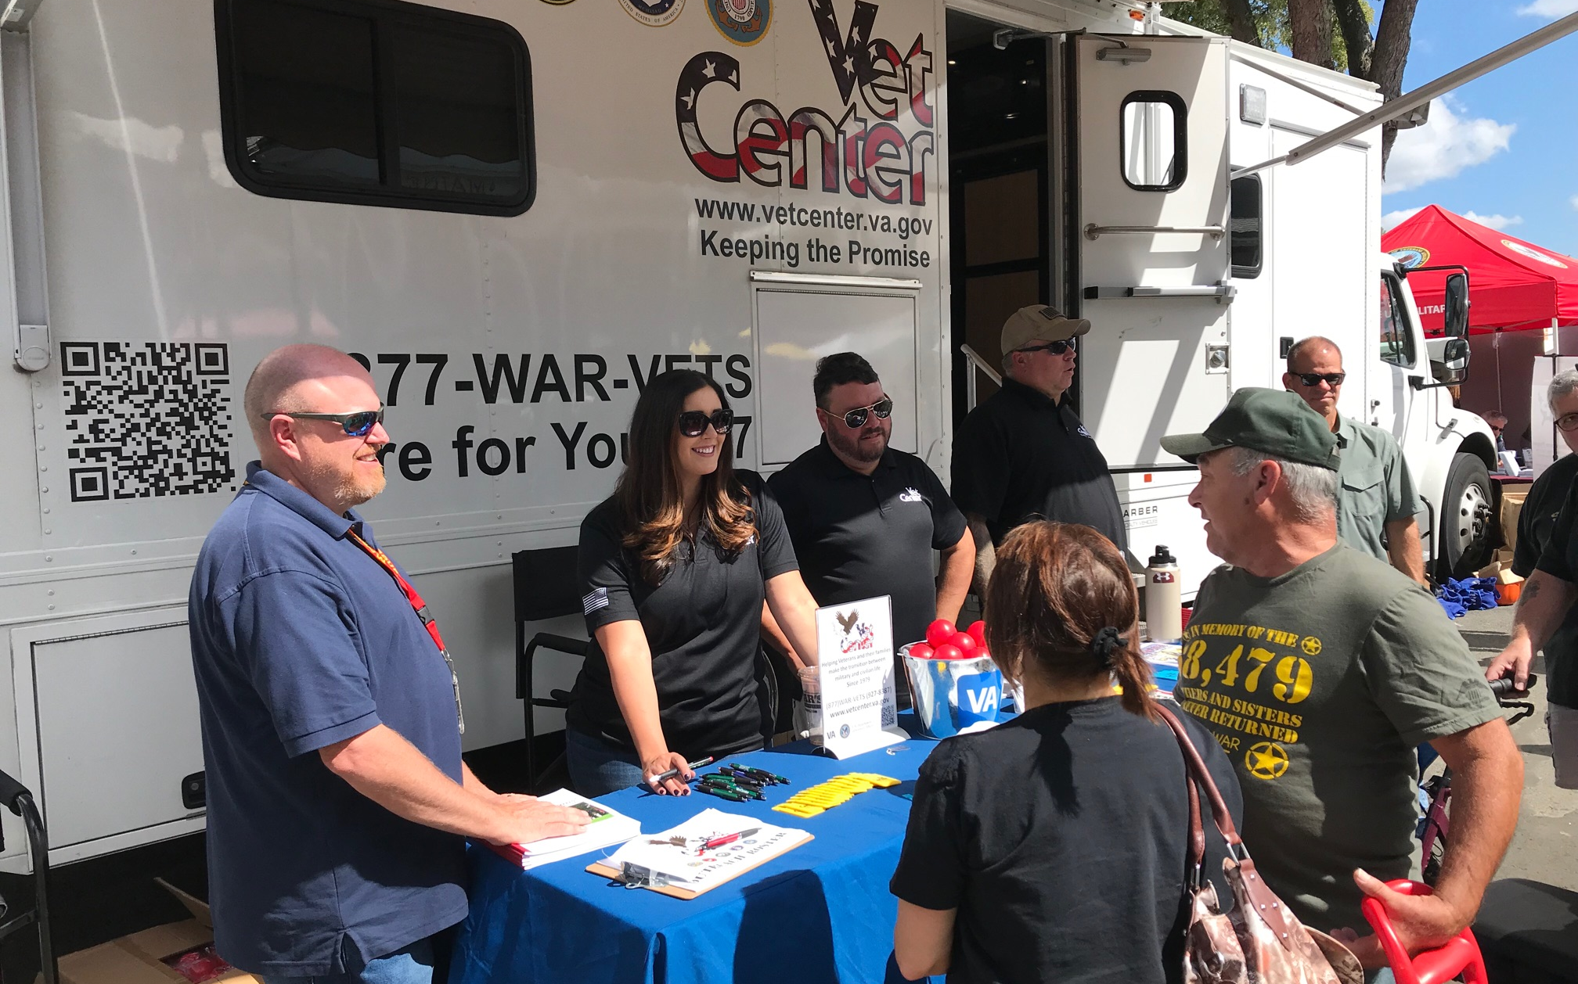
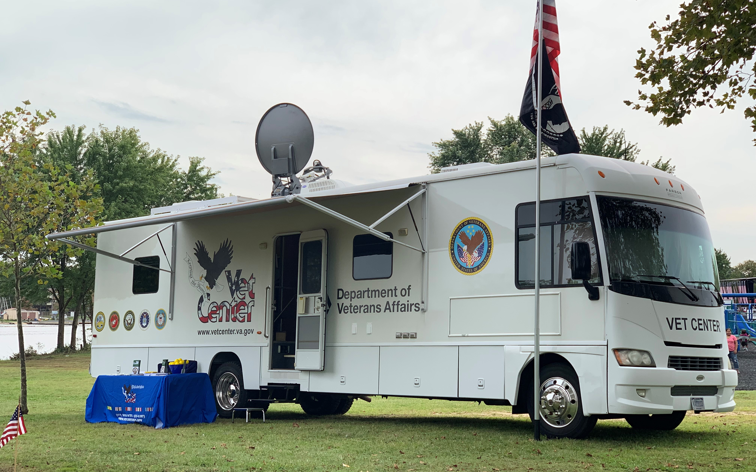
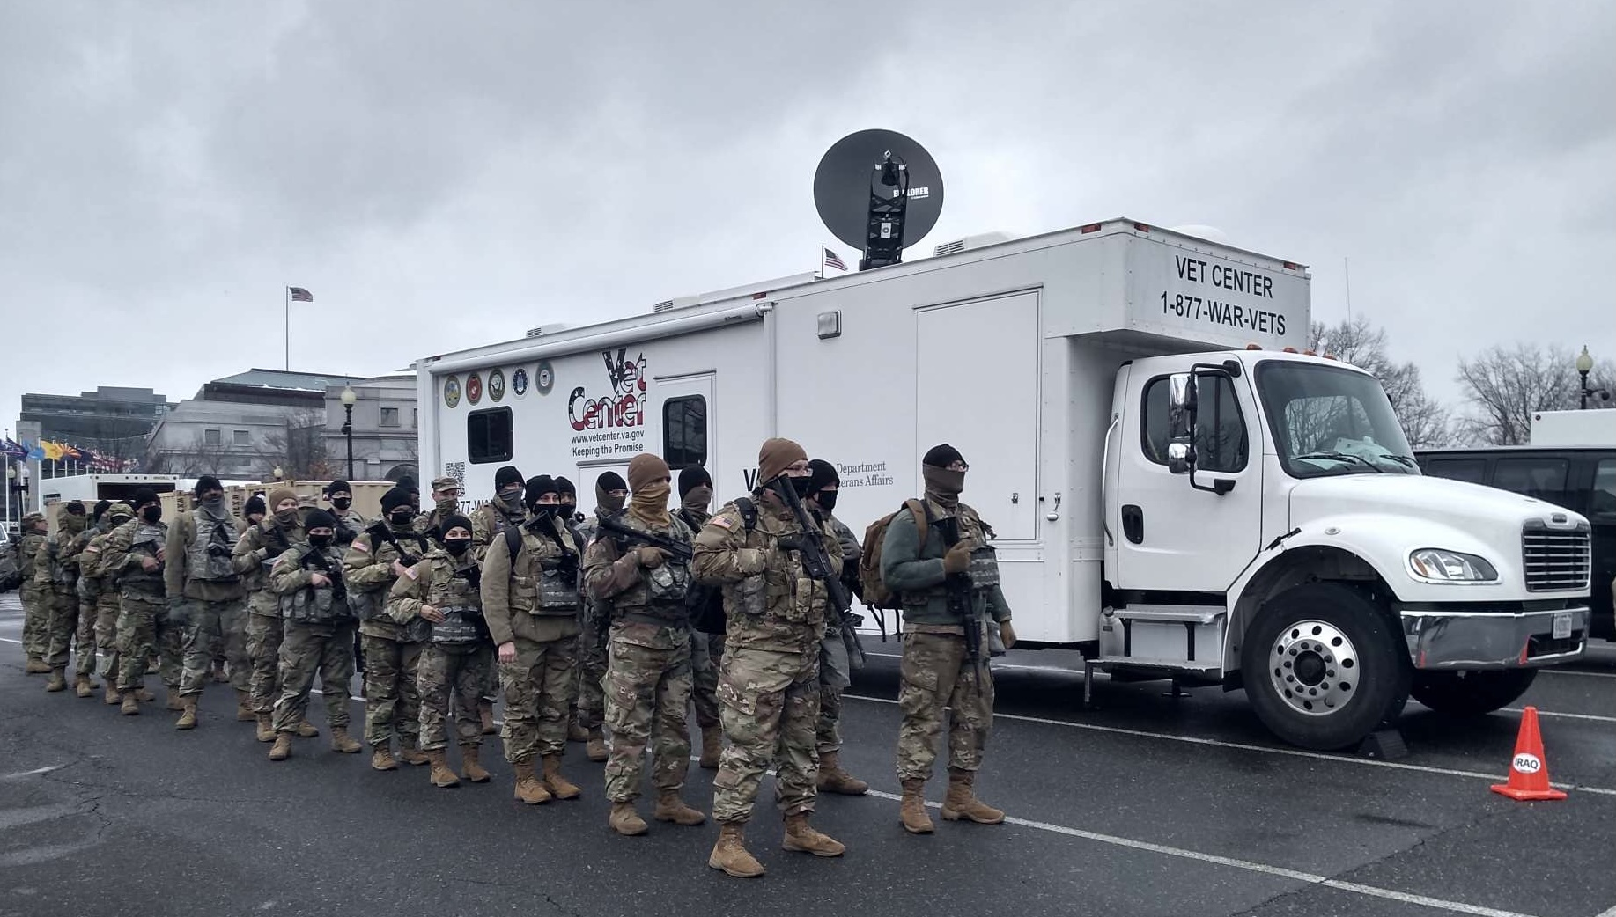
Mobile Vet Centers
Fleet of 83 Vehicles
Provides outreach and services to Veterans and families geographically distant from existing VA services.
Provides early access to Vet Center services to Veterans newly returning from war via outreach to demobilization active military bases, National Guard, and Reserve locations nationally.
Each Mobile Vet Center is equipped with a state of the art satellite communications package that includes fully encrypted tele-conferencing equipment, access to all VA systems and connectivity to emergency response systems.

Slide 14
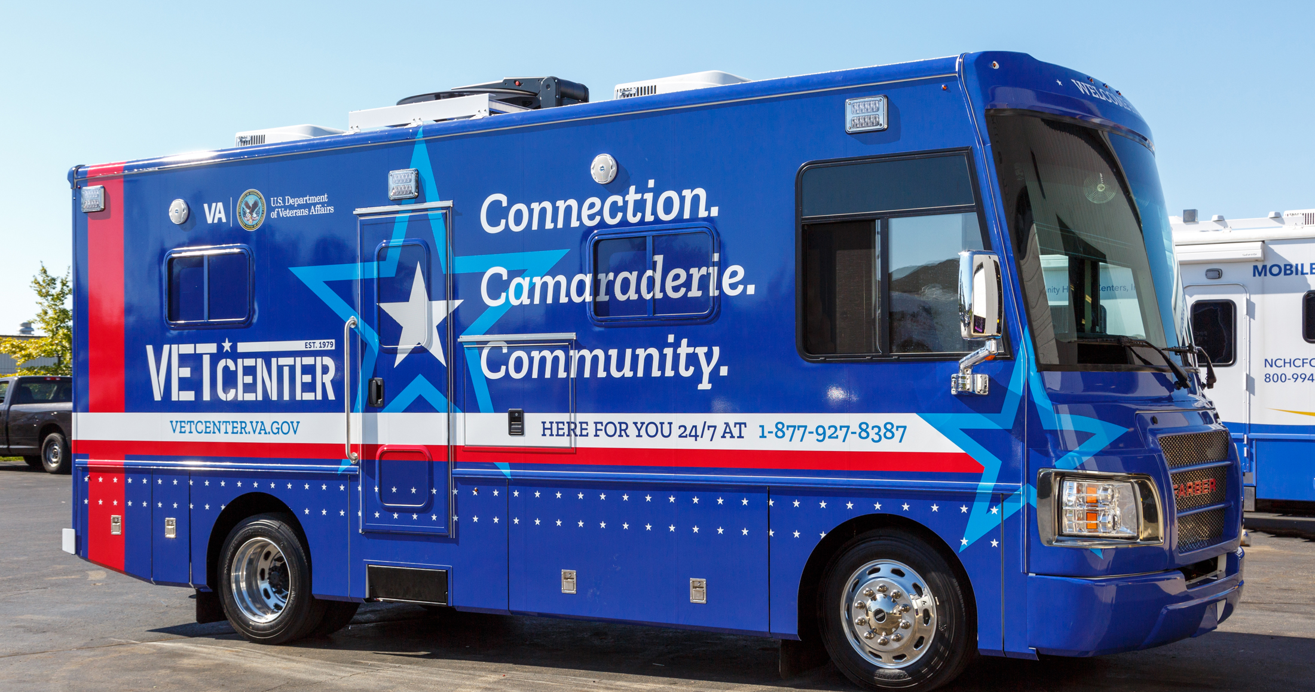

Slide 15
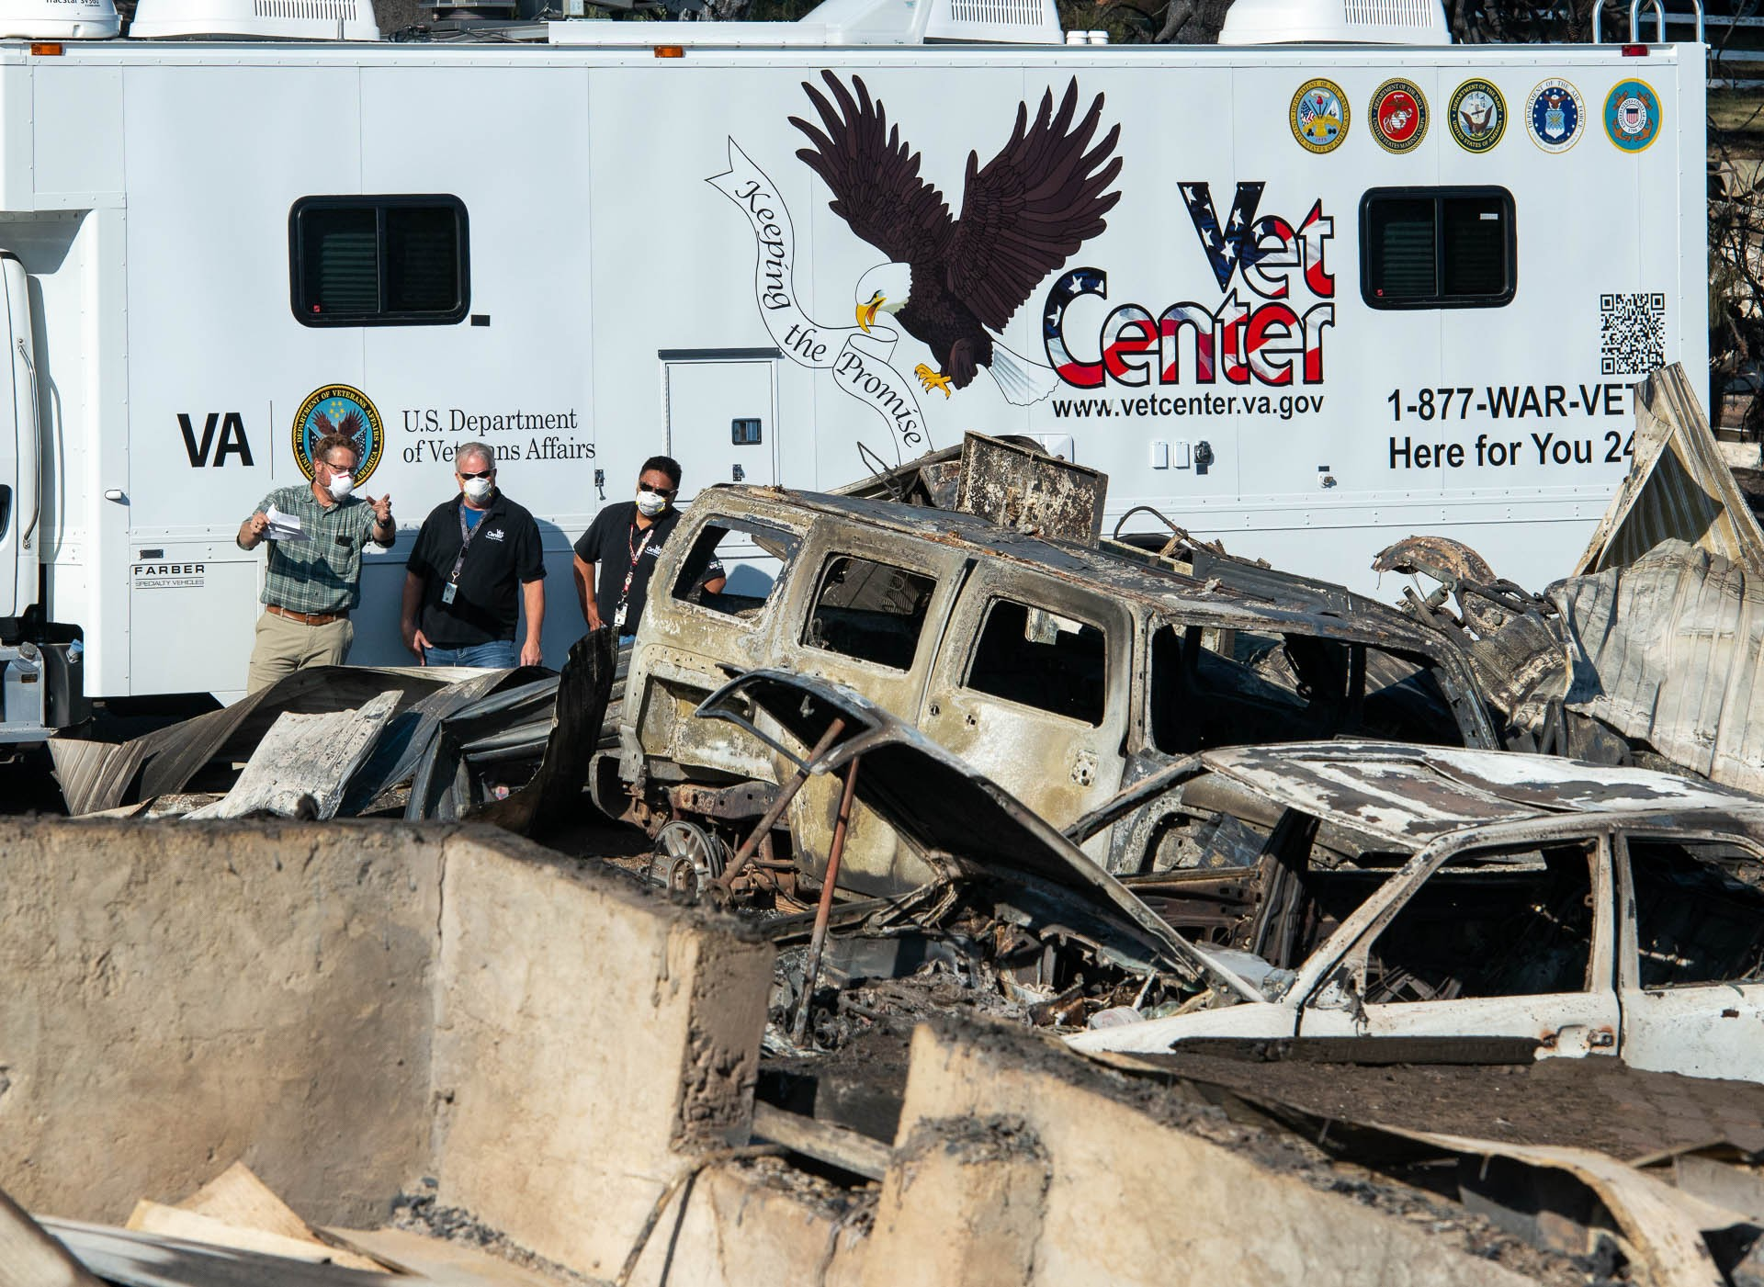
Vet Center Deployments in FY ‘20
Purpose
Direct service and care coordination;
Determine local community needs
Steadfast support throughout the COVID-19 response.
Outcome
20 deployments meeting VA’s 4th Mission;
11 supported COVID-19 outreach and support
Six Emergency Management responses; three supporting VAMCs.
927 Veterans, 100 service members, 272 family members, and 3,662 civilians served.

Slide 16
Questions??
Edward McEvoy
National Outreach Specialist
Cell: 202-873-5785
Office: 202-461-5934
edward.mcevoy@va.gov

