Slide 1
VSO Notification Process
Brad Hazell
Assistant Director, Compensation & Pension Policy

Slide 2
VSO Notification Process Background
On March 1st, 2021, VA reached out to Veteran service organizations for feedback on a pilot program called VSO Notification.
The purpose of the program is to notify VSOs when a document from a specified category of letters is added to the eFolder of one of our veterans. VA wishes to switch from paper notification to electronic by using this program.
VA solicited feedback from VSO Leadership on the framework of the program and what we would like to see included in the program.
VSO testers were trained to troubleshoot the program on 7/26/21 - 7/27/21 and given the opportunity to test the program in its entirety prior to its release on 8/15/2021
Despite the program going live, we have not signed off on a Memorandum Of Agreement switching from paper to electronic notification.
* Please note all PII displayed on this presentation is fabricated and does not contain any real veteran information.

Slide 3
The 6 Categories of notification
The Notification Process allows you to choose to be notified for one or more categories of VA Notifications. There are 6 categories, and they are:
Appeal
Development
Due Process
General
Notification
Medical Records

Slide 4
The 6 Categories of notification continued…
Each notification category has its own Description/Documents.
For example, the Appeal Category governs the following Descriptions/Documents:
BVA Decision
CAVC Decision
Appeal Notification Letter
BVA General
Appeal Satisfaction Notice
A Complete list of every Category and Description/Documents can be found on the last 3 slides of this presentation.

Slide 5
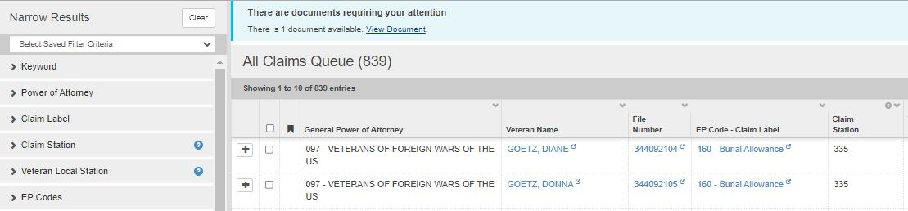
How does it work?
Step 1
Log into VBMS

Slide 6
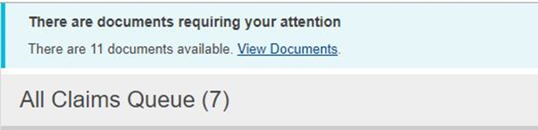
How does it work?
Step 2
Click on “View Documents” hyperlink located in the banner at the top of your VBMS all claims Queue
Special note* the documents that are available under View documents in this banner are for every new notification within our entire organization and cannot be filtered by office prior to loading.

Slide 7
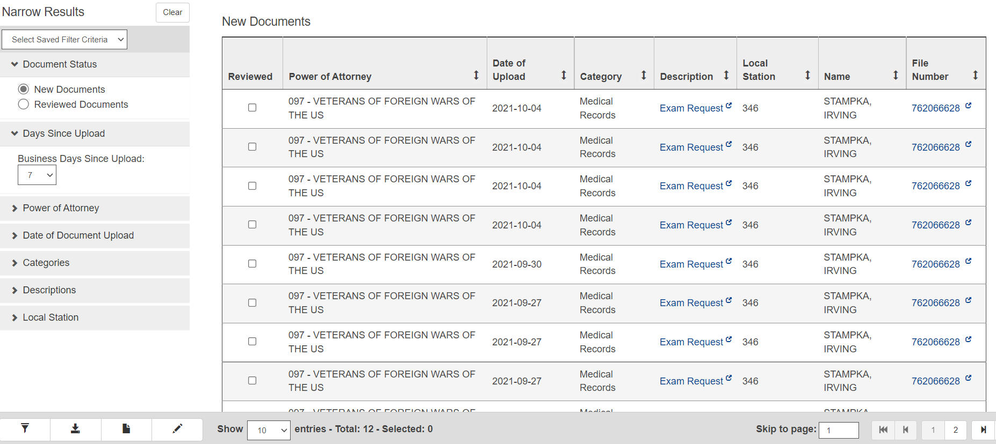
How does it work?
Step 3
Once you click on the banner you will be redirected to a page that contains all notifications for the organization.

Slide 8
How does it work?
Step 4
Now it’s time to set up your filters. These filters will narrow down all notifications so that only filtered results will be displayed.
Here are the filters and their role:
New or Reviewed Documents: Filters new or previously reviewed documents
Days since Upload: Shows only documents uploaded within X amount of busines days
Date of Document Upload: Allows you to select a specific date you wish to view
Categories: Appeal, Development, Due Process, General, Notification, Medical Records
Descriptions: Allows input of a specific document type as opposed to all in that category
Local Station: filters by all in your local station
Power of Attorney: If you have cross accreditation, you can choose which POA to view. Be sure to only view one POA at a time.
Special note* Claim station is the station the claim is being worked, whereas local station is the station associated with home address.
Special note* You can choose to filter by viewing every document/description, category or both when you set up your filters.

Slide 9
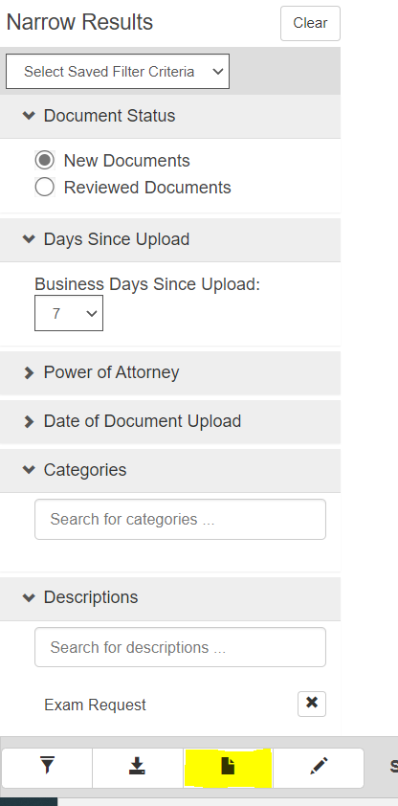
How does it work?
Step 4 continued
Once your filters are in place you will want to click “Save New Filter”.

Slide 10
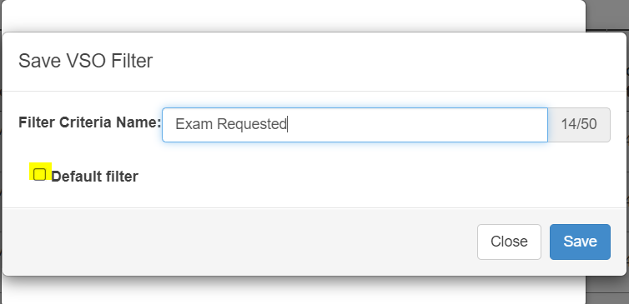
How does it work?
Step 4 continued
From here you can choose to name your filter as well as make it your Default Filter.
The Default filter will automatically populate only notifications that meet the filtered criteria every time you open this page.

Slide 11
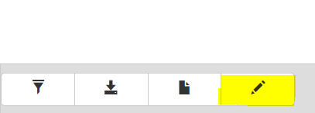
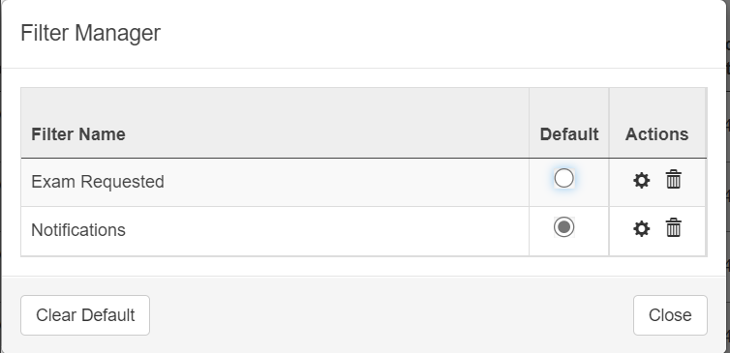
How does it work?
Step 4 continued
You can save multiple filters and manage them with the “Managed Saved filters button”.
When you press the Managed Saved Filters Button you are directed to the Filter Manager. This allows you to delete filters as well as change your Default Filter.

Slide 12
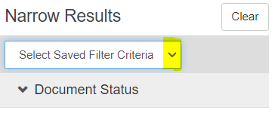
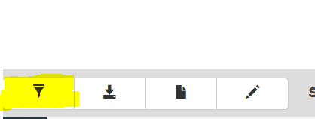
How does it work?
Step 4 continued
If you click on the drop-down arrow you can select what filter you would like to populate.
Once your desired filter is selected press the “Apply Filter” Button to update your queue.

Slide 13
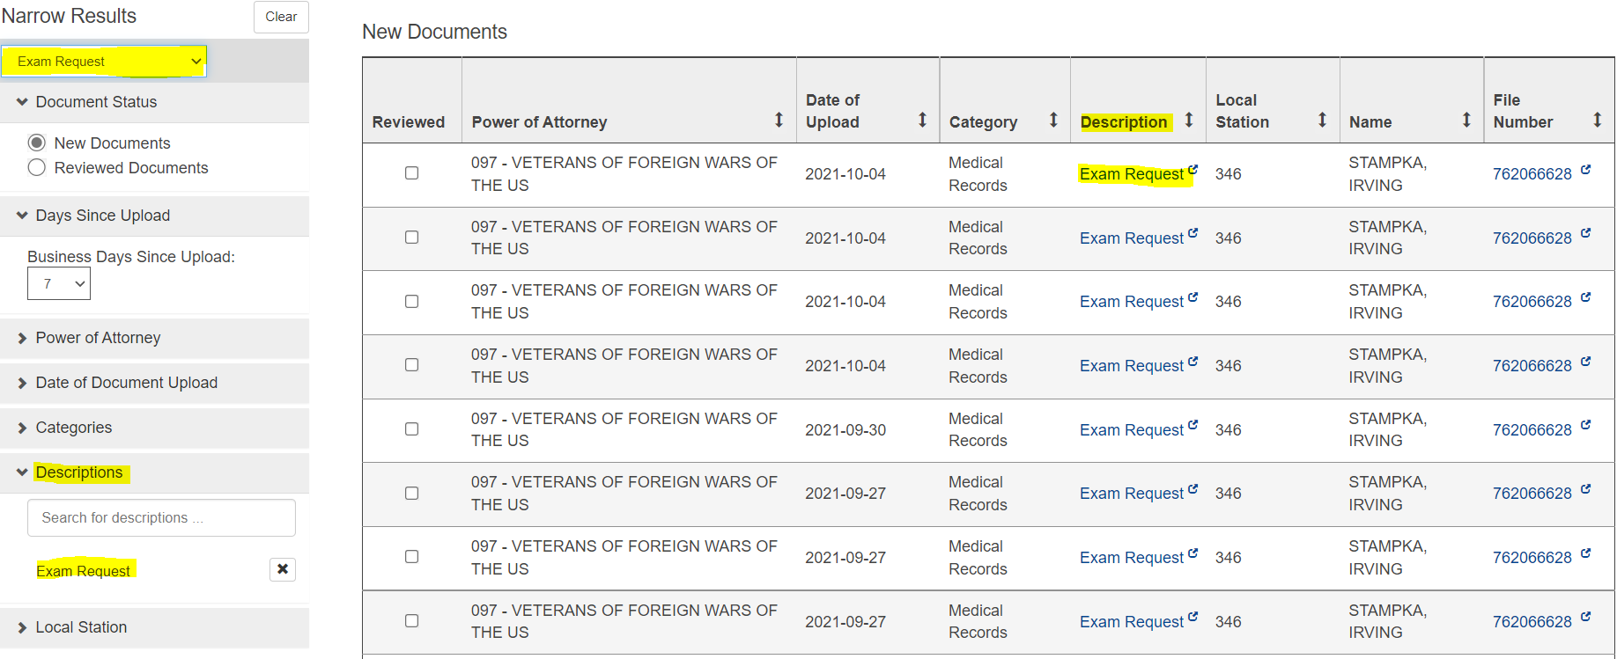
How does it work?
Step 5
Once your filters have been updated, your queue will now reflect only notifications that meet your perimeters.

Slide 14
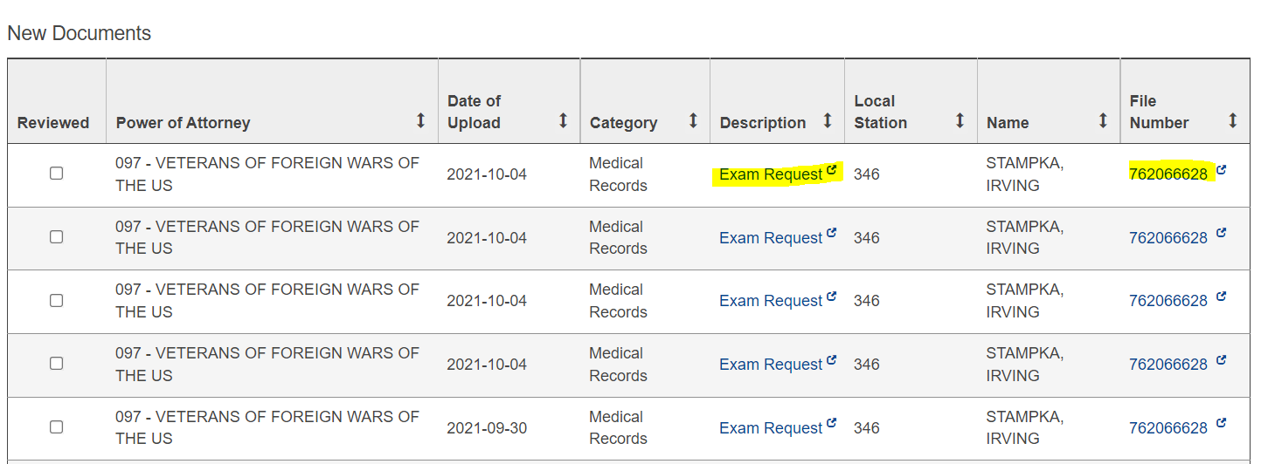
How does it work?
Step 6
With your updated work queue now in place you can review your filtered notifications.
Special Note* Clicking on the description item opens that specific item.
Special Note* Clicking on the file number opens the veterans claim folder

Slide 15
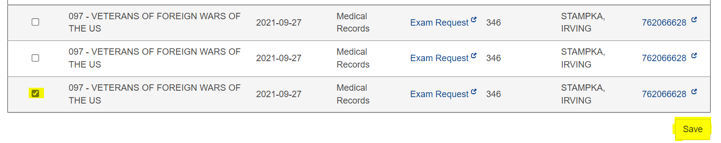
How does it work?
Step 7
Once you have viewed the notification you can clear it. To remove the notification, click on the “Reviewed” box next to the notification you reviewed and click save.

Slide 16
QUESTIONS?

Slide 17
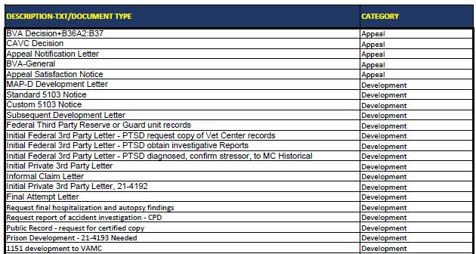
All Description/ Document types and Categories

Slide 18
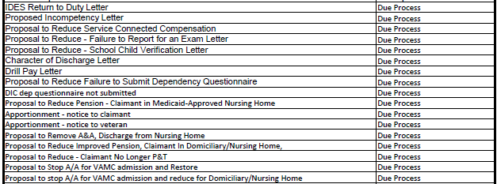
All Description/ Document types and Categories

Slide 19
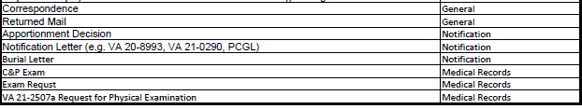
All Description/ Document types and Categories

