Slide 1
CONDUCTING AN INTERVIEW

Slide 2
OBJECTIVE
In this class, we are going to discuss how to prepare for and conduct an interview.

Slide 3
PURPOSE
Interviews provide both the veteran and the service officer with the necessary information needed to determine what is needed and manage future expectations.
Notes:
Veterans may not know what they need until they talk to a representative: Appeal, Initial Claim, DIC, Health Care enrollment etc

Slide 4
TYPES OF INTERVIEWS
What are some types of interviews?
What is the most common interview used by VFW representatives?
Notes:
Types of interviews:
Job Interview, Journalistic/Talk show, Police questioning, Medical appointments
Intake interview is the most common.

Slide 5
PREPARATION
What are items a representative should have ready for the intake interview?
What should the representative do prior to arrival of a veteran?
Notes:
Possible items – Forms, references, contact numbers for agencies to get additional evidence or financials, etc
Prior to arrival – Log into needed systems and ensure connectivity, Familiarize yourself with claim and veteran details, Protect PII
Update VetraSpec with any 21-22 info or other updates

Slide 6
PREPARATION
How do you set up your veteran for success?
  Did you let them know what to bring?
  Do you have a checklist you send?
How were they referred to your office?
  What might this tell you if they were referred by the Vet Center?
What should you make sure the veteran understands before the initial interview?
  What is your security like in your building…what about parking?
Notes:
What items to bring – DD214, Wedding/Divorce certificates, Dependent SSNs etc
Referral – How they were referred will also indicate what the veteran needs, whether it be via friends, Vet Center, Shelter or other sources
Set expectations before meeting with the veteran, Security requirements

Slide 7
ENVIRONMENT – Your Attire
Dress properly
- What is your office dress code?
- Shirt Check…
- Wrinkles?
- Collared Shirt?
- Does it pass the smell fresh test?
Notes:
Turn display screen away from client if possible
Anticipate potential situations – bathroom, food, exits

Slide 8

ENVIRONMENT - PII
Ensure that your office is free of clutter, no personal identifying information (PII) is exposed
  That last veteran you assisted…is that info still on the screen or desk?
Notes:
Turn display screen away from client if possible
Anticipate potential situations – bathroom, food, exits

Slide 9
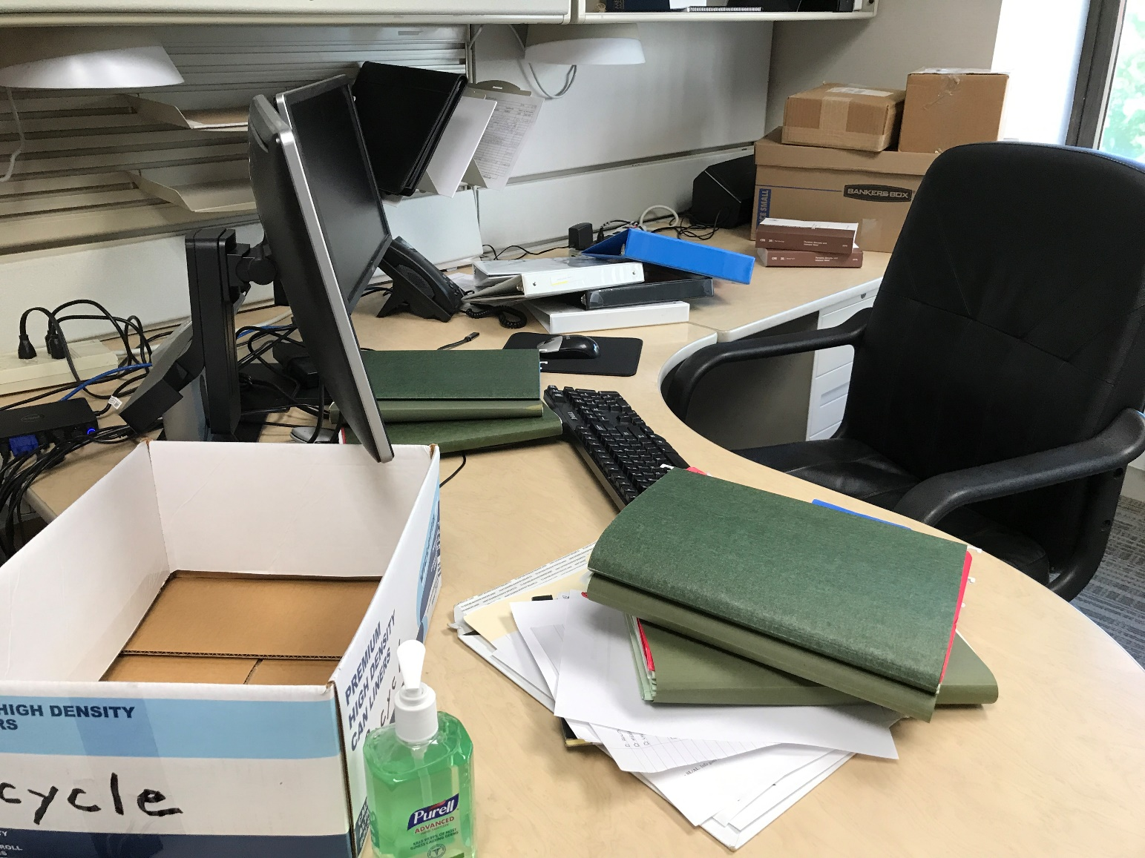
ENVIRONMENT – Office/Desk
Is this your desk?
  What do you see in the photo?
  Good/bad/improve?
  Is your client’s chair lower than yours?
Look at your space from the veteran’s point of view
Bring in a friend or family member to view your space
Notes:
Turn display screen away from client if possible
Anticipate potential situations – bathroom, food, exits

Slide 10
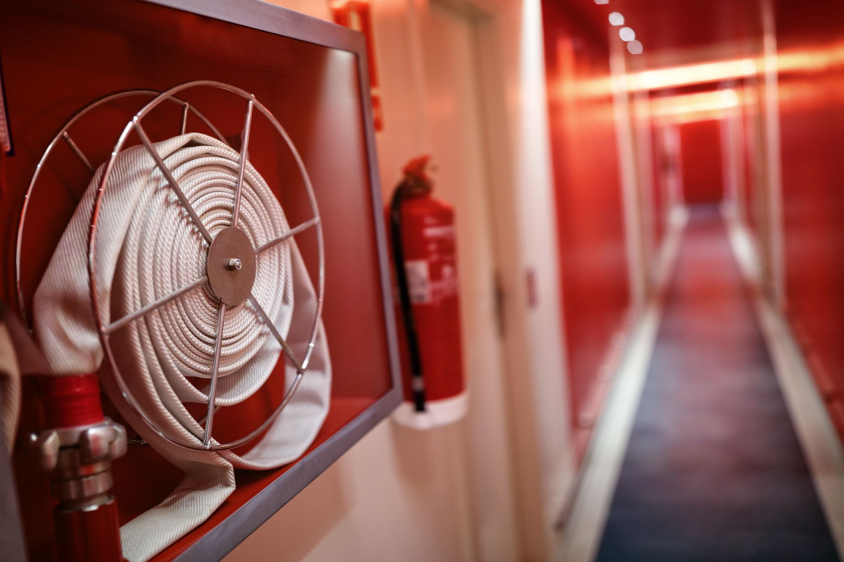

ENVIRONMENT – Bldg layout
Know layout of building, emergency protocols and restrooms
Notes:
Turn display screen away from client if possible
Anticipate potential situations – bathroom, food, exits

Slide 11
LIMIT DISRUPTIONS – Privacy
Do you use an “in meeting” sign?
Are disruptions frequent in your office when you have a client?
What do you do about incoming calls?
  What signal does it send to your veterans if you take a call during the interview?
Notes:
Note: hold all calls, veterans deserve all your attention
Do not have people walk in and out of your office while conducting interview. PRIVACY is critical when interviewing. You do not know what they have been through.

Slide 12
SET THE TONE
When setting the tone, consider:
Context of meeting
  Reductions, appeals…how pleasant are those?
Introduction/greeting
  Do you greet the veteran when they arrive?
  Get up from the desk and meet at the door if possible
Notes:
Survivors, reductions: this is not going to be as cheery of a visit. Pay attention to your body language – psyche yourself up for the interview. Veteran’s privacy is paramount - lead to interview space before discussing sensitive topics

Slide 13

INTRODUCTIONS
Introduce yourself to the veteran or claimant
  Handshake or Fist bump? (COVID-19)
  Please don’t shake someone’s fist bump
Provide a short intro of your background
  Allow the veteran or claimant to do the same
  Common ground helps build rapport
Ask the purpose of the visit
Not this
Notes:
If the claimant has brought another person in, explain the process and try to read if you need time with just the veteran.
Determine the issue(s) to be raised
Discuss what benefits are available

Slide 14
Representation
First form VA 21-22
  Are they represented by another VSO? Is there a legitimate reason to switch?
  Does it need to be updated? How old is the VA 21-22?
  What has been your experience with older VA 21-22s?
  What about those who want to switch?
Notes:
Note:
Stress importance of communication added in system.
If the veteran is represented by another agency, direct them to that agency unless they have a legitimate reason to switch representation.

Slide 15

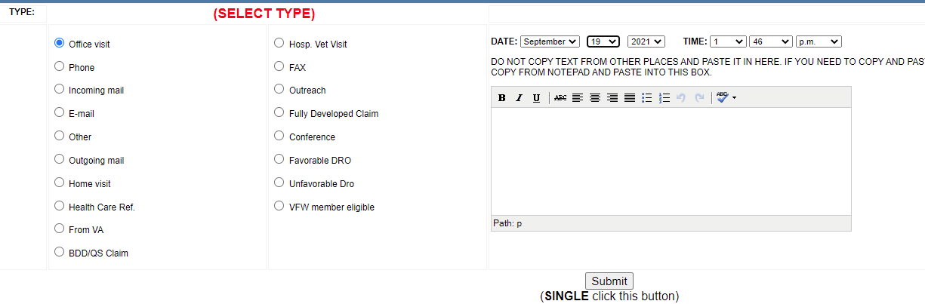
Vetraspec
Get the basic info into Vetraspec
  It will help populate forms
  Don’t forget the communications section.
    This will assist other service officers if you are out and they need to pick up the case or just answer some questions.
Notes:
Note:
Stress importance of communication added in system.
If the veteran is represented by another agency, direct them to that agency unless they have a legitimate reason to switch representation.

Slide 16
MAKE SURE YOU ARE UNDERSTOOD
“Do you understand the words that are coming out of my mouth?!”
Avoid jargon
  “Let me fire up old Jake the computer and see what’s in VBMS”
  “I see what you put in SEP, but it’s not cested yet”
  “Let me get this on a TPS report. The boss wants it on there”
Consider the client’s background, do not condescend
  “You filled out section II on the 674. Did you not read the instructions?”
  Think of VA forms like IRS forms. It’s just as foreign to the veteran
Notes:
Use proper language that will not be taken inappropriately. Avoid using slang words.
You are here to assist people. Respect every individual, do not talk down to people.

Slide 17
ACTIVE LISTENING – This is difficult
Active listening is defined as:
Clearly understanding, interpreting, and evaluating the message presented.
During an interview, use the following active listening steps:
Turn your focus to your customer/your client
Let the client talk
Listen carefully to what he/she is saying
Restate what you heard
Allow the client to correct or clarify the information
Notes:
Note: if necessary ask veteran to clarify point. This will inform person that active listening is occurring.

Slide 18
The question type can influence the level of detail received
TYPES OF QUESTIONS
Close-ended Vs
Require only short or single word answers
Are easy to answer
Provide factual information
Keep control of conversation
Open-ended
Allow for full paragraph answers
Require thought before responding
Provide information containing opinions and feelings
Give control of the conversation
Notes:
Note: learn to select which type of questions are to be asked depending on the topic, situation and time restriction.
*emphasize that types of questions are important for hearings too… will be taught later in week.
The type of person also dictates the type of question along with topic situation and time

Slide 19
TYPES OF QUESTIONS
Examples of when to use closed vs open
Notes:
Note: learn to select which type of questions are to be asked depending on the topic, situation and time restriction.
*emphasize that types of questions are important for hearings too… will be taught later in week.
The type of person also dictates the type of question along with topic situation and time

Slide 20
IDENTIFY POTENTIAL ELIGIBILITY TO BENEFITS
Provide context to questions
Instead of “Are you married? Do you have children?”
Explain: “Sometimes there are VA benefits available for veterans who have dependents – do you have a spouse or children?”
Listen to conversational cues
“I see you are retiring from the military in 4 months. Are you staying in the area?”
“Yes, in fact we are looking at purchasing a new home - we’re looking to downsize since our kids are all off to college now”
Notes:
Repeated questions without context can seem like you are interrogating
Conversational cues clue you in to needs not previously mentioned – VA home loan guaranty, DEA/dependency

Slide 21
FLOW OF THE INTERVIEW
Records review
  What was identified by representative
  Additional items of concern to the veteran
  Is there anything that is bothering you today that you feel started in the military or was caused by your service?
  Having a standard order helps avoid confusion during the review
What is your order; your rhythm?
Notes:
Would not start with mental health, but may not want to save for the end so you’re not pressed on time.

Slide 22
COMMUNICATING
WITH THIRD PARTIES
Remember the claim is the client’s
If a family member is accompanying the client, set expectations of privacy, when they will leave and re-enter
If the family member is also a veteran, set a separate appointment to work on their claim
Ensure a VA form 21-0845 is signed by client if claim information is to be disclosed to a third party, including Post Service Officers
If the veteran/client tells you information should not be divulged to a spouse or other family member, put a note in their VetraSpec file, and never assume
Notes:
Don’t be late. Respect people’s time. If another appointment will run into someone else’s time schedule current appointment for a follow up or at least go inform your client waiting of your delay.
Keep conversations on topic.
Address people with proper respect. Treat people as you would like to be treated.
Don’t lie, only provide factual information. You are not expected to know every regulation, but you should know how to gather the correct information (network).

Slide 23
HANDLING COMMON COMMUNICATION SITUATIONS
How might you handle these situations?
Client becomes tearful
Client will not listen, persists on same topic
Client frequently gets off-topic
You do not know how to handle the client’s issue
Notes:
Provide tissues, offer a break/water/coffee, acknowledge painful feelings, take some time to print some documents etc. that do not involve client input
Do not lead people to believe they are entitled to benefits that you are positive they do not qualify for, but if they insist, file as long as claim is not fraudulent. Ask if there is anything else you can assist with.
Thank them for the detail, remind them that you do need to get through some more paperwork – if they are describing a personal story such as stressors, do not interrupt. Wait for a break and empathize. Let them know they will likely need to discuss this in the C&P exam – offer referral to GWOT/MST coordinator/VA health care if they are in the building.
Let them know you’ll need some time to research the issue, ask your supervisor or others for assistance or where to refer.

Slide 24
HANDLING CRITICISM
Agree with the truth/the odds but disagree with the criticism
“Yes, it will delay your claim but VA is not trying to make you wait on purpose. A new examination will allow you to present new evidence and better support your claim.”
Set boundaries of what you will and won’t accept
Broken record – restate what you can and can’t do
Call a time out - reschedule
Ask for assistance
Notes:
Ask for assistance from supervisor/NVS – we first refer complaints to DSO.

Slide 25
STRONG EMOTIONS:
ALWAYS REMAIN PROFESSIONAL
Sometimes veterans come in with “baggage”
At no time do you ever argue with a client. If the client refuses to calm down, kindly ask them to leave or if a phone call, let them know you will need to end the call.
What do you do if you cannot de-escalate?
What can your office do?
Inform the veteran that we reserve the right to revoke our representation if necessary

Slide 26
ENDING THE INTERVIEW
AND FOLLOWING UP
Summarize what was done
Give the client a typed list of any “homework”
Suggest a deadline, and how they should submit it (fax, follow up appointment, Email, or submit directly to VA?)
Explain the next step in the process and when to follow up
  Manage expectations
  Stress timelines
Notes:
Always suggest the client follow up with you, they have the most at stake

Slide 27
ENDING THE INTERVIEW
AND FOLLOWING UP
Give them your preferred office contact information
Thank them for their visit/call, and walk them to the lobby
“Oh one other thing…” –if you do not have enough time set aside to address the new issue, triage and set up a new appointment, whether it is later that day or another day
Add a communication in VetraSpec after every meeting with a brief summary of what took place
Notes:
Non-verbal body language to let them know interview is over – stand up, raise/lower pitch of voice, give office contact information

Slide 28
If you have any questions regarding this topic, please email them to the DSO Helpdesk at DSOHelpdesk@vfw.org.
When sending a question, please title your email as: Virtual Basic Training Question

