Slide 1
How to Use Title 38 CFR

Slide 2
HOW TO USE TITLE 38 CFR
What is the CFR?
Why Learn the CFR?
How is the CFR Organized?
Browsing the CFR and eCFR
What is in the CFR?
What is the Rating Schedule?
How to Read a Diagnostic Code
Searching the eCFR
How to Obtain a CFR

Slide 3
WHAT IS THE CFR?
“Titles” of the CFR are issued for each Government Agency
Title 38 governs all VA benefits
  Books are updated once per year
  If there are any changes between printings, the changes will be printed in the Federal Register (www.federalregister.gov) and eCFR (www.ecfr.gov)
  Title 10 governs DoD Benefits
      Active duty benefits, military retired pay, commissary

Slide 4
WHY LEARN THE CFR?
38 CFR:
Is the basis of all VA decisions
Helps you understand eligibility for benefits
Helps you be an informed advocate: back up your arguments

Slide 5
HOW IS THE CFR ORGANIZED?
The CFR is divided into “Parts”
A part is like a chapter of a book
It describes a particular area of benefits
Title 38 has Parts 0 through 200
Not all parts are currently used – some have been “reserved” for future use

Slide 6
HOW IS THE CFR ORGANIZED?
Most Commonly Used Parts of Title 38 CFR:
Part 3: Adjudication/Eligibility
Part 4: Rating Schedule
Part 14: Accreditation
Part 17: Health Care
Part 19: Appeals
Part 20: Appeals

Slide 7
THE eCFR
Where to find the eCFR:
http://www.ecfr.gov
Updated frequently (paper CFR is only updated once a year, typically in July)
Search feature

Slide 8
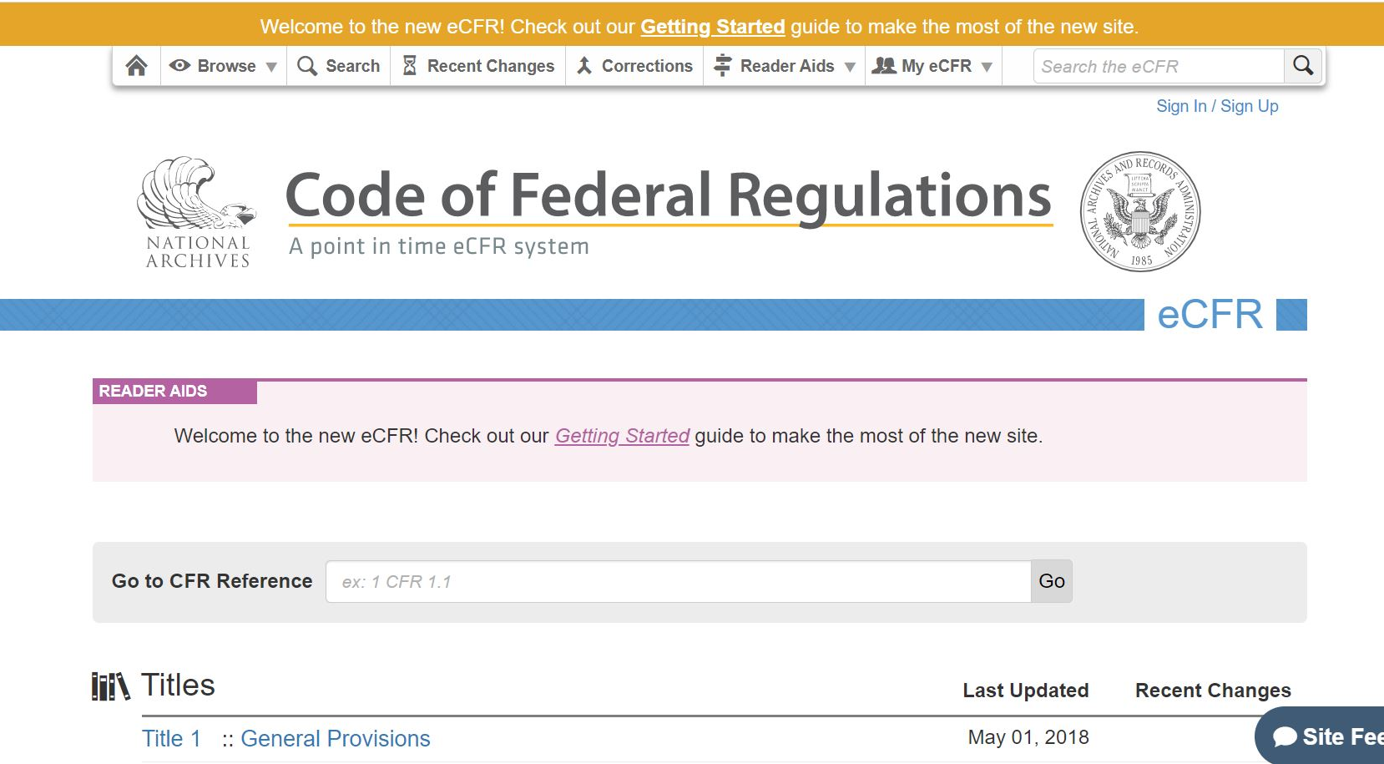
USING THE eCFR
When you visit the eCFR you will be taken to this homepage
You can search for a direct reference here using the citation or a keyword
If you do not know the citation number, you can browse the CFR by clicking the title (Title 38)
Notes:
Browse is best when you don’t know exactly what you are looking for, or viewing a large section like Part 4 at the same time.

Slide 9
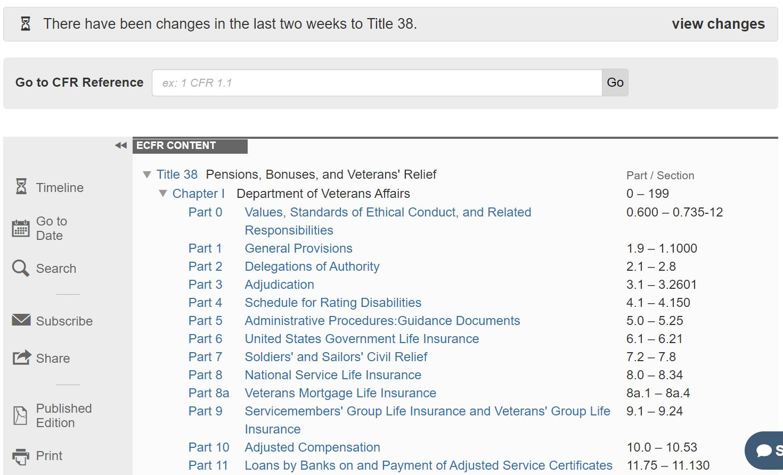
USING THE eCFR
After you select Title 38, select which part of the CFR you want to browse
Parts 0-17 contain the most commonly searched benefits – compensation, pension, survivor benefits, health care
Parts 18-199 include appeals, education benefits, loan guaranty, cemeteries, and special programs

Slide 10
BROWSING THE CFR
Tips for Browsing the CFR
  Become familiar with what you will find in each Part
  In the GPO version and the eCFR, at the beginning of each Part is a list of all the Subparts, which helps organize the Part
  Let’s look at the beginning of Part 20.
  In which Subpart will you find information about legal holidays?
Notes:
Subpart B – 20.111 Legal Holidays

Slide 11
SEARCHING THE eCFR
Tips for Searching the eCFR
  Use the “Search” feature if you know a keyword you are looking for
  Try to use more uncommon keywords: “unemployability” versus “compensation”

Slide 12
HOW IS THE CFR ORGANIZED?
Each Part is further divided into Sections
A period or decimal point is used to separate Part and Section
Sections are found in numerical order
Example:
38 CFR 3.304 comes after 38 CFR 3.57

Slide 13
HOW IS THE CFR ORGANIZED?
§ is a symbol that means section when referencing legal code such as (38 CFR § 3.1)
When you hear someone refer to a section of the CFR, you will typically hear them cite the Title, Part, Point, and Section.
For example, what is the subject of “Thirty-Eight CFR Three Point One-Five-Five”?
If you say, “Thirty-Eight CFR Three Point One Hundred Fifty-Five”, you will still be understood
Notes:
38 CFR 3.155 (How to file a claim)

Slide 14
QUICK TIP # 1
Instead of looking at the entire number as a whole, look at the digits before and after the decimal point as two separate numbers.
Example: 3.957
Part Section

Slide 15
QUICK TIP # 2
Do NOT reference the CFR by page numbers

Slide 16
HOW IS THE CFR ORGANIZED?
Sections may be divided into subparagraphs
Works like an outline you may have used in school
For every “A”, there is a “B”, for every “i” there is a “ii”

Slide 17
HOW IS THE CFR ORGANIZED?
Example: 38 CFR §3.1(n)(2)
First Find 3.1
Then
Find Paragraph (n)
Then
Find Subsection (2)
  What is VA’s stance when it comes to willful misconduct and police regulations?
Notes:
Mere technical violation of police regulations or ordinances will not per se constitute willful misconduct.

Slide 18
WHAT IS IN THE CFR?
Definitions
Definitions of the same term may be different for different benefits
Example: Definition of a veteran?
Compare: 38 CFR 3.1(d)(1) versus 38 CFR 3.1(d)(2)
Notes:
38 CFR 3.1(d)(1) – DIC definition
38 CFR 3.1(d)(2) – Death pension definition – must have had 2 years service

Slide 19
WHAT IS IN THE CFR?
May vs Shall
The difference between may & shall is extremely important
May = expresses a possibility
Shall = expresses an instruction
38 CFR §3.151: A claim by a veteran for compensation may be considered to be a claim for pension; and a claim by a veteran for pension may be considered to be a claim for compensation.
38 CFR §4.68: The combined rating for disabilities of an extremity shall not exceed the rating for the amputation at the elective level, were amputation to be performed. For example, the combined evaluations for disabilities below the knee shall not exceed the 40 percent evaluation

Slide 20
WHAT IS IN THE CFR?
Other important terms:
And/Or/Not/Except
Not limited to/Such as
Before/After/Not later than/Not before
Earlier/Later
Notes:
Especially important in Part 4 (describe diabetes regulation 7913)

Slide 21
WHAT IS IN THE CFR?
Cross-References
  Sometimes you will start reading one section and need to refer to another section for the full definition or eligibility criteria
  Look up 38 CFR 3.52(a) – Which regulation does it direct you to reference?
Notes:
38 CFR 3.52(a) – Marriage is valid if a child was born
38 CFR 3.54(d) – definition of a child born

Slide 22
WHAT IS IN THE CFR?
Footnotes
  There are footnotes in many sections of the CFR but most are found in the VA Schedule for Rating Disabilities, Part 4, Subpart B (called the “rating schedule” or “VASRD”)
  Look at 38 CFR §4.97 – What does the Note state under sinusitis?
Notes:
Note 1: An incapacitating episode is a period during which bed rest and treatment by a physician are required.

Slide 23
WHAT IS THE RATING SCHEDULE?
  The Rating Schedule contains information on how to determine disability ratings and listings of rateable disabilities
  The Rating Schedule is divided into “diagnostic codes” that are used to evaluate the severity of a veteran's disability
  Pay close attention – notes may be placed before or after the diagnostic code

Slide 24
HOW TO READ A DIAGNOSTIC CODE
  Look up 38 CFR §4.119 DC 7913
  Notice the percentages read from highest to lowest
  It helps to start at the bottom and work up
  Pay attention to the and(s), or(s), and Notes
  What is the correct rating if a veteran’s diabetes is manageable by restricted diet only?
Notes:
4.119 DC 7913 – Diabetes mellitus 10%

Slide 25
QUICK TIP #3
Don’t try to memorize the CFR!

Slide 26
HOW TO OBTAIN A CFR
Where to find the Paper CFR:
  Order 38 CFR through Government Publishing Office (GPO)
  Order “LEXIS-NEXIS Veterans Laws, Rules & Regulations”
  Older pdf versions are available at gpo.gov

Slide 27
Final Thoughts
The CFR is the most important reference that you will use to help veterans
Always make sure that you are using the correct version whether that be the most current or an older version
Never guess a regulation… always look it up if you are not 100% sure of the law

