Slide 1
Foreign Claims
Liz Salvador
Regional Quality Assurance Specialist -East
Lsalvador@vfw.org
Elizabeth.Salvador@va.gov

Slide 2
Objectives
What is a Foreign Claim?
Regional Office Jurisdictions
Preparing the Claim
C&P Exams
Foreign Medical Program
Scenarios
Questions?????

Slide 3
The purpose of this class is to discuss how VA processes claims for veterans and claimants living overseas and how you can assist them.

Slide 4
What is a foreign claim?
VA flashes a claim as foreign if the veteran or claimant’s address shows they are living or traveling overseas at the time the claim is filed.
Veterans remain entitled to the benefits and services they earned through their military service no matter where they live or travel.
Most VA benefits are payable regardless of the veteran’s or claimant's place of residence or nationality.

Slide 5
Regional Office Jurisdictions for Service-Connected Claims
Manilla RO:
Philippines
Honolulu RO:
Northern Mariana Islands
Guam
American Samoa
San Juan RO:
U.S Virgin Islands
Puerto Rico
Pittsburgh RO:
All other countries

Slide 6
Regional Office Jurisdictions for Service-Connected Claims
Special Missions of a Regional Office who already has jurisdiction over a claim:
Pittsburgh RO: Any foreign clams containing C-123 aircraft, mustard gas, radiation and Camp Lejeune. All other special missions are developed by their respective RO.
Manilla & San Juan RO: Claims containing any special missions are developed by their respective RO
Reference: List of special mission Regional Offices

Slide 7
Regional Office Jurisdictions for Service-Connected Higher-Level Reviews
Quick refresh on a Higher-Level Review:
HLR’s consist of a de novo review of the issue(s) identified by the requester on a completed VA Form 20-0996.
The VA will not consider the previous decision when completing their review
VA must receive the completed HLR within one year of the notification letter for the decision that is in question.
Reference: Definition of Higher-Level Reviews
Notes:
De novo means: from the beginning

Slide 8
Regional Office Jurisdictions for Service-Connected Higher-Level Reviews
Higher Level Reviews are processed at Decision Review Operation Centers (DROC). The three DROCs are in:
Seattle, WA
St. Petersburg, FL
Washington, District of Columbia
Foreign claims that are normally assigned to the Pittsburgh VARO (based on the veteran’s location) are unofficially sent to Seattle DROC if they file an HLR.
If the HLR becomes a Supplemental, foreign claims are then sent back to their respective ROs for action
Reference: Locations of DROCs

Slide 9
Regional Office Jurisdictions at the Pension Management Center
This is a general reference for all Pension Management Center (PMC) claims regardless of location of veteran or claimant:
The Veterans Benefits Administration (VBA) consolidated claims involving service connection for cause of death, DIC and Burial to Philadelphia PMC. Remaining PMC workload is processed by Milwaukee and St. Paul PMC.
Reference: Purpose of Pension Management Centers
Change date: December 1, 2021

Slide 10
Regional Office Jurisdictions at the Pension Management Center
Service-connected death, DIC and burial claims are assigned to the Philadelphia Pension Management Center when the claimant resides in any foreign country including the Philippines
All remaining Pension Management Center claims (to include supplemental claims) are shared between Milwaukee and St. Paul PMCs except the Philippines; they are specifically assigned to Milwaukee PMC
Reference: Jurisdiction of claims

Slide 11
Preparing the Claim
The address on the claim form will be the address VA/National Work Queue(NWQ) uses to assign the claim and order exams.
Use the address where the claimant is physically located at on the claim. You can submit a 21-4138 to supply a mailing address if need be, HOWEVER, VA may not “see” it.
List the country code when putting the phone number
(049) 555-5555-555
Country Code
Notes:
Example: Veteran lives in Brazil but uses his parents address in Florida for his mail. Veteran files 21-526EZ on va.gov and uses the FL address. VA/NWQ will assign the claim as if he if physically living in FL and request exams there.

Slide 12
Preparing the Claim – Adding Dependents
Adding dependents remains the same, however, some dependents do not have a Social Security Number (SSN) if they were not born in the U.S. or never applied for an SSN. The claimant is still entitled to receive dependent pay regardless of the dependent’s citizenship.
On the VA Form 21-686c list the dependent as usual, then in box 25 list the reason of why dependent does not have an SSN.
If the veteran was married abroad or a dependent was born abroad, submit all marriage certificates, birth certificates, etc.
If the dependent is over 18 but under 23, make sure the dependent’s school is an U.S. accredited school. VA may require documentation from the school.

Slide 13
Exams Overseas
VA uses only one third-party contractor called Veteran Evaluation Services (VES) in some countries outside of the U.S.
VES will contact the veteran similarly to how a contractor contacts a veteran stateside.
Upload times for exams into VBMS may take longer than stateside exams.
VES reimburses the veteran for mileage at the stateside rate.
VA may approve an Acceptable Clinical Evidence (ACE) exam for the veteran.

Slide 14
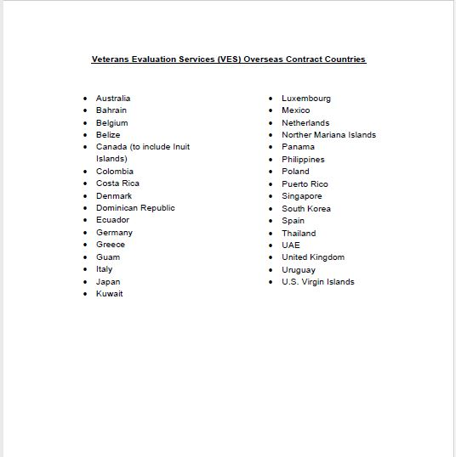
Veteran Evaluation Services Contract Countries

Slide 15
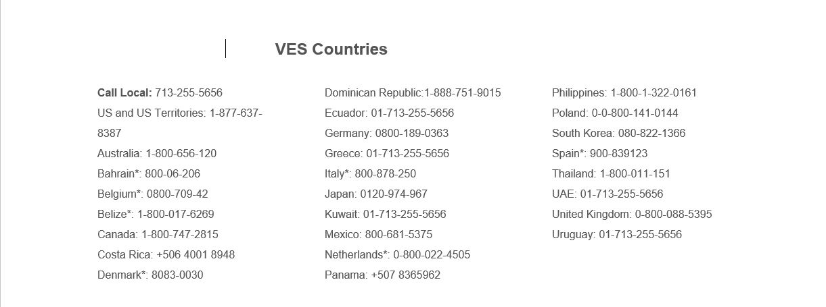
Veteran Evaluation Services Contract Country Numbers

Slide 16
Exams Overseas
If an exam cannot be ordered through Veteran Evaluation Services or tele-health, VA will request exams through the US Embassy or Consulate in the country that the veteran resides in.
VA will notify veteran by letter that they have 60 days to contact the US Embassy to schedule exams.
VA will also email the US Embassy and make them aware.
VA cannot force an Embassy or Consulate to conduct exams.

Slide 17
Exams Overseas
Common issues with US Embassy exams
Veteran does not receive the letter to contact the Embassy within the 60 days and VA denies claim for failure to report to exams.
Embassy does not have a doctor that is familiar with American medical terminology (TBI, DSM-V, hearing loss, etc) and refuses the exam.
The Embassy is too far from veteran (VA does not reimburse for travel to Embassy exam).
Embassy charges a lot of money for the exam. Veteran must pay this themselves. Veteran can file a claim with the Foreign Medical Program to be reimbursed if they are service connected for that condition.

Slide 18
Exams Overseas
The veteran also has the option to submit Disability Benefit Questionnaires (DBQs).
DBQ’s must be signed by a licensed medical provider who has a National Provider Identifier (NPI) number.
A NPI number is a unique 10-digit number issued to healthcare providers in the U.S. by the Centers for Medicare and Medicaid Services.
Notes:
VA doesn’t question NPI on medical statements. For example, veteran lives in Africa and his doctor doesn’t have an NPI number. Doctor can submit a statement/letter in lieu of DBQ for consideration.

Slide 19
Exams Overseas
If none of these exam options are available to the veteran, they will have to schedule the exam in another country or stateside at their own expense.
If the veteran needs to go to another country for an exam, submit a VA Form 21-4138 to VA with the address of where the exams need to be held and that the veteran is willing to report to an exam.
Notes:
For example, veteran lives in Sweden and exhausted all options for exams. Veteran has a brother in Germany and is visiting next month and can do exams while there. Submit a 4138 to VA stating this, give the dates and location where veteran will be staying. Also, give VA enough time to process.

Slide 20
Foreign Medical Program
The Foreign Medical Program (FMP) provides health care benefits to service-connected veterans who are residing or traveling abroad.
FMP will pay for or reimburse veterans for health care services, medications and medical equipment for service-connected conditions.
FMP DOES NOT PROVIDE MEDICAL SERVICES
VA may also authorize foreign medical services for any condition if the veteran is participating in Vocational Readiness & Employment (VR&E).
Veterans living in the Philippines can receive medical services at the Manila VA Outpatient Clinic.

Slide 21
Foreign Medical Program
The Veteran must complete the Foreign Medical Program (FMP) Registration form (VA Form 10-7959f-1) and submit it directly to FMP. Contact information is listed on the form.
Once FMP decides on eligibility, the veteran will receive an FMP authorization letter called an Explanation of Benefits (EOB) that identities the VA service-connected disabilities or VR&E status for authorized treatment.
VA automatically sends a foreign veterans’ codesheet to FMP regardless of FMP registration status.

Slide 22
Foreign Medical Program
Once authorized, veteran can submit a Claim Cover Sheet (VA Form 10-7959f-2) along with any invoices and/or receipts to the Foreign Medical Program.
Veteran has 2 years from date of services or discharge to file with FMP.
FMP payments are written on U.S. Treasury checks and are issued in U.S. currency. Payment is based on the exchange rate applicable on the date of service provided, or in the case of hospitalization, the discharge date.
For more information, please visit VA's Community Care website

Slide 23
Foreign Medical Program
Veterans living in Canada are under the jurisdiction of FMP. However, inquiries and claims are submitted through the Foreign Countries Operations in Canada.
Mail or fax to:
Foreign Countries Operations (FCO)
2323 Riverside Dr., 2nd Floor Ottawa, Ontario Canada, K1A 0P5
Toll-free: 1-888-996-2242 Fax: 1-613-991-0305

Slide 24
Foreign Medical Program
If the veteran disagrees with a decision concerning covered services or calculation of benefits, a reconsideration or appeal may be requested
Requests must be submitted in writing to:
VHA Office of Community Care Reconsiderations/Appeals
P.O. Box 460948 Denver, CO 80246-0948
There is no standard form for FMP reconsiderations or appeals. If the veteran appeals, a Statement of the Case will be sent to the veteran and a Form 9 must be submitted to continue the appeal at the BVA.
No FMP documents are kept in VBMS
Notes:
Fun fact. There are only 2 forms used at the FMP. The registration form and the claims coversheet

Slide 25
Foreign Medical Program
Requests for reconsideration or appeal must:
• Be submitted within one year of the date of the decision or Explanation of Benefits (EOB)
• State why it is believed the decision is in error
• Include any new and relevant information not previously considered

Slide 26
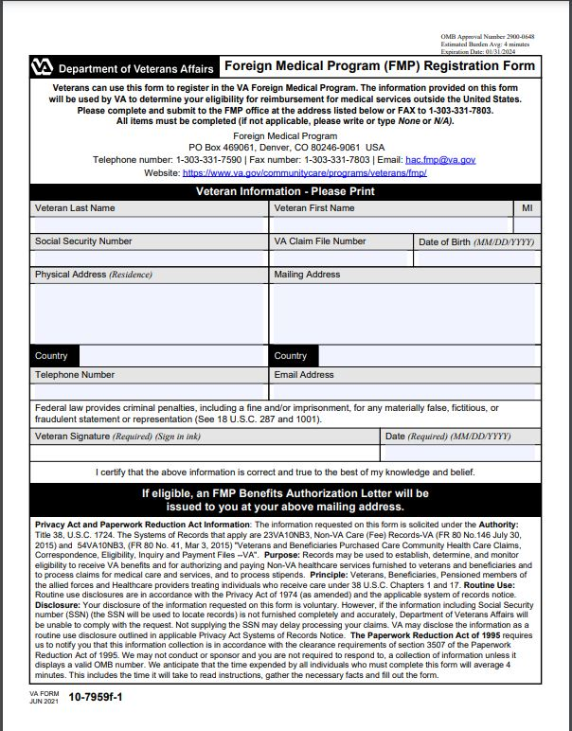
Foreign Medical Program VA Form 10-7959f-1

Slide 27
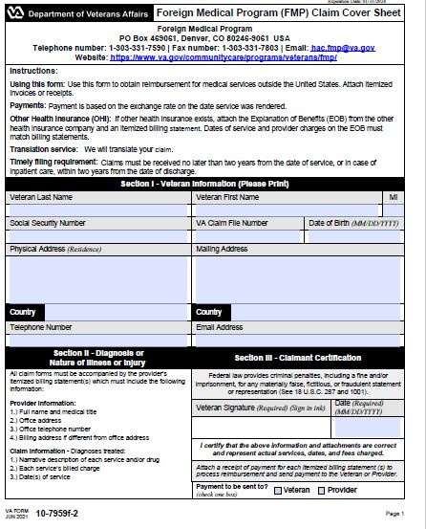
Foreign Medical Program VA Form 10-7959f-1

Slide 28
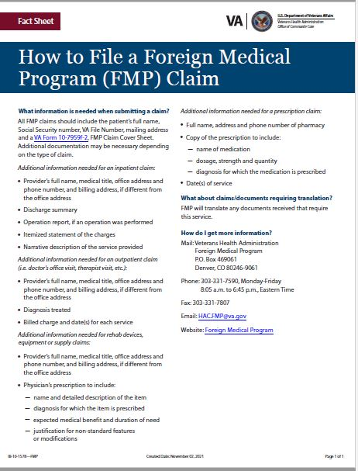
Fact Sheet

Slide 29
Questions?????

Slide 30
Scenarios

Slide 31
Scenario 1
Veteran living in Italy contacts you for assistance with a claim she filed over a year ago. She hasn’t heard anything. Upon checking VBMS, you notice the claim was denied 5 months ago because she didn’t attend exams. What steps should you take next?
Notes:
Confirm physical address, confirm phone number, supplemental claim with 4138 that veteran is willing to report to exam.

Slide 32
Scenario 2
Veteran living in Canada contacts you and says that Veteran Evaluation Services (VES) wants him to travel 100 miles to be examined for his claim. Veteran has Parkinson’s Disease and can’t travel that far. Assuming we already have a 21-22 on file with VA, what should you do next?
Notes:
Confirm physical address and phone number, give veteran VES phone number in Canada and have him ask if there is another provider closer to veteran, DBQ, VES reimburses.

