Slide 1


Slide 2
How to Prepare and Present a Benefits Brief
Daniel Fletcher
Special Assistant,
Training & Quality Assurance
DFletcher@vfw.org

Slide 3



Functions Check
Before we get started, let’s perform a functions check to ensure everyone can participate and follow along.
Ensure that you’re in a quiet space in your home or office
Ensure that your computer is charged and/or plugged in.
Next, please keep your microphone on mute unless you are speaking. To mute or unmute your microphone, click on the microphone icon in the lower, left corner of the screen. Click on the icon to mute or unmute
You can start or stop your video at any time by clicking on the video icon in the lower, left corner of the screen. Click on the icon to start or stop.

Slide 4


Functions Check
If you’re having trouble hearing the presentation, first ensure that your volume is on and turned up. Then, if using headphones, check the settings by using the arrow next to the microphone icon to ensure that you’re using the correct settings for headphones.
To use the chat feature, click on the chat icon at the bottom, middle of the screen.
You can choose to chat with everyone or a specific person by using the arrow.

Slide 5


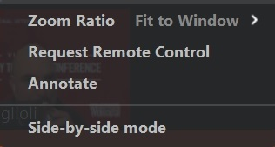

Functions Check
You can give a virtual thumbs up or clap by using the reactions icon. Click on the icon then choose a reaction the reaction will
display on your screen for a few seconds and go away on its own.
Annotate (arrow) - Top, middle. Choose View Options and Annotate.
Then choose Arrow -
**Please only use these features when instructed to do so.

Slide 6
Functions Check
If you have a QUESTION during the presentation, please enter a question mark (?) into the chat box and the presenter or facilitator will call on you to address your question.
PLEASE WAIT UNTIL YOU ARE RECOGNIZED BEFORE UNMUTING YOUR MICROPHONE
If you’re having technical difficulties please contact Brad Hazell via private message in the chat box or at bhazell@vfw.org.
If you need a comfort break, please do so and return as soon as possible.
Please remember, these sessions will be recorded for future use.
Everything on the internet lasts forever!

Slide 7
Disclaimer
This is a consolidation of recommendations and lessons learned, designed to give you pointers and tips on how to prepare and present a benefits brief and coordinate outreach events.
This class is not all inclusive, a lot of what we will discuss should be applied to the situation and adapted to meet your requirements and obligations when preparing or presenting your own benefits brief or outreach event.

Slide 8
Objectives
The Basics
5 “Ws and an H”
Virtual Briefs
Public speaking tips
Outreach
Types of outreach
Social Media
Evaluating effectiveness of outreach
Resources
Notes:
When I was tasked with creating this class, I had to consider how to give a benefits brief, or any brief, make the information easily understood at multiple levels, and teach it to a large audience with a huge variance of experience in this topic. We all come from different backgrounds and have varied abilities. Some love public speaking, some hate it. Some have a little experience or can make it through, some are well qualified to create and teach this class. These are the basics.

Slide 9
Knowledge Check
What is your experience level with briefs, outreach, and public speaking?
Slightly experienced
Beginner
Intermediate
Expert
Notes:
A test already? Before we begin, let’s see what your experience level is. Please place an arrow in the colored box under the level that best describes your experience with briefs, public speaking, and outreach. (Allow some time for response)

Slide 10
What are your thoughts?
When preparing for a brief or outreach event, what are some of the questions you would ask to prepare?
Please use the chat feature to enter your answers.
Notes:
(Allow some time for response)

Slide 11
Basics of Any Brief
Who
What
When
Where
Why
How
Notes:
These are the most basic parts of any decision really. You can remove some of them based on the situation but in most cases, you can base almost any decision on the 5Ws and the H. I like check lists, you could generate a checklist and track progress based on this information.

Slide 12
Who
Whether you organize the event yourself, or if you’re invited to speak, you need to know your audience in order to provide relevant information.
Speak to event organizers to get an understanding of the target audience
Ask for suggested topics during sign up if possible
Poll the audience to gain information during the event
If there is a host or organizer, keep in touch
Bring backup if possible, things happen. If another Service Officer is available, bring them with you
Notes:
If invited to speak, you should have a good idea of what the topic is as well.
If organizing your own brief, collect this information from the intended audience prior to the brief if possible.
2 is one, 1 is none, bring back up if possible what if you lose your voice?
Inform or invite Dept Leadership

Slide 13
What
Knowing who you’ll be speaking to will help determine what you will speak about.
Tailor your brief to your audience, you don’t want to speak about BDD claims to Viet Nam vets, not relevant
Conduct research and provide the most current and relevant information.
Use official websites like VA.gov, not a lawyer’s website.
Study your material. Preparation will help to relieve anxiety
Anticipate questions, try to answer them in the brief
Notes:
Use reliable sources VA.gov instead of Lawyer websites
Don’t talk about BDD to Viet Nam Vets, not relevant
Try to think of questions that may be asked, Answer them in the brief if possible

Slide 14
When and Where
This is the most important step. Make sure you show up early and prepared.
Double check your calendar, make sure you’re available
Confirm with the organizer of the event
Confirm with venue if you’re the organizer
Arrive early, especially if you’ve never been there before
Conduct pre-checks on all media and equipment
Get a feel for the room

Slide 15
When and Where (cont.)
Practice at the actual location, if possible
Have a backup plan in case of global pandemics
Cancel only if necessary and as early as possible if unavoidable
If you’re the organizer, maintain a list of attendees and notify them ASAP if cancelling
If event is cancelled, utilize additional means to distribute information
Do they have Wi-Fi/proper equipment?

Slide 16

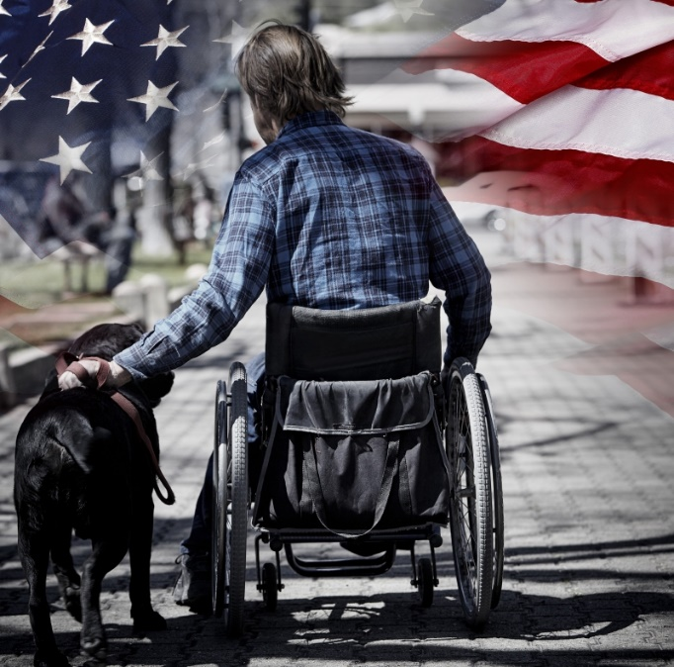

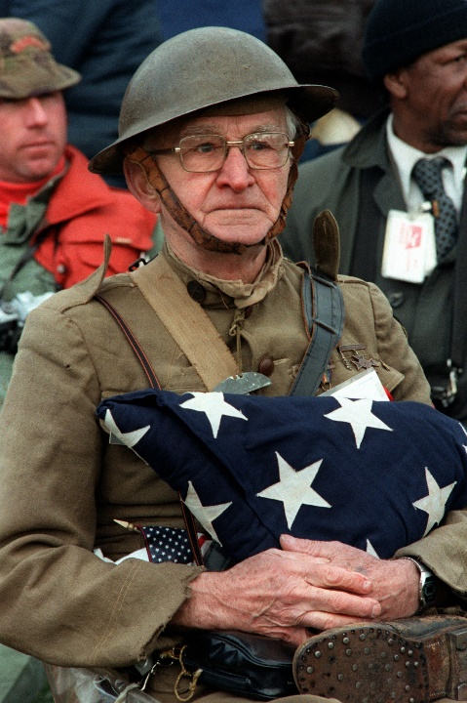

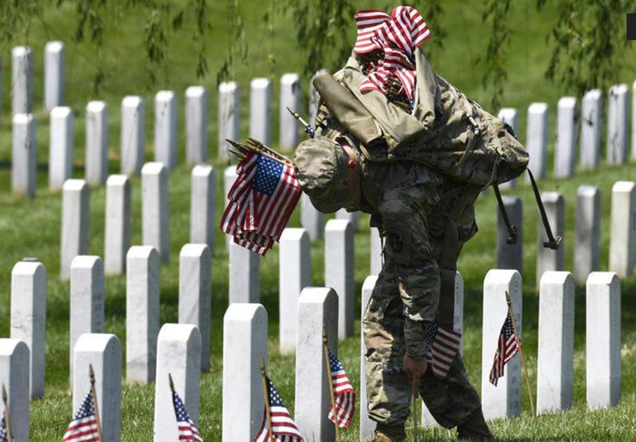
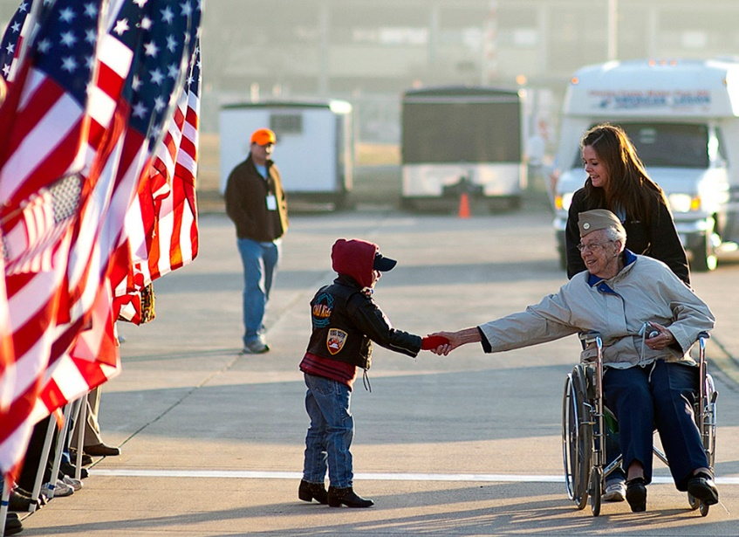
Why?
Why not? It’s what we do…

Slide 17
Why?
Depending on the situation, a benefits brief or outreach event could help with:
Providing info to those that need assistance
Getting info to those that weren’t aware of your services
Building your client base, recruiting/membership
After a good brief, people will want to work with you or refer people to you
“The effect you have on others is the most valuable currency there is.” –Jim Carey
Notes:
Like a good video/meme on the internet, if you like it, you share it.

Slide 18
How
How will you present your information?
PowerPoint/media
Handouts/Flyers
Business cards
The 5W’s will determine topics, how much time to spend on each topic, and the total time required
Pop up tents, VFW materials
Virtual Briefs
Notes:
Use the information from Who, What, When and Where to figure out how you will present etc.

Slide 19

Virtual Briefs
Commonly used in BDD offices
USO
Transition Assistance Program (TAP) briefs
Obviously, we’re attending one as well
Virtual instruction is much different than in-person classrooms
Platforms vary in ability and price
Virtual presentations usually involve more people if you’re the host
Facilitators are very helpful to assist with tech issues for the participants and answering questions
Notes:
Platform options to consider: Max number of participants, length of sessions, host controls and audience interactions

Slide 20
Virtual Briefs (cont.)
Dress the part. It’s easier to play the part if you’re dressed for it.
If your virtual platform allows background changes, keep it professional, best to choose an organized area in your home or office that’s not distracting and stay away from random pictures as backgrounds
Tailor your brief to a virtual classroom
Consider different ways to keep the audience involved
Ask them to take notes to keep their attention
“Pulse checks”

Slide 21
Consolidation
Once you’ve collected information and the 5 Ws, you can consolidate the information into a checklist or timeline to track progress and ensure that deadlines are met.
Ensure completion of tasks assigned to others
Reminders for confirmations, follow-ups, etc.
Don’t forget essential items- Laptop, scanner, signature pad, etc.
Dress to impress, but dress for the occasion
Wear VFW branded shirts, hats etc. (If possible)
Consider your audience, wearing a business suit to a brief with homeless veterans may make you seem unapproachable

Slide 22

Public Speaking
Is this thing on?
Notes:
Ask the audience to give a thumbs up on their screen if they can hear you…pulse check

Slide 23
Public Speaking
A few public speaking tips:
Many Americans are afraid or very afraid of public speaking
Mostly due to fear of being judged, don’t forget your power to share a message
Use metaphors, similes, and analogies
Ask rhetorical questions to keep the audience involved
Prepare!
Remember, no one wants to see you fail
If someone dislikes your presentation, that doesn’t mean they don’t like you.
Some veterans can get a little grumpy
Notes:
Fear of public speaking can be caused just by mentioning the act to some people. The best way to relieve anxiety is to prepare and practice. If you’ve prepared and practiced, there’s less fear involved because you’ve done all that you can to ensure success.
Even if they don’t like your presentation, that doesn’t mean they don’t like you. No one wants to see you fail.

Slide 24





Comfort Check
What is your comfort level with public speaking?
OH NO!
Moderate
Average
No problem
Notes:
Another test? Let’s see what your comfort level is. Please place an arrow in the colored box under the level that best describes your comfort level with briefs, public speaking, and outreach.

Slide 25
Public Speaking (cont.)
Virtual “public speaking” is very different:
It can be much more awkward when everyone is looking right at you from the chest up
Limits ability to use hand gestures or body language if that’s your style
It will be ok, just make sure you…
Prepare
For the presentation
For the virtual portion
Notes:
It’s like walking around the room with everyone staring at you the whole time or being a news anchor. It’s like a news show in a way, there are a lot of people involved behind the scenes but you’re the host. Find different ways to keep or draw attention to key points. Explain the system and how to use prior to the session and arrive early to ensure all functions are working properly.
Add reassurance that it will be ok, just prepare to…

Slide 26
What is Outreach?
Any time you interact with veterans outside the normal office environment.
Home visits
Hospital visits
Various other events
Before conducting outreach, ensure that you inform your Department Leadership.

Slide 27
Types of Outreach
What are some of your ideas that you can share to assist others with their outreach programs?
Enter a question mark (?) in the chat box to briefly share your ideas and experiences with outreach.
Notes:
Ask participants to enter at least one character in the chat box if they have suggestions, allow them to share with the class.

Slide 28
Types of Outreach
There are a number of ways to participate in or hold an outreach event. You just need to figure out where to find the veterans. Below are some common ideas
VFW Posts
Colleges
Sporting events, major or local
Community Events
Other VSO events
State and county fairs
VA hospitals
Job fairs
Social Media
Notes:
Where do veterans typically get together or hang out?

Slide 29
Social Media
Social media is more than a tool for connecting, sharing and learning. It also gives all of us the power to create, collaborate, solve problems and is one of the best ways to advertise our services.
Some of you may even manage a Facebook page or group designed to assist or get information to veterans.
Be very mindful of what you say when representing the VFW on social media.
*Do not identify people in social media posts or note they are working on a claim.*
Give facts not opinions

Slide 30
Social Media
Always Remember: VFW is one of the largest and most respected veterans’ organizations in the country. The VFW trusts us to serve as its representatives; we must always act appropriately.
Please ensure that all outreach events, media pitches, or editorial content are run through the appropriate Chain of Command before publishing.
In the age of social media our audience expects more transparency, more clarity, and a higher level of accountability.
As we’ve said at the beginning of each presentation, everything on the internet lasts forever.

Slide 31
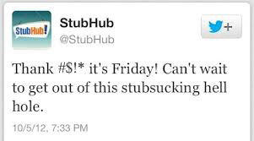
What DON’T We Want?

Slide 32
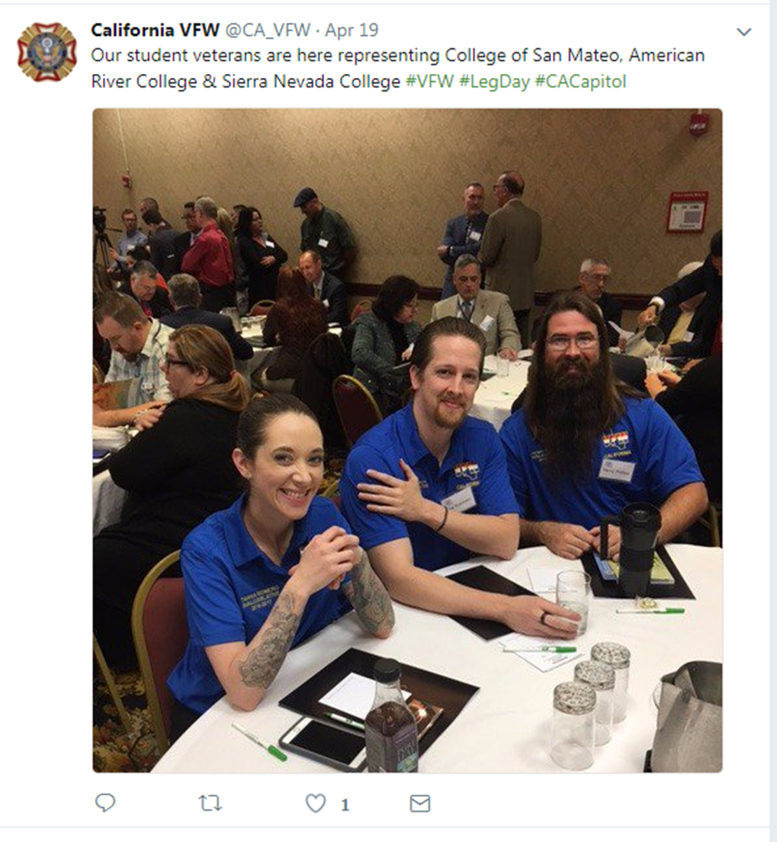
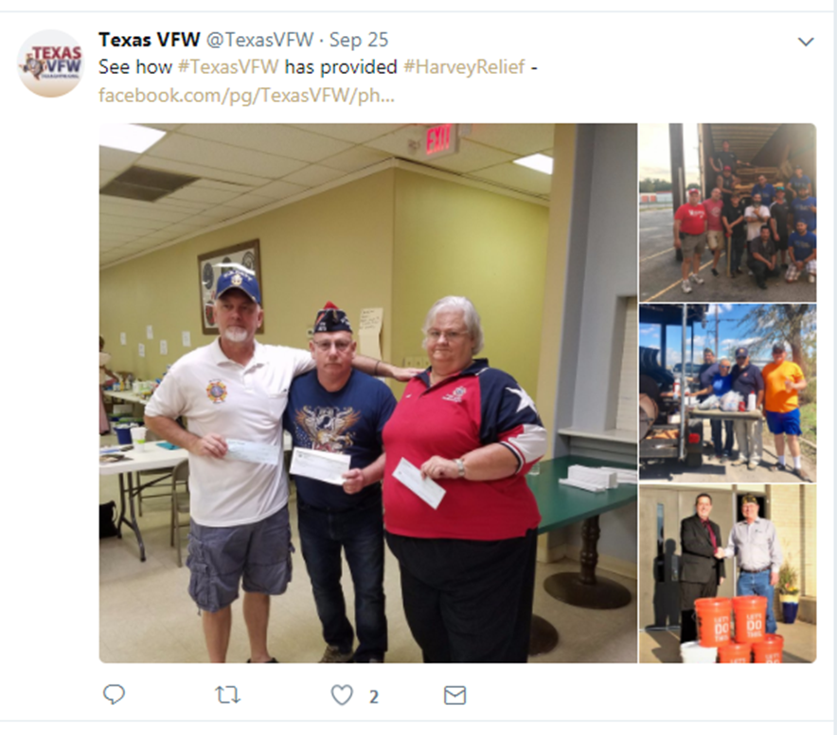
What We DO Want!

Slide 33
Evaluating Effectiveness
One way to evaluate effectiveness of your outreach is to determine if you’re receiving requests for assistance from the people you’ve briefed. Others ways to evaluate effectiveness may include:
Participant responses during and after the brief
Consider creating critique sheets for classroom type events
Ask them how they heard of your office and track answers so that you can see if your events are bringing business
Use all of this information to determine if you should continue events at that location or explore other options

Slide 34
Evaluating Effectiveness
What are some of the ways that you evaluate effectiveness of your outreach events?
Enter a question mark (?) in the chat box to briefly share your ideas and experiences with outreach.
Notes:
Ask participants to enter at least one character in the chat box if they have suggestions, allow them to share with the class.

Slide 35
Resources
A number of resources are available to help you with outreach events:
National Staff
Department Staff/Leadership
VFW Publications/Store (paid for by Dept.)
VARO Service Center Manager/Outreach Coordinator

Slide 36
QUESTIONS?

