Slide 1


Slide 2
Consulting Skills for Veteran Service Officers
Laura Bartus
June 2020

Slide 3



Functions Check
Before we get started, let’s perform a functions check to ensure everyone can participate and follow along.
Ensure that you’re in a quiet space in your home or office
Ensure that your computer is charged and/or plugged in.
Next, please keep your microphone on mute unless you are speaking. To mute or unmute your microphone, click on the microphone icon in the lower, left corner of the screen. Click on the icon to mute or unmute
You can start or stop your video at any time by clicking on the video icon in the lower, left corner of the screen. Click on the icon to start or stop.

Slide 4


Functions Check
If you’re having trouble hearing the presentation, first ensure that your volume is on and turned up. Then, if using headphones, check the settings by using the arrow next to the microphone icon to ensure that you’re using the correct settings for headphones.
To use the chat feature, click on the chat icon at the bottom, middle of the screen.
You can choose to chat with everyone or a specific person by using the arrow.

Slide 5


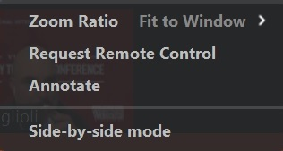

Functions Check
You can give a virtual thumbs up or clap by using the reactions icon. Click on the icon then choose a reaction the reaction will
display on your screen for a few seconds and go away on its own.
Annotate (arrow) - Top, middle. Choose View Options and Annotate.
Then choose Arrow -
**Please only use these features when instructed to do so.

Slide 6
Functions Check
If you have a QUESTION during the presentation, please enter a question mark (?) into the chat box and the presenter or facilitator will call on you to address your question.
PLEASE WAIT UNTIL YOU ARE RECOGNIZED BEFORE UNMUTING YOUR MICROPHONE
If you’re having technical difficulties please contact Chris Macinkowicz via private message in the chat box or at cmacinkowicz@vfw.org.
If you need a comfort break, please do so and return as soon as possible.
Please remember, these sessions will be recorded for future use.
Everything on the internet lasts forever!

Slide 7
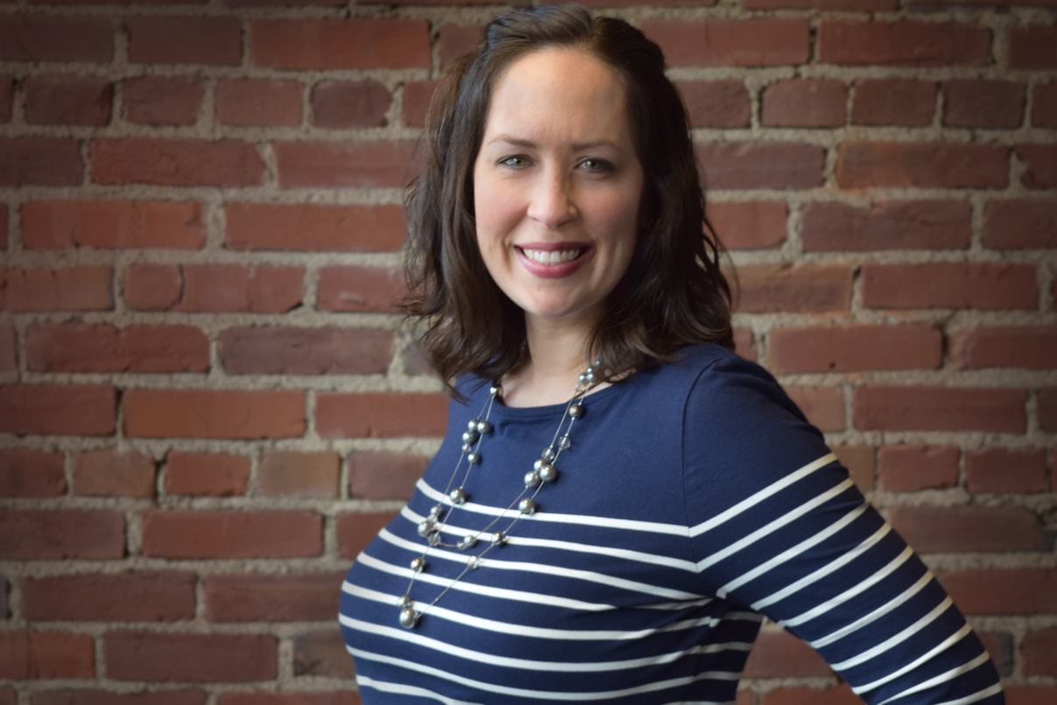
Presenter
Laura Bartus
Learning Systems Lead
At Humana
Former high school English teacher
My team trains Humana’s sales agents
I partner with Humana’s Veterans team

Slide 8

About Humana
Headquartered in Louisville, KY
46,000 employees
Number 52 on Fortune 500
Over 13 Million members
Founded in 1961 as a nursing home, purchased hospitals, branched out into health insurance
We focus mainly on Medicare Advantage and Prescription Drug Plans
Our name is indicative of our focus on Human Care (humane care)

Slide 9

Consulting Skills Agenda
Defining Consulting Skills
Relationship Management
Before your meeting
During the Meeting
Client Contract and Boundaries
Active Listening Skills / Establishing Trust
Needs Analysis
Interview Techniques
Interview Questions
After the Meeting
Notes:
This is the 300 level partner class to Workload Management, which you all took previously.

Slide 10
What is a Consultant?

Slide 11
Types of Consultants
Expert
Pair of Hands
Collaborative

Slide 12
Why Consulting Skills?

Slide 13
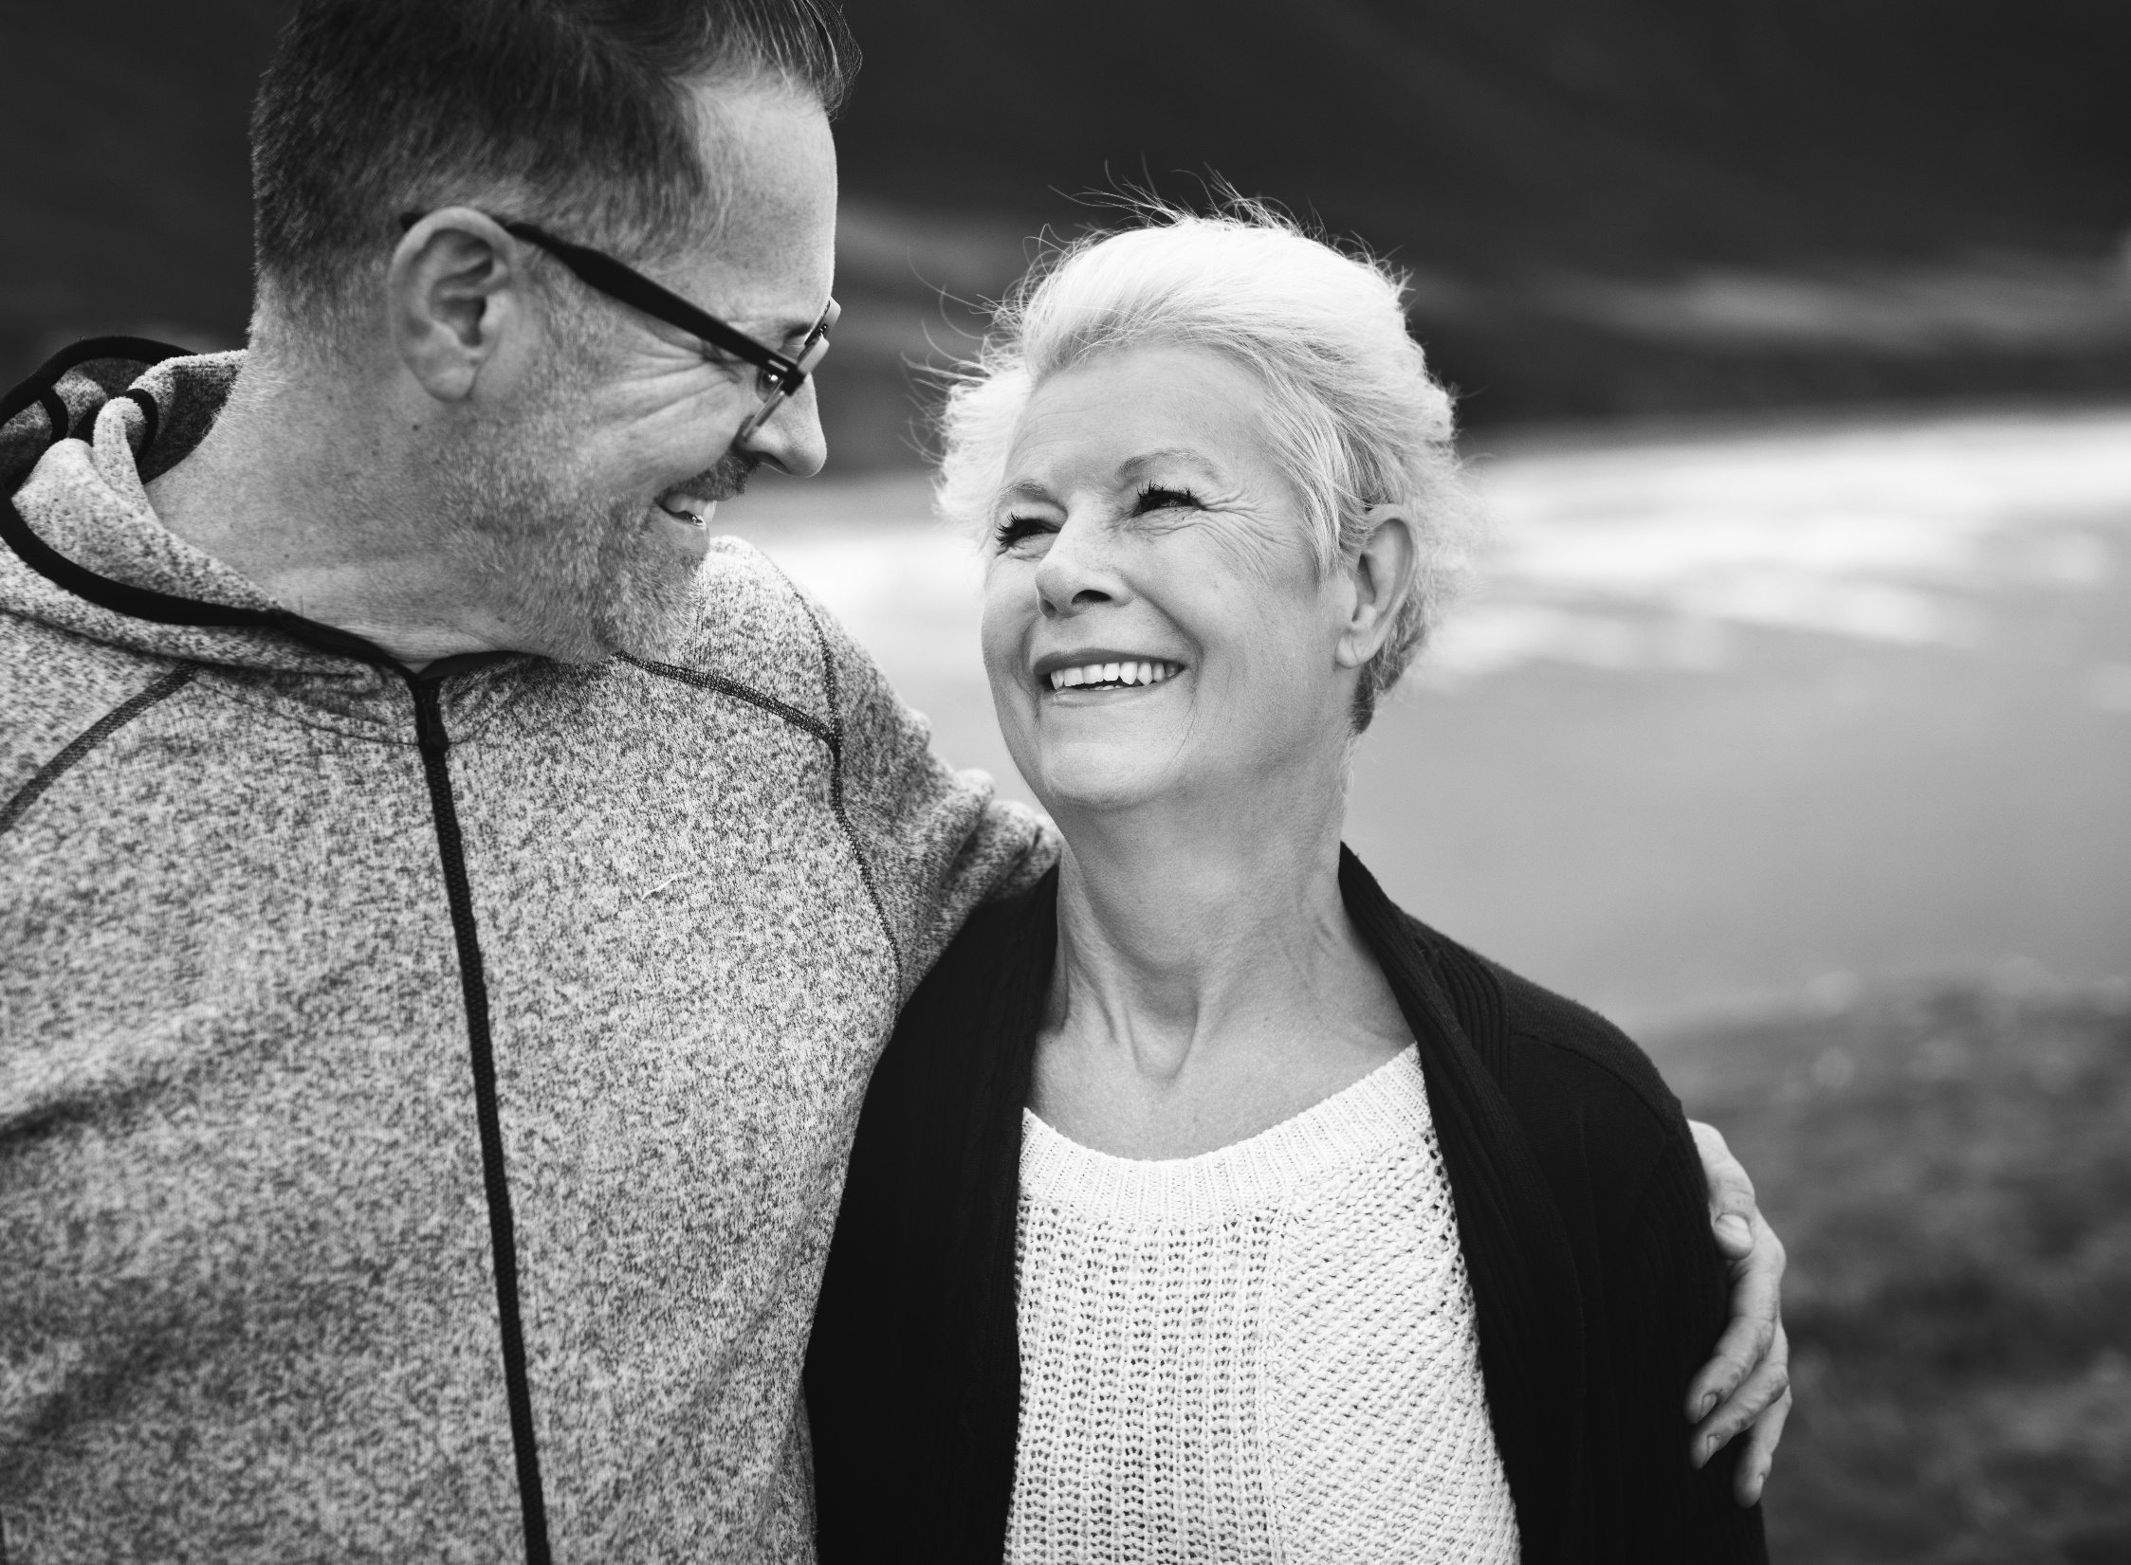
Put People First
Notes:
In your job, your role is to put people first and help them. This class is an in-depth look at how you can better serve the veterans who you encounter. Hopefully this will help you build a few more leadership skills to take back to your offices and teams, and give you a few insights into how to alleviate some of the concerns and fears your clients are facing.

Slide 14

Before the Meeting

Slide 15
A Note on COVID and Safety
Most are still working remote.
Some in offices / VA locations that have re-opened.
If and when our offices re-open, we need to be sensitive to our clients’ fears about in-person meetings and provide clean, open spaces to meet with precautions in place.

Slide 16
Before the Meeting
Conduct background research on client’s needs (if possible).
If in person: ensure your office has a sign-in sheet to record who has visited!
Prepare your office for visitors:
Both virtual and in person:
What’s on your desk / bookshelves? What do visitors see when they sit in your office / video call (if applicable)?
Ensure you have a quiet place to meet with your client
In person:
Have tissue within arms’ reach
Put away confidential information
Ensure the temperature in your office is comfortable!
Virtual / phone:
If possible, have your client’s records open so they don’t have to wait

Slide 17
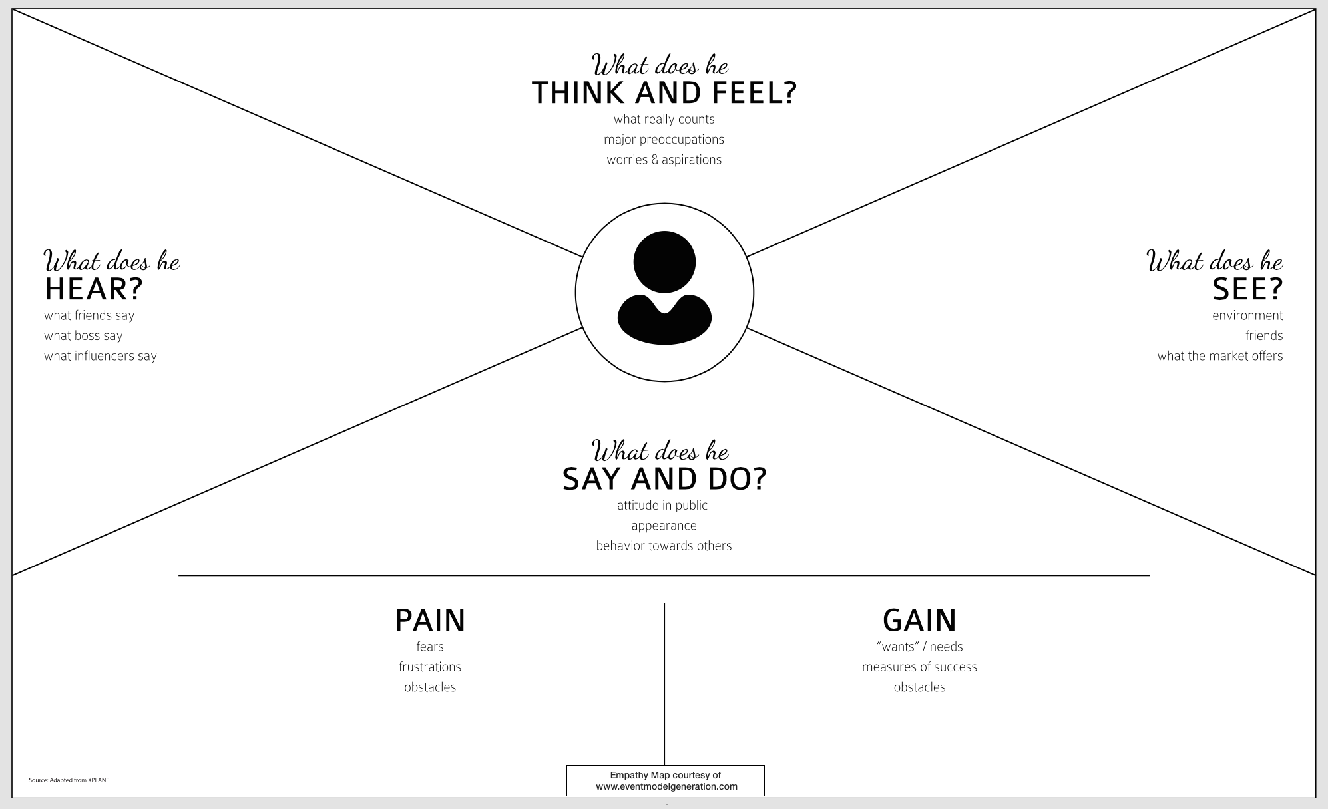
Empathy Map
Notes:
This graphic is called an empathy map. It shows us a different way to approach conversations with our clients, co-workers, and even family members. When you walk into a conversation with someone, considering a few things from this map can help you consider the needs of the whole person and not just what they are saying to you.
What do they think and feel? What’s worrying/stressing them?
What do they see? Who do they surround themselves with, and what is their market like?
What do they say and do? We all have areas of pain or challenges, along with fears, and also gain (things we want).
What do they hear? What are people telling them about their job security, how plans are looking for next year, etc.
Learner question (5 mins): Let’s each think about one of our biggest partner agents/agencies in our area. Pick one person we work closely with at that agency. Let’s answer each of these questions for that partner.
Share-out (5 mins): Tell us a few insights you want to share about one of those partners. It could be their biggest fears, biggest measures of success, what worries them, etc.
When we approach conversations with people, we should remember that we’re interacting with a whole person. Just like us, everyone we encounter is fighting a tough battle either in their personal or professional life. They all have things they’re celebrating, worries about the future, or even assumptions about us and the company. Being a good listener, in large part, starts before the conversation starts. If you approach a conversation with an open mind, you will find that you can better listen to your conversation partner.

Slide 18
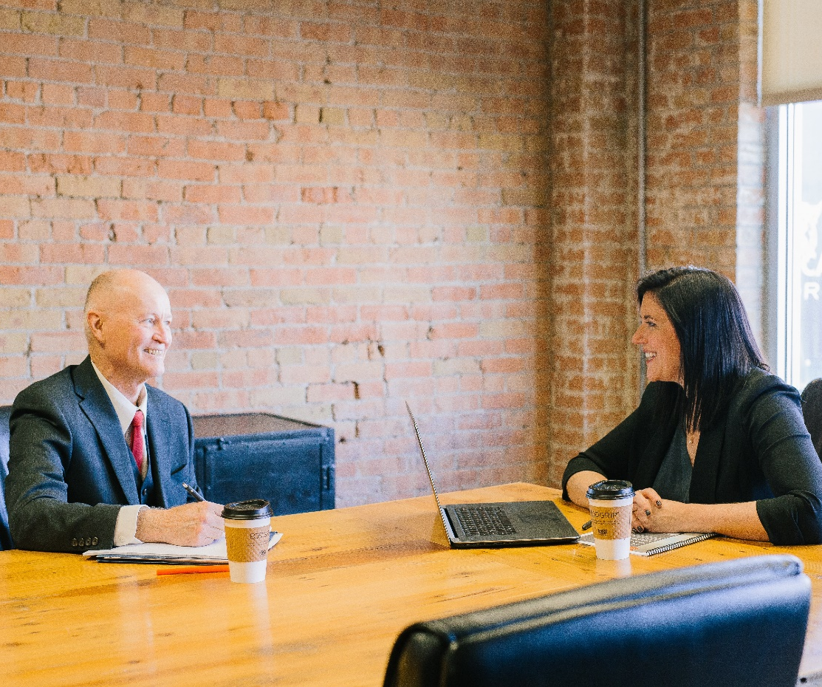
During the Meeting

Slide 19
Emotional Intelligence
Four Domains
Self Awareness
Self Management
Social Awareness
Relationship Management

Slide 20
Relationship Management Strategies
Be Open and Be Curious
Enhance Your Natural Communication Style
Avoid Giving Mixed Signals
Remember the Little Things That Pack a Punch
Take Feedback Well
Build Trust
Have an “Open-Door” Policy
Only Get Mad on Purpose
Don’t Avoid the Inevitable
Acknowledge the Other Person’s Feelings
Complement the Person’s Emotions or Situation
When You Care, Show It
Explain Your Decisions, Don’t Just Make Them
Make Your Feedback Direct and Constructive
Align Your Intention With Your Impact
Offer a “Fix-it” Statement during a Broken Conversation
Tackle a Tough Conversation
Notes:
Learner Discussion (5 mins): Which strategy do you like best?
If people are shy in discussing, here are a couple examples:
BUILD TRUST – Perfect Experience heavily emphasized this. Mary can discuss this one being the company differentiator.
Offer a “Fix It” statement during a broken conversation. Hey, I think this conversation might be leading us down a negative path. Let’s try to reframe it a little bit.
Be Open and Curious – try to look at other people’s motivations, ask questions about their opinions.

Slide 21
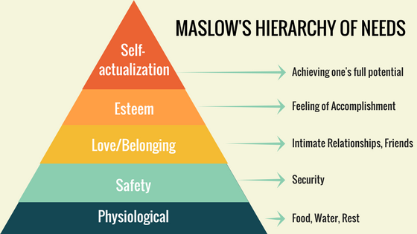
Providing Psychological Safety
The same principles apply whether interacting with clients online, in-person, or over the phone. You need to provide psychological safety before your client will trust you.
What you do is crucial to helping other people achieve health and happiness!

Slide 22
Providing Psychological Safety
You will encounter clients with a history of domestic violence, sexual assault, or other difficult situations. Help your clients understand your meeting is a safe place by opening your discussion with a few items:
Confidentiality – you are bound by the Privacy Act and VA restrictions to not disclose their info to anyone, except to other authorized entities who need to be involved in their benefit questions. Note: NEVER discuss a specific client’s issues with anyone else!
Medical Terminology – you have medical terminology training, and will use formal health terminology instead of slang.
Difficult Questions – you might need to ask tough questions as you identify their needs. Let them know you will only ask what’s necessary!
Sensitivity to Difficult Topics – you will not mock or make light of their challenges or questions. What seems minor to you might not be minor to them! You will maintain your composure and professionalism, no matter what they tell you. Note: please become familiar with sexually transmitted infections and terminology, as these might be embarrassing for your clients to fully disclose.
Discrimination - as a VFW service officer, you may have to work with people who do not necessarily share your beliefs or views, however, professionally accredited representatives of the VFW assist all veterans and their families and do not discriminate or refuse services based on racial, religious, age-related, sexual or ethnic background.

Slide 23

Client Contract and Boundaries
Boundaries
Objectives
The kind of information sought
Your role
Product
Client support
Time
Confidentiality
Feedback

Slide 24
Do you have questions about preparing for client meetings?

Slide 25

Listening Skills

Slide 26
What do you think makes people good listeners?
Notes:
Learner question (5 mins): Let’s go around the room…What do you think makes a good listener?

Slide 27
What Good Listeners Do
Good listening is much more than being silent while the other person talks!
Periodically ask questions that promote discovery and insight
Challenge old assumptions but do it in a positive way
Ask for additional information
It’s a two-way dialogue
The best conversations are active!
Notes:
Good listeners practice active listening strategies. We’ll talk about specific examples of those in just a minute. An active listener engages their conversation partner as they talk. This helps the person talking to know you are invested in the conversation and you’re really listening to them! Periodically ask questions that promote discovery and insight, Challenge old assumptions but do it in a positive way, Ask for additional information, and remember that your conversation is a two-way dialogue!
Learner question (2 mins): Tell me some active listening strategies that you can think of.

Slide 28
Active Listening Strategies
Body language – look the person in the eye, and position your body toward them while they talk. Have an open stance (i.e. no crossed arms or frowning).
Reduce distance between you and the speaker – Don’t sit awkwardly close, but close enough to converse in a natural way.
Ask clarifying questions – if you don’t understand something, ask the speaker what they mean!
Eliminate Distractions – If your cell phone keeps dinging or vibrating, it will automatically distract both you and the speaker. Just put it away! Similarly, turn off other media like televisions and background music if appropriate.
Focus on the Speaker – Let distracting thoughts go. Stop worrying about how you are going to respond and instead pay attention to the speaker.
Notes:
(Read the slide, and ask learners to write down a few active listening strategies that will work for them.)

Slide 29
What Good Listeners Do
Good listening includes interactions that build a person’s self-esteem!
Make the conversation a positive experience for the other party
Make the other person feel supported and convey confidence in them
Create a safe environment in which you can discuss issues and differences
The best conversations are supportive!
Notes:
Good listeners help speakers feel supported. You can support someone in a conversation by empathizing with their situation, and even just by allowing the speaker to finish a point before asking a question (i.e. not interrupting). You can also encourage the speaker to keep talking when they seem unsure of themselves.
Learner question (2 mins): In a conversation, how else can you show that you’re supportive, and how can you create a safe place to discuss difficult topics? (Open responses)

Slide 30
What Good Listeners Do
Good listening is seen as a cooperative conversation!
Feedback flows smoothly in both directions with neither party becoming defensive about comments the other made
In contrast, poor listeners are competitive – listening only to identify errors in reasoning/logic, using your silence to prepare their next response
You can challenge assumptions and disagree, but the person being listened to should feel you’re trying to help and not win an argument
The best conversations are collaborative!
Notes:
If you want to build a collaborative relationship with someone else and encourage open and honest communication, keep the dialogue going back and forth between you and the speaker. You can give brief feedback about the other person’s ideas, you can talk through aspects of their thoughts that you find interesting, let them you’re interested in hearing more on a certain part of the topic they’re discussing, and even empathize by relating it to your own life if appropriate.
If you want to shut down a conversation really quickly, and ultimately lose trust with someone, you should definitely use the time while the other person is talking to think of your own counter arguments. Poor listeners are only thinking about how to respond, how to get a leg up on their conversation partner. You are NOT trying to win an argument, so you don’t want the speaker to feel like you are trying to beat them in any way.

Slide 31
What Good Listeners Do
Good listeners tend to make suggestions!
Include some feedback that others will accept and that opens up new paths to consider
Don’t just jump to solving the problem – bounce ideas off the other person
Amplify, energize, and clarify the other person’s thoughts
The best conversations are clarifying!
Notes:
You can see how every aspect of active listening is related to the previous ones. The best listeners help clarify the thinking of their conversation partners. They ask for more explanation, they gently explore new ideas, and they help the other person think of new ways to approach problems. You don’t necessarily need to be the problem solver, but try to at least be a sounding board for the speaker.

Slide 32
What level of listening are you aiming for?
Level 6: Ask clarifying questions to help the other person see the issue in a new light
Level 5: Increasingly understand the other person’s emotions / feelings
Level 4: Observe non-verbal cues
Level 3: Seek to understand the substance of what the other person is saying: capture ideas, ask questions, and restate issues to confirm understanding
Level 2: Clear away distractions and focus on the other person
Level 1: Create a safe environment where you can discuss difficult, complex, or emotional issues
Notes:
Now that we have talked through a few aspects of active listening, let’s discuss the different levels of active listening. This pyramid sort of reminds me of Maslow’s Hierarchy of Needs; Maslow’s pyramid shows shelter and safety at the bottom of the pyramid, and with self actualization at the top. You can’t achieve self actualization if you don’t have safety and security, food, fulfillment, etc.
Learner question (2 mins): This pyramid has “creating a safe environment” at the very base of the listening levels. Why is that the case? (Answer: You can’t have a truly collaborative conversation with another person, and come up with new ideas and insights, if you don’t have trust. You need to establish trust with your conversation partner to get anywhere in your conversation!

Slide 33
Never hijack
the conversation!
(It’s a balance)
Notes:
Here’s a really important point for us, especially since we’re in sales. Never hijack the conversation with someone else!
Learner question (2 mins): What does it mean when you hijack the conversation? (Answer: you steer the conversation in the direction you want it to go, and away from the point your conversation partner was making to you).
Learner question (2 mins): Why is it bad if you hijack the conversation? (Answer: your conversation partner won’t feel that you’ve listened to them at all, and they’ll become uninvested in the conversation. They might think you’re just trying to sell them or use the conversation instead of really hearing them.

Slide 34
What can your client’s body language tell you?

Slide 35
What’s Next?
Try implementing a listening strategy or two in your next conversation with a client!
Notes:
The next time you meet with a partner or have a tough conversation with a family member or friend, try putting some active listening strategies to use! You may find that it helps you build trust and a deeper connection with the other person, understand their difficulties, and focus in on how you can best support them in their particular challenges.

Slide 36
Do you have questions about listening to clients during meetings?

Slide 37
What is Needs Analysis?
Notes:
Needs Analysis Activity (5 mins): Ask audience what they think Needs Analysis is. Enter questions in the chat.

Slide 38
Needs Analysis
The process of identifying a gap
Looking deeper than surface level to see where there are issues to resolve

Slide 39
Interview Technique: Active Inquiry
Active inquiry – you are actively in charge of the conversation while maintaining a supportive, listening posture. Purpose:
Build up client’s status and confidence
Gather as much info as possible about the situation
Involve client in process of diagnosis and action planning
Create a situation for the client in which it is safe to reveal anxiety-provoking info and feelings

Slide 40
Interview Questions
Eligibility: (these are just a starting point, not all-encompassing)
Have you ever filed a claim with VA? (If they have, you can skip basic eligibility requirements and move on, after verifying that there is a VA record)
(If they’ve never filed a claim with VA) Do you have any of your service records to include medical records and your DD214 or proof of service? (If not, we can help them obtain them.)
Notes:
Ask: what other eligibility questions would you ask clients? I’m not a service officer, so these are just high-level overview questions

Slide 41
Interview Questions
Determining What Disabilities to Claim:
Do you have any medical records that show diagnoses or treatment for any disabilities that you believe are the result of your service
Is there anything medical that is bothering you today that began while you were in the military?
Are you currently seeking treatment for any medical conditions?
Did you seek/do you remember seeking treatment for any disabilities, diseases, or injuries during service? (if so, when?)

Slide 42
Interview Questions
Other Information to Request:
Personal contact information
Dates and branch of service/did you have any war time service? (if so, when/where)
Employment status (TDIU)
Marital status/ dependent status (ages of children; if ages 18-23, are they in school full time?)
Housing status (are you currently or are you at risk of becoming homeless?)
Income (in certain cases)

Slide 43
Basic Needs
All of the questions you ask and all of the info you gather will help you meet the basic needs of the veteran sitting across from you.
You might not be physically driving them to a food bank, but you are helping them get medical care, get a job, increase their education, find interview help, get housing assistance, or many other basic necessities.

Slide 44
After the Meeting
Document everything!
Document all decisions made and all resources given to veteran in the Communications tab of VetraSpec
Enter all the client’s paperwork (medical records, statements, evidence, etc) into the Documents section of VetraSpec
Note: if you don’t have VetraSpec, enter the information into whatever claims management database you have!

Slide 45
Why is it important to document everything in VetraSpec?
Notes:
Answer: It ensures you have all the evidence needed to help the veteran access to benefits, all in one place, and it helps the veteran continue getting help and access benefits even if they move. Any service officer with access to VetraSpec could continue working on their benefits in another state.

Slide 46
After the Meeting
Follow Up:
Give the veteran your contact information to follow up
Set expectations for next steps, and when to expect them (i.e. often it’s an examination).
If the veteran has any deliverables, lay out those steps in writing for them
Add goal dates. Ex: “We know a claim like yours takes 120 days, so follow up with me if you don’t hear back from the VA / other entity in that amount of time.”
Tell the veteran to let you know if they receive communications from the VA – we don’t know what you don’t tell us!

Slide 47
Any questions on Consulting Skills?
Notes:
Answer: It ensures you have all the evidence needed to help the veteran access to benefits, all in one place, and it helps the veteran continue getting help and access benefits even if they move. Any service officer with access to VetraSpec could continue working on their benefits in another state.

