Slide 1

VA Debt Management Center
(DMC)
VFW Presentation
May 2022
LESSONS LEARNED

Slide 2
Purpose
              Provide introduction to DMC
              Update on COVID-19 Operations
              Update on Debt Portal
              Answer questions
2

Slide 3
DMC Overview
DMC Mission:
Provide distinctive, high quality accounts receivable services through a compassionate and value-added approach, empowering our stakeholders to focus on core missions.
1
DMC is a franchise fund aligned with VA’s Office of Finance (OF) within the Office of Management (OM)
2
DMC’s staff of approximately 320 employees works to service VA benefit debts, counsel Veterans on options and outcomes, and offer resolutions for each unique situation.
3
DMC provides accounts receivable services to VBA, VHA, NCA
4
The DMC collects approximately $1.8 billion annually
3

Slide 4
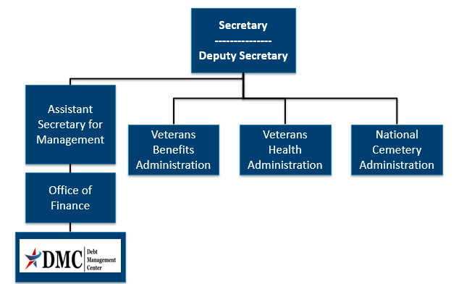
Organization Chart
4

Slide 5
Collection Process
DMC sends Notice of Indebtedness letters, monitors accounts, and advises debtor of any delinquency, including the requirement to refer their account to Treasury
DMC Sends 1st NOI
30 or 90 days
DMC Sends 2nd NOI
30 days
DMC Sends 3rd NOI
If DMC receives payment, next collection letter is deferred
Debt is Referred to Cross Servicing
Note:
Cross Servicing and TOP Referrals are paused until July 2022
60 days
Debt is Referred to Treasury Offset Program
60 days
5

Slide 6
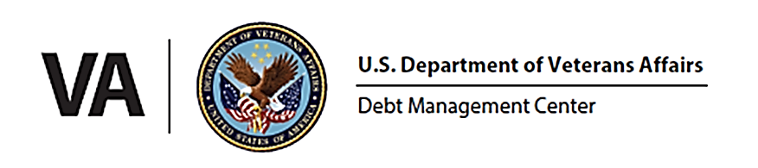
Standard Debt Relief Options
Process | Considerations
Waiver | First letter determines: 180 days to request, VA Form 5655, letter of explanation
Dispute | First letter determines: 30 or 90 days to stop collection, clear explanation of concern
Compromise | Does not stop collection, lump sum payment, VA Form 5655 and proposed amount
Repayment Plan | Eligibility varies depending on a variety of criteria, may need VA Form 5655
Disaster Relief Suspension | Typically 90 days, requested because of impact from hurricanes, wildfires, etc.
6

Slide 7
COVID-19 Operations
DMC resumed sending debt letters to Veterans on October 1, 2021
  Phased release for debts created between April 2020 & October 2021
  Veterans in later phases will receive quarterly informational letters
DMC resumed benefit offsets in January 2022
DMC will not resume referrals to Credit Reporting Agencies or Credit Alert Verification Reporting System (CAIVRS) until July 2022
U.S. Department of the Treasury activity resumed October 1, 2021 for debts under their jurisdiction prior to the pandemic
DMC will not refer additional VBA debts to Treasury until July 2022
7

Slide 8
COVID-19 Operations
Backlog of over 405,000 accounts needed due process notification as of October 1, 2021
Backlog reduced to 132,100 as of March 31, 2022
8

Slide 9
COVID-19 Debt Relief Options
If Veterans are experiencing financial hardship, DMC is providing continued relief options:
Extending repayment plans
Requesting debt forgiveness through the waiver process
Submitting a compromise offer to settle the debt for less than the full amount
Requesting a temporary hardship suspension of repayment until September 30, 2022
9

Slide 10
Process Enhancements
Compensation and Pension debtors with VA benefits will not be offset for 90 days after their due process letter
Automated 36-month payment plan for Compensation and Pension debts
No Financial Status Report required for payment plans up to 60 months
Veterans with VBA debts created prior to April 6, 2020 not under Treasury jurisdiction received additional notification letters
Partnered with VA Suicide Prevention Program to support at risk Veterans
Established a threshold for reporting to Credit Reporting Agencies that will reduce referrals by 99%
Implemented post call survey to obtain customer experience feedback
10

Slide 11
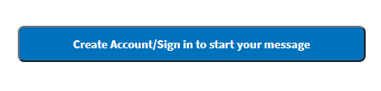
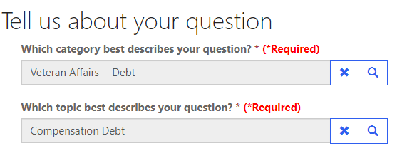
Ask VA (AVA) – DMC tips
AVA offers both an option to sign in and an option to start your message without signing in
  We need users to sign in if they want to discuss specific account details
Options to reach DMC are found under “Veteran Affairs- Debt” category and then topics are used to select the type of debt for proper routing
11

Slide 12
VSO, SCO and Veteran emails (VetResources, VA Benefits Newsletter)
Borne the Battle Podcast
VAntage Point Blog
  VA launches user-friendly online financial status report form for VBA debts
VA social media
  Did you know VA has a social media directory?
Press releases
  February 2, 2022: VA Establishes new Threshold for Reporting Benefit and Medical debt
Outreach and Updates
12

Slide 13
VA Debt Portal: Mission
Offer Veterans an online experience that can help them understand
  why they have debt
  what the status of their debt is
  what steps they need to take to resolve their debt
13

Slide 14
VA Debt Portal: Products
Benefit Debt
Financial Status Report (FSR) VA Form 5655
Medical Copay
14

Slide 15
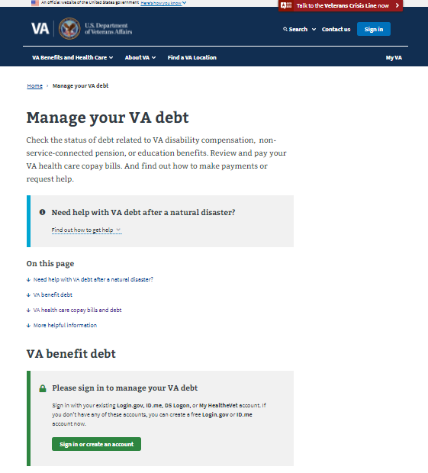
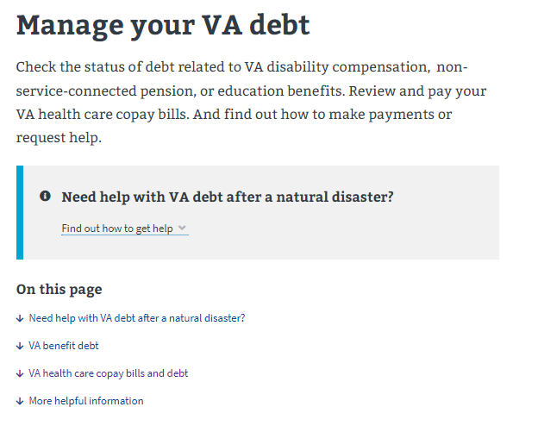
VA Debt Portal Features: Portal Overview
All data in this document is mock data
15

Slide 16
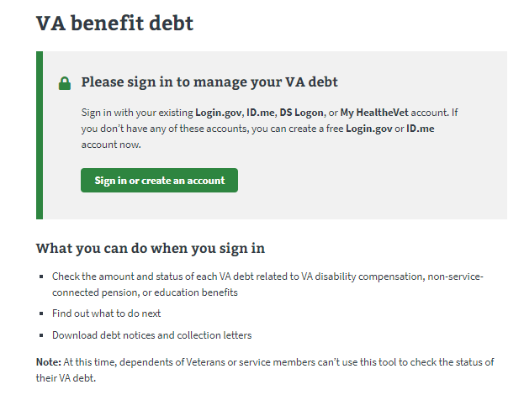
VA Debt Portal Features: Portal Overview
All data in this document is mock data
16

Slide 17
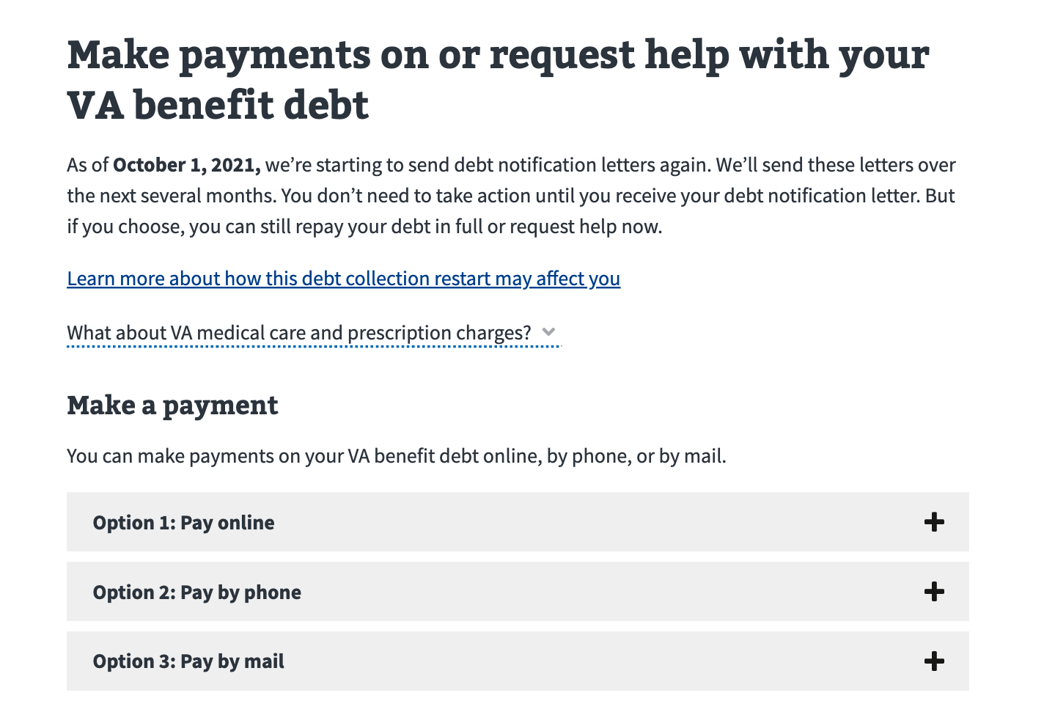
VA Debt Portal Features: Portal Overview
All data in this document is mock data
17

Slide 18
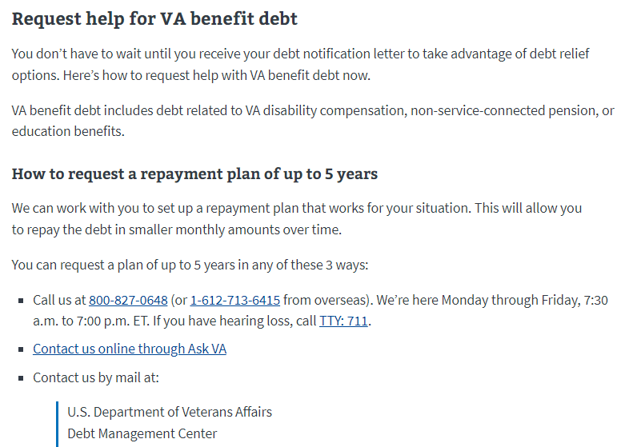
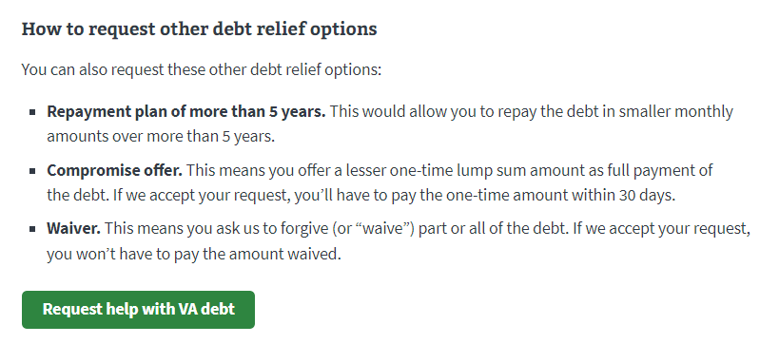
VA Debt Portal Features: Portal Overview
All data in this document is mock data
18

Slide 19
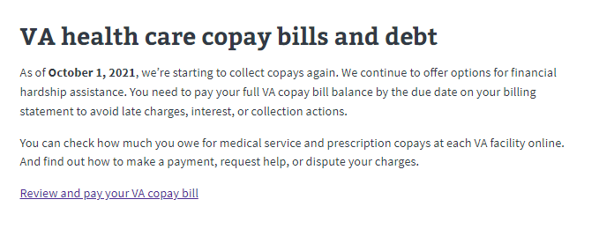
VA Debt Portal Features: Portal Overview
All data in this document is mock data
19

Slide 20
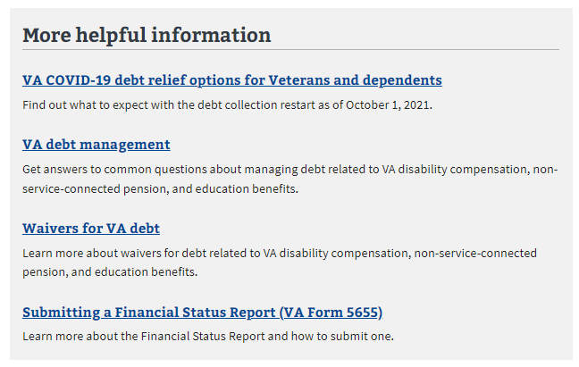
VA Debt Portal Features: Portal Overview
All data in this document is mock data
20

Slide 21
VA Debt Portal: Benefit Debt
Allows Veterans to:
check the amount and status of each VA benefit debt
  disability compensation
  non-service-connected pension
  education
learn how to make payments
understand resolution options and navigate to the online FSR
download DMC’s 5 primary debt collection letters
21

Slide 22
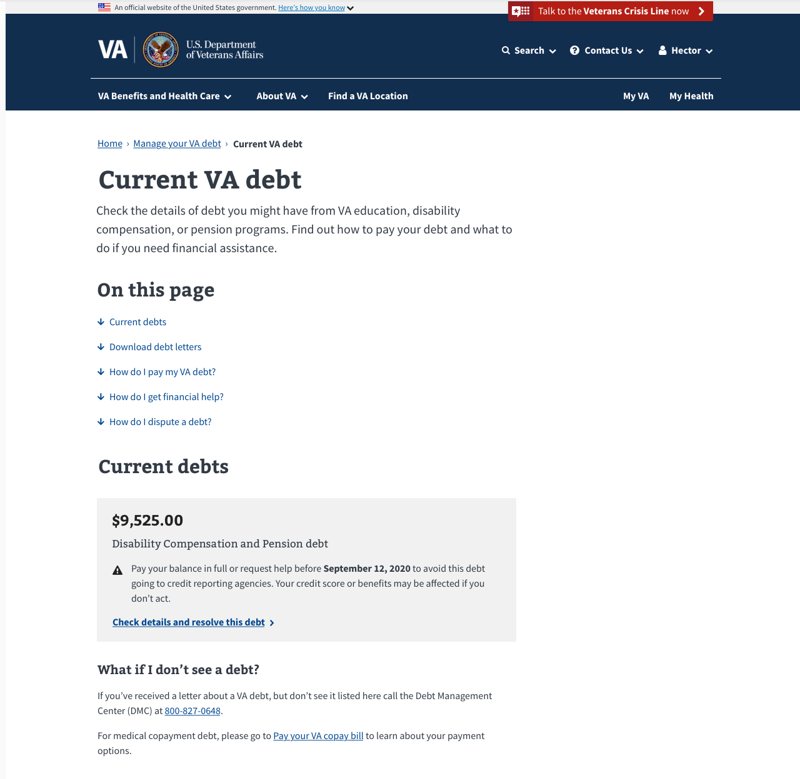
VA Debt Portal Features: Benefit Debt
All data in this document is mock data
22

Slide 23
VA Debt Portal Features: Benefit Debt
All data in this document is mock data
23

Slide 24
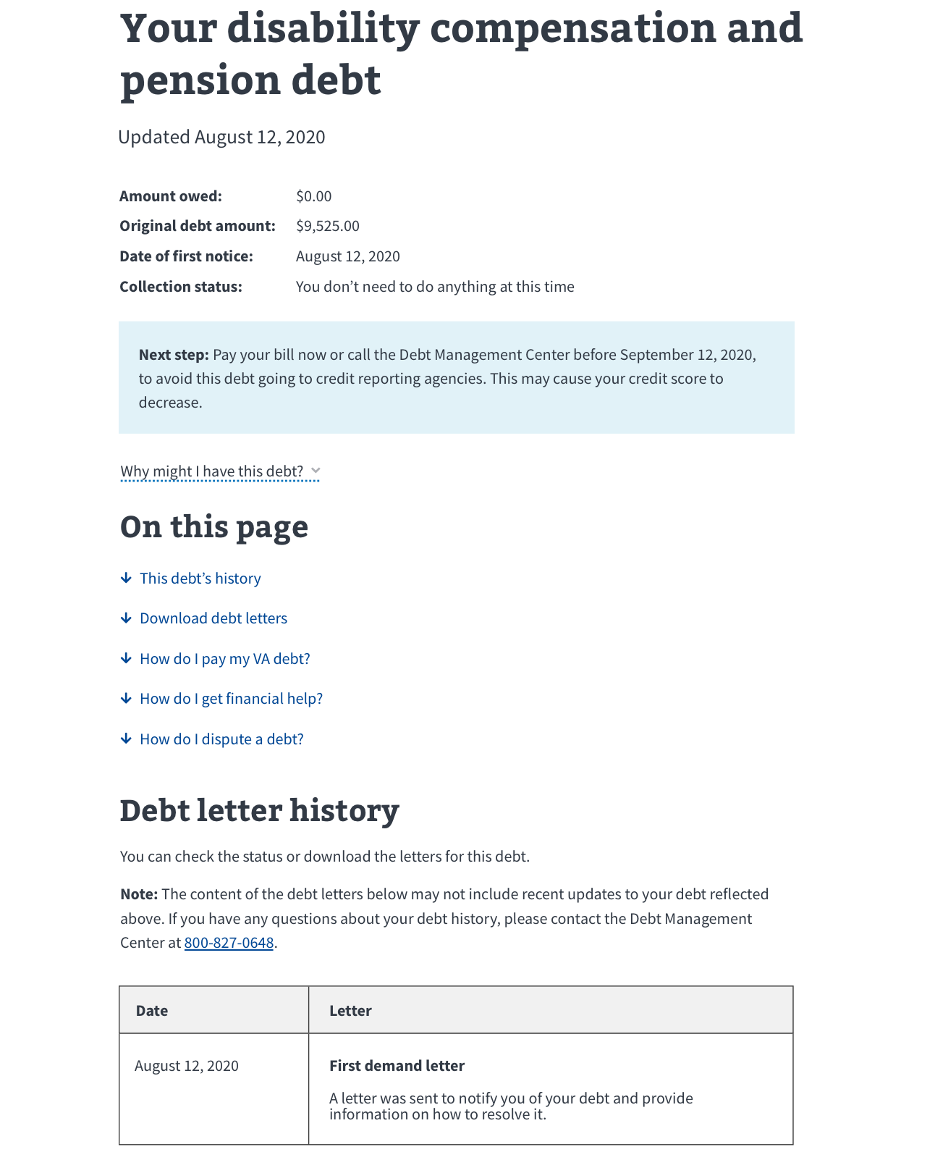
VA Debt Portal Features: Benefit Debt
All data in this document is mock data
24

Slide 25
VA Debt Portal Features: Benefit Debt
All data in this document is mock data
25
Notes:
.

Slide 26
VA Debt Portal: Online FSR
Allows Veterans to:
complete and submit the form online accurately and completely (field validation and auto-calculated fields guard against incomplete data, miscalculations and omissions)
save the form while they are in-progress so they can complete it later
26

Slide 27
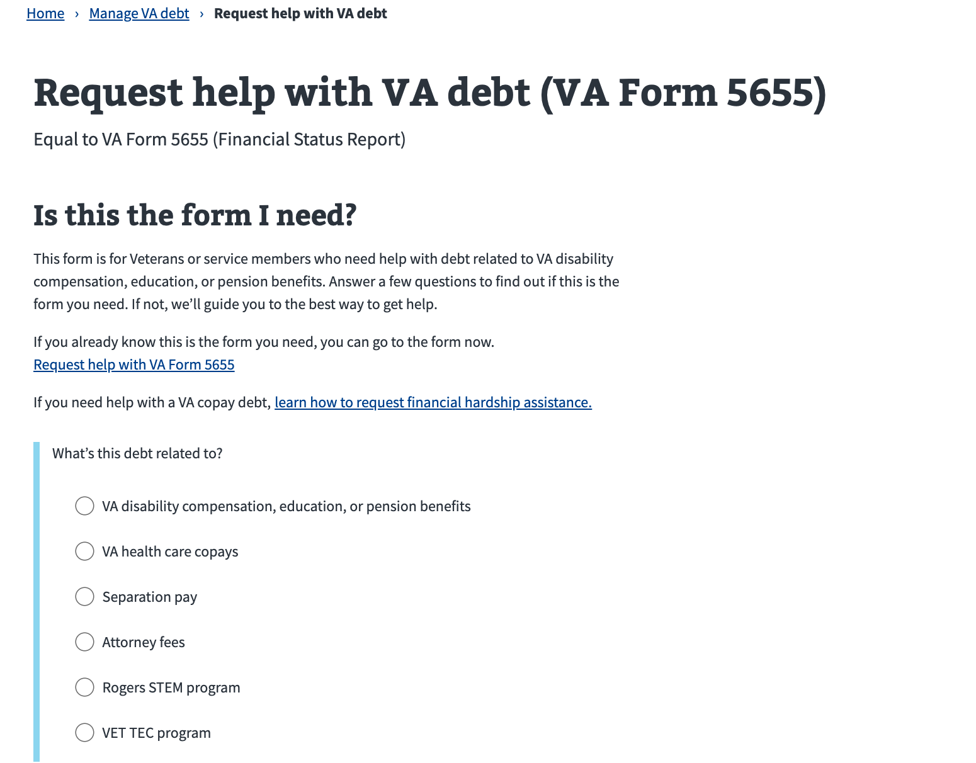
VA Debt Portal Features: Online FSR
All data in this document is mock data
27

Slide 28
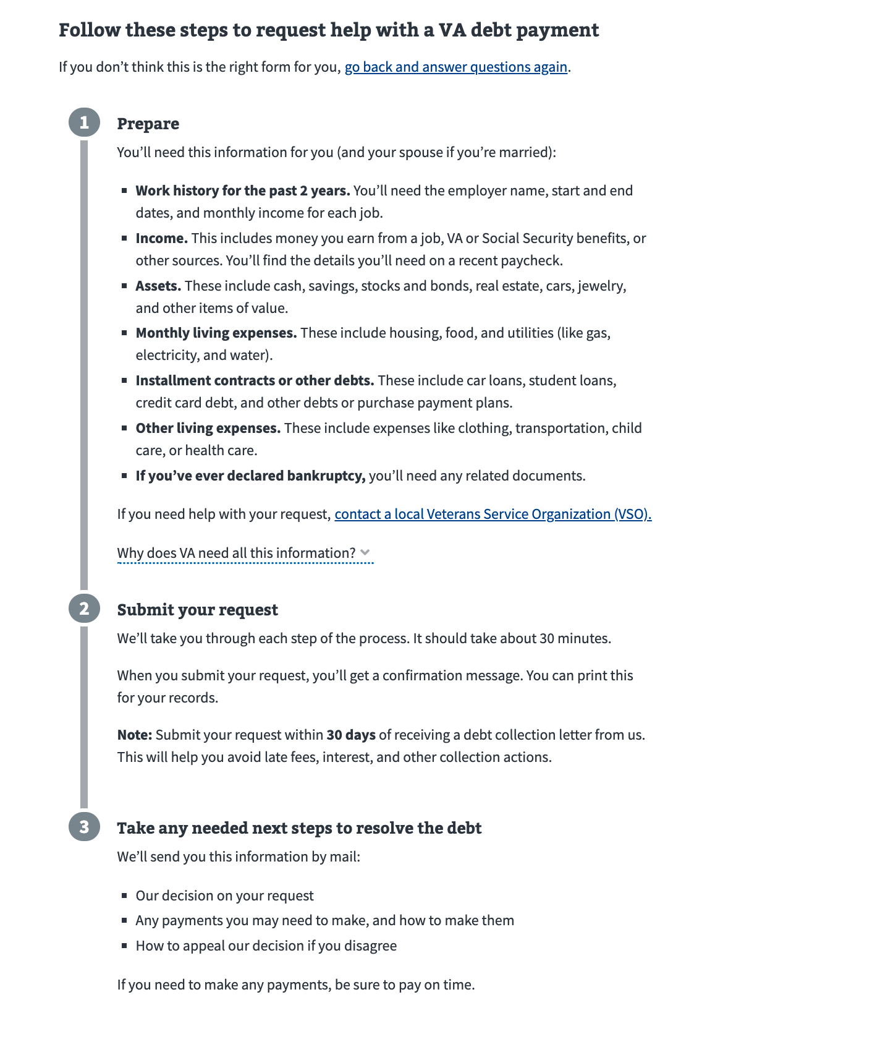
VA Debt Portal Features: Online FSR
All data in this document is mock data
28

Slide 29
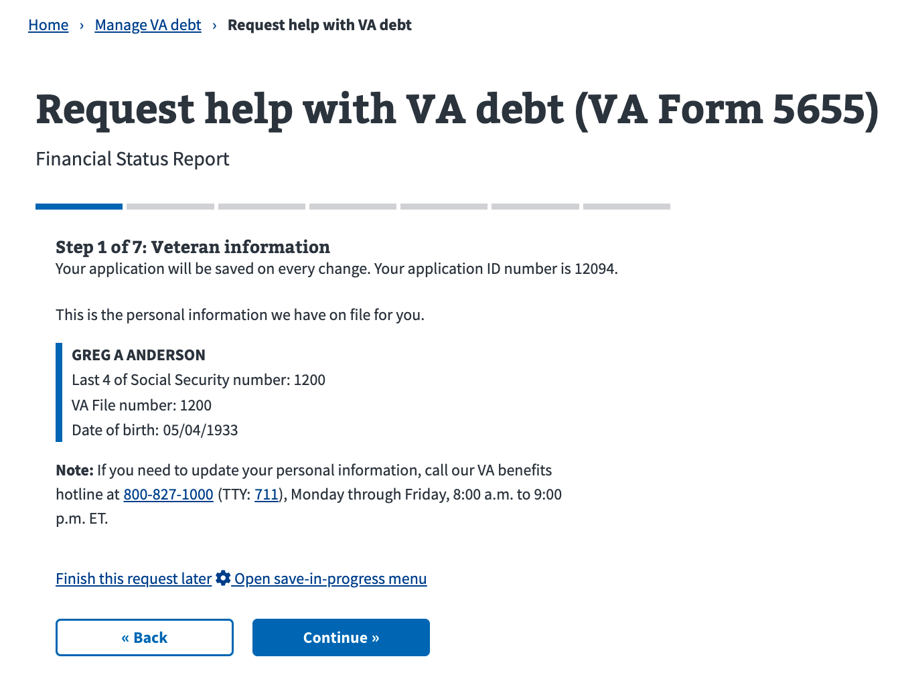
VA Debt Portal Features: Online FSR
All data in this document is mock data
29

Slide 30
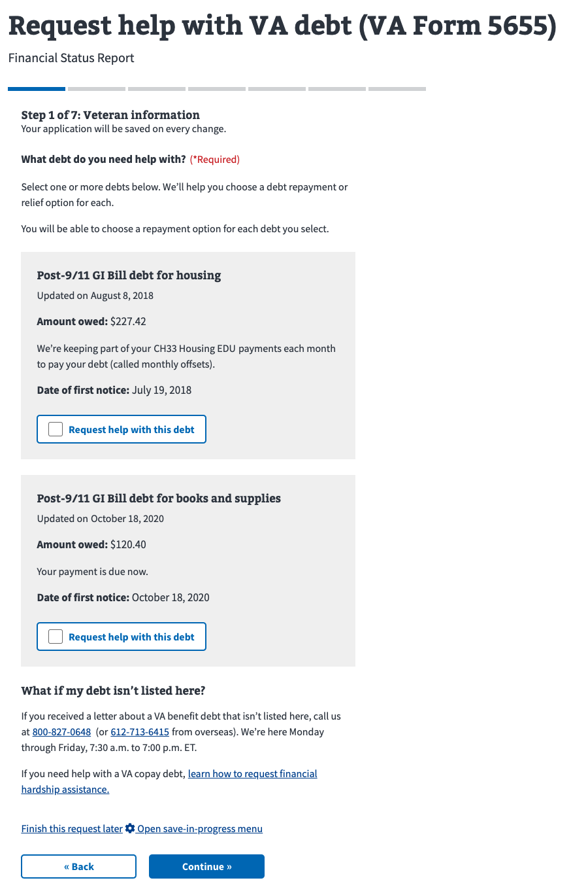
VA Debt Portal Features: Online FSR
All data in this document is mock data
30

Slide 31
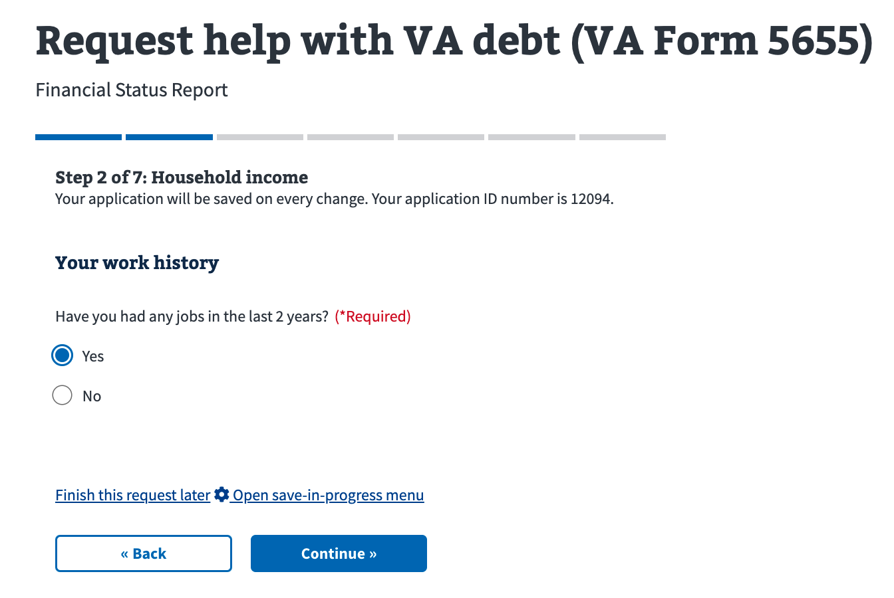
VA Debt Portal Features: Online FSR
All data in this document is mock data
31

Slide 32
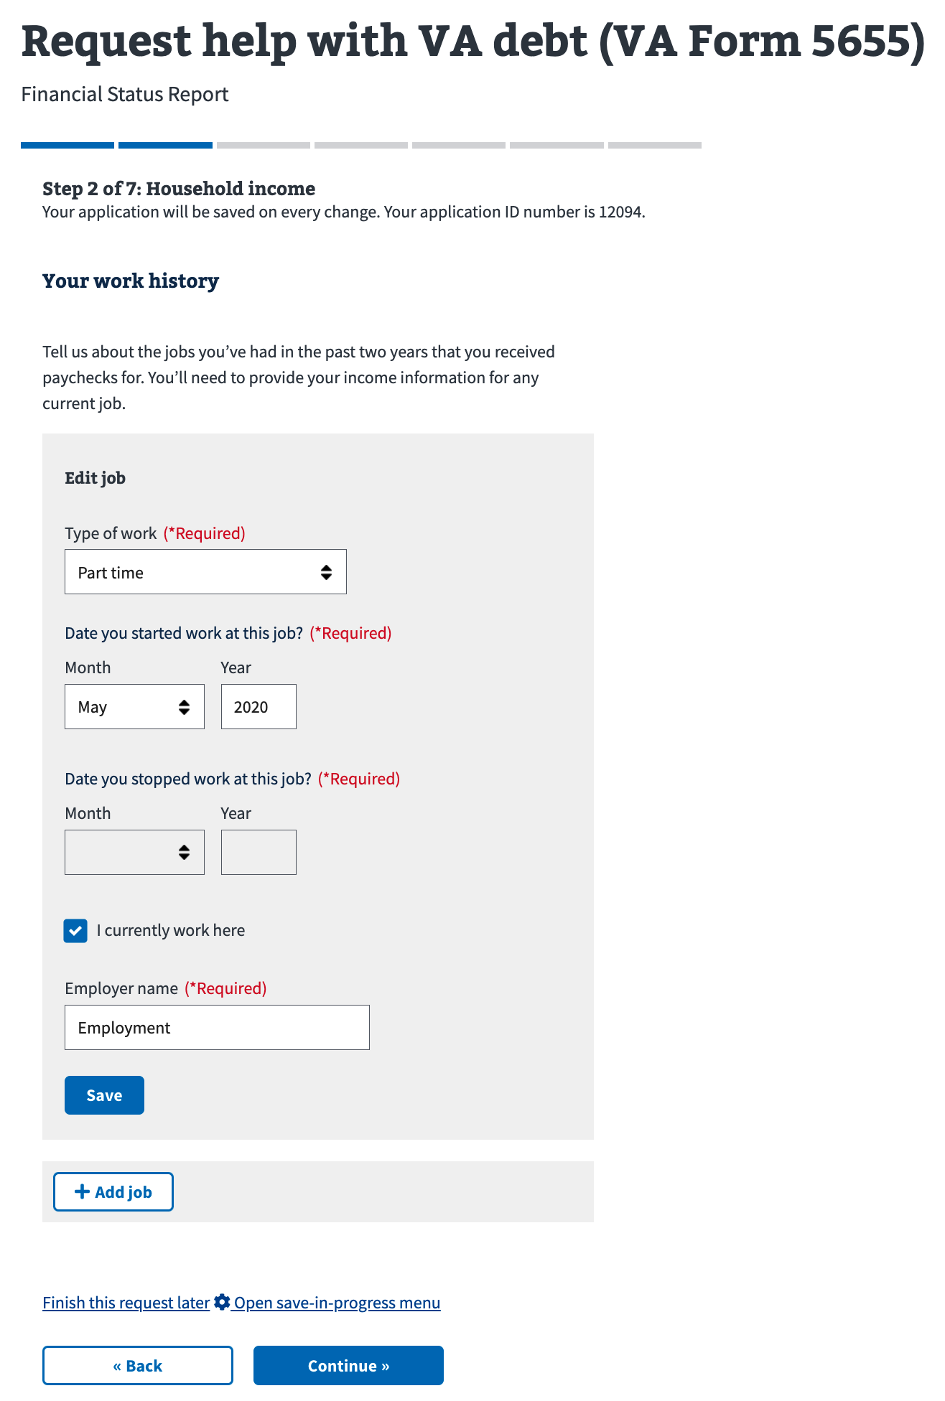
VA Debt Portal Features: Online FSR
All data in this document is mock data
32

Slide 33
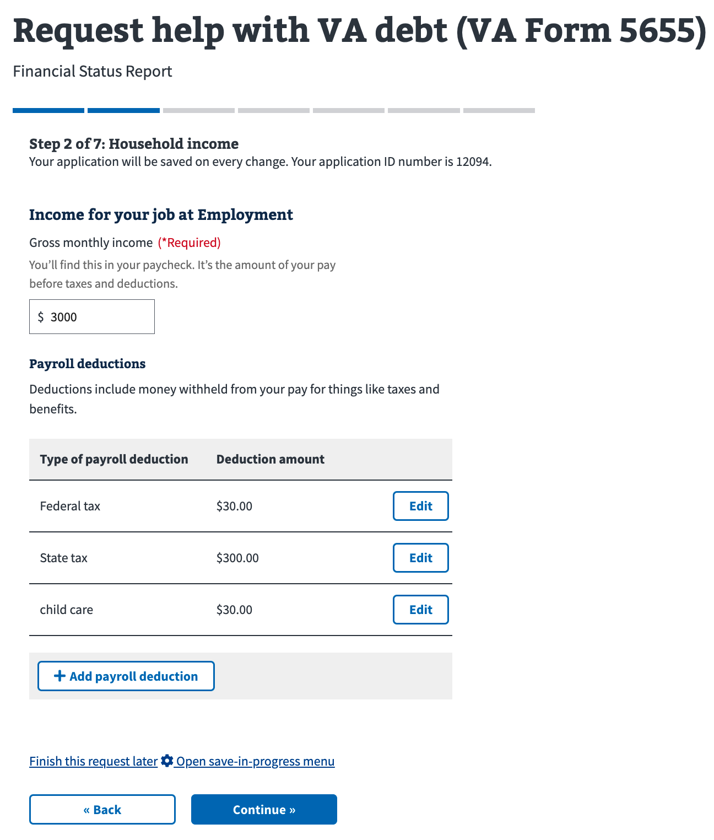
VA Debt Portal Features: Online FSR
All data in this document is mock data
33

Slide 34
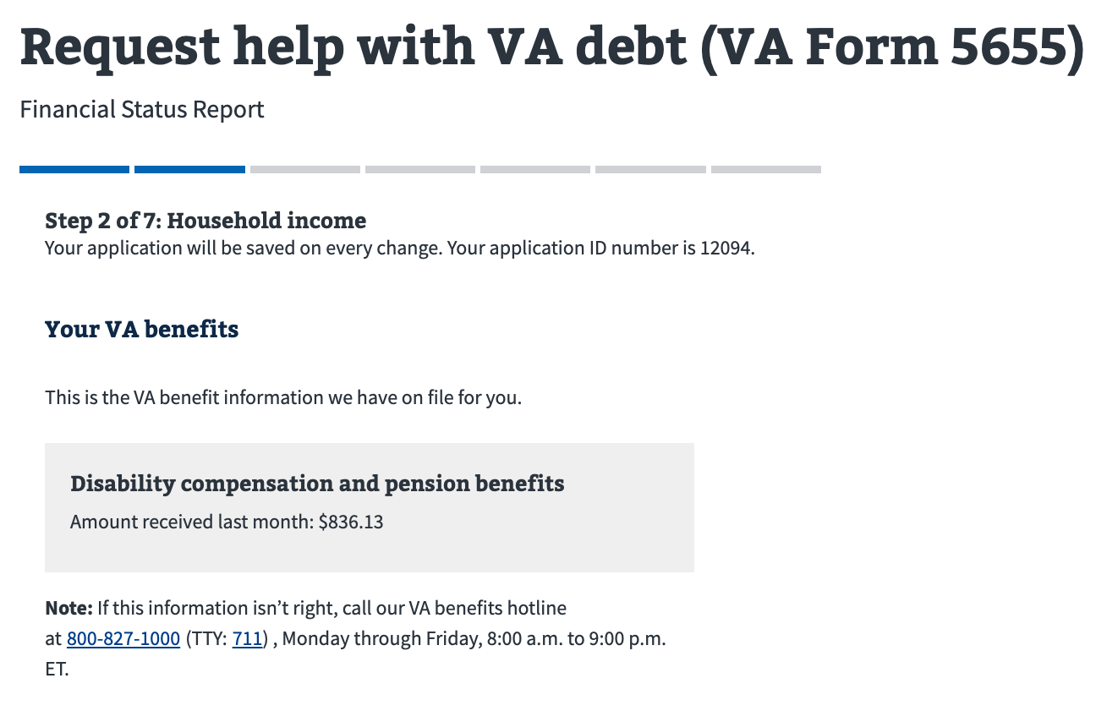
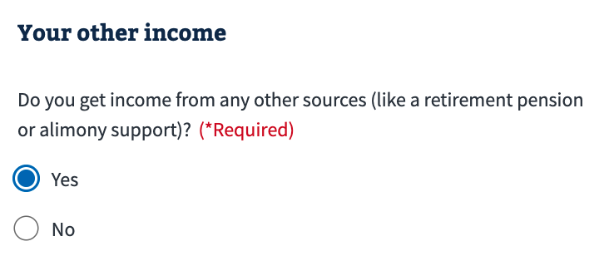
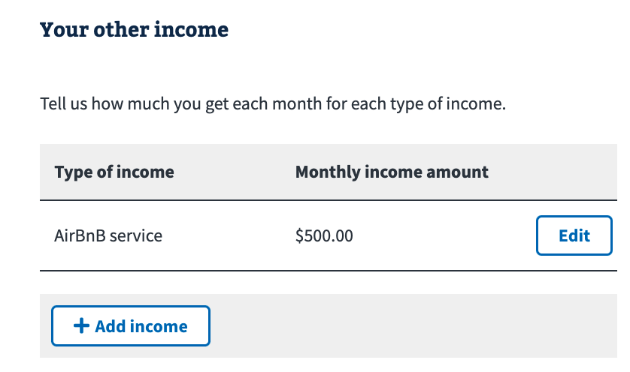
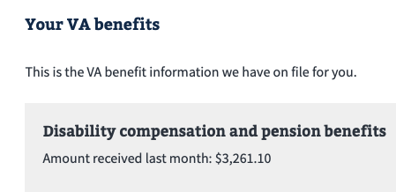
VA Debt Portal Features: Online FSR
All data in this document is mock data
34

Slide 35
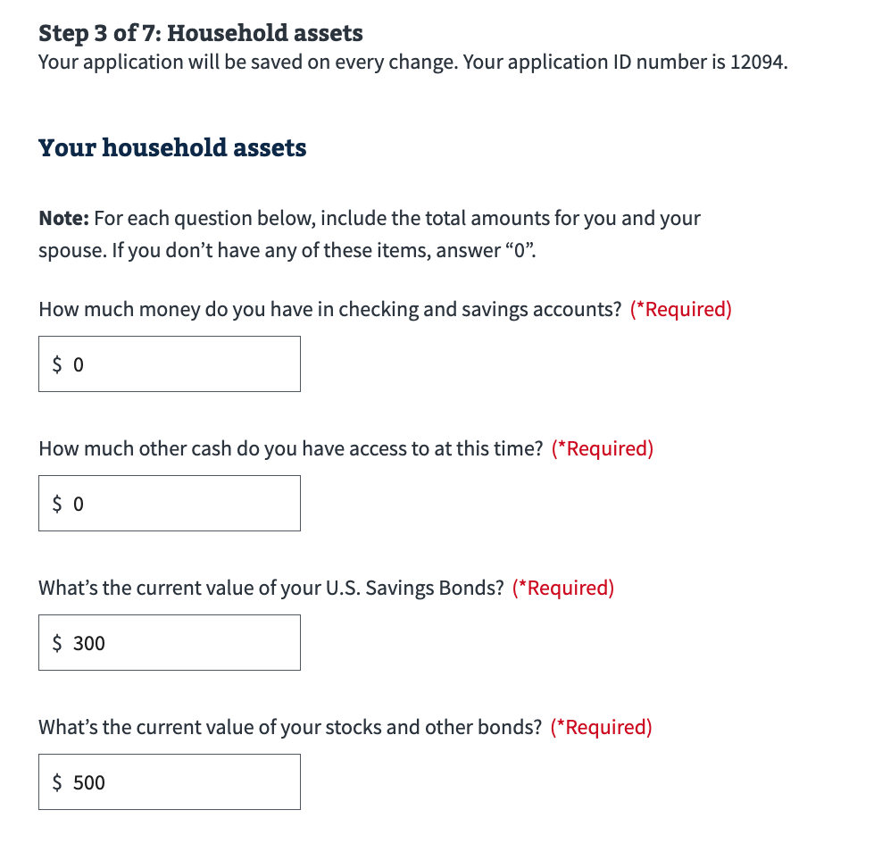
VA Debt Portal Features: Online FSR
All data in this document is mock data
35

Slide 36
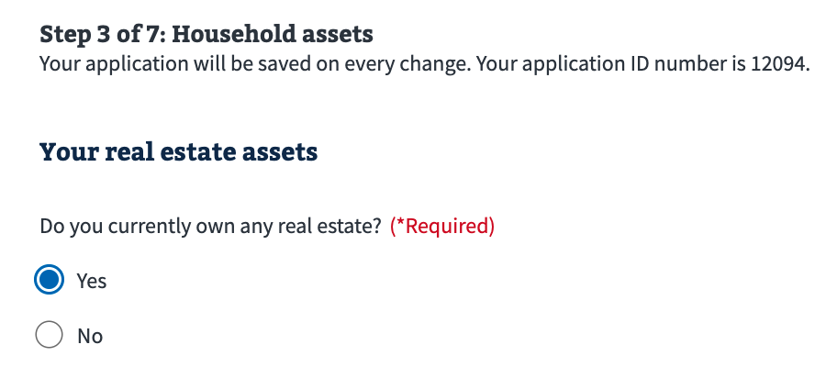
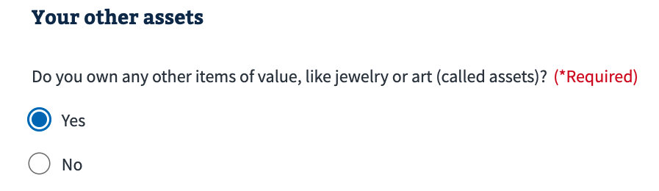
VA Debt Portal Features: Online FSR
All data in this document is mock data
36

Slide 37
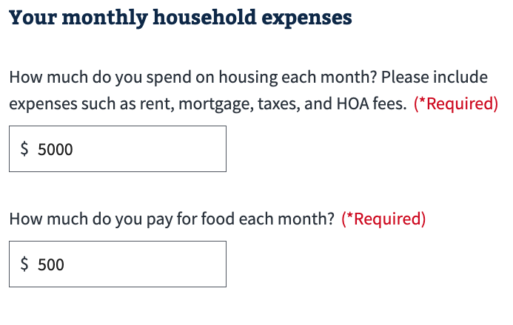
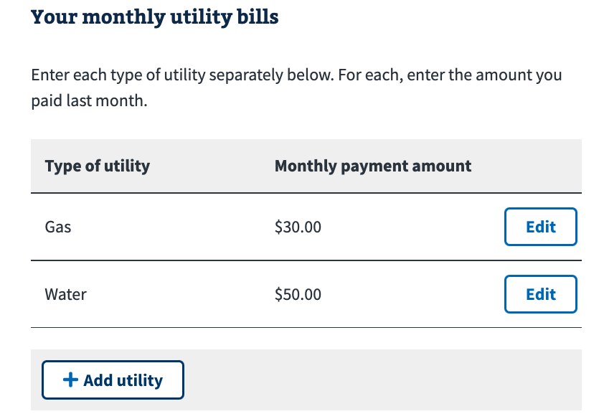
VA Debt Portal Features: Online FSR
All data in this document is mock data
37

Slide 38
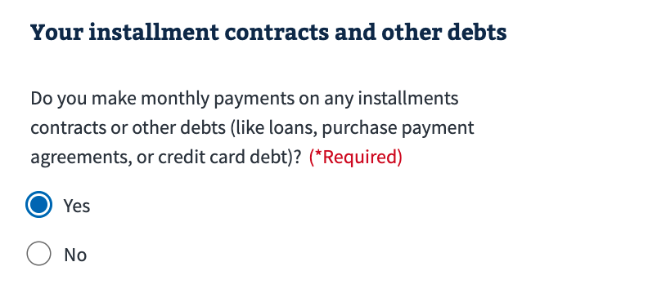
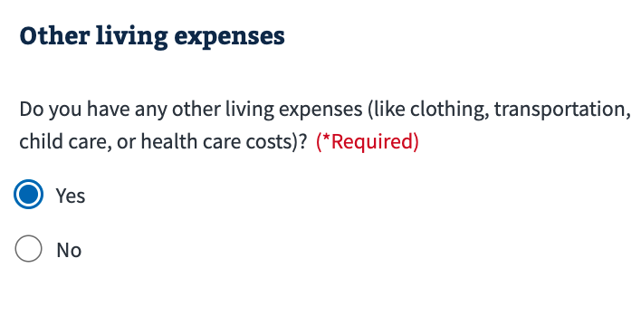
VA Debt Portal Features: Online FSR
All data in this document is mock data
38

Slide 39
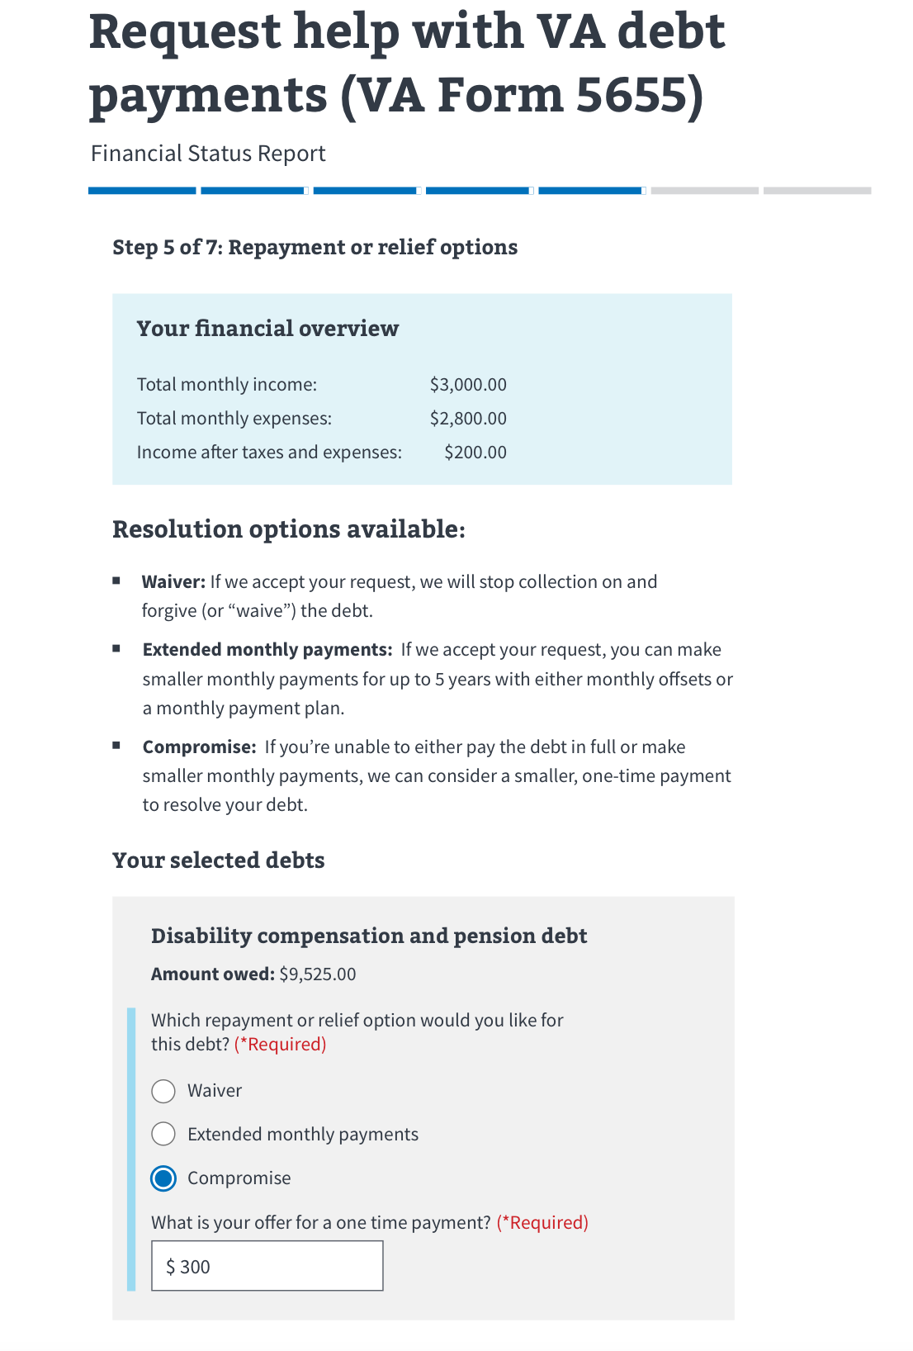
VA Debt Portal Features: Online FSR
All data in this document is mock data
39

Slide 40
VA Debt Portal Features: Online FSR
All data in this document is mock data
40

Slide 41
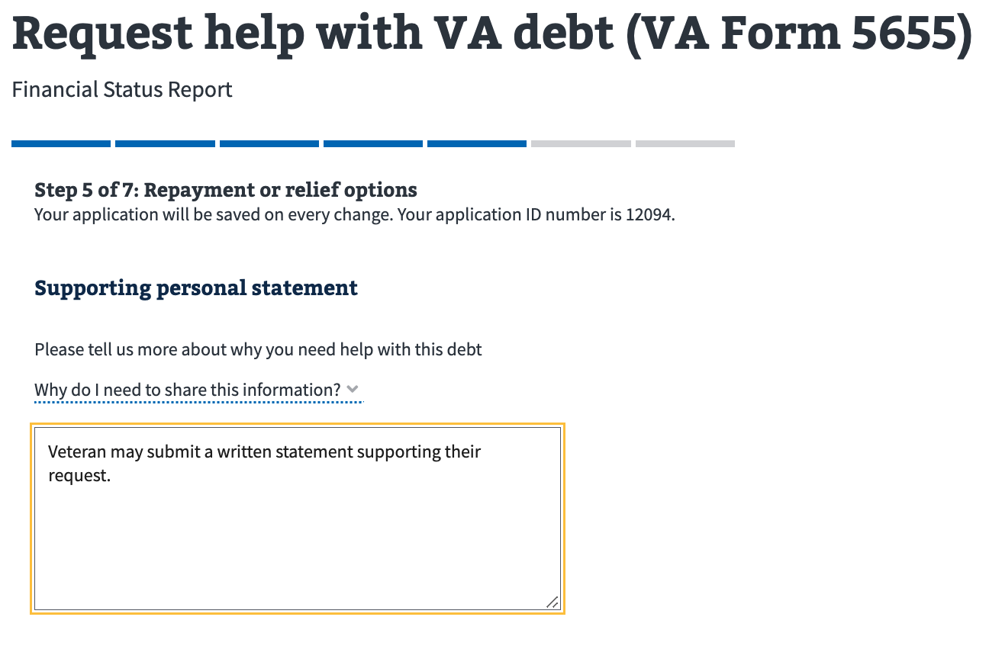
VA Debt Portal Features: Online FSR
All data in this document is mock data
41

Slide 42
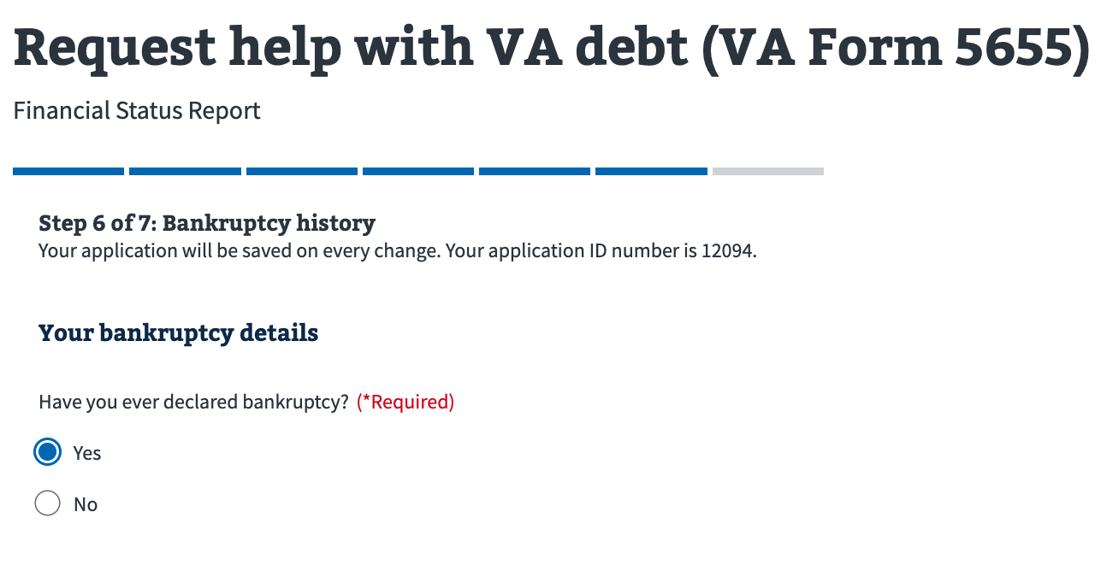
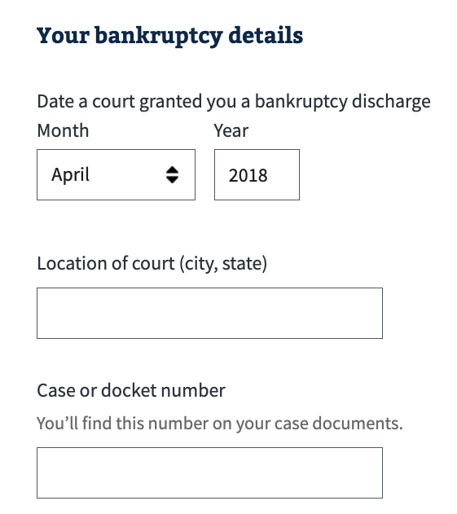
VA Debt Portal Features: Online FSR
All data in this document is mock data
42

Slide 43
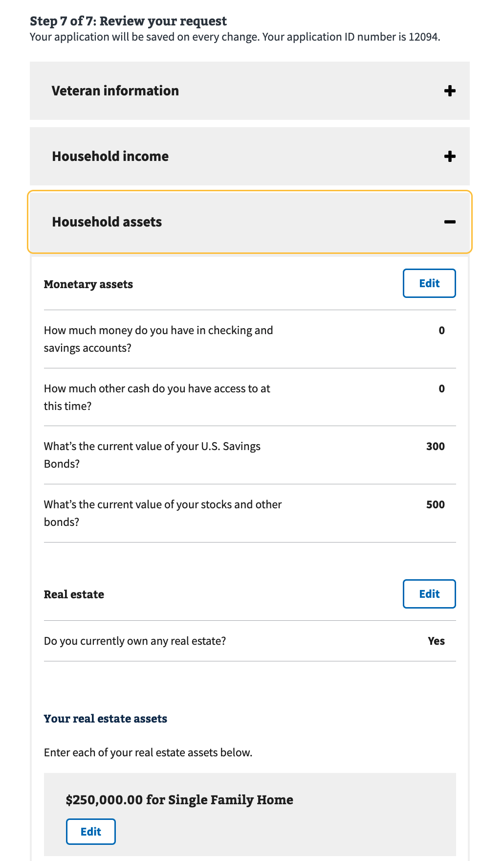
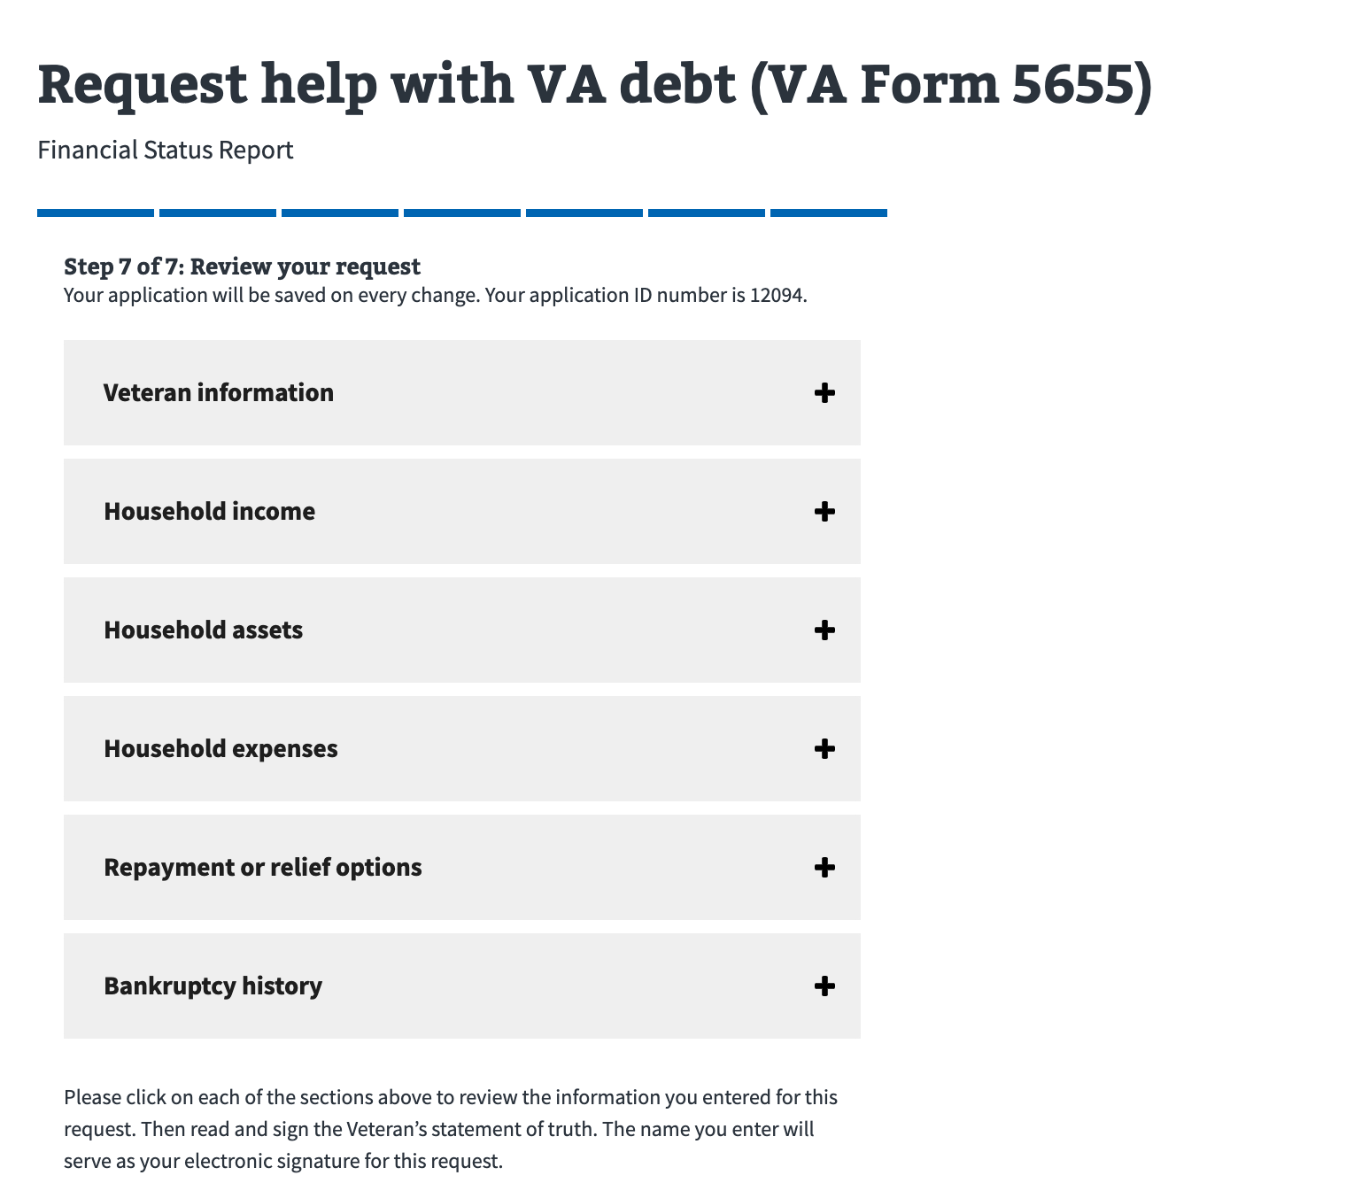
VA Debt Portal Features: Online FSR
All data in this document is mock data
43

Slide 44
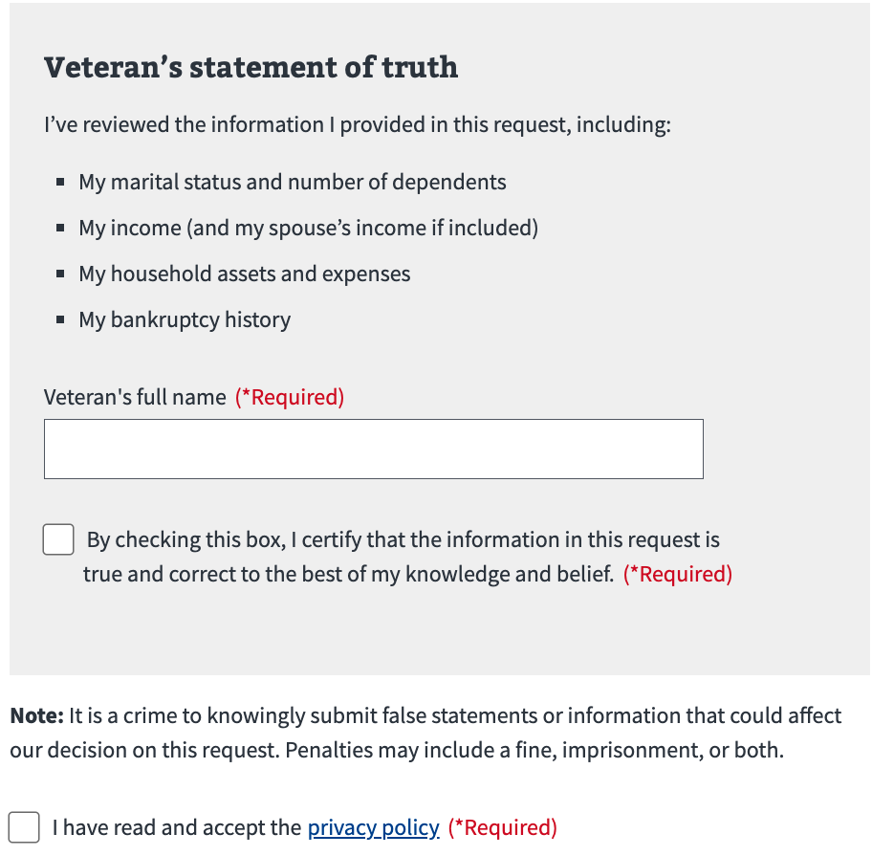
VA Debt Portal Features: Online FSR
All data in this document is mock data
44

Slide 45
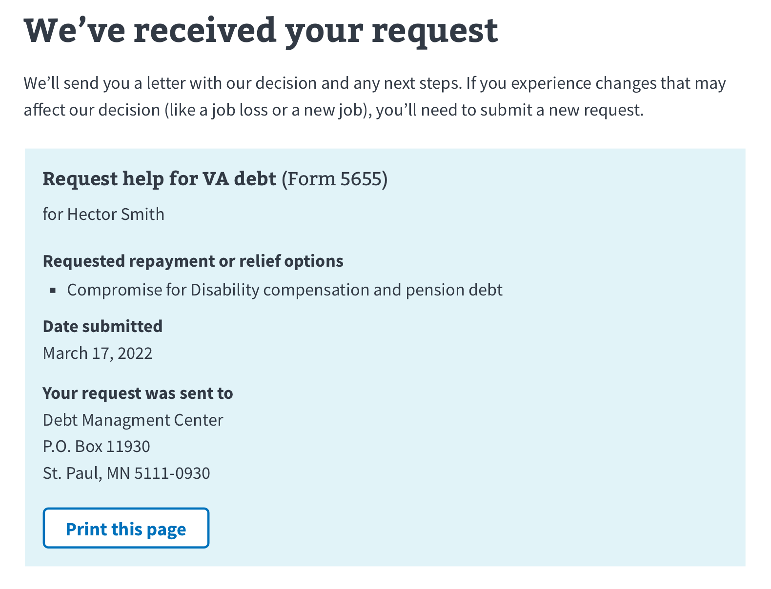
VA Debt Portal Features: Online FSR
All data in this document is mock data
45

Slide 46
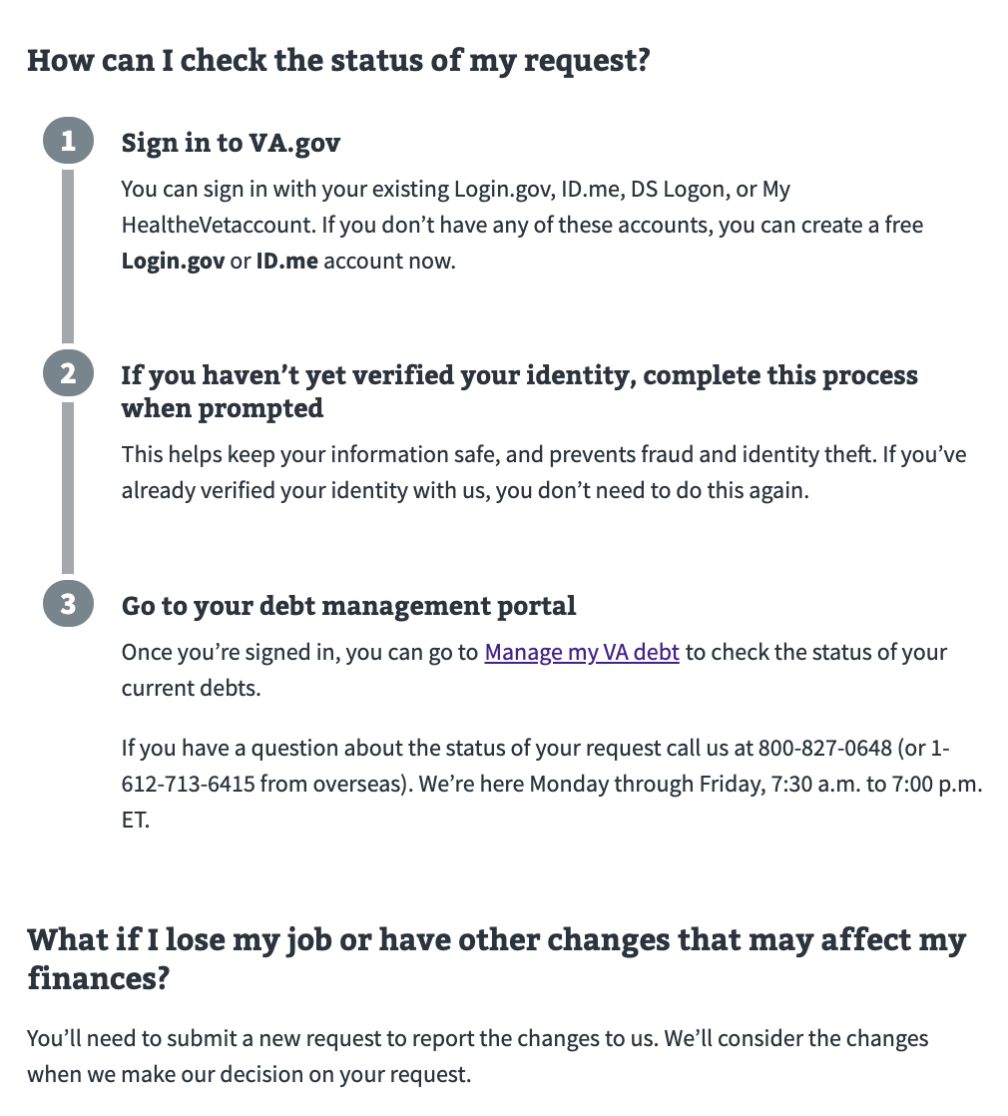
VA Debt Portal Features: Online FSR
All data in this document is mock data
46

Slide 47
VA Debt Portal: Medical Copay
Allows Veterans to:
review medical copay statements
find out how to make a payment thru a variety of payment options
learn how to request help or dispute charges
download PDF statements
47

Slide 48
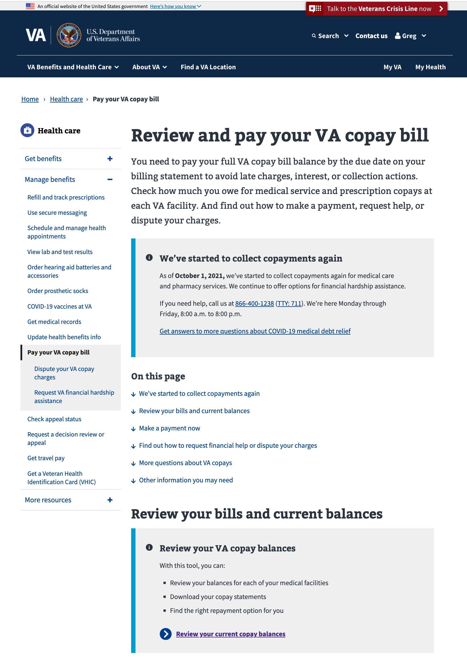
VA Debt Portal Features: Medical Copay
All data in this document is mock data
48

Slide 49
VA Debt Portal Features: Medical Copay
All data in this document is mock data
49

Slide 50
VA Debt Portal Features: Medical Copay
All data in this document is mock data
50

Slide 51
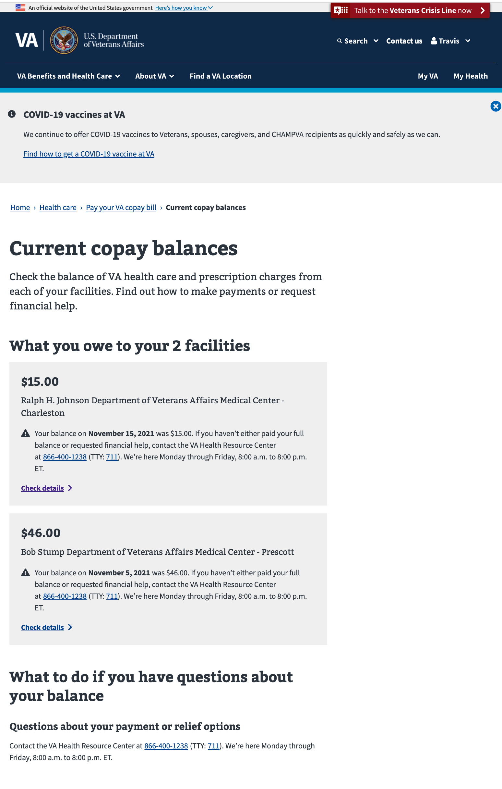
VA Debt Portal Features: Medical Copay
All data in this document is mock data
51

Slide 52
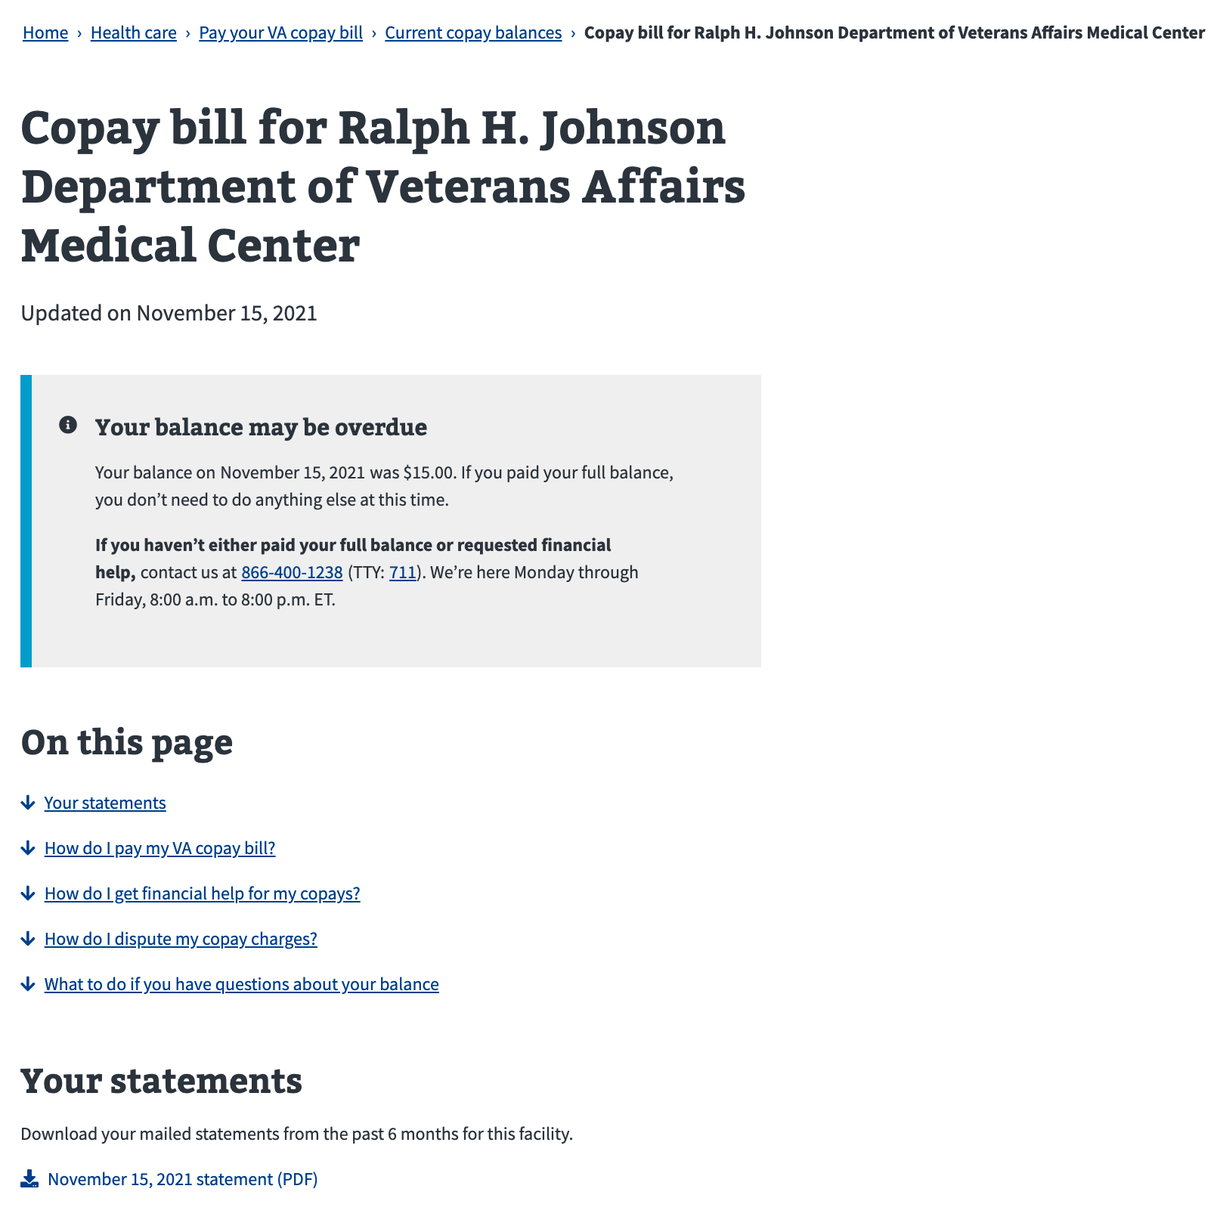
VA Debt Portal Features: Medical Copay
All data in this document is mock data
52

Slide 53
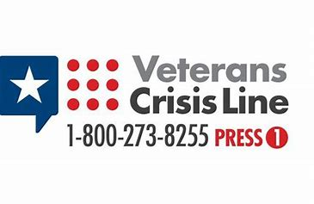

At Risk Veterans
If Veterans are homeless or facing eviction, please let us know when you contact DMC
Text 838255
www.VeteransCrisisLine.net
(online chat)
Veterans having difficulty with a
VA-guaranteed home loan can call
1-877-827-3702
to reach the nearest Loan Guaranty office
53

Slide 54
VHA Debts
For questions about medical care and pharmacy services copayment debt, contact the Health Resource Center: 1-866-400-1238
VA has options for Veterans who suffer from difficult financial circumstances and struggle to pay VA copayments:
  Health Resource Center: 1-866-400-1238
  https://www.va.gov/COMMUNITYCARE/revenue_ops/Financial_Hardship.asp
54

Slide 55

Become a Debt Superstar (Contact DMC)
https://www.va.gov/manage-va-debt/ | Veteran Debt Portal
https://ask.va.gov | Online inquiry system
800-827-0648 | DMC Veteran Toll Free Line
612-970-5688 | Fax
612-970-5737 | DMC VSO Only Line
55

Slide 56
DMC Presentation Survey
DMC values your time and feedback on our presentation. We would appreciate it if you’re able to complete the survey below.
  https://www.surveymonkey.com/r/DMCVSO
56

