Slide 1


Slide 2
Using Electronic Submission Systems
Brad Hazell
Assistant Director, Compensation and Pension Policy
bhazell@vfw.org

Slide 3



Functions Check
Before we get started, let’s perform a functions check to ensure everyone can participate and follow along.
Ensure that you’re in a quiet space in your home or office
Make sure that your computer is charged and/or plugged in.
Next, please keep your microphone on MUTE unless you are speaking. To mute or unmute your microphone, click on the microphone icon in the lower, left corner of the screen.
You can start or stop your camera video at any time by clicking on the video icon in the lower, left corner of the screen. Click on the icon to start or stop.

Slide 4


Functions Check
If you’re having trouble hearing the presentation, first ensure that your volume is on and turned up. Then, if using headphones, check the settings by using the arrow next to the microphone icon to ensure that you’re using the correct settings for headphones.
To use the CHAT feature, click on the chat icon at the bottom, middle of the screen.
You can choose to chat with everyone or a specific person by using the arrow.

Slide 5


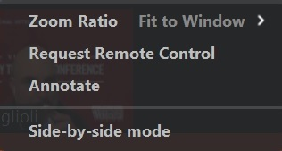

Functions Check
You can give a virtual thumbs up or clap by using the reactions icon. Click on the icon then choose a reaction the reaction will display on your screen for a few seconds and go away on its own.
Annotate (arrow) - Top, middle. Choose View Options and Annotate.
Then choose Arrow -
**Please only use these features when instructed to do so.

Slide 6
Functions Check
If you have a QUESTION during the presentation, please enter a question mark (?) into the chat box and the presenter or facilitator will call on you to address your question.
PLEASE WAIT UNTIL YOU ARE RECOGNIZED BEFORE UNMUTING YOUR MICROPHONE
If you’re having technical difficulties please contact Chris Macinkowicz via private message in the chat box or at cmacinkowicz@vfw.org.
If you need a comfort break, please do so and return as soon as possible.
Please remember, these sessions will be recorded for future use.
Everything on the internet lasts forever!

Slide 7
Lesson Plan
Reviewing POA requests, submitting claims and evidence using the VA Stakeholder Enterprise Portal (SEP)
How to submit claims and evidence using the VetraSpec Direct Submit Tool
Submitting claims and evidence using the VA Direct Upload Tool in Centralized Mail Portal (CMP)
How to submit claims and evidence using D2D in VetraSpec
Understanding when to use each system

Slide 8
Before using any Electronic Submission Method
Recommended Scanner Settings:
Image quality: Normal (300 dpi)
Color Mode: B&W
Scanning Side: Duplex (Double-sided)
Image Rotation: Automatic
Blank Page Removal: Yes
Continue Scanning after last page: Yes
You May want to have a PDF editor installed such as Adobe Acrobat DC or Nuance Power PDF Standard if you have large files that need to be split
Notes:
ENSURE TO EXPLAIN THE IMPORTANCE OF CHECKING SETTINGS OF SCANNER TO ENSURE THAT FILES ARE SMALLER AND QUICKER TO UPLOAD

Slide 9
Stakeholder Enterprise Portal (SEP)
The Stakeholder Enterprise Portal was created to allow accredited representatives a way to see what the veteran sees in eBenefits
Claims and evidence can be uploaded through this portal
This is where electronic POA requests are reviewed
Notes:
SPEND SOME TIME EXPLAINING WHAT SEP IS GOOD FOR, SUCH AS UPLOADING RECORDS, THAT YOU WOULD LIKE UPLOADED INTO VBMS FASTER.
POA REQUEST ACCEPTANCE, USEFUL FOR ASSISTING VETERANS REMOTELY – PROVIDE EXAMPLE:
EXAMPLE: ASSISTING VETERAN OVER THE PHONE, EMAIL. VETERAN CAN REQUEST POA ON EBENEFITS AND YOU ACCEPT ON SEP AND WORK CLAIM FROM THERE.

Slide 10
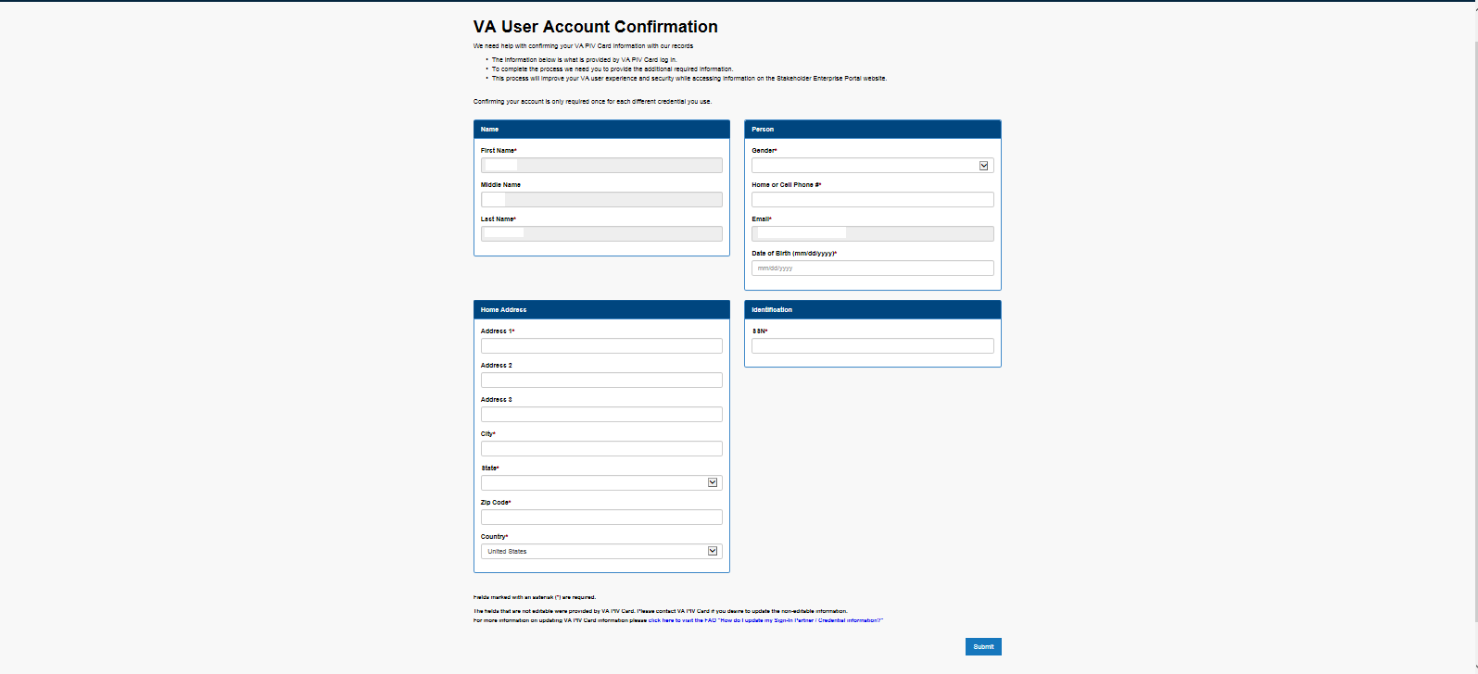
SEP: Registration
If this is your first time logging in, you will need to register for SEP
Once registered, you may need to request the ability to approve or deny POA requests from Theresa Aldana (taldana@vfw.org)
Notes:
EVERYONE REGISTERING FOR FIRST TIME, WILL MORE THAN LIKELY NEED TO HAVE THERESA GIVE THEM ACCESS TO ACCEPT OR DENY POA REQUEST. IT WILL BE UP TO DSO, IF THEY WANT TO PROVIDE THEM ACCESS, SO THAT HE/SHE, CAN EMAIL THERESA REQUESTING ACCESS FOR SUCH INDIVIDUAL.

Slide 11
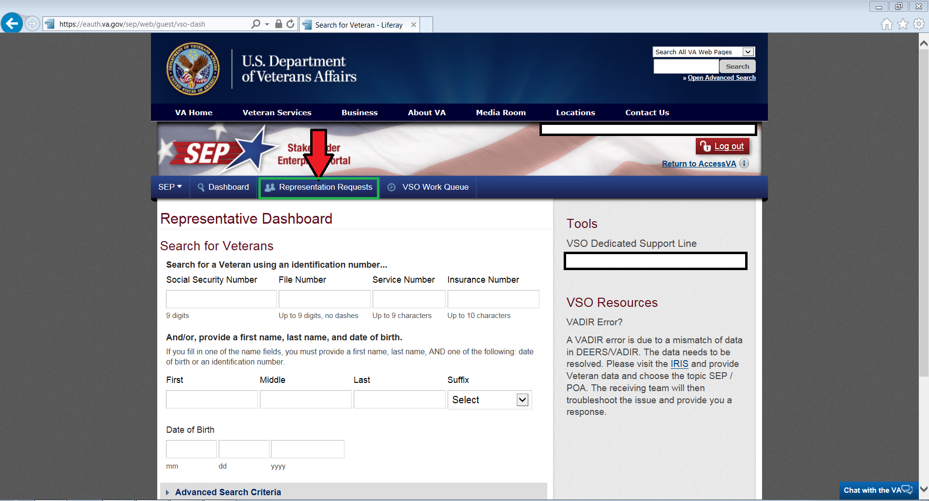
SEP: Reviewing Representation Requests
Select Representation Requests

Slide 12
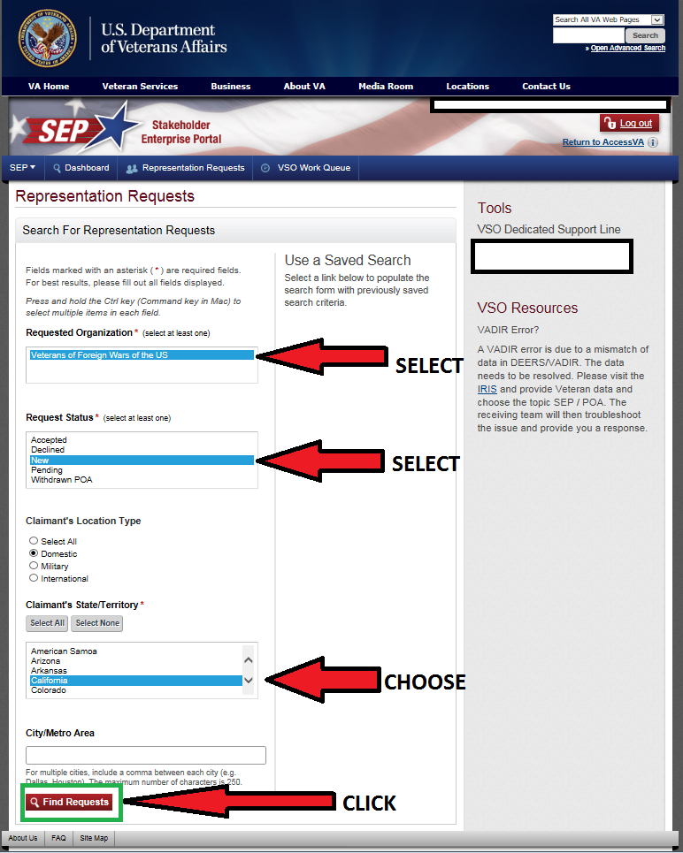
SEP: Reviewing Representation Requests
Select VFW
Hold Ctrl and select New and Pending
Choose the state that you want to search
Click “Find Requests”

Slide 13
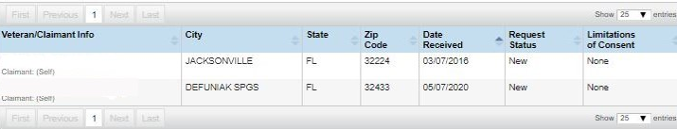
SEP: Reviewing Representation Requests
Once requests are generated, select the name to continue and see limited information for the veteran
Under “Limitations of Consent” ensure that the veteran did not put any limitation to health related information, otherwise the POA will need to be rejected.
A solution is for you to contact the veteran and explain the reason for having access to health related information, so that the veteran can re-submit the request.
SMITH, JOHN PAUL
JONES, DAVEY L
Notes:
EXPLAIN TO CLASS THAT IF ANYONE PUTS ANY LIMITATION ON HEALTH INFO, THEN THEY SHOULD ATTEMPT TO FOLLOW UP WITH VETERAN AND EXPLAIN TO THEM, WHAT THE LIMITATION OF HEALTH INFO DOES TO POA ACCESS.
SUGGEST TO CLASS TO CREATE A TEMPLATE TO QUICKLY SEND EMAIL WITH EXPLANATION OF DENIAL AND REASON.

Slide 14
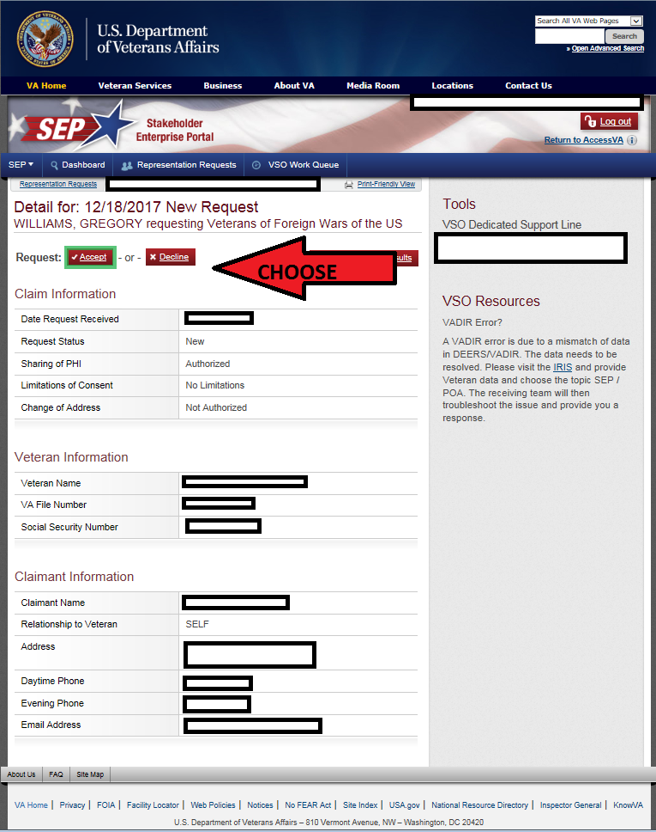
SEP: Reviewing Representation Requests
Before accepting a request, ensure that the veteran has no formal appeals pending
You can verify appeals statuses by contacting the local appeals team
Remember: You can accept POA for veteran as long as an appeal to the BVA has not been submitted
If you accept a POA that has a pending appeal at BVA contact VA Public Contact to remove the POA
Select “ACCEPT” or “DECLINE”
Notes:
ENCOURAGE THEM TO MAKE A POC AT LOCAL APPEALS TEAM, SO THAT THEY CAN FIND ANY STATUS OF APPEALS FOR POA REQUEST.

Slide 15
SEP: Reviewing Representation Requests
NVS Policy states that all POA requests must be acted upon within 5 business days
Not reviewing SEP POA requests is the same as ignoring a veteran that comes to your office for help

Slide 16
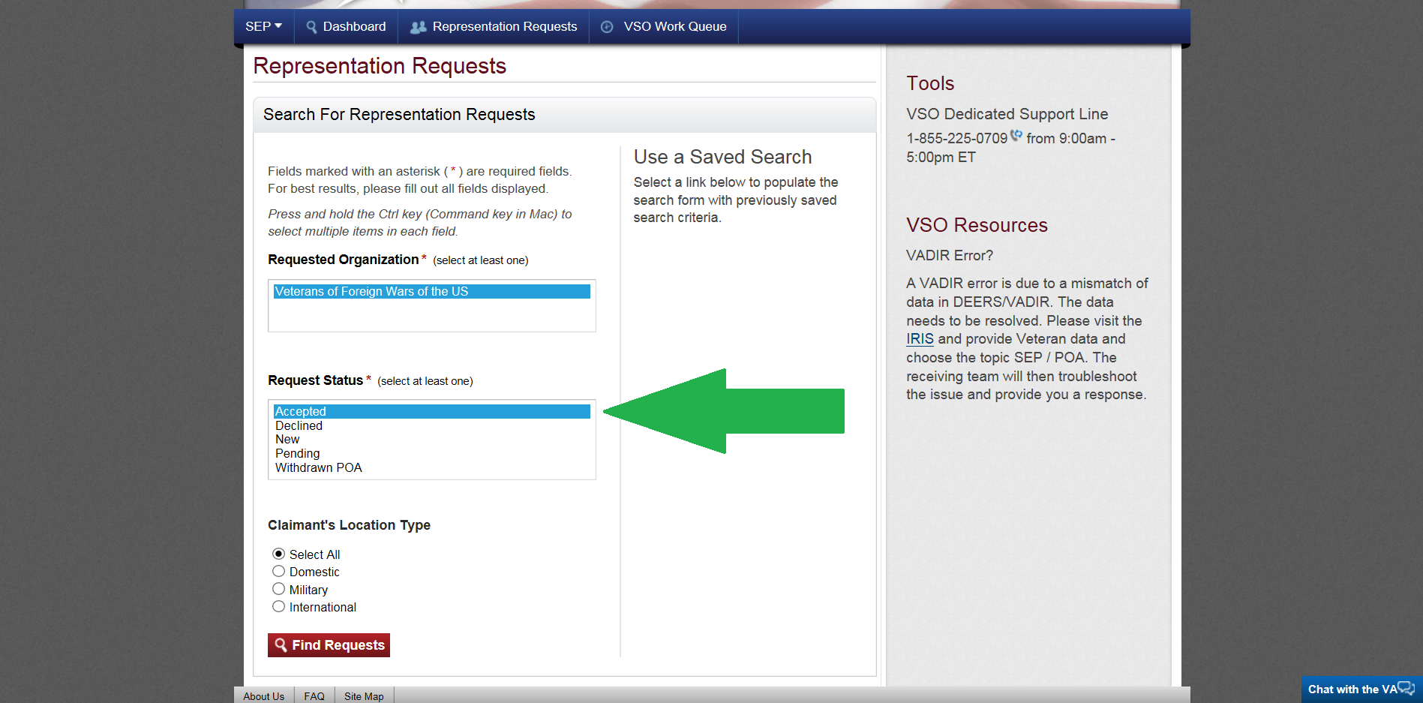
SEP: Viewing Accepted Requests
SEP allows you to view POA files you have accepted
In order for you to access these files select the “accepted” option displayed on the left and click on “find request”.
This will allow you to view clients accepted by VFW, so that you can add them into VetraSpec.

Slide 17
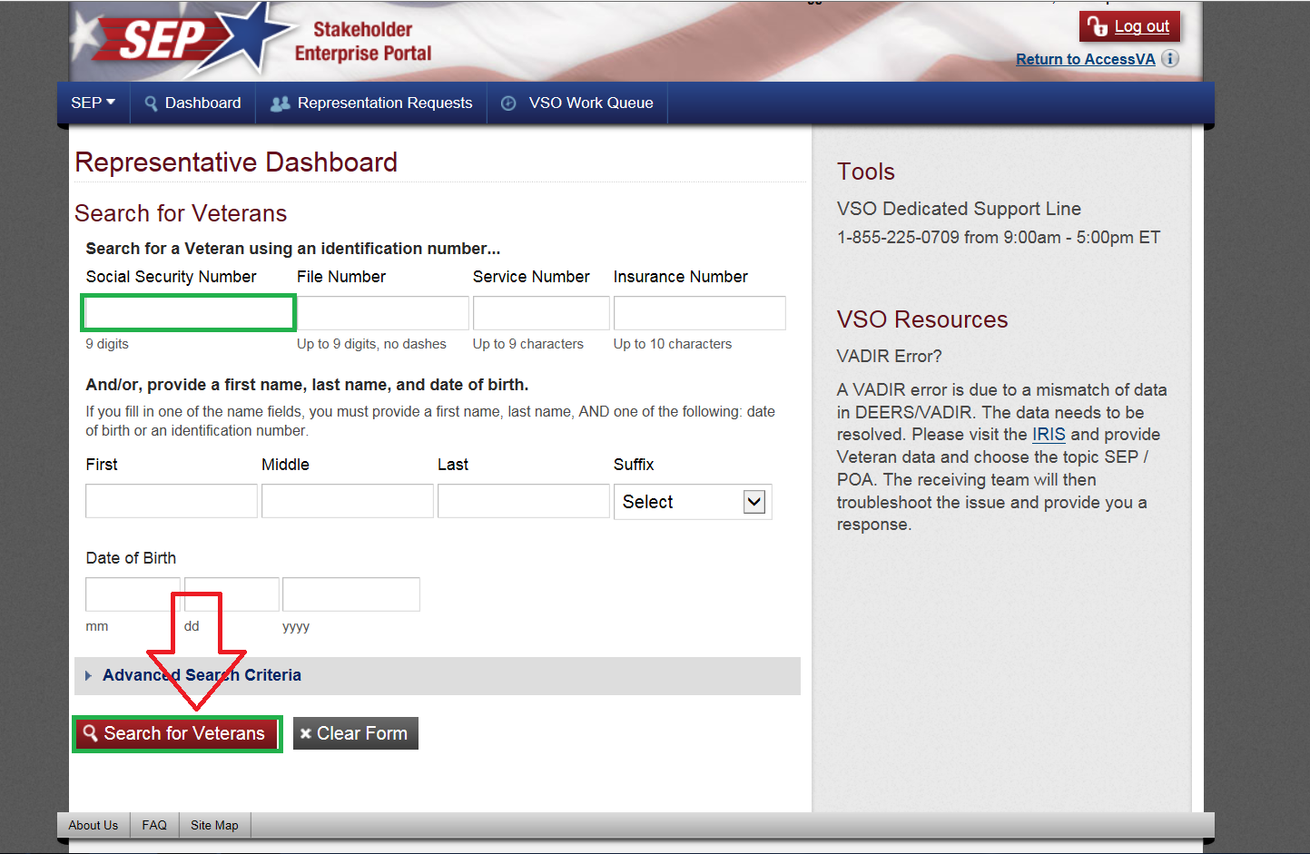
SEP: Viewing a Veteran’s File
SEP allows you to view what the veteran sees in eBenefits
The easiest way to search for a veteran is by by SSN in the Dashboard
Afterwards click on “search for veterans”

Slide 18
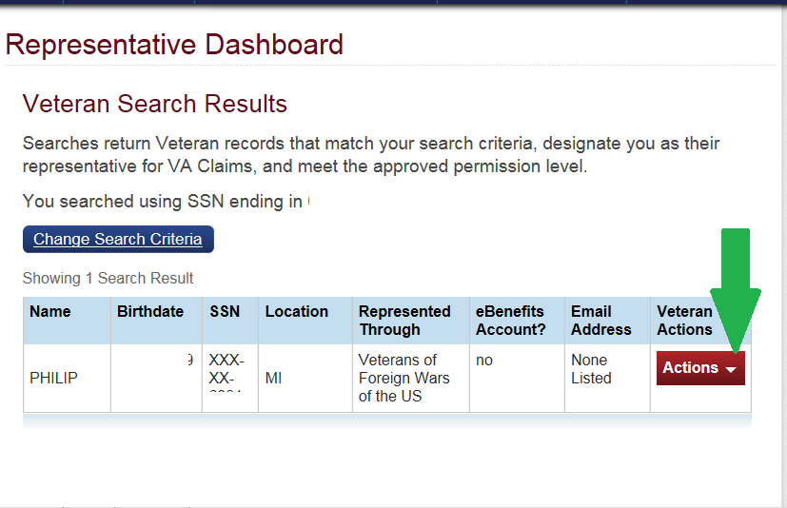
SEP: Completing Forms and Uploading Documents
After you search for veterans file, this screen on left will appear
From here there are many actions that you can select from

Slide 19
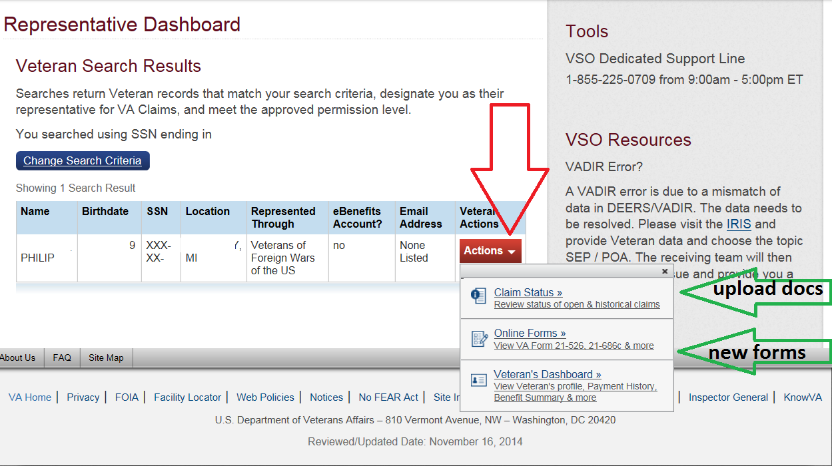
SEP: Completing Forms and Uploading Documents
To upload documents, first click on “actions” then click on “Claim Status”
This will bring you to the Work in Process screen as shown on next slide
You can also start a new form, such as VA form 21-526ez by selecting “online forms”

Slide 20
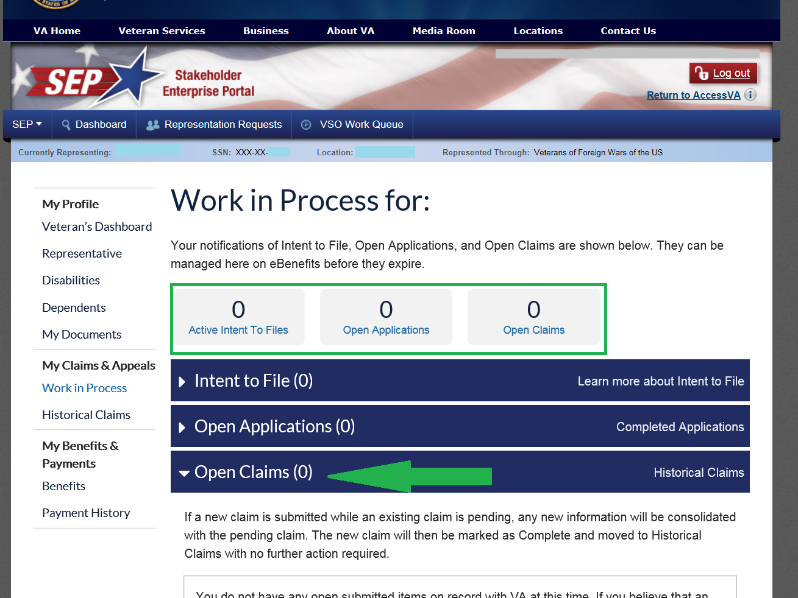
SEP: Completing Forms and Uploading Documents
To upload documents into a pending claim, select “Open Claims”
This will expand the window to allow you to “upload documents”
This screen also shows what the file has open or pending you can get a quick idea of any ITF’s, pending claims or open claims.
For more detailed claim information use VBMS

Slide 21
SEP: Completing Forms and Uploading Documents
Once you have finished uploading evidence or creating forms in SEP you MUST enter a communication in VetraSpec with a brief description of what was submitted.
If any evidence was uploaded to SEP, you SHOULD upload it to VetraSpec as well

Slide 22
Direct Submit
Direct Submit is a new tool that was recently added to VetraSpec
Allows accredited reps the ability to submit all claims and evidence directly from VetraSpec
Works similarly to the Centralized Mail Portal

Slide 23
Direct Submit
In order to gain access to Direct Submit, you must successfully complete the Direct Submit Instructions in the VFW Online Learning Portal (OLP)
Attending this session does not exclude you from the Online Learning Portal Class
Only accredited representatives can use Direct Submit
Notes:
Taking this class does not take place of the direct submit instructions class on the OLP
Even though we have non-accredited VetraSpec users, only accredited reps should be using direct submit

Slide 24
Direct Submit - Key Features
A VA issued PIV card and/or remote access to VA systems is NOT required to use this tool
Any documents or forms that are created in or stored in VetraSpec can be submitted using Direct Submit
Once successfully submitted, VetraSpec automatically logs the proof of submission in the veteran’s record
If it is stored or created in VetraSpec, you can submit it using Direct Submit

Slide 25
Direct Submit - Key Features
Forms created and digitally signed in VetraSpec can be sent with no additional steps
If the form is not signed, the entire form must be printed, signed, and uploaded to the documents section
Only documents in PDF format are accepted
All uploaded documents must be named properly when saved to your computer. Spaces and special characters are not allowed in the filename.
PDF’s cannot be password protected, this often happens when medical records are stored on a CD (DoD)

Slide 26

How to use Direct Submit
Once Direct submit is enabled on your VetraSpec Account, and you have a submission ready, click the Direct Submit Button to begin submitting a claim or evidence

Slide 27
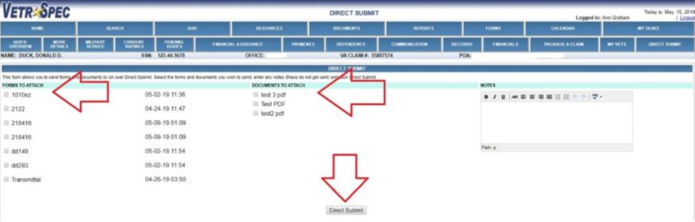
How to use Direct Submit
Select the forms and/or documents you want to attach and then click Direct Submit

Slide 28
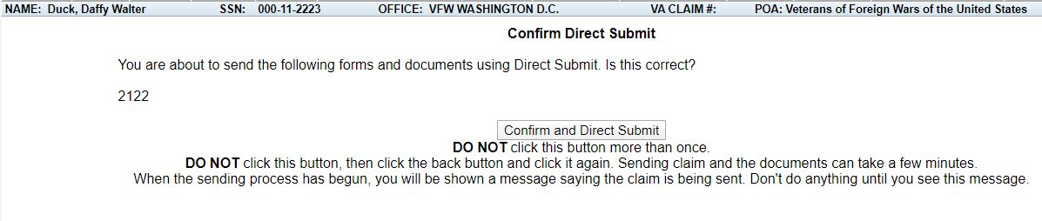
How to use Direct Submit
Confirm that your submission is correct and click the Confirm and Direct Submit button once.
Once the submission process begins you will be shown a success page.

Slide 29
Direct Submit: Checking Status
After submitting forms or documents with Direct Submit, you must check the status to ensure the submission was successful
There are 2 ways to do this:
Select the Direct Submit button in the veteran’s record
or
Select Direct Submit Status on the Home Screen

Slide 30
Direct Submit: Checking Status in the Veteran’s Record
To check the status in the veteran’s record:
Direct Submit does not automatically refresh the status update. There is a Check Status link under Action that must be selected to view the most up-to-date status of the submission.
You may have to refresh your screen after clicking Check Status to see the most current status.

Slide 31
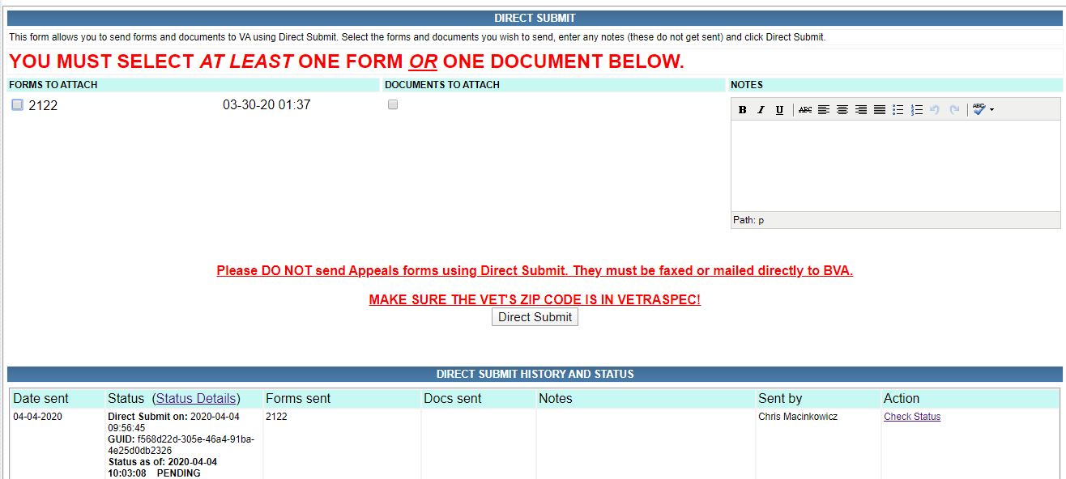
Direct Submit: Checking Status in the Veteran’s Record
Displayed Status

Slide 32
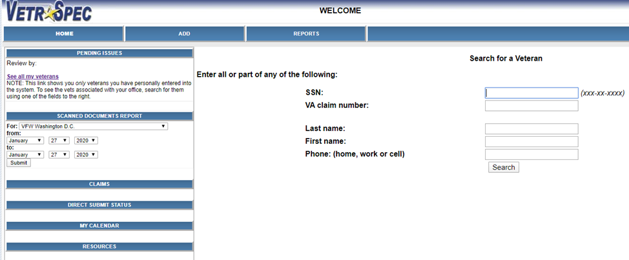
Direct Submit: Checking Status From the Home Screen
To check the status from the Home Screen, select Direct Submit Status

Slide 33
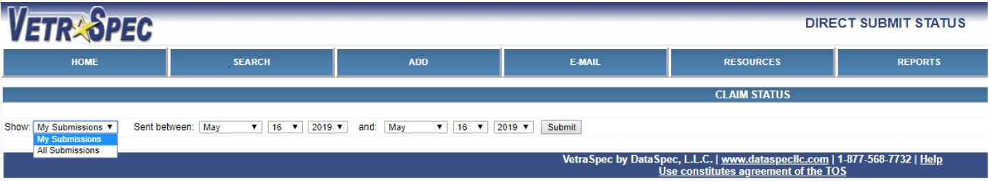
Direct Submit: Checking Status From the Home Screen
My Submissions will show you all direct submissions you have personally sent.
All Submissions will show you all submissions that have been sent to VA by any VetraSpec user.

Slide 34
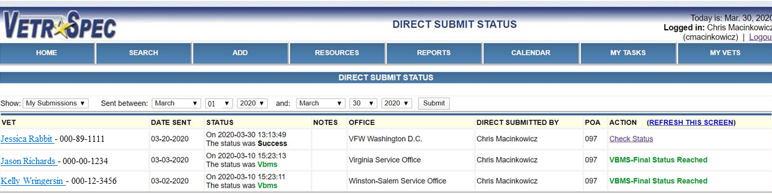
Direct Submit: Checking Status From the Home Screen
The report will show you the Direct Submit items that have been sent to VA during the time frame you selected.
From here you can Check Status of each submission. Once you click Check Status next to a submission, click Refresh All to see the updated status.
You can click as many Check Status buttons as you want prior to clicking Refresh All, however to see the updated status of any submission you must select Refresh All.

Slide 35
Direct Submit: Potential Statuses
STATUS | Explanation
PENDING | The package is being transferred electronically.
UPLOADED | The package has been uploaded, but NOT yet processed or added to Centralized Mail.
RECEIVED – Once you receive this status the submission date is preserved. | Indicates package has been successfully added to Centralized Mail.
PROCESSING | The package is being processed by VA systems.

Slide 36
Direct Submit: Potential Statuses
STATUS | Explanation
SUCCESS | The package has been received, processed and is being worked by a human at VA.
VBMS | Package has been uploaded successfully into VBMS.
EXPIRED | There was a lag on the VA system and the submission was not accepted. Resubmit.
ERROR | There was an error in the submission, look at the error code to determine the solution

Slide 37
Direct Submit: Potential Statuses
Be aware that the status will not automatically refresh. You must refresh manually to see the current status
An error can occur at any step in the process

Slide 38
Centralized Mail Portal
Formally known as Dimensions 360 is now called Centralized Mail Portal
Several names including the following: CMP, Direct Upload, and Direct Upload Mail Portal (DUMP)
You can “DUMP” anything into the VA file
Provides another option instead of sending faxes to Janesville
Notes:
DIRECT UPLOAD IS MANY VSO’S PREFERRED SUBMITTAL PORTAL, DUE TO ITS SIMPLICITY
IT IS IMPORTANT TO FOLLOW UP ON FILES, TO ENSURE THAT FILES ARE UPLOADED

Slide 39
Centralized Mail Portal: Getting started
Link: https://dmhs.digitalcontentservices.com/ (This link can be accessed inside or outside of the VA firewall)
A DoD CAC, a VA issued PIV card, or an ID.me account is required to use this program
You will need to create an account
If you encounter errors registering, submit a VA IT ticket

Slide 40
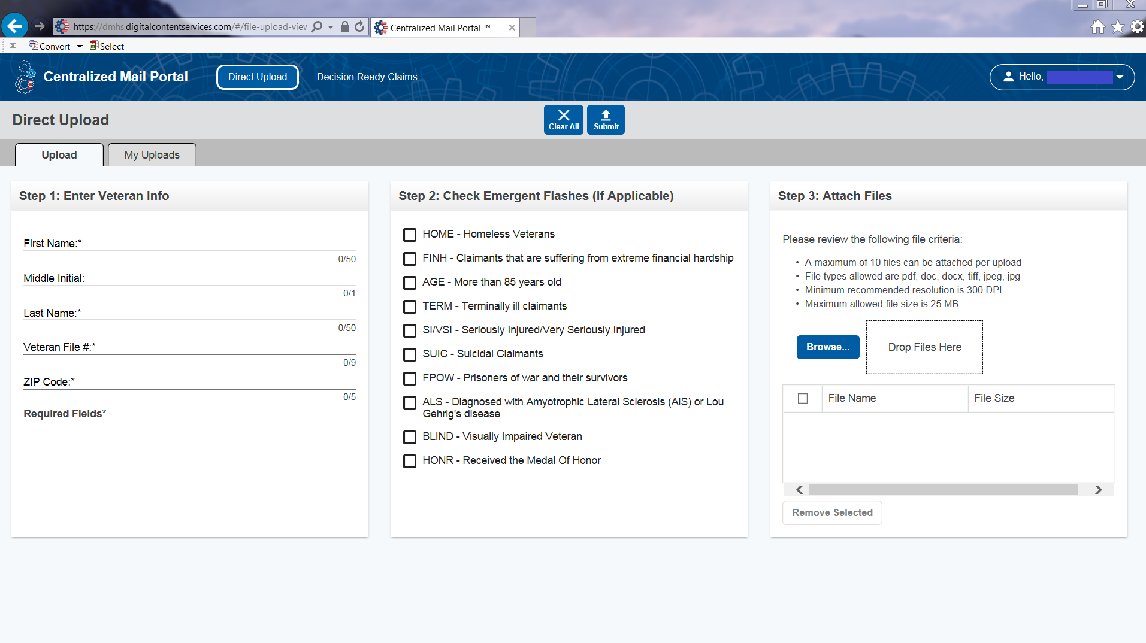
How to use the Centralized Mail Portal
1
5
1 - Select Direct Upload
2 - Enter the veteran’s information
3 - Check any emergent flashes that apply
4 - Attach Files
5 - Click SUBMIT
4
2
3
Notes:
ANY RESTRICTED FILES “SENSITIVE FILES” SHOULD HAVE A RESTRICTED FILE COVER SHEET. YOU CAN OBTAIN A COPY OF COVER SHEET BY CONTACTING YOUR VARO’S CMA.

Slide 41
Centralized Mail Portal: Proof of Submissions
After you submit documents in direct upload, you MUST copy and paste the confirmation number into the communications section of the veteran’s VetraSpec file
The confirmation number will display on the screen after submission, and will also be e-mailed to you
You will need the confirmation number to track packets after submission

Slide 42
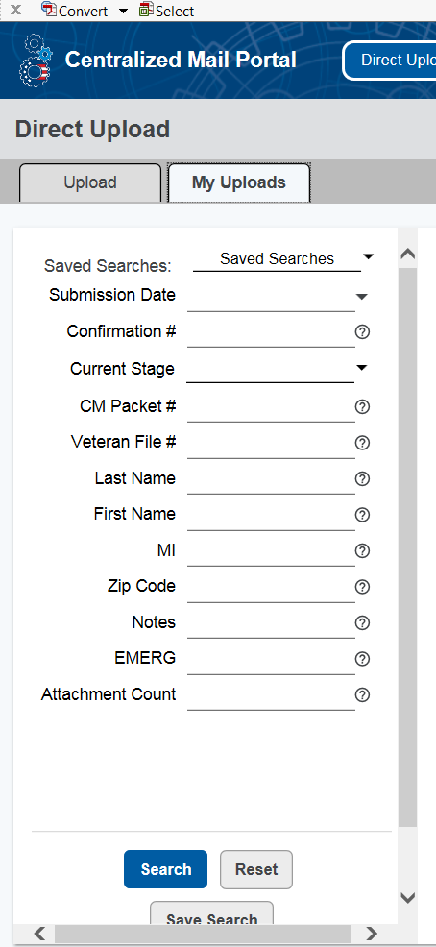
Centralized Mail Portal: Tracking Submissions
To track your submissions in CMP, first select My Uploads
Then, enter your search criteria and select Search
Notes:
DEMONSTRATE HOW TO TRACK STATUS OF UPLOADED FILES

Slide 43
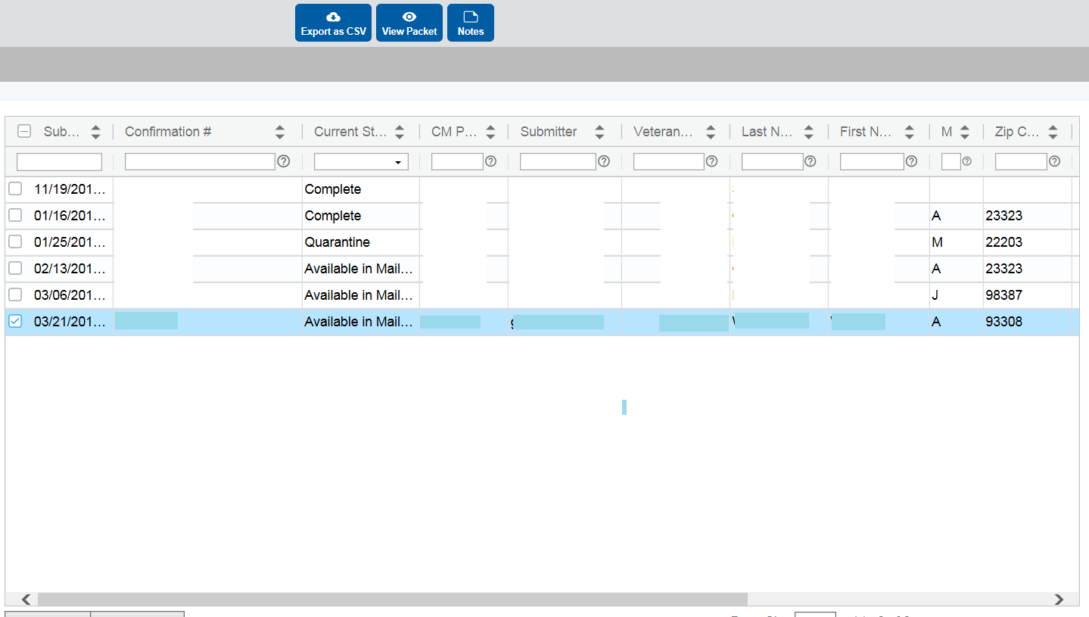
Centralized Mail Portal: Tracking Submissions
Once you select Search, any submissions that meet the search criteria will be displayed
You can double click on any claim or check the box and click view packet to view what was submitted
Notes:
DEMONSTRATE WHERE TO CLICK TO EXPAND OPTIONS OF SELECTED FILE
THE STATUS IMAGE, IS A VISUAL THAT CAN HELP TRACK STATUS OF FILE UPLOAD, EXPLAIN TO CLASS THAT IF THE FILES HAS BEEN SITTING UNDER “AVAILABLE IN MAIL PORTAL” STATUS FOR MORE THAN 5 BUSINESS DAYS, THEN HAVE THEM CONTACT THE IPC COACH AND USE THE CONFIRMATION NUMBER AS REFERENCE. OR THEY CAN CONTACT THE IPC INBOX

Slide 44
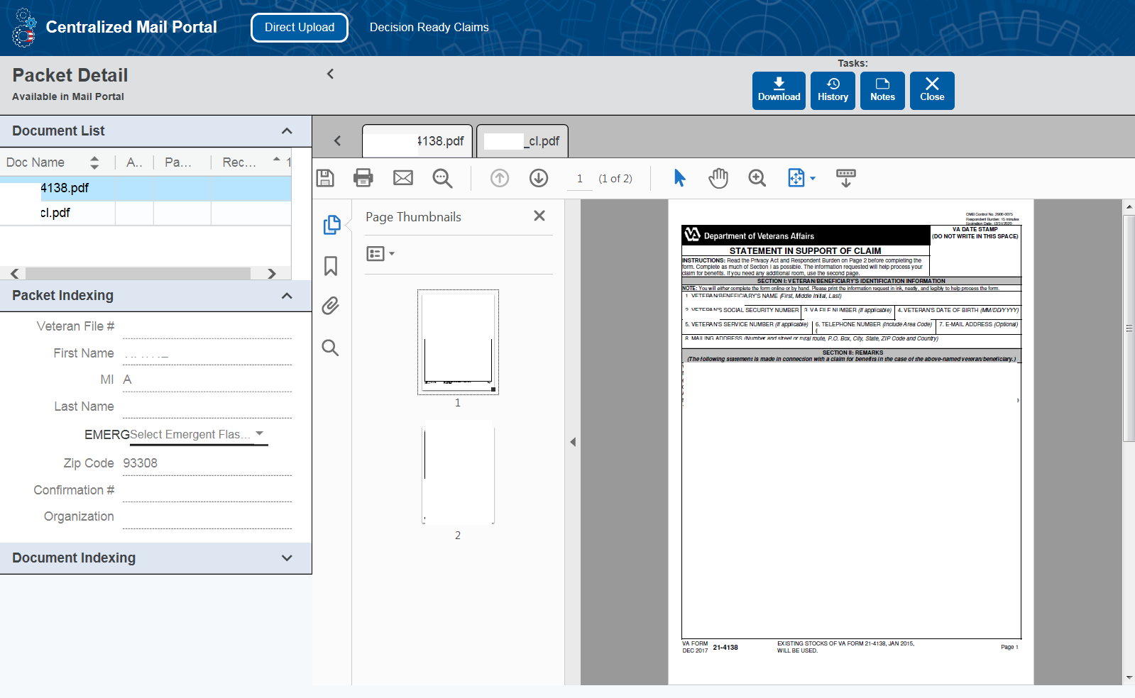
Centralized Mail Portal: Tracking Submissions

Slide 45
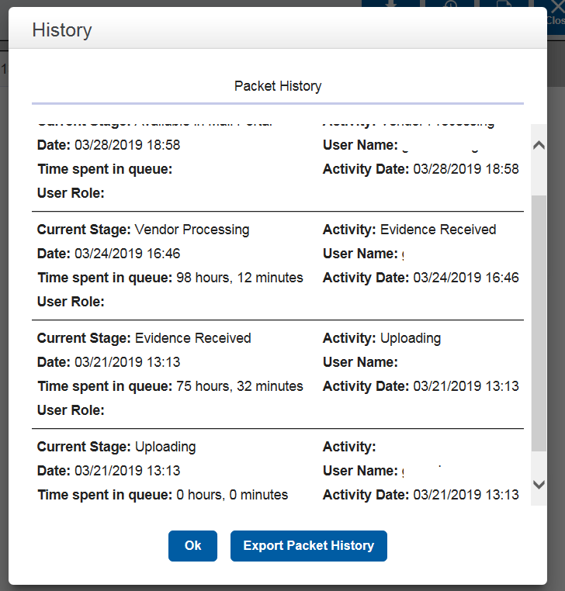
Centralized Mail Portal: Package History
If you click the history button at the top of the Packet Detail screen, it will show all of the steps that have taken place to upload the packet to VBMS

Slide 46
Centralized Mail Portal: Packet Status
Uploading – The packet is being sent to VA
Evidence Received – The packet has been received by the Janesville Centralized Intake Center (JCIC) but has not been processed or uploaded to the veteran’s claim file
Vendor Processing – The JCIC is preparing the packet to be uploaded to VBMS
Available in Mail Portal – The packet is now with a VSR at a VARO to establish the packet in VBMS
Complete – The packet has been successfully uploaded to VBMS
Quarantine – Errors have been identified and the packet will not be uploaded until any errors are resolved

Slide 47
Centralized Mail Portal: Quarantined Packets
If one of your submissions becomes quarantined, you will need to resubmit the packet. Prior to resubmitting, verify that none of the files are password protected and that none of the files have been corrupted.

Slide 48
What is D2D?
D2D is a VetraSpec system that allows users to submit COMPENSATION claims directly to VA which will then be added to the veteran’s file within minutes
D2D can only send forms that were created and electronically signed in VetraSpec using a digital signature pad
You can only send evidence if it is accompanied by a claim form

Slide 49
What is D2D?
Do not create blank forms to submit evidence to VA using D2D
This can create issues with the claim when VA establishes or updates the veteran’s file
If you have evidence to send without a claim form do not use D2D

Slide 50
What is D2D?
Before you can use D2D you (or VA IT) must install signature pad software and pDoc Signer on your computer.
Instructions on how to install and use the digital signature pad can be found on the VFW Online Learning Portal in the Resources area

Slide 51
What can be Submitted via D2D?
If the VFW does not have POA for the veteran, the VA Form 21-22 must be sent first by itself
The VA Form 21-0966 (ITF) must be sent alone
The VA Form 21-526ez can be sent alone or with other documents/evidence
All other forms/evidence must be sent with the VA Form 21-526ez
If you have evidence to submit but do not have a VA Form 21-526ez to submit, use a different submission method
Notes:
The 21-22 is the key to the door

Slide 52
D2D: Required Info in VetraSpec
Your OGC number (in the control panel)
Personal information for the veteran (must contain date of birth & phone number)
A correctly completed, electronically signed form with no special characters

Slide 53
D2D: Tips on completing forms
Items to Remember:
D2D uses “Skip Logic”: If you select yes to a question that has a follow up answer in a form, you must complete the second answer.
Example:
Have you ever filed a claim? If “yes”, you MUST write claim number.

Slide 54

How to use D2D
In the Veteran’s VetraSpec File, once you have completed and electronically filled out a form in VetraSpec, Select Package This Claim to get to the D2D area.
Notes:
This is a backup slide if VetraSpec is down or the screen doesn’t share properly. During the session, the instructor will demonstrate in VetraSpec

Slide 55
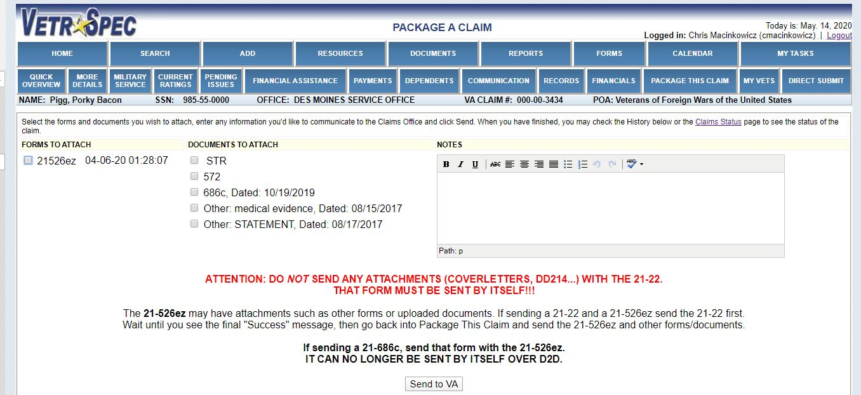
How to use D2D
Select the form(s)/evidence you want to submit under “Forms to Attach” or “Documents to attach and click “Send to VA”

Slide 56
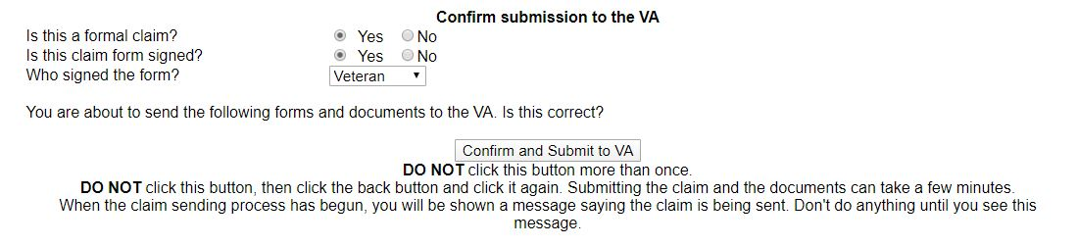
How to use D2D
After you select Send to VA, you will be asked to confirm your submission. Answer the questions accurately and then click “Confirm and Submit to VA”
Notes:
Remind students to not press the confirm button in class

Slide 57
D2D: Ensure Claim was Submitted
Allow VetraSpec several minutes to upload the claim to VA Computer Systems (use this time to explain claims process if the veteran is in your office)
Refresh VetraSpec (select “Package This Claim”)
You should see that the claim was processed with all attachments “Failed-None” at the bottom of the screen
Another option to check submission status is to select “Claims” on the left side of the Home screen in VetraSpec.

Slide 58
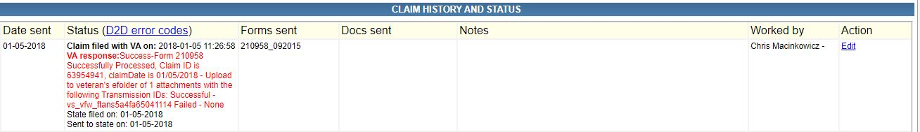
D2D: Ensure Claim was Submitted
If, when checking the status of a D2D submission, you receive an error code, you can select “D2D error codes” to see a list of errors and how to resolve your error.

Slide 59
Electronic Systems: How big of a file can be submitted?
Uploading size limits in the different systems:
D2D size limit = 5mb per file
Direct Submit size limit = 5mb per file 10 files per upload
SEP size limit = 25mb per file
Centralized Mail Portal size limit = 25mb per file, 10 files per upload

Slide 60
Review
Remember what each system is most useful for:
D2D- submitting POA’s, Compensation claims
SEP- Accepting POA requests, VAF 686c & VAF 674
CMP / Direct Submit - Useful for submitting anything (replaces fax machines)

Slide 61
QUESTIONS?

