Slide 1
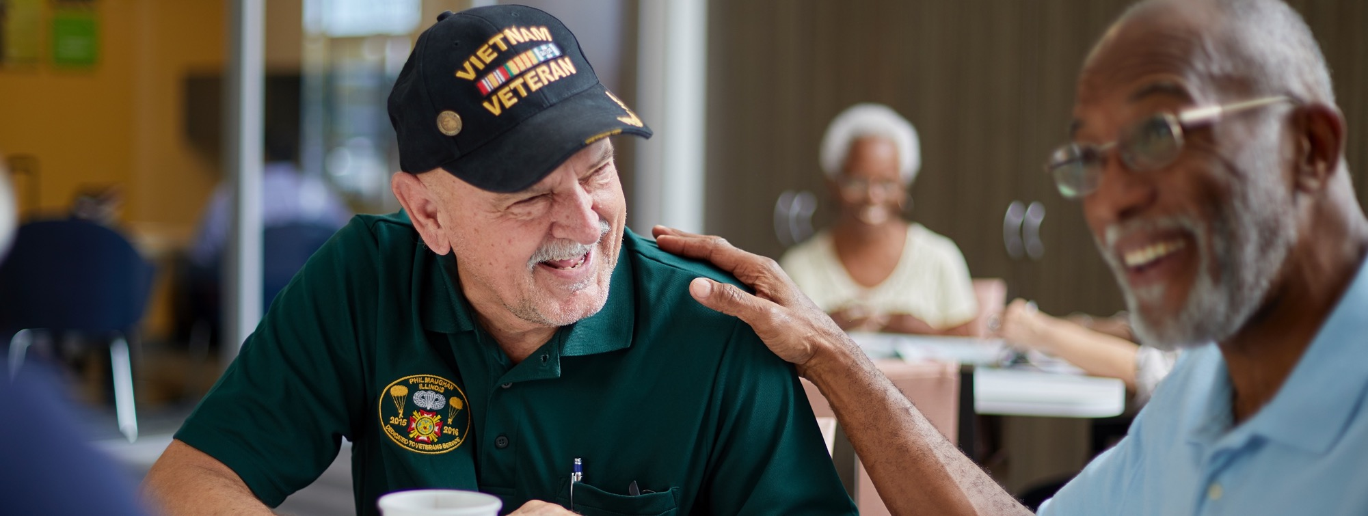


  Visit Go/Brand to ensure you are always
  using the latest version of this template.
Humana is committed to veterans
We’re proud to serve those who’ve proudly served

Slide 2

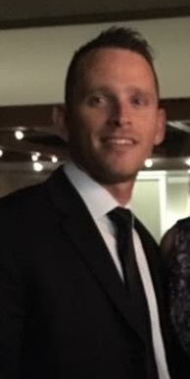
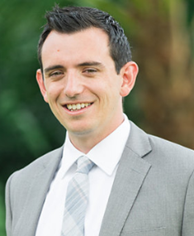
Your Presenters
Darin Davis
Northwest Regional Veterans Executive
Little Rock, AR
ddavis21@humana.com
12+ years with Humana
  (Sales & Mgmt)
Veteran - U.S. Army National Guard
Aaron McCoy
Northeast Regional Veterans Executive
Cleveland, OH
amccoy3@humana.com
7+ years with Humana
  (Sales & Mgmt)
Veteran - U.S. Army

Slide 3
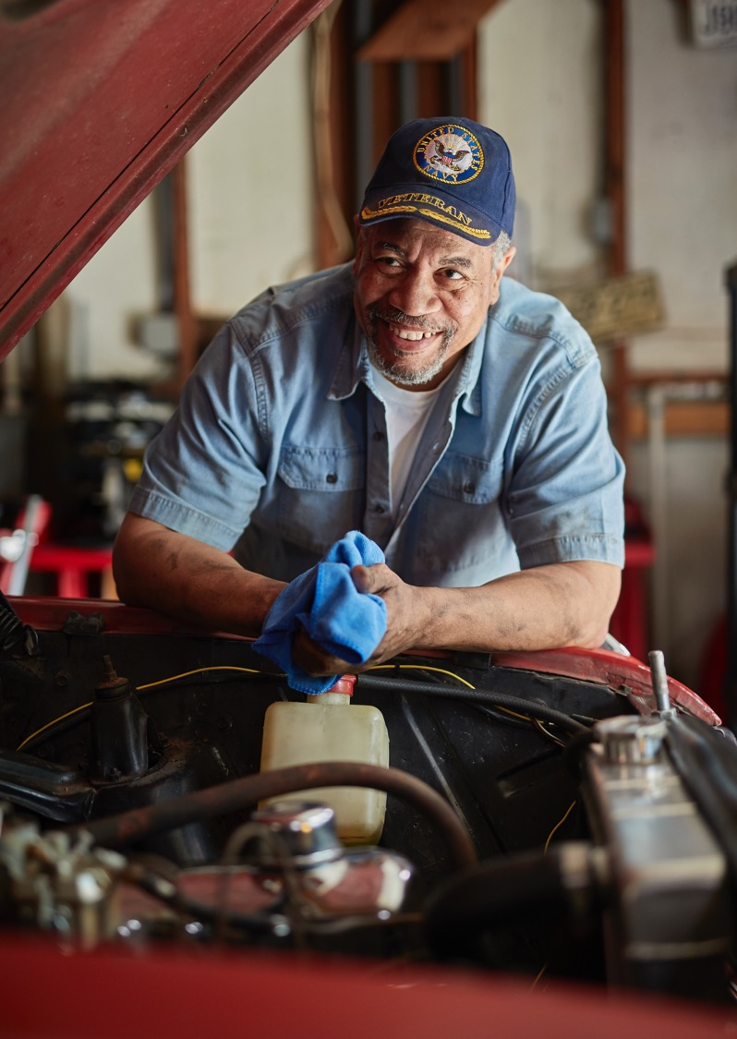
We’re leveraging our Bold Goal research and success in addressing Social Determinants of Health to improve the health of the veteran community
  Through a population health study, Humana will screen members of the Veterans of Foreign Wars for social determinants of health.
  Humana will also survey VFW members using the Healthy Days measurement to help predict outcomes and connect members with high Unhealthy Days to needed community resources and support.
  Additionally, Humana Military has established an Office of Population Health to address these issues and more

Slide 4
Social determinants of health and Veterans
17%
# Humana MA Veteran members are food insecure¹
25%
# Humana MA Veteran members report feelings of loneliness and/or social isolation¹
18%
# Humana MA Veteran members who report having one or more housing quality issues¹
8%
# Humana MA Veteran members have a transportation barriers¹
¹https://ignitewithhumana.com/ed/playbooks/bold-goal/bold-goal-whole-health-toolkit/?topics=bold-goal

Slide 5

VFW + Humana | Uniting to Combat Hunger
Timeline of Meals Raised¹
2018
2019
2020
2021
200K
300K
1M
1M
Raise awareness about Veteran food insecurity
¹https://www.vfw.org/uniting-to-combat-hunger

Slide 6

Ways to raise food
Host a gleaning event
Volunteer at a food bank
Start a food drive

Slide 7
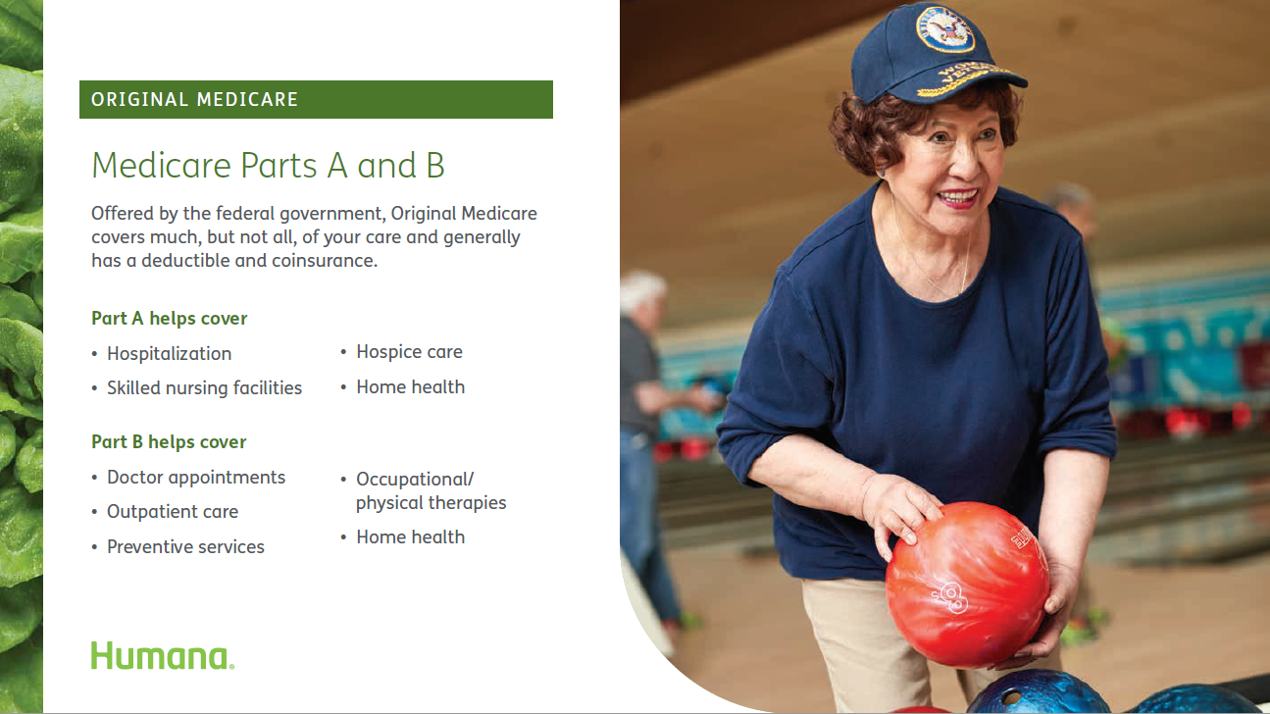

Slide 8
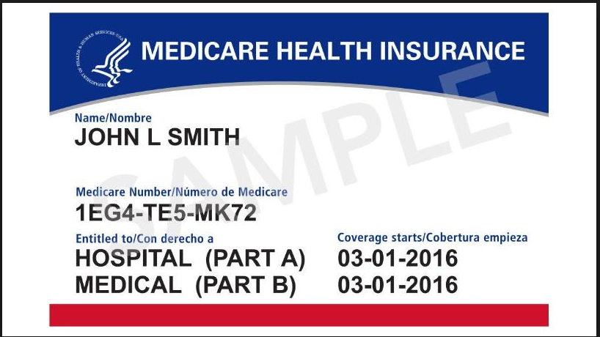
“VA does not recommend Veterans cancel or decline coverage in Medicare (or other health care or insurance programs) solely because they are enrolled in VA health care.”
I have VA Healthcare, why take out Part B?
Some Veterans consider opting out of Part B, to avoid paying the Part B premium. If they need to apply for Part B after their Initial Enrollment Period (IEP), they may pay a penalty because the VA Healthcare is NOT creditable medical coverage for Part B of Medicare (VA healthcare is creditable coverage for Part D of Medicare)
In order for a Veteran to get a Medicare Advantage plan, the person has to have Medicare Part B.
Medicare Part B and Medicare Advantage plans provides Veterans with more health care options.
VA and Medicare Advantage do NOT interfere with each other nor do they coordinate benefits. The VA does not file claims with Medicare (Parts A, B or C). The VA is a provider, but is not health insurance.

Slide 9
TRICARE for Life (TFL), CHAMPVA and Medicare Part B
Do TFL beneficiaries need to enroll in Part B of Medicare?
  They need to take Part B to transition to Tricare for Life (TFL)
  Medicare will be primary and Tricare will be secondary
  Can see any provider who accepts original Medicare
  Medicare will automatically bill Tricare for Medicare covered expenses
  Beneficiary will have no out of pocket cost for services covered by Medicare and Tricare
Should CHAMPVA beneficiaries enroll in Part B of Medicare?
  Beneficiaries must enroll in Part B of Medicare to continue utilizing CHAMPVA
  Medicare will become primary and CHAMPVA will become secondary
  Beneficiaries may see any provider who accepts Medicare
  Medicare will automatically bill CHAMPVA for covered expenses
  Beneficiaries will have no out of pocket costs for services covered by Medicare and CHAMPVA

Slide 10
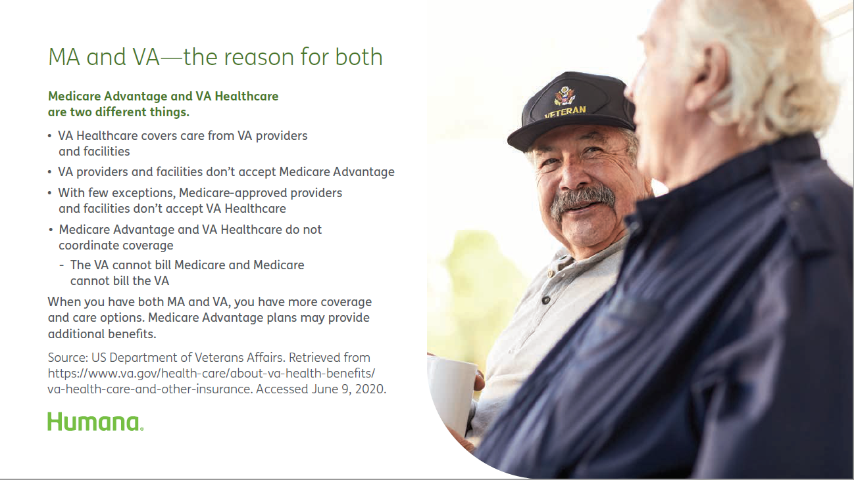

Slide 11

Humana Honor Plans
  The Plan is $0 premium, and offers a Part B giveback (premium reduction/depends on market).
  Enrolling in Humana Honor may augment VA coverage and help close any gaps in health care coverage.
  Humana Honor may provide Medicare-eligible veterans with additional health care services and location options.
  Humana Honor may give veterans access to dental coverage.
  Humana Honor plans offer a broad network, including Urgent Care access.
  Anyone with Medicare Parts A and B can enroll in the Humana Honor Plan
The combination of VA Health Care and a Medicare Advantage Plan provides the most options.

Slide 12
Next Steps
  Contact Darin or Aaron to introduce yourselves
  Set up a time for an in person meeting. Humana can bring your office lunch to make introductions and begin working together
  Help ensure local Humana associates are there as a resource for all Medicare questions. You don’t need to be Medicare experts.
  Help educate your local Humana teams on veteran benefits and when they should be referring veterans to your office and your service officers
  Let Humana know about ways they can work with and support your service officers, posts and departments

Slide 13
Contact us
Darin Davis
Northwest Regional Veterans Executive
Little Rock, AR
ddavis21@humana.com
12+ years with Humana
  (Sales & Mgmt)
Veteran- U.S. Army National Guard
Aaron McCoy
Northeast Regional Veterans Executive
Cleveland, OH
amccoy3@humana.com
7+ years with Humana
  (Sales & Mgmt)
Veteran- U.S. Army
Notes:
You can modify or remove this slide to accommodate your needs. The agents/partners you’re presenting to most likely know who you are already so you can use this however you’d like.

