Slide 1
The Federal Register
Brad Hazell
Assistant Director, Compensation & Pension Policy
Bhazell@vfw.org

Slide 2
Objectives
What is the Federal Register?
How to Access the Federal Register
How to Access VA Regulations
What is a Proposed Rule?
How do Proposed Rules become Final Rules?
What are Comments?
What does NVS do with the Federal Register?
What is your role with the Federal Register?

Slide 3
What is the Federal Register?
Each Federal business day, the Office of the Federal Register publishes the Federal Register, which contains:
Current Presidential proclamations and Executive orders
Federal agency regulations
Proposed agency rules
Documents required by statute to be published
Each year all Federal Regulations in force are published in the CFR
Notes:
The federal register does not only publish VA regulations; it publishes regulations for all federal agencies.

Slide 4
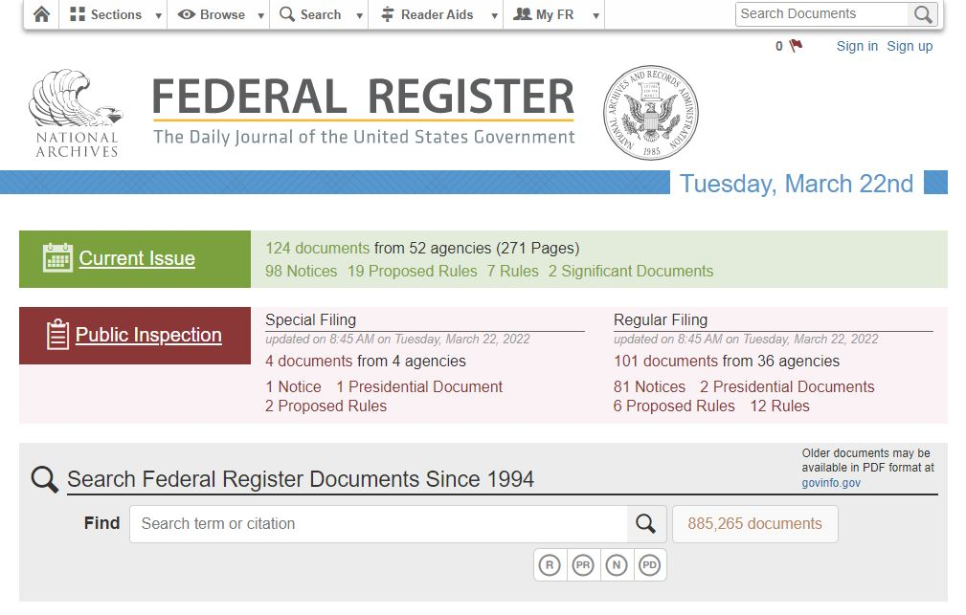
How to access the Federal Register
The Federal Register can be accessed by visiting:
https://www.federalregister.gov/

Slide 5
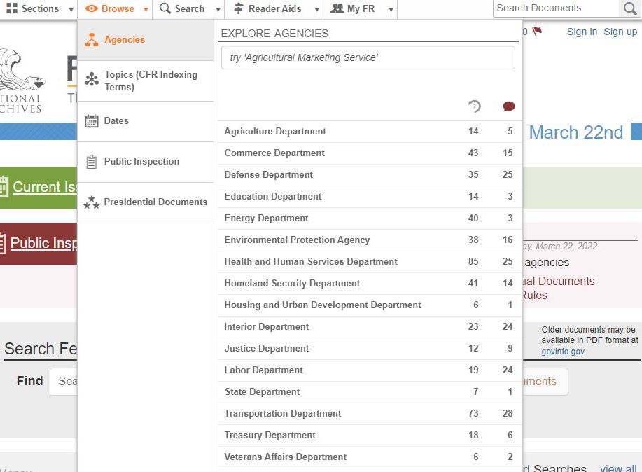
How to access VA Regulations in the Federal Register
Once in the Federal Register you can access VA regulations by selecting:
“Browse”
then
“Veterans Affairs Department”

Slide 6

How to access VA Regulations in the Federal Register
After selecting Veterans Affairs Department, you will be given a list of regulations and notices
You will likely have to click the “more” button to find the regulation you’re looking for
**PR = Proposed Rule
**R= Rule

Slide 7
How to access VA Regulations in the Federal Register
The Federal Register has an option to create an account which allows you to receive notifications on Federal Register Postings
If you choose to receive notifications, ensure that you select VA updates and any other agency you wish to view otherwise you will receive updates for every agency

Slide 8
What is a Proposed Rule?
A proposed rule is the official document that announces and explains the agency’s plan to address a problem or accomplish a goal
Proposed rules contain a summary of the issue, discusses the merits of the proposed solution, cites the information used to gather the data used during the rulemaking process, and the regulatory text
All proposed rules must be published in the Federal Register to notify the public and give an opportunity to submit comments
REMEMBER – Proposed Rules are not in effect and have no legal standing until adopted as a final rule

Slide 9
How do Proposed Rules become Final Rules?
In most cases, the public will have between 30 – 60 days to comment on proposed regulations once they are published in the Federal Register
For more complex regulations longer comment periods can be assigned (180 days or more)
Instructions on how to comment and the comment period deadline are listed in the Proposed Rule

Slide 10
How do Proposed Rules become Final Rules?
Members of the public may request more time to comment, and agencies may consider comments filed after the deadline if the schedule permits
There is no legal requirement for agencies to accept late comments or extend the comment period
The proposed rule will usually provide information indicating whether they will accept late comments

Slide 11
How do Proposed Rules become Final Rules?
Once the comment period has ended the agency must review and address all submitted comments – this may take weeks, months, or even years
If the agency feels there were not enough high-quality comments or if public comments make a good case for adding more time, the agency may reopen the comment period
If new issues are raised in the comments, a series of proposed rules may be published to address the new issues (similar to a deferred rating on a decision)

Slide 12
What does NVS do with the Federal Register?
The NVS Assistant Director for Compensation and Pension Policy reviews the Federal Register and drafts the VFW’s official comments for proposed rule changes
Once drafted, the comments are sent to the NVS Deputy Directors, NVS Director, and VFW Executive Director for edits and final approval
Once approved the comments are submitted to the Federal Register for publication

Slide 13
What does NVS do with the Federal Register?
The public is allowed and encouraged to comment on the Federal Register. However, if you decide to make a comment, ensure that you are making it as an individual, NOT speaking for the VFW.

Slide 14
What does NVS do with the Federal Register?
If you have suggestions for Federal Register comments you can submit them to NVS for consideration as part of the VFW’s official comments

Slide 15
What is your role with the Federal Register?
As an accredited representative, it is important to be aware of potential regulation changes in order to keep our veterans informed

Slide 16
What is your role with the Federal Register?
Scenario 1:
You are working in your office when Kelly Porter, a retired Navy veteran, calls to ask about the email she received from VA stating that there is proposed regulations about changing the mental health rating schedule. She believes that her current rating will be reduced. Generally speaking, what should be your response?
Explain that the email is informational and that it won’t affect her rating because she is grandfathered in
File an ITF or claim for increase today to prevent the reduction
Tell Ms. Porter that unfortunately once the rating schedule is changed her rating will likely be reviewed and may be reduced

Slide 17
What is your role with the Federal Register?
Scenario 2:
Mr. Jason Cartwright contacted you today to ask if he should file a claim for sleep apnea because he was told ratings for OSA would be going away soon. What should you do? Why?
What if he doesn’t have a diagnosis yet?
Notes:
If the claim or an ITF is filed before the law change goes into effect, the more favorable rating would apply.

Slide 18
What is your role with the Federal Register?
Knowledge Check:
VA uses the Federal Register to inform the public about changes to:
Adjudication Procedures Manual (M21-1)
United States Code and Statutes
Federal Regulations
All of the above

Slide 19
Final Thoughts
The Federal Register publishes regulations that will be included in the Code of Federal Regulations
The comment period is an important part of the Federal Rulemaking process that allows the public to provide feedback on proposed rules
Until the final rule is published, the regulations are just proposed and have no legal effect
If you have a veteran who may want to file a claim for a condition that may be affected by a rule change, file the claim as soon as possible so that the most favorable rating would apply

Slide 20
QUESTIONS?

