Slide 1
Tyler Veterans Benefits (TVB)
Part 1

Slide 2
This class has been split into three parts that will take place during this conference
Part 1: General Navigation and Creating a veteran folder
Part 2: Completing Forms and Submitting items to VA
Part 3: Demonstration and Question & Answer Session

Slide 3
Learning Objectives
What is the TVB Website
How to log in
Navigating the Home screen and TVB
How to create a veteran folder

Slide 4
TVB Website/log in
Prior to the migration from VetraSpec to TVB, you will be provided your login credentials.

Slide 5
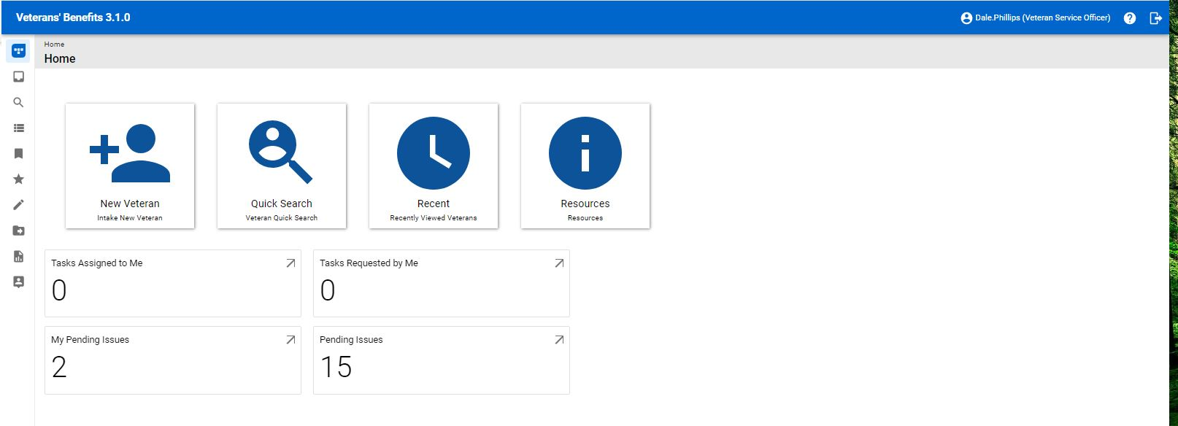
TVB Home Screen

Slide 6
TVB Home Screen New Veteran
The New Veteran Button is used to create new veteran folders

Slide 7
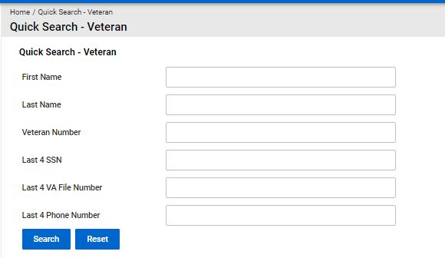
TVB Home Screen Quick Search
The Quick Search function allows you to search for veteran folders

Slide 8
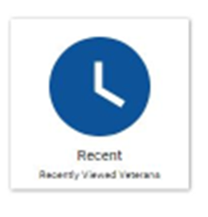
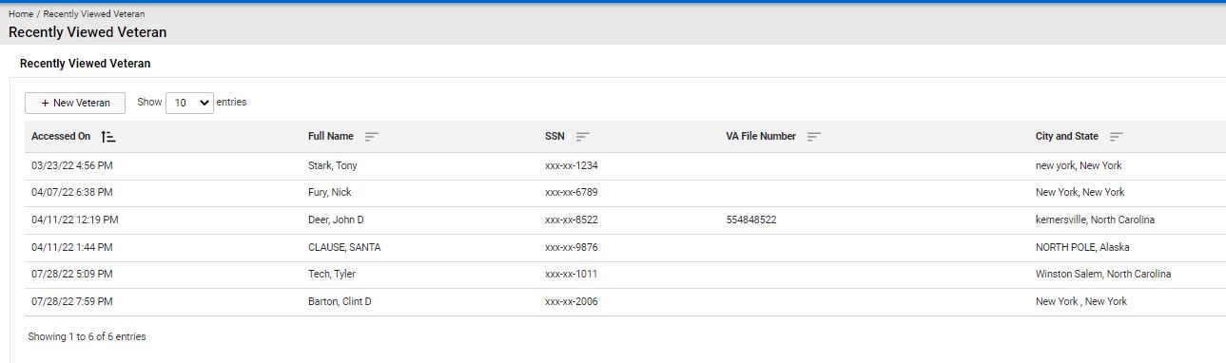
TVB Home Recent
The Recent function takes you to a listing of recent veteran folders you visited

Slide 9

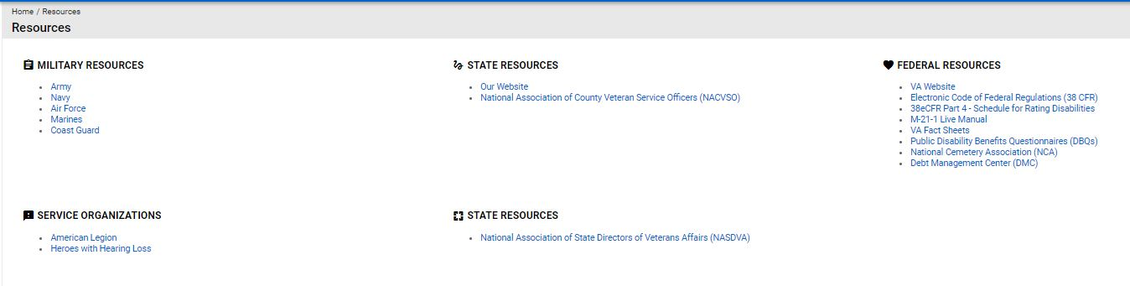
TVB Home Resources
The Resources function takes you to a listing of DOD and VA resources

Slide 10
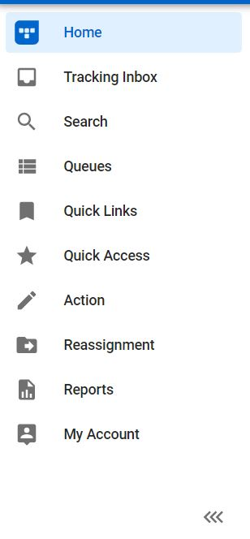
TVB Home Screen Columns
The home screen displays a column with icons. To expand this to show what each icon is named, click on the arrows marked below.

Slide 11
Adding a new Veteran
To add a new veteran from the home screen you will need to click on the icon that says“+ New Veteran”

Slide 12
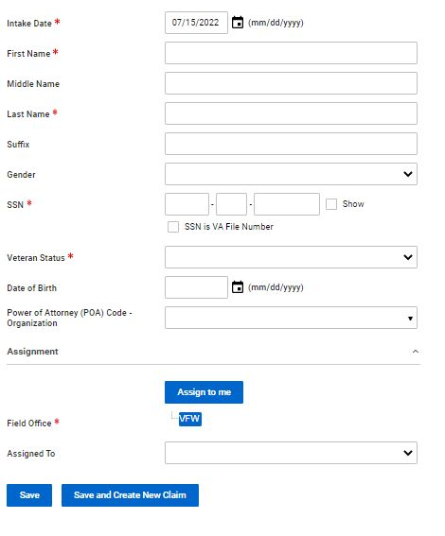
Required fields
Required information to accept a veteran:
Intake Date
First Name
Last Name
SSN
Veteran Status: Active, Inactive, Pending or Revoked
Field Office

Slide 13
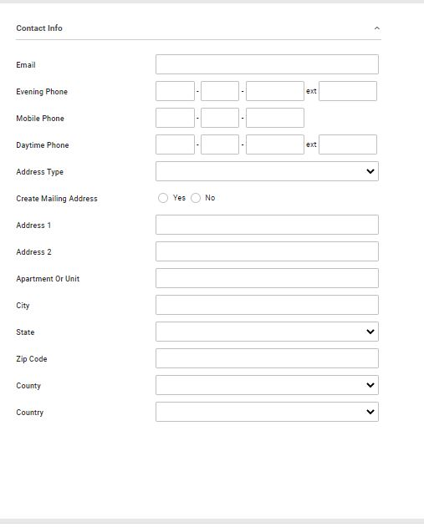
Additional fields
Additional information to accept a veteran:
Phone Number
Email
Address
City
State
Zip Code
*Despite these being listed as optional, this data will be required in further fields.

Slide 14
Things to consider when adding a veteran
Though all of the fields aren’t required to create a record, it is encouraged to fill out all applicable fields. Reasons for this include:
Missing fields on veteran screen = missing fields on future claim forms submitted from TVB
If you omit the contact information, you may not be able to contact your veteran
The data will need to be captured at some point, capture it correctly in the beginning.
The more data you capture, the easier it is to track trends and search for specific situations
The data is only as good as the data entered “ Garbage in Garbage out”

Slide 15
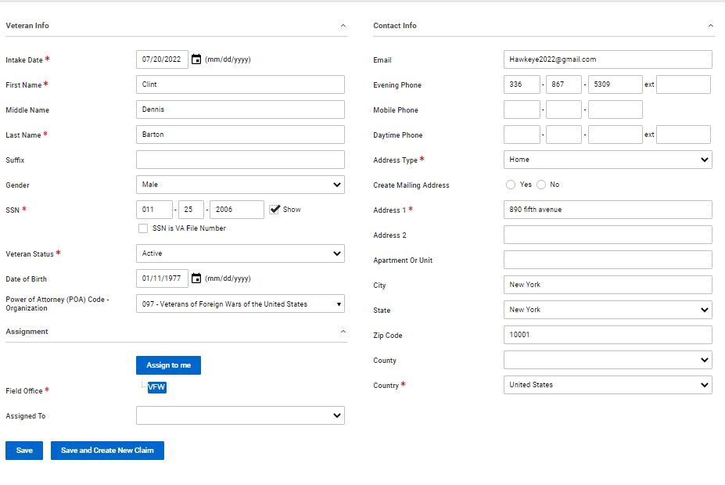
What to do with a completed veteran folder
Once all information is added for the new veteran, to continue you will be given two options
Save
Save and Create New Claim

Slide 16
Proceeding down the “Save” Path
Once in a Veteran’s folder, you will see a header with tabs that take you to other aspects of the veteran’s folder.
Special Note** When clicking a tab, to enter data into the corresponding section, you must click +New
Claim
Military Service
Contact and Dependent
Medical Condition
Document
Communication
Note
Email
Address
Work Request
Finance
Employment
Education
Previous Marriage
Other Names Served
Audit Log

Slide 17
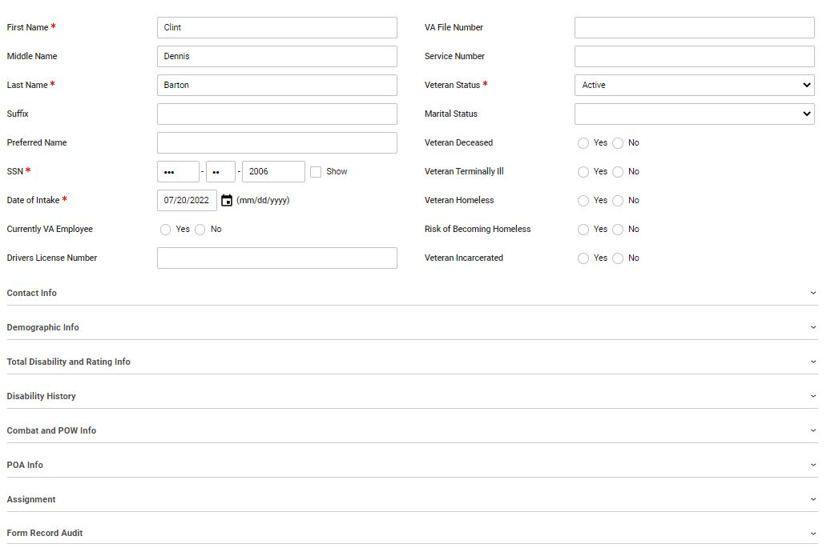
Tabs in Veteran Folder: Veteran
The first tab is the
Veteran where you
can add additional
information such as
if veteran is homeless
or if they are a VA
employee

Slide 18
Tabs in Veteran Folder: Claim
The next tab listed in the veteran’s folder is the Claim section which we will cover in TVB 2
Notes:
1 Reword and center – covered in TVB 2

Slide 19
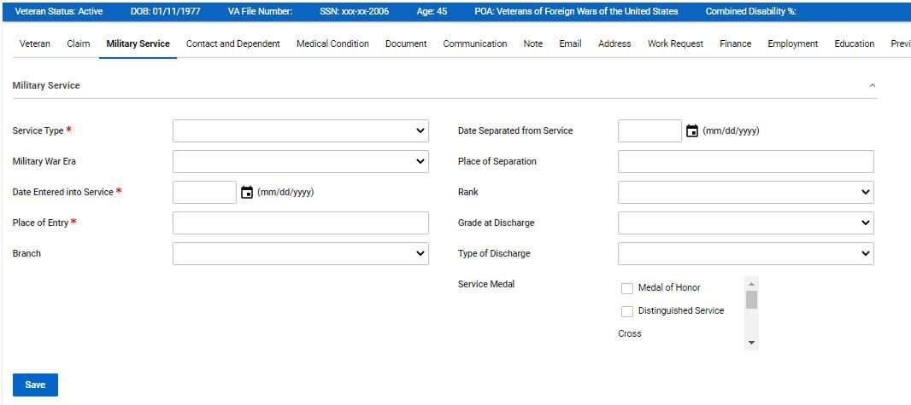
Tabs in Veteran Folder: Military Service
For Military Service 3 fields are required:
Service Type
Date Entered
Place of Entry

Slide 20
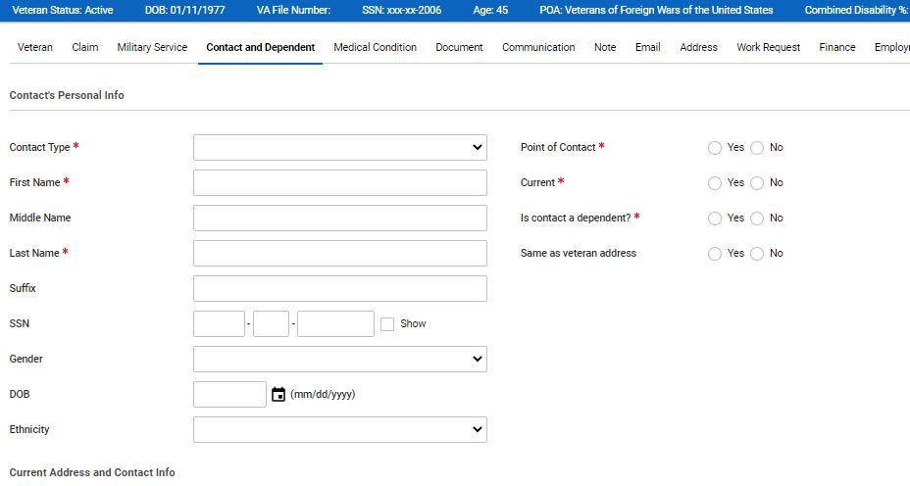
Tabs in Veteran Folder: Contact and Dependent
For Contact and Dependent information the required fields are:
Contact type
First Name
Last Name
Point of Contact
Current
Are they a dependent?

Slide 21
Tabs in Veteran Folder: Medical Condition
The current version of TVB has entry-level steps for Application Programming Interface (API) using the Medical Condition Tab.
Currently, this API is not ready for use but once it is, we will release training material on how to utilize this advanced functionality.

Slide 22
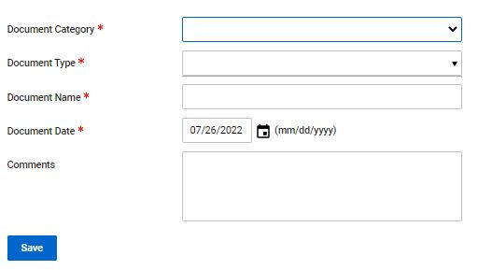
Tabs in Veteran Folder: Document
When entering in a document into TVB, All fields are required with the exception of “Comments”.
It is encouraged to use the comments if the file name does not accurately describe what document you are uploading.
Notes:
1 increase font

Slide 23
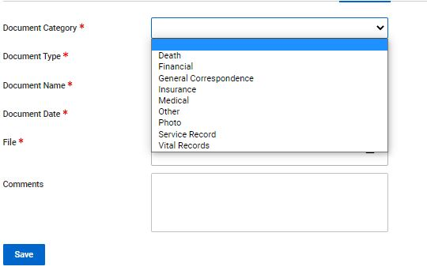
Tabs in Veteran Folder: Document Category
Document Category: You must select from one of the dropdown options before proceeding. Other should be used if the document you are uploading does not match any of the required selections.
Document Type: The Document Categories you select will pre-populate a new “Document Type”.
Before a document can be uploaded a Valid Document Category AND Document Type MUST be selected

Slide 24
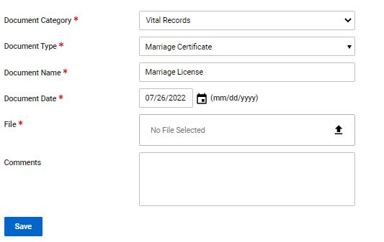

Tabs in Veteran Folder: Document Upload/ Download
Document Upload: Once a Document Category and Document Type have been selected, your document Date should populate to today's date. From here you click the up arrow which will prompt you to find the file you wish to attach.
Once selected press Save and your file is uploaded.
Document Download: Open the document tab and select the file you want to download. Once selected the screen will look like the upload screen BUT the file will be populated which you can click on and automatically download.

Slide 25
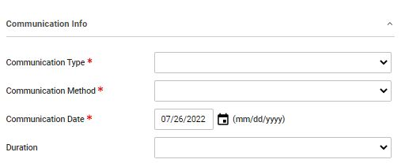
Tabs in Veteran Folder: Communication: Communication Info
Communication Info: Contains the following required fields:
Communication Type: Inbound or Outbound
Communication Method: Email, In Person, Online, Phone, Outreach, Mail, Fax, Video Conference, Other
Communication Date: Auto populates
*Optional*Duration allows you to select a dropdown box capturing the communication duration.

Slide 26
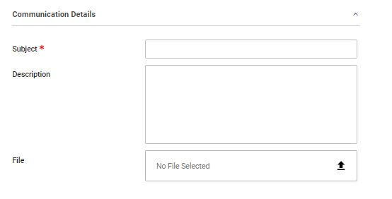
Tabs in Veteran Folder: Communication: Communication Details
Here you enter in the required Subject of the communications along with the optional description and a file you wish to upload with the communication.
Files uploaded this way WILL NOT be stored in the veteran’s Document Tab but instead will only be located in the individual communication that the file was associated with.

Slide 27
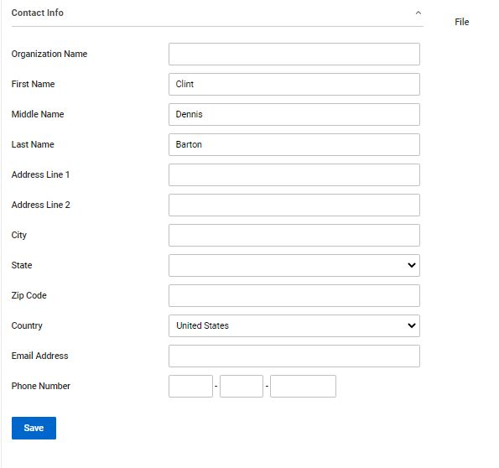
Tabs in Veteran Folder: Communication: Contact Info
Under Contact Info no field is required.
Information will be populated here based upon data previously entered in Veteran’s Folder
Unfortunately, information captured here will NOT populate in other areas of the veteran’s folder.

Slide 28
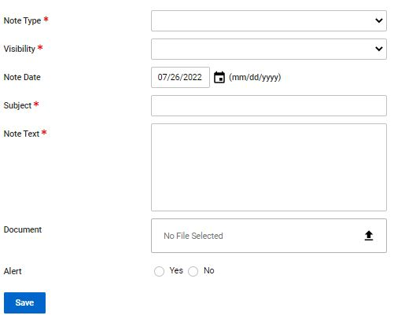
Tabs in Veteran Folder: Note
When Creating a Note The following items are required:
Note Type: Veteran info, Dependent Info, Claim Contact Info
Visibility: Private or Public
Subject: Name of Subject
Note Text: Purpose of the note
You also can upload a document and choose an alert.
Click Save to complete the note.
Notes:
1 increase font

Slide 29
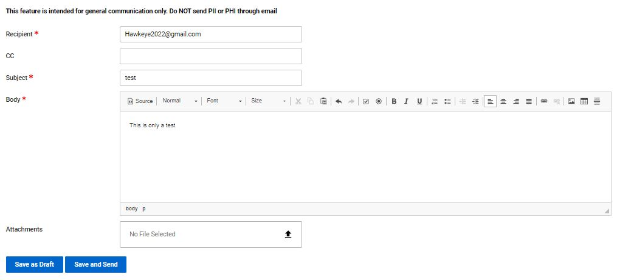
Tabs in Veteran Folder: Email
To send an email through TVB Enter in the Recipient Email Address, Subject and compose your email.
You can also attach files in the email.
To send your email click “Save and Send”.

Slide 30
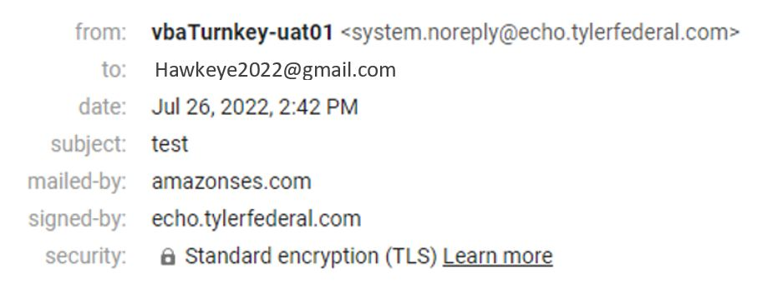
Tabs in Veteran Folder: Email
Once an email is sent it should look like this:

Slide 31
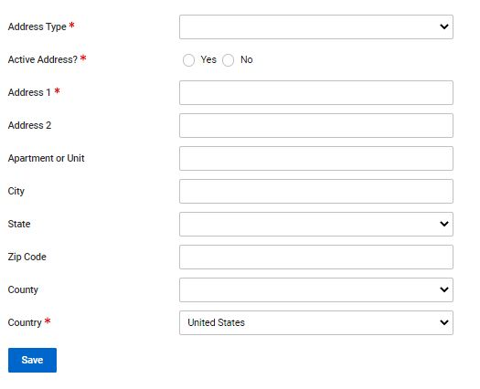
Tabs in Veteran Folder: Address
For the required field of Address Type there is a dropdown box that contains the following selections:
Forwarding
Home
Mailing Address
Main Residence
Other
Work
Click Save when finished

Slide 32
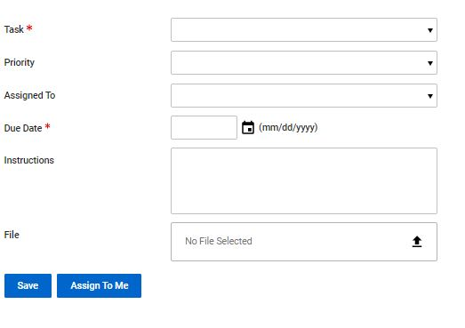
Tabs in Veteran Folder: Work Request
A Work Request is when you assign a task to one of your fellow service officers through TVB.
Fields include:
Task: General, Record Request, To Do, and Veteran Work Request
Priority: Low, Medium, High
Assign To: Used to select TVB User recipient
Instructions and file: Explains what action is required and any supporting documentation.
To complete this action you can either hit Save if sending it to another user or hit “Assign To Me”

Slide 33
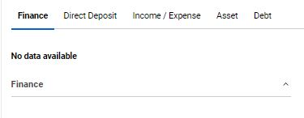
Tabs in Veteran Folder: Finance
Under Finance you have the option to add Financial data to the veteran’s folder. Data includes:
Direct Deposit
Income/Expense
Assets: such as Boats, Real-estate, Stocks, Saving Bonds
Debt

Slide 34
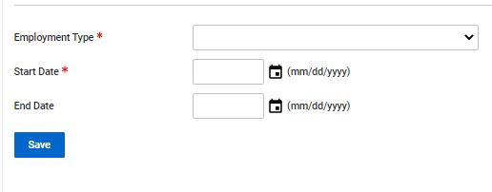
Tabs in Veteran Folder: Employment
Under Employment the required fields are:
Employment Type: Employed, Self-Employed, Unemployed, Retired
Start Date.

Slide 35
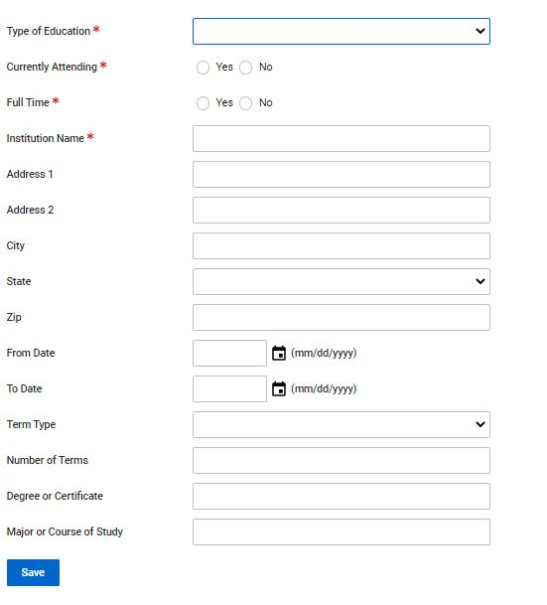
Tabs in Veteran Folder: Education
Under Education the required fields are:
Type of Education: College, Vocational/Trade, Licensing or Certification etc…
Currently attending?
Full time?
Institution Name
Notes:
1 increase font bullet

Slide 36
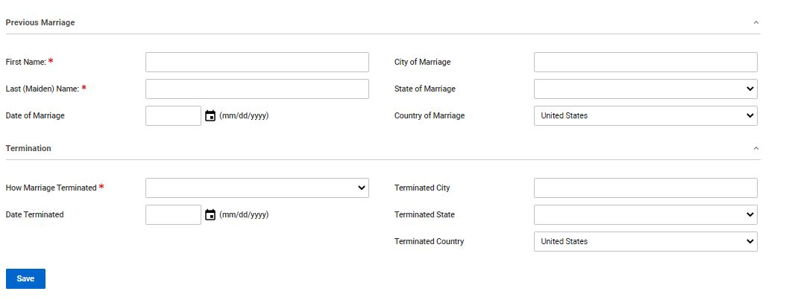
Tabs in Veteran Folder: Previous Marriage
This section is only used if veteran was previously married.

Slide 37
Tabs in Veteran Folder: Other Names Served
This section is only used if the veteran served under another name.
Don’t assume that only females served under another name

Slide 38
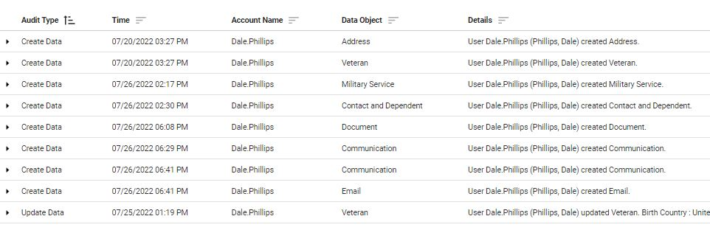
Tabs in Veteran Folder: Audit Log
Whenever someone creates data in the veteran’s folder, it is captured in the Audit Log.
This provides a “History” of the veteran’s folder.

Slide 39
In TVB Part 2 we will cover how to create forms and submit claims

