Slide 1
VA
Board of Veterans’ Appeals Update
VFW May 2021

Slide 2
Board of Veterans’ Appeals Overview
Mission
The Board of Veterans’ Appeals (Board) support’s VA’s mission of providing benefits and services to Veterans.
The mission of the Board is to conduct hearings and decide appeals properly before the Board in a timely manner. See 38 United States Code (U.S.C.) § 7101(a).
Background
All questions under 38 U.S.C. § 511(a) are subject to decision by the Secretary and shall be subject to one review on appeal to the Secretary. Final decisions on such appeals are made by the Board.
The Board is the final appellate body within the Department and is responsible for resolving appeals on behalf of the Secretary arising out of VBA, VHA, NCA, and OGC.
The Board is governed by statute, case law, and OGC opinions.

Slide 3
Board’s Organizational Structure
Realigned to provide Veteran-facing service and meet the mission-critical requirements.
Chairman
The Board is made up of approximately 1,200 FTE which includes 103 judges, approximately 830 decision writing attorneys/clerks and approximately 167 appellate operational support and 100 administrative staff.
(includes vacant positions)
Executive Assistant
Senior Advisor
Vice Chairman
Chief of Staff
Chief of Budget & Internal Controls
Chief Counsel
Deputy Vice Chairman
Deputy Vice Chairman
Deputy Vice Chairman
Deputy Vice Chairman (VACANT)
Deputy Vice Chairman (VACANT)
SES Executive Director, Appeals Support
Office of the Chief Counsel
Legal Operations/ Administrative Support
Legal Operations/ Administrative Support
Legal Operations/ Administrative Support
Legal Operations/ Administrative Support
Legal Operations/ Administrative Support
Director
5

Slide 4

Board of Veterans’ Appeals
DECISIONS FOR VETERANS | HEARINGS HELD
PARTNERSHIPS
UNION
Expanded telework and remote work for all employees to include full telework during pandemic and adjusted core hours and allowed maxiflex
Count attorney output number by issues and decisions
After listening sessions with employees- assessed workload, output and mission, reduced the required average output number of veterans’ appeal decisions per week: 3.25 to 3 per week for FY 2021
Additional prorated hours during IT downtime
80 hours proration during pandemic
15,669
Due to
COVID-19
E-Mail Reminders for Hearings
VIRTUAL HEARINGS
95% increase in decisions in 3 years
FY 2021 Goal of 93,600 Decisions
Extensive outreach and training
https://www.bva.va.gov/docs/VirtualHearing_FactSheet.pdf
Exclusive option during pandemic -10,000+ Virtual Hearings Held to date
95% of hearings held virtually in FY 2021
APPEALS MODERNIZATION ACT
PL 115-55 (implemented 2/2019) improving Veterans’ choices to appeal VA benefits & services decisions
Veteran Choice to Appeal Directly to Board
+79,000 AMA Cases Docketed by the Board
Working in conjunction with resolution of legacy appeals
VSOs, PRIVATE REPRESENTATIVES, & STAKEHOLDERS
Strong engagement & relationships
MILITARY SPOUSE EMPLOYMENT
Champion for Federal Government Hiring
Led hiring collaboration across Federal Government through VA partnership with Hiring our Heroes and DOD
REACH Campaign (www.reach.gov)
National Ambassador focused on changing the culture through discussion and awareness about mental health and suicide prevention
EMPLOYEE ENGAGEMENT
Index | 2018 Board | 2019 Board | 2020 Mini | 2020 Board | 2020 VA
Employee Engagement | 61% | 68% | N/A* | 76% | 72%
Best Places to Work | 36% | 52% | 62% | 66% | 69%
https://www.bva.va.gov/
https://twitter.com/BoardVetAppeals
Employee Engagement ↑ 15% | Best Places to work ↑30%
Board interim (mini) AES to gauge any COVID-19 impacts

Slide 5
Hearings at the Board
The Board’s goal for FY 2021 is 50,000 hearings, using all available hearing platforms. There has been an increase in hearing requests due to the COVID-19 pandemic.
  Prioritize legacy hearings
  Focus on Virtual tele-hearings
The Board judges are ready to hold hearings.
The Board has the capacity to schedule 1,000 Virtual tele-hearings weekly. We are holding about 500+ per week.
Travel Boards may start at limited locations on Q4.
Video hearings are available at 52 ROs nationwide, but at half the pre-COVID number of hearings per docket.
Please encourage your Veterans to choose a virtual tele-hearing when possible!

Slide 6
Legacy Hearing Requests
Prioritize Legacy Hearings
19% Decrease in pending hearing requests since start of FY 2021.

Slide 7
Board of Veterans’ Appeals – Hearings Held FYTD
Maximize Access & Utilization
Virtual tele-hearing 11,048 (97%) held virtually in FY 2021.

Slide 8
Board of Veterans’ Appeals – Decisions
93,600 Decision Goal in FY 2021
55,000+ decisions thru April 25 and ~4,000 above goal.

Slide 9
VA Legacy Appeals Drawdown
VA INVENTORY DRAWDOWN SUCCESS
↓68% in 3-Years
Another ↓67% by CY 2022
Increase in Board Inventory from original resolution plan
    Shift in VBA defined working inventory of 50K to 17K pushed appeals to Board faster
    Ultimately results in faster resolution for Veterans - - ADC ~100 days for Board remands
    Projections to be revisited after FY 2021 concludes and FY 2022 budget enacted
45,000
Notes:
~50% of Board decisions are fully resolved and ~50% remanded to VBA
110K – Projected case receipts from VBA in FY21-22
A 10% increase in Board output above goal (production per FTE or OT) = VA Pending: 37K Board Pending: 25K by end CY2022
Plausible given history of board decisions…FY18 85,288 (+5% above goal) FY19 95,089 (+6%) FY20 102,663 (+12%).

Slide 10
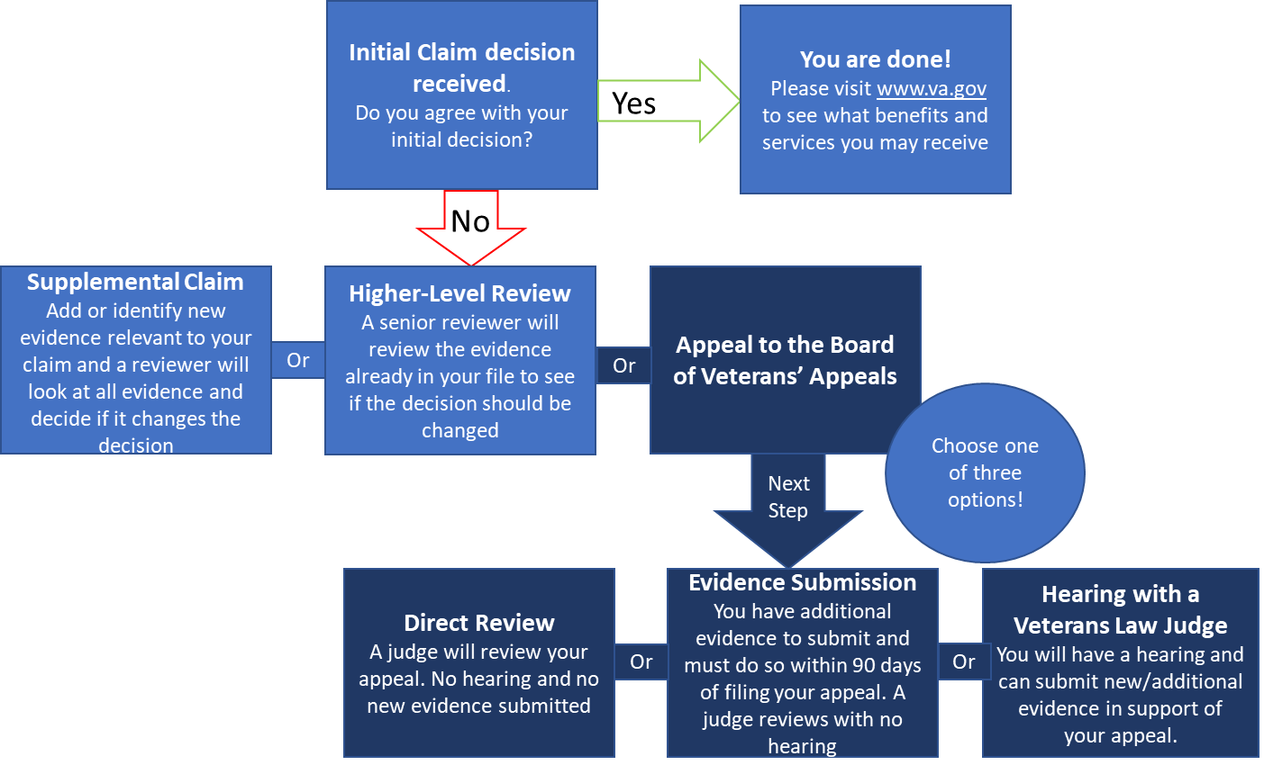
Appeals Modernization: Which Board docket to choose?
What happens after you receive your initial claim decision?

Slide 11
Switching Dockets Under Appeals Modernization
If your Veteran would like to switch Board dockets, and they have an appeal in the new system, they will need to submit a new VA Form 10182, Notice of Disagreement, with a new docket choice marked. Do not simply withdraw the request.
Situations where changing dockets may not work:
  If a Veteran has already submitted new evidence or testified at a Board hearing and wants to switch to the direct docket.
  If the docket switch request is received outside of time limits specified in the regulation.

Slide 12
FY 2021 AMA Decisions and Inventory
Total : 12,668 (23% of FY 2021 Board Decisions)

Slide 13
Remand Rates for Legacy and AMA Issues
Lower AMA Remand Rates
10.2% less AMA issues remanded then Legacy

Slide 14
Resources & Materials
The Board of Veterans’ Appeals:
https://www.bva.va.gov/
Appeals Status Tracker:
https://www.va.gov/claim-or-appeal-status/
Claimants can find information on filing requirements and the forms to apply at https://www.va.gov/decision-reviews.
Board has a twitter page – follow us!

