Slide 1
Membership
Soft Touch
Recruiting
NVS Training

Slide 2
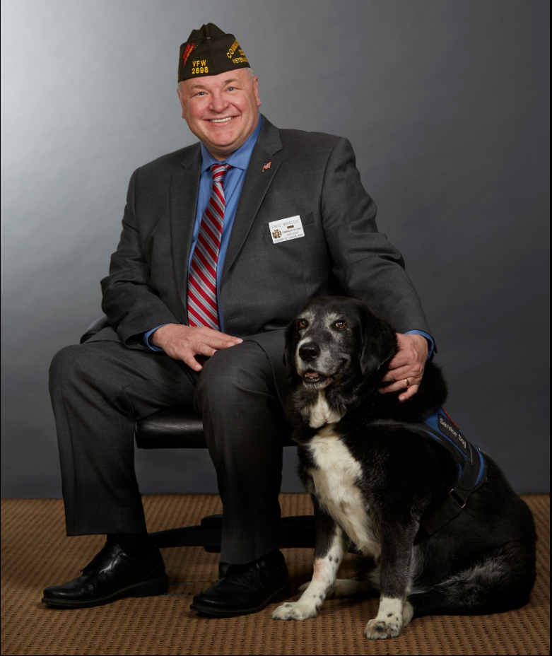

Commander-in-Chief
Fritz Mihelcic

Slide 3
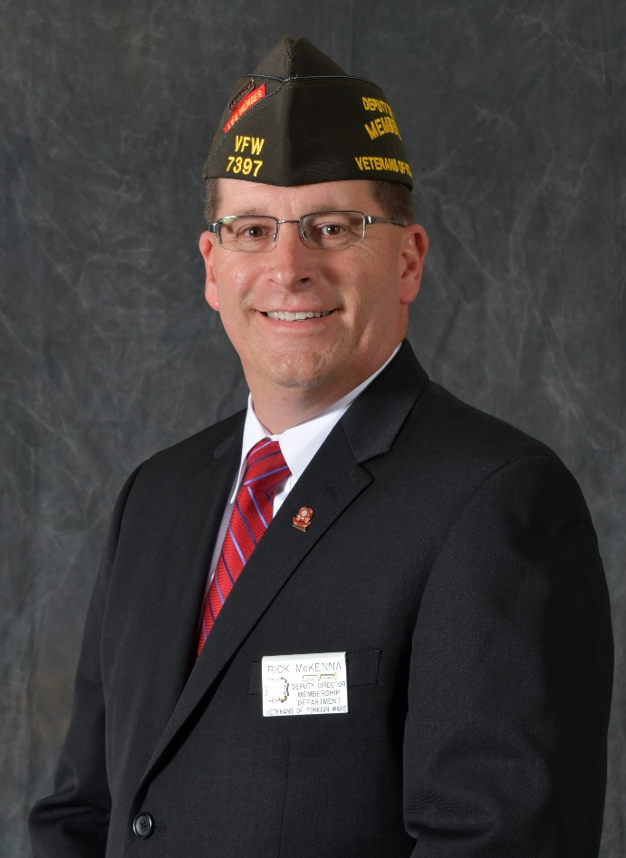
Rick McKenna
Deputy Director, Membership
Air Force Master Sergeant (Ret), 22 years
Air Force Career Recruiter, 10 years
Senior Recruiter/Sales Trainer
Former Inflight Refueling Specialist, KC-135
Deployed Desert Shield/Storm, Somalia,
Croatia/Bosnia.
Senior Vice Commander – Post 7397, Lenexa,
KS & District Inspector
Gold Legacy Life Member – Post 7397, Lenexa, KS

Slide 4
Question:
What is the only thing in life that we never get a 2nd chance?
In Many cases, you are the first VFW representative a veteran may encounter from our organization.
How your Client/Veteran sees you is often how they see the organization you represent

Slide 5

Knowledge of the VFW
Founded in 1899
Oldest Veterans Organization
VFW Priorities
Veterans Service
Community Service
Legislative Action
Youth Service

Slide 6

VFW Legislative Achievements
1920 – Widows and Orphans Pension Act (Spanish-American War)
1924 – House Veterans Affairs Committee Established
1930 – Veterans Administration (VA) created
1931 – The Star Spangled Banner becomes the National Anthem
1938 – Armistice Day (Nov 11) became a legal holiday
1943 – Disabled Veterans Rehabilitation Act
1944 – GI Bill of Rights passed
1989 – VA becomes a Cabinet department
2006 – Protesters banned from military funerals
2008 – GI Bill for the 21st Century (Post 9/11 GI Bill) allows dependents to use
2015 – Eliminated 1% COLA reduction penalty on future military retirees
2017 – Prevented significant copayment increases for TRICARE
2017 – Forever GI Bill gives veterans a lifetime to use GI Bill benefits
2018-Passed the Mission Act: Improved VA community care and expanded Caregivers benefit
2019-Passed Blue Water Navy Agent Orange Act: Provided benefits and care for sailors affected by Agent Orange
2020-Eliminated the Widows Tax: Repealed the unfair financial offset of benefits for widows and families of passed service members

Slide 7
VFW Mission:
To foster camaraderie among United States veterans of overseas conflicts. To serve our veterans, the military and our communities. To advocate on behalf of all veterans.
VFW Vision:
Ensure that veterans are respected for their service, always receive their earned entitlements, and are recognized for the sacrifices they and their loved ones have made on behalf of this great country.

Slide 8

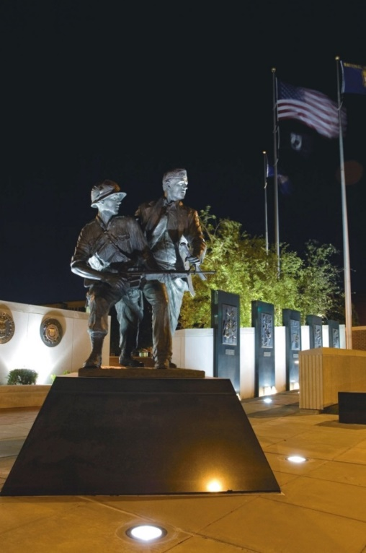
VFW moves to Kansas City, Mo. in 1930

Slide 9
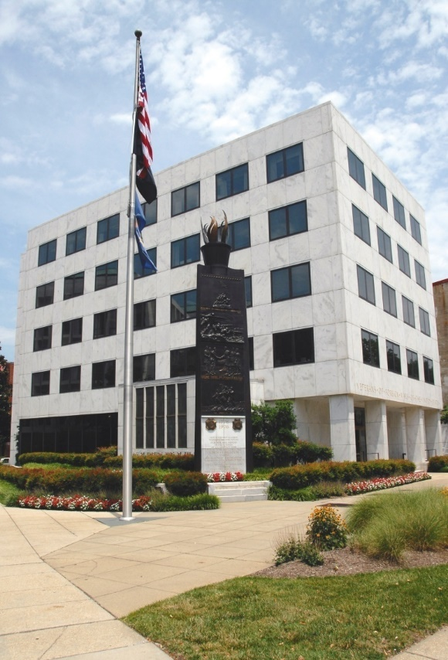
1960 – VFW dedication of the Washington Memorial Building at 200 Maryland Ave N.E., Washington, D.C.

Slide 10
Interviewing Techniques
First and most important, if you ask a question listen and understand the answer.
A friendly and welcoming introduction, followed by the reason why you are meeting with the potential member.
Use open and closed ended questions to see if the veteran is eligible for membership. This will avoid wasting your time and the veteran’s time.

Slide 11
Opening
Introduce yourself and make it clear you are with the “Veterans of Foreign Wars ” not everyone will know what “VFW” stands for
Qualifying
Questions
Use open and closed questions to determine if the veteran is eligible
Show VFW
Facts
Show brochures and facts on the VFW to show them what the organization does and why it is important for the to join.
Ask to Join
If you never ask them to join they never will.

Slide 12
Share your Story of why you’re a member of the Veterans of Foreign Wars
Great example is the similarities between yourself and the other members of the VFW

Slide 13

EMPATHY & UNDERSTANDING
You too have been;
Overseas.
In Harm’s Way.
In the Military
To Boot Camp
In the Chow Line.
Etc…

Slide 14
VFW Membership Age
Current as of July 1, 2021

Slide 15
2005 | 1,795,833 | (15,069) | 99.17 %
2006 | 1,763,242 | (32,591) | 98.19 %
2007 | 1,723,696 | (39,546) | 97.76 %
2008 | 1,646,850 | (76,846) | 95.54 %
2009 | 1,544,101 | (102,749) | 93.76 %
2010 | 1,524,286 | (19,815) | 98.72 %
2011 | 1,445,550 | (78,736) | 94.83%
2012 | 1,418,420 | (26,981) | 98.12%
2013 | 1,360,297 | (58,272) | 98.04%
2014 | 1,320,800 | (39,497) | 97.10%
2015 | 1,282,444 | (38,356) | 97.10 %
2016 | 1,234,985 | (47,459) | 96.30%
2017 | 1,201,231 | (33,754) | 97.27%
2018 | 1,160,151 | (41,080) | 96.58%
2019 | 1,164,860 | 4,709 | 100.40%
2020 | 1,045,244 | (119,616) | 89.73%
2021 | 1,035,735 | (9509) | 99.09%
17 Year Net
Loss of
777,167
Members
Annual Average Decline of 45,716 Members per year since 2005.

Slide 16
    Screening Process
    When screening a fellow veteran, you are trying to determine if they meet the basic eligibility qualifications for Membership in the VFW.
    Keep it effective, yet simple.
    Be careful not to interrogate and don’t ask questions in a way that suggests a right or wrong response.
    Not your job to do a hard sale on them to become a member, but simply provide the information and plant the seed.

Slide 17
VFW Eligibility Can Be In A Form Of;
Performance reports, medals report, returning orders, letters from officers you served with.
Realize a DD214 is not the only document that can be used as proof of eligibility.
BUT DON’T FORGET THAT
WE HAVE A RESPONSIBILITY TO PROTECT THE VFW FROM “WANNABES”

Slide 18


Member At Large Online Application is at www.vfw.org

Slide 19

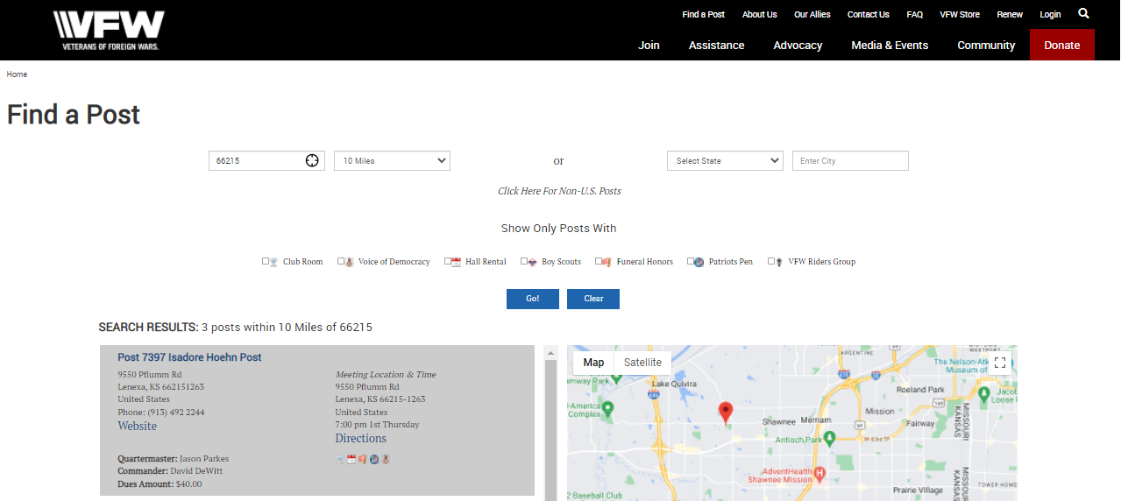
Post Location & Contact info at www.vfw.org

Slide 20

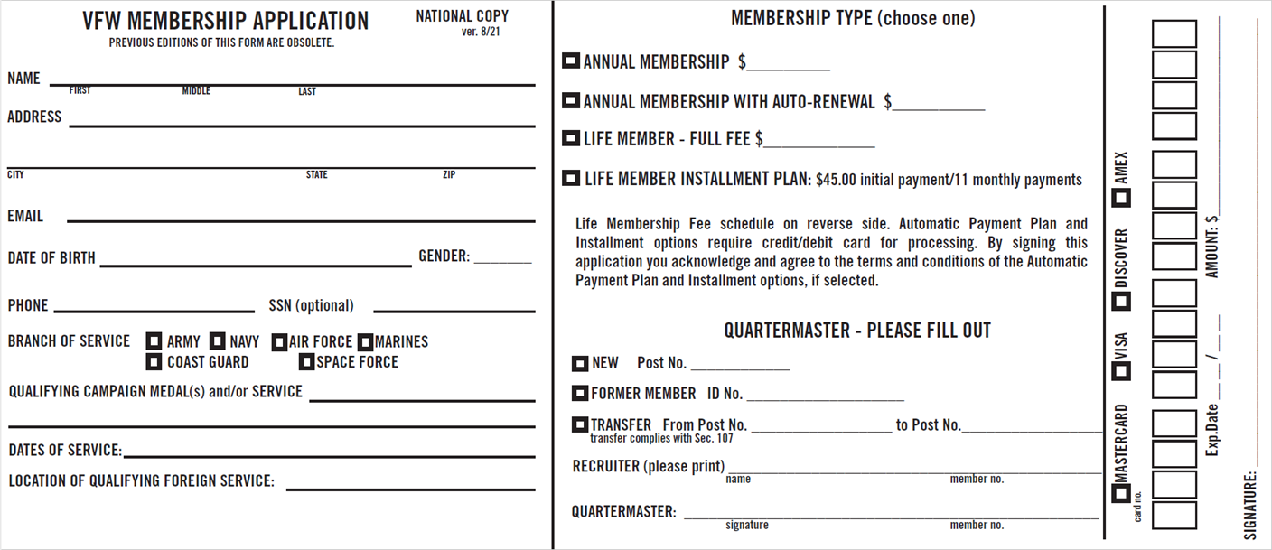


What is a New Member ?
* if you do not collect dues, you did not recruit a member *
** sending application to a post, expecting post to collect dues is not recruiting **

Slide 21

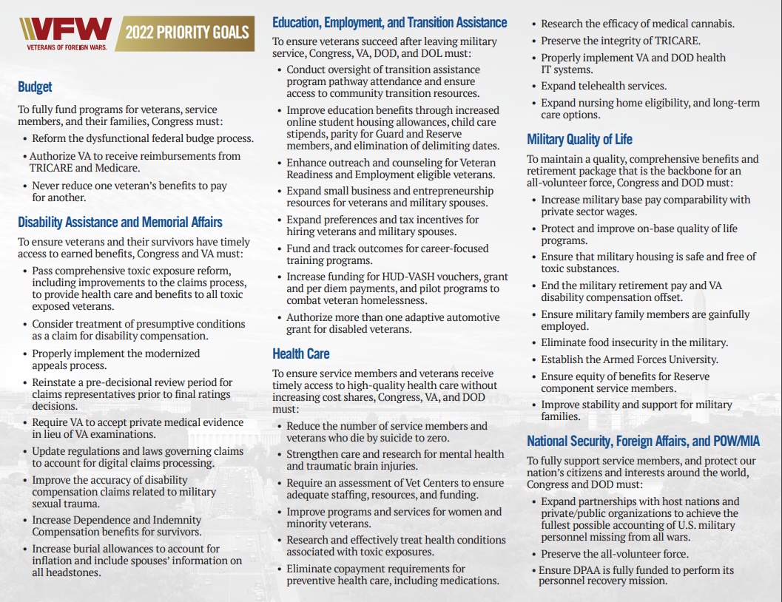

All Potential Members will want to know, “What’s in it for me?”

Slide 22

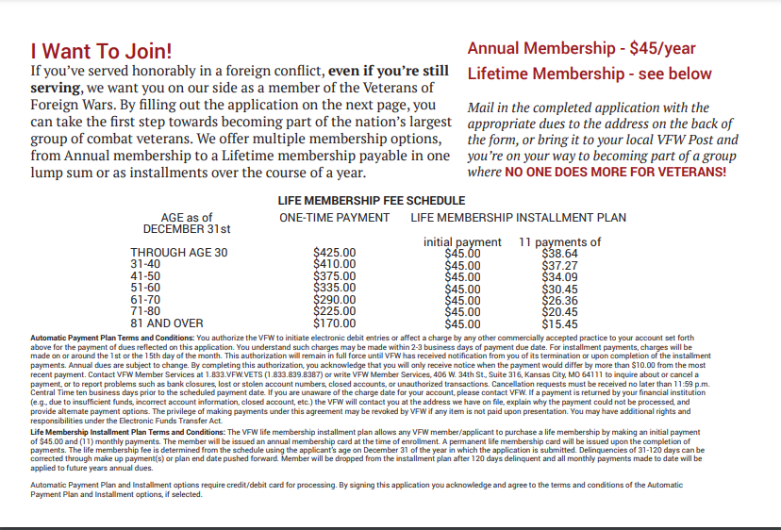
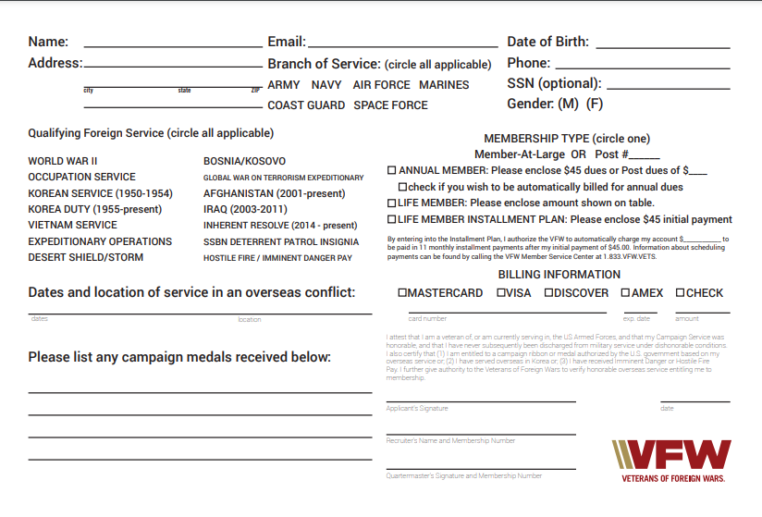
Welcome Home Brochure
Provides insight to our organization and its programs

Slide 23

Women Veterans Brochure
Since 2008, Women veterans in the VFW increased from 3977 members to 31,983 on 7/1/2021 = 3.06% of our membership.

Slide 24



Slide 25
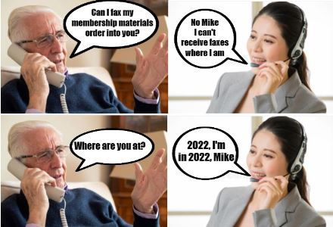

Slide 26


Slide 27
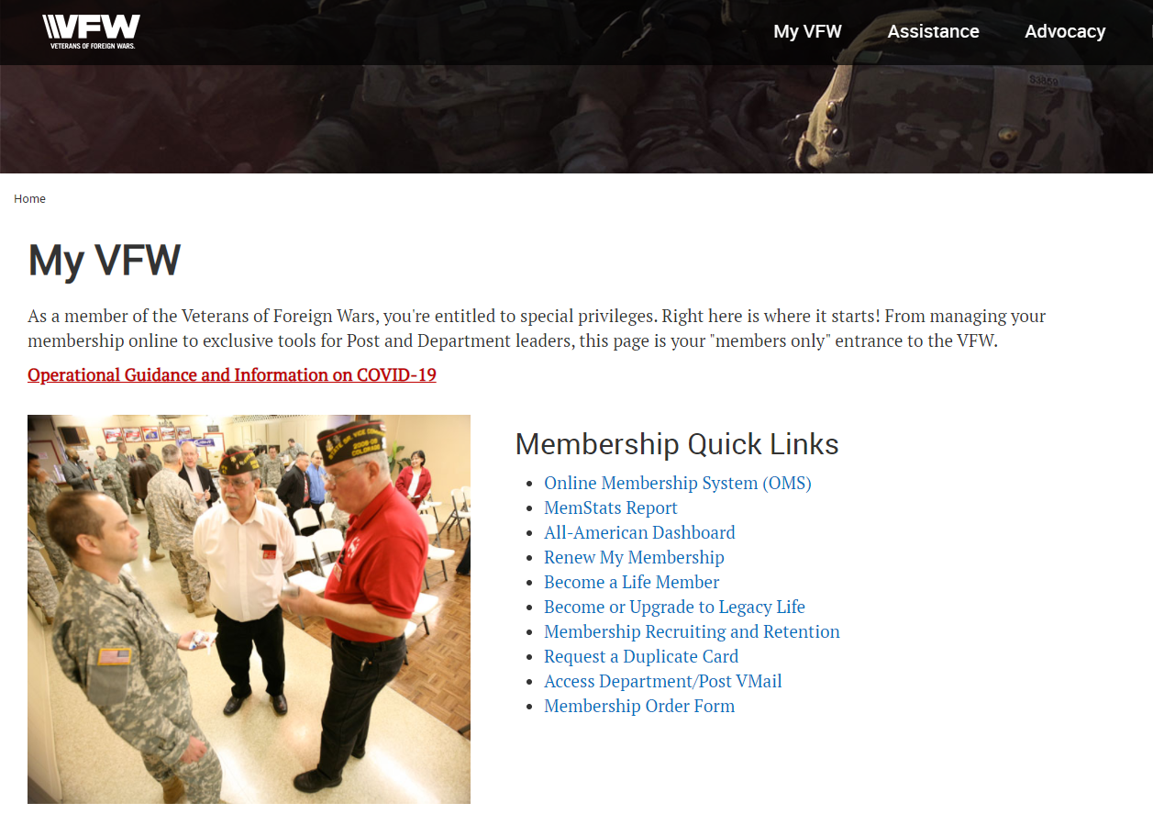

Membership Online Material Order Form

Slide 28

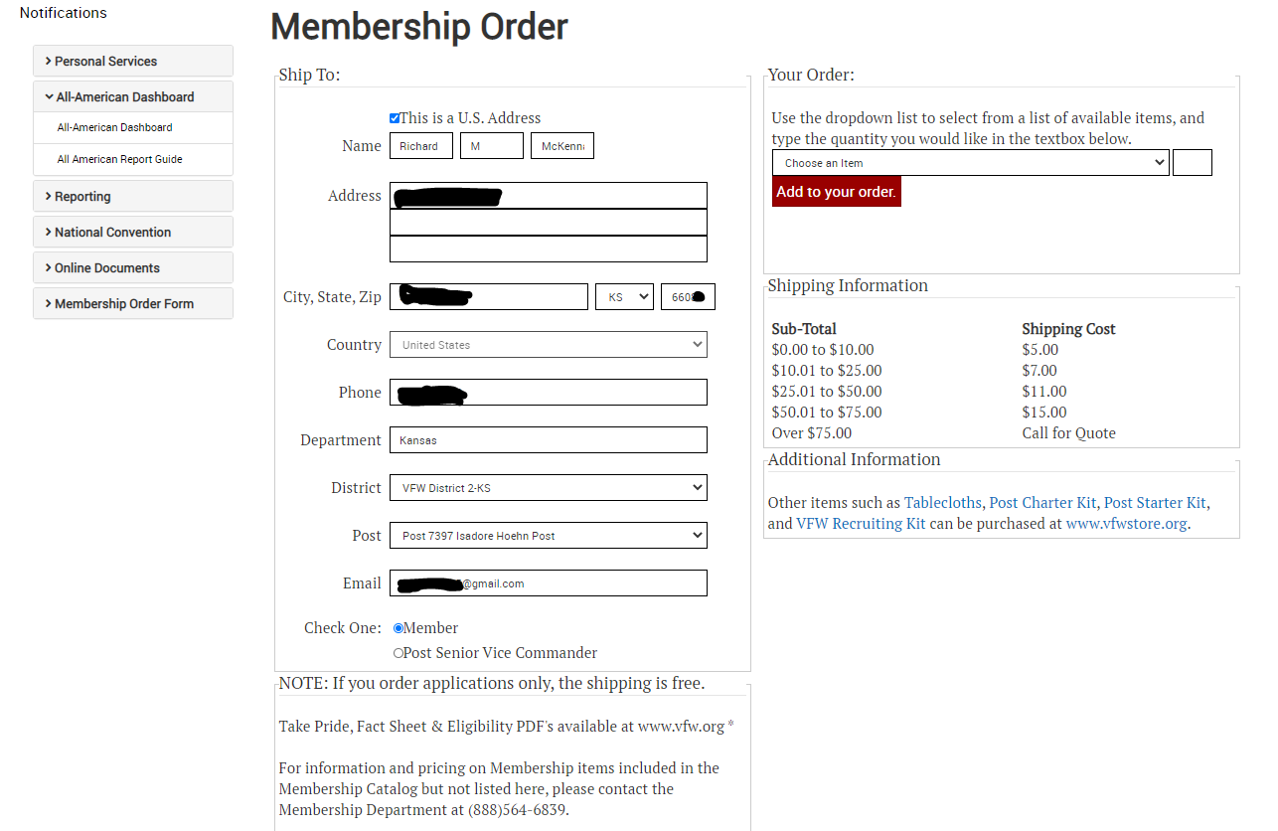



Slide 29
Membership Materials Ordering
Shipping Fees will be waived for orders for the following to be used in your offices:
Membership Applications
New Member Brochure
Fact Sheet
Women’s Brochure
Priority Goals
After submitting an order for any of these, please contact Leticia Cortez at 888.564.6839 or Lcortez@vfw.org to let her know you are a Service Officer.

Slide 30

www.vfw.org

Slide 31
Membership Resources

Slide 32
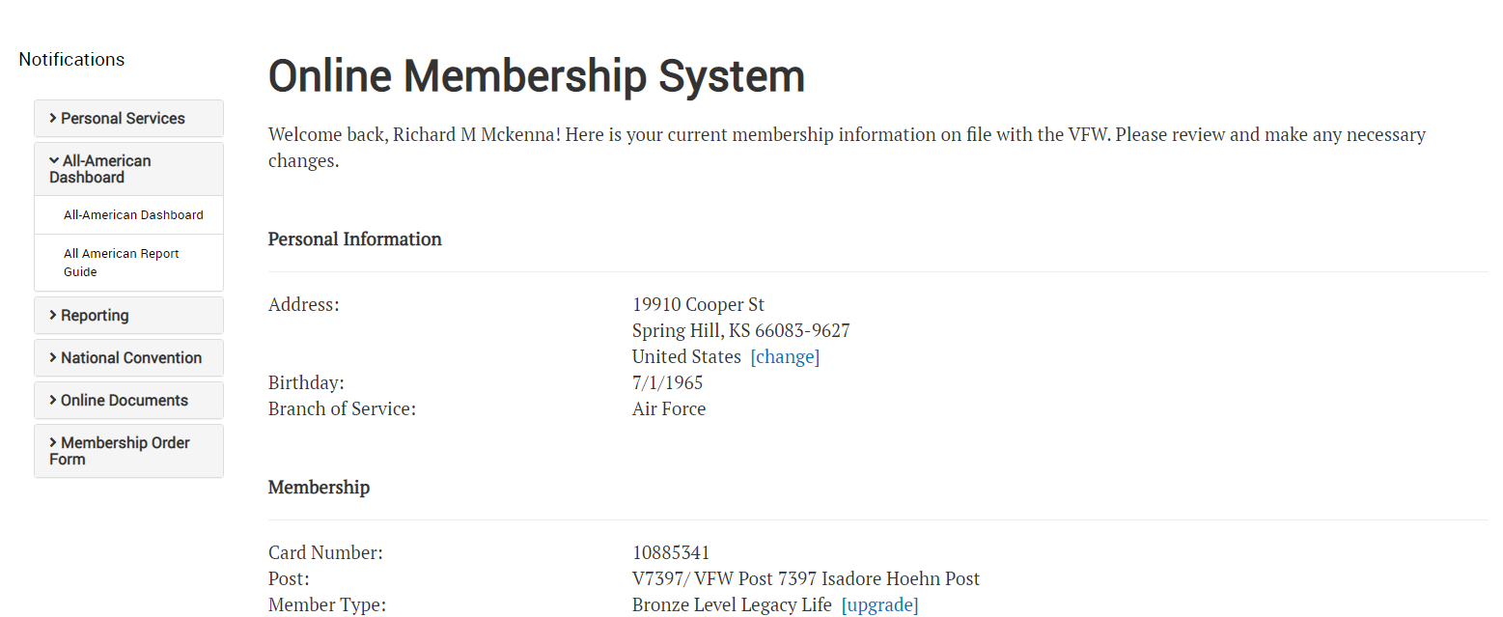



Slide 33
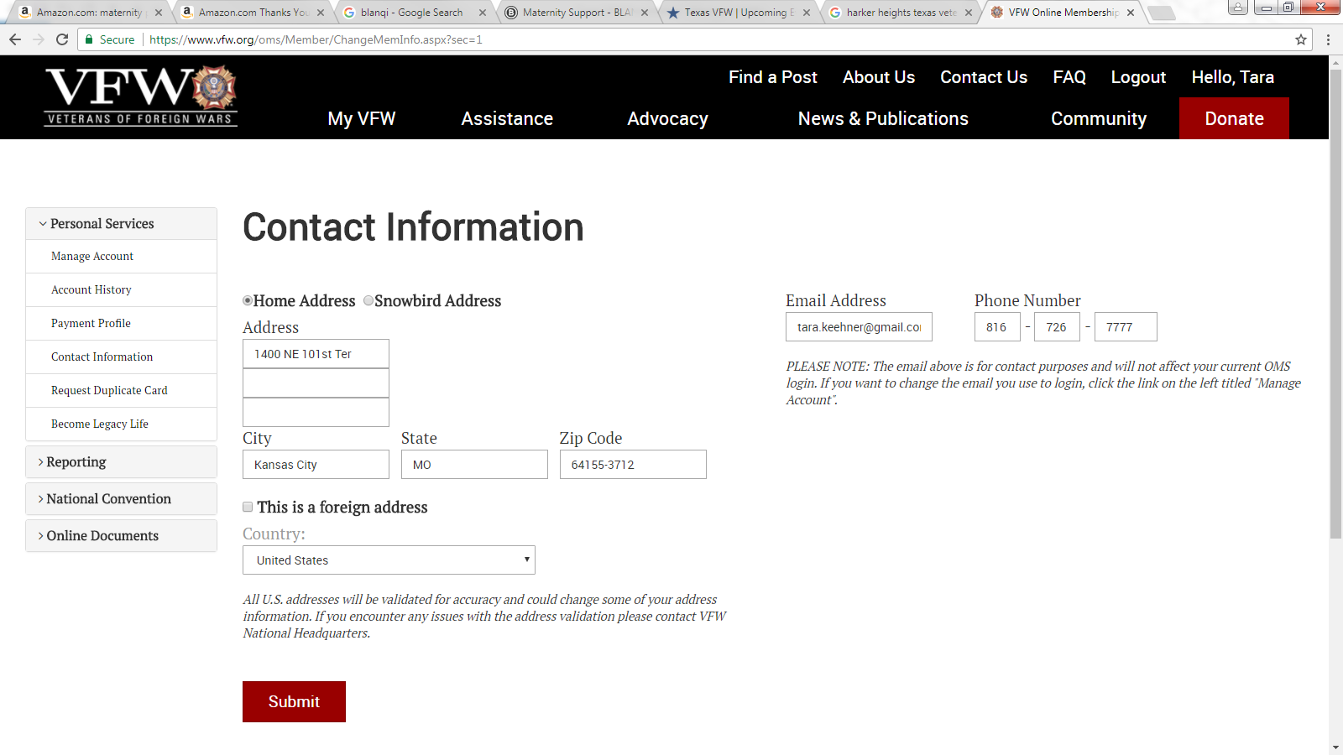


Slide 34
Retention
The retention of all ages of veterans is paramount to the growth and survivability of the VFW.

Slide 35
Our current challenges with retaining members
Attrition - we are losing our older veterans at high rates. This is inevitable, given that for decades the largest block of VFW members was WW2 veterans who are all now in their 80s and older. Our Vietnam veterans (currently the largest block) are also starting to creep into their 70s.
Inaction - Posts that are not actively working to serve their community and attract new members by giving them a reason to seek out the Post and learn about membership are a cancer that is rapidly killing the VFW.
"Slipping out the back door“ - annual members are not renewing their dues, and the main reason is that they either do not see any benefit to their membership or they do not feel welcome at the Post.

Slide 36


Welcome email – From the VFW Commander-in-Chief (upon sign up)
Welcomes new members
Encourages creation of an OMS Account
Explains how to get involved
Highlights important services and member benefits
Offers new members a featured VFW Store item

Slide 37
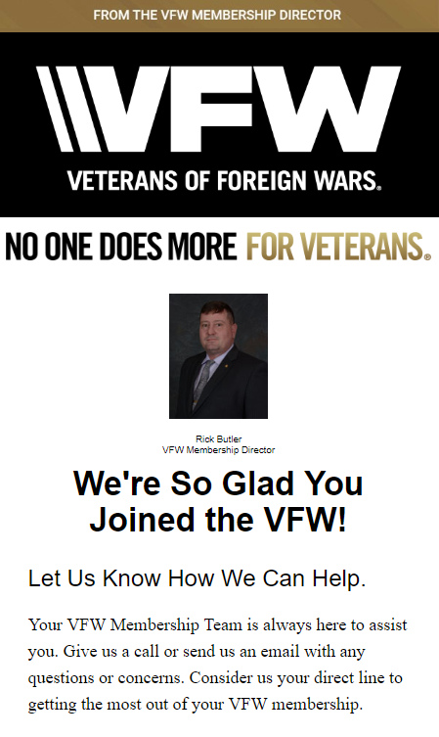
Membership Department Email – From the Membership Director (15 Days following sign up)
Evokes a more personal tone from a “real person”
Encourages joining a Post and getting involved
Emphasizes the importance of creating an OMS Account
Explains features available through an OMS Account
Offers personalized assistance directly from the Membership Department

Slide 38
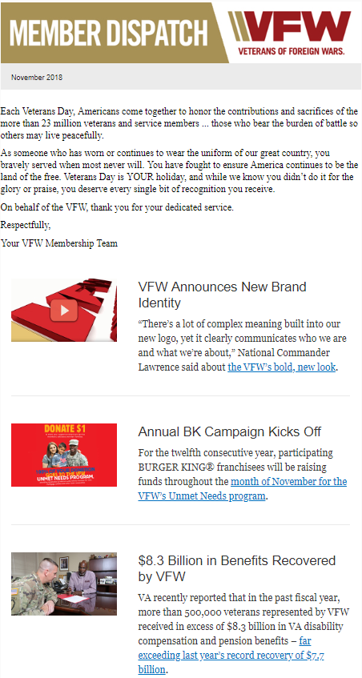
VFW Dispatch
Monthly emailed newsletter, received by all members with a valid email address in OMS
Update your email address!

Slide 39
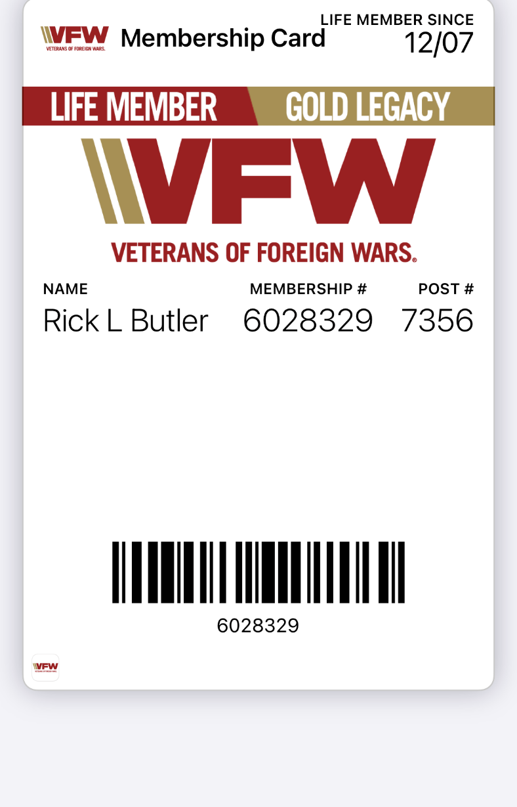
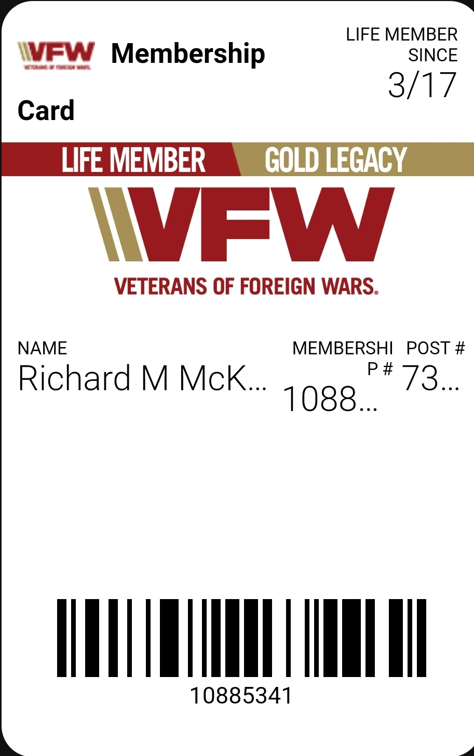
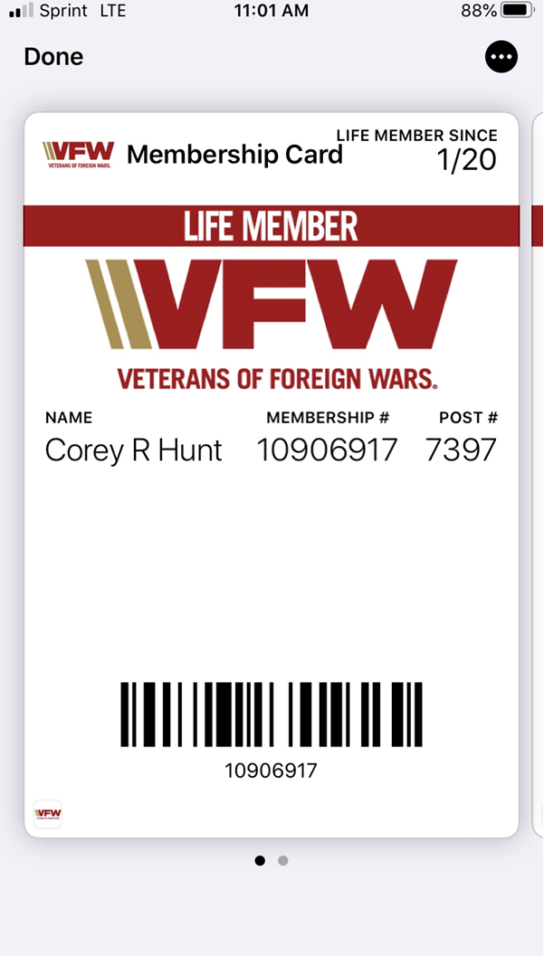
Digital Membership Card

Slide 40

Questions?

Slide 41
Membership Department
Director
Rick Butler
816-968-2752
rbutler@vfw.org
Deputy Director
Rick McKenna
816-968-1138
rmckenna@vfw.org
Associate Director
Corey Hunt
816-968-2788
coreyhunt@vfw.org

