Slide 1
VetraSpec:
VetraSpec ID
General Contact Log
Fixing Direct Submit Errors
Brad Hazell
Assistant Director,
Compensation & Pension Policy
Bhazell@vfw.org

Slide 2
Topics
In this class we will discuss:
VetraSpec Acquisition
VetraSpec ID
General Contact Log
Fixing Direct Submit Errors
Although we will be discussing VetraSpec’s Direct Submit, this is not a class on how to use this program.
For information on how to use Direct Submit, please visit the VFW Online Learning Portal at https://vfw.psycharmor.org

Slide 3
VetraSpec Acquisition
In March 2021, DataSpec, which is the company that created and manages VetraSpec, announced that they have been acquired by Tyler Technologies
Currently we not aware of any changes to the software or administrative functions as a result of this acquisition

Slide 4
VetraSpec ID
The VetraSpec ID is:
An unique identification number automatically assigned to each veteran that has a VetraSpec record
A secure way to identify a veteran without using sensitive or protected information such as Social Security Numbers
Secure to send via unencrypted email as it only exists in VetraSpec and only VetraSpec users can use the ID to locate a veteran’s record
Searchable from the Home Screen
Located under the tab bar near the veteran’s Social Security Number and VA File Number when working in the veteran’s record

Slide 5
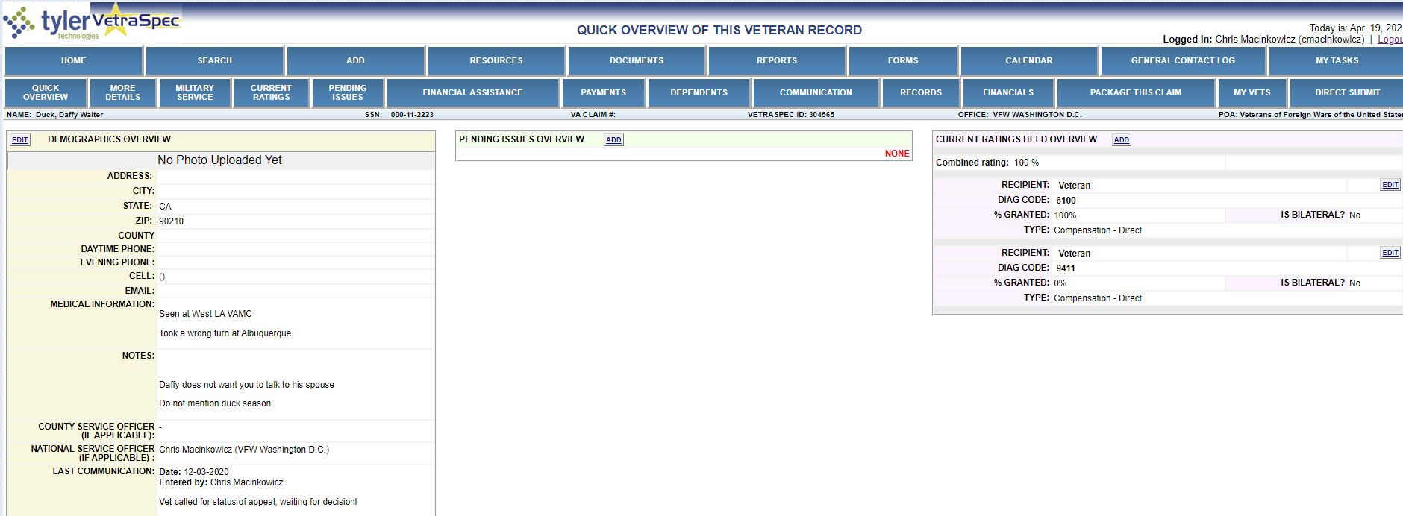
VetraSpec ID
What is this veteran’s VetraSpec ID?

Slide 6
VetraSpec General Contact Log
The VetraSpec General Contact Log is a tool intended for recording communications in your office that are not associated with a veteran’s record, such as general inquiries or interactions with veterans we do not represent
This feature can be used in place of the office administration veteran record that many offices use to log these types of communications
Anyone assigned to your office can access and add to your General Contact Log
Why should you log these types of communications?
Notes:
To help account for admin time and to keep accurate numbers of who has received assistance from the office

Slide 7
VetraSpec General Contact Log
General Contact Log entries will NOT be associated with a specific veteran, even if you enter the veteran's name.
You may use the General Contact Log while working in a veteran’s record or from the home screen.
If you are working in Mr. Smith’s record and receive a phone call from a veteran that does not have a VetraSpec record, you can access the General Contact Log, enter your communication, then continue working in Mr. Smith’s Record

Slide 8
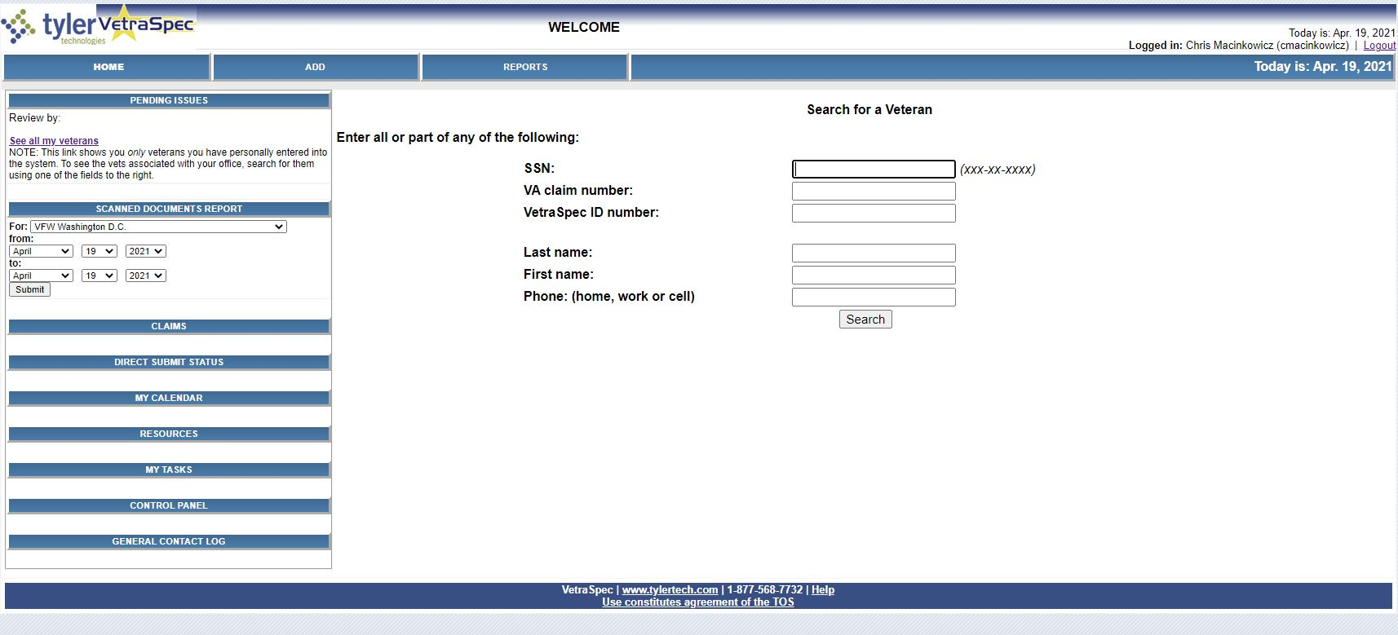
VetraSpec General Contact Log
You can access the General Contact Log from the Home Screen by clicking here
Notes:
To help account for admin time and to keep accurate numbers of who has received assistance from the office

Slide 9
VetraSpec General Contact Log
You can access the General Contact Log from within a veteran’s record by clicking here
Notes:
To help account for admin time and to keep accurate numbers of who has received assistance from the office

Slide 10
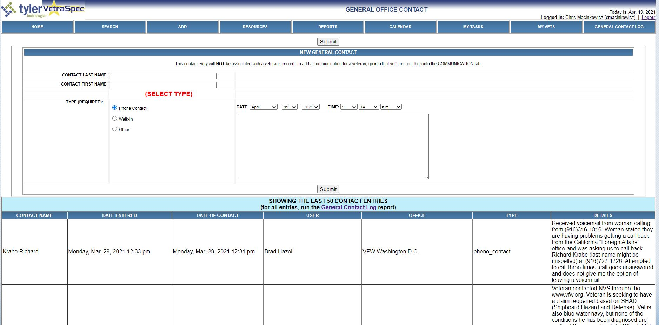
VetraSpec General Contact Log
You can view the last 50 entries for your office in this screen. If you need to see more entries, click here to view all the entries for your office
Notes:
To help account for admin time and to keep accurate numbers of who has received assistance from the office

Slide 11
VetraSpec General Contact Log Demonstration
Now we are going access VetraSpec and show a live demonstration of the General Contact Log

Slide 12
VetraSpec Direct Submit
VetraSpec’s Direct Submit feature allows users to submit documents directly to VA within the VetraSpec system
This system offers an alternative to faxing, mailing, or accessing the VA Intranet to submit claims
NVS requires all users to successfully complete the Direct Submit Course in the VFW Online Learning Portal (OLP) prior to having this feature activated for their account
Effective April 19, 2021: New users who complete the OLP Direct Submit course must email the NVS helpdesk (dsohelpdesk@vfw.org) to have this feature activated

Slide 13
Direct Submit Submission Status
Once documents are submitted via Direct Submit, you must check the status to ensure there are no errors
Direct Submit does not automatically refresh the status update. You must click the Check Status link under Action
Once you see “Final Status Reached” you do not need to continue checking the status, but you must verify that the submission made it into VBMS
You may have to refresh your screen after clicking Check Status to see the most current status.
If you use Direct Submit, you should check the status of your submissions every day

Slide 14
STATUS | Explanation
PENDING | The package is being transferred electronically.
UPLOADED | The package has been uploaded, but NOT yet processed or added to Centralized Mail.
RECEIVED – Once you receive this status the submission date is preserved. | Indicates package has been successfully added to Centralized Mail.
PROCESSING | The package is being processed by VA systems.
SUCCESS | The package has been received, processed and is being worked by a human at VA.
VBMS | Package has been uploaded successfully into VBMS.
EXPIRED | There was a lag on the VA system and the submission was not accepted. Please resubmit.
ERROR **This chart can also be found in the Direct Submit Instructions located in the VFW Online Learning Portal Resource Library** | DOC101 - System error – email ann@vetraspec.com DOC102 - Bad vet data. Make sure the vet's name, SSN and zip code are in the database. DOC103 - Bad PDF. The error will tell you which document isn't readable. DOC104 - Rejected by a VA system. The error detail will tell you which one. DOC105 - Unknown sender. This can be an issue with VA systems. Wait a little while and resubmit. DOC201- Internal VA server error. Try again later. DOC202 - Error in a VA system. The error detail will provide more information.

Slide 15
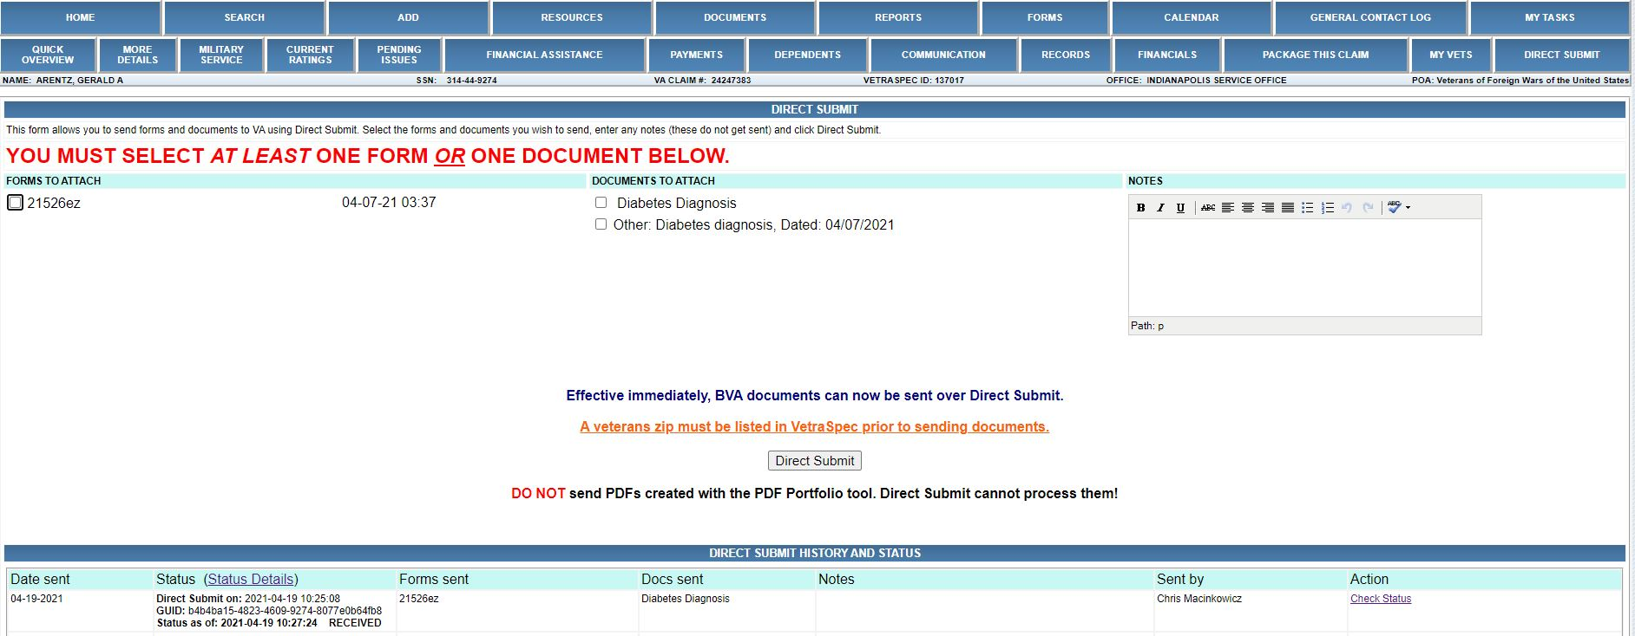
Direct Submit Submission Status
Click here to view the Status Chart
Click here to check the status of the submission

Slide 16
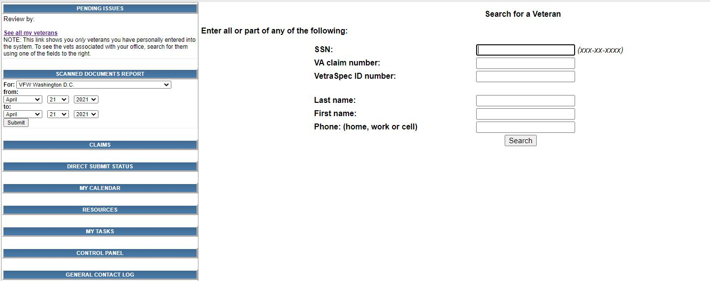
Direct Submit Submission Status – Checking Multiple Submissions
Instead of checking each status individually, you can check multiple statuses at once using the Direct Submit Status link available from the Home Screen
Direct Submit Status Button

Slide 17
Fixing Direct Submit Errors
If you receive an error during submission, view the Status Chart for more information on the error and for a potential resolution
You may have to resubmit the documents using a different submission method
Remember: If the error occurred before the “received” status was reached the effective date of the submission has not been preserved

Slide 18
Fixing Direct Submit Errors
What if the Direct Submit Status has reached or passed the received status but the documents never made it into VBMS?
If this happens, you will need to email the Veterans Claims Intake Program mailbox at vcip.vbaco@va.gov with the veteran’s claim number and a brief explanation of what happened so that the effective date can be preserved.
You may need to resubmit the documents
*Please CC your VARO’s Change Management Agent or your VARO director’s office when emailing VCIP

Slide 19
Fixing Direct Submit Errors
Now we are going to log into VetraSpec and show a live demonstration on how to view Direct Submit Statuses

Slide 20
Questions?
Brad Hazell
Assistant Director,
Compensation & Pension Policy
Bhazell@vfw.org

