Slide 1
What’s New at the VA
By Amanda Berry
September 2022

Slide 2


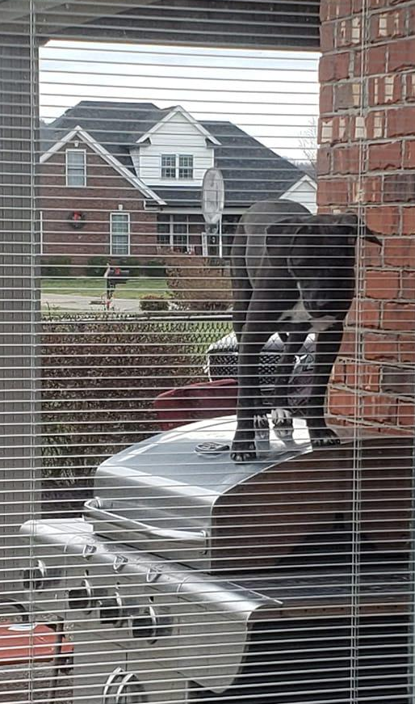
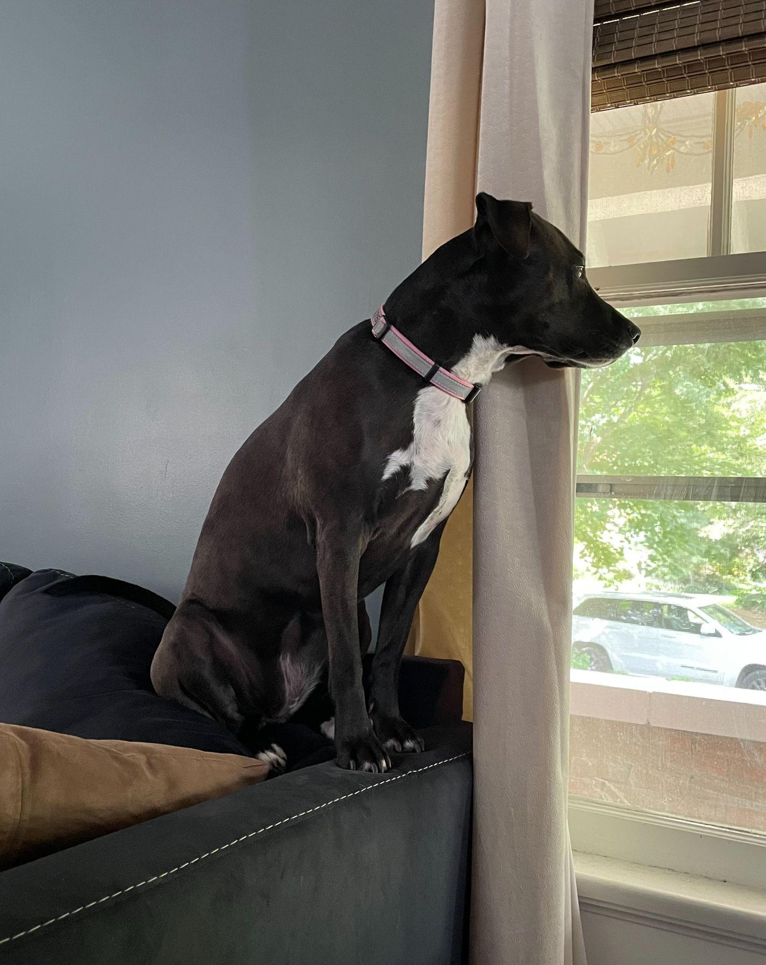


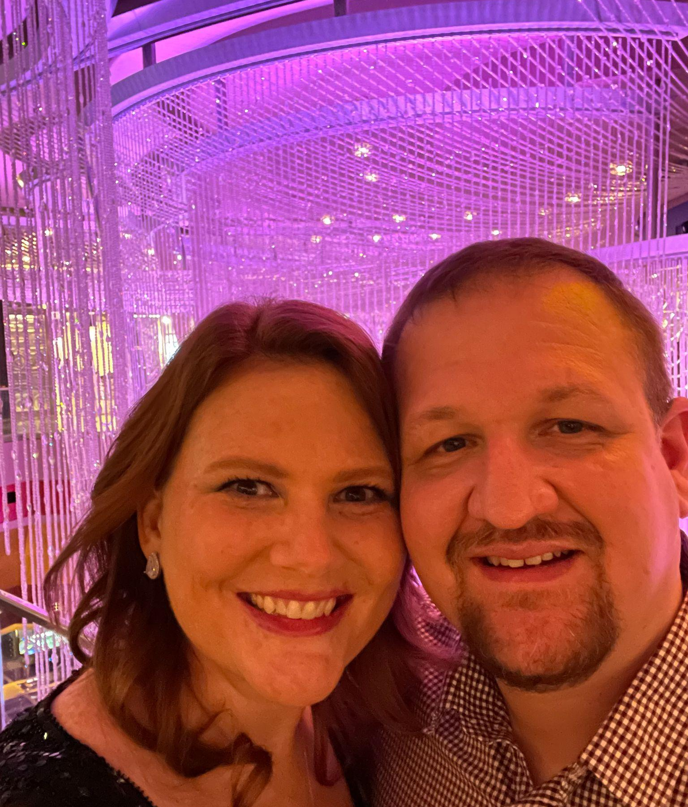


Hi there! Nice to meet you!

Slide 3
Agenda
Welcome Back! Updates?
High Impact Court Decisions
Latest PACT Act stuff
Pop Quiz!

Slide 4
What are court cases and why are they important?
Court Cases - started as a claim, went to appeals, passed the Board of Veterans Appeals, went to Court of Veterans Appeals (outside VA), then was appealed to the Federal Circuit Court.
A court case is the final judicial interpretation of the Code of Federal Regulations (CFR)
Court Cases set precedents - tells VA how to apply the rules of the law.

Slide 5
Court Decision’s – High Impact
Newman v. McDonough, June 16, 2022
The benefit of the doubt standard governs in all cases where VA must determine whether a claimant possesses Veteran status.
Long v. McDonough, June 29, 2022
Direct causation between a secondary condition and an original condition is not required for extra-schedular consideration of the secondary condition.
Walleman v. McDonough, June 9, 2022
The rule against pyramiding does not preclude a separate rating under DC 5257 for lateral instability simply because a claimant is also in receipt of a rating under DC 5259

Slide 6
Court Decision’s – High Impact
Craig-Davidson v. McDonough, May 16, 2022
Reinforces that a Notice of Appeal (NOA) at the Court of Appeals for Veterans Claims (CAVC) may be considered timely after the appeal period has expired in cases of unusual circumstances.
Rivera-Colon v. McDonough, April 11, 2022
CAVC- the term “symptoms” is not so broad as to encompass all possible symptoms and that extra-scheduler evaluations are permitted, when warranted, for gastritis evaluated at any scheduler level under DC 7307.
Bareford v. McDonough, February 28, 2022
Addresses who can request headstones and markers.

Slide 7
Newman v. McDonough
June 16, 2022

Slide 8
Newman v. McDonough, June 16, 2022
What the case is about:
Joel Newman was a substitute appellant for his brother, Marshall Newman (Mr. Newman), following his death. Mr. Newman originally filed a claim for 'nervous condition' as directly due to service.
Mr. Newman served in the Marine Corps from 1973 to 1999. Mr. Newman went AWOL from his unit 3 separate times for a total period of 9,000 days and was discharged under other than honorable conditions. Per 38 CFR 3.12, a character of discharge determination was conducted by the Regional Office (RO).

Slide 9
Newman v. McDonough, June 16, 2022
What the case is about:
The RO correctly applied 38 CFR 3.12 to deny benefits. Mr. Newman was discharged under other than honorable conditions as a result of being AWOL for a continuous period greater than 180 days.
38 CFR 3.12- “by reason of a discharge under other than honorable conditions issued as a result of an AWOL for a continuous period of 180 days. This bar to benefit does not apply if there are compelling circumstances to prolonged unauthorized absence”.

Slide 10
Newman v. McDonough, June 16, 2022
What the case is about:
Joel Newman, the substitute claimant, argued that his brother was insane at the time of going AWOL.
38 CFR 3.12 (b) - “a discharge or release from service under one of the conditions specified in this section (AWOL) is a bar to the payment of benefits unless it is found that the person was insane at the time of committing the offense”
The Board of Veterans Appeals disagreed that the evidence did not support a finding of insanity.

Slide 11
Newman v. McDonough, June 16, 2022
Argument:
Joel Newman appealed this decision to CAVC. The claimant argued that the 'Benefit of the Doubt' standard, 38 U.S.C. 5107 (b) had not been applied to the insanity determination by the board.
CAVC determined that while the Board and VA had been determining Benefit of the Doubt on Veteran status (character of discharge determinations) the same had not been applied by statute to insanity determinations.

Slide 12
Newman v. McDonough, June 16, 2022
What this means:
The CAVC set a precedent and determined that the benefit of the doubt should be applied to all decisions that the VA makes.
Any decisions that the VA makes are worthy of an appeal based on the lack of 'Benefit of the Doubt' determinations. These are not usually included in rating decisions, thus, any denial you believe to have merit should be appealed for a benefit of the doubt determination by the Board of Veterans Appeals.

Slide 13
Long v. McDonough
June 29, 2022

Slide 14
Long v. McDonough, June 29, 2022
What the case is about:
This appeal was contested all the way to the Court of Appeals for the Federal Circuit (CAFC) from the CAVC. Mr. Long was a Veteran of the Air Force and served as an air traffic controller radar repairman from 1969 to 1976. He was exposed to active runways without adequate hearing protection. In 2009, Mr. Long filed a claim for hearing loss and tinnitus. He was assigned service-connection (SC) for hearing loss at 0% and tinnitus at 10% according to scheduler criteria in 38 CFR 4.85.

Slide 15
Long v. McDonough, June 29, 2022
The Argument:
Mr. Long appealed the decision to the Board of Veterans Appeals (the Board) arguing the VA should have referred the matter for extra-scheduler consideration (38 CFR 3.321(b)(1)).
Mr. Long contended that the scheduler rating did not capture the functional impact of his hearing loss, most notably the ear pain that was caused by wearing hearing aids for his SC hearing loss.

Slide 16
Long v. McDonough, June 29, 2022
The Argument:
Mr. Long contended that extra-scheduler consideration should have been applied since the scheduler rating criteria under 38 CFR 4.85 was inadequate to describe the severity and symptoms of his disability. Additionally, that the disability was unusual enough to cause marked interference with employment and/or frequent periods of hospitalization. The award of such consideration is in the interest of justice for the Veteran as noted in 38 CFR 3.321(b)(1).

Slide 17
Long v. McDonough, June 29, 2022
The Argument:
Mr. Long was denied by the Board because the claimed ear pain did not warrant extra-schedular consideration because the Court found no direct casual link between his ear pain and his SC hearing loss.
Mr. Long argued that the Court was wrong in requiring a direct causation between his ear pain and his SC hearing loss.

Slide 18
Long v. McDonough, June 29, 2022
The Outcome:
CAVC agreed with Mr. Long. A secondary condition is considered service connected if it is “proximately due to or the result of” a SC disability. Thus, direct causation is not required.
In sum, the Veterans Court erred in stating that direct causation between a secondary condition and an original condition is required for extra-scheduler consideration of the secondary condition. Thus, extra-scheduler determinations can be applied to secondary disabilities that are 'proximately due to' as opposed to be directly caused by, the SC disability.

Slide 19
Long v. McDonough, June 29, 2022
The Outcome:
The previous decision was vacated and ultimately remanded. However, Mr. Long went on to lose his case.
The CAFC agreed with the analysis that direct causation was not necessary for his claim for extra-schedular consideration of his SC hearing loss, but he ultimately failed to provide that the hearing loss and ear pain caused a marked interference with employment or frequent periods of hospitalization. The evidence provided did not meet the criteria per 38 CFR 3.321.

Slide 20
Long v. McDonough, June 29, 2022
What this means:
Direct causation from a secondary condition and the original condition is not required in the application for extra-scheduler consideration for the secondary condition.
For example, an amputee could receive extra-schedular consideration for pain caused by a prosthetic, even though that pain is attributed to the service connected loss of limb. The 'limb pain' could be the basis for grant of extra-schedular evaluation on a secondary basis to the originally SC loss of limb.

Slide 21
Walleman v. McDonough
June 9, 2022

Slide 22
Walleman v. McDonough, June 9, 2022
What the case is about:
Following Mr. Walleman's separation from service in 1997, he underwent a left knee meniscectomy. He later mobilized to Iraq in March 2003 and argued that his duties there aggravated his left knee disability. Following examination, a rating decision granted SC for a left knee torn meniscus status post menisectomy. A 10% evaluation was assigned for painful motion and symptomatic residuals of semiluminar cartilage removal under DC 5259-5260. Mr. Walleman appealed the evaluation assigned in this decision.

Slide 23
Walleman v. McDonough, June 9, 2022
Argument:
Mr. Walleman appealed on the basis that separate evaluations for his left knee disability would not constitute pyramiding under 38 CFR 4.11.
§ 4.14 Avoidance of pyramiding.
The evaluation of the same disability under various diagnoses is to be avoided. Disability from injuries to the muscles, nerves, and joints of an extremity may overlap to a great extent, so that special rules are included in the appropriate bodily system for their evaluation. Dyspnea, tachycardia, nervousness, fatigability, etc., may result from many causes; some may be service connected, others, not. Both the use of manifestations not resulting from service-connected disease or injury in establishing the service-connected evaluation, and the evaluation of the same manifestation under different diagnoses are to be avoided.

Slide 24
Walleman v. McDonough, June 9, 2022
Argument:
After a remand by BVA, a new examination was requested in November 2019. In addition to the previous disabilities, slight instability was noted on examination. The Board found that Mr. Walleman’s disability is most appropriately rated separately under DC's 5259 and 5260, rather than collectively under 5259-5260. A 10% evaluation under DC 5260 for limited flexion of the left knee due to pain was assigned. Additionally, the Board assigned a separate 10% disability rating under DC 5259 based on appellant's "symptomatic residuals from his left knee meniscectomy [that] have manifested by swelling, popping, locking, stiffness, grating, and clicking." (38 CFR 4.71a)

Slide 25
Walleman v. McDonough, June 9, 2022
Argument:
The Board also acknowledged appellant's slight instability of the left knee, but it declined to award another separate 10% disability rating under DC 5257 because "[k]nee instability is contemplated by the rating criteria under both DC's 5257 and 5259, with instability as a symptomatic residual of the
meniscectomy." The Board concluded that assigning a separate disability rating under DC 5257 in addition to 10 percent evaluations under 5259 and 5260, under those circumstances, would violate the rule against pyramiding. Mr. Walleman further appealed this decision to CAVC.

Slide 26
Walleman v. McDonough, June 9, 2022
Outcome:
CAVC determined the rule against pyramiding does not categorically preclude a separate rating under DC 5257 for lateral instability simply because a veteran is also in receipt of a rating under DC 5259.

Slide 27
Walleman v. McDonough, June 9, 2022
What this means:
Be wary of a veteran who is service connected for a meniscal disability. Multiple evaluations can be assigned for instability (DC 5257), removal of semiluminar cartilage (meniscus) (DC 5258), and for limitation of flexion (to include pain!) (5260). Review those exams and look for criteria from 38 CFR 4.71a!!

Slide 28
Walleman v. McDonough, June 9, 2022
What this means:
MR 21-1 changes as of April 25, 2022
V.iii.1.B.4.e.
Separate Evaluation of Meniscal Disabilities Evaluation of a knee disability under 38 CFR 4.71a, DC 5257, DC 5260, or 5261 does not, as a matter of law, preclude separate evaluation of a meniscal disability of the same knee under:
38 CFR 4.71a, DC 5258 (dislocated semilunar cartilage), or
38 CFR 4.71a, DC 5259 (symptomatic removal of semilunar cartilage).

Slide 29
Walleman v. McDonough, June 9, 2022
What this means:
MR 21-1 changes as of April 25, 2022
V.iii.1.B.4.e. (continued)
A meniscal disability may be rated separately under 38 CFR 4.71a, DC 5258/5259 apart from:
38 CFR 4.71a, DC 5257 for manifestations of the knee disability other than recurrent subluxation and instability, and/or
38 CFR 4.71a, DC 5260/5261 if a manifestation of the meniscal disability did not result in an elevation of the disability evaluation warranted under 38 CFR 4.71a, DC 5260/5261 via application of 38 CFR 4.40 and 38 CFR 4.45 pursuant to DeLuca v. Brown.45

Slide 30
Walleman v. McDonough, June 9, 2022
Example DBQ
Section 3 (III) = 5260
Section 6 (VI) = 5257
Section 8 (VIII) = 5259

Slide 31
Walleman v. McDonough, June 9, 2022
Example Narrative (current CFR!):
5260 (Section III of DBQ)
We have assigned a 10 percent evaluation for your left knee torn meniscus status post meniscectomy, limitation of flexion based on:
• Limitation of flexion of 31 to 45 degrees
Additional symptom(s) include: • Painful motion of the knee
• Sprain, incomplete ligament tear, or complete ligament tear (repaired, unrepaired, or failed repair)
causing persistent instability, without a prescription from a medical provider for an assistive device (e.g.,cane(s), crutch(es), walker) or bracing for ambulation
• Symptomatic residuals of semilunar cartilage removal
The provisions of 38 CFR §4.40 and §4.45 concerning functional loss due to pain, fatigue, weakness, or
lack of endurance, incoordination, and flare-ups, as cited in DeLuca v. Brown and Mitchell v. Shinseki,
have been considered and are not warranted.
A higher evaluation of 20 percent is not warranted for limitation of flexion of the knee unless the
evidence shows: • Limitation of flexion of 16 to 30 degrees. (38 CFR 4.71a)

Slide 32
Walleman v. McDonough, June 9, 2022
Example Narrative (current CFR!):
5259 (Section VI of DBQ)
We have assigned a 10 percent evaluation for your left knee torn meniscus status post meniscectomy based on:
• Symptomatic residuals of semilunar cartilage removal
Additional symptom(s) include:
• Painful motion of the knee
• Sprain, incomplete ligament tear, or complete ligament tear (repaired, unrepaired, or failed repair) causing persistent instability, without a prescription from a medical provider for an assistive device (e.g., cane(s), crutch(es), walker) or bracing for ambulation
This is the highest schedular evaluation allowed under the law for removal of semilunar cartilage of the knee. (38 CFR 4.71a)

Slide 33
Walleman v. McDonough, June 9, 2022
Example Narrative (current CFR!):
5257 (Section VIII of DBQ)
We have assigned a 10 percent evaluation for your instability, left knee torn meniscus status post meniscectomy based on:
• Sprain, incomplete ligament tear, or complete ligament tear (repaired, unrepaired, or failed repair) causing persistent instability, without a prescription from a medical provider for an assistive device (e.g., cane(s), crutch(es), walker) or bracing for ambulation
Additional symptom(s) include:
• Painful motion of the knee
• Symptomatic residuals of semilunar cartilage removal

Slide 34
Walleman v. McDonough, June 9, 2022
Example Narrative (current CFR!):
5257 (Section VIII of DBQ)
A higher evaluation of 20 percent is not warranted for impairment of the knee unless the evidence shows:
A diagnosed condition involving the patellofemoral complex with recurrent instability after surgical repair that requires a prescription by a medical provider for one of the following: a brace, cane, or walker; or,
Sprain, incomplete ligament tear, or repaired complete ligament tear causing persistent instability and
a medical provider prescribes a brace and/or assistive device (e.g., cane(s), crutch(es), walker) for ambulation; or,
Unrepaired or failed repair of complete ligament tear causing persistent instability, and a medical provider prescribes either an assistive device (e.g. cane(s), crutch(es), walker) or bracing for ambulation.
(38 CFR 4.71a)

Slide 35
Craig-Davidson v. McDonough
May 16, 2022

Slide 36
Craig-Davidson v. McDonough, May 16, 2022
What the case is about:
Mr. Virgil Davidson served honorably in the Marine Corps from 1955 to 1961. Mr. Davidson had filed a claim for lung cancer, which was denied by the regional office, and promptly appealed to the Board of Veterans Appeals (Board). The Board continued that denial and issued a Decision on December 3, 2019. Unfortunately, Mr. Virgil died on May 23, 2020. His widow, Ms. Sherry Craig-Davidson, filed a Notice of Appeal (NOA) 30 days following his death, which was 202 days after the Board had issued its decision. The Secretary moved to dismiss the case as received untimely as the Veteran died more than 120 days after the Board issued its decision.

Slide 37
Craig-Davidson v. McDonough, May 16, 2022
The Argument:
While the appeal was received >120 days after the Board's decision, to include after the veteran’s death, Ms. Craig-Davidson's attorneys argued the issue of 'equitable tolling', and that the appeal should be considered timely as being received within 30 days of the Veterans death.
Generally, to obtain CAVC review of an adverse Board decision an NOA must be received within 120 days of that decision.

Slide 38
Craig-Davidson v. McDonough, May 16, 2022
The Argument:
Equitable tolling in this case is a principle of law stating that the statute of limitations shall not bar a claimant from dispute due to extraordinary circumstances.
Ms. Craig-Davidson argued that while the Veterans death was outside the 120 day time limit to file an NOA, she could not file an appeal as a substitute Claimant until his death as the veteran was incapacitated from the time of the Boards decision to his death. She submitted evidence of the Veteran receiving palliative care, even prior to the Board's decision.

Slide 39
Craig-Davidson v. McDonough, May 16, 2022
Outcome:
The Court determined that Ms. Craig-Davidson had constitutional standing to continue the appeal as a substitute Claimant. The veteran was incapacitated and due to equitable tolling, the timeline to file an NOA should have been ‘stopped’ during this period of incapacitation. Since the substitute appeal was filed within 30 days of the veteran’s death, the Court found that the NOA will be treated as timely and denied the Secretary's motion to dismiss the case.

Slide 40
Craig-Davidson v. McDonough, May 16, 2022
What this means:
Generally, through the appellate process, most appeals follow a “stop-clock” or “tolling” approach (for example a NOA to be timely it must be received within 120 days). This decision opens up timely filings to be considered on a case by case basis. In Mr. Davidson's case, he was unable to file a timely appeal as he was in palliative care. Thus, ending the time period at 120 days was not equitable.
When any of your appeals are rejected as untimely, review for any extenuating circumstances that may have prevented the veteran (or substitute) from timely pursuing their appeal.

Slide 41
Rivera-Colon v. McDonough
April 11, 2022

Slide 42
Rivera-Colon v. McDonough, April 11, 2022
What the case is about:
Veteran Jose Rivera-Colon served in the Army from August 1979 to August 1982 and was in receipt of 10 percent compensation for his service-connected gastritis. In August 2016, he filed a claim for increase. He was examined and his evaluation was confirmed and continued. After appealing to the Board, he submitted a DBQ completed by a VA physician, to which the Board continued the 10% evaluation. Evidence used in the Board's decision included a 2015 endoscopy report showing 'mild gastritis', the 2016 and 2018 DBQ's, and VA emergency room treatment.

Slide 43
Rivera-Colon v. McDonough, April 11, 2022
What the case is about:
The Board noted that the veteran’s disability picture did not support the higher evaluation of 30 percent under DC 7307 as the evidence did not demonstrate multiple small eroded or ulcerated areas.
7307 Gastritis, hypertrophic (identified by gastroscope):
Chronic; with severe hemorrhages, or large ulcerated or eroded areas 60
Chronic; with multiple small eroded or ulcerated areas, and symptoms 30
Chronic; with small nodular lesions, and symptoms 10

Slide 44
Rivera-Colon v. McDonough, April 11, 2022
The Argument:
Mr. Rivera-Colon appealed to the Court that the Board's reasons for continuing the evaluation were inadequate as it did not consider if extra-schedular evaluation was warranted.
In exceptional cases, extra-schedular evaluation can be warranted if the disability picture is so unusual to cause marked interference with employment or causing frequent periods of hospitalization.
It was argued that the severity of his condition was not properly captured in the 10% evaluation, as the evaluation criteria simply lists 'symptoms'.

Slide 45
Rivera-Colon v. McDonough, April 11, 2022
The Argument:
Mr. Rivera-Colon believed that his 'symptoms' should have been compensated at a higher level and referred for extra-schedular consideration, as his symptoms were atypical and severe enough to have a marked impact on his employment as well as caused routine hospitalization.
Thus, the term 'symptoms' in the rating schedule was so ambiguous it did not allow consideration above 10% without the very constricted 'eroded or ulcerated areas'.

Slide 46
Rivera-Colon v. McDonough, April 11, 2022
The Outcome:
The Court remanded the decision for further development, if necessary, to include re-adjudication for extra-schedular consideration.

Slide 47
Rivera-Colon v. McDonough, April 11, 2022
What this means:
Basically, the term “symptoms” is not so broad to encompass all possible symptoms and that extra-schedular evaluations are permitted, when warranted, for gastritis evaluated under any schedular level under DC 7307.
Appeal those gastritis claims that have severe 'symptoms' that aren't considered for extra-schedular evaluation.

Slide 48
Bareford v. McDonough
February 28, 2022

Slide 49
Bareford v. McDonough, February 28, 2022
What the case is about:
Upon executive order from President Roosevelt in 1933 directing that 25,000 WWI Veterans were to be enrolled in an Emergency Work Program, approximately 700 Veterans were sent to the Florida Keys to build bridges. In 1935, a rare category 5 hurricane made landfall on Labor Day, September 2, 1935.
Roy Anderson, an Army Veteran from WWI was one of the many Veterans killed while performing federal duty that day. Mr. Anderson, had no surviving family to claim his remains.

Slide 50
Bareford v. McDonough, February 28, 2022
What the case is about:
On September 4,1935 President Roosevelt ordered VA to bury unclaimed veterans remains at Arlington National Cemetery. However, in 1937 Anderson’s cremated remains were commingled with hundreds of other veterans and civilians in a crypt. A monument was erected there in Islamorada, Florida. His name does not appear there, or anywhere else.
In August 2017 Richard Bareford, retired Army major and historian, applied for a headstone or marker to memorialize Mr. Anderson.

Slide 51
Bareford v. McDonough, February 28, 2022
What the case is about:
In September 2017, the National Cemetery Administration (NCA) denied the request. They explained that Mr. Bareford was not a recognized applicant under 38 CFR 38.630 and 38 CFR 38.631.
In October 2017 he appealed and was furnished a statement of the case in November 2017 again stating he was not an authorized applicant. He immediately filed a Substantive appeal. In July 2019 the Board found that it was bound as a matter of law and Mr. Bareford was not a proper applicant per 38 CFR 38.630(c).

Slide 52
Bareford v. McDonough, February 28, 2022
38 CFR 38.630(c):
(c) Definitions
(1) Applicant. An applicant for a burial headstone or marker for an eligible deceased individual, or an applicant for a medallion to be affixed to a privately purchased headstone or marker, may be:
(i) A decedent's family member, which includes the decedent's spouse or individual who was in a legal union as defined in 38 CFR 3.1702(b)(1)(ii) with the decedent; a child, parent, or sibling of the decedent, whether biological, adopted, or step relation; and any lineal or collateral descendant of the decedent;
(ii) A personal representative, as defined in § 38.600(a);
(iii) A representative of a congressionally chartered Veterans Service Organization;

Slide 53
Bareford v. McDonough, February 28, 2022
38 CFR 38.630(c):
(iv) An individual employed by the relevant state or local government whose official responsibilities include serving veterans and families of veterans, such as a state or county veterans service officer;
(v) Any individual who is responsible, under the laws of the relevant state or locality, for the disposition of the unclaimed remains of the decedent or for other matters relating to the interment or memorialization of the decedent; or
(vi) Any individual, if the dates of service of the veteran to be memorialized, or on whose service the eligibility of another individual for memorialization is based, ended prior to April 6,1917.

Slide 54
Bareford v. McDonough, February 28, 2022
38 CFR 38.631(c):
Definitions -
(1) Applicant. An applicant for a memorial headstone or marker, to commemorate an eligible individual under paragraph (a)(1) of this section, must be a member of the decedent's family, which includes the decedent's spouse or individual who was in a legal union as defined in 38 CFR 3.1702(b)(1)(ii) with the decedent; a child, parent, or sibling of the decedent, whether biological, adopted, or step relation; and any lineal or collateral descendant of the decedent.

Slide 55
Bareford v. McDonough, February 28, 2022
Argument:
Mr. Bareford argued that the plain language of the statute reflected Congress's unambiguous intent that anyone may request a burial or headstone or marker on behalf of a deceased Veteran, and by imposing limits on who may make such requests (38 CFR 38.631(c)), it conflicts with its own subsections (a) and (b) which states that, “the Secretary shall furnish, when requested,' appropriate Government headstones or markers”. Mr Bareford argued that the language is 'mandatory' and leaves no 'gap to be filled by agency regulation'.

Slide 56
Bareford v. McDonough, February 28, 2022
Argument:
Mr. Bareford contended that the regulation “conflicts with congressional intent by making it impossible to mark the graves of Veterans who lack an identifiable and cooperative family member. He argued that the requirements were arbitrary and ambiguous.
The Secretary argued that “It is only after finding statutory ambiguity that courts may consider the possibility that Congress delegated to an agency the power to fill a gap”.

Slide 57
Bareford v. McDonough, February 28, 2022
The Decision:
When the Court interprets a statute, it looks to the statute's text and structure, as well as its legislative history. (Chevron U.S.A. Inc., v. Natural Resources Council Fed. Cir. 2007) In Chevron Step One, once it is determined that the statute in question is ambigous and leaves a gap for the agency to fill, under step two of Chevron, the analysis turn to whether the agency's interpretation is permissible. “If an agency's choice of policy 'represents a reasonable accommodation of conflicting policies........(the Courts) should not disturb it' unless it appears from its legislative history that it was not of Congress's intent.

Slide 58
Bareford v. McDonough, February 28, 2022
The Decision:
The Court Vacated the July 1, 2019 Board decision and SET ASIDE 38 CFR 38.631(c) as the requirements for application for a marker and remanded for additional development, and if necessary, re-adjudication.

Slide 59
Bareford v. McDonough, February 28, 2022
What this means:
The court observed that the memorial entitlement is to the veteran, not the family. The Secretary filed a motion to stay the precedential effect of the decision, which was subsequently denied as the Court's decision is yet final (remanded). Stay tuned!

Slide 60
PACT Act of 2022
(Have you heard of it?)

Slide 61
PACT Act Claims Stay Guidance
As of now, VA is encouraging veterans and beneficiaries to file claims and began to send out informational literature but will not start processing claims until January 1, 2023.
If a claimed issue can be granted under any other theory of entitlement, it will still be addressed. If can only be possibly granted under PACT Act legislation, it will be deferred in the Rating Decisions, pending further guidance. No educational material been released to VA processors as of the date of this class.

Slide 62
QUESTIONS?

Slide 63

Game Time! Trivia Set Up!
To play, go to https://www.crowd.live/K8IJY
OR scan this QR code with your smartphone
Create a name (doesn’t have to be your real name) AND choose your team.
The results of the game will be shared with all, so if you want to use an alias, feel free!

