Slide 1
What’s New at the VA
By Amanda Berry
May, 2022

Slide 2







Hi there! Nice to meet you!

Slide 3
Agenda
Who are you? What do you want to know?
High Impact Court Cases
M21-1 manual updates
Changes to GI Bill verification procedures
Benefits Eligibility to LGBTQ+ Veterans
Game time!!

Slide 4

What do you want to know?

Slide 5
What are court cases and why are they important?
Court Cases - started as a claim, went to appeals, passed the Board of Veterans Appeals, went to Court of Veterans Appeals (outside VA), then was appealed to the Federal Circuit Court.
A court case is the final judicial interpretation of the Code of Federal Regulations (CFR)
Court Cases set precedents - tells VA how to apply the rules of the law.

Slide 6
Court Decision’s – High Impact
Hall v. McDonough, October 18, 2021
The particular form a Claimant submits, correct or otherwise, has no bearing on the Board's jurisdiction to hear an appeal
Petite v. McDonough, December 16, 2021
What qualifies as a 'school child' for CHAMPVA.
Wilson v. McDonough, December 20, 2021
VA must consider historical diastolic pressure readings when
determining hypertension ratings even if it is a claim for increased
rating.
Philbrook v. McDonough, October 8, 2021
What constitutes a 'correctional facility' when considering entitlement to total disability based on individual unemployability (TDIU)

Slide 7
Hall v. McDonough, October 18, 2021
What the Case is About:
Mr. Walter Hall served in the Marine Corps from 1999 until 2001. In January 2018, he sought service connection for ankle, foot, and hip conditions as secondary to a service-connected knee disability. A month later, VA’s regional office (RO) denied his claims and sent him a letter stating that if he disagreed with the decision he must complete “a Notice of Disagreement, VA Form 21-0958, by March 1, 2019, one year from the date of this notice.”

Slide 8
Hall v. McDonough, October 18, 2021
What the Case is About:
On February 19, 2019, the Veterans Appeals Improvement and Modernization Act of 2017 (VAIMA) went into effect, creating a new administrative appeal system for rating decisions issued on or after that date. VAIMA procedures apply only to claims that the RO addressed in a rating decision dated on or after February 19, 2019, while those adjudicated before that date are deemed “legacy” claims.
Additionally, VA regulations require that veterans use the different Notice of Disagreement (NOD) form, VA Form 10182, when seeking Board review of decisions issued on or after that date.

Slide 9
Hall v. McDonough, October 18, 2021
What the Case is About:
On February 19, 2019—the same day the VAIMA went into effect—Mr. Hall submitted the VAIMA form (i.e., VA Form 10182) to appeal his February 2018 rating decision despite the fact that this rating decision remained under the domain of the legacy system. The RO never issued a Statement of the Case (SOC). However, in November 2019, the Board dismissed the veteran’s claims after finding that he used
the wrong form, VA Form 10182, in filing his NOD. The Board held that it did not have jurisdiction to hear the appeal and the claims must be dismissed.

Slide 10
Hall v. McDonough, October 18, 2021
The Argument:
Mr. Hall asked the Court to reverse the Board’s finding that it lacked jurisdiction over his appeal. He doesn’t dispute that he filed the wrong form but argues that the requirement to use VA Form 21-0958 is not a jurisdictional hook and the Board waived that requirement when it accepted and processed his appeal. The RO never issued an SOC after Mr. Hall filed his NOD. Thus, if the Board accepts Mr. Hall’s legacy appeal, it has an obligation to ensure that the RO complies with
its duty to issue an SOC.

Slide 11
Hall v. McDonough, October 18, 2021
The Outcome:
The Court reversed the Board’s finding that it lacked
jurisdiction over Mr. Hall’s claims, vacated the November 4, 2019, Board decision, and remanded the matter for adjudication.

Slide 12
Hall v. McDonough, October 18, 2021
What This Means:
Due to the change with VAIMA, any RO decision prior February 19, 2019 where an appeal is timely filed (within a year of the decision) does not require a standardized form; utilizing the prior standards.
Look out for any appeals that may have been dismissed in this time window!

Slide 13
Petite v. McDonough, December 16, 2021
What the case is About:
The appellant's father, veteran Darren J. Petite, served on active duty in the U.S. Army from October 1993 to October 1999. Ms. Florence Petite was born on August 2, 1999. In May 2008, VA determined that the veteran was permanently and totally disabled due to service-connected disabilities.
Ms. Petite applied for CHAMPVA benefits later that month, which were granted in July 2008. She was 8 at the time.
Nine years later, in May 2017, VA informed Ms. Petite that, to remain eligible for CHAMPVA benefits after she turned 18, she needed to submit evidence that she was pursuing a full-time course of instruction.

Slide 14
Petite v. McDonough, December 16, 2021
What the Case is About:
Ms. Petite did not respond so the day after her 18th birthday, VA notified her that she was no longer eligible to receive CHAMPVA benefits.

Slide 15
Petite v. McDonough, December 16, 2021
The Argument:
Ms. Petite filed a Notice of Disagreement later that month, arguing that it was unfair that she was "'kicked off' the CHAMPVA health plan at age 18, when other insurance carriers allow dependents to remain covered on their parents' plans until age 26."
In August 2019, the Board denied the appeal citing "controlling regulations," and found that Ms. Petite was not eligible for continued CHAMPVA benefits because she was over age 18 and had not demonstrated that she was permanently incapable of self-support or was pursuing a full-time course of instruction at a VAapproved educational institution.

Slide 16
Petite v. McDonough, December 16, 2021
The Argument:
On October 1, 2021 the case was brought before the CAVC.
There are three statues at issue with this case.
38 U.S.C. § 1781 (CHAMPVA statute)
38 U.S.C. § 101(4)(A) (Definition of a ‘child’)
10 U.S.C. § 1072 (statute that relates to the Armed Forces for definition of a ‘child’)

Slide 17
Petite v. McDonough, December 16, 2021
The Argument:
Ms. Petite argued that CHAMPVA statute, 38 U.S.C. § 1781, which authorizes the Secretary to "provide medical care, in accordance with provisions of subsection (b) of this section," to certain individuals "who are not otherwise eligible for medical care under [TRICARE]."
The problem is that 38 U.S.C. § 1781 does not expressly define "child" for CHAMPVA purposes and it was argued that "child" is defined for title 38 purposes set forth in 38 U.S.C. § 101(4)(A).

Slide 18
Petite v. McDonough, December 16, 2021
The Argument:
38 U.S.C. § 101(4)(A) defines that defines a "child," for the purposes of title 38, as an unmarried person who has a specified qualifying parent- child relationship with the veteran and:
(i) who is under the age of eighteen years;
(ii) who, before attaining the age of eighteen years, became permanently incapable of self-support; or
(iii) who, after attaining the age of eighteen years and until completion of education or training (but not after attaining the age of twenty-three years), is pursuing a course of instruction at an approved educational institution.

Slide 19
Petite v. McDonough, December 16, 2021
The Argument:
Ms. Petite argued that she met the definition of "child" set forth in section 101(4)(A)(iii) because she is 22 years old, she is currently enrolled as a part-time student, and section 101(4)(A)(iii) does not require that an individual be pursuing a full-time course of education or training to qualify as a child for VA benefits purposes.

Slide 20
Petite v. McDonough, December 16, 2021
The Argument:
The Secretary points to 10 U.S.C. § 1072, a statute that relates to the Armed Forces, for his definition of "child." That statute contains definitions of terms for TRICARE, a Department of Defense healthcare program, which the Secretary argued {...} defines a "dependent" for TRICARE purposes as including a child who "has not attained the age of 23, is enrolled in a full-time course of study [...]. The Secretary argued the Board correctly determined that Ms. Petite was not eligible to continue receiving CHAMPVA benefits because she was over age 18 and had not provided proof that she was pursuing a full-time course of study at an approved educational institution.

Slide 21
Petite v. McDonough, December 16, 2021
The Argument:
The Secretary argued the Board correctly determined that Ms. Petite was not eligible to continue receiving CHAMPVA benefits because she was over age 18 and had not provided proof that she was pursuing a full-time course of study at an approved educational institution.
Ms. Petite disputes this interpretation, arguing that section is limited to the provision of medical care, not to benefits eligibility.

Slide 22
Petite v. McDonough, December 16, 2021
The Decision:
The court agreed that the correction definition of “child” for CHAMPVA resides in 38 U.S.C. 101(4)(A)(iii) and since it does not explicitly note what is "pursuing a course of instruction at an approved educational institution," it can't be presumed whether that course of instruction is part-time or full-time.

Slide 23
Petite v. McDonough, December 16, 2021
What This Means:
If the Claimant meets the definition of 'child', specifically 'school child', the Claimant is eligible for CHAMPVA benefits up to age 23 if they are pursuing education at an approved facility, whether part time or full time.
This is a major change! Look out for your dependency claims!

Slide 24
Wilson v. McDonough, December 20, 2021
What this case is about:
Mr. Leon Wilson was an Army National Guardsman. He had a period of active duty for training from March to August 1982; he also deployed from September 1990 to 1991 as part of Operation Desert Storm. Prior to leaving service, the Veterans diastolic blood pressure readings were predominantly over 100. Before leaving service, he was prescribed medication which controlled his blood pressure to a non-compensable level.

Slide 25
Wilson v. McDonough, December 20, 2021
What this case is about:
38 CFR Part 4 (schedule of rating disabilities)
7101 Hypertensive vascular disease (hypertension and isolated systolic hypertension):
Diastolic pressure predominantly 130 or more | 60
Diastolic pressure predominantly 120 or more | 40
Diastolic pressure predominantly 110 or more, or; systolic pressure predominantly 200 or more | 20
Diastolic pressure predominantly 100 or more, or minimum evaluation for an individual with a history of diastolic pressure predominantly 100 or more who requires continuous medication for control | 10

Slide 26
Wilson v. McDonough, December 20, 2021
What this Case is About:
Veteran Leon Wilson appealed a 2019 Board decision that denied a minimum compensable rating for his service-connected hypertension because the Board found that his diastolic blood pressure was not predominantly 100 or greater during the appeal period.
The Board declined to address Mr. Wilson's blood pressure readings taken before the appeal period—specifically, those captured before he took medication to treat his hypertension. The secretary argued that this information was irrelevant to the claim for increase as it was not during the appeal period.

Slide 27
Wilson v. McDonough, December 20, 2021
The Argument:
Mr. Wilson argued that DC 7101 required VA to consider only premedication blood pressure readings when determining whether he had a history of diastolic pressure predominantly over 100 and that his proposed interpretation was supported by the M21-1.
V.iii.5.3.b. Blood Pressure Readings Required for SC of Hypertension
When SC is established based on the exception above (where current readings do not meet the regulatory definitions), the disability percentage will be either 0 percent or 10 percent, depending on whether or not the predominant diastolic pressure was 100 or more before symptoms were controlled with medication

Slide 28
Wilson v. McDonough, December 20, 2021
The Argument:
The Board interpreted the M21-1 provision to apply only to the assignment of an initial rating for hypertension and found the provision irrelevant to Mr. Wilson's increased rating claim.
It argued that "a current rating based on measurements taken in 1991 is manifestly inconsistent with establishing the degree of disability shown during the period of the appeal." The Board, therefore, focused its evaluation on the rating period beginning with the claim for increase.

Slide 29
Wilson v. McDonough, December 20, 2021
The Outcome:
CAVC determined that the Board's rationale amounts to legal error as it fails to account for the plain language of DC 7101.
The phrase in DC 7101 "history of diastolic pressure of 100 or greater" refers to blood pressure readings before such readings were subdued by medication.
Thus, the M21-1 unambiguously states that premedication blood pressure readings stand as the appropriate data set when determining whether a veteran who controls hypertension with medication has a history of diastolic pressure predominantly over 100.

Slide 30
Wilson v. McDonough, December 20, 2021
The Outcome:
CAVC remanded the case to BVA to determine whether Mr. Wilson's diastolic blood pressure was predominantly over 100 before he began taking medication for hypertension.
What’s interesting about this case is the way “history” is interpreted.

Slide 31
Wilson v. McDonough, December 20, 2021
What This Means:
To date, the M21-1 has not been updated as of yet to reflect this decision. The last noted change date of section V.iii.5.3 is November 15, 2021. This may be because the case is still under remand to the BVA.
It is currently unknown if this decision is subject to liberalizing legislation, but other historic decisions have not supported this. Since this decision will most likely be point forward, previous evaluations are not likely to be subject to a clear and unmistakable error, as the prior interpretation was still in effect at that time.

Slide 32
Wilson v. McDonough, December 20, 2021
However.....
Get those claims for increase in, but still expect a battle while the MR is awaiting change.
Understand that you may have to dig for the objective readings that support a compensable evaluation. VBA often relies on the DBQ's, and more specifically the examiner, to ascertain the 'history' of diastolic pressure.
If you can find a history of pressure that meets higher evaluation prior to being controlled by hypertensive medication then submit those claims for increase!!

Slide 33
Philbrook v. McDonough, October 8, 2021
What the Case is About:
Mr. Philbrook served in the Army from 2000 to 2004. Immediately upon leaving service, he was awarded disability compensation for PTSD with a 70% rating. (That evaluation was decreased to 50% five years later, but it was raised to 70% again in 2013.) In October 2009, the veteran was arrested after seriously injuring another individual. The record is sparse on details, but authorities charged him with attempted murder, first-degree assault, and unlawful use of a weapon. The matter proceeded in the Circuit Court of Oregon for the County of LincolnI

Slide 34
Philbrook v. McDonough, October 8, 2021
What the Case is About:
In April 2011, that court entered a "Judgment Upon Stipulation and Finding of Guilty Except for Insanity." It determined that Mr. Philbrook's actions constituted the crime of attempted murder, a class A felony. Consistent with his plea, the Court found him "guilty except for insanity of the crime of attempted murder."
Given the veteran's danger to others, the court ordered him "placed under the jurisdiction of the Psychiatric Security Review Board . . . for care, custody and treatment for a maximum period not to exceed 20 years"; and "committed [him] to the custody of the Oregon State Hospital."

Slide 35
Philbrook v. McDonough, October 8, 2021
What the Case is About:
While in custody, Mr. Philbrook sought TDIU, a total disability rating granted to a veteran who is "unable to secure or follow a substantially gainful occupation as a result of service connected disabilities."

Slide 36
Philbrook v. McDonough, October 8, 2021
What the Case is About:
In a June 2018 decision, the Board denied a rating for total disability based on individual unemployability (TDIU) for Mr. Philbrook stating that under federal provisions that prohibit the assignment of a TDIU rating to a veteran who "is incarcerated in a Federal, State or local penal institution or correctional facility for conviction of a felony." 38 U.S.C. § 5313(c); accord 38 C.F.R. § 3.341(b) (2021). In a May 2020 memorandum decision, the CAVC affirmed the Board's decision, holding that the plain language of the statute ("incarcerated" in a "correctional facility") covered the veteran's situation— confinement at the Oregon State Hospital after entering a stipulation of guilty except for insanity.

Slide 37
Philbrook v. McDonough, October 8, 2021
The Argument:
Mr. Philbrook appealed to the U.S. Court of Appeals for the Federal Circuit, which held that "the Oregon State Hospital is not a 'penal institution or correctional facility' under § 5313(c)" and reversed this CAVC "decision that Mr. Philbrook was barred from receiving a TDIU rating as a matter of law." The claim was remanded for readjudication.
The Federal Circuit decision effectively defined that a hospital or psychiatric facility is not a 'penal institution or correctional facility' and is not a bar from entitlement to TDIU.

Slide 38
Philbrook v. McDonough, October 8, 2021
The Outcome:
The Federal Circuit decision effectively defined that a Hospital or psychiatric facility is not a 'penal institution or correctional facility' and is not a bar from entitlement to TDIU.
On February 11, 2022 CAVC vacated and remanded the Board's June 19, 2018 decision denying TDIU for readjudication.

Slide 39
Philbrook v. McDonough, October 8, 2021
What this Means
The term “correctional facility” cannot encompass a hospital that treats civil patients and a hospital cannot be a correctional facility for some patients and not others.

Slide 40
M 21 Manual Updates
New Manual Updates!
XII.i.1.B.1.h. When a Medical Opinion Is Required
VA clarifies when medical opinions are required for COVID-19 deaths
IX.iii.1.G.2.c. List of Common Allowable Medical Expenses
VA clarifies which medications and medical supplies are acceptable medical expense. Removed the requirement to obtain proof that a healthcare provider instilled a claimant to purchase non prescription drugs and medical supplies.

Slide 41
M 21 Manual Updates
Changed September 16, 2021
XII.i.1.B.1.h. When a Medical Opinion Is Required
  When SC for the cause of the Veteran’s death cannot be granted based on the evidence of record, a medical opinion may be needed.
  A medical opinion must be requested if SC for the cause of death cannot be granted and the following apply:
    COVID-19 (coronavirus disease) is listed as a primary or contributory cause of death, and
    the Veteran was SC for one of the conditions listed on the Centers for Disease Control and Prevention website that are more likely to lead to severe illness from COVID-19.
  Medical opinions being requested that include COVID-19 as a primary or contributory cause of death must include a request for a contributory cause of death opinion.

Slide 42
M 21 Manual Updates
XII.i.1.B.1.h. When a Medical Opinion Is Required
  Important: In all situations that warrant a medical opinion for contributory cause of death, it is important to specifically request that the examiner opine whether or not the SC condition(s) in question
    contributed substantially or materially to the Veteran’s death
    that it combined to cause death, or
    that it aided or lent assistance to the production of death.
  It is not sufficient to show that it casually shared in producing death, but rather it must be shown that there was a causal connection per 38 CFR 3.312(c)(1).
https://www.cdc.gov/coronavirus/2019-ncov/need-extra-precautions/people-with-medical-conditions.html

Slide 43
M 21 Manual Updates
Change date March 8, 2022
IX.iii.1.G.2.c. List of Common Allowable Medical Expenses
  medications (to include prescription and non-prescription), medical supplies, medical equipment
  Notes: Medical supplies include items such as incontinence supplies, bandages, thermometers, heating pads, back braces, compression stockings, and first aid kits.

Slide 44
M 21 Manual Updates
Change date March 8, 2022
IX.iii.1.G.3.r. Vitamins, Food Supplements, and Herbal Remedies
  the cost of such items is an allowable medical expense deduction.
  Develop to the claimant for proof that a healthcare provider, authorized to write prescriptions, instructed the claimant or relative to purchase vitamins, etc if the amount claimed is over $1,500 per household member per calendar year.
  If the claimant does not respond to the request, allow a medical expense deduction up to $1,500 (per household member per calendar year) for vitamins, food supplements and/or herbal remedies.

Slide 45
Changes to GI Bill Verification Procedures
Under new guidance, students receiving Post-9/11 GI Bill housing payments are now required to verify enrollment to VA by the end of each month. (VA is providing the option to verify enrollment easily and securely via text message.) This requirement is only for Post-9/11 GI Bill.
https://benefits.va.gov/gibill/isaksonroe/verification_of_enrollment.asp
Major change to be aware of!!!

Slide 46
Benefits Eligibility to LGBTQ+ Veterans
Memo dated September 17, 2021 “Benefits Eligibility for Gay, Lesbian, Bisexual, Transgender and Queer (LGBTQ+) Former Service Members
https://www.benefits.va.gov/persona/lgbt.asp
https://www.militarytimes.com/veterans/2021/09/17/lgbt-vets-with-other-than-honorable-discharges-will-get-va-benefits-under-new-plan/

Slide 47
Benefits Eligibility to LGBTQ+ Veterans
Memo dated September 17, 2021 “Benefits Eligibility for Gay, Lesbian, Bisexual, Transgender and Queer (LGBTQ+) Former Service Members provides policy and manual changes.
M21-1, Part X, Subpart iv, Chapter 1, Section A - Character of Discharge (COD) and Bars to Benefits: Biologically-nonconforming gender identity, lesbian, gay, bisexual, non-binary or other sexual identity or orientation, and positive HIV status are not disqualifying for VA purposes.

Slide 48
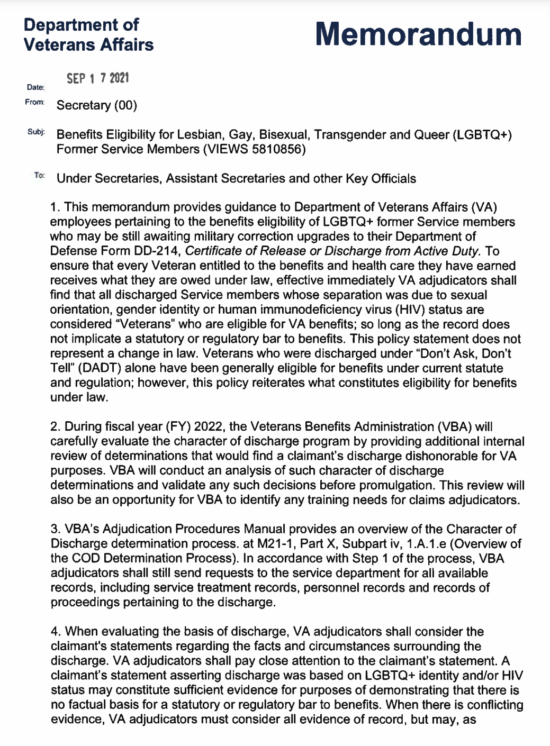
Benefits Eligibility to LGBTQ+ Veterans
Notes:
Link to Memo on VFW server when able.

Slide 49
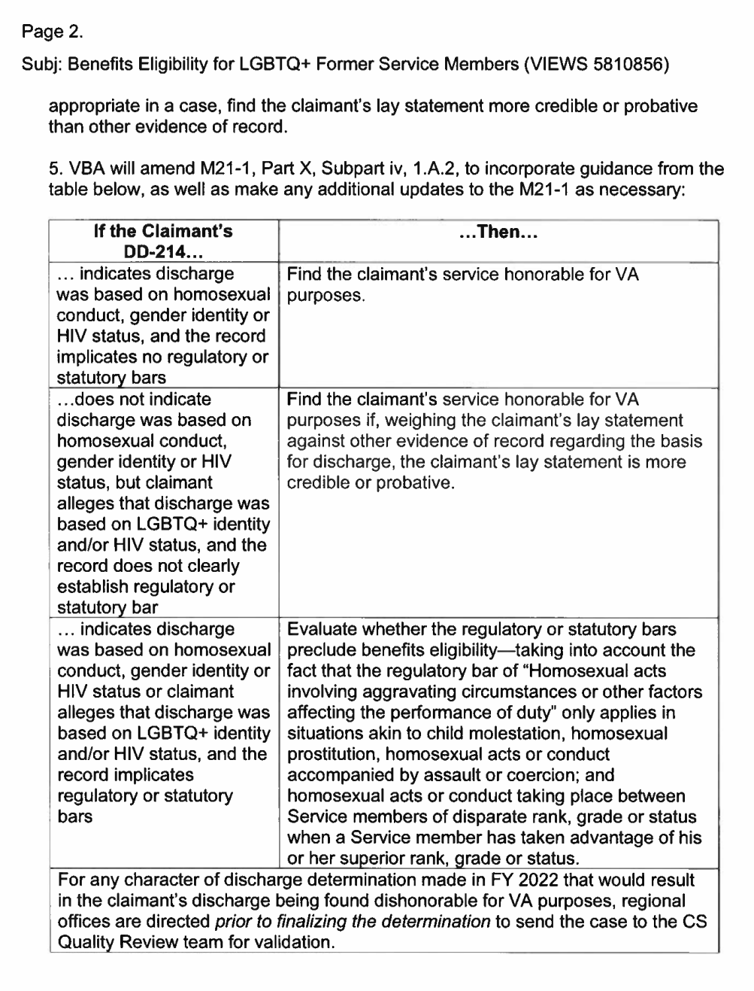
Benefits Eligibility to LGBTQ+ Veterans
Notes:
Link to Memo on VFW server when able.

Slide 50
QUESTIONS?

Slide 51

Game Time! Trivia Set Up!
To play, go to https://www.crowd.live/K8IJY
OR scan this QR code with your smartphone
Create a name (doesn’t have to be your real name) AND choose your team.
The results of the game will be shared with all, so if you want to use an alias, feel free!
Notes:
Link to Memo on VFW server when able.

