Slide 1
What’s New at the VA
Amanda Berry
May 2021

Slide 2
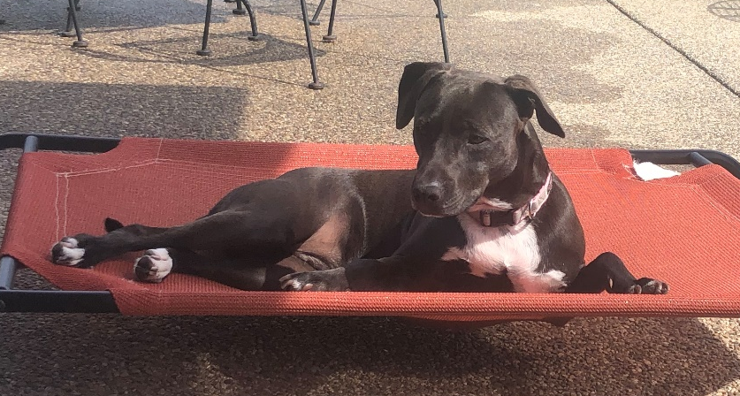
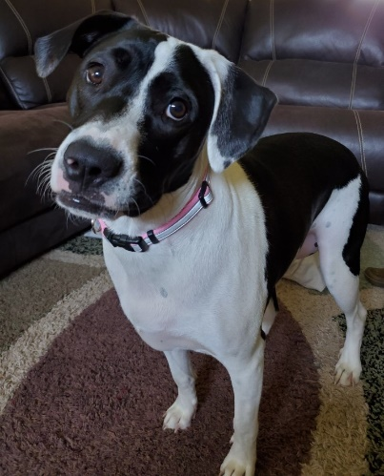

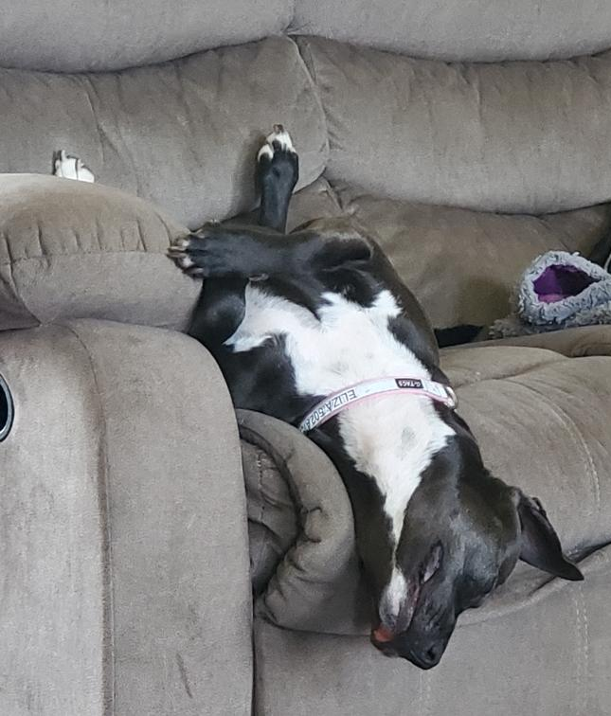
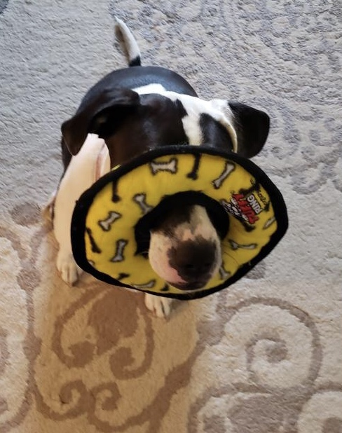

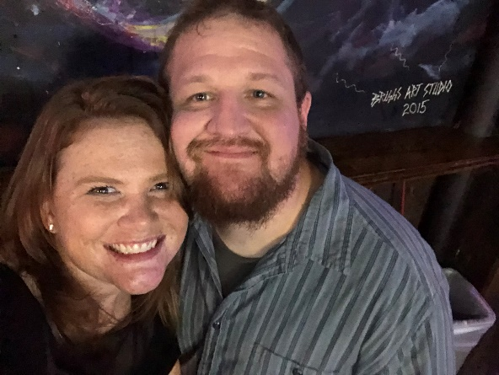
Hi there! Nice to meet you!
Amanda Berry

Slide 3
Agenda
2021 William M. Thornberry Defense and Authorization Act
  New Agent Orange Presumptives!!
Highlights of the Deborah Sampson Act
  Establishment of Office of Women’s Health
  Increased Standard of Health Care for Women
Johnny Jackson and David P. Roe Veterans Health Care and Benefits Improvement Act of 2020
  If you think you know it, it’s probably changed by this act.
New VA Forms
  VA Form 20-10206, FOIA/Privacy Act Request
  VA Form 20-10207, Priority Processing Request
  VA Form 20-10208, Document Evidence Submission
  VA Form 21-10210, Lay/Witness Statement
  VA Form 20-10212, Chapter 31 Request for Assistance
Pop Quiz!

Slide 4
What’s missing!?
What!?! No court cases?
I KNOW!
This time, we are all about the Acts.
What is an Act anyway?

Slide 5
All About Acts
An Act of Congress is a statute enacted by Congress. Acts can affect only individual entities (called private laws), or the general public (public laws). For a bill to become an act, the text must pass through both houses with a majority, then be either signed into law by the President of the United States or receive congressional override against a presidential veto. Congress may pass bills by simple majority votes. If the President vetoes a bill, Congress may override the veto by a two-thirds supermajority of both houses.
Veto - The procedure established under the Constitution by which the President refuses to approve a bill or joint resolution and thus prevents its enactment into law. A regular veto occurs when the president returns the legislation to the house in which it originated. The president usually returns a vetoed bill with a message indicating his reasons for rejecting the measure. The veto can be overridden only by a two-thirds vote in both the Senate and the House.
If the act gets through Congress and the President (or is unable to be vetoed by a President) it becomes law.

Slide 6
2021 William M. Thornberry Defense and Authorization Act
The William M. (Mac) Thornberry National Defense Authorization Act for Fiscal Year 2021 is a United States federal law which specifies the budget, expenditures and policies of the U.S. Department of Defense (DOD) for fiscal year 2021. The act is named in honor of Representative Mac Thornberry,^{[3]} who served as either the chair or the ranking member of the House Armed Services Committee. Thornberry retired from Congress at the end of the congressional session. The $740 billion bill includes pay raises for America's soldiers, modernizations for equipment, and provisions to require more scrutiny before troops are withdrawn from Germany or Afghanistan.
The bill passed both the House and Senate with veto-proof majorities on December 11, 2020. On December 23, President Trump vetoed the bill. The House and Senate voted on December 28 and January 1, 2021, respectively, to override the veto; this was the first and only veto override of Trump's presidency.
6

Slide 7
2021 William M. Thornberry Defense and Authorization Act
What it means for your Veterans?
New Agent Orange Presumptives
  Bladder Cancer
  Hypothyroidism
  Parkinsonism, or Parkinson-like symptoms
7
Notes:
The bill passed both the House and Senate with veto-proof majorities on December 11, 2020. On December 23, President Trump vetoed the bill. The House and Senate voted on December 28 and January 1, 2021, respectively, to override the veto; this was the first and only veto override of Trump's presidency.

Slide 8
2021 William M. Thornberry Defense and Authorization Act
What it means for your Veterans?
VA’s Current Procedures – awaiting procedural guidance from Central Office
  Deferring or otherwise holding any decision on a claim for one or any of the three new presumptive conditions where herbicide exposure has been conceded unless service connection can be decided on another basis (for example, direct).
  IV.ii.1.H.1.b.
Continue to file claims for these conditions, especially if you can show direct service connection.
8
Notes:
The bill passed both the House and Senate with veto-proof majorities on December 11, 2020. On December 23, President Trump vetoed the bill. The House and Senate voted on December 28 and January 1, 2021, respectively, to override the veto; this was the first and only veto override of Trump's presidency.

Slide 9
Deborah Sampson Act
The Act, named for Deborah Sampson—one of the first American women to serve in combat—seeks to correct what the bill’s sponsor described as the “second-class” treatment that the more than two million women veterans in the United States often receive. This Act is a provision of the Veterans Health Care and Benefits Improvement Act of 2020.
Deborah Sampson Gannett (December 17, 1760 – April 29, 1827), better known as Deborah Sampson, was a Massachusetts woman who disguised herself as a man in order to serve in the Continental Army during the American Revolutionary War. She is one of a small number of women with a documented record of military combat experience in that war. She served 17 months in the army under the name "Robert Shirtliff" (also spelled in various sources as Shirtliffe and Shurtleff) of Uxbridge, Massachusetts, was wounded in 1782, and was honorably discharged at West Point, New York in 1783.
9

Slide 10
Deborah Sampson Act
Establishes the Office of Women’s Health
  Headed by the Chief Officer of Women’s Health
  Centralize the VA’s efforts to evaluate and improve healthcare provided to women by the VA
  Minimum standards of care requires that each VAMC and CBOC have one primary care provider specifically designated for women’s health
  Improve counseling programs, newborn and childcare, and emergency transportation for women veterans
  Requires the VA to enter into agreements with public or private entities to provide additional legal services for women veterans. I.e, hild support, prevention of eviction and foreclosure, discharge upgrades, financial guardianship, credit counseling, and family reconciliation assistance
10

Slide 11
Deborah Sampson Act
  Requires the VA Secretary to create a comprehensive policy to end harassment and sexual assault, including gender-based harassment, at all VA facilities. As well as centralize the VA’s efforts to evaluate and improve healthcare provided to women by the VA
  Requires the VA to establish specialized teams to process claims related to military sexual trauma. The Act also includes reporting requirements related to these
      Prompted by VA Office of Inspector General report in 2018 which, “found that nearly half of (MST) military sexual trauma-related claims were not properly processed following VBA policy,” possibly resulting in “the denial of benefits to potential victims of MST who could have been entitled to receive them.”
  Lowers the age from 57 to 55 to remarry without incurring penalties for surviving spouses receiving dependency and indemnity compensation.
11

Slide 12
Veterans Health Care and Benefits Improvement Act of 2020
On December 17, 2020, a 340-page-plus law created sweeping changes in support for the United States veteran community was unanimously passed by the House and Senate. The law was sent for the President’s signature the day before Christmas 2020 and on January 5, 2021, became law. It’s full title is the Johnny Isakson and David P. Roe Veterans Health Care and Benefits Improvement Act of 2020.
Some aspects of the bill were effective immediately, some (education specifically) have set dates for implementation.
For light reading, go here: https://militarybenefits.info/vhcbi-act/#ixzz6s8Hcl9B8
For the full laws/changes, go here: https://www.congress.gov/bill/116th-congress/house-bill/7105/text#toc-HFD6B384E90A94D8D9808A7512CE17F4B
12
Notes:
On December 17, 2020, a 340-page-plus law created sweeping changes in support for the United States veteran community was unanimously passed by the House and Senate. The law was sent for the President’s signature the day before Christmas 2020 and on January 5, 2021, became law.
Read more: https://militarybenefits.info/vhcbi-act/#ixzz6s8Hcl9B8

Slide 13
Veterans Health Care and Benefits Improvement Act of 2020
Expanded VA Memorial Benefits
  Requires the VA to bear the costs to transport the remains of veterans to state cemeteries and tribal veteran cemeteries (within two years). Before the Act, the VA was only required to pay transport costs to a national veteran's cemetery.
  Begin providing urns for veterans who wish to be cremated. Surviving family members are offered a free urn from the VA or a free headstone. Those who opt for a free VA-provided headstone may also have a spouse’s name engraved on the headstone at no cost. Before this, families were required to pay for this service.
Ending VA Copays For Native American Veterans
  Within a year of the new law, the Department of Veterans Affairs must end VA copays for healthcare and medication. This requirement applies whether or not the patient has a service-connected disability.
13
Notes:
On December 17, 2020, a 340-page-plus law created sweeping changes in support for the United States veteran community was unanimously passed by the House and Senate. The law was sent for the President’s signature the day before Christmas 2020 and on January 5, 2021, became law.
Read more: https://militarybenefits.info/vhcbi-act/#ixzz6s8Hcl9B8

Slide 14
Veterans Health Care and Benefits Improvement Act of 2020
Expanded Medal of Honor Pension
  Surviving spouses qualify to receive the pension paid to Medal of Honor awardees when the service member dies. Spouses who are paid VA Dependency Indemnity Compensation are not eligible.
VA Life Insurance
  Starting in 2023 the Department of Veterans Affairs must offer whole life insurance to all disabled veterans under age 81. Unlike VGLI, there is no time limit to sign up post-service.
Expanded Accountability At Veterans Homes
  The 162 state-run veterans' homes in the United States are required to establish a consistent and ongoing report about COVID-19 cases, deaths, and related issues.
14
Notes:
On December 17, 2020, a 340-page-plus law created sweeping changes in support for the United States veteran community was unanimously passed by the House and Senate. The law was sent for the President’s signature the day before Christmas 2020 and on January 5, 2021, became law.
Read more: https://militarybenefits.info/vhcbi-act/#ixzz6s8Hcl9B8

Slide 15
Veterans Health Care and Benefits Improvement Act of 2020
Enhanced GI Bill Protections
  Requires more scrutiny of institutions of higher learning that have a dubious past when it comes to taking advantage of GI Bill students. VA must now analyze whether schools subject to punishment or legal action from the government should have their GI Bill funds suspended.
Service-Connected Deaths Related To Coronavirus
  Members of the Guard and Reserve who die of COVID-19 shall have their deaths identified as service-connected.
Help For Homeless Veterans
  Gives the VA enhanced abilities to provide funds to agencies that assist homeless veterans as well as expanding a federal voucher program offered to veterans without honorable discharges who are experiencing homelessness.
15
Notes:
On December 17, 2020, a 340-page-plus law created sweeping changes in support for the United States veteran community was unanimously passed by the House and Senate. The law was sent for the President’s signature the day before Christmas 2020 and on January 5, 2021, became law.
Read more: https://militarybenefits.info/vhcbi-act/#ixzz6s8Hcl9B8

Slide 16
Veterans Health Care and Benefits Improvement Act of 2020
Public Use Disability Benefits Questionnaire’s
  Requiring the VA to make disability benefit questionnaires available for public use
Definition of Vietnam Veteran
  Changing the statutory definition of "Vietnam Veteran" to include people who served in the Republic of Vietnam from Nov. 1, 1955 to Feb. 27, 1961.
  Previously this was from February 28, 1961 and ending of May 7, 1975 for a veteran who served in the Republic of Vietnam (38 U.S.C. § 101(29)(A)).
  More guidance to follow.
Help For “K2” Veterans
  Require the VA to study incidents of cancer and other illnesses experienced by service members who served at the Karshi-Khanabad Air Base in Uzbekistan between Oct. 1, 2001, and Sept. 30, 2005
16
Notes:
On December 17, 2020, a 340-page-plus law created sweeping changes in support for the United States veteran community was unanimously passed by the House and Senate. The law was sent for the President’s signature the day before Christmas 2020 and on January 5, 2021, became law.
Read more: https://militarybenefits.info/vhcbi-act/#ixzz6s8Hcl9B8

Slide 17
Veterans Health Care and Benefits Improvement Act of 2020
There are so many changes in this act it will take a while to determine the full impact and implementation.
Bottom line – if you used to know it – check this act because it was probably changed.
17
Notes:
On December 17, 2020, a 340-page-plus law created sweeping changes in support for the United States veteran community was unanimously passed by the House and Senate. The law was sent for the President’s signature the day before Christmas 2020 and on January 5, 2021, became law.
Read more: https://militarybenefits.info/vhcbi-act/#ixzz6s8Hcl9B8

Slide 18
New Forms!!
VA Form 20-10206 Freedom of Information Act (FOIA) or Privacy Act (PA) Request
VA Form 20-10207 Priority Processing Request
VA Form 20-10208 Document Evidence Submission
VA Form 21-10210 Lay/Witness Statement
VA Form 20-10212 Chapter 31 Request for Assistance
Why new forms!? This effectively streamlines processing of claims. Now when this evidence is uploaded to VBMS, there is less chance of it being overlooked. Information sent with cover pages or on VA Form 21-4138’s are too generic and can be overlooked. These new forms provide ease of use for VSO’s and can be directly uploaded.
18

Slide 19
QUESTIONS?

Slide 20
Pop Quiz Ya’ll!!!
Questions and answers may appear later. At a very important time. Like on a test or something, idk.

