Slide 1
What’s New at NVS
Part 1
Ryan Gallucci
Director, NVS
Rgallucci@vfw.org
Gregg Orto
Deputy Director, NVS
Gorto@vfw.org
Chris Macinkowicz
Asst. Director, Training & QA Cmacinkowicz@vfw.org

Slide 2
Quality Assurance
The goal of the Quality Assurance Program is to strengthen the relationship between the DSOs and NVS.
Each region now has a dedicated NVS staff member (Regional QA Specialist) whose duty it is to assist, mentor, and serve their fellow service officers in their region.

Slide 3
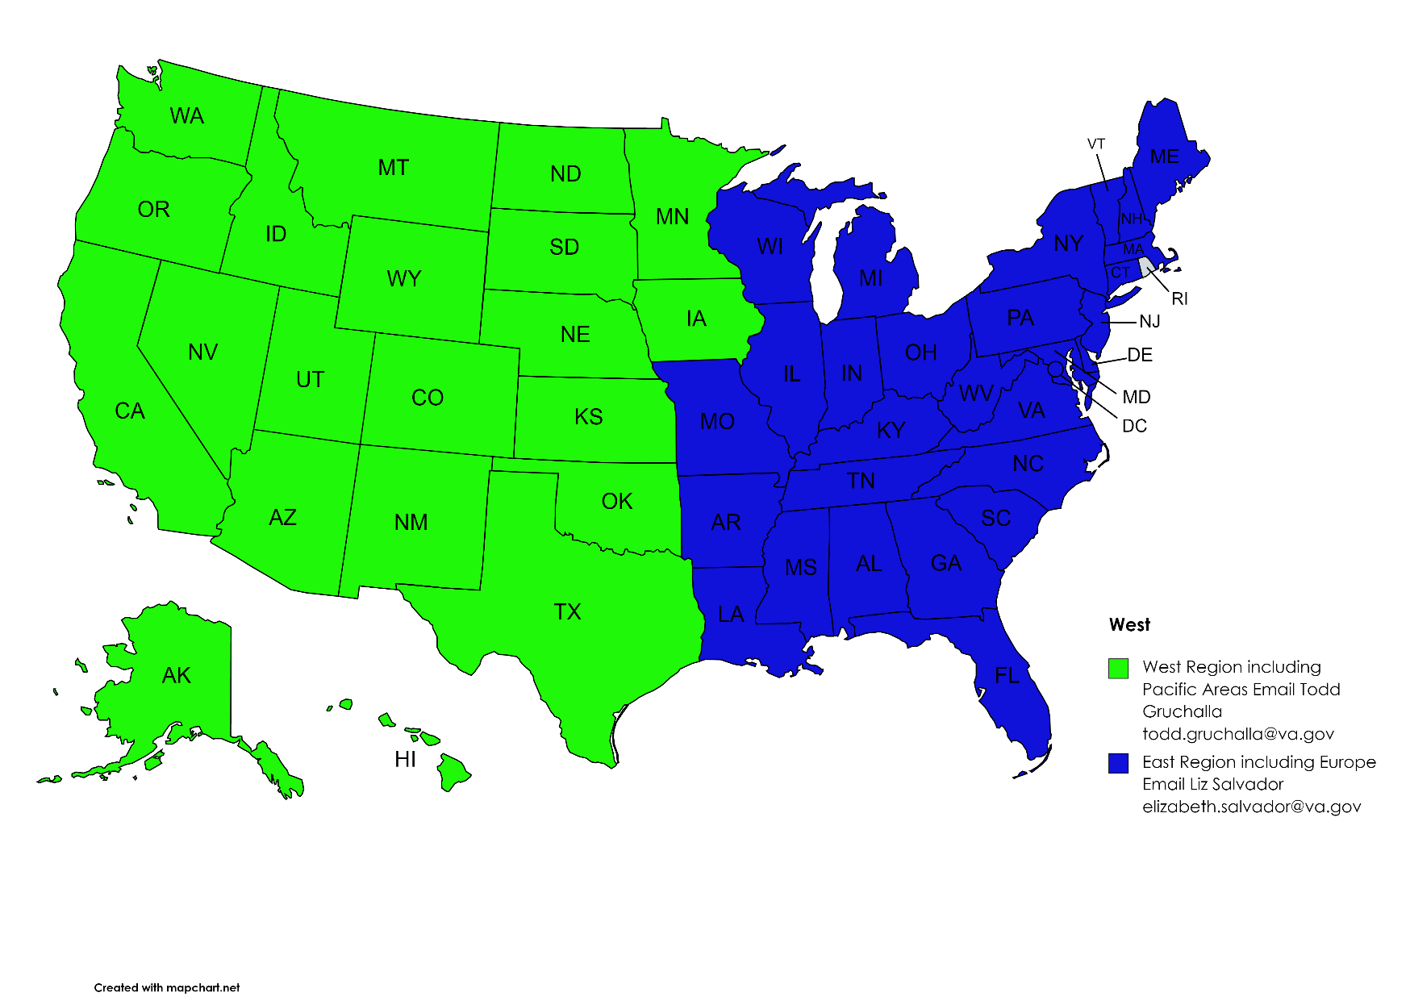
Who are our Regional QA Specialists?
Todd Gruchalla
West Region including Pacific Areas
Liz Salvador
East Region including Europe

Slide 4
West Region Regional Offices
Des Moines, IA 333
Lincoln, NE 334
St. Paul, MN 333
Denver, CO 339
Albuquerque, NM 340
Salt Lake City, IU 341
Oakland, CA 343
Los Angeles, CA 344
Phoenix, AZ 345
Seattle, WA 346
Boise, ID 347
Portland, OR 348
Waco, TX 349
Muskogee, OK 351
Reno, NV 354
Manila, Philippines 358
Houston, TX 362
San Diego, CA 377
Ft. Harrison, MT 436
Fargo, ND 437
Sioux Falls, SD 438
Cheyanne, WY 442
Wichita, KS 452
Honolulu, HI 459
Anchorage, AK 463

Slide 5
East Region Regional Offices
Boston, MA 301
Providence, RI 304
New York, NY 306
Buffalo, NY 306
Hartford, CT 308
Newark, NJ 309
Philadelphia, PA 310
Pittsburgh, PA 311
Baltimore, MD 313
Roanoke, VA 314
Huntingdon, WV 315
Atlanta, GA 316
St. Petersburg, FL 317
Winston-Salem, NC 318
Columbia, SC 319
Nashville, TN 320
New Orleans, LA 321
Montgomery, AL 322
Jackson, MS 323
Cleveland, OH 325
Indianapolis, IN 326
Louisville, KY 327
Chicago, IL 328
Detroit, MI 329
Milwaukee, WI 330
St. Louis, MO 331
Little Rock, AR 350
San Juan, PR 355
Washington, DC 372
Manchester, NH 373
Togus, ME 402
White River Junction, VT 405
Wilmington, DE 480

Slide 6
How will the Regional QA Specialists help?
Regional QA Specialists are your liaison between National Veteran Service and your office.
Regional QA Specialists will:
Provide technical expertise, mentorship, and support to Department service office staff and other VFW- accredited representatives on a continuing basis
Provide periodic claims assistance to veterans including providing coverage for gaps in VA Regional Offices when VFW Departments experience turnover at the direction of the NVS Director
Conduct VFW Service Office visits including initial site visits to newly hired DSOs to provide introductory training and establish a relationship conductive to future mentoring

Slide 7
How will the Regional QA Specialists help?
Regional QA Specialists will:
Respond to service officer calls and when applicable use these calls as training opportunities
Conduct Monthly SEP POA reports and work with states in their region to ensure POA requests stay up to date
Monitor the VSO Notification Queue for trends and errors
Attend Director, Service Center Manger, and other VBA meetings for the VAROs in their region

Slide 8
What can you do to help this be successful
We created these two new positions to be of service to you and your offices. For this program to be successful, we need your support. Here are some ways you can support us:
Contact your Regional QA Specialist for all general inquiries that you make to NVS. Please refer to your NVS Contact Sheet for contact information and when to contact.
Keep your Regional QA Specialist in the loop of what is happening in your office.
Do not be afraid to contact them if you have a question with a veteran’s claim.
If you have ideas for future training or ideas on how to improve the VFW, reach out to your Regional QA Specialist.

Slide 9
NVS Grant Review
National Veterans Service Restricted Grant:
Must be used to fund work related to veterans’ benefits assistance
Reported out annually to the VFW Quartermaster General Subsequently reported to NVS
Based on 2019 and 2020 reviews, National Council of Administration provided a 10% increase in the current VFW fiscal year (2021-2022) with the directive for NVS to review every three years
In compliance with the Council’s directive, NVS is again reviewing the grant structure to provide an update to the Council of Administration in August 2022
THERE ARE NO ANTICIPATED CHANGES IN 2022-2023

Slide 10
Questions?

