Slide 1
What’s New at NVS
Part 2
Ryan Gallucci
Director, NVS
Rgallucci@vfw.org
Mike Figlioli
Deputy Director, NVS
Mfiglioli@vfw.org
Jeff Wishneski
Associate Director, BVA Jwishneski@vfw.org

Slide 2
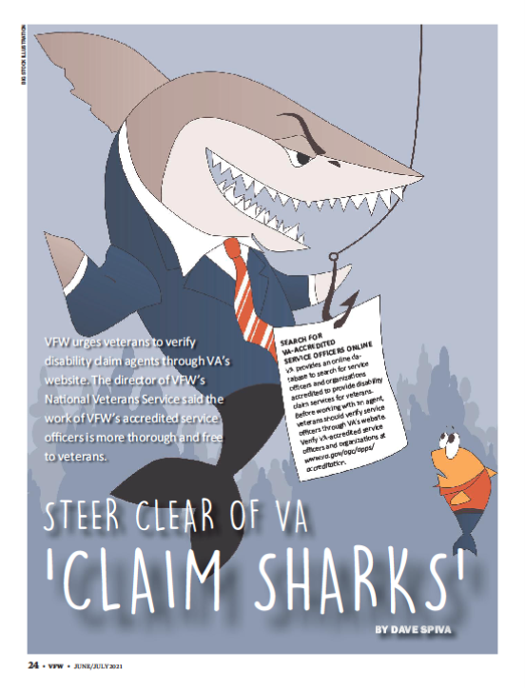
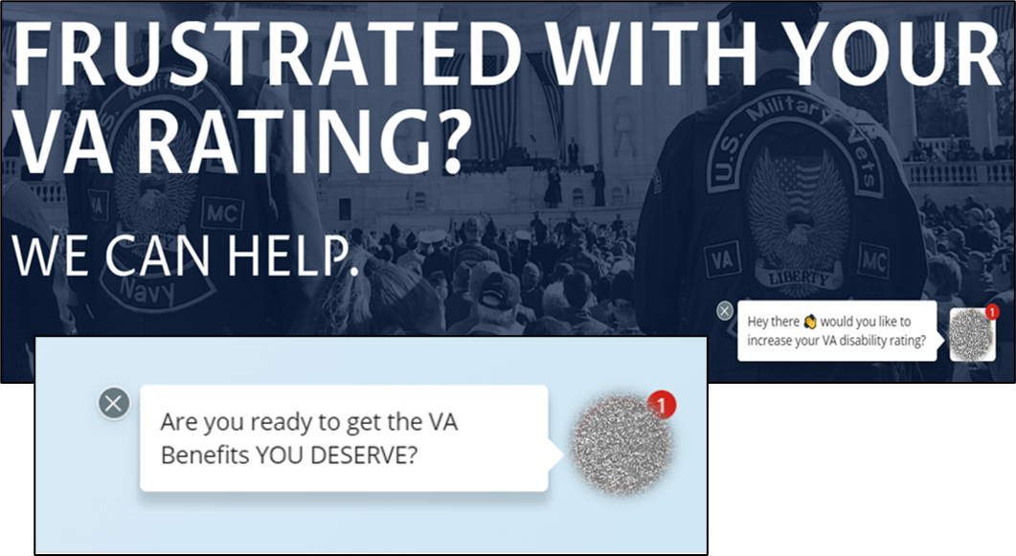
Combating Claim Sharks
REFRESHER:
A Claim Shark is an individual or company that “assists” or “consults” veterans with VA claims even though they are not accredited with VA
Many of these companies charge fees for their services, sometimes totaling in the tens of thousands of dollars for services that veterans can receive from you FOR FREE
These companies have used the pandemic to their advantage, offering fully remote “assistance” and easy to access “one click away buttons” in order to capitalize on the reduced resources available due to VA closures

Slide 3
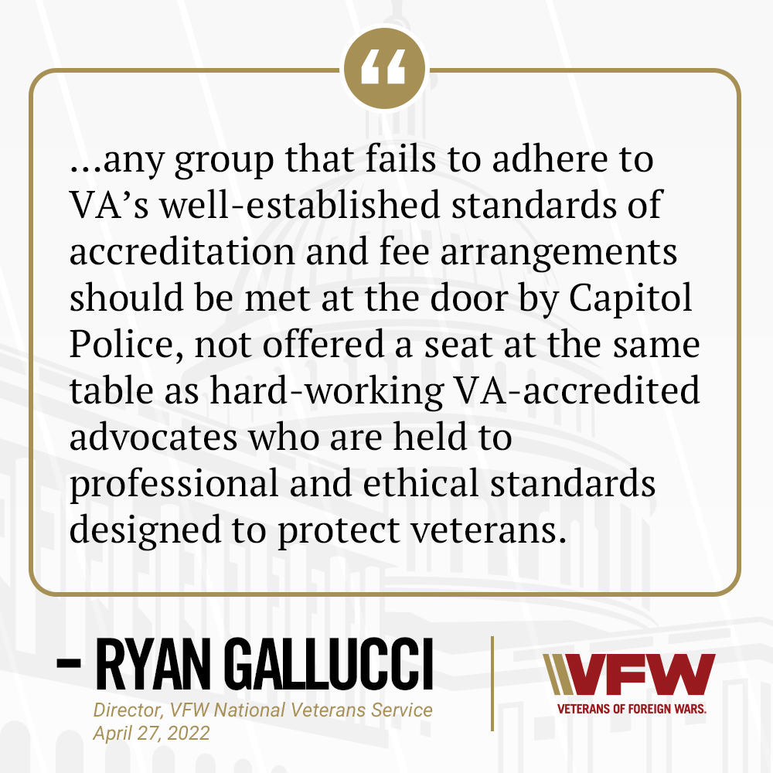
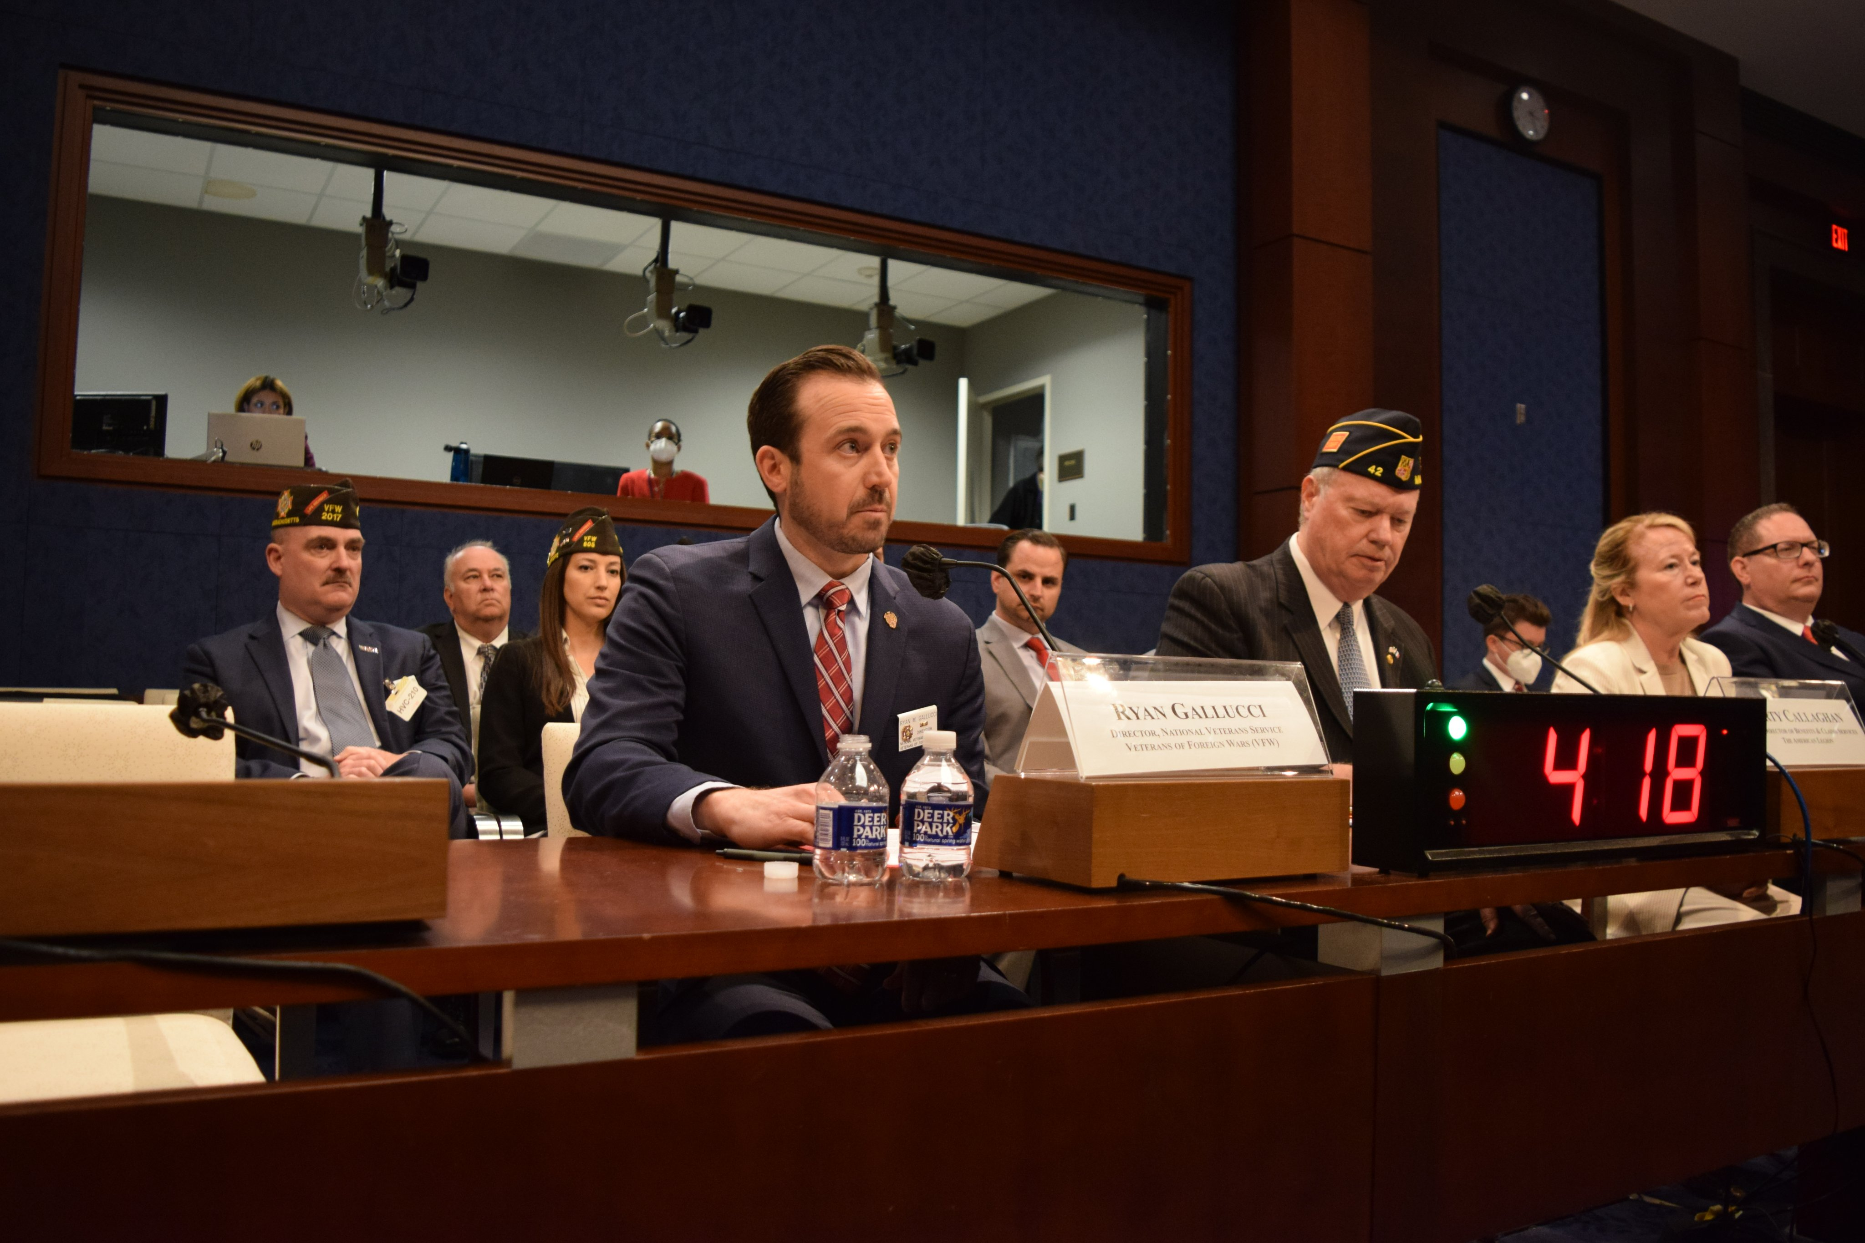
Combating Claim Sharks
UPDATE:
VFW and WWP published join op-ed on predatory claims consulting on April 19
VFW Testified before House DAMA and O&I Subcommittees on April 27

Slide 4
Combating Claim Sharks
POLICY DISCUSSIONS:
Congress must reinstate penalties for charging veterans for claims assistance
Are these contracts even enforceable under current VA benefits law, and if not, what steps can VA do to help veterans get out of them or even restore benefits for those who have already been exploited?
When these companies provide referral for medical opinions of questionable value, are they at best delaying the veteran’s claim from proper adjudication or, at worst, potentially defrauding the VA benefits system?
Are their predatory marketing practices and manipulative language violations under the Program Fraud Civil Remedies Act of 1986.
Do VA and DoD have mechanisms in place to sanction these companies should they seek to access a veteran’s sensitive logon credential for eBenefits or VA.gov?

Slide 5
Combating Claim Sharks
RED FLAGS FOR VSOs and VETERANS:
Promises or guarantees to increase disability ratings and secure “X” amount percentage increases.
Companies advertising services that are done faster or better than a veterans service organization or accredited agents.
Requesting sensitive login credentials to access the veteran’s info through secure VA websites like eBenefits or VA.gov.
Using confusing tactics or ambiguous language in contracts designed to mislead the veteran.
Offering health consultation within their own network of doctors and telling veterans to forego VA exams for a faster decision.
Link to VFW/WWP op-ed: https://www.militarytimes.com/opinion/commentary/2022/04/19/how-we-can-protect-americas-veterans-from-predatory-benefits-claims-practices/

Slide 6
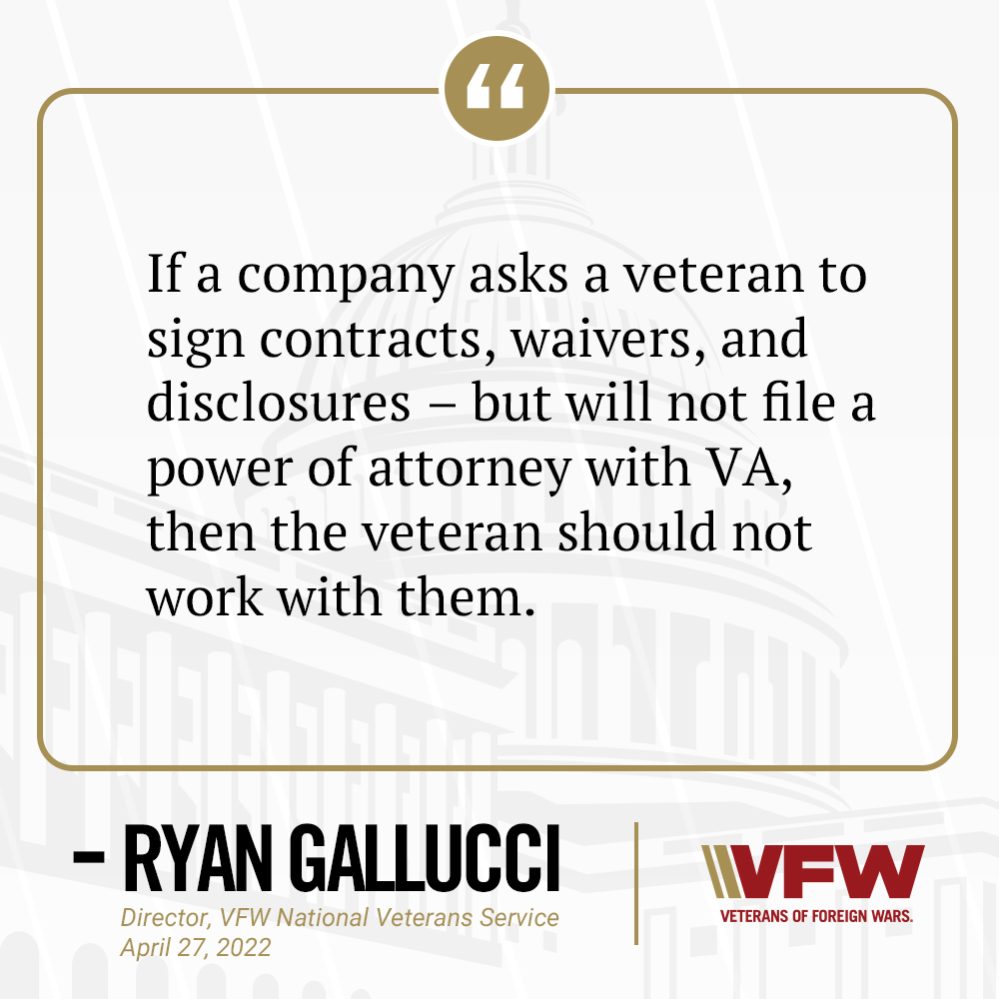
Combating Claim Sharks
TELL VETERANS:
Always work with ACCREDITED Representatives
Do not sign contracts
Do not agree to fees or prospective benefit payments
Do not agree to pay for medical consultations or opinions
Do not provide access to PHI/PII to unaccredited individuals
No 21-22, No Service!

Slide 7
Combating Claim Sharks
HOW YOU CAN HELP:
If you are assisting a veteran who has been “helped” by a claim shark, ask if they have information for the company and forward it to Brad Hazell at Bhazell@vfw.org
If the veteran can provide a copy of their contract it will be extremely helpful, even if it is not signed
NVS is compiling information to help VA put a stop to these practices as they are extremely harmful to veterans and often illegal
As tempting as it may be, do NOT conduct your own investigation into these companies
Do not contact them or post comments to their social media pages
If a veteran asks about a specific company, do not speak negatively, instead advise them to use an accredited representative and offer to check the OGC website.
Example: Accredited agents and attorneys may maintain web sites that look similar. However, any agreements that a veteran signs an agent or attorney is subject to strict VA oversight and perfectly legitimate. These sites WILL disclose VA accreditation.
No 21-22, No Service!

Slide 8
BVA Modernization

Slide 9
Questions?

