Slide 1
CARDIOVASCULAR
SYSTEM
By Vicki Von Loh

Slide 2


Functions Check
Before we get started, let’s perform a functions check to ensure everyone can participate and follow along.
Ensure that you’re in a quiet space in your home or office
Ensure that your computer is charged and/or plugged in.
Next, please keep your microphone on mute unless you are speaking. To mute or unmute your microphone, click on the microphone icon in the lower, left corner of the screen. Click on the icon to mute or unmute
You can start or stop your video at any time by clicking on the video icon in the lower, left corner of the screen. Click on the icon to start or stop.

Slide 3


Functions Check
If you’re having trouble hearing the presentation, first ensure that your volume is on and turned up. Then, if using headphones, check the settings by using the arrow next to the microphone icon to ensure that you’re using the correct settings for headphones.
To use the chat feature, click on the chat icon at the bottom, middle of the screen.
You can choose to chat with everyone or a specific person by using the arrow.

Slide 4
Functions Check
If you have a QUESTION during the presentation, please enter a question mark (?) or enter your question into the chat box and the presenter or facilitator will address your question.
PLEASE WAIT UNTIL YOU ARE RECOGNIZED BEFORE UNMUTING YOUR MICROPHONE
If you’re having technical difficulties, please contact the Technical Advisors listed in the agenda.
If you need a comfort break, please do so and return as soon as possible.
Please remember, these sessions will be recorded for future use.
Everything on the internet lasts forever!

Slide 5
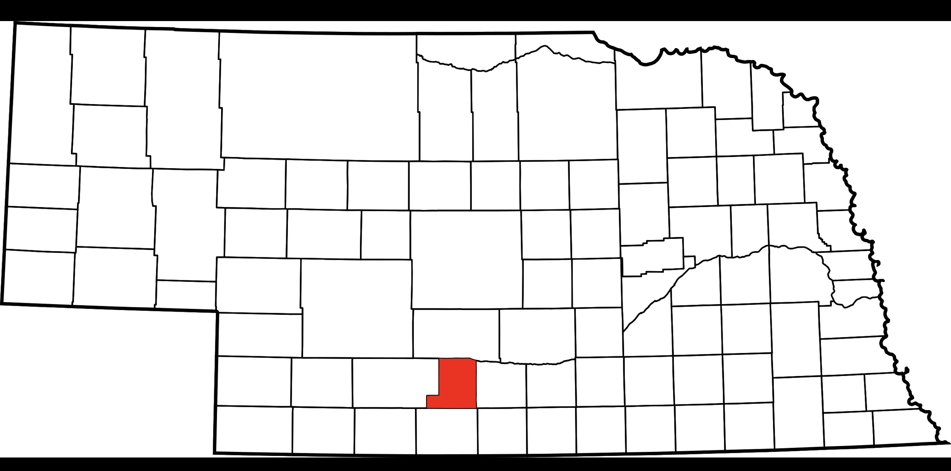

Slide 6
Heart Defined
The Heart is an organ of the body that pumps blood throughout the blood vessels by repeated, rhythmic contractions.
The heart and circulatory system make up the cardiovascular system.

Slide 7
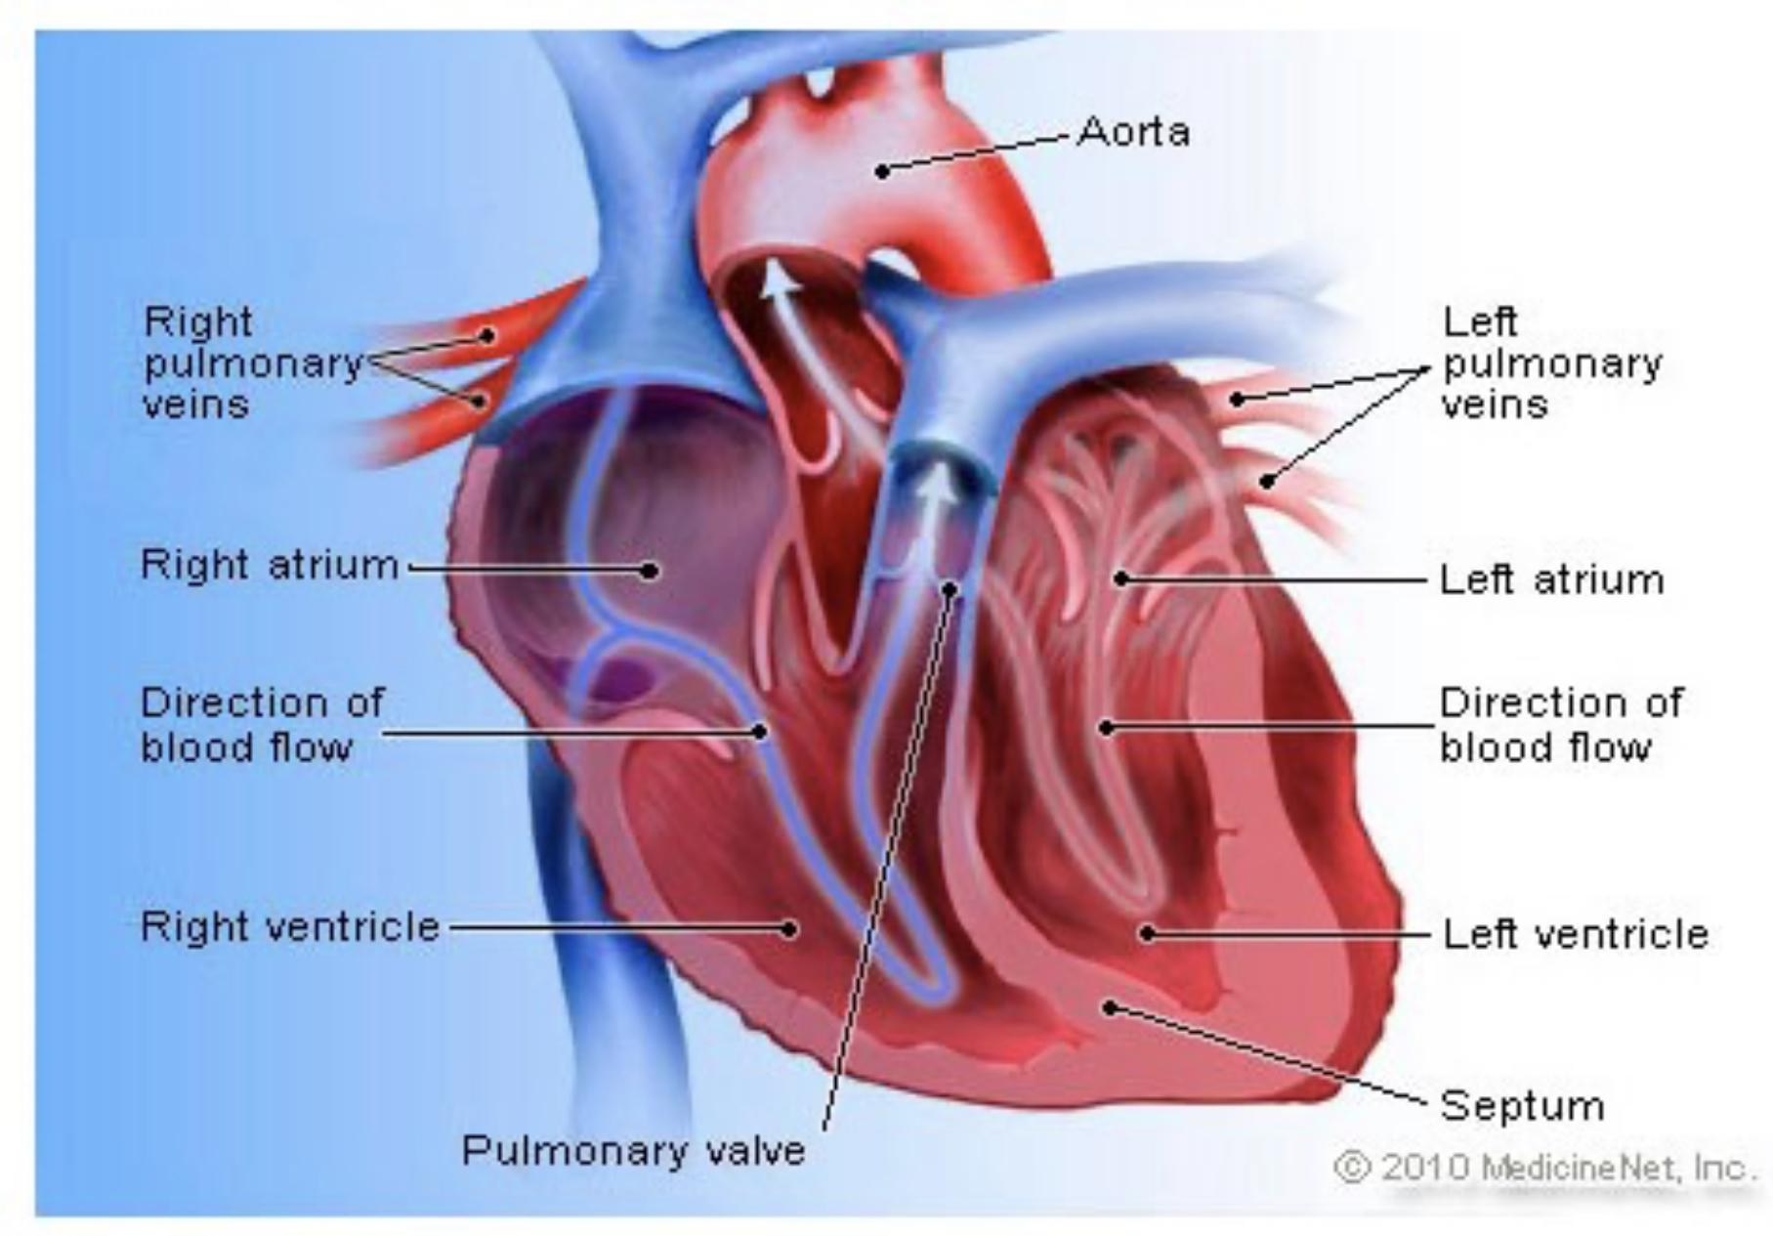
The Heart

Slide 8
Diseases of the Heart
Valvular - affecting any of the four valves of the heart; mitral, aortic, pulmonary, or tricuspid.
Inflammatory - inflammation of the heart muscle.
Hypertensive - caused by high blood pressure.
Arrhythmias - irregular heartbeat.
May be subject to a presumption of service connection (38 CFR 3.309(a)) if manifested compensable within one year of discharge.

Slide 9
Diseases of Heart (continued)
Ischemic - an inadequate supply of blood and oxygen to the heart.
acute, sub-acute, and old myocardial infarction
atherosclerotic cardiovascular disease including coronary artery disease
coronary bypass surgery
stable, unstable and Prinzmetal's angina
If due to herbicide (A/O) exposure and diagnosed prior to August 31, 2010, then 38 CFR 3.114 applies!

Slide 10
Heart Highlights
Coronary Artery Disease
Myocardial Infarction
Coronary Bypass Surgery
Implantable Cardiac Pacemakers
Automatic implantable Cardioverter-Defibrillator (AICD)

Slide 11
38 CFR 4.100
Evaluation CRITERIA for Diagnostic Codes 7000-7007, 7011, and
7015-7020
Whether there is cardiac hypertrophy or dilatation (documented by electrocardiogram, echocardiogram, or X-ray)
Whether there is need for continuous medication
Estimated METs (UNLESS you can assign a 60 or 100% on another basis such as ejection fraction or congestive heart failure)
**If left ventricular ejection fraction (LVEF) testing is not of record, evaluate based on the alternative criteria unless the examiner states that the LVEF test is needed in a particular case because the available medical evidence does not sufficiently reflect the severity of the cardiovascular disability.

Slide 12
Terms
Cardiac hypertrophy is the abnormal enlargement, or thickening, of the heart muscle, resulting from increases in cardiomyocyte size and changes in other heart muscle components, such as extracellular matrix.
Cardiomyopathy is a disease in which the heart muscle becomes weakened, stretched, or has another structural problem. Dilated cardiomyopathy is a condition in which the heart muscle becomes weakened and enlarged. As a result, the heart cannot pump enough blood to the rest of the body. There are many types of cardiomyopathy. Dilated cardiomyopathy is the most common.

Slide 13
Terms
Ejection fraction (EF) is the percentage of blood that’s pumped out with each heartbeat. There are two types - left ventricular and right ventricular. Left ventricular (LVEF) is typically what is referred to as ejection fraction.
The metabolic equivalent of task (MET) is the objective measure of the ratio of the rate at which a person expends energy, relative to the mass of that person, while performing some specific physical activity compared to a reference, set by convention at 3.5 mL of oxygen per kilogram per minute, which is roughly equivalent to the energy expended when sitting quietly.

Slide 14
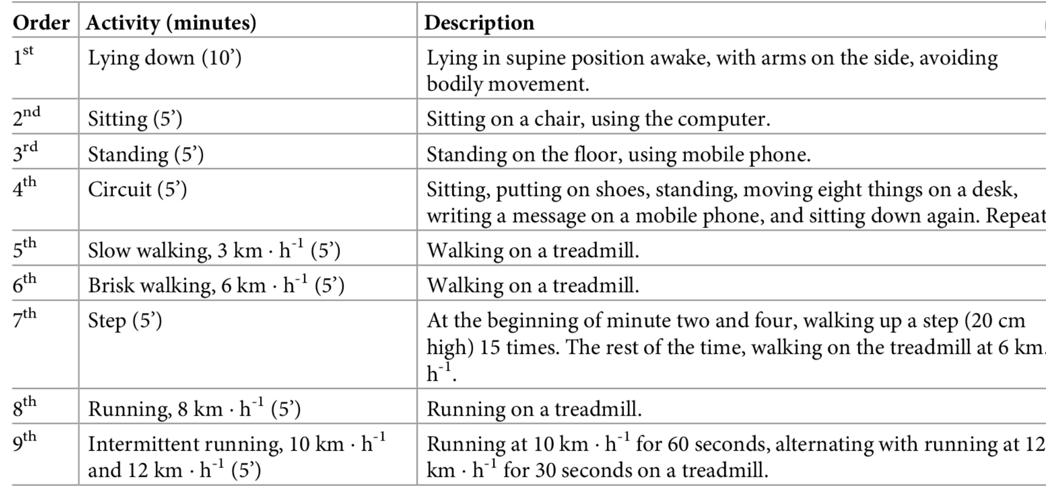
METS Equivalent

Slide 15
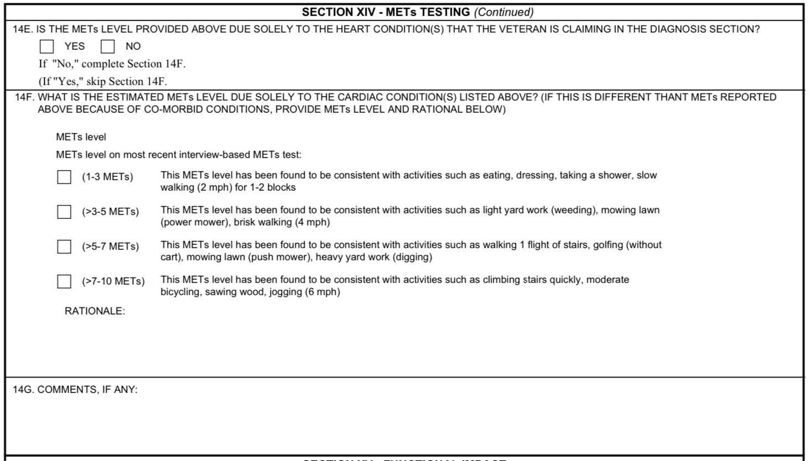
METS on Heart DBQ

Slide 16
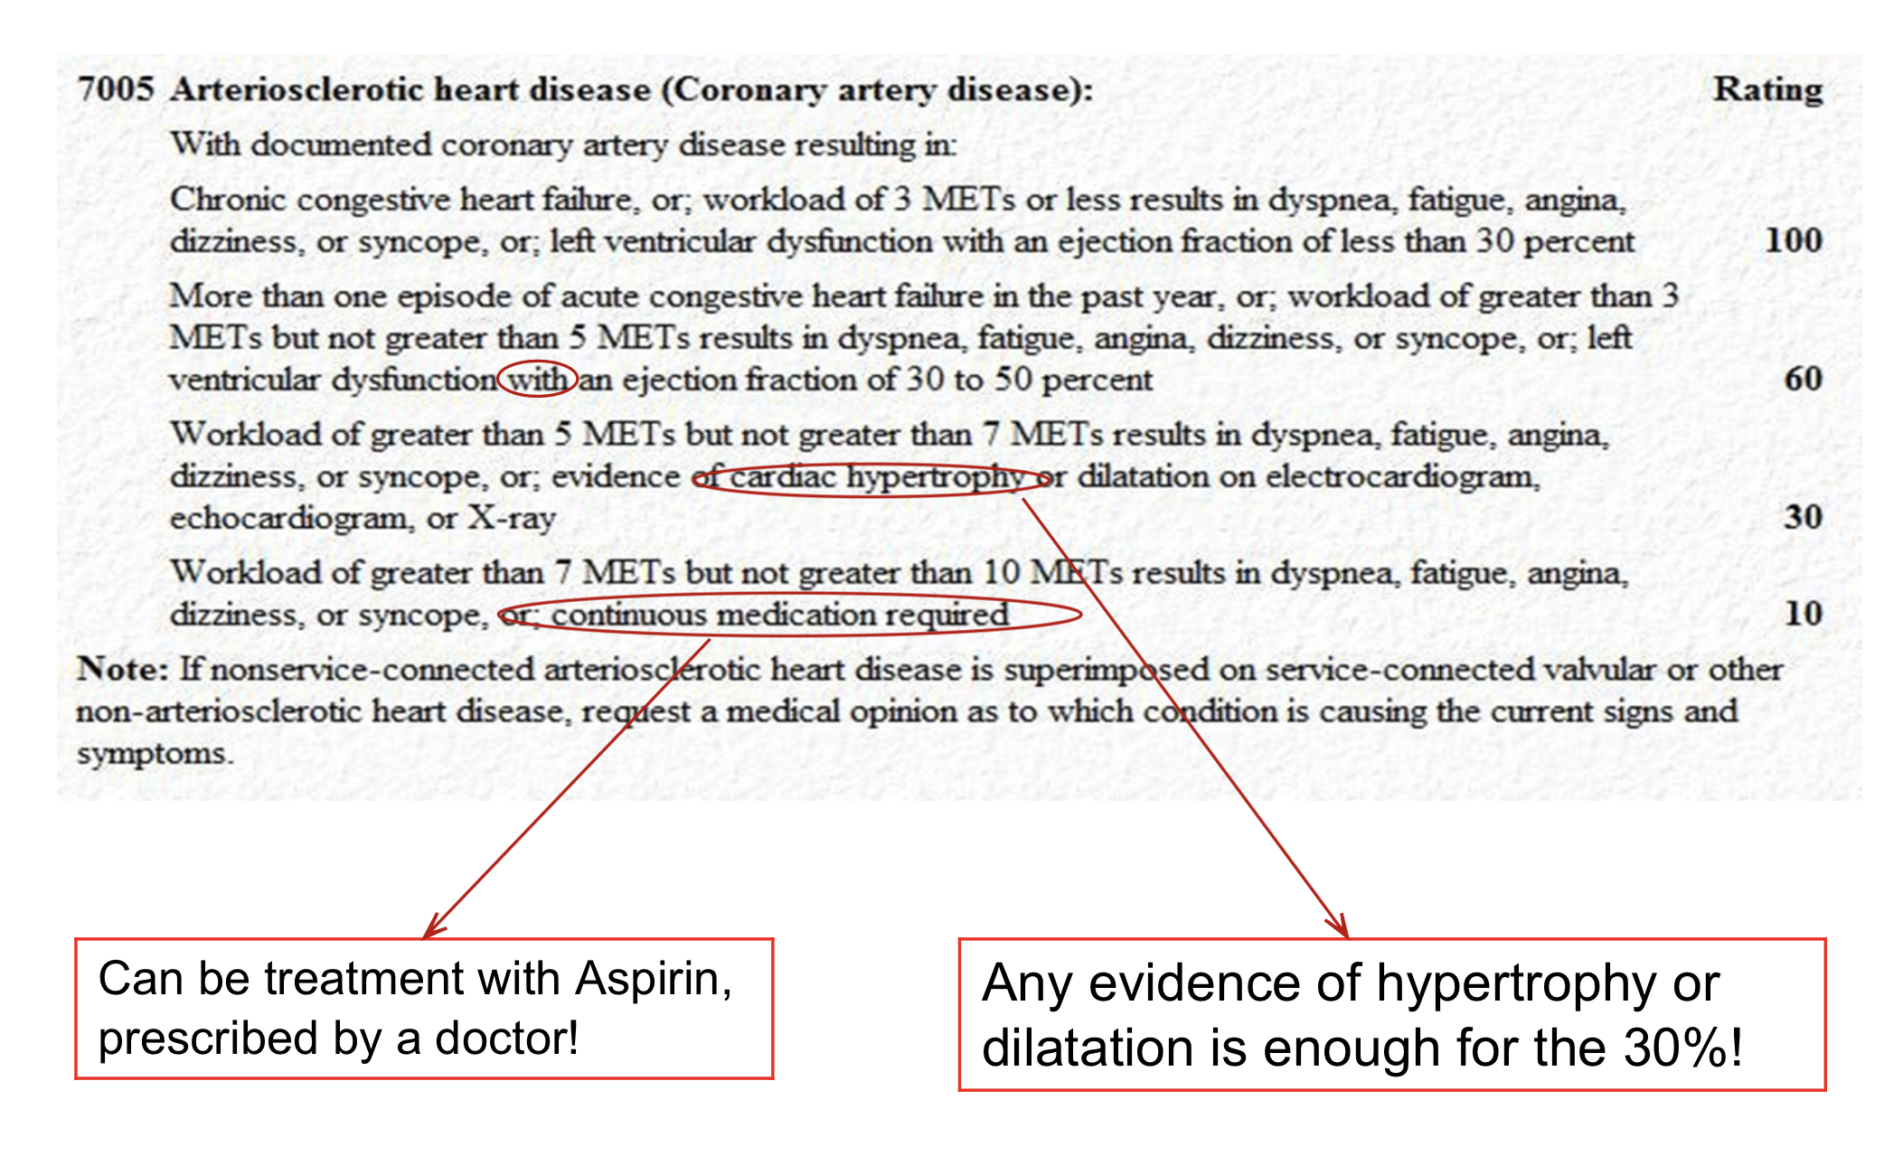
Rating Criteria Coronary Artery Disease DC 7005

Slide 17
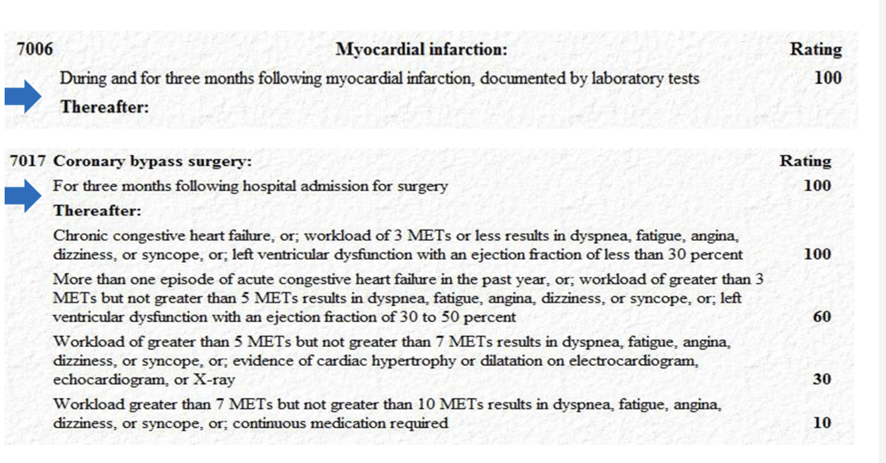
Rating Criteria Myocardial Infarction DC 7006; CABG DC 7017

Slide 18
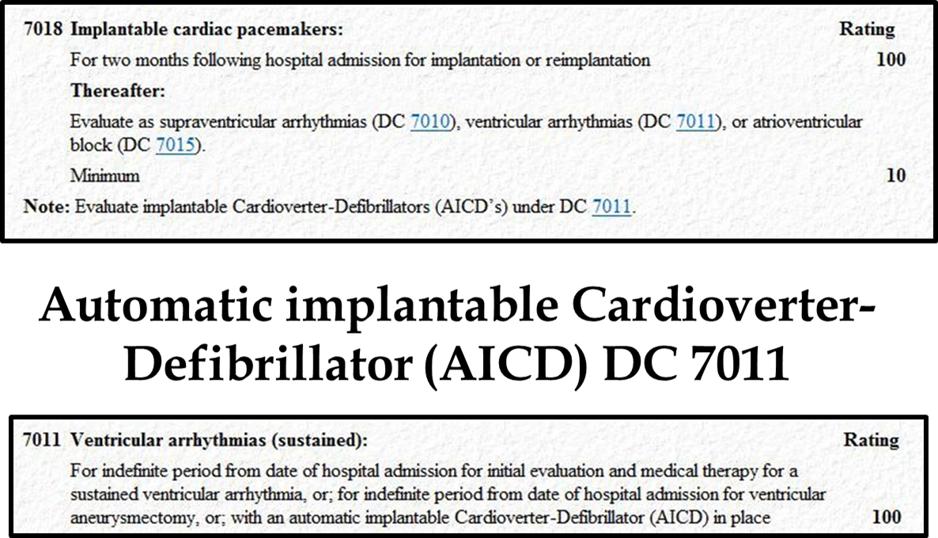
Rating Criteria Implantable Cardiac Pacemaker DC 7018

Slide 19
Pacemakers
Depending on your condition, you might have one of the following types of pacemakers.
Single chamber pacemaker. This type usually carries electrical impulses to the right ventricle of your heart.
Dual chamber pacemaker. This type carries electrical impulses to the right ventricle and the right atrium of your heart to help control the timing of contractions between the two chambers.
Biventricular pacemaker. Biventricular pacing, also called cardiac resynchronization therapy, is for people with heart failure with abnormal electrical systems. This type of pacemaker stimulates the lower chambers of the heart (the right and left ventricles) to make the heart beat more efficiently.

Slide 20
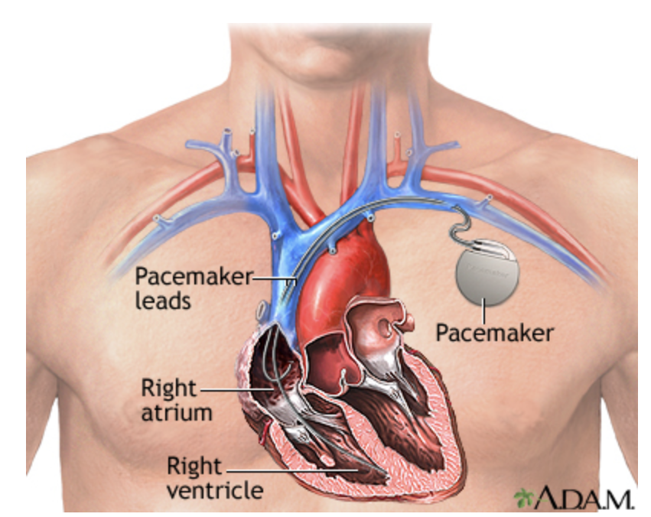
Pacemakers
A pacemaker is a small, battery-operated device that senses when your heart is beating irregularly or too slowly. It sends a signal to your heart that makes your heart beat at the correct pace.

Slide 21
Defibrillators
Also known as Automated External Defibrillator (AED), Implantable Cardioverter Defibrillator (ICD), Wearable Cardioverter Defibrillator (WCD)
Defibrillators are devices that restore a normal heartbeat by sending an electric pulse or shock to the heart. They are used to prevent or correct an arrhythmia, a heartbeat that is uneven or that is too slow or too fast. Defibrillators can also restore the heart’s beating if the heart suddenly stops.
Different types of defibrillators work in different ways. Automated external defibrillators (AEDs), which are in many public spaces, were developed to save the lives of people experiencing sudden cardiac arrest. Even untrained bystanders can use these devices in an emergency.

Slide 22
Defibrillator (continued)
Other defibrillators can prevent sudden death among people who have a high risk of a life-threatening arrhythmia. They include implantable cardioverter defibrillators (ICDs), which are surgically placed inside your body, and wearable cardioverter defibrillators (WCDs), which rest on the body.
It can take time and effort to get used to living with a defibrillator, and it is important to be aware of possible risks and complications.

Slide 23
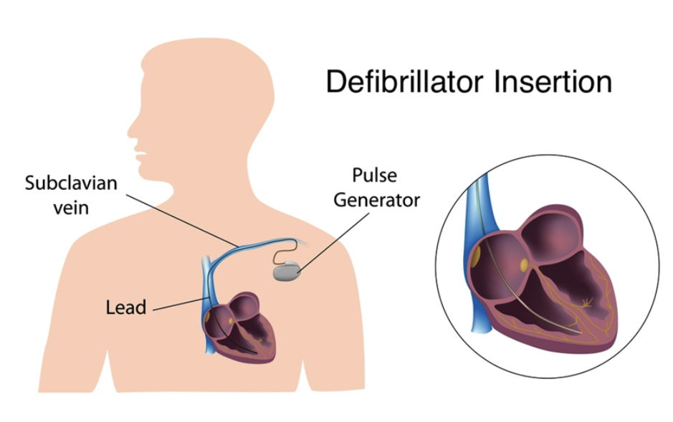
Defibrillator Insertion

Slide 24
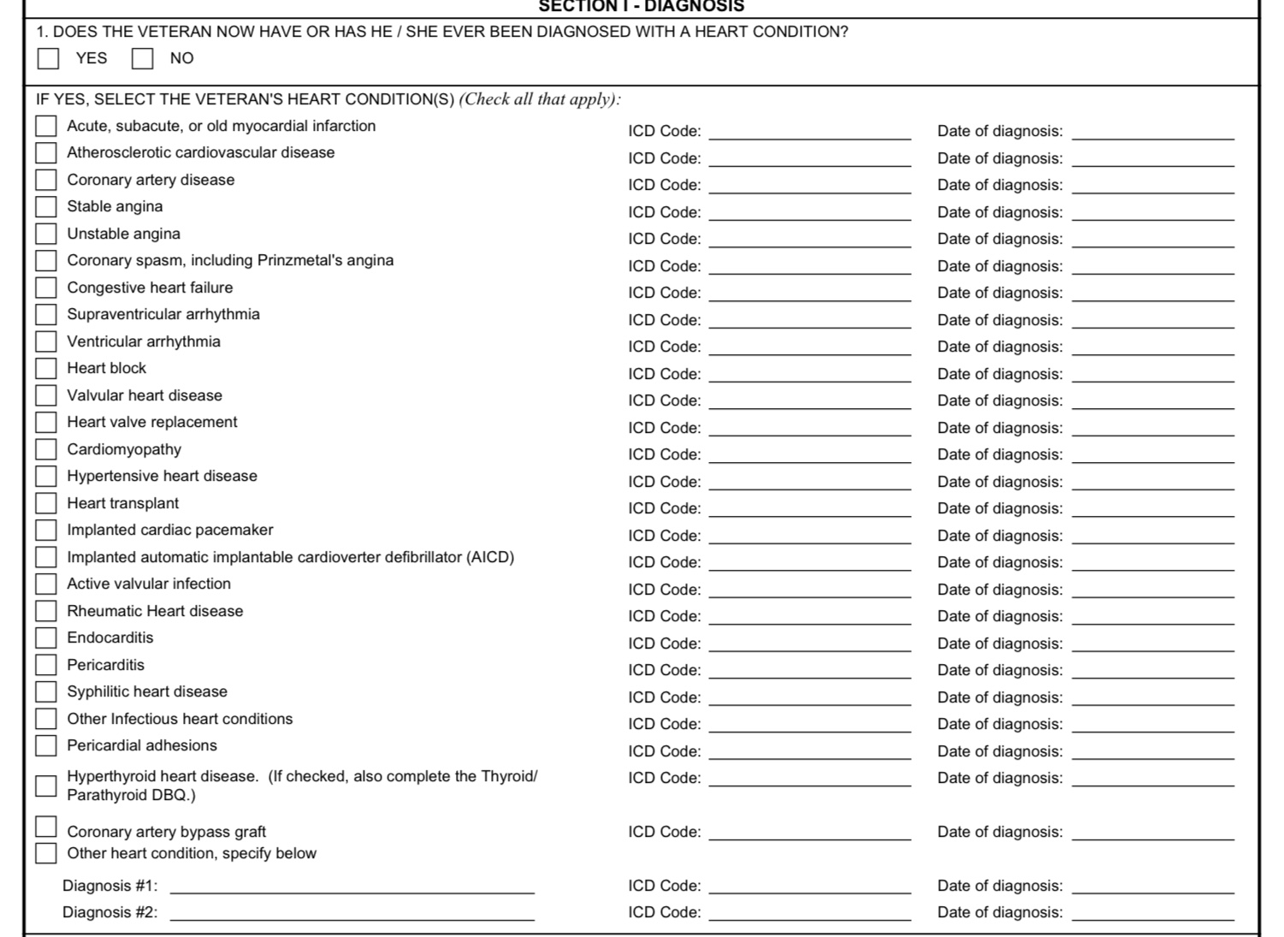
Heart Conditions DBQ

Slide 25
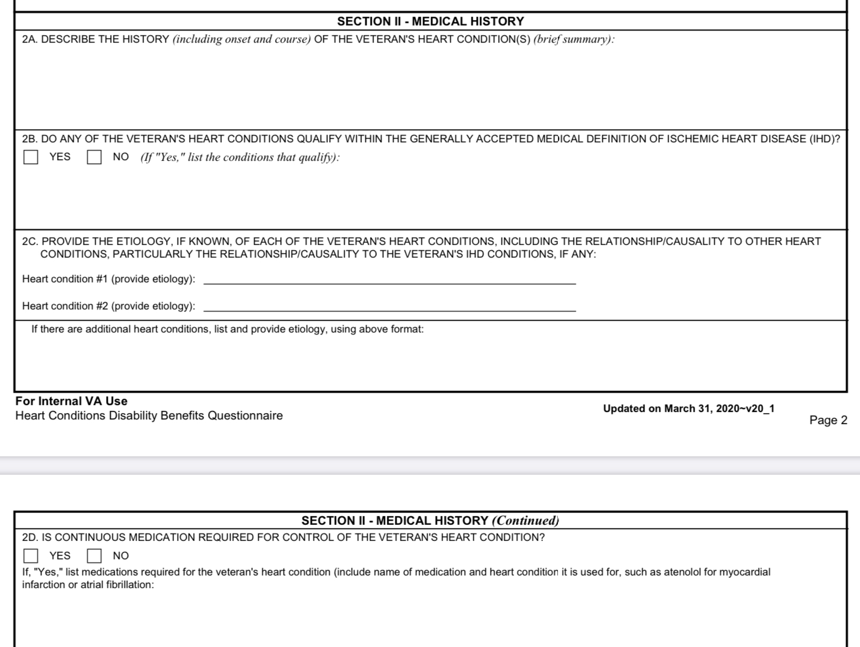
Heart DBQ (continued)

Slide 26
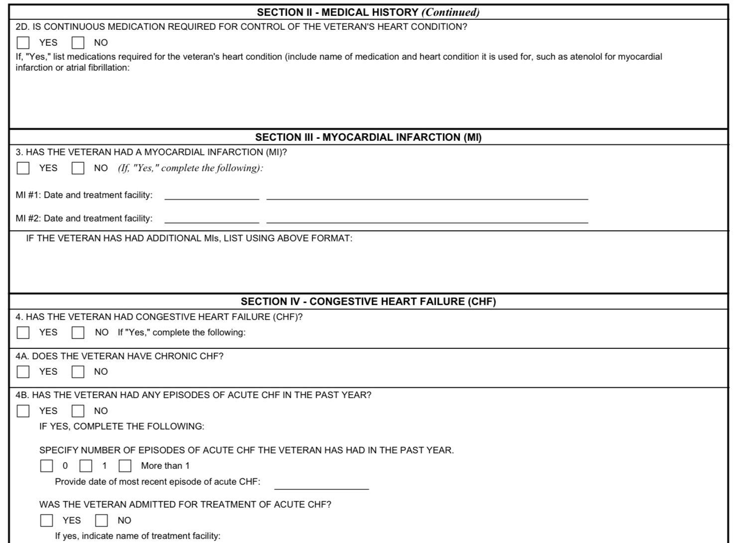
Heart DBQ (continued)

Slide 27
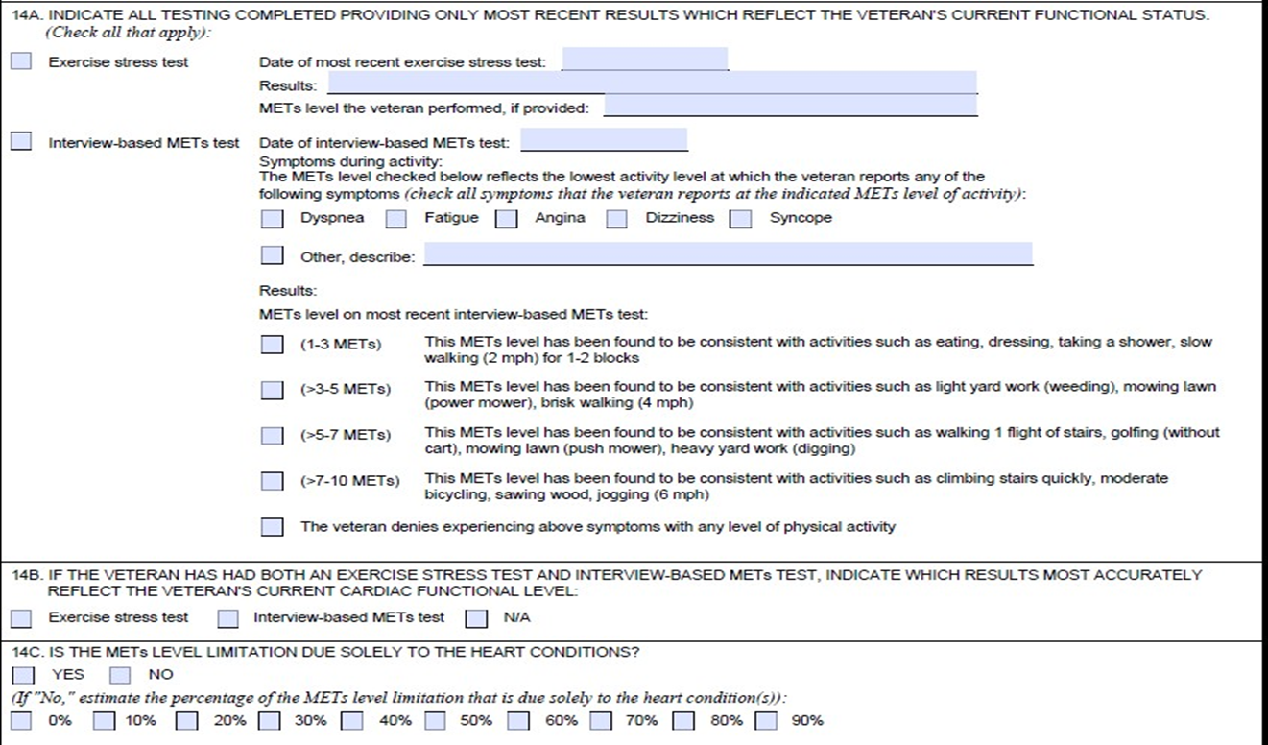
Heart DBQ (continued)

Slide 28
Arteries and Veins

Slide 29
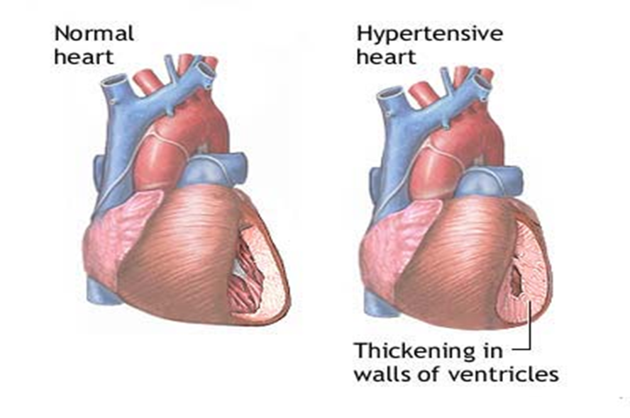
Hypertension DC 7101
A condition in which a patient has a higher than normal blood pressure.

Slide 30
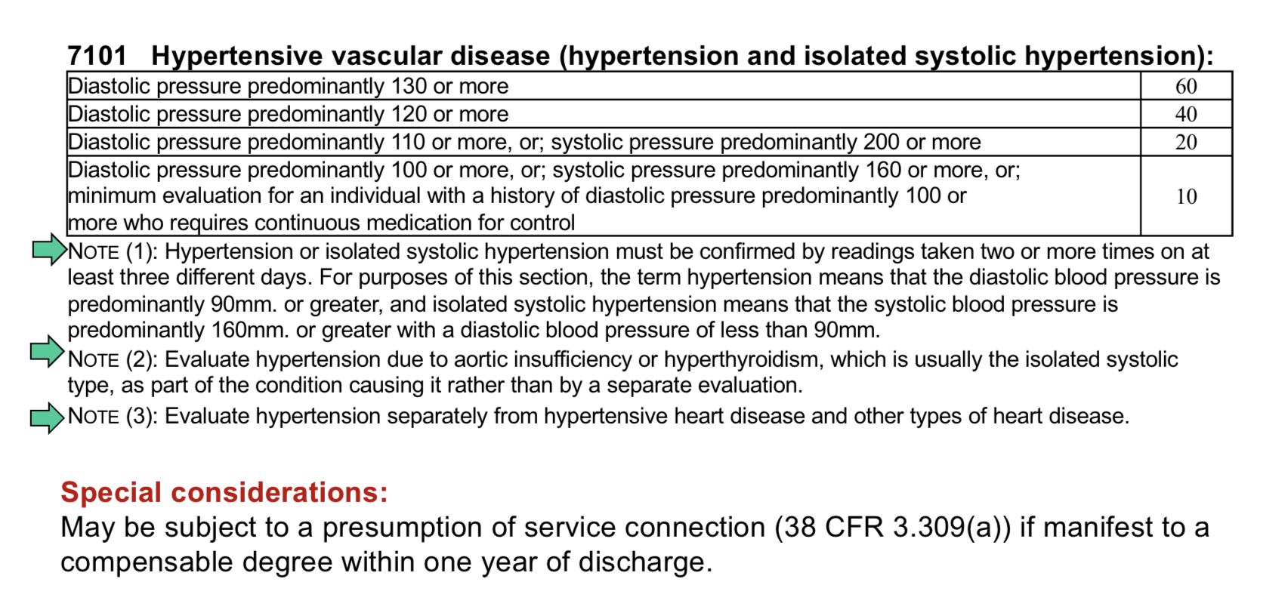
Rating Criteria Hypertension DC 7101

Slide 31
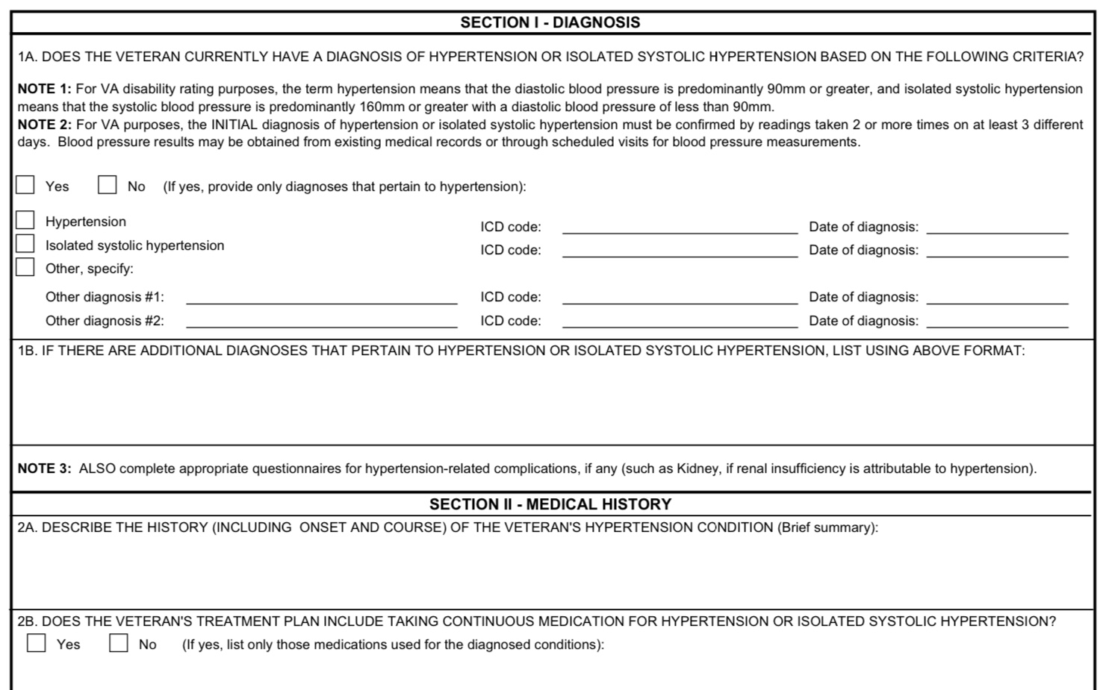
Hypertension DBQ

Slide 32
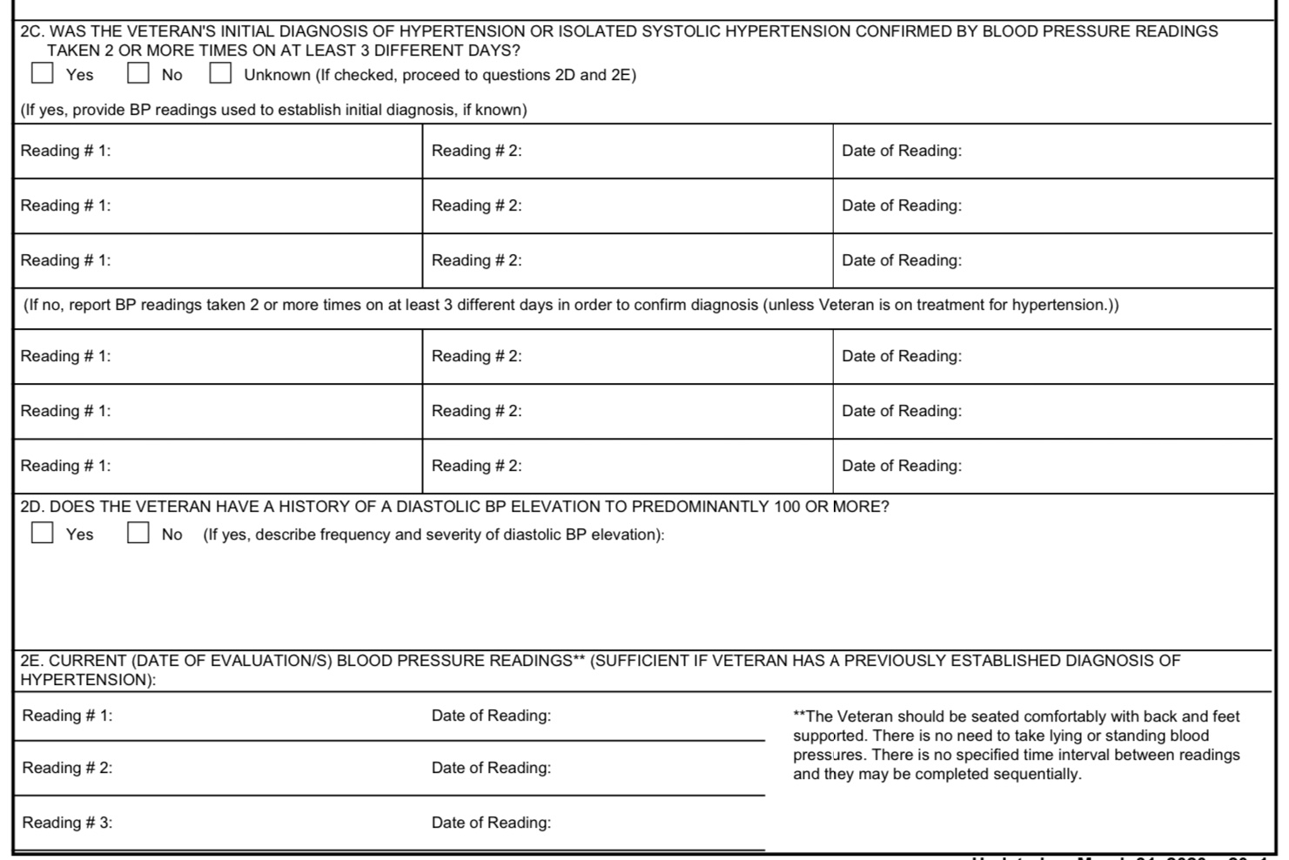
Hypertension DBQ Continued

Slide 33
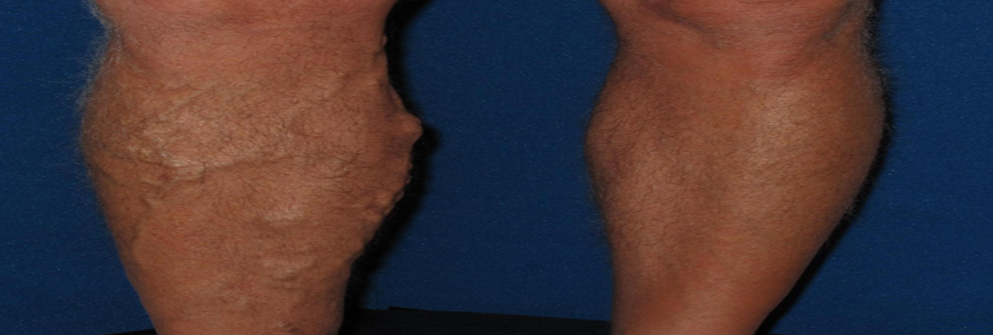
Varicose Veins DC 7120
In varicose veins, the veins are twisted and abnormally enlarged, with valves that leak and are incompetent.

Slide 34
Rating Criteria Varicose Veins DC 7120
7120 Varicose veins:
With the following findings attributed to the effects of varicose veins: Massive board-like edema with constant pain at rest |  | 100
Persistent edema or subcutaneous induration, stasis pigmentation or eczema, and persistent ulceration |  | 60
Persistent edema and stasis pigmentation or eczema, with or without intermittent ulceration |  | 40
Persistent edema, incompletely relieved by elevation of extremity, with or without beginning stasis pigmentation or eczema |  | 20
Intermittent edema of extremity or aching and fatigue in leg after prolonged standing or walking, with symptoms relieved by elevation of extremity or compression hosiery |  | 10
Asymptomatic palpable or visible varicose veins |  | 0
Note: These evaluations are for involvement of a single extremity. If more than one extremity is involved, evaluate each extremity separately and combine (under §4.25), using the bilateral factor (§4.26), if applicable.

Slide 35
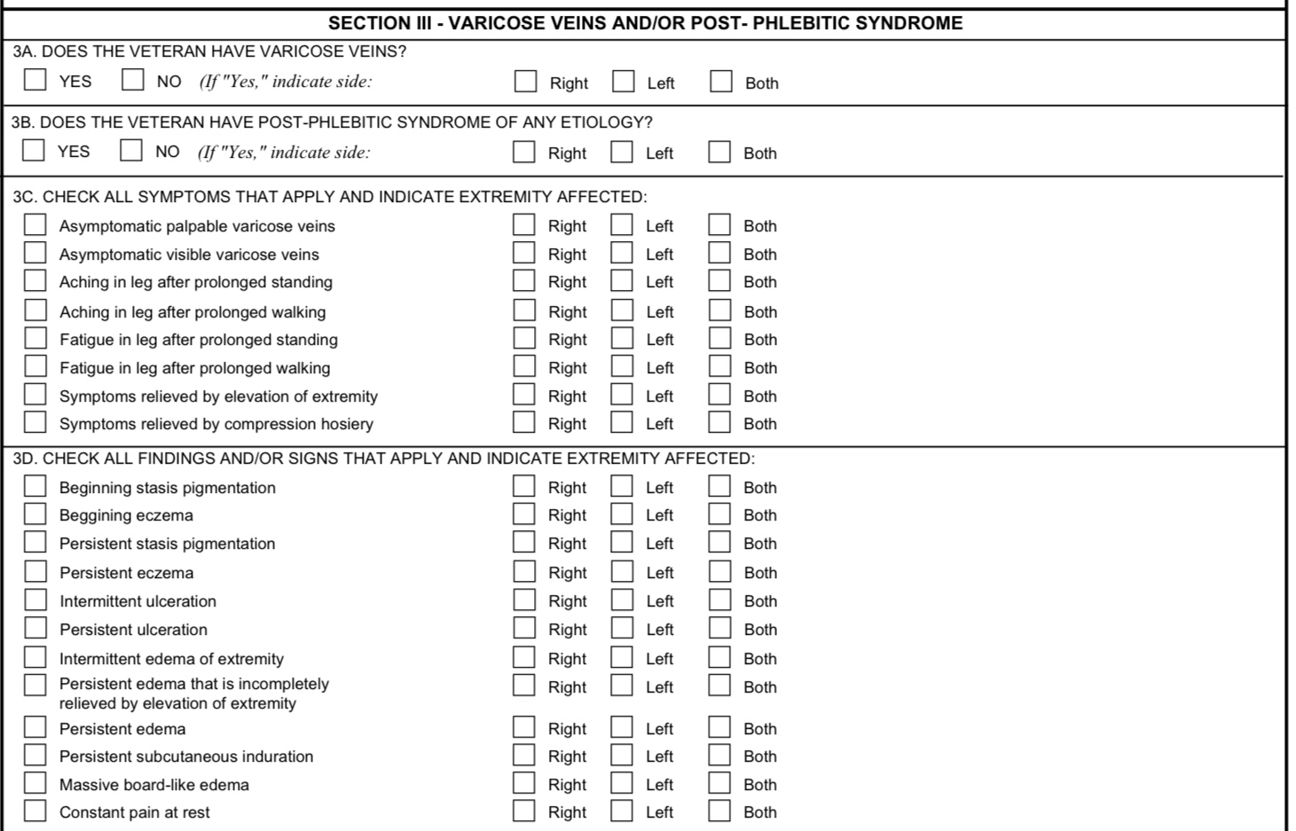
Varicose Veins DBQ

Slide 36
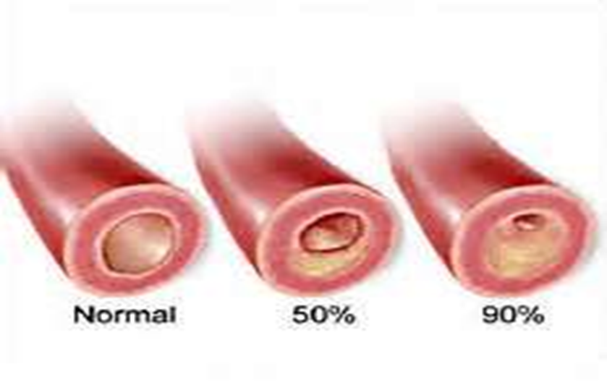
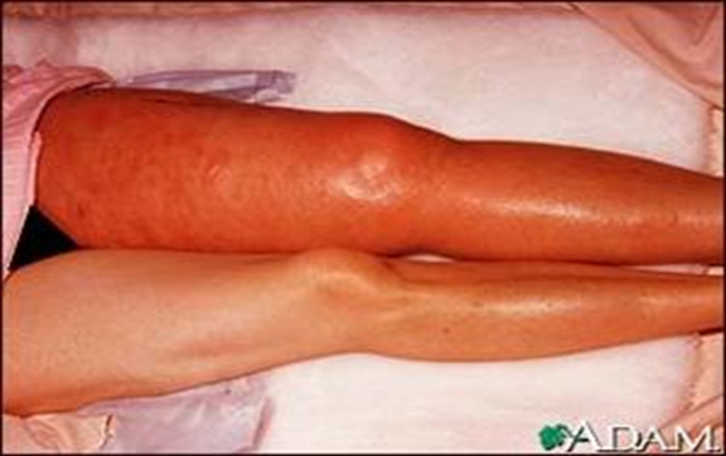
Peripheral Vascular Disease DC 7114
A term indicating diseases of the arteries and veins of the extremities, especially conditions that interfere with adequate blood flow to or from the extremities. Also known as Peripheral Artery Disease (PAD).

Slide 37
Rating Criteria Peripheral Vascular Disease DC 7114
7114 Arteriosclerosis obliterans:
Ischemic limb pain at rest, and; either deep ischemic ulcers or ankle/brachial index of 0.4 or less | 100
Claudication on walking less than 25 yards on a level grade at 2 miles per hour, and; either persistent coldness of the extremity or ankle/brachial index of 0.5 or less | 60
Claudication on walking between 25 and 100 yards on a level grade at 2 miles per hour, and; trophic changes (thin skin, absence of hair, dystrophic nails) or ankle/brachial index of 0.7 or less | 40
Claudication on walking more than 100 yards, and; diminished peripheral pulses or ankle/brachial index of 0.9 or less | 20
Note (1): The ankle/brachial index is the ratio of the systolic blood pressure at the ankle (determined by Doppler study) divided by the simultaneous brachial artery systolic blood pressure. The normal index is 1.0 or greater.
Note (2): Evaluate residuals of aortic and large arterial bypass surgery or arterial graft as arteriosclerosis obliterans.
Note (3): These evaluations are for involvement of a single extremity. If more than one extremity is affected, evaluate each extremity separately and combine (under §4.25), using the bilateral factor (§4.26), if applicable.

Slide 38
Claudication
Claudication is a common muscular condition brought on by exercise and often presents as painful cramps in the lower part of the leg caused by too little blood flowing to the muscles in this area. The discomfort is usually felt during walking and tends to go away again once exercise ends. However, some people with more sever cases feel pain even when they are not exercising.

Slide 39
Ankle-Brachial Index
The ankle-brachial index test is a quick, noninvasive way to check for peripheral artery disease (PAD). The disease occurs when narrowed arteries reduce the blood flow to your limbs. PAD can cause leg pain when walking and increases the risk of heart attack and stroke.
The ankle-brachial index test compares the blood pressure measured at your ankle with the blood pressure measured at your arm. A low ankle-brachial index number can indicate narrowing or blockage of the arteries in your legs.
You may have ankle-brachial index testing before and immediately after walking on a treadmill. An exercise ankle-brachial index test can assess the severity of the narrowed arteries during walking.

Slide 40
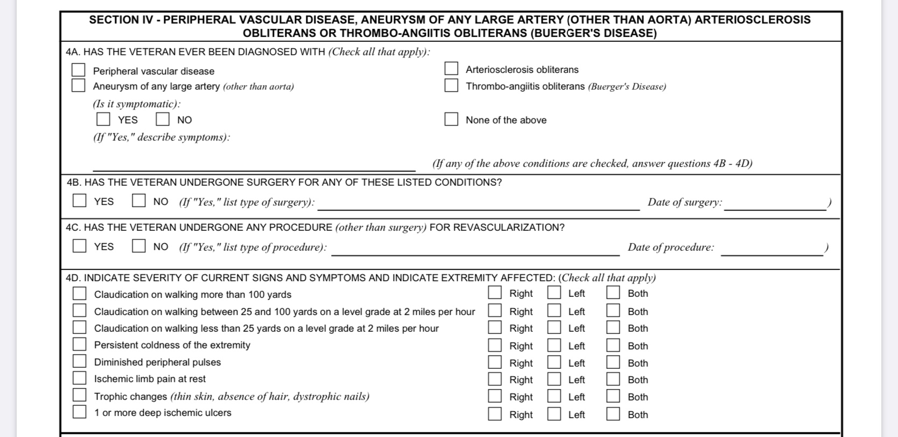
Peripheral Vascular Disease DBQ

Slide 41
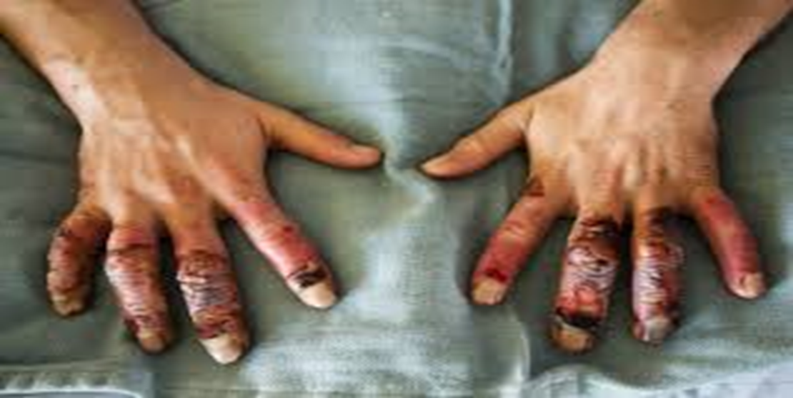
Cold Injuries DC 7122
Injury by cold causes structural and functional disturbances of small blood vessels, cells, nerves, skin, and bone. Exposure to damp cold causes frostnip and immersion (trench) foot. Exposure to dry cold causes frostbite.

Slide 42
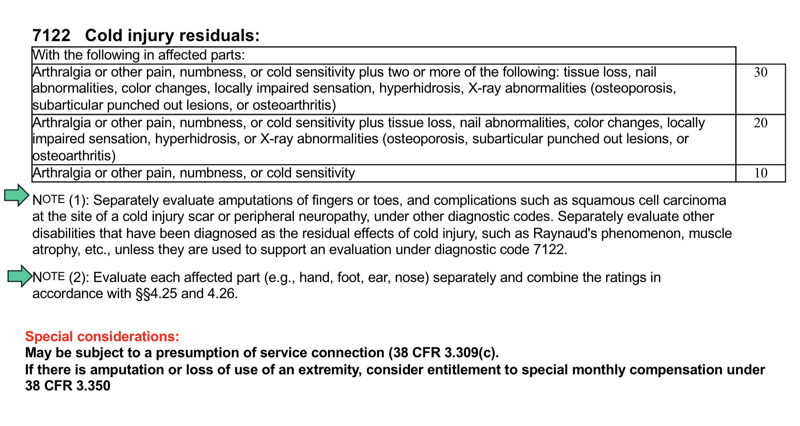
Rating Criteria Cold Injury DC 7122

Slide 43
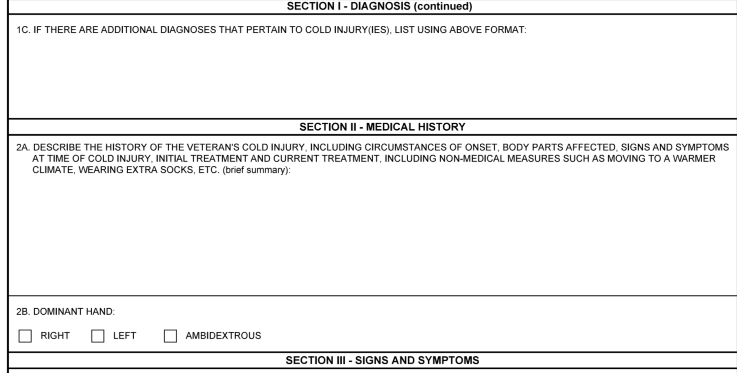
Cold Injury DBQ

Slide 44
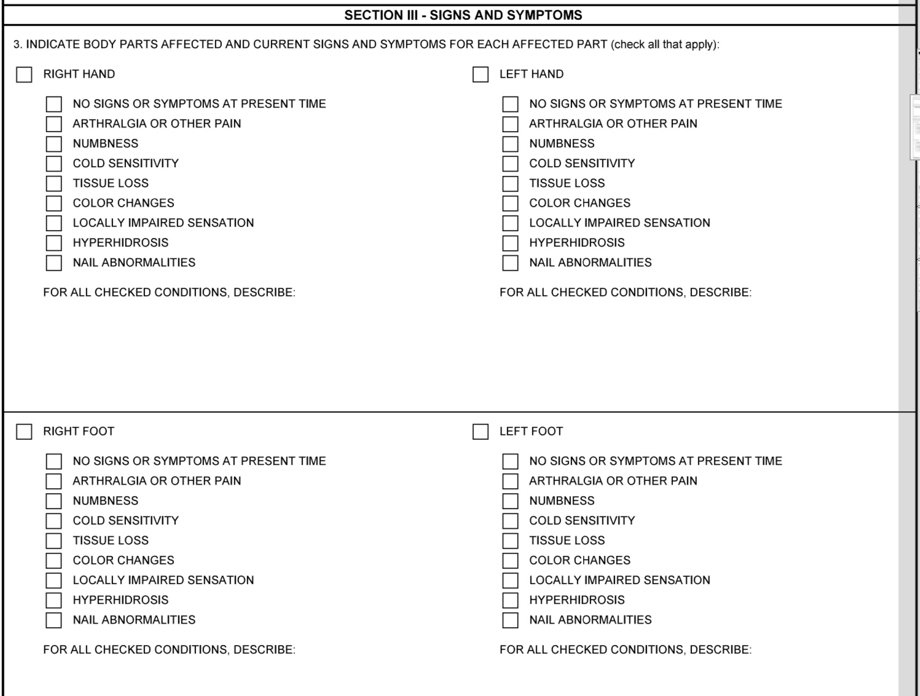
Cold Injury DBQ (continued)

Slide 45
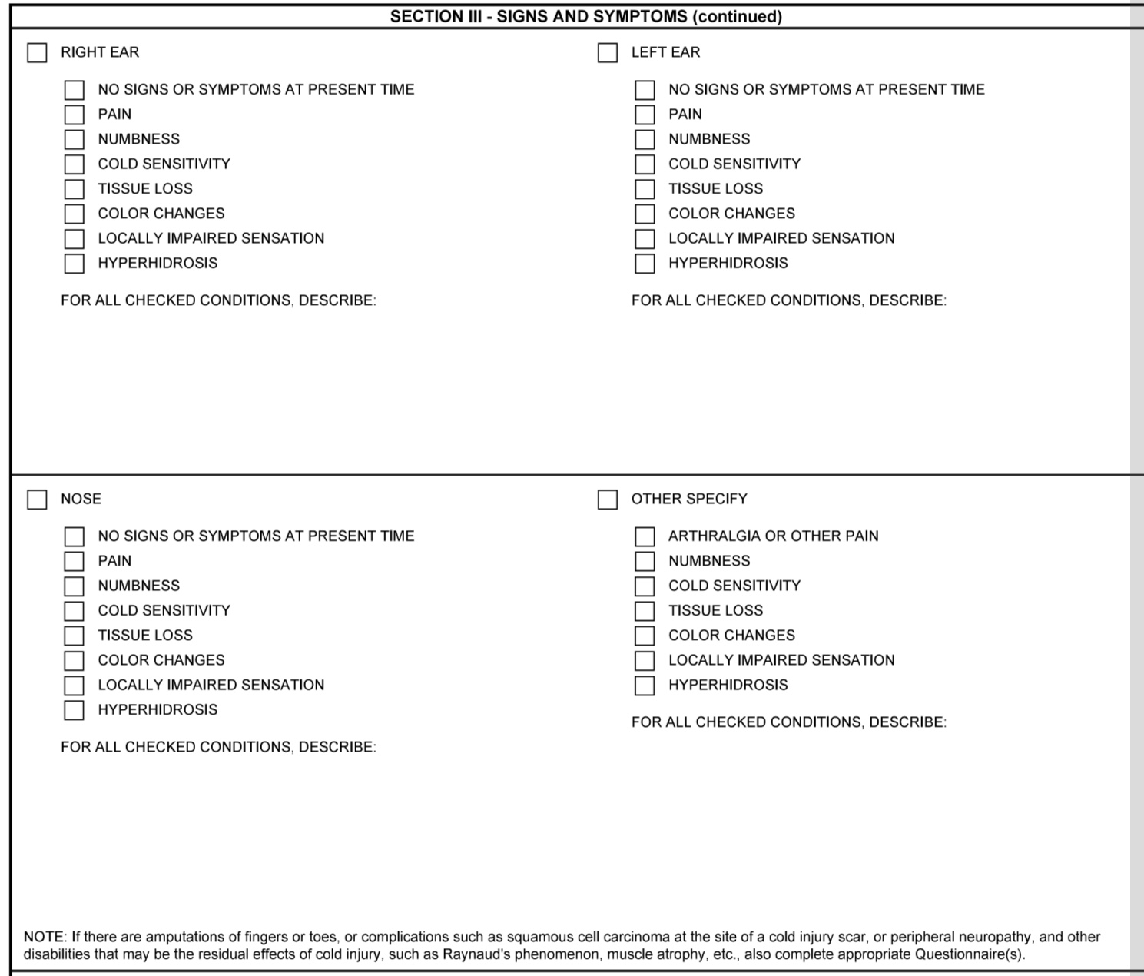
Cold Injury DBQ (continued)

Slide 46
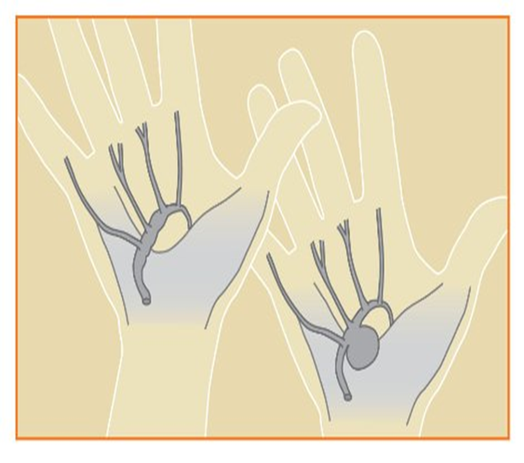
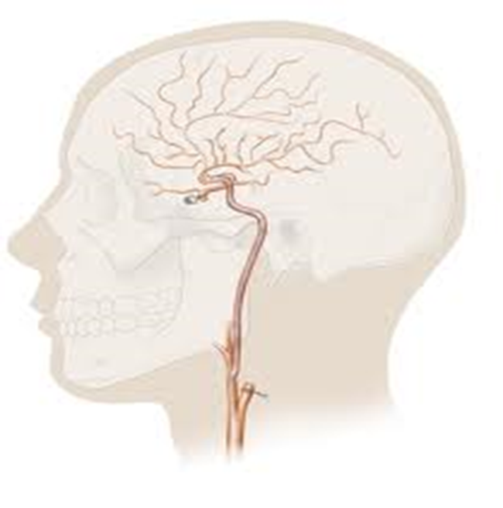
Aneurysms
Bulging or sac of a blood vessel formed by the dilation of the wall of an artery, a vein, or the heart.

Slide 47
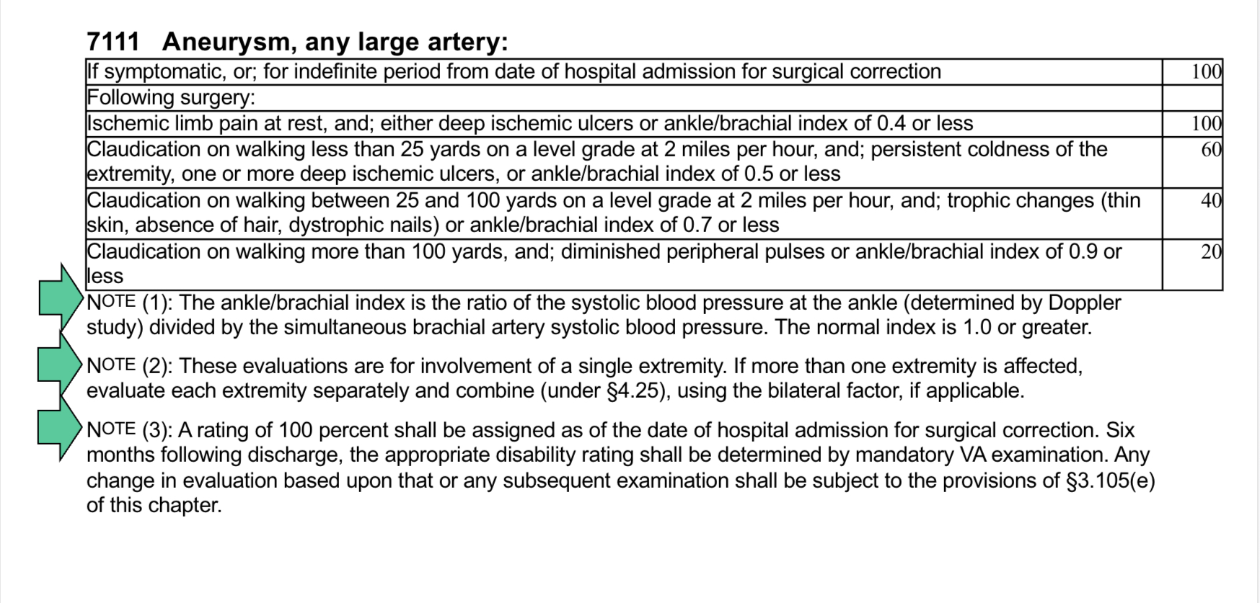
Rating Criteria Aneurysm, Large Artery DC 7111

Slide 48
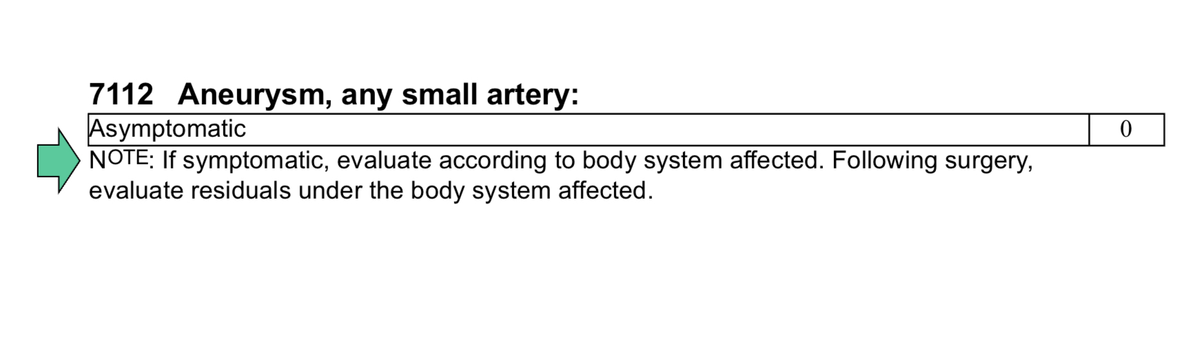
Rating Criteria Aneurysm, Small Artery DC 7112

Slide 49
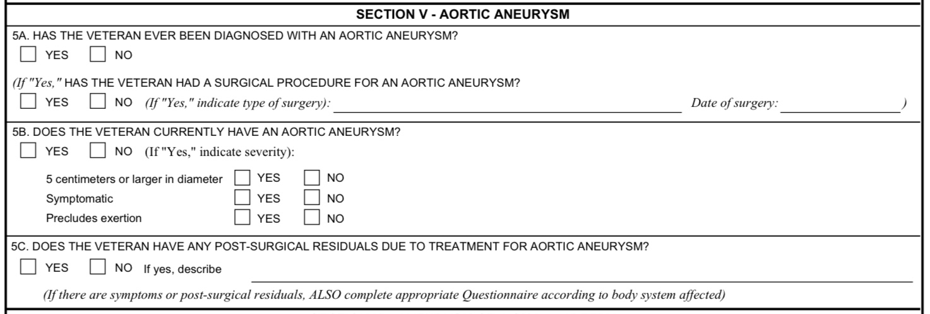
Aortic Aneurysm DBQ

Slide 50
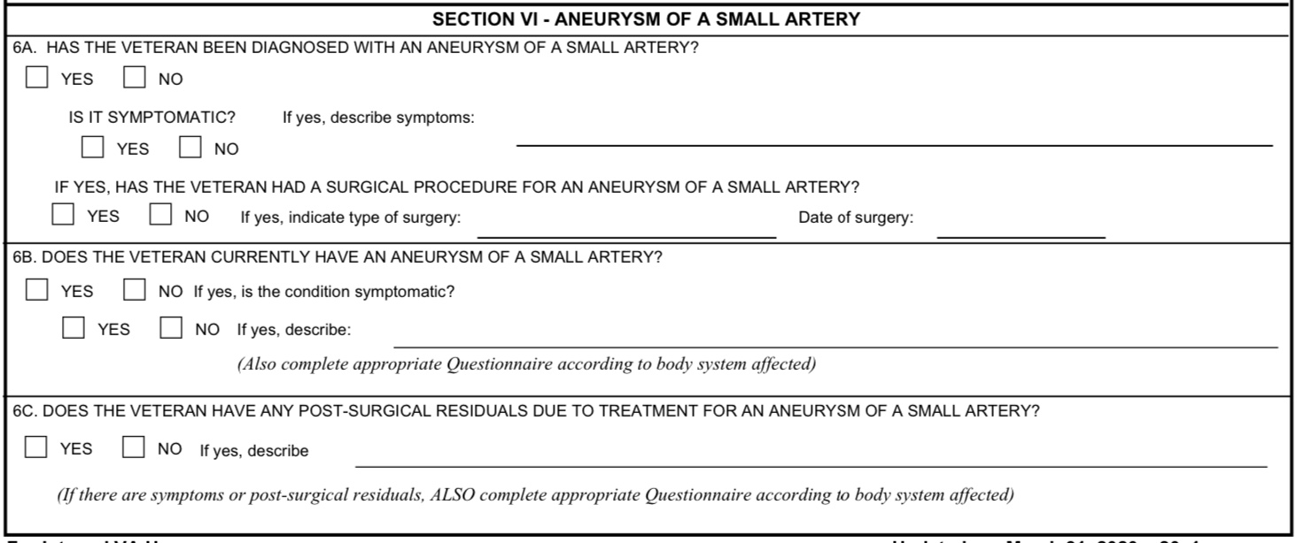
Aneurysm Small Artery DBQ

Slide 51
Exercises
Veteran served in the US Army from May 6, 1962 through May 31, 1965. 21-526EZ for hypertension is received January 10, 2016. STRs reflect no evidence of complaint, treatment, or diagnosis of hypertension during military service. Post-service treatment records reflect a substantiated diagnosis of hypertension in February 1966. Three day blood pressure readings reflected the following:
Day #1 145/94, 140/92, 140/90
Day #2: 140/95, 145/100, 140/97
Day #3: 160/90, 145/95, 145/95
Veteran has been prescribed hypertension medication since that time.
Based on the above information, should service connection be granted? If so what rating should be assigned?

Slide 52
Exercises (continued)
How would you evaluate a claim for a Veteran that has claudication on walking on more than 100 yards with an ankle/brachial index of 0.5 on each leg?
20%
40%
60%

Slide 53
Exercises (continued)
While on active duty a Veteran was diagnosed with a uterine aneurysm. The treatment resulted in a hysterectomy.
If a benefit is granted are there any other benefits we need to consider?

Slide 54
Helpful Evidence
Buddy statements
Private medical evidence
What else?

Slide 55
Special Considerations
Presumptive Disabilities
Special Monthly Compensation
Ancillary Considerations
Special Development
Rating Schedule Changes

Slide 56
References
38 CFR 3.307 Presumptive service connection
38 CFR 3.309 Diseases subject to presumptive service connection
38 CFR 3.310(c) Disabilities that are proximately due to, aggravated by, service-connected disease or injury: Cardiovascular disease
38 CFR 3.350 Special Monthly Compensation
38 CFR 4.100 Application of the evaluation criteria for diagnostics 7000-7007, 7011, and 7015-7020
38 CFR 4.104 Schedule of ratings – Cardiovascular system

Slide 57
References
M21-1 Part III. Subpart iv. Chapter 4. Section E Cardiovascular System Conditions
M21-1 Part IV. Subpart ii. Chapter 2.Section C Service Connection (SC) for Disabilities Resulting From Exposure to Environmental Hazards or Service in the Republic of Vietnam (RVN)
Droksy v Brown No. 96-573. May 14,1997
Otero-Castro v. Principi No.01-1360. October 4, 2002

Slide 58
QUESTIONS?
Vicki Von Loh
308-785-8028 (Office)
vvonloh@gmail.com

