Slide 1
PTSD Claims Development
By Vicki Von Loh
September 2022

Slide 2
Shell Shock Definition
Shell shock is a term coined in World War I by British psychologist Charles Samuel Myers^{[2]} to describe the type of post traumatic stress disorder many soldiers were afflicted with during the war (before PTSD was termed).^{[3]} It is a reaction to the intensity of the bombardment and fighting that produced a helplessness appearing variously as panic and being scared, flight, or an inability to reason, sleep, walk or talk.

Slide 3
During the War, the concept of shell shock was ill-defined. Cases of "shell shock" could be interpreted as either a physical or psychological injury, or simply as a lack of moral fibre. The term shell shock is still used by the United States’ Department of Veterans Affairs to describe certain parts of PTSD, but mostly it has entered into memory, and it is often identified as the signature injury of the War.

Slide 4
Post Traumatic Stress Disorder
Post-traumatic stress disorder (PTSD) is a disorder that develops in some people who have experienced a shocking, scary, or dangerous event.
It is natural to feel afraid during and after a traumatic situation. Fear triggers many split-second changes in the body to help defend against danger or to avoid it.

Slide 5
A traumatic event is also referred to as a “stressor.” The U.S. Department of Veterans Affairs states a PTSD stressor involves exposure to death, threatened death, actual or threatened serious injury, or actual or threatened sexual violence.
The exposure can be:
Direct exposure
Witnessing in-person
Indirect exposure, by learning that a close relative or close friend was exposed to trauma. If the trauma involved actual or threatened death, it must have been violent or accidental.
Repeated or extreme indirect exposure to details of the trauma. This is usually in the course of professional duties.

Slide 6
How To Concede Stressor
When a Veteran has received any of the combat decorations listed below, VA will presume that the Veteran engaged in combat with the enemy, unless there is clear and convincing evidence to the contrary:
Air Force Achievement Medal with “V” Device
Air Force Combat Action Medal
Air Force Commendation Medal with “V” Device
Air Force Cross
Air Medal with “V” Device
Army Commendation Medal with “V” Device
Bronze Star Medal with “V” Device
“C” device, denoting combat conditions, when affixed to other awards for meritorious service or achievement

Slide 7
Combat Action Badge (CAB)
Combat Action Ribbon (CAR) (Prior to February 1969, the Navy Achievement Medal with “V” Device was awarded.)
Combat Aircrew Insignia
Combat Infantry/Infantryman Badge (CIB)
Combat Medical Badge
Distinguished Flying Cross
Distinguished Service Cross
Fleet Marine Force (FMF) Combat Operations Insignia
Joint Service Commendation Medal with “V” Device
Medal of Honor
Navy Commendation Medal with “V” Device
Navy Cross
Parachutist Badge with Combat Jump Device
Purple Heart, and/or Silver Star.

Slide 8
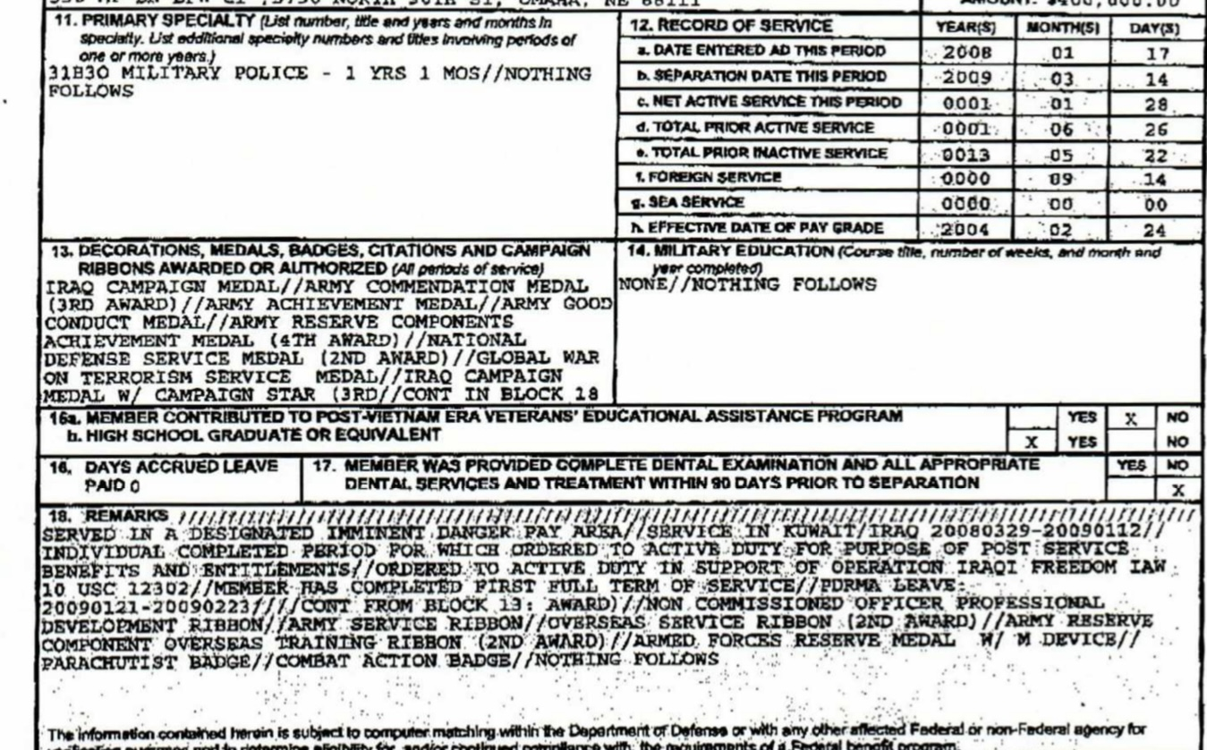
Extract DD214 Gulf War

Slide 9
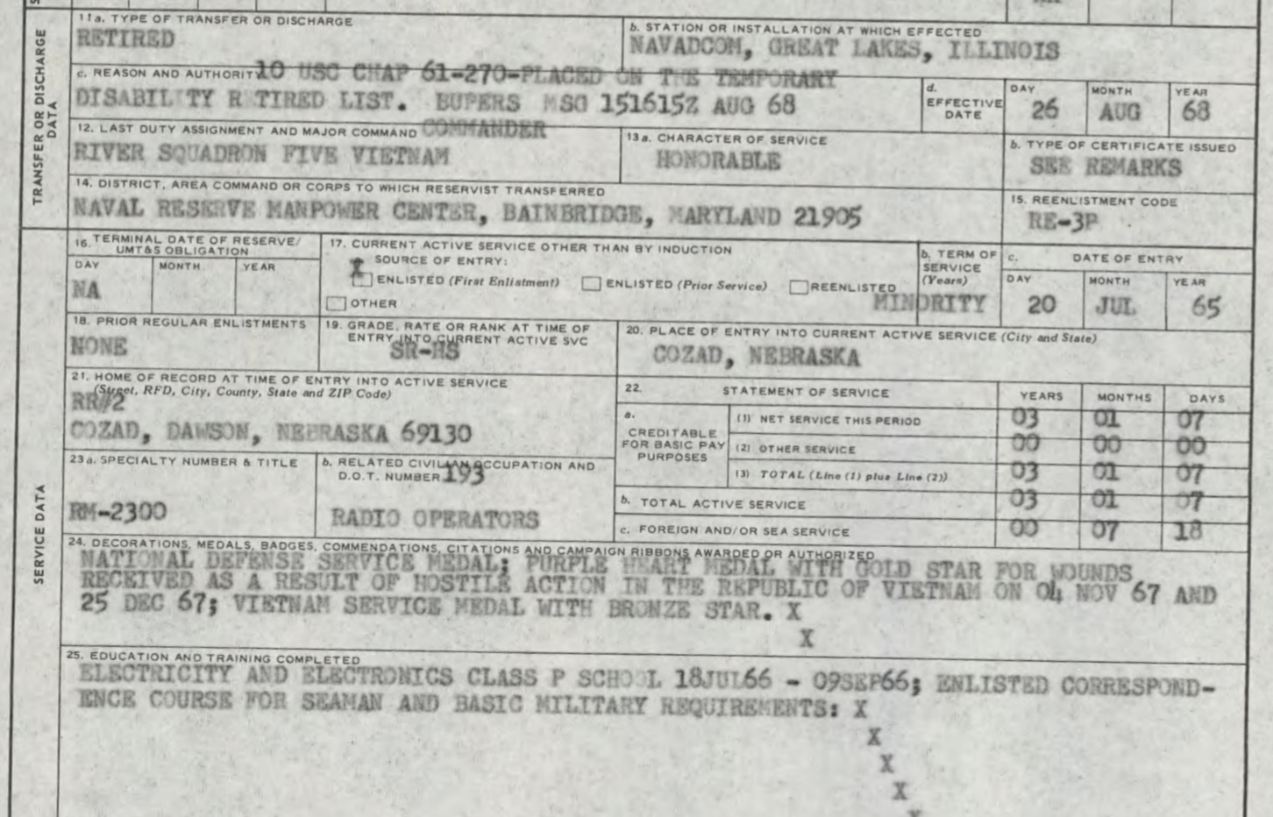
DD214 Vietnam

Slide 10
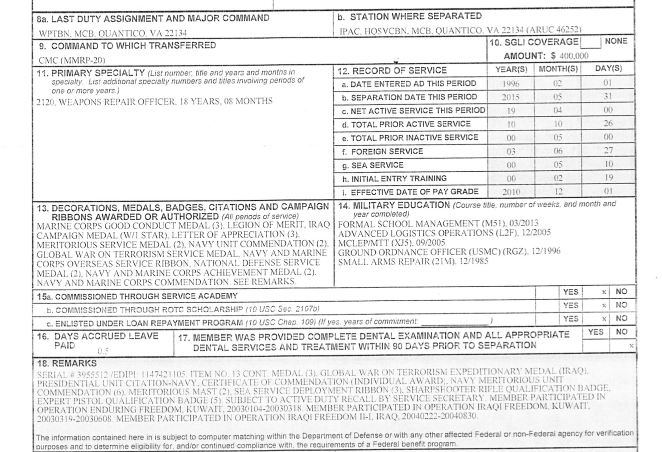
DD214 USMC CW5

Slide 11
PTSD Requirements
Under 38 CFR 3.304(f), SC for PTSD associated with an in-service stressor requires
credible supporting evidence that the claimed in-service stressor actually occurred
medical evidence diagnosing the condition in accordance with 38 CFR 4.125, and
a link, established by medical evidence, between current symptomatology and the claimed in-service stressor.

Slide 12
PTSD Development
Prior to July 12, 2010, VA had to verify the claimed stressor.
This was done through a variety of ways:
Verification of the incident
Verification of veterans claimed in service event
Could reasonable doubt be established?

Slide 13
Establishment of “Fear”
The Department of Veterans Affairs (VA) amended its adjudication regulations governing service connection for posttraumatic stress disorder (PTSD) by liberalizing in some cases the evidentiary standard for establishing the required in-service stressor.
This amendment eliminated the requirement for corroborating that the claimed in-service stressor occurred if a stressor claimed by a veteran is related to the veteran's fear of hostile military or terrorist activity.

Slide 14
Fear (continued)
When determining whether a stressor related to fear of hostile military or terrorist activity is still established, consider places, types, and circumstances of service where risks or danger from such activity are most likely to exist.
Deployed service overseas related to combat, security, or support of combat or security missions is the most likely to involve risks or danger from hostile military forces or terrorist attacks.

Slide 15
Fear (continued)
A VA psychiatrist or psychologist, or a psychiatrist or psychologist with whom VA has contracted, must have confirmed that the claimed stressor was adequate to support a diagnosis of PTSD and that the veteran's symptoms were related to the claimed stressor, provided that the claimed stressor is consistent with the places, types, and circumstances of the veteran's service.
This became effective on July 12, 2010.

Slide 16
Evidence Required From Veteran
Can claimed stressor be verified based on review of service records?
If no, VA will send development letter to veteran with VA Form 21-0781, Statement in Support of Claim for Service Connection for Post Traumatic Stress Disorder attached.
Veteran will be given a time limit of 30 days to submit requested evidence.
Additional records will be requested if veteran responds with additional evidence.
If additional service records are required, development will continue until evidence is received or negative response from service department is received.

Slide 17
Evidence from Veteran
The veteran will be further advised:
if evidence is not submitted within 30 days, VA may decide the claim based on the information and evidence of record, and
The veteran has one year from the date of VA's request to submit evidence or information to substantiate the claim.

Slide 18
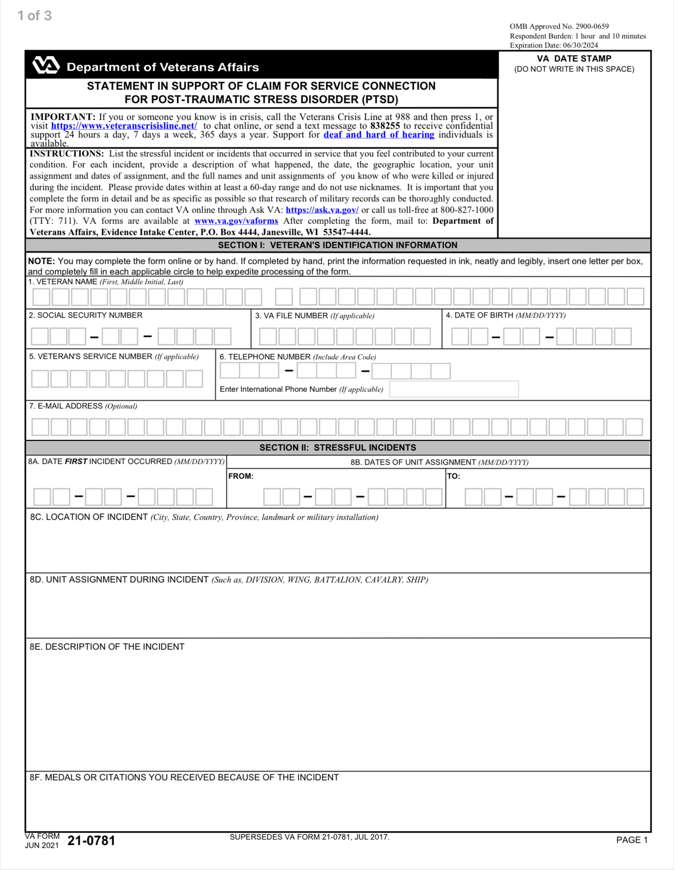
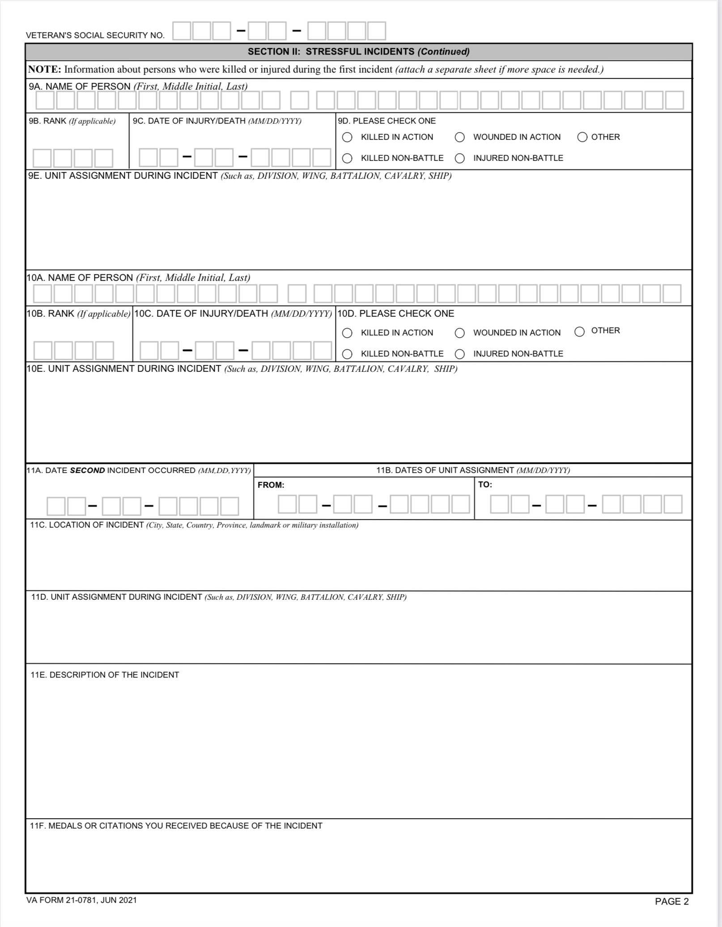
Completion of PTSD Development-
VA Form 21-0781

Slide 19
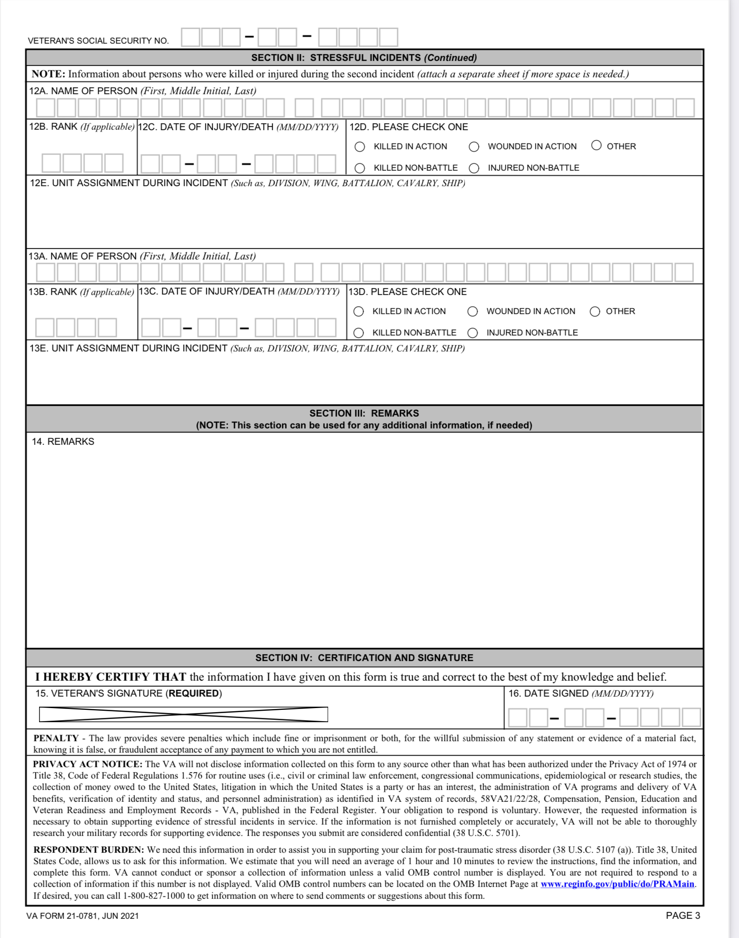
VA Form 21-0781 (continued)

Slide 20
Documentation
Appropriate situations for such development/submission methods include, but are not limited to, requests to the claimant for
medical evidence
Social Security numbers (SSNs)
award/denial letters for certain benefits, such as Social Security disability benefits
addresses
employment information, and
clarification of income-related issues and medical expenses.

Slide 21
Documentation
If a service member obtains treatment "off-base" at a civilian facility, any mental health records created during the course of treatment are not automatically associated with the service member's STRs. It is the responsibility of the patient and civilian provider to transfer records of care to the service department.
Records retained by a civilian provider are not records in the custody of a Federal department or agency. They are not forwarded for long-term storage to the National Personnel Records Center (NPRC) and cannot be obtained through Personnel Information Exchange System (PIES)/Defense Personnel Records Image Retrieval System (DPRIS).

Slide 22
Documentation
When a claimant submits evidence in response to a request, the evidence will be submitted to either authorization or rating activity (whichever has responsibility for deciding the corresponding claim) for a decision. The same action will be taken if claimant does not respond to a request for evidence within 30 days.
If VA requested evidence from a private physician or medical facility on behalf of the claimant, do not deny the claim before taking the actions required under Section 5103, as explained in M21-1, Part III, Subpart i, 2.C.2.

Slide 23
Documentation
If VA obtains any medical evidence in connection with the claim, (such as treatment records from a VA medical facility), the rating activity must determine whether it justifies an award of benefits.
VA considers evidence received by e-mail or electronic submission to be authentic unless there is a specific reason to question the source of the document.
The instructions for handling correspondence received through traditional means apply to correspondence received by e-mail or electronic submission.

Slide 24
Lay evidence
What is lay evidence?
Why is it important?

Slide 25
38 US Code 1154
38 U.S. Code § 1154 - Consideration to be accorded time, place, and circumstances of service
(a)The Secretary shall include in the regulations pertaining to service-connection of disabilities (1) additional provisions in effect requiring that in each case where a veteran is seeking service-connection for any disability due consideration shall be given to the places, types, and circumstances of such veteran’s service as shown by such veteran’s service record, the official history of each organization in which such veteran served, such veteran’s medical records, and all pertinent medical and lay evidence,

Slide 26
38 USC 1154 (continued)
(2) the provisions required by section 5 of the Veterans’ Dioxin and Radiation Exposure Compensation Standards Act (Public Law 98–542; 98 Stat. 2727).
(b)In the case of any veteran who engaged in combat with the enemy in active service with a military, naval, air, or space organization of the United States during a period of war, campaign, or expedition, the Secretary shall accept as sufficient proof of service-connection of any disease or injury alleged to have been incurred in or aggravated by such service satisfactory lay or other evidence

Slide 27
38 USC 1154 (continued)
of service incurrence or aggravation of such injury or disease, if consistent with the circumstances, conditions, or hardships of such service, notwithstanding the fact that there is no official record of such incurrence or aggravation in such service, and, to that end, shall resolve every reasonable doubt in favor of the veteran. Service-connection of such injury or disease may be rebutted by clear and convincing evidence to the contrary. The reasons for granting or denying service-connection in each case shall be recorded in full.

Slide 28
PTSD Stressor
If the claimed stressor is not related to combat, experience as a former prisoner of war, fear of hostile military or terrorist activity, or drone aircraft crew member duties, a claimant’s lay testimony regarding in-service stressors
is not sufficient, by itself, to establish the occurrence of the stressor, and
must be corroborated by credible supporting evidence.
Credible supporting evidence of this type of stressor may include service treatment records (STRs) or service personnel records

Slide 29
PTSD Stressor (continued)
When determining the occurrence of stressors to establish SC for PTSD, consider the following
PTSD does not need to have its onset as a result of combat (for example, vehicular or airplane crashes, large fires, floods, earthquakes, and other disasters evoke significant distress in most involved persons).
The trauma may be experienced alone, such as in cases of rape or assault, or in the company of groups of people, such as in military combat.
Do not limit a stressor to just one single episode; a group of experiences also may affect an individual, leading to the development of PTSD.

Slide 30
PTSD Stressor (continued)
PTSD can develop hours, months, or years after a stressor.
Notes:
The relationship between stressors during military service and current problems/symptoms will govern the question of SC.
Symptoms must have a clear relationship to the military stressor as described in the medical reports.
Despite the possibly long latent period, PTSD may be recognizable by a relevant association between the stressor and the current presentation of symptoms.

Slide 31
PTSD Stressor (continued)
Every decision involving the issue of SC for PTSD that allegedly developed as a result of combat must include a factual determination as to whether or not the Veteran was engaged in combat, including the reasons or bases for that finding.
Important: In order to conclude that a Veteran “engaged in combat with the enemy,” the evidence must establish that the Veteran was present during an encounter with a military foe either as a combatant or as a service member performing duty in support of combatants.

Slide 32
Lay Evidence
Lay evidence is acceptable for the purpose of establishing service incurrence or aggravation, in the absence of service treatment records (STRs), for a combat Veteran or former prisoner of war (FPOW), if the evidence:
is satisfactory
is consistent with the circumstances, conditions, or hardships of combat or FPOW internment, and
can prevail in spite of the absence of official records showing incurrence or aggravation of the disease or injury during service.

Slide 33
Lay Evidence (continued)
Important: Medical evidence of a link to a current condition is still needed to establish service connection.
A non-combat Veteran’s lay statements may be acceptable for establishing service incurrence or aggravation but must be weighed against other evidence in the claims folder including the absence of military records documenting or supporting the statements.

Slide 34
Lay Evidence (continued)
Lay evidence is generally afforded probative value if it is provided by a person who has knowledge of facts or circumstances and conveys matters that can be observed and described by a lay person.
The value accorded to other types of lay evidence depends on such factors as
the accuracy or clarity of the individual’s memory
direct personal knowledge or experience
recency of the event, and
the competence of the reporting person.

Slide 35
Lay Evidence (continued)
A medically-untrained individual is not usually competent to offer a medical opinion regarding the etiology of disorders and such an opinion is generally assigned little probative weight.
References: For more information on
using lay evidence to support a claim, see Espiritu v. Derwinski, 2 Vet.App. 492 (1992), and
definition of lay evidence, see 38 CFR 3.159(a)(2).

Slide 36
Lay Evidence (continued)
A claimant’s own statement, covering in sufficient detail a condition that is within the claimant's ability to describe, such as their own symptoms, may to that extent constitute evidence.
Rationale: While such statements have self-serving aspects, the claimant is often the most qualified source to describe the circumstances of the disabling effects of the disease or injury.

Slide 37
Personal Trauma Definition
Personal trauma for the purpose of Department of Veterans Affairs (VA) disability compensation claims based on posttraumatic stress disorder (PTSD) refers broadly to stressor events involving harm perpetrated by a person who is not considered part of an enemy force.
Examples: Assault, battery, robbery, mugging, stalking, harassment
Military sexual trauma is a subset of personal trauma.

Slide 38
Military Sexual Trauma (MST)
Definition
VA uses the term “military sexual trauma” (MST) to refer to sexual assault or sexual harassment experienced during military service. MST includes any sexual activity during military service in which you are involved against your will or when unable to say no.
Examples include:
Being pressured or coerced into sexual activities, such as with threats of negative treatment if you refuse to cooperate or with promises of better treatment

Slide 39
Military Sexual Trauma Definition
(continued)
Sexual contact or activities without your consent, including when you were asleep or intoxicated
Being overpowered or physically forced to have sex
Being touched or grabbed in a sexual way that made you uncomfortable, including during “hazing” experiences
Comments about your body or sexual activities that you found threatening
Unwanted sexual advances that you found threatening

Slide 40
Definition of MST Breakdown
Perpetrator does not have to be in the military
The location of the MST does not matter – it can be on or off the military base
The event may occur during both active and inactive duty to be considered MST by VA standards

Slide 41
Military Sexual Trauma
When a Veteran claims service connection (SC) for PTSD based on in-service personal trauma, undertake required development of the claim for credible evidence to support the Veteran’s assertion that the stressful event occurred.
Because a personal trauma is an extremely personal and sensitive issue,
many incidents of personal trauma are not officially reported, and
the victims of this type of in-service trauma may find it difficult to produce evidence to support the occurrence of the stressor.

Slide 42
Military Sexual Trauma (continued)
Important:
Identifying possible sources of evidence to support the claim may require asking the Veteran for information concerning the traumatic incident. Make this request as compassionately as possible in order to avoid causing further trauma.
Although personal trauma is most often thought of as involving female Veterans, male Veterans may also be involved. Be sure requests for evidence/information reflect the appropriate gender of the Veteran.

Slide 43
Military Sexual Trauma (continued)
The Secretary of Veterans Affairs has undertaken a special obligation to assist a claimant in producing corroborating evidence of an in-service stressor in personal trauma claims per Patton v. West, 12 Vet. App. 272 (1999). In view of this special obligation, it is critical that VA:
make all required efforts to obtain evidence of personal trauma, and
consider all available evidence bearing on the question of whether the trauma occurred.

Slide 44
Military Sexual Trauma Development (continued)
DoD offers two reporting options for MST, restricted and unrestricted. Restricted reporting allows a service member to file a report confidentially without initiating the investigative process.
Following an MST incident, a service member may elect one of these reporting options by completing DD Form 2910, Victim Reporting Preference Statement.
The service member may also elect an optional sexual assault forensic examination (SAFE), which is performed by a health care provider and is documented on DD Form 2911, Forensic Medical Report: Sexual Assault Examination.

Slide 45
Military Sexual Trauma Development (continued)
Note: DoD may have used other forms prior to the issuance of DD Form 2910. For example, the Department of the Navy used the form NAVPERS 1752/1, Sexual Assault Incident Data Collection Report.
Reference: For more information on requesting an MST report from DoD, see M21-1, Part VIII, Subpart iv, 1.B.2.c.

Slide 46
Military Sexual Trauma Development (continued)
Did VA receive a response from DoD within 30 days?
If yes, VA will go to the next step in development process
If no,
  VA will send a follow-up letter to the appropriate base and establish a 30-day control
  VA will notify the Veteran of the delay in obtaining the records, and
  VA will ask the Veteran to submit any restricted or unrestricted records that they have in their possession.

Slide 47
Military Sexual Trauma Development (continued)
In certain cases, the Veteran may identify police reports as a relevant alternative source of evidence. If the report is not already part of the available military or other records, obtain reports, as appropriate, from:
military police
shore patrol
a provost marshal’s office, or
other military or civilian law enforcement offices.

Slide 48
Military Sexual Trauma Development (continued)
Stressor verification information can often be found in the Veteran’s service records or other official documents. The list below, although not all-inclusive, provides examples of the types of official service records that may be useful in stressor verification:
service personnel records and pay records
military occupation evidence
hazard pay records
service treatment records (STRs)
military performance reports
verification that the Veteran received Combat/Imminent Danger/Hostile Fire Pay

Slide 49
Military Sexual Trauma Development (continued)
unit and organizational histories
daily staff journals
operational reports-lessons learned (ORLLs)
after action reports (AARs)
radio logs, deck logs, and ship histories
muster rolls
command chronologies and war diaries, and
monthly summaries and morning reports.

Slide 50
Military Sexual Trauma Development (continued)
Accept a buddy statement from a fellow Veteran as corroboration of a claimed in-service stressor if the statement is consistent with the time, place, and circumstances of the service of both the Veteran and the fellow Veteran making the buddy statement.
If the evidence available calls into question the qualifications of the fellow Veteran to make the statement, ask the person to submit their DD Form 214, Certificate of Uniformed Service, or other evidence of service with the claimant.

Slide 51
Military Sexual Trauma Development (continued)
When stressor development is needed:
VA will enclose the VA Form 21-0781a to solicit specific details of the in-service stressor, such as the
  date of the incident
  place of the incident
  unit of assignment at the time of the incident
  detailed description of the event
  medals or citations received as a result of the incident, and
  name and other identifying information concerning any other individuals involved in the event, if appropriate, and

Slide 52
Military Sexual Trauma Development (continued)
If service records contain no explicit documentation that personal trauma, including in-service sexual assault, occurred, evidence from alternative sources other than the Veteran's service records may corroborate the Veteran's account of the stressor incident.
Examples of such alternative sources of evidence include, but are not limited to
a rape crisis center or center for domestic abuse
a counseling facility or health clinic

Slide 53
Military Sexual Trauma Development (continued)
civilian police reports
medical reports from civilian physicians or caregivers who treated the Veteran immediately following the incident or sometime later
a chaplain or clergy
fellow service members, and
personal diaries or journals.

Slide 54
Military Sexual Trauma Development (continued)
Note: 38 CFR 3.304(f)(5) provides that in PTSD claims based on in-service personal assault, evidence from sources other than the Veteran’s service records may be used to corroborate the Veteran’s account of the stressor incident. However, VA Office of General Counsel concluded in VAOPGCPREC 3-2012 that PTSD personal assault regulation changes and guidance are not a sufficient basis for invocation of liberalizing law effective date rules.

Slide 55
Military Sexual Trauma Development (continued)
Important: VA may not treat the absence of a service record documenting an unreported sexual assault as evidence that the sexual assault did not occur as indicated in AZ and AY v. Shinseki, 731 F.3d 1303 (Fed. Cir. 2013). In addition, VA may not rely on a Veteran’s failure to report an in-service sexual assault to military authorities as pertinent evidence that the sexual assault did not occur. Therefore, do not use the absence of service record documentation or lack of report of in-service sexual assault to military authorities as evidence to conclude that a sexual assault did not occur.

Slide 56
Military Sexual Trauma Markers
(continued)
If service records contain no explicit documentation that personal trauma occurred, and alternative sources of evidence do not provide credible supporting evidence of the trauma, evidence of behavioral changes around the time of, and after, the incident(s), may constitute a marker of a personal trauma PTSD stressor.
The term marker means an indicator of the effect or consequences of the personal trauma on the Veteran. A marker could be one or more behavioral events, or a pattern of changed behavior. Even if there is no reference to the personal trauma, evidence of the behavior changes below may circumstantially support the possibility that the claimed stressor occurred.

Slide 57
Military Sexual Trauma Markers
(continued)
Evidence that may be a marker of trauma includes but is not limited to:
increased use or abuse of leave without an apparent reason, such as family obligations or family illness
episodes of depression, panic attacks, or anxiety without identifiable reasons
visits to a medical or counseling clinic or dispensary without a specific diagnosis or specific ailment
use of, or increased interest in, pregnancy tests or tests for sexually-transmitted diseases (including the human immunodeficiency virus (HIV)) around the time of the incident

Slide 58
Military Sexual Trauma Markers
(continued)
changes in performance and performance evaluations
increased or decreased use of prescription medications
increased use of over-the-counter medications
alcohol or drug abuse
increased disregard for military or civilian authority
obsessive behavior such as overeating or undereating
unexplained economic or social behavior changes
treatment for physical injuries around the time of the claimed trauma, but not reported as a result of the trauma, and/or

Slide 59
Military Sexual Trauma Markers
(continued)
the breakup of a primary relationship.
Notes:
Behavioral change evidence may include lay statements or documentary evidence.
Although the examiner’s opinion is not determinative of the outcome of the claim, it will be accepted as significant probative evidence when evaluating service connection (SC) for the diagnosed mental disorder by VA.

Slide 60
Military Sexual Trauma
Evidence of behavioral changes typically needs interpretation by a clinician in personal trauma claims.
Submit evidence received for a medical opinion as to whether the credible factual evidence of behavior changes demonstrated by the Veteran is consistent with the expected reaction or adjustment of a person who has been subjected to an assault.

Slide 61
Military Sexual Trauma
If the examiner offers a credible, unequivocal, and nonspeculative assessment that the evidence of record is consistent with the occurrence of the claimed assault, that opinion can constitute credible supporting evidence that the claimed in-service stressor occurred. If the opinion is merely speculative, equivocal, contradictory, or otherwise insufficient for rating purposes, it should be returned for clarification.

Slide 62
Military Sexual Trauma
Veterans whose stressor occurred during inactive duty for training (INACDUTRA) are eligible for SC in the same manner as those whose stressor occurred during active duty or active duty for training.
The VA Office of General Counsel concluded in VAOPGCPREC 8-2001 that “PTSD resulting from sexual assault may be considered a disability resulting from an injury.”

Slide 63
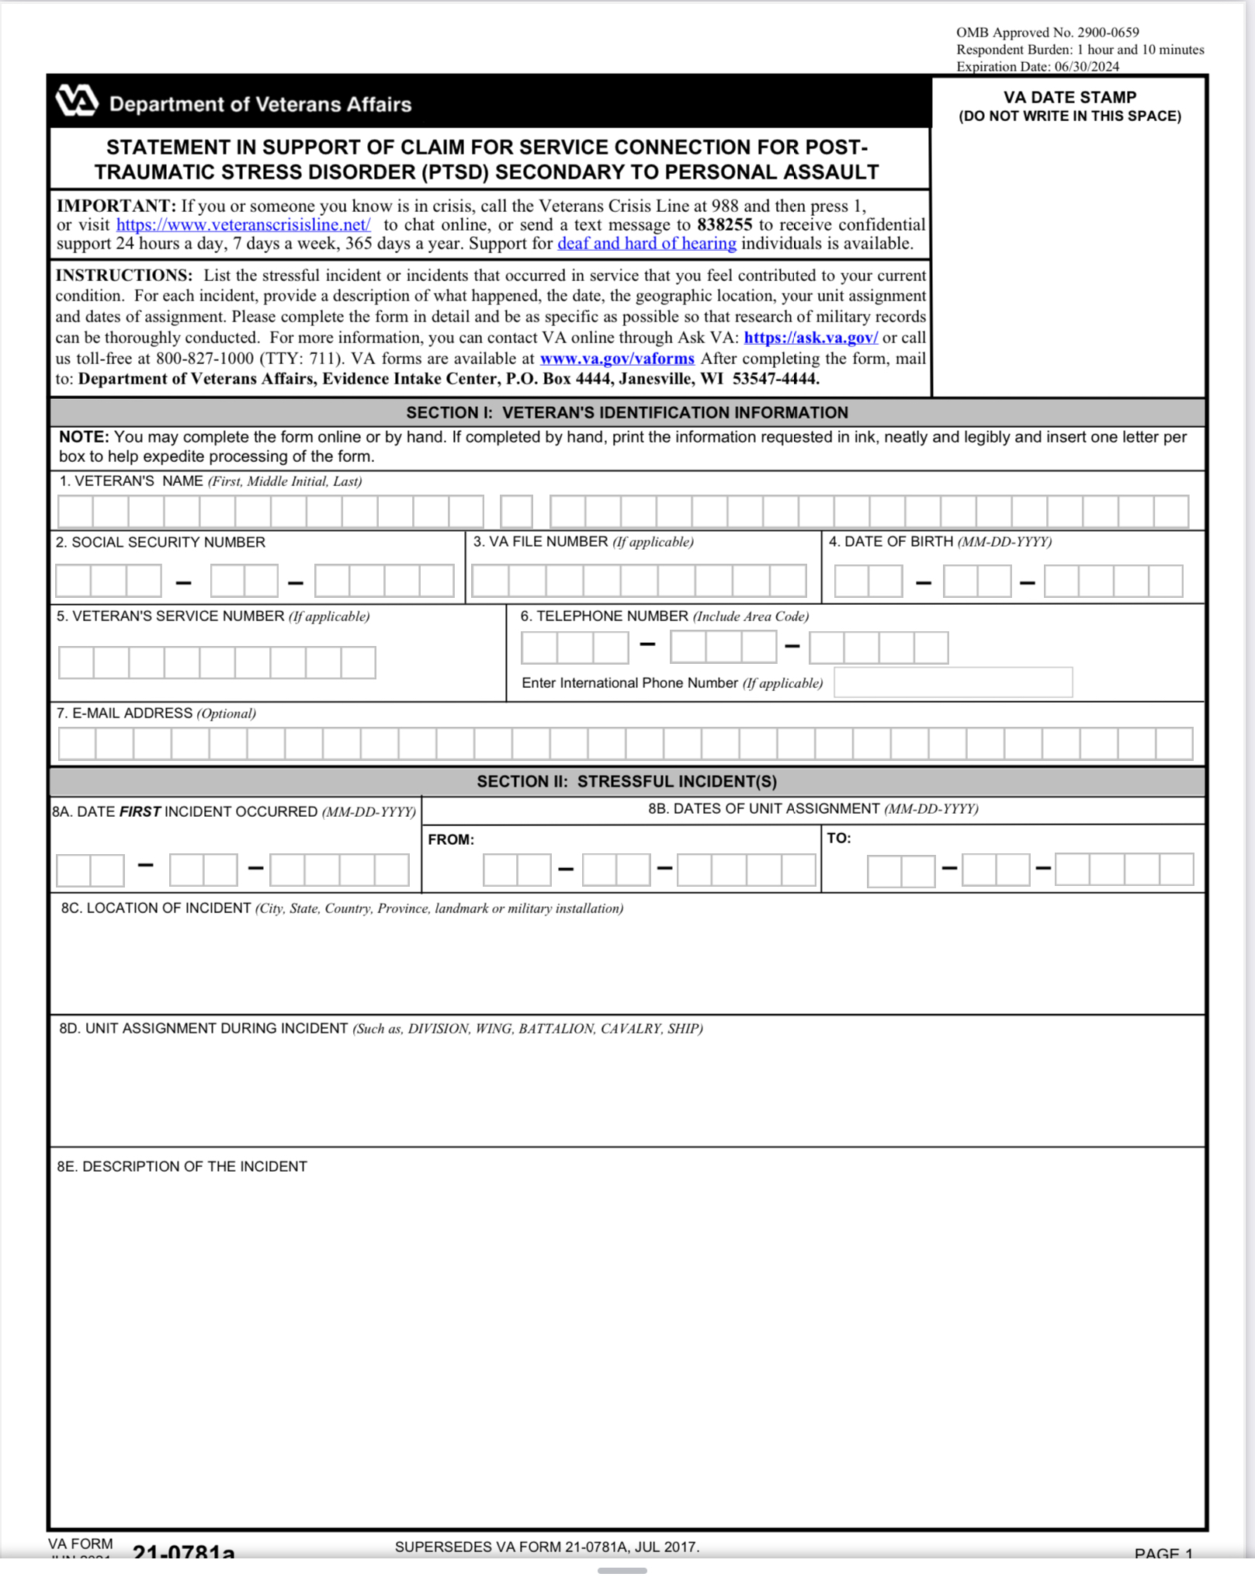
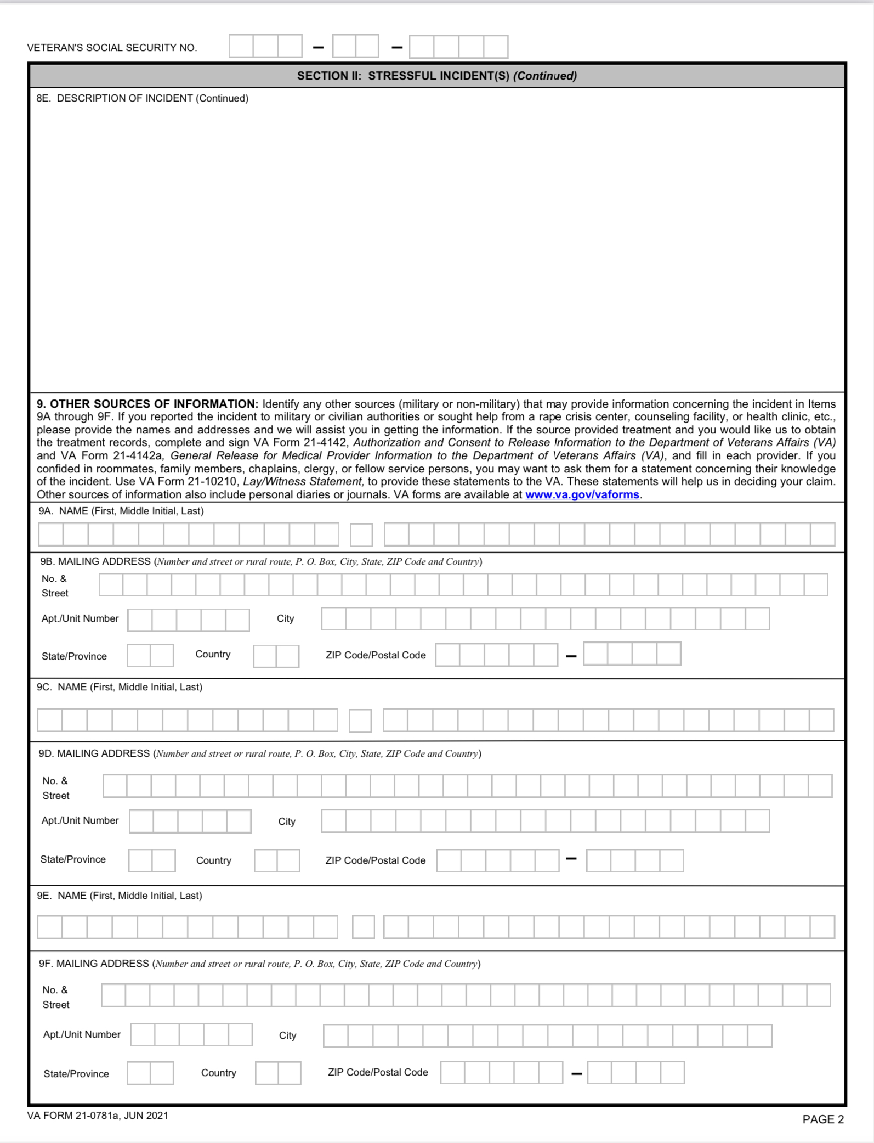
Statement in Support Of Claim for PTSD secondary to Personal Assault
VA Form 21-0781a

Slide 64
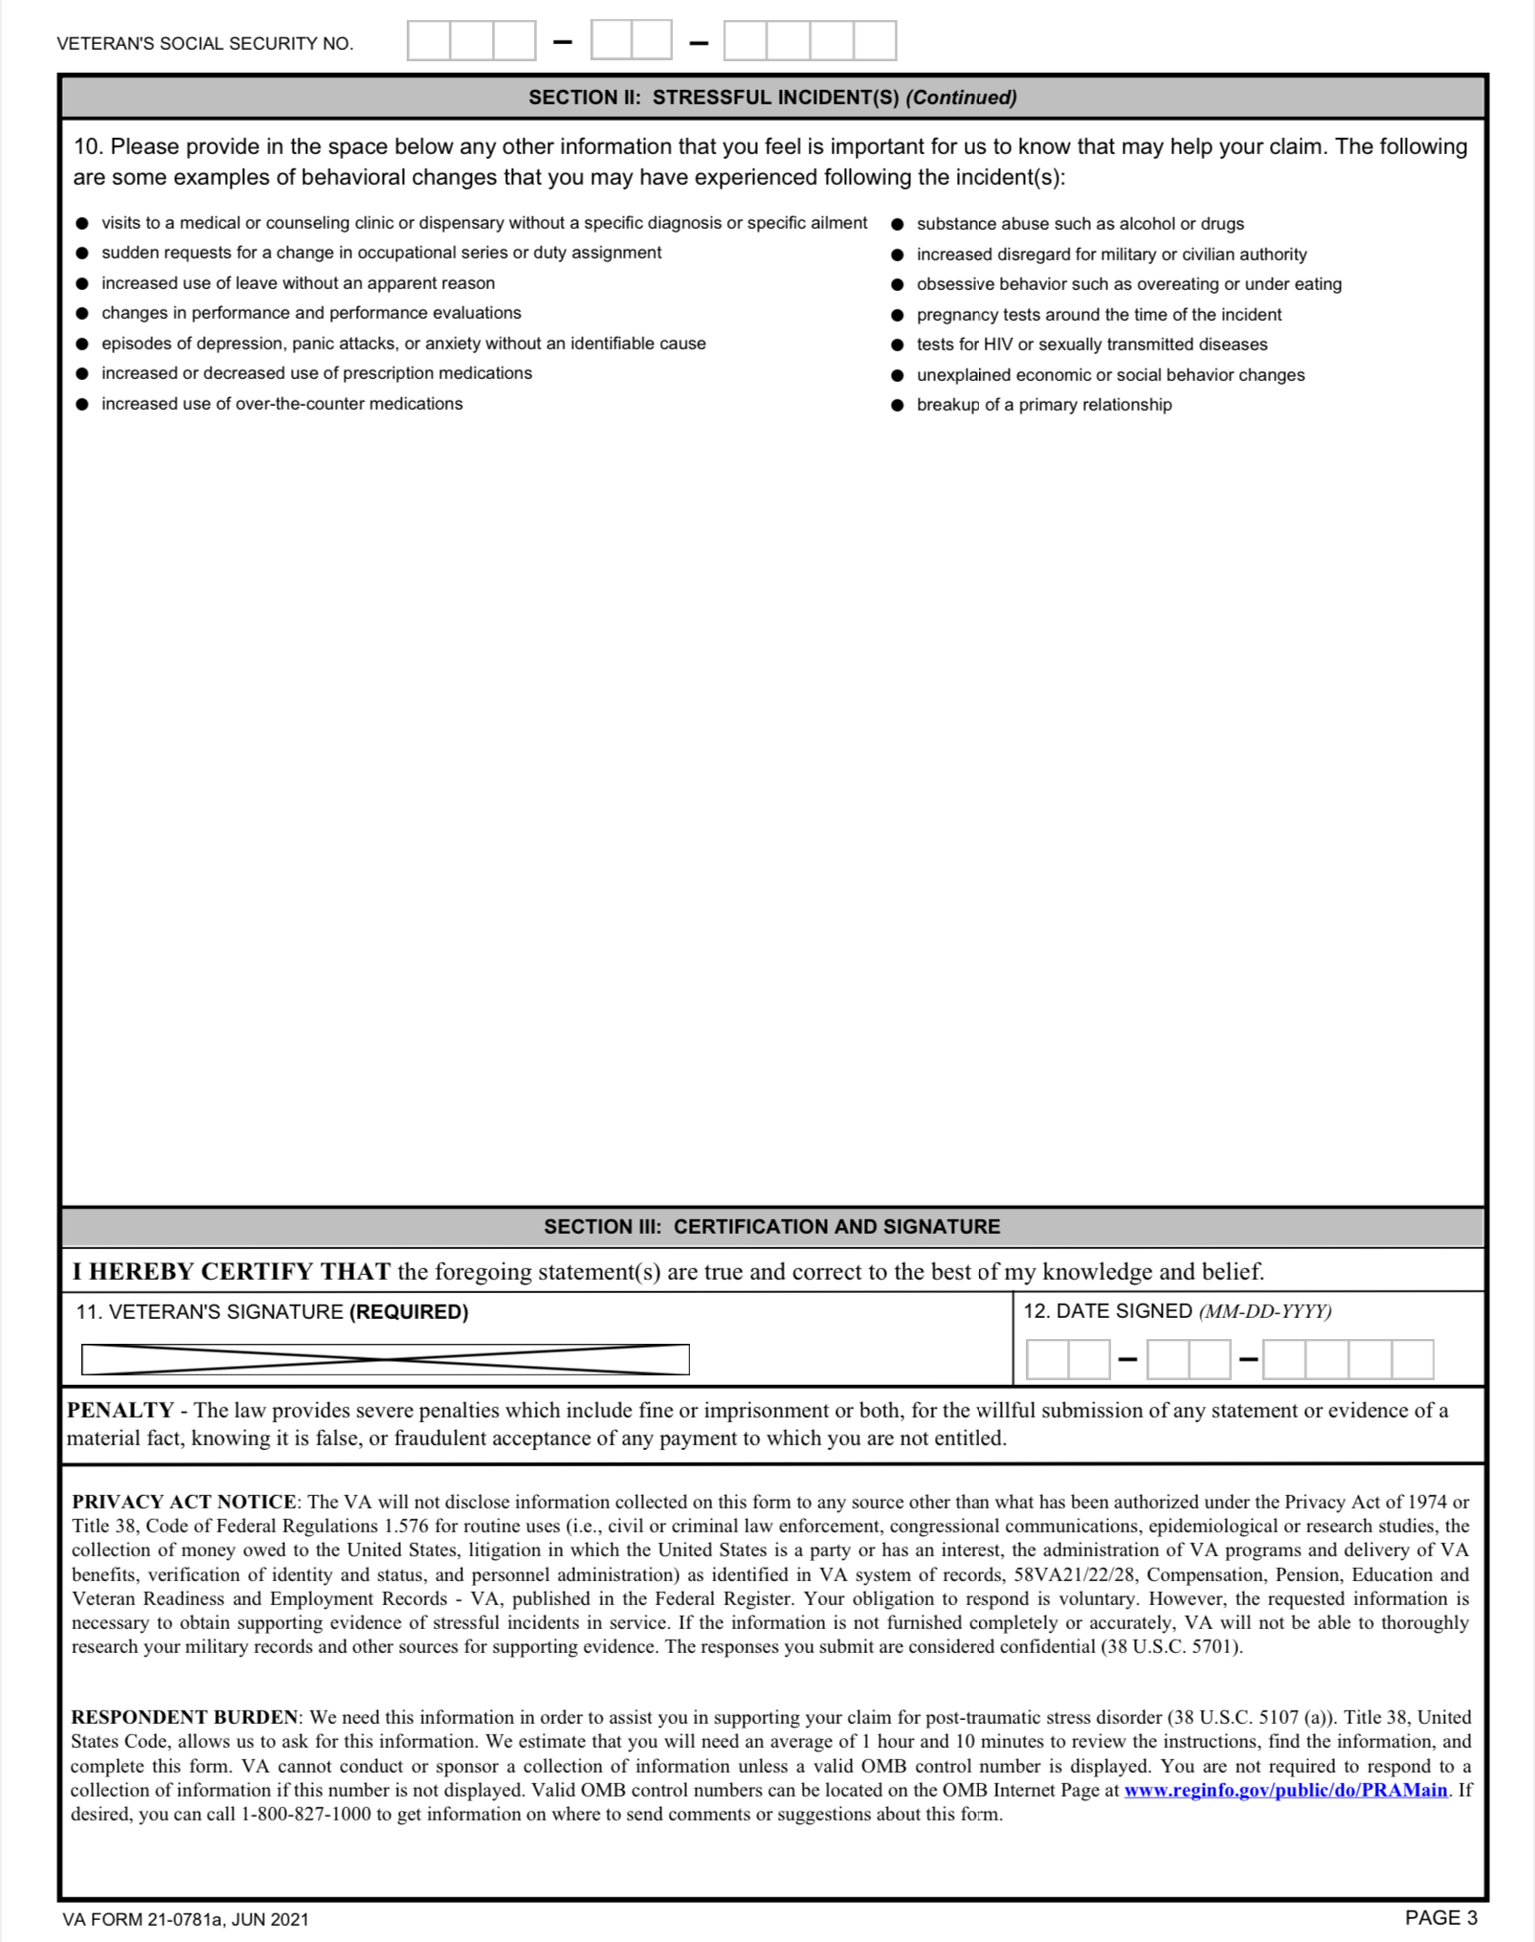
Statement in Support Of Claim for PTSD secondary to Personal Assault
VA Form 21-0781a

Slide 65
Lay evidence
What is
lay evidence?
Why is it important?

Slide 66
PTSD In-Service
To establish SC for PTSD based on an in-service stressor, the relationship between stressor and symptoms must be:
specifically addressed in the examination report, and
supported by documentation.
When PTSD is properly diagnosed in service, the Veteran’s testimony alone may establish that the claimed in-service stressor occurred, as long as the claimed stressor is
related to the Veteran’s service, and
consistent with the circumstances, conditions, or hardships of that service.

Slide 67
PTSD – Presumption of Soundness
If a Veteran is sound on enlistment and develops delayed or late-onset PTSD in service related to a pre-service stressor, the claim may be granted under 38 U.S.C. 1110, which contains the general criteria for establishing SC for a chronic disability.
Notes:
The existence of a pre-service stressor does not rebut the presumption of soundness under 38 U.S.C. 1111.
There is no statutory or regulatory requirement for credible supporting evidence of a pre-service stressor.

Slide 68
How will you document?

Slide 69
References
For more information on:
applying the benefit-of-the-doubt rule, see
  M21-1, Part X, Subpart ii, 5.A.3.c, and
  M21-1, Part V, Subpart ii, 1.A.1.j
negative evidence, see
  Forshey v. Principi, 284 F.3d 1335 (Fed. Cir. 2002) (en banc), and
  Maxson v. Gober, 230 F.3d 1330 (Fed. Cir. 2000), and

Slide 70
References
For more information on negative MST evidence, see
M21-1, Part V, Subpart ii, 1.A.2.f-h
Forshey v. Principi, 284 F.3d 1335 (Fed. Cir. 2002) (en banc), and
Maxson v. Gober, 230 F.3d 1330 (Fed. Cir. 2000).
For more information on absence of military documentation of a sexual assault, see
  M21-1, Part VIII, Subpart iv, 1.E.1.c, and
  AZ, AY v. Shinseki, 731 F.3d 1303 (Fed. Cir. 2013).
interpretation of behavior changes by a clinician, see Patton v. West, 12 Vet. App. 272 (1999), and
probative value of evidence, see M21-1, Part V, Subpart ii, 1.A.

Slide 71
References
For more information on:
VA’s responsibility to obtain evidence needed to corroborate a personal trauma claim, see Patton v. West, 12 Vet.App. 272 (1999)
use of medical opinion evidence to determine whether a stressor is corroborated, see Menegassi v. Shinseki, 638 F.3d 1379 (Fed. Cir, 2011)
qualification requirements for mental health examiners see M21-1, Part IV, Subpart i, 3.A, and
requesting medical opinions, see M21-1, Part IV, Subpart i, 2.A.7.

Slide 72
References
For more information on:
considerations to make when the evidence establishes a diagnosis of PTSD during service, see 38 CFR 3.304(f)(1)
when a Veteran’s testimony alone may establish a claimed stressor, see M21-1, Part VIII, Subpart iv, 1.A.3.b, and
developing for in-service mental health records, see M21-1, Part VIII, Subpart iv, 1.A.2.

Slide 73
Mental Health Examinations

Slide 74
Mental Health Examinations
In claims for service connection (SC) for posttraumatic stress disorder (PTSD), an examination will be requested if:
there is credible supporting evidence that the claimed stressor occurred
evidence (to include lay statements) indicates the Veteran currently suffers from symptoms consistent with a diagnosis of PTSD, and
medical evidence adequate for rating purposes is not already of record.

Slide 75
Mental Health Examination
(continued)
An examination will not be requested until development for credible supporting evidence of the claimed stressor is complete as outlined in either M21-1, Part VIII, Subpart iv, 1.A.3 and 4, or M21-1, Part VIII, Subpart iv, 1.B.
The claims folder will be forwarded to the examining facility and request its review as part of the examination process any time the issue is SC for PTSD.

Slide 76
Military Sexual Trauma Examination
In PTSD claims alleging personal trauma based on military sexual trauma (MST), a Department of Veterans Affairs (VA) examination should be scheduled and a medical opinion requested when there is either evidence of the claimed stressor or a “marker” found in the records.

Slide 77
VA Mental Examination
When evidence of exposure to stressors related to combat, experience as a former prisoner of war (FPOW), fear of hostile military or terrorist activity, or drone aircraft crew member duties is established by a Veteran’s individual decoration(s) or other military records, a statement to that effect in should be included in the Remarks section of the examination request. This evidence allows VA (including the examiner) to accept the Veteran’s own description of the specific events without further corroboration.
Important: Evidence of experience as an FPOW, exposure to combat, fear of hostile military or terrorist activity, or drone aircraft crew member duties, in itself, does not satisfy the diagnostic criteria for PTSD.

Slide 78
VA Examination (continued)
In compliance with 38 CFR 3.159(c)(4), an examination will always be needed when a thorough review shows:
a current medical diagnosis of PTSD or the Veteran’s lay statements describing PTSD symptoms
credible supporting evidence of the personal trauma incident or evidence of a marker in the in-service or post-service records
indication that the PTSD symptoms may be associated with the claimed MST stressor (established by applying a low threshold and liberal approach satisfied by virtue of a current diagnosis or symptoms and the presence of a marker), and

Slide 79
VA Mental Examination (continued)
medical evidence adequate for rating purposes is not already of record.
In cases where the only evidence of the personal trauma stressor are behavioral changes that may be markers of the claimed trauma, an examination is almost always needed because the marker itself does not establish the occurrence of the stressor, but the opinion of the qualified examiner can provide credible and probative evidence to make that determination. The examination is needed specifically to determine:

Slide 80
VA Mental Examination (continued)
whether a medical opinion can provide evidence for occurrence of the claimed in-service personal trauma stressor based on the marker and the Veteran’s lay statement, and
whether that claimed stressor is related to current PTSD symptoms.
Important: In order to ensure the examination request language is adequate, the VA will use the existing examination request tools to generate the necessary PTSD MST or PTSD personal trauma (non-MST) medical opinion based on the nature of the claimed stressor.

Slide 81
Reasons for an Insufficient Examination
Reasons that a PTSD examination report may be insufficient for VA purposes include
the assessment does not conform to current Diagnostic and Statistical Manual of Mental Disorders (DSM) standards
it does not identify or adequately describe the claimed stressor(s)
it does not sufficiently describe symptomatology, social and occupational functional impairment or other facts required by the regulatory diagnostic criteria
the examiner did not discuss the significance of, and reconcile, any differential diagnoses or changes in diagnosis

Slide 82
Reasons for an Insufficient Examination (continued)
the claims folder was not provided or the examiner did not review provided claims folder material
the examiner did not offer a requested comment or opinion
the examiner was not sufficiently qualified to render an initial diagnosis as specified in M21-1, Part IV, Subpart i, 3.A.1.h
the examiner did not justify a conclusion that an opinion could not be provided without resorting to mere speculation, or
the examination was not conducted by a properly-qualified examiner.

Slide 83
VA Mental Examination
Notes:
The diagnosis of PTSD must be made by a competent (properly qualified) medical professional and should be unequivocal.
The examining psychiatrist or psychologist should comment on whether the Veteran has experienced other traumatic events and, if so, indicate the relevance of these events to the current symptoms.
Based on the May 2013 publication of DSM-5, 38 CFR 4.125 was updated to specifically refer to DSM-5 effective August 4, 2014.
Important: Mental health examinations conducted after August 2014, to include PTSD examinations, must comply with DSM-5 standards.

Slide 84
References
For more information on:
the duty to assist with providing a medical examination or opinion, see M21-1, Part IV, Subpart i, 1.A
the evidentiary standards for finding an examination or opinion necessary, see M21-1, Part IV, Subpart i, 1.B
requesting examinations, see M21-1, Part IV, Subpart i, 2, and
the duty to assist with obtaining records, see M21-1, Part III, Subpart i, 2.C.

Slide 85
References
For more information on:
evidence of stressors related to combat, experience as an FPOW, a fear of hostile military or terrorist activity, or drone aircraft crew member duties, see
  M21-1, Part VIII, Subpart iv, 1.D.2, and
  M21-1, Part VIII, Subpart iv, 1.B.1 and 3, and
medical opinions and the initial PTSD disability benefits questionnaire, see M21-1, Part IV, Subpart i, 2.A.7.i.

Slide 86
References
For more information on:
requesting examinations, see M21-1, Part IV, Subpart i, 2
evidence that may constitute markers of trauma, see M21-1, Part VIII, Subpart iv, 1.E.1.d, and
medical opinions to interpret evidence of behavioral changes, see
  M21-1, Part VIII, Subpart iv, 1.E.1.e, and
  Patton v. West, 12. Vet.App. 272 (1999).

Slide 87
References
For more information on:
PTSD examination reports and DSM criteria, see M21-1, Part VIII, Subpart iv, 1.C.2.b, and
examination report requirements, see M21-1, Part IV, Subpart i, 3.A.
PTSD based on fear of hostile military or terrorist activity, see
  M21-1, Part VIII, Subpart iv, 1.D.2.d, and
  M21-1, Part VIII, Subpart iv, 1.A, and
handling insufficient PTSD examination reports, see M21-1, Part VIII, Subpart iv, 1.C.2.a.

Slide 88
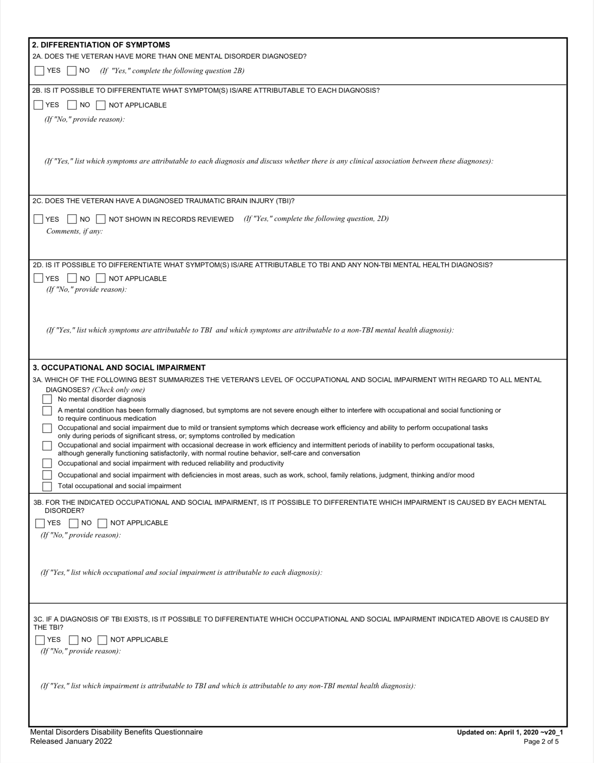
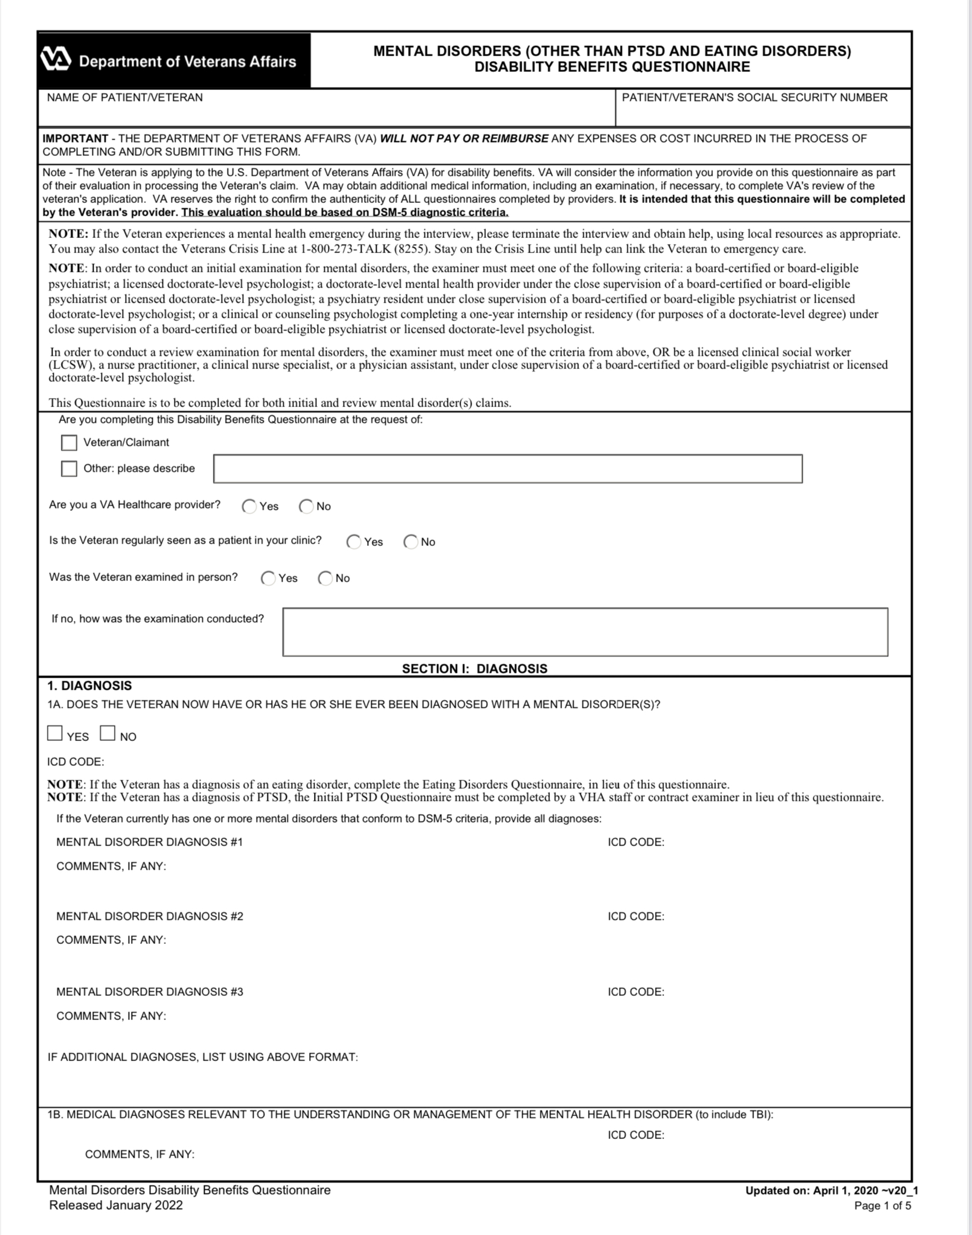
Initial PTSD Examination

Slide 89
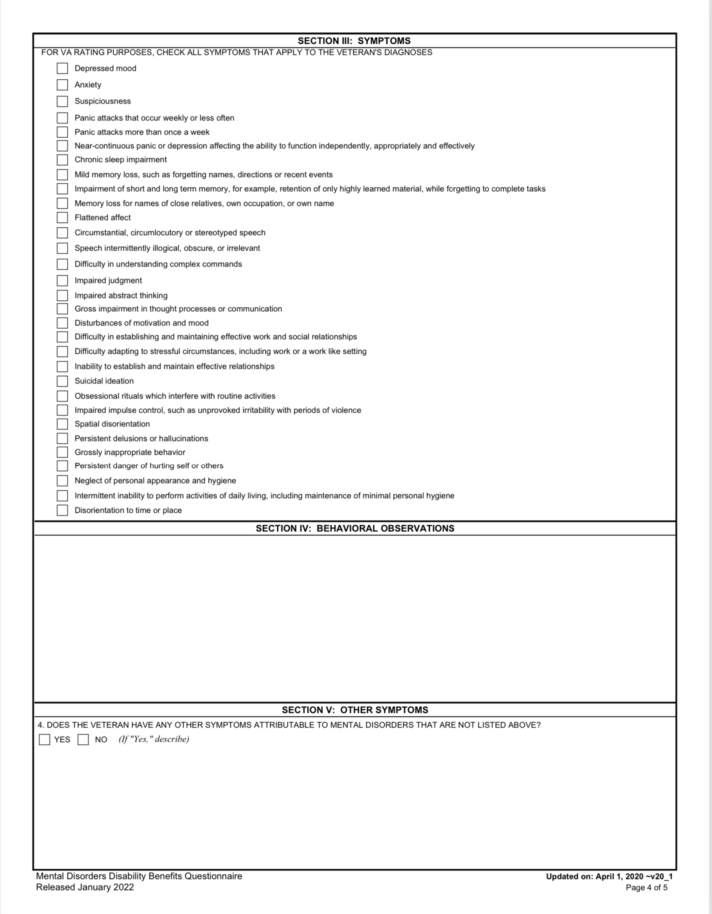
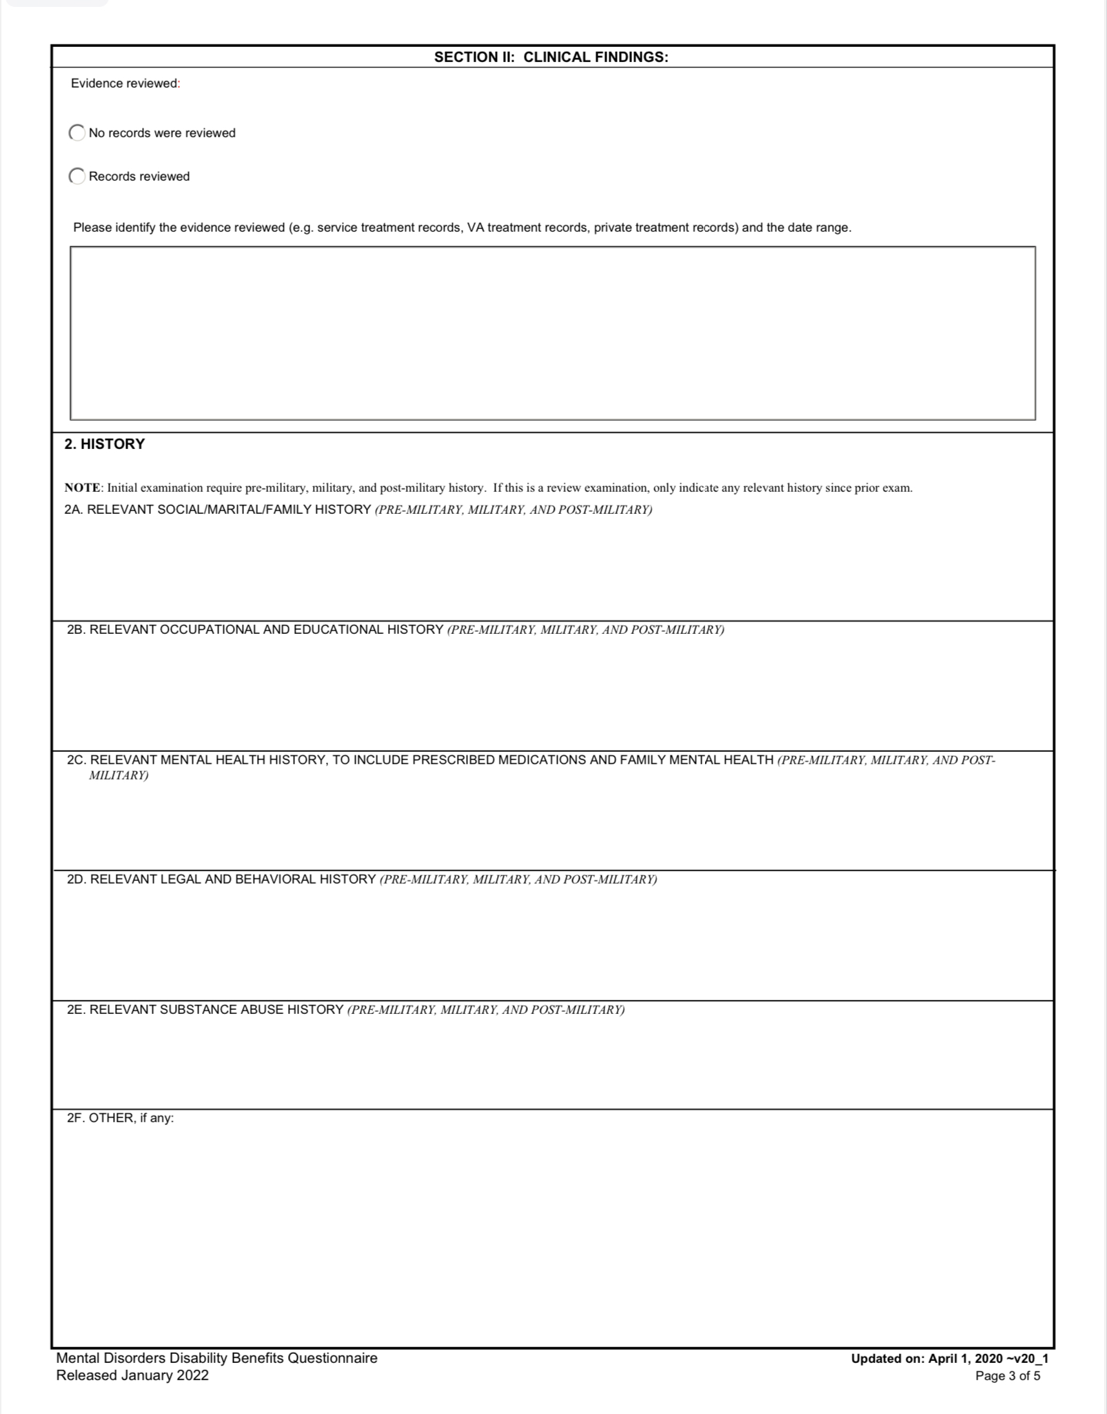
Initial PTSD Examination (continued)

Slide 90
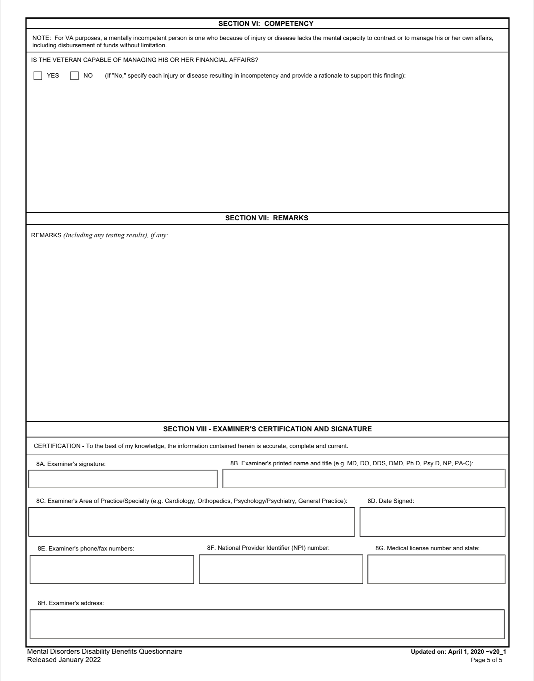
Initial PTSD Examination (continued)

Slide 91
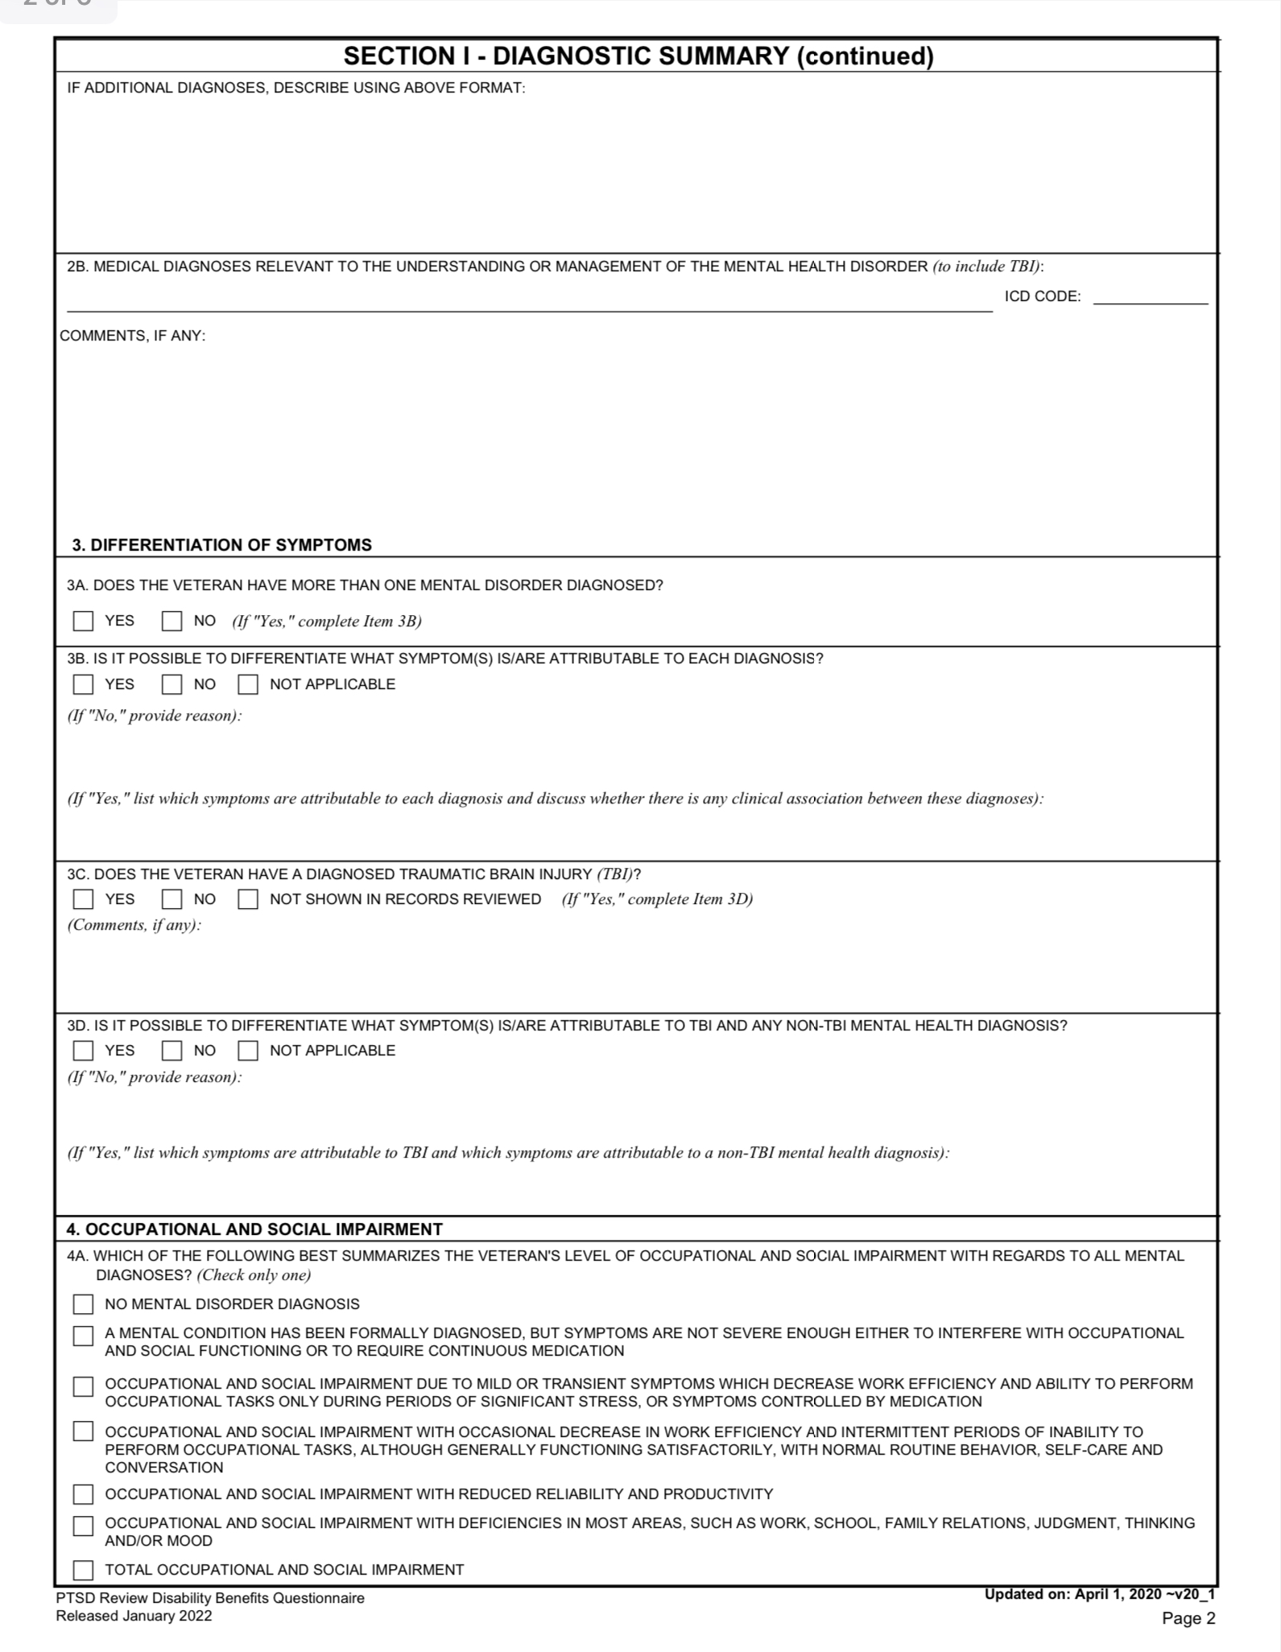
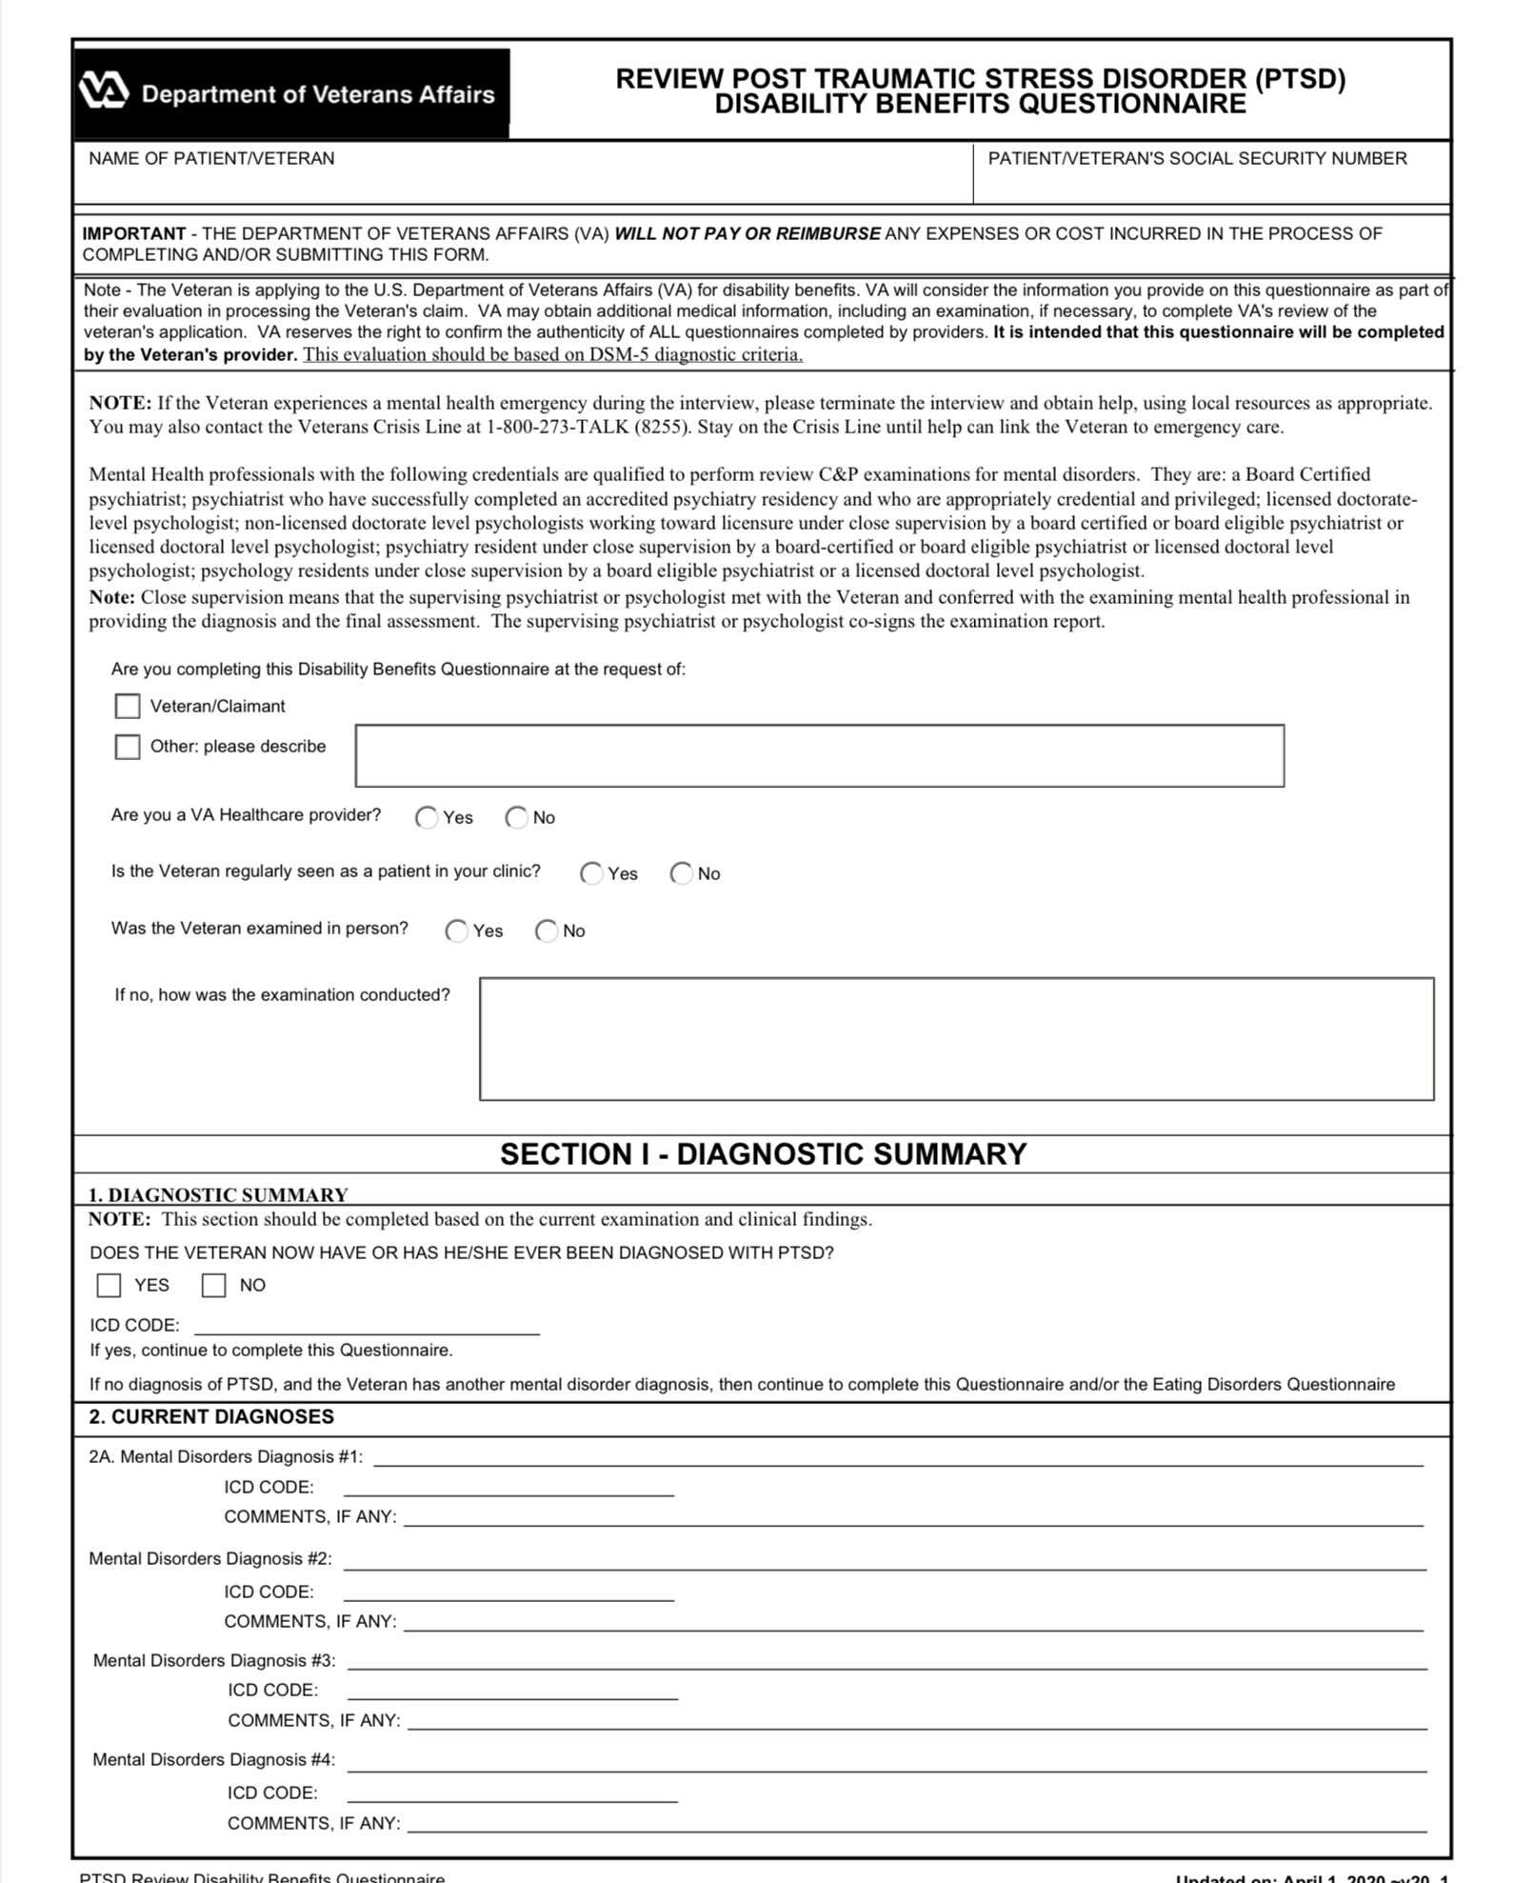
PTSD Review Examination

Slide 92
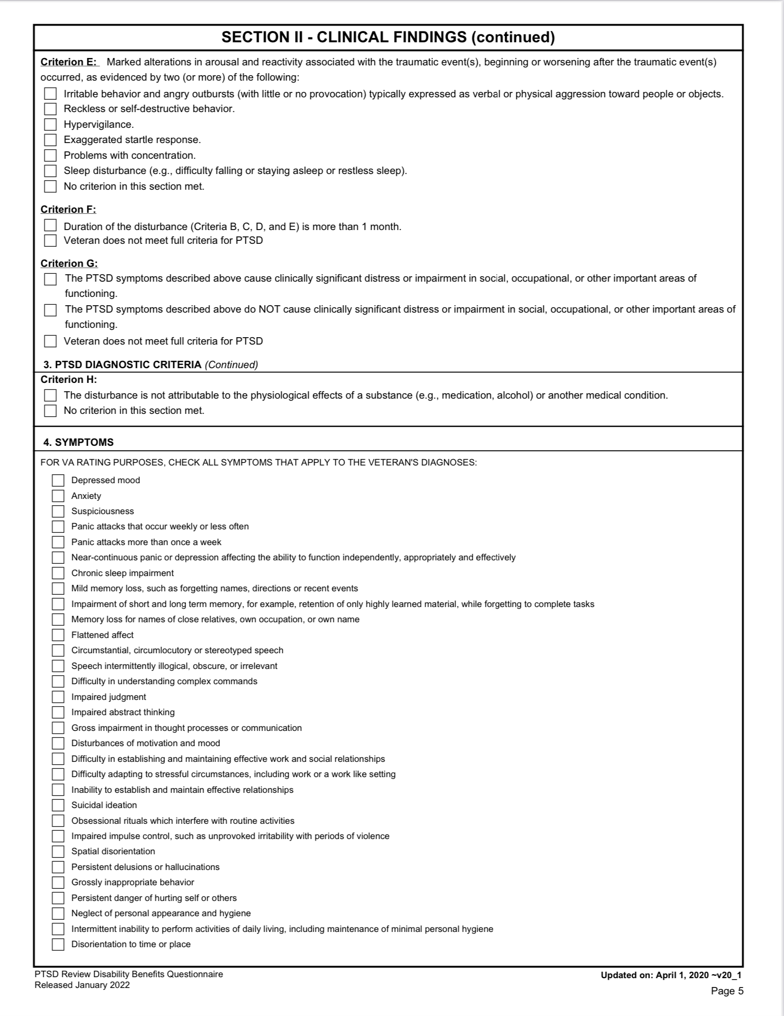
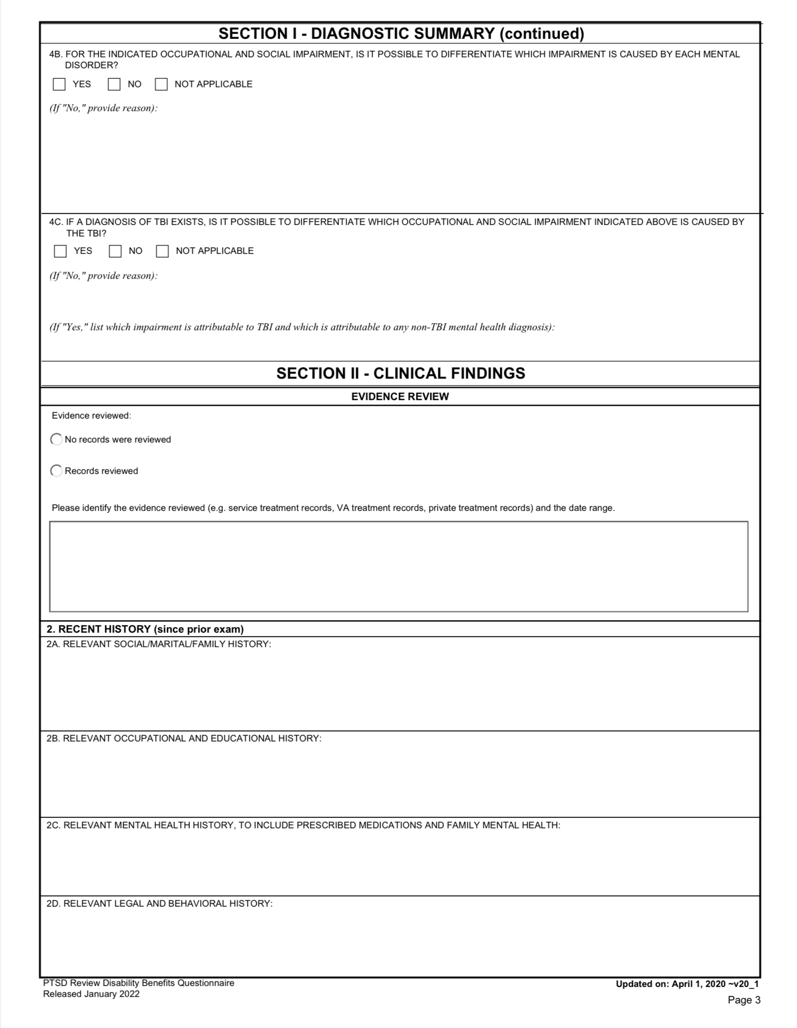
PTSD Review Examination

Slide 93
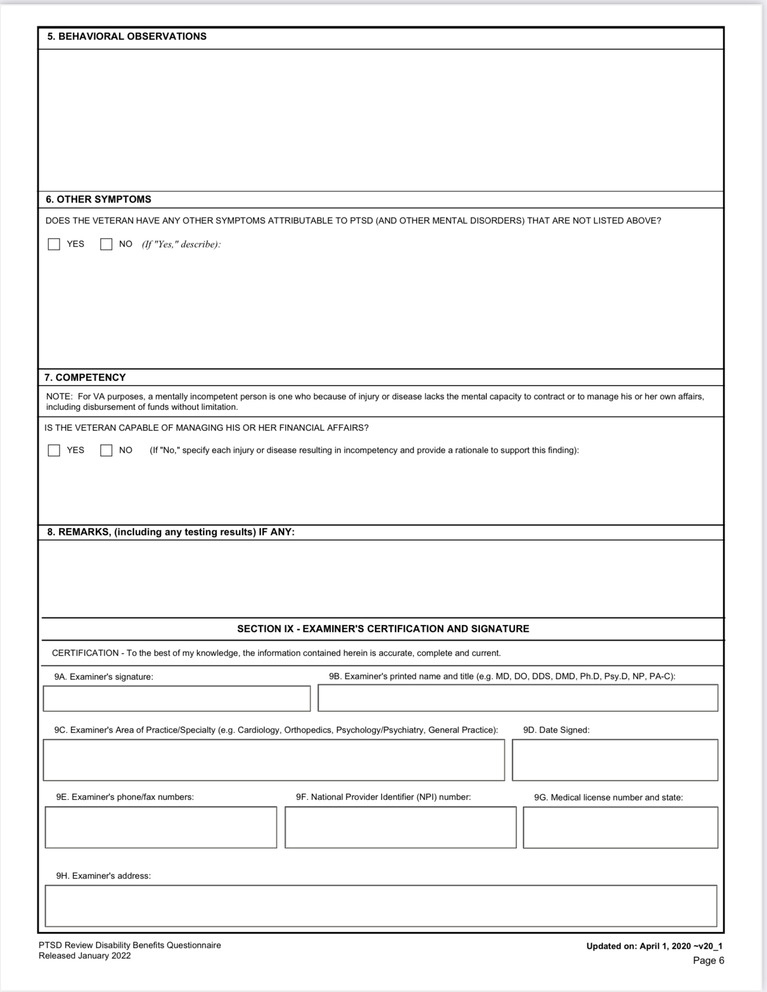
PTSD Review Examination (continued)

Slide 94
Other Examination Considerations
BDD (Benefits Delivery at Discharge)
IDES (Integrated Disability Evaluation System)
FDC (Fully Developed Claim)

Slide 95
38 CFR 4.126
4.126 Evaluation of disability from mental disorders.
(a) When evaluating a mental disorder, the rating agency shall consider the frequency, severity, and duration of psychiatric symptoms, the length of remissions, and the veteran's capacity for adjustment during periods of remission. The rating agency shall assign an evaluation based on all the evidence of record that bears on occupational and social impairment rather than solely on the examiner's assessment of the level of disability at the moment of the examination.

Slide 96
38 CFR 4.126 (continued)
b) When evaluating the level of disability from a mental disorder, the rating agency will consider the extent of social impairment but shall not assign an evaluation solely on the basis of social impairment.
(c) Neurocognitive disorders shall be evaluated under the general rating formula for mental disorders; neurologic deficits or other impairments stemming from the same etiology (e.g., a head injury) shall be evaluated separately and combined with the evaluation for neurocognitive disorders (see § 4.25).

Slide 97
38 CFR 4.129
§ 4.129 Mental disorders due to traumatic stress.
When a mental disorder that develops in service as a result of a highly stressful event is severe enough to bring about the veteran's release from active military service, the rating agency shall assign an evaluation of not less than 50 percent and schedule an examination within the six month period following the veteran's discharge to determine whether a change in evaluation is warranted.
(Authority: 38 U.S.C. 1155)

Slide 98
Rating Criteria for
38 CFR 4.130
§ 4.130 Schedule of ratings - Mental disorders.
The nomenclature employed in this portion of the rating schedule is based upon the American Psychiatric Association's Diagnostic and Statistical Manual of Mental Disorders, Fifth Edition (DSM-5) (see § 4.125 for availability information). Rating agencies must be thoroughly familiar with this manual to properly implement the directives in § 4.125 through § 4.129 and to apply the general rating formula for mental disorders in § 4.130. The schedule for rating for mental disorders is set forth as follows:

Slide 99
38 CFR 4.130 (continued)
We are not going to address DC 9201-9327, 9400-9410, or 9412-9413
9411 Posttraumatic stress disorder
**But if another diagnosis is established by examination or other medical evidence, a claim should be considered.

Slide 100
38 CFR 4.130 Rating Evaluation
General Rating Formula for Mental Disorders Rating
Total occupational and social impairment, due to such symptoms as: gross impairment in thought processes or communication; persistent delusions or hallucinations; grossly inappropriate behavior; persistent danger of hurting self or others; intermittent inability to perform activities of daily living (including maintenance of minimal personal hygiene); disorientation to time or place; memory loss for names of close relatives, own occupation, or own name.
100 percent

Slide 101
38 CFR 4.130 Rating Evaluation (continued)
Occupational and social impairment, with deficiencies in most areas, such as work, school, family relations, judgment, thinking, or mood, due to such symptoms as: suicidal ideation; obsessional rituals which interfere with routine activities; speech intermittently illogical, obscure, or irrelevant; near-continuous panic or depression affecting the ability to function independently, appropriately and effectively; impaired impulse control (such as unprovoked irritability with periods of violence); spatial disorientation; neglect of personal appearance and hygiene; difficulty in adapting to stressful circumstances (including work or a worklike setting); inability to establish and maintain effective relationships.
70 percent

Slide 102
38 CFR 4.140 Rating Evaluation (continued )
Occupational and social impairment with reduced reliability and productivity due to such symptoms as: flattened affect; circumstantial, circumlocutory, or stereotyped speech; panic attacks more than once a week; difficulty in understanding complex commands; impairment of short- and long-term memory (e.g., retention of only highly learned material, forgetting to complete tasks); impaired judgment; impaired abstract thinking; disturbances of motivation and mood; difficulty in establishing and maintaining effective work and social relationships.
50 percent

Slide 103
38 CFR 4.130 Rating Evakuation (continued)
Occupational and social impairment with occasional decrease in work efficiency and intermittent periods of inability to perform occupational tasks (although generally functioning satisfactorily, with routine behavior, self-care, and conversation normal), due to such symptoms as: depressed mood, anxiety, suspiciousness, panic attacks (weekly or less often), chronic sleep impairment, mild memory loss (such as forgetting names, directions, recent events) .
30 percent

Slide 104
38 CFR 4.130 Rating Evaluation (continued)
Occupational and social impairment due to mild or transient symptoms which decrease work efficiency and ability to perform occupational tasks only during periods of significant stress, or symptoms controlled by continuous medication. 10 percent
A mental condition has been formally diagnosed, but symptoms are not severe enough either to interfere with occupational and social functioning or to require continuous medication.
0 percent

Slide 105
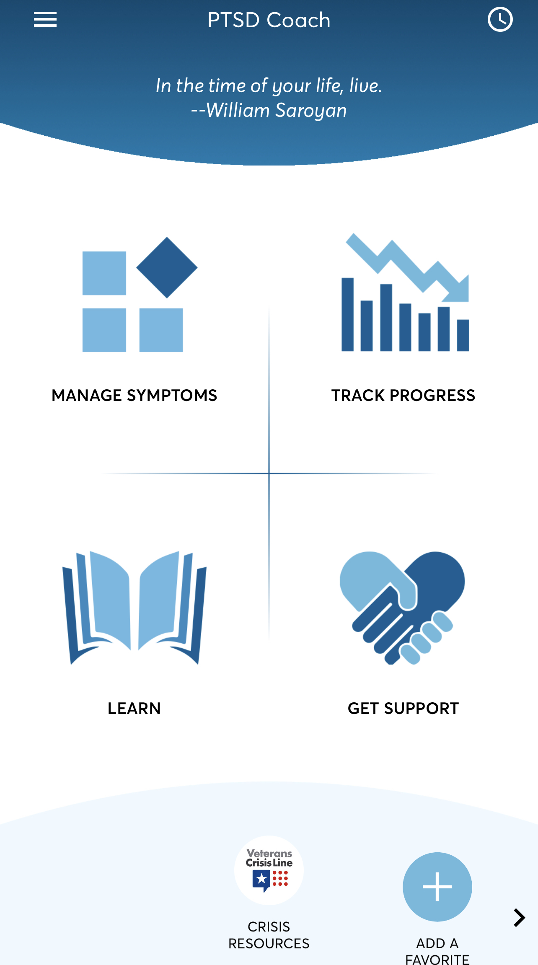
PTSD Coach Application

Slide 106
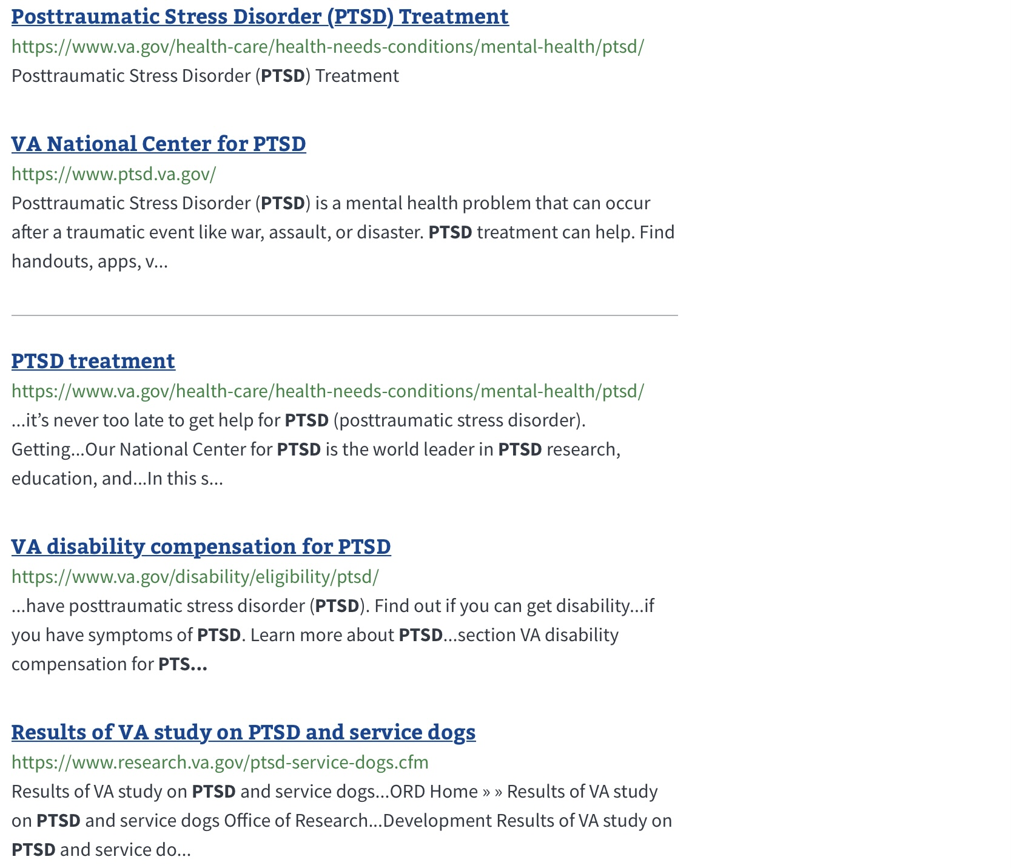
PTSD Resources (search on VA.gov – more available)

Slide 107
Additional Information
MST Special Review – Ruth Moore Act passed in late 2016
Office of Inspector General Investigation Report before Congress dated November 17, 2021
Military sexual assault cases will be removed from chain of command from National Defense Authorization Act enacted on January 1, 2021

Slide 108
References
VA.gov
38 CFR 3.159
38 CFR 4.125, 4.126, 4.127, 4.128
38 CFR 4.129 and 4.130
M21-1.III.ii.2
M21-1.IV.i
M21-1.V.ii
M21-1.VIII.iv
M21-1.X.I

Slide 109
References (continued)
38 USC 1110
38 USC 1111
38 USC 1154
38 USC 1720D
VAOPGCPREC 3-2012
VAOPGCPREC 3-2018
VAOPGCPREC 8-2001

Slide 110
QUESTIONS?
Vicki Von Loh
402-499-6836
vvonloh@gmail.com

